Slide 1

Detecting and Digitizing Handwritten Dates in Real Time
Presented By: Lakshmi Sravani

Slide 2
Index
Use case
Why Still Exists
Pipeline of prediction
Pre-processing
Model
Challenges
Future work
Conclusion

Slide 3

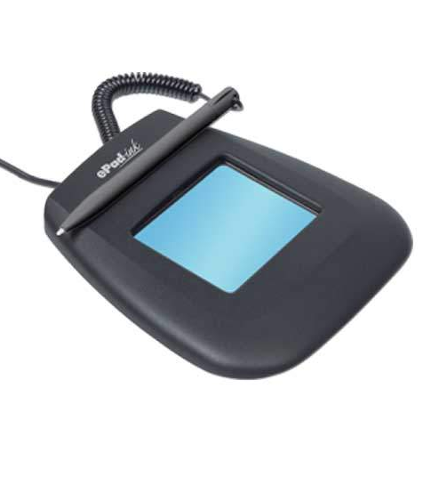

Use case
In many Hospitals, patients write the date(Signature and date) on a digital pad (e.g., with a stylus).
The goal of this project is to instantly recognize those handwritten digits and digitize the date for accurate and fast medical record-keeping.

Slide 4
Why Handwriting Still Exists in Hospitals
Signatures and dates are legally required in many medical forms.
01
Digital pads mimic paper, making the experience intuitive and natural.
02
Patients, especially elderly, feel more comfortable writing than typing.
03
Hybrid systems store handwriting digitally, but don’t interpret it — your system fills that gap.
04

Slide 5
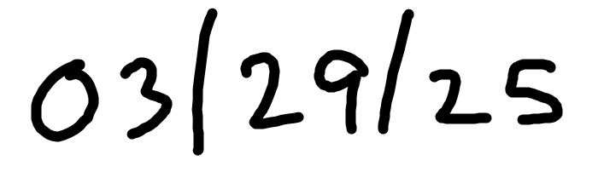
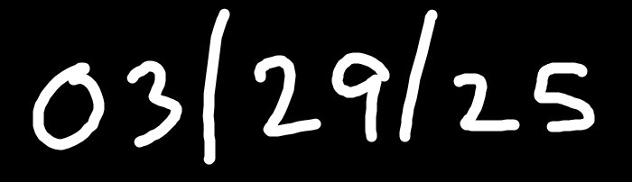

Image
Image of date
Splitting
Segmenting the date into individual Digits
Preprocessing
Each digit of size 28*28 pixel (Each digit image has 784 pixels.)
Each array
Model
Naive bayes and Non Naive bayes
Digital character
Combine Digital date
03/29/25
Merge Digital character and form a date

Slide 6
Dataset
The MNIST dataset is one of the most widely used benchmarks in machine learning for handwritten digit recognition.
It contains 70,000 labeled images of handwritten digits from 0 to 9 — all written by real people.
60,000 training images
10,000 testing images
Each image in the dataset is 28×28 pixels, making a total of 784 features per image.
They are grayscale images, meaning each pixel holds a value between 0 (black) and 255 (white).

Slide 7
Pre-processing
Normalize pixel values by dividing by 255.0
X_train_nor = X_train / 255.0
Preprocessing ensures all pixel values are in the range [0, 1], improving model performance
Normalize both train and test dataset
This setup allows models to focus purely on digit shape, unaffected by intensity variations

Slide 8

Models
Naive Bayes
Naive Bayes assumes pixel independence and computes probabilities using mean and variance. It gave us a decent accuracy of 77.91%.
Non Naive Bayes
Non-Naive Bayes does not assume feature independence, meaning it considers feature correlations by computing the full covariance matrix instead of using only variances. Accuracy of 95.44%
KNN
K-Nearest Neighbors (KNN) is a algorithm that classifies data points based on the majority class of their K closest neighbors. Takes long time to run.

Slide 9
Challenges
Segmenting entire handwritten date into individual digits
Recognizing characters like slashes, hyphen (/,-)
Date format can be different i.e., 03/29/2025, 3/29/25, 3-29-2025

Slide 10

Future Work
Build a real-time web or tablet interface
1
Automate digit segmentation from date input - CV
2
Expand to recognize different characters slashes, Hyphen and period
3

Slide 11
Conclusion
We introduced a real-world system to digitize handwritten dates, capable of recognizing various handwriting styles by training the model with 60,000 records.
Using Non-Naive Bayes, we achieve a 95.4% accuracy in digit prediction.
The predicted digits form a date in the MM/DD/YYYY format and are stored in the patient's medical record.

Slide 12

Thank You

