Slide 1
PIP4004 - INTERNSHIP Review-3 Presentation Attendance Management System
Student Details
Name | Ameena Sardar , Lakshmi M
Roll No | 20221LCS0036 , 20221LCS0033
Section | 8CSE14
Batch No. | 118
Under the Supervision of,
Saurabh Sarkar
School of Computer Science and Engineering
Presidency University
Name of the Program: CSE
Name of the HoD: Dr. Asif Mohammed H.B
Name of the Program Project Coordinator:
Name of the School Internship Coordinators: Mr. Md Zia ur Rahman

Slide 2
Introduction
Attendance Management System is software developed for daily student attendance in schools, colleges and institutes. It facilitates to access the attendance information of a particular Employee in a particular industry. The information is sorted by the operators, which will be provided by the employee/teachers for a particular working day. This system will also help in evaluating attendance eligibility criteria of employee/student.

Slide 3
Objective
The Main Objective of Attendance Management System is to go with computerized system, instead of old-fashioned manual process. As compared to manual process online system easily help management to analyze student’s attendance details as per requirement.
Reports are easily generated: Various reports such as Student wise attendance, Day wise attendance, Month Wise Class Attendance etc. can be easily generated. Current and back-dated reports can be available instantly.

Slide 4
Research Gaps
Inadequate Security and Data Privacy Controls
Session Management with PHP:
After login, PHP sessions are used to maintain user state. This prevents unauthorized users from accessing protected pages by directly entering URLs.
Localhost Security:
Since the system is hosted on XAMPP, it's isolated from the public internet by default, providing an added layer of security during the development and testing phase.
User Engagement Features
Responsive UI with Bootstrap:
The interface adjusts smoothly across desktops, improving accessibility.
Instant Feedback Mechanisms:
When attendance is updated or a record is inserted, confirmation messages are displayed using Bootstrap alerts—improving clarity for users.
CSV Export Functionality:
Users can easily export data for offline viewing or backup, empowering teachers and admin staff with more control over their data.

Slide 5
Process Flow
Step 1: Login Process
Users must enter their Username and Password.
The system verifies credentials before granting access.
If incorrect, an error is displayed.
Step 2: Viewing Attendance Records
Once logged in, admins or teachers can access the Attendance Records Page.
This page contains student registration numbers, attendance status, and timestamps.
The data can be exported as CSV or printed.

Slide 6
Step 3: Managing Courses/Units
The system allows users to view, add, and manage courses.
Attendance is linked to specific courses.
Admins can assign students to courses.
Step 4: Managing Student Information
Student details such as Name, Registration Number, Course, and Attendance Record can be updated.
Upon successful update, a confirmation message is displayed.
Step 5: Exporting Reports
Attendance reports can be saved as CSV files.
Print Preview allows direct hard copy printing.

Slide 7
Software & Technologies Used
Front-End:
HTML, CSS, JavaScript – For UI design.
Bootstrap – To enhance UI responsiveness.
Back-End:
PHP – For handling server-side logic and database operations.
MySQL – Database for storing attendance records and user data.
XAMPP – A local server solution that includes Apache, MySQL, and PHP for testing the system.
Development Tools:
Visual Studio Code – For code editing.
phpMyAdmin – For managing MySQL database.

Slide 8
Conclusion & Benefits Realized
The Attendance Management System simplifies attendance tracking and reduces errors in manual record-keeping. Using PHP, MySQL, and HTML, the system enables easy management of attendance with features like CSV export, print preview, and course tracking. This system is ideal for educational institutions and organizations seeking efficient attendance tracking solutions.
Benefits:
Time-saving for faculty and administrative staff.
Reduction in human error and manipulation risks.
Better decision-making through accurate records and insights.

Slide 9
Future Scope
To further enhance its utility and scope, the following additions are proposed:
Integration with mobile platforms (Android/iOS).
Addition of biometric/RFID systems.
Student portals for self-monitoring.
Dashboard analytics for attendance trends.
This project not only achieved technical goals but also empowered the development team with practical
experience, laying the foundation for future contributions to educational technology

Slide 10
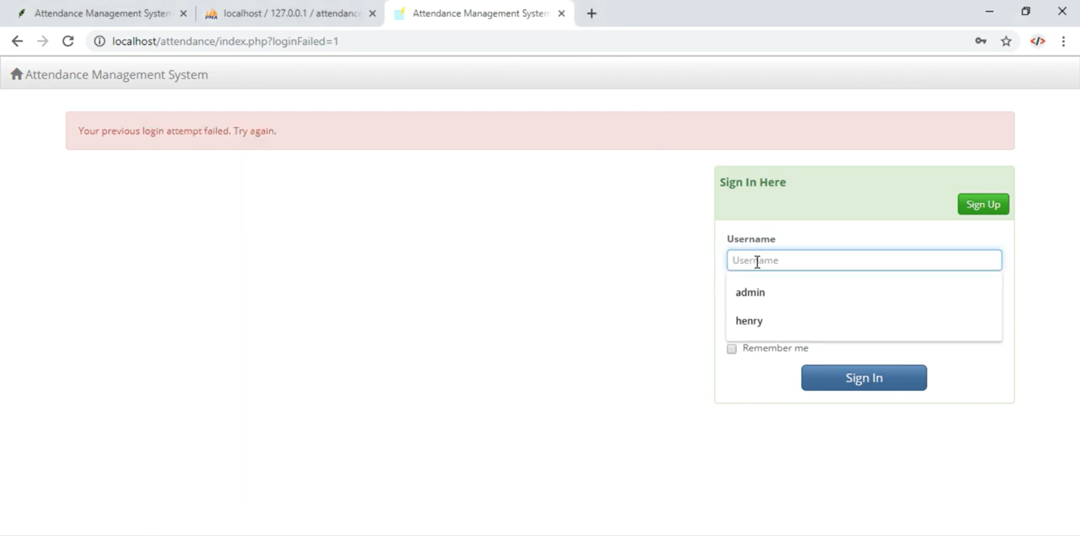
Login:

Slide 11
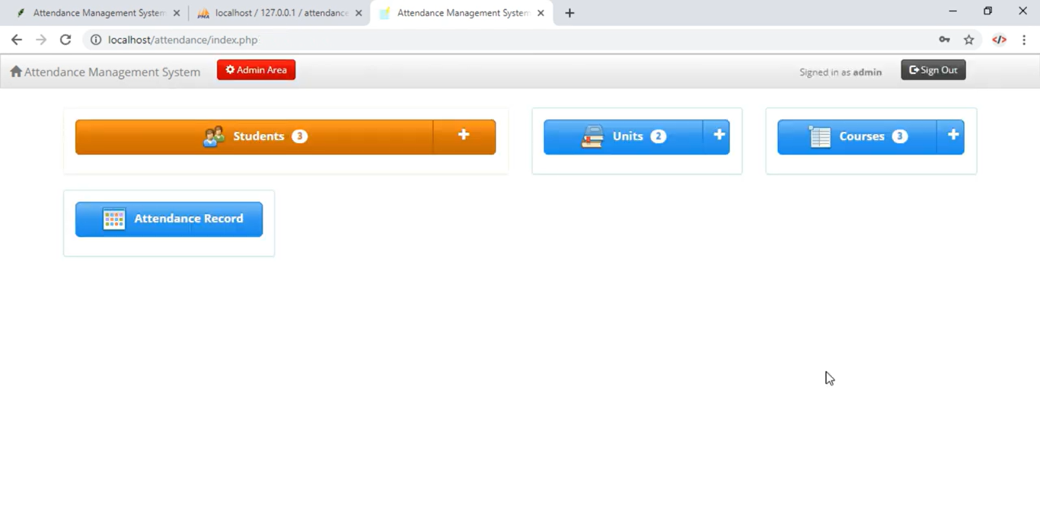
Home Page:

Slide 12
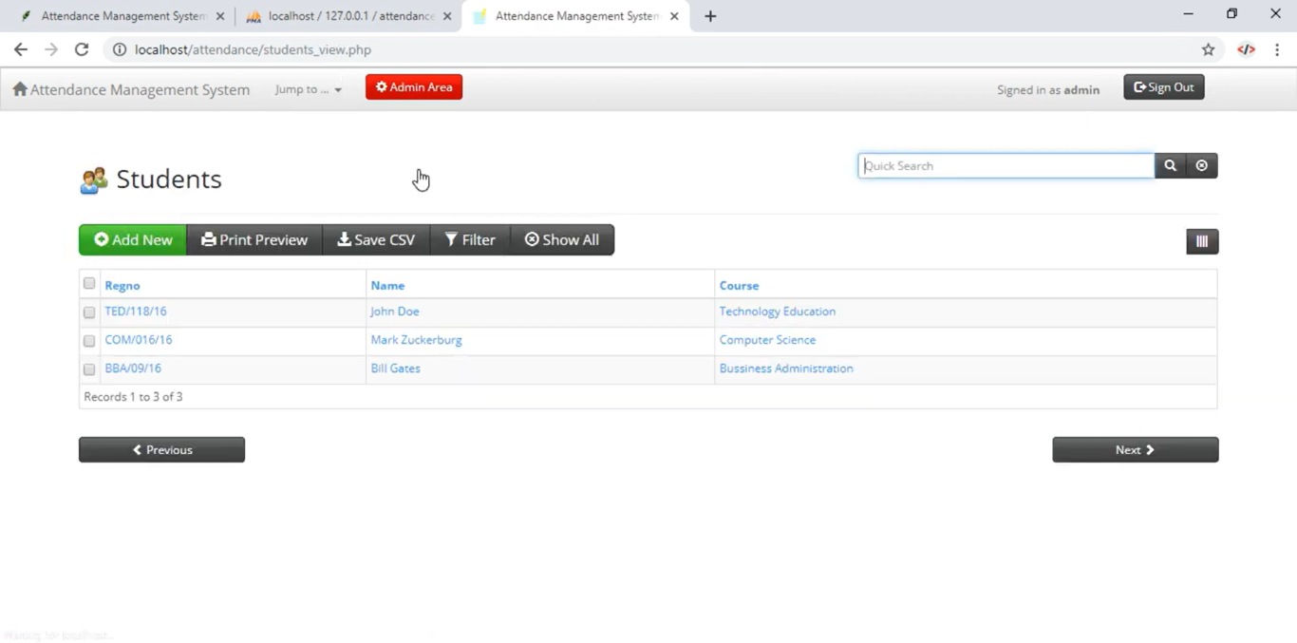
Students Page:

Slide 13
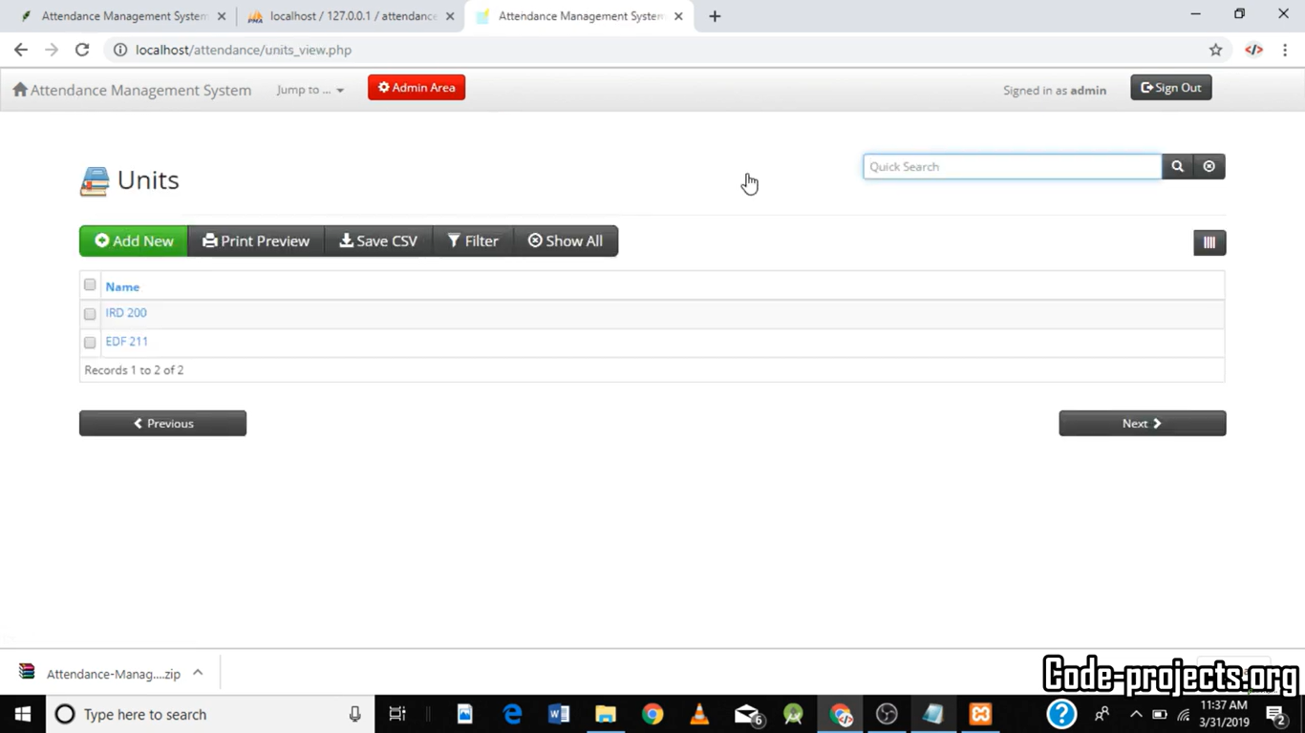
Units Page:

Slide 14
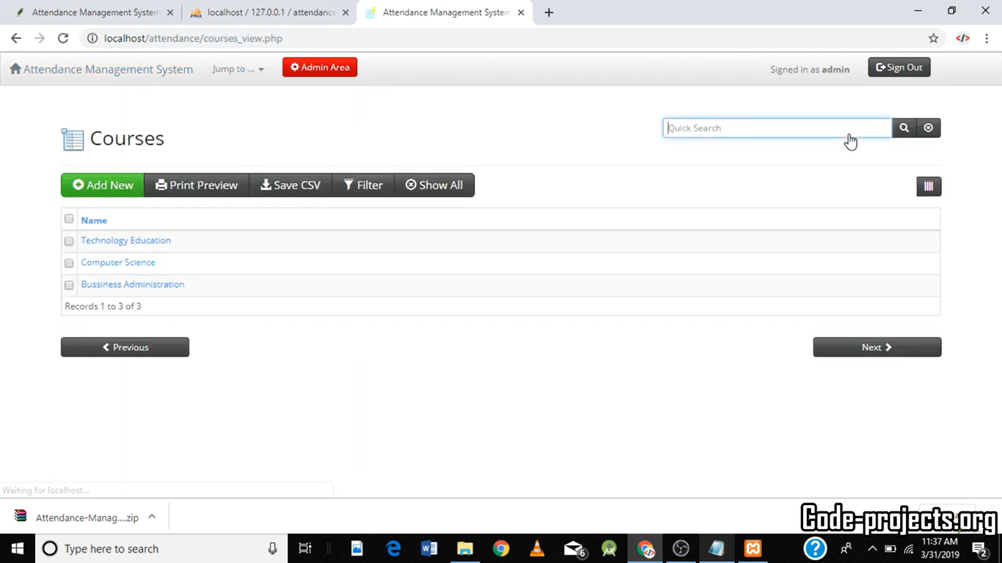
Course Page:

Slide 15
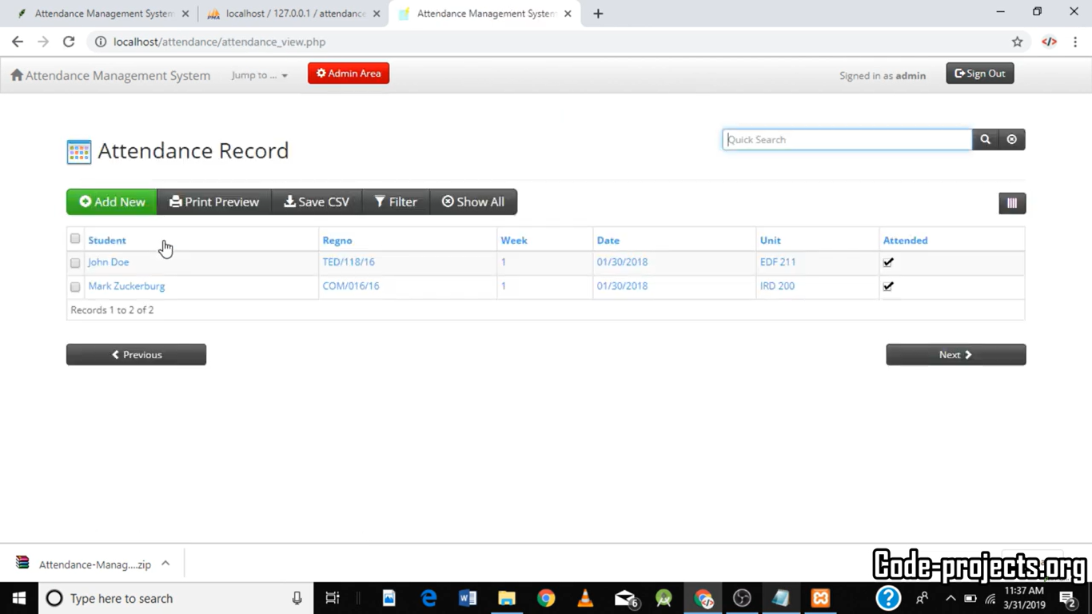
Attendance Record:

Slide 16
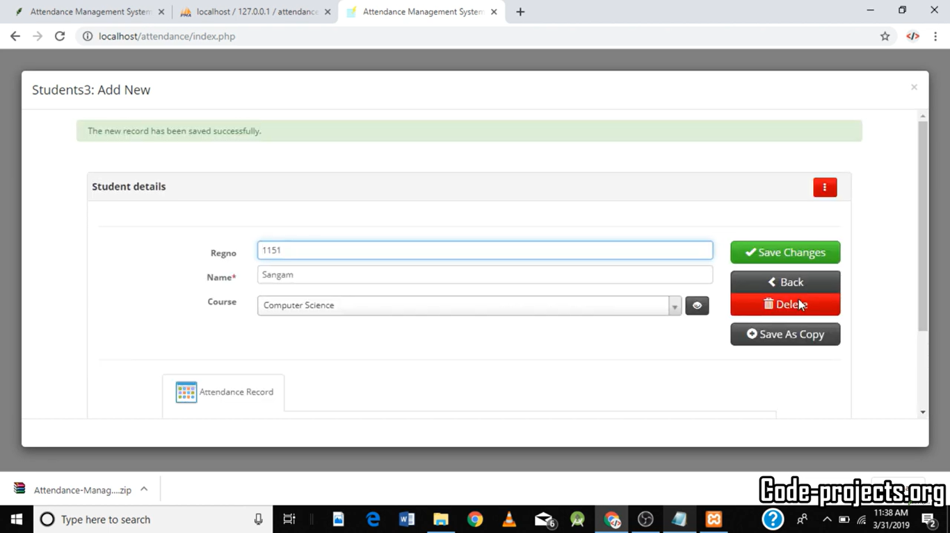
Adding/Deleting Students:

Slide 17
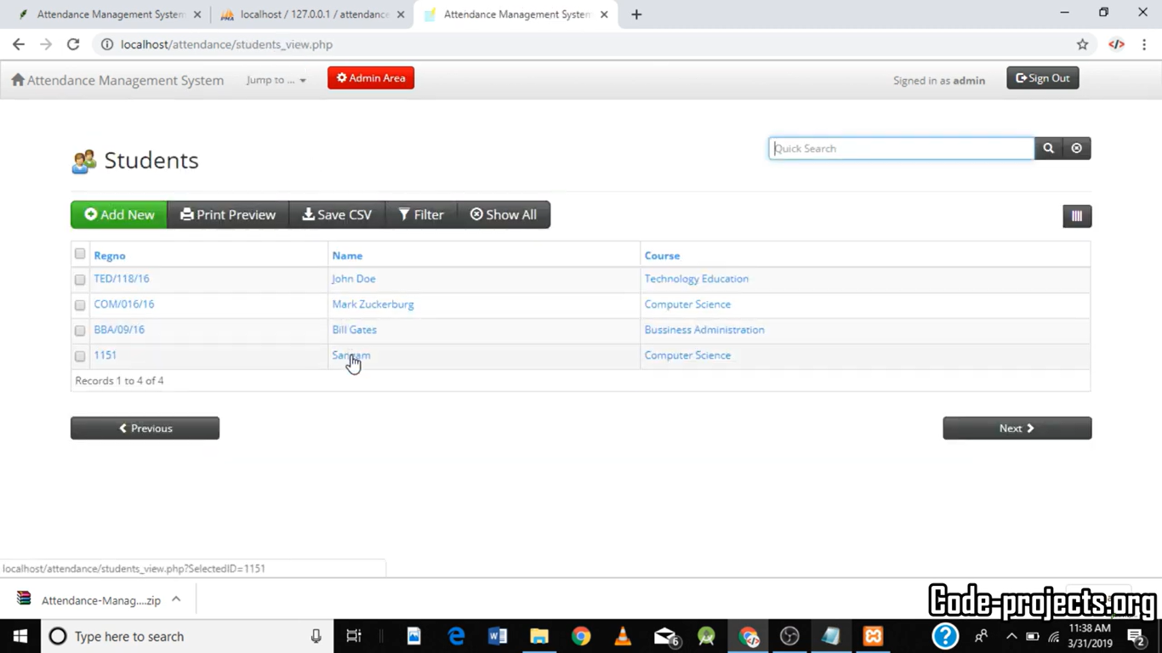
New Student Record added:

Slide 18
Internship Road Map
Note: Write in the below table what u will be achieving in each review
Review 0
6 Feb 2025
Topic Finalization
Review 1
20 Feb 2025
Literature review about the project
Review 2
27 March 2025
Front end
implantation of the project
Review 3
25 April 2025
Project
has been
completed

Slide 19
Github Link
https://github.com/ameenasardar/Internship.git

Slide 20
Thank you !!

