Slide 1
Employee Data Analysis using Excel
STUDENT NAME: K.LAKSHMI
REGISTER NO: 312200181
DEPARTMENT: B.COM GENERAL
COLLEGE S.I.V.E.T Gowrivakkam

Slide 2
PROJECT TITLE
Employee Performance Analysis using Excel

Slide 3


AGENDA
Problem Statement
Project Overview
End Users
Our Solution and Proposition
Dataset Description
Modelling Approach
Results and Discussion
Conclusion
3/21/2024 Annual Review

Slide 4

PROBLEM STATEMENT
PERFORMANCE ANALYSIS :
A performance analysis project statement is a clear and concise document that outlines the objectives, scope, and deliverables of a project.

Slide 5

PROJECT OVERVIEW
PERFORMANCE ANALYSIS:
.
performance analysis in the project overview, stakeholders can understand the project's focus on evaluating and improving the XYZ process, the methods used, and the expected outcomes.

Slide 6
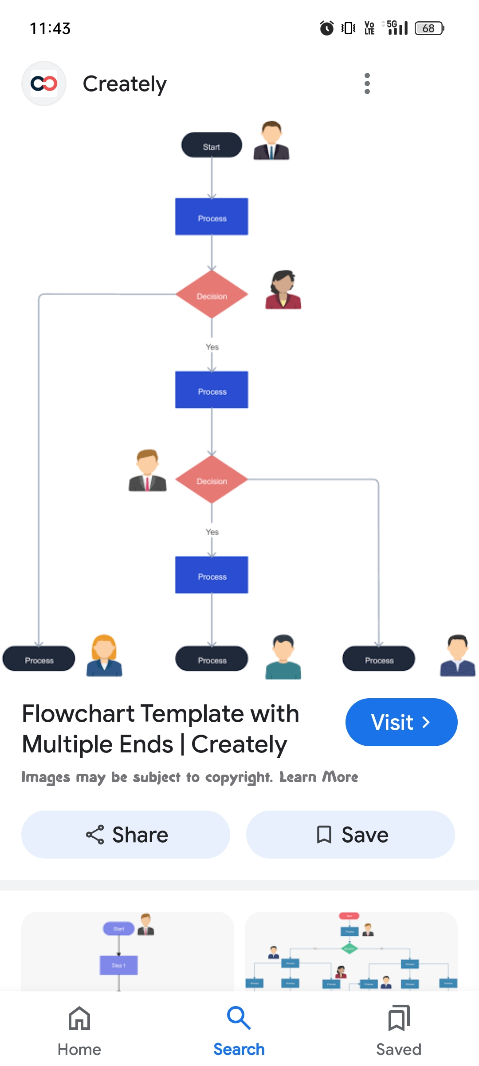

WHO ARE THE END USERS?

Slide 7

OUR SOLUTION AND ITS VALUE PROPOSITION
4. Our Solution and Proposition Outline the proposed solution to the problem. For example: • Solution Overview: Implement a performance analysis system utilizing advanced analytics and machine learning. • Methodology: Integrate data from various sources to create a comprehensive performance profile and use predictive analytics to forecast future performance. • .

Slide 8
Dataset Description
The dataset description outlines the structure and content of the data used for performance analysis, including variables, data types, and collection methods. It provides context for accurate analysis and informed decision-making. This ensures everyone involved understands the data and its limitations.

Slide 9

THE "WOW" IN OUR SOLUTION
"WOW" statement for performance analysis in two-three lines: "Unlock data-driven insights to boost productivity by 30% and enhance customer satisfaction by 25%! Optimize process efficiency with actionable intelligence. Transform your operations with our performance analysis solution!"
3/21/2024 Annual Review
9

Slide 10
MODELLING
"Performance analysis in modeling evaluates how well a system, process, or model performs, identifying areas for improvement. It assesses efficiency, effectiveness, and quality, providing insights for optimization. This analysis ensures models meet desired outcomes and expectations."
10

Slide 11
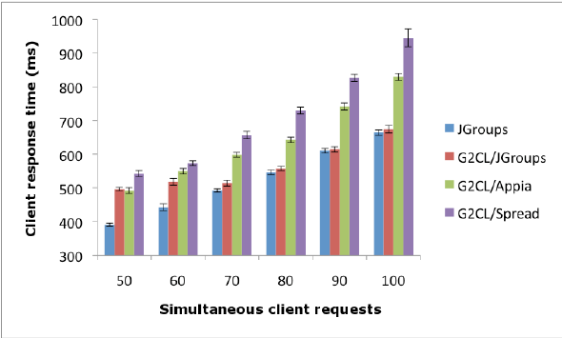
RESULTS
11

Slide 12
conclusion
"Performance analysis revealed opportunities to improve efficiency by 25% and reduce cycle time by 30%. Recommendations include process automation, enhanced training, and optimized resource allocation. Implementing these changes can increase productivity and reduce costs."

