Slide 1

SMART INDIA HACKATHON 2026
TITLE PAGE
Problem Statement ID –
Problem Statement Title-
Theme-
PS Category- Software/Hardware
Team ID-
Team Name (Registered on portal)

Slide 2
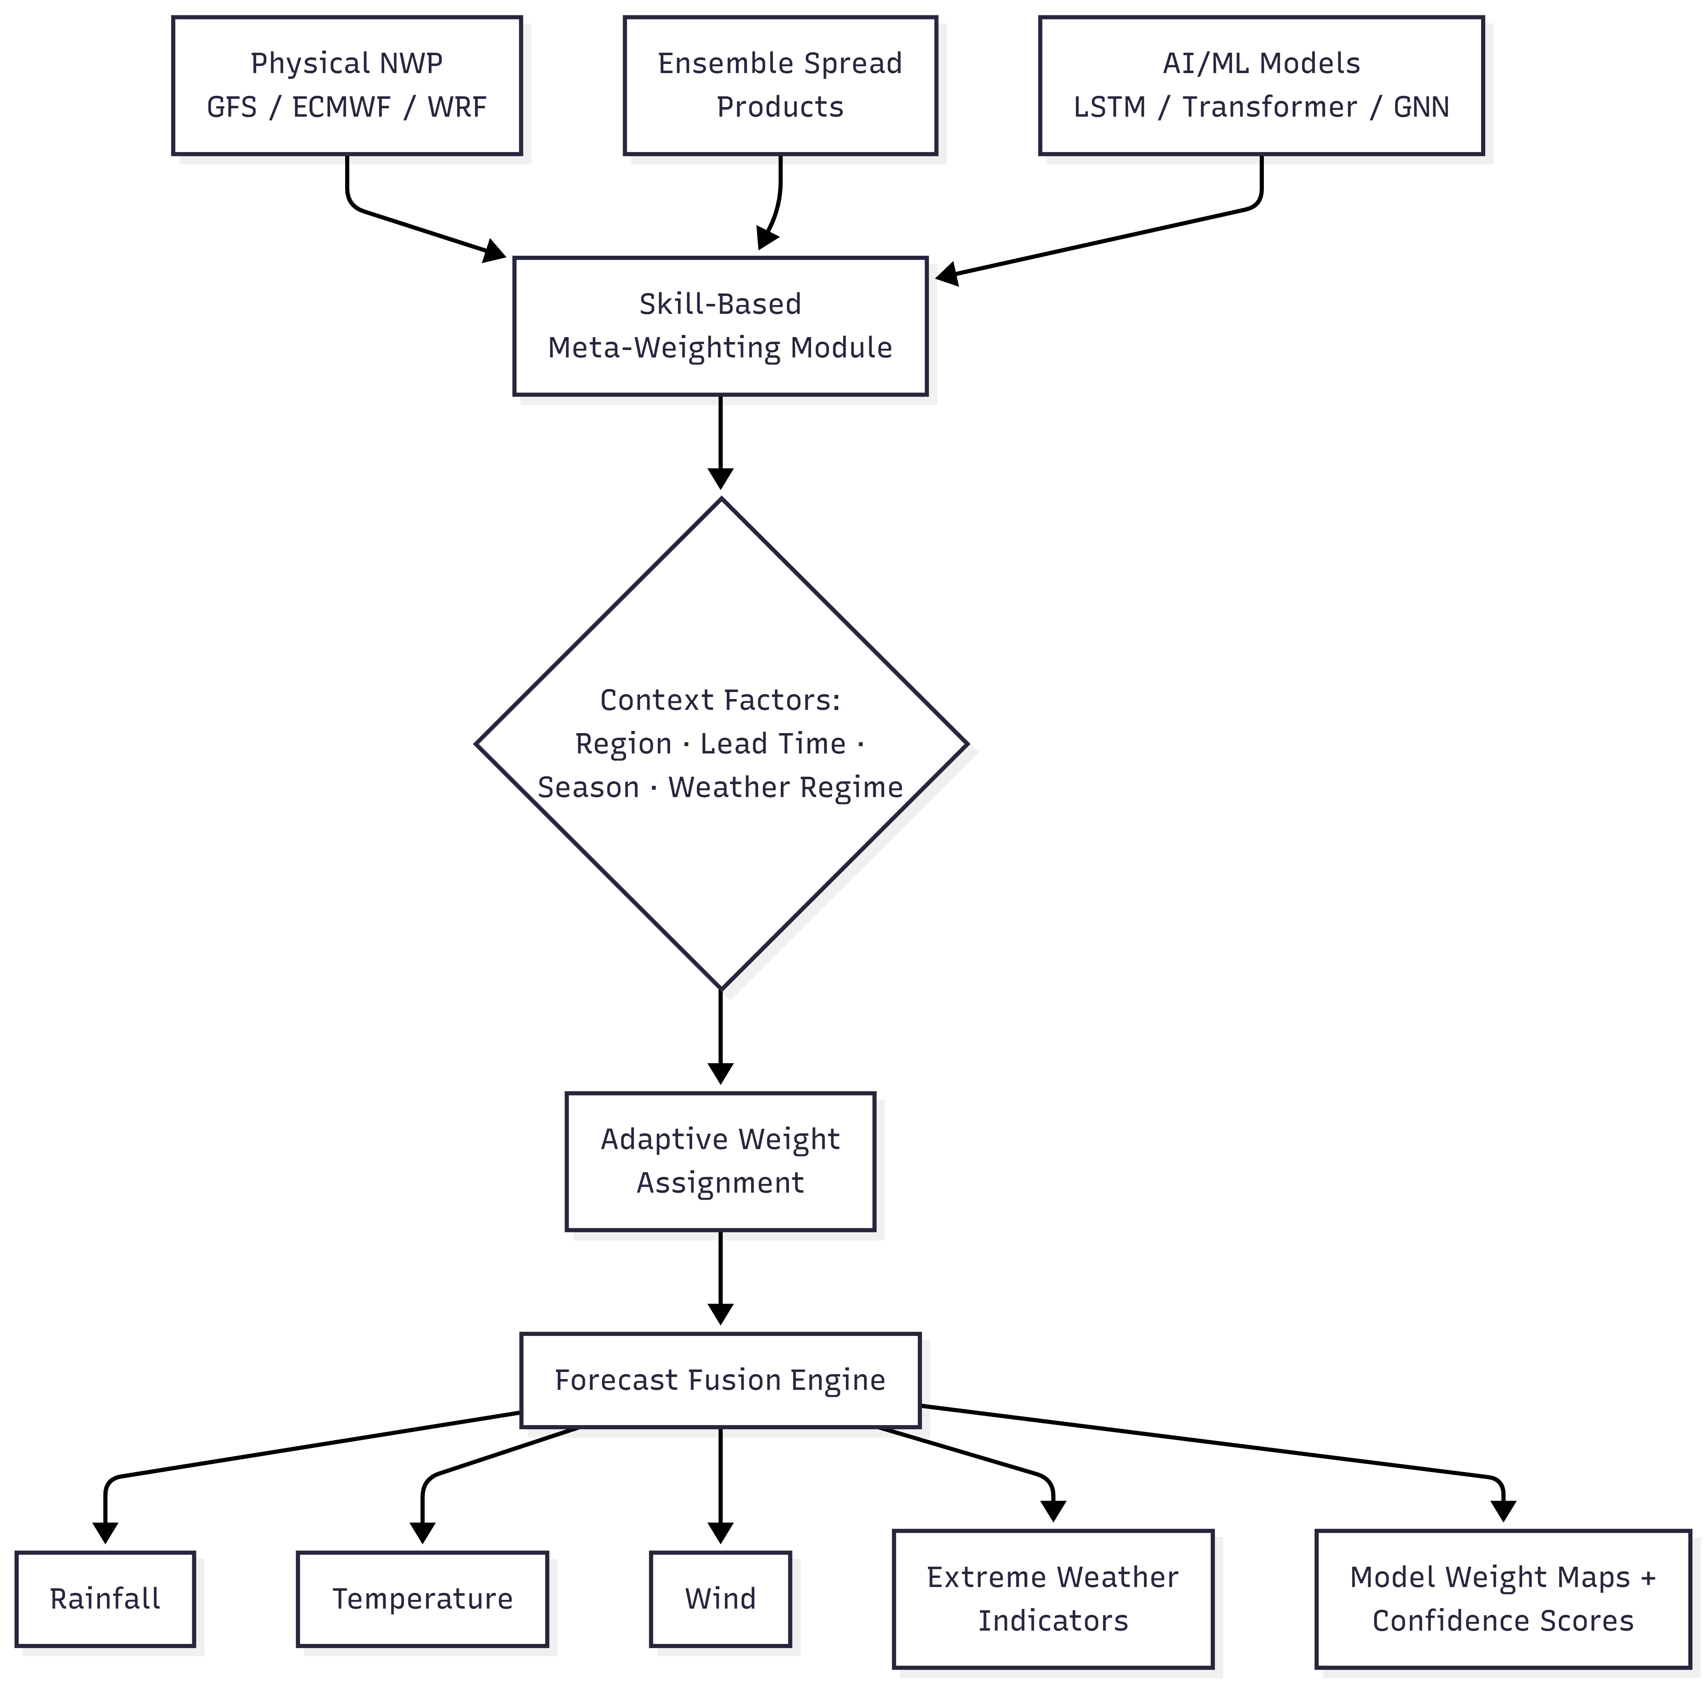
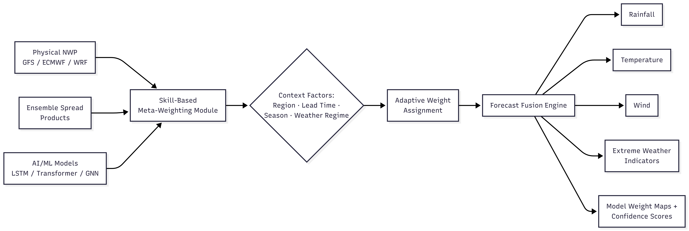
IDEA TITLE
Your Team Name
AI-NWP Adaptive Forecast Blending Framework (Dynamic Multi-Model Weather Blending Engine)
- Fuses NWP, ensemble, and AI/ML forecasts using adaptive, skill-based weights - Weights vary by region, lead time, season, and weather regime - Outputs one optimized forecast for rainfall, temperature, wind, extremes — with confidence scores - Self-updating: re-weights sources as their performance shifts, unlike static model selection - Novel: regime-aware, explainable (weight maps), and light enough for real-time deployment

Slide 3
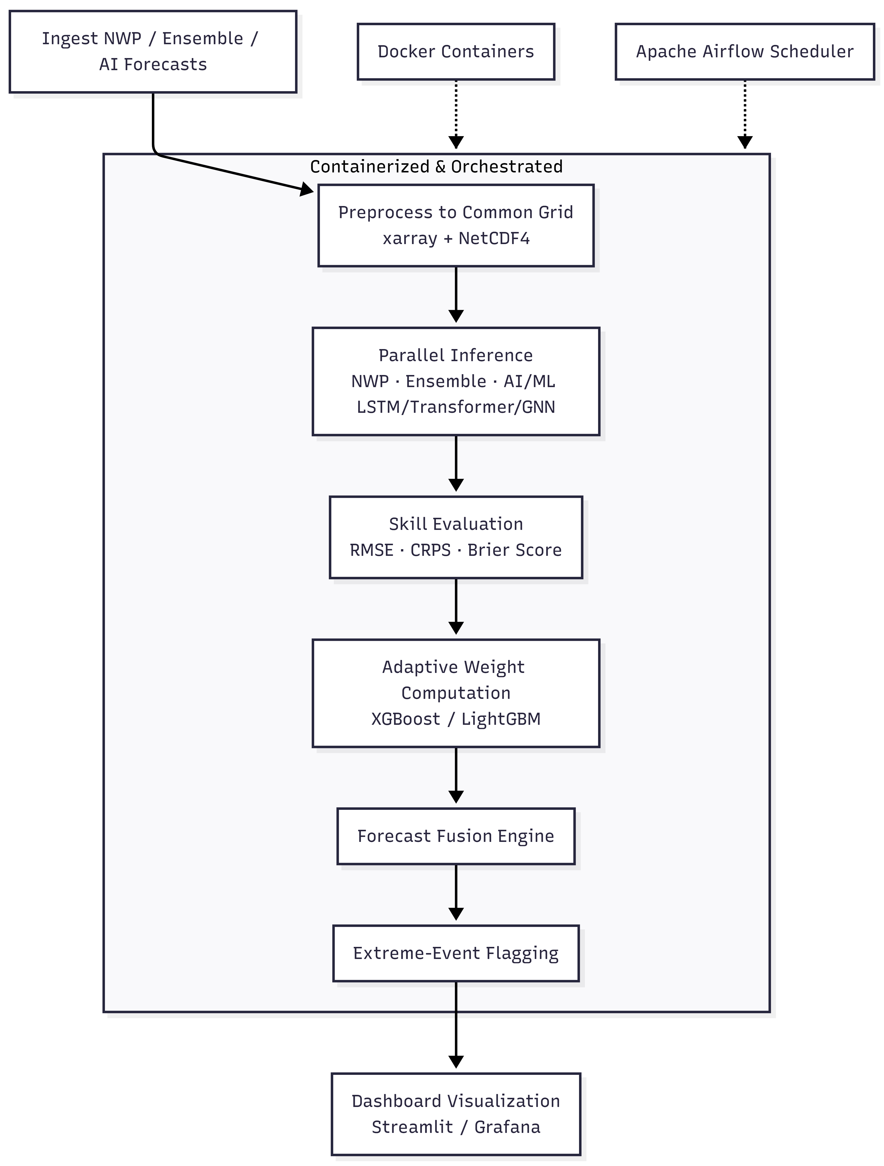
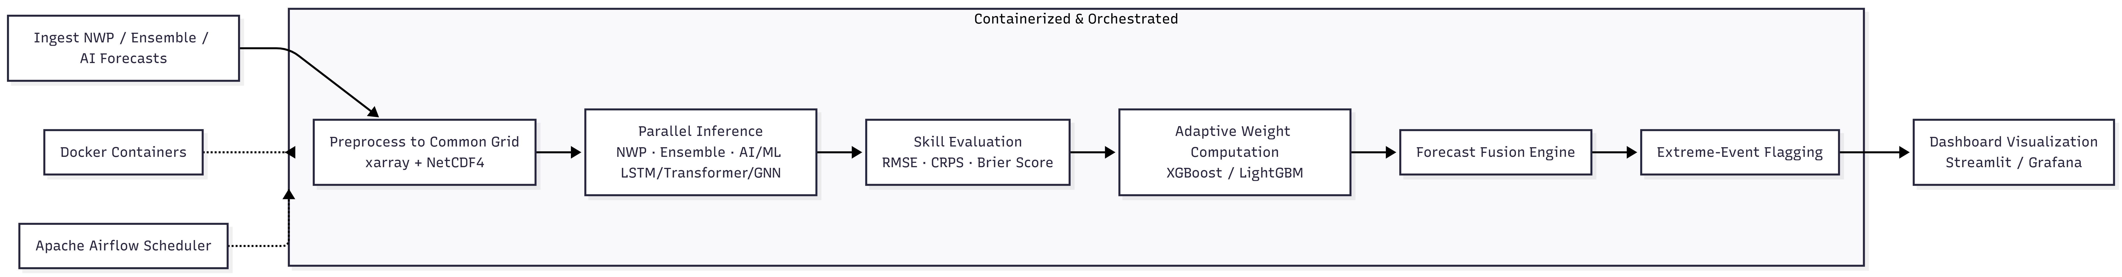
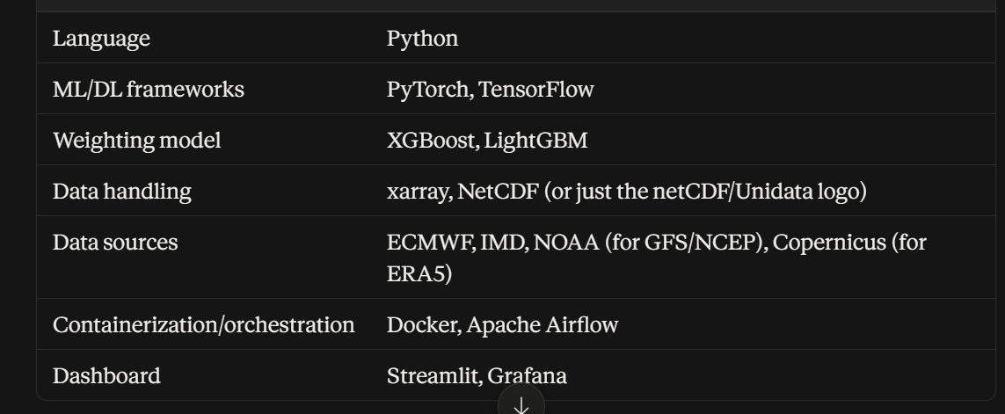
TECHNICAL APPROACH
Your Team Name
Technical Approach
- Core stack: Python, PyTorch/TensorFlow, XGBoost/LightGBM, xarray/NetCDF4
- Data: IMD/NCMRWF, ECMWF ENS/GFS, ERA5 reanalysis, ground + INSAT satellite obs
- AI models: LSTM, Transformer, Graph Neural Network (spatial correlation)
- Blending: rolling skill scoring (RMSE/CRPS/Brier) → Gradient Boosted Trees adaptive weights
- Pipeline: ingest → infer → score → weight → fuse → flag extremes → visualize (Docker + Airflow)
- Deployment: REST API + Streamlit/Grafana dashboard, automated runs, extreme-weather alerts

Slide 4
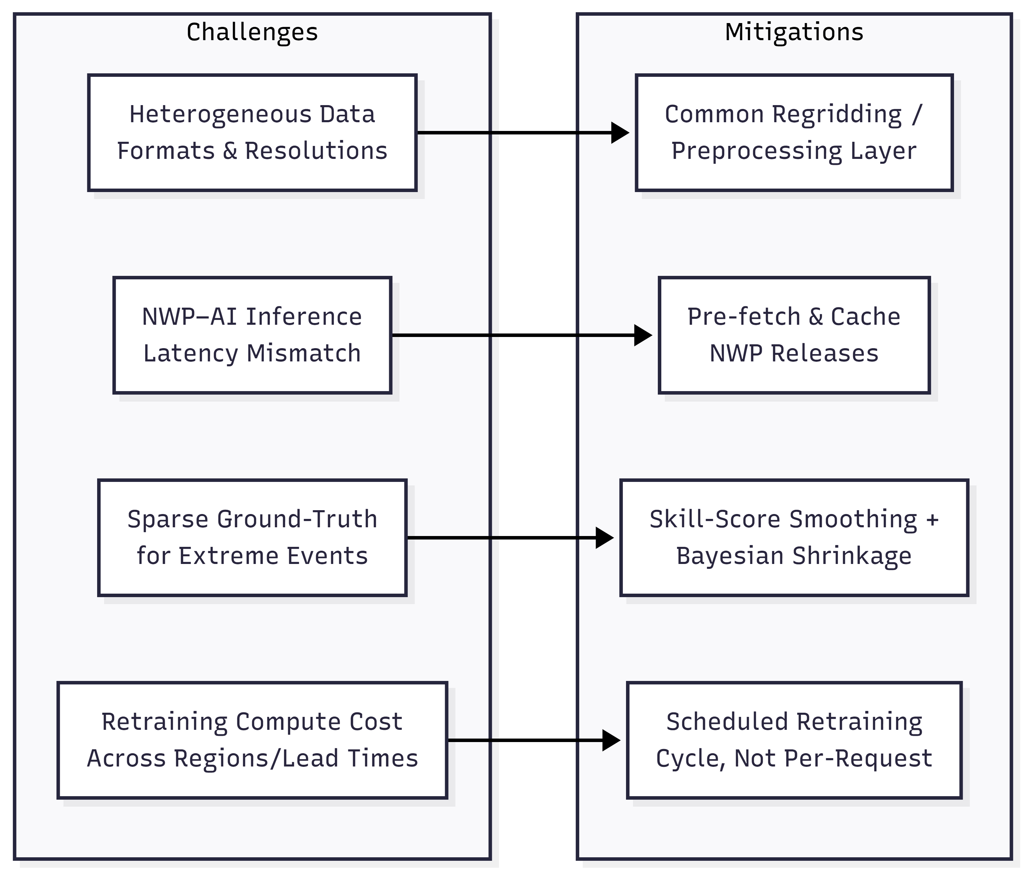
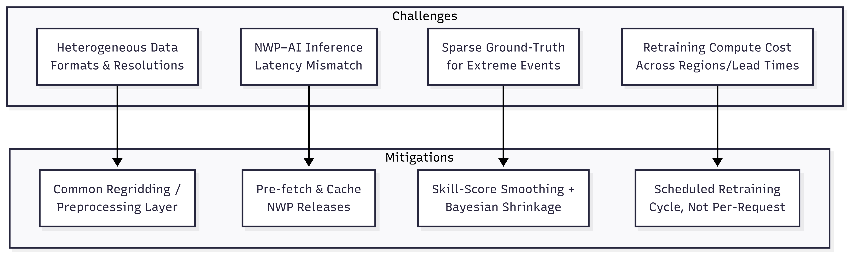
FEASIBILITY AND VIABILITY
Your Team Name
Feasibility and Viability
- Feasible: all data sources public (IMD, NCMRWF, ECMWF, GFS); blending is well-understood weighted-ensembling, not novel deep learning
- Challenges: heterogeneous data formats, NWP–AI latency mismatch, sparse extreme-event ground-truth, retraining compute cost
- Mitigation: common regridding layer, pre-fetched/cached NWP, skill-score smoothing + Bayesian shrinkage, scheduled (not per-request) retraining

Slide 5
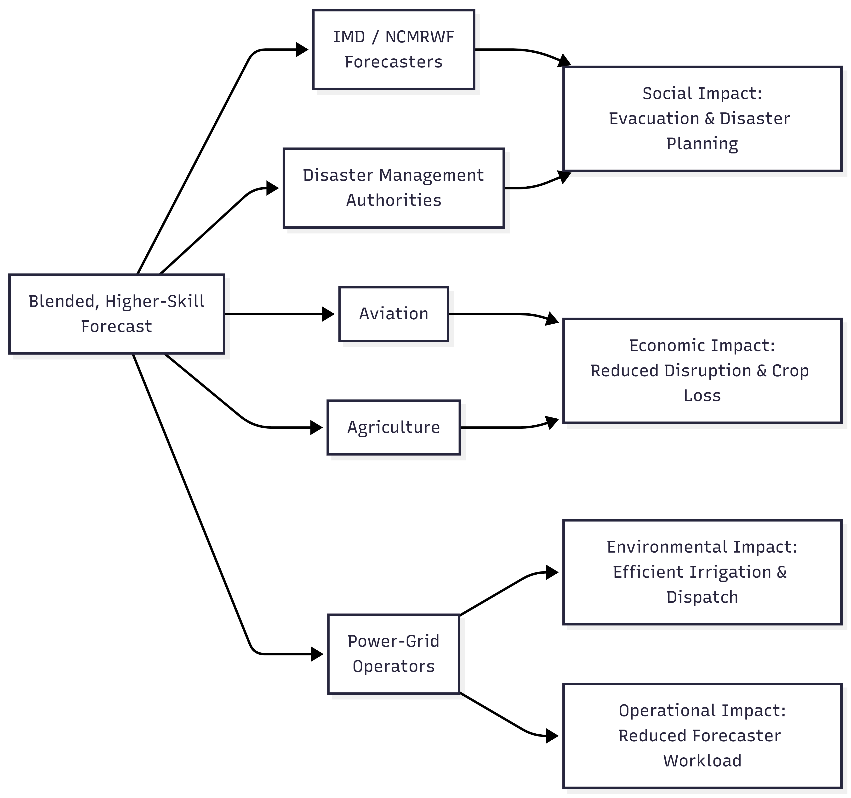
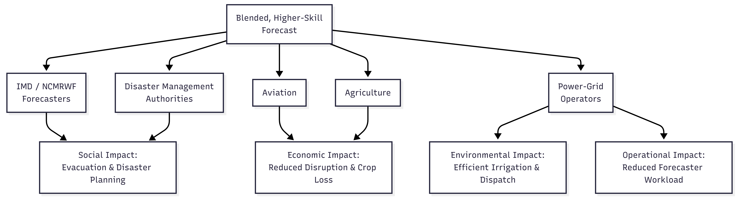
IMPACT AND BENEFITS
Your Team Name
Impact and Benefits
- Direct users: IMD/NCMRWF forecasters, disaster management, aviation, agriculture, power-grid operators
- Social: better lead time on rainfall/heatwave/wind warnings → evacuation & disaster planning
- Economic: less crop loss, optimized solar/wind scheduling, fewer aviation/logistics disruptions
- Environmental: more efficient irrigation and power-dispatch planning
- Operational: automated blending cuts manual forecaster workload during extreme events

Slide 6
RESEARCH AND REFERENCES
Your Team Name
Research and References
- IMD Forecast Verification: https://mausam.imd.gov.in/
- NCMRWF: https://www.ncmrwf.gov.in/
- ECMWF Open Data (ENS + HRES): https://www.ecmwf.int/en/forecasts/datasets/open-data
- ECMWF Open Data docs (Confluence): https://confluence.ecmwf.int/display/DAC/ECMWF+open+data%3A+real-time+forecasts
- Krishnamurti et al. (1999), "Improved Weather and Seasonal Climate Forecasts from Multimodel Superensemble," Science 285(5433): https://doi.org/10.1126/science.285.5433.1548
- NOAA NCEP – GFS model info: https://www.ncep.noaa.gov/
- ERA5 Reanalysis – Copernicus Climate Data Store: https://cds.climate.copernicus.eu/

