Slide 1


Physics-Informed Sparse Dynamics Discovery for Quadrotor Using Compressed Sensing and SINDy
Team 22:
DHIVYALAKSHMI M — CH.SC.U4AIE24016
LAKSHMI KANTHAN S — CH.SC.U4AIE24041
AKSHAYA SUNDAR — CH.EN.U4RAI24002

Slide 2
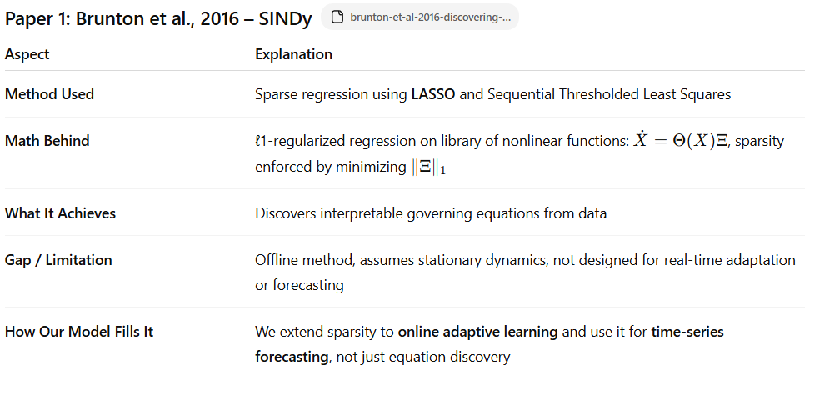
Methodological Comparison of Existing Sparse and Adaptive Models

Slide 3
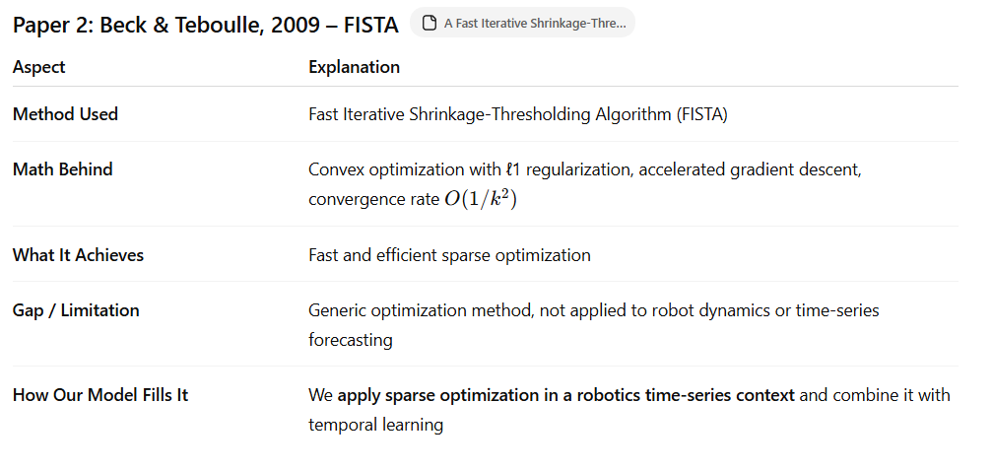

Slide 4
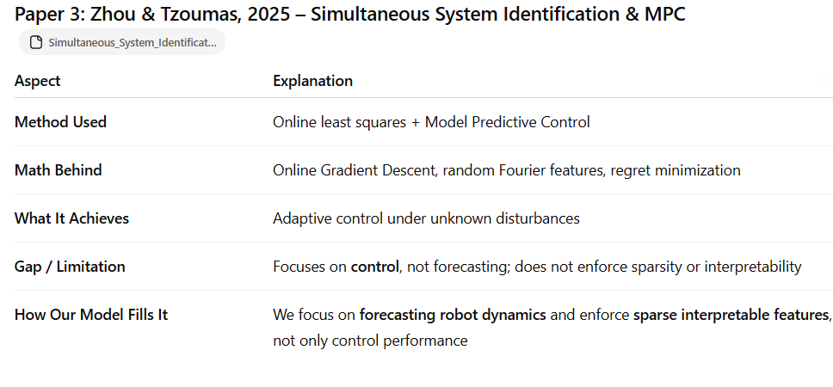

Slide 5
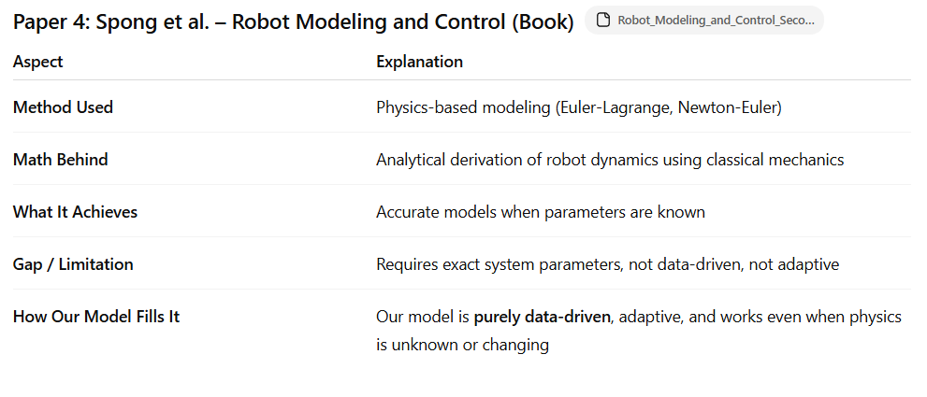

Slide 6
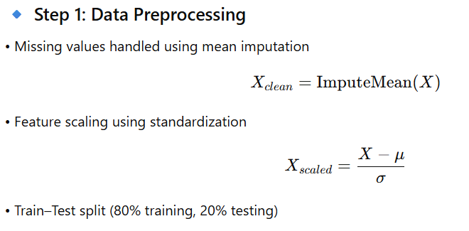
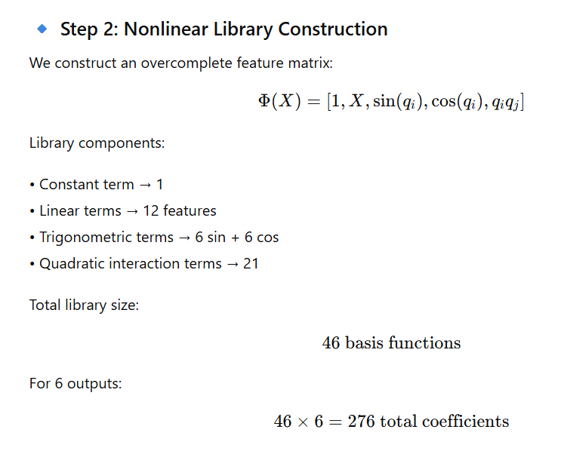
IMPLEMENTATION

Slide 7
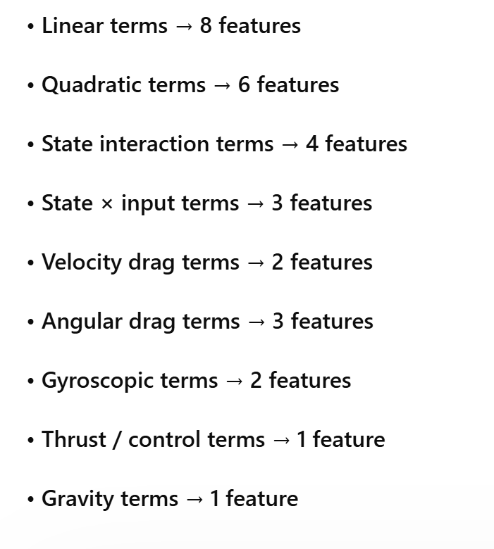

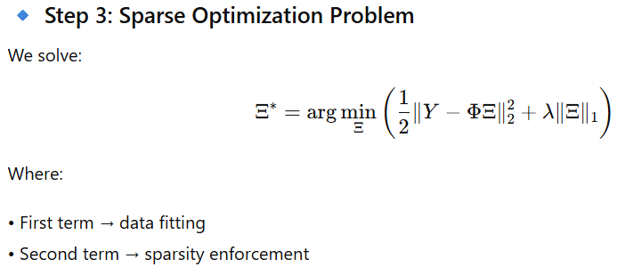
IMPLEMENTATION
Robotic dynamics are inherently nonlinear due to rotational motion, trigonometric relationships, and joint coupling effects, so linear models alone are insufficient.
A nonlinear library enriches the feature space by adding functions like sine, cosine, and quadratic interaction terms.
This transformation allows complex nonlinear behavior to be represented as a linear combination of nonlinear basis functions.
As a result, compressed sensing can efficiently select the most relevant terms and identify a sparse governing equation.

Slide 8
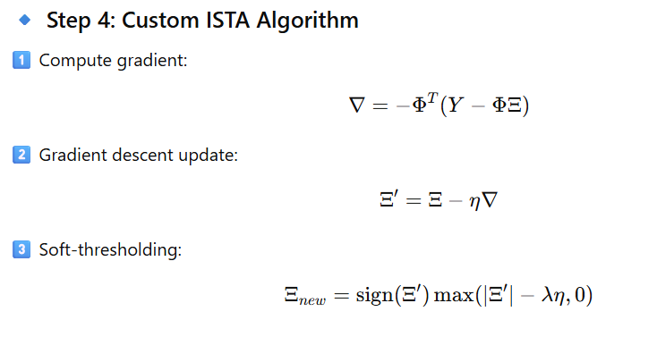
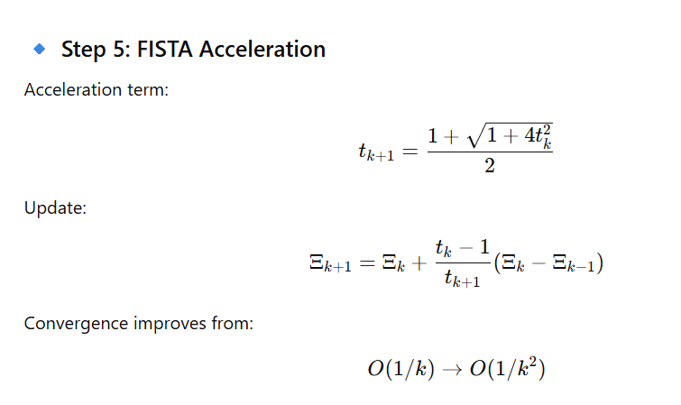
IMPLEMENTATION

Slide 9
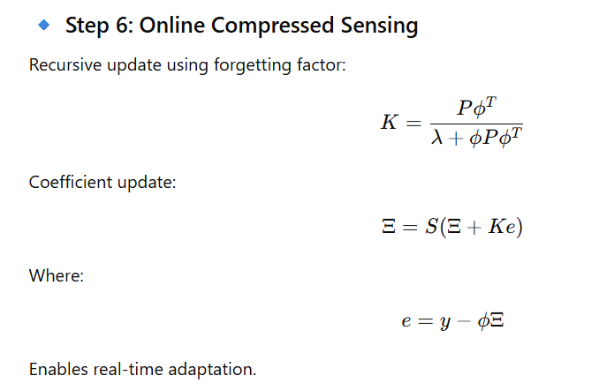
IMPLEMENTATION

Slide 10
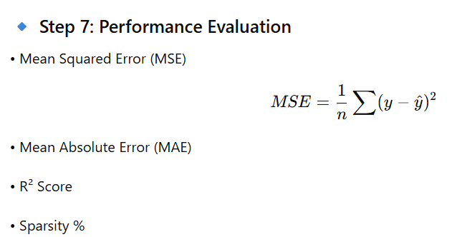
IMPLEMENTATION
• Real Data: R²=0.825 | MSE=12.156 | MAE=1.61
•Synthetic: R²=0.925 | MSE=0.353 | MAE=0.408
•Real: 31/186 active terms | 83.3% sparse | 4.07ms
•Synthetic: 22/186 active terms | 88.2% sparse | 2.98ms

Slide 11
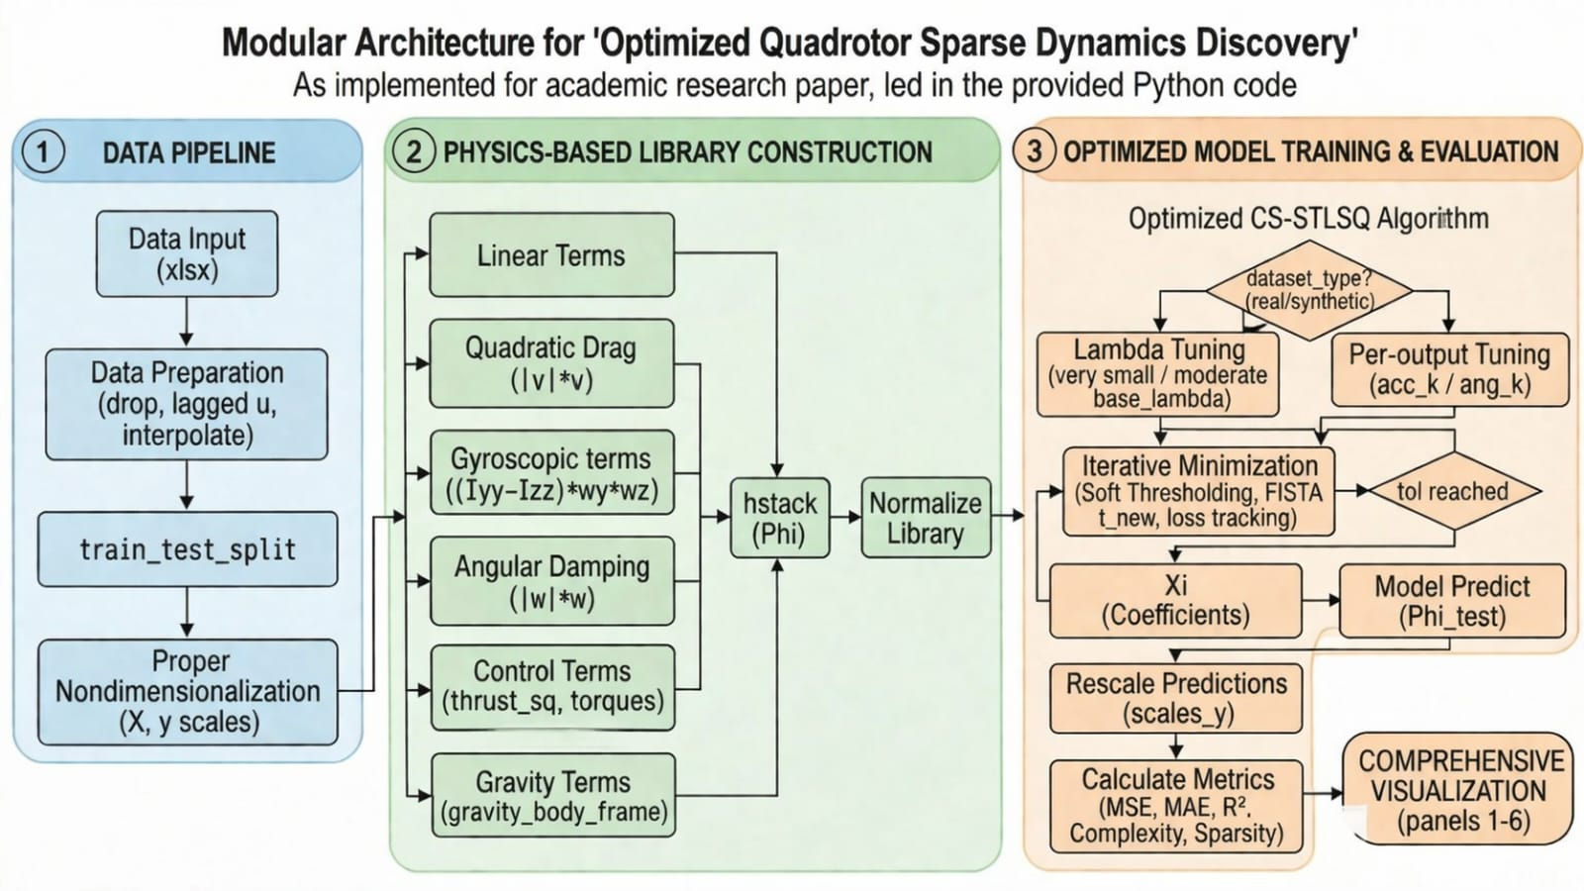
Methodology
Real vs Synthetic: Comparison of Key Metrics
Model | MSE | MAE | R2 | Latency | Complexity | Sparsity
Real Data | 12.156 | 1.61 | 0.825 | 4.07 ms | 31/186 | 83.3%
Synthetic | 0.353 | 0.408 | 0.925 | 2.98 ms | 22/186 | 88.2%

Slide 12
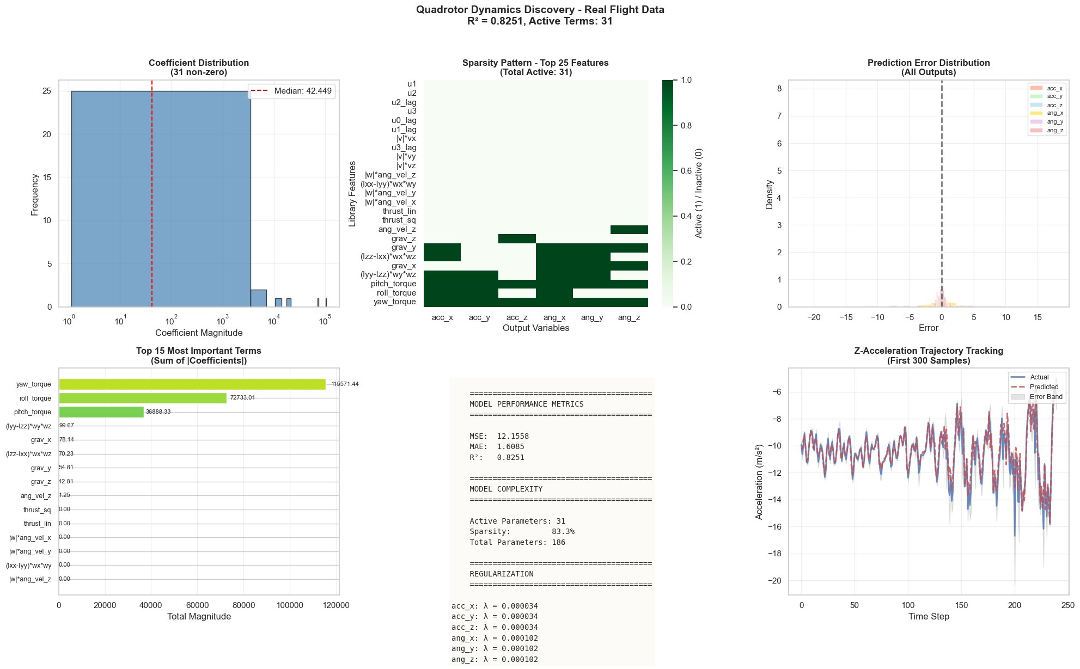

Slide 13
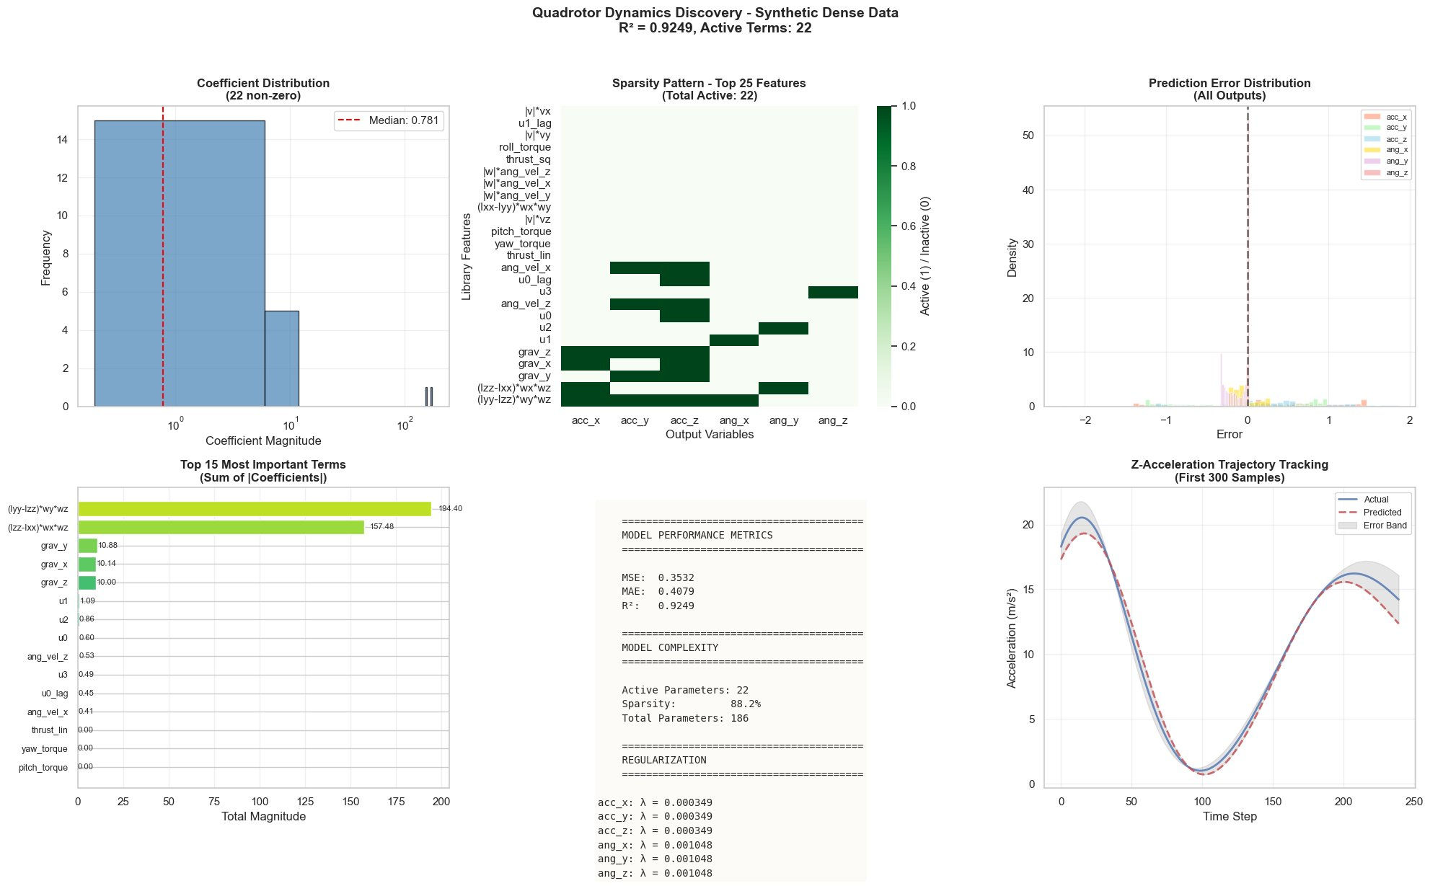

Slide 14
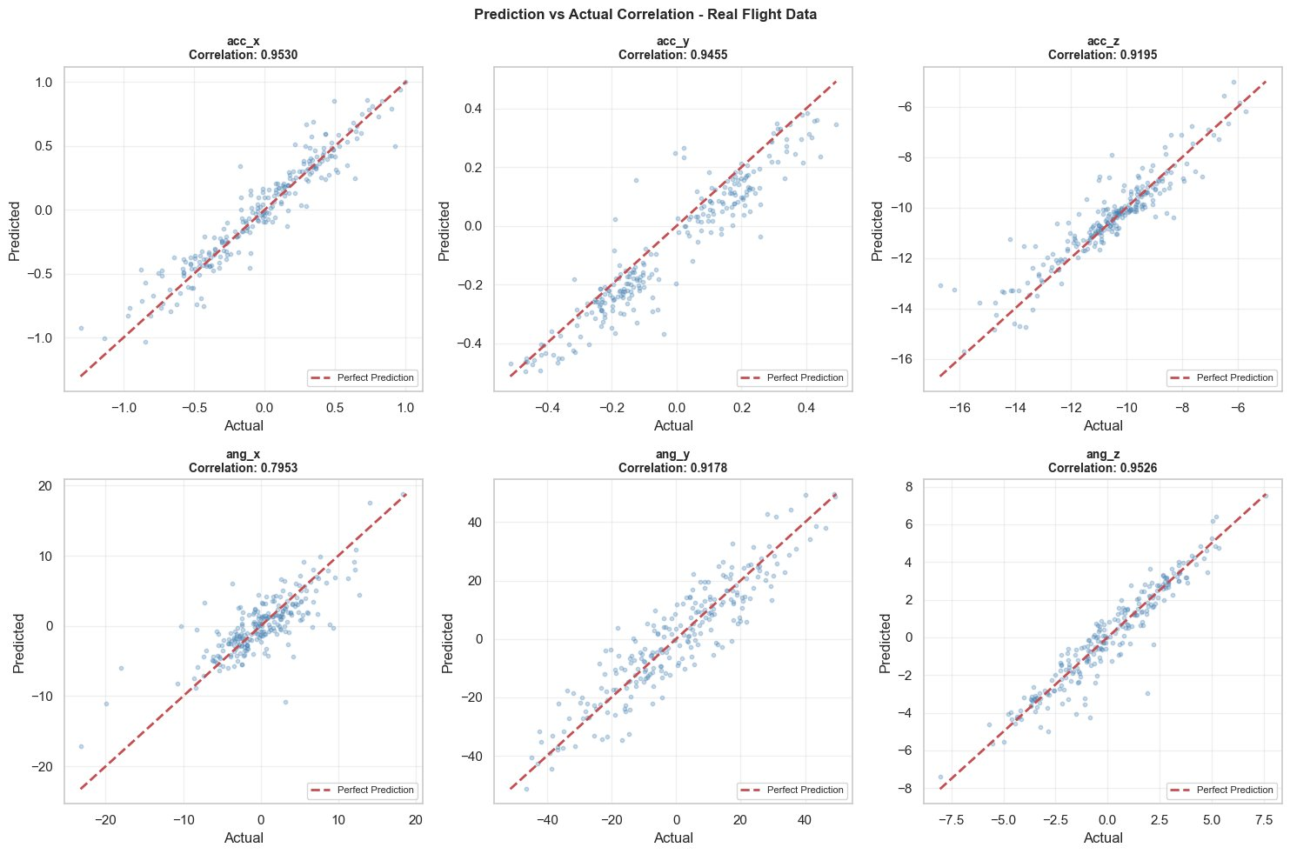

Slide 15
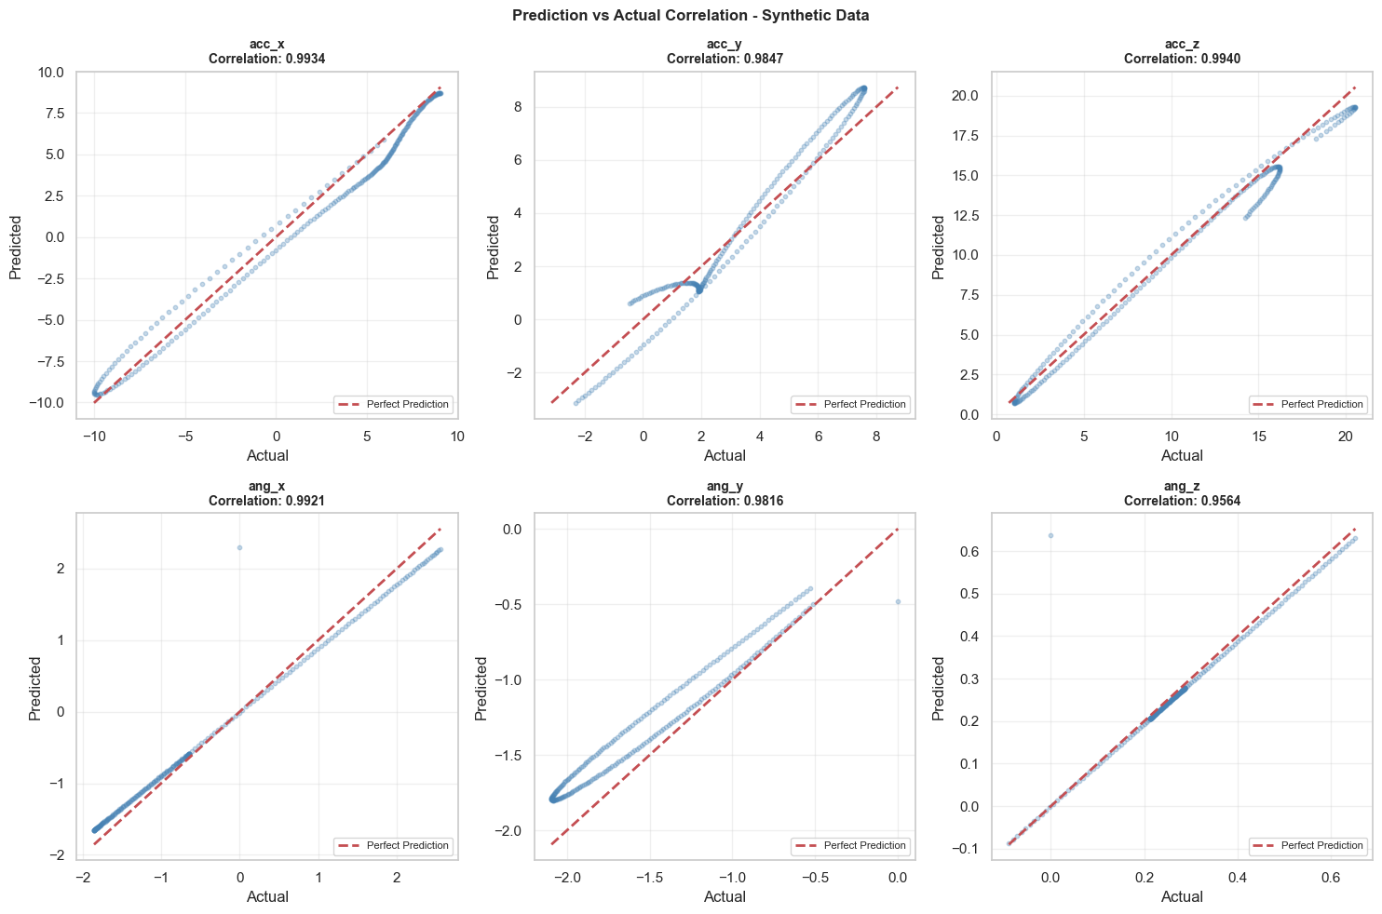

Slide 16


