Slide 1
BOOSTING ALGORITHMS
Boosting is an ensemble learning technique that combines multiple weak learners (typically decision trees) to create a strong predictive model.
It works by sequentially training models, where each new model corrects the errors of the previous one.

Slide 2
POPULAR BOOSTING ALGORITHMS
Ada BOOST (Adaptive Boosting)
XG BOOST (eXtreme Gradient Boosting)
LG BOOST(Light Gradient Boosting)

Slide 3
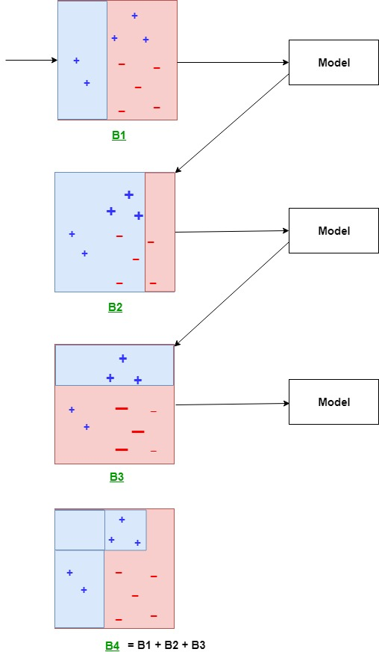
Ada BOOST

Slide 4
Ada BOOST
AdaBoost combines multiple weak learners (usually shallow decision trees, or "stumps") into a strong learner.
It assigns higher weights to previously mispredicted points, forcing the next model to focus on difficult cases.
The final prediction is a weighted combination of all weak learners.

Slide 5
Advantage & Disadvantage of Ada Boost Algorithm
Advantages:
Simple and interpretable.
Works well on small datasets.
Disadvantages:
Sensitive to outliers.
Slower on large datasets.

Slide 6
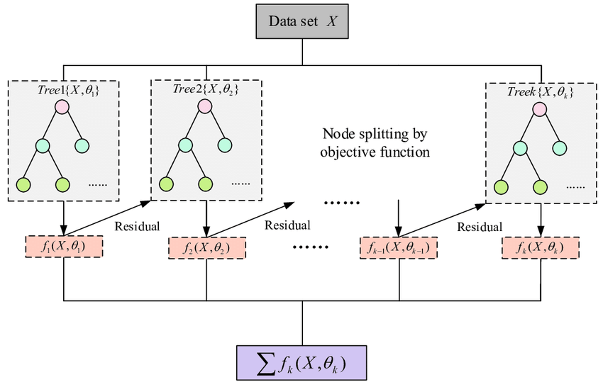
XG BOOST

Slide 7
XG BOOST
Improved gradient boosting with regularization (L1 & L2) to reduce overfitting.
Uses second-order derivatives (Hessian matrix) for better optimization.
Efficiently handles sparse data and missing values.
Handling complex dataset
Grows trees Level-wise

Slide 8
Advantage & Disadvantage of XG Boost Algorithm
Advantages:
Faster than AdaBoost.
Handles missing values well.
Reduces overfitting via regularization.
Disadvantages:
Requires tuning for best performance.

Slide 9
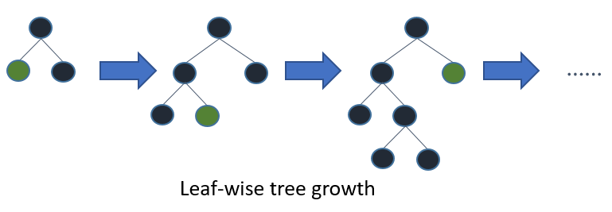
LG BOOST

Slide 10
LG BOOST
A faster, memory-efficient gradient boosting method.
Uses histogram-based learning for speed improvements.
Grows trees leaf-wise instead of level-wise (like XGBoost), making it faster on large datasets.

Slide 11
Advantage & Disadvantage of LG Boost Algorithm
Advantages:
Fastest among the three (best for large datasets).
Handles categorical features without encoding.
Uses less memory.
Disadvantages:
Can overfit if not properly tuned.

