Slide 1

Analyzing Cyber Attacks In WSNs using Ensemble Techniques
by
Lakshmi Moksha B
Roll No. 224G1A3246
Dinesh Reddy C
Roll No. 224G1A3218
Karthik P
Roll No. 224G1A3239
Akash R
Roll No. 224G1A3206
Under the guidance of
Dr. P. Chitralingappa _{M. Tech., Ph.D.}
Associate Professor & HOD
Department of Computer Science and Engineering (Data Science)
Srinivasa Ramanujan Institute of Technology
(Affiliated to JNTUA & Approved by AICTE) (Accredited by NAAC with ‘A’ Grade & Accredited by NBA (EEE, ECE & CSE)
Rotarypuram Village, B K Samudram Mandal, Ananthapuramu – 515701.
2025 - 2026

Slide 2
Analyzing Cyber Attacks In WSN using Ensemble Techniques
Review – 0 comments
Improve clarity of problem statement, abstract, and system description
Strengthen literature survey by clearly identifying the research gap
Include simulation to support project concept and analysis
Review – 1 comments
Proceed with COOJA simulation
Demonstrate practical WSN network behavior.
Analyze cyber attack behavior using simulation results

Slide 3


Contents
Abstract
Problem Statement
Objectives of Project
Literature Survey
Proposed work
Introduction
Existing System
Proposed System
Planning and Design
Requirements
Modules
UML Diagrams
Data Flow Diagram
Screenshots (Project Output)
References
GitHub Link

Slide 4
Abstract
Cyber security plays a vital role in protecting Wireless Sensor Networks (WSNs), which are widely used in industrial monitoring, environmental sensing, and smart applications. Due to wireless communication and limited computational resources, WSNs are highly vulnerable to various cyber-attacks. Many existing security solutions mainly focus on detecting attacks and fail to accurately classify different attack types. This project proposes an ensemble-based cyber attack detection and classification system using machine learning and deep learning models such as Stacking, XGBoost, AdaBoost, MLP, and Autoencoder. The system analyzes network behavior using the WSN-DS dataset to detect and classify cyber-attacks effectively. Simulation is performed using the COOJA simulator to analyze node communication behavior and validate the system performance. The proposed system improves detection accuracy, reliability, and security of Wireless Sensor Networks.

Slide 5
Problem Statement
Wireless Sensor Networks (WSNs) are widely used in industrial, environmental, and smart applications
Due to wireless communication and limited computational resources, WSNs are vulnerable to cyber-attacks
Attacks such as Flooding, Blackhole, Grayhole, and TDMA can disrupt network performance and data reliability
Existing security systems mainly detect attacks but may not clearly classify different attack types
Single machine learning models may not effectively handle complex and diverse attack patterns
There is a need for an efficient and intelligent system to detect and classify multiple cyber-attacks in WSNs

Slide 6
Objectives of Project
To detect cyber-attacks in Wireless Sensor Networks using machine learning techniques.
To classify different types of cyber-attacks such as Flooding, Blackhole, Grayhole, and TDMA attacks.
To improve detection accuracy using ensemble and deep learning models.
To analyze network behavior using the WSN-DS dataset.
To validate system performance using COOJA simulation

Slide 7
Literature Survey for first objective
Objective 1: To Improve Cyber Attack Detection in Wireless Sensor Networks
Al-Quayed et al. (2023) proposed a cyber security framework for WSNs using MLP and Autoencoder models.
Their system detected attacks such as Blackhole, Grayhole, Flooding, and Scheduling attacks by learning network behavior patterns.
The results showed deep learning models can effectively identify abnormal network activities.
However, the system mainly focuses on attack detection and may not always provide consistent classification of different attack types.
This work supports improving cyber attack detection in Wireless Sensor Networks.

Slide 8
Literature Survey for second objective
Karthikeyan et al. (2025) proposed a machine learning-based cyber attack detection system for WSNs
Objective 2: To Improve Cyber Attack Detection and Classification Using Machine Learning Techniques
Karthikeyan et al. (2025) proposed a machine learning-based cyber attack detection system for WSNs.
Their system analyzed network traffic behavior and used ML techniques to detect cyber-attacks.
The results showed better detection accuracy compared to traditional detection methods.
However, the system mainly uses individual machine learning models and does not clearly classify different types of cyber-attacks.
This research supports improving cyber attack detection and classification using advanced learning techniques

Slide 9
Proposed work
Design and develop a cyber attack detection and classification system for Wireless Sensor Networks.
Use ensemble and deep learning models such as Stacking, XGBoost, AdaBoost, MLP, and Autoencoder.
Detect and classify different cyber-attacks such as Flooding, Blackhole, Grayhole, and TDMA attacks.
Analyze network behavior using the WSN-DS dataset.
Improve detection accuracy and classification performance compared to single ML models.
Provide prevention methods and mitigation suggestions after detecting attacks.
Validate system behavior using COOJA simulation.

Slide 10
Introduction
Cyber security is important for protecting networks, communication systems, and data from cyber-attacks and unauthorized access.
Wireless Sensor Networks (WSNs) consist of sensor nodes that collect and transmit data wirelessly to a base station.
WSNs are widely used in industrial monitoring, environmental monitoring, healthcare, military applications, and smart city systems.
Due to wireless communication and limited battery, memory, and processing power, WSNs are highly vulnerable to cyber-attacks.
Attacks such as Flooding, Blackhole, Grayhole, and TDMA scheduling attacks can disrupt network communication and affect data reliability.
Machine learning, deep learning, and ensemble learning techniques help in detecting and classifying cyber-attacks by analyzing network behavior.

Slide 11
Existing System
Existing cyber security systems for Wireless Sensor Networks mainly use individual machine learning or deep learning models to detect abnormal network behavior.
These systems analyze network parameters like packet transmission, node communication and energy usage to identify possible cyber-attacks.
Many existing approaches mainly focus on detecting the presence of attacks and may not clearly classify different types of cyber-attacks.
Detection performance of single models may vary based on attack type and network conditions.
Individual models may not effectively handle complex and diverse cyber attack patterns.
Most existing systems focus only on detection and do not provide proper prevention or mitigation methods after attack detection.

Slide 12
Proposed System
The proposed system is designed to detect, classify, and prevent cyber-attacks in Wireless Sensor Networks using advanced learning techniques.
The system uses ensemble and deep learning models such as Stacking, XGBoost, AdaBoost, MLP, and Autoencoder for better detection performance.
The system can detect and classify multiple cyber-attacks such as Flooding, Blackhole, Grayhole, and TDMA scheduling attacks.
Ensemble learning improves detection accuracy and helps handle complex and diverse attack patterns compared to single models.
The system analyzes network behavior using the WSN-DS dataset for training and testing.
The system also provides prevention and mitigation suggestions after detecting cyber-attacks and is validated using COOJA simulation.

Slide 13
Planning & Design
Planning:
The project is planned to develop a cyber attack detection, classification, and prevention system for Wireless Sensor Networks.
The WSN-DS dataset is selected for training and testing the machine learning and deep learning models.
Multiple models such as Stacking, XGBoost, AdaBoost, MLP, and Autoencoder are selected for cyber attack detection and classification.
COOJA simulator is planned to simulate Wireless Sensor Network node communication and cyber attack behavior.
The system aims to improve cyber attack detection accuracy and overall network security.

Slide 14
Planning & Design
Design:
The system is designed to take network traffic data as input from the Wireless Sensor Network environment.
The input data is processed using machine learning, deep learning, and ensemble learning models.
The system is designed to detect and classify different cyber-attacks based on network behavior patterns.
The system provides prevention and mitigation methods after detecting cyber-attacks.
COOJA simulation is used to analyze real-time node communication and attack behavior.
The final output provides attack detection results, attack classification, and prevention support.

Slide 15
Requirements
Functional Requirements:
The system should allow users to upload WSN network dataset files for analysis.
The system should allow selection of different machine learning models for cyber attack detection.
The system should detect cyber-attacks based on network traffic data.
The system should classify detected cyber-attacks into specific attack types.
The system should provide prevention and mitigation suggestions after attack detection.
The system should display prediction results and forensic analysis information to the user.

Slide 16
Requirements
Non-Functional Requirements:
The system should provide high detection accuracy for cyber attack identification.
The system should ensure reliable and consistent performance during analysis.
The system should provide fast processing and response time for prediction results.
The system should ensure data security and safe handling of uploaded datasets.
The system should provide a user-friendly interface for easy interaction.
The system should be scalable to handle large WSN datasets and multiple users.

Slide 17
Modules
User Modules:
Registration & Login: Users can register and log in securely to access the system.
Dataset Upload: Users can upload WSN network dataset files for cyber attack analysis.
Model Selection & Prediction:Users can select machine learning models and perform cyber attack detection.
Attack DetectionResults:Users can view detected attack type, severity level, and analysis results.
Prevention & Forensic Report: Users can view prevention methods and forensic analysis details.
System Modules:
Attack Detection Module: Uses machine learning, deep learning, and ensemble models to detect cyber attacks.
Attack Classification Module: Classifies detected attacks into specific cyber attack types.
Prevention Suggestion Module: Generates prevention and mitigation methods for detected attacks.
Forensic Logging Module: Stores attack details, severity level, and mitigation data for analysis.
Result Visualization Module : Displays attack results, severity levels, and analysis reports in a user-friendly format.

Slide 18
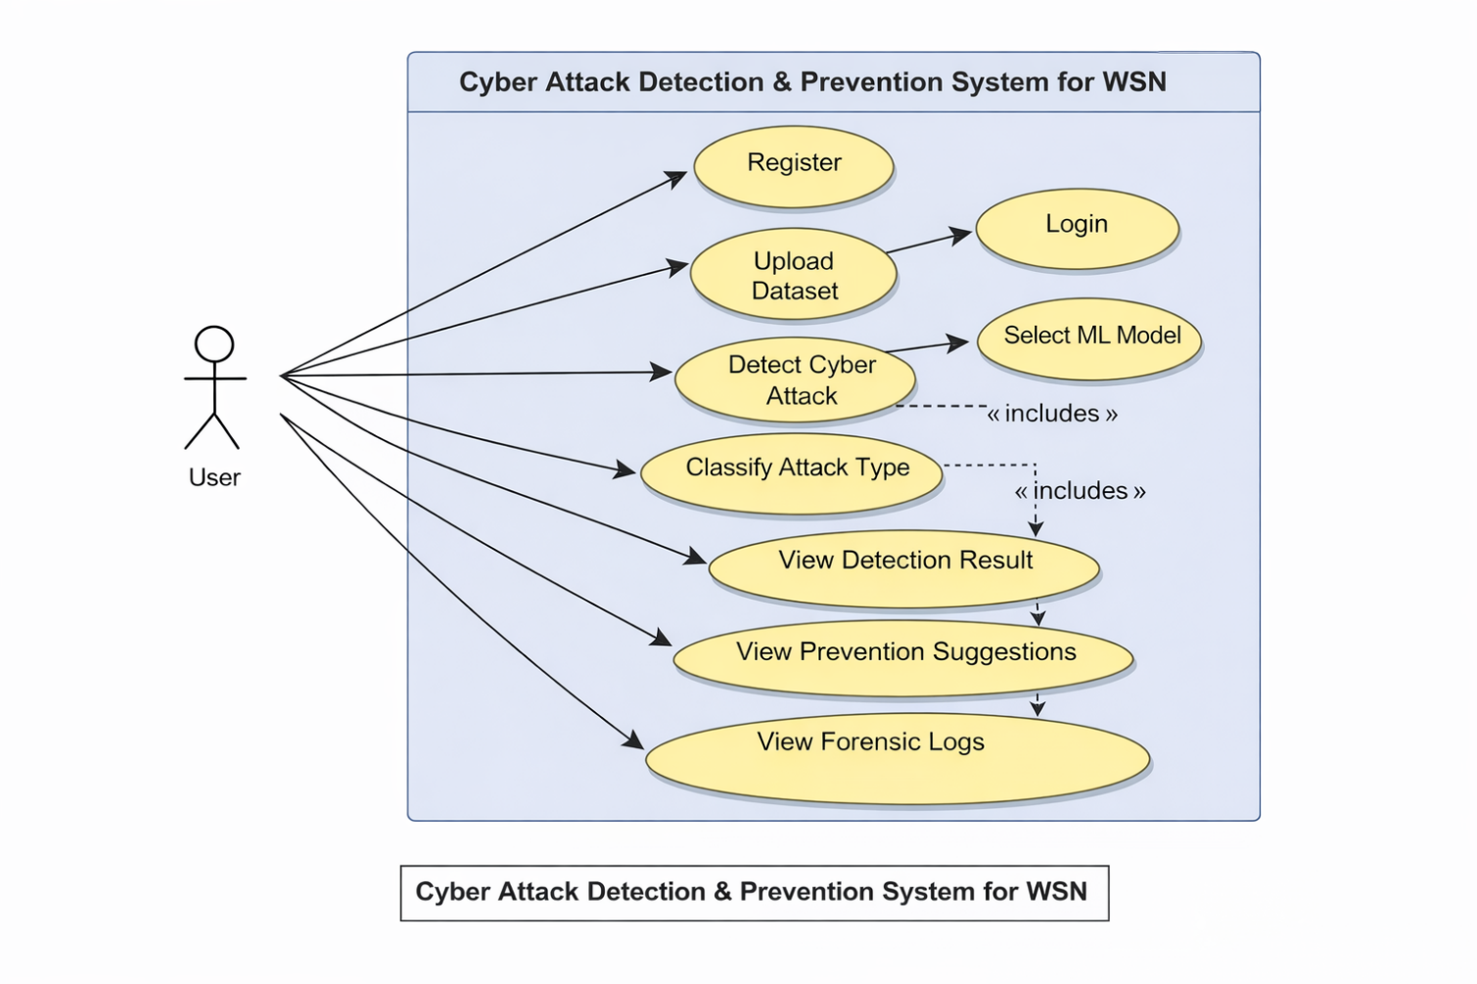
UML Diagrams
Use Case Diagram:
The UML Use Case Diagram shows the interaction between the user and the cyber attack detection and prevention system..
The user can register, log in, upload WSN dataset, and select machine learning models for attack detection.
The system detects and classifies cyberattacks and provides prevention suggestions.
The system also stores attack details in forensic logs for monitoring and analysis.

Slide 19
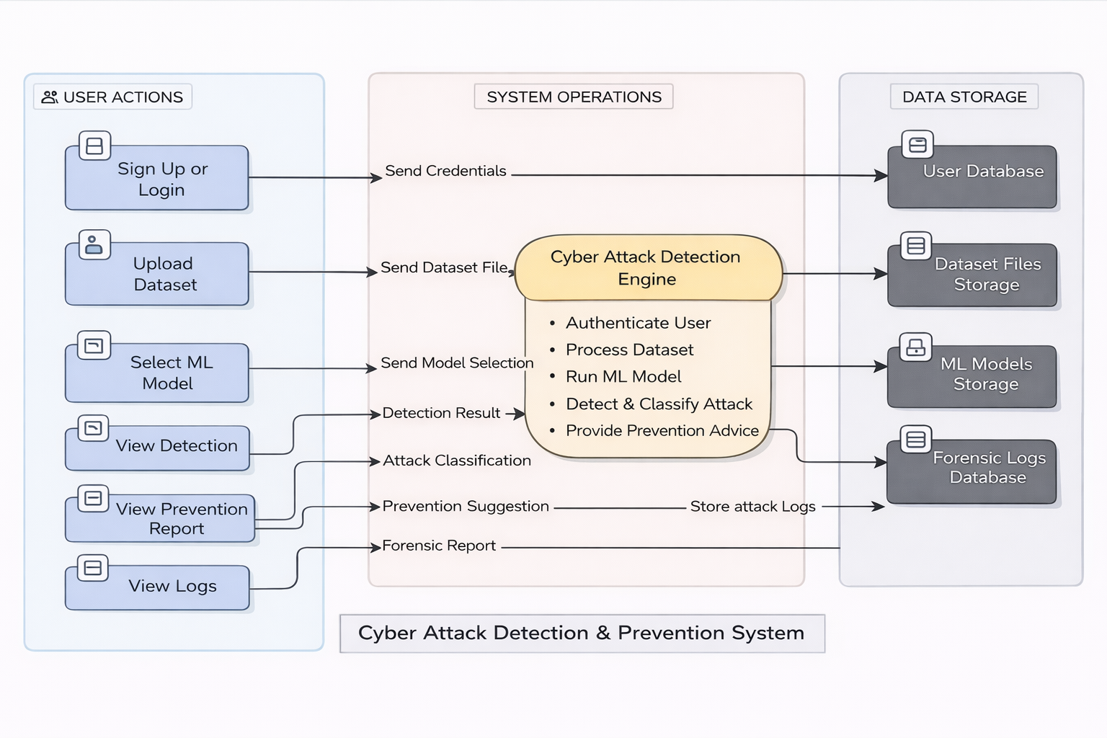
Data Flow Diagram

Slide 20
Data Flow Diagram
The diagram shows how data flows between the user, system processing unit, and data storage components..
The user performs actions such as login, dataset upload, and machine learning model selection.
The system processes the uploaded dataset using trained machine learning models to detect cyber attacks.
The system classifies detected attacks and generates prevention suggestions and forensic reports.
Important data such as user information, dataset files, ML models, and forensic logs are stored in separate data storage modules.
The system sends detection results, attack classification details, and prevention suggestions back to the user.

Slide 21
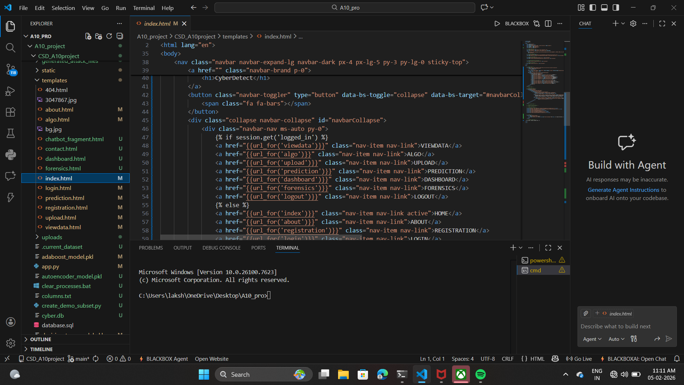
Sample Code

Slide 22
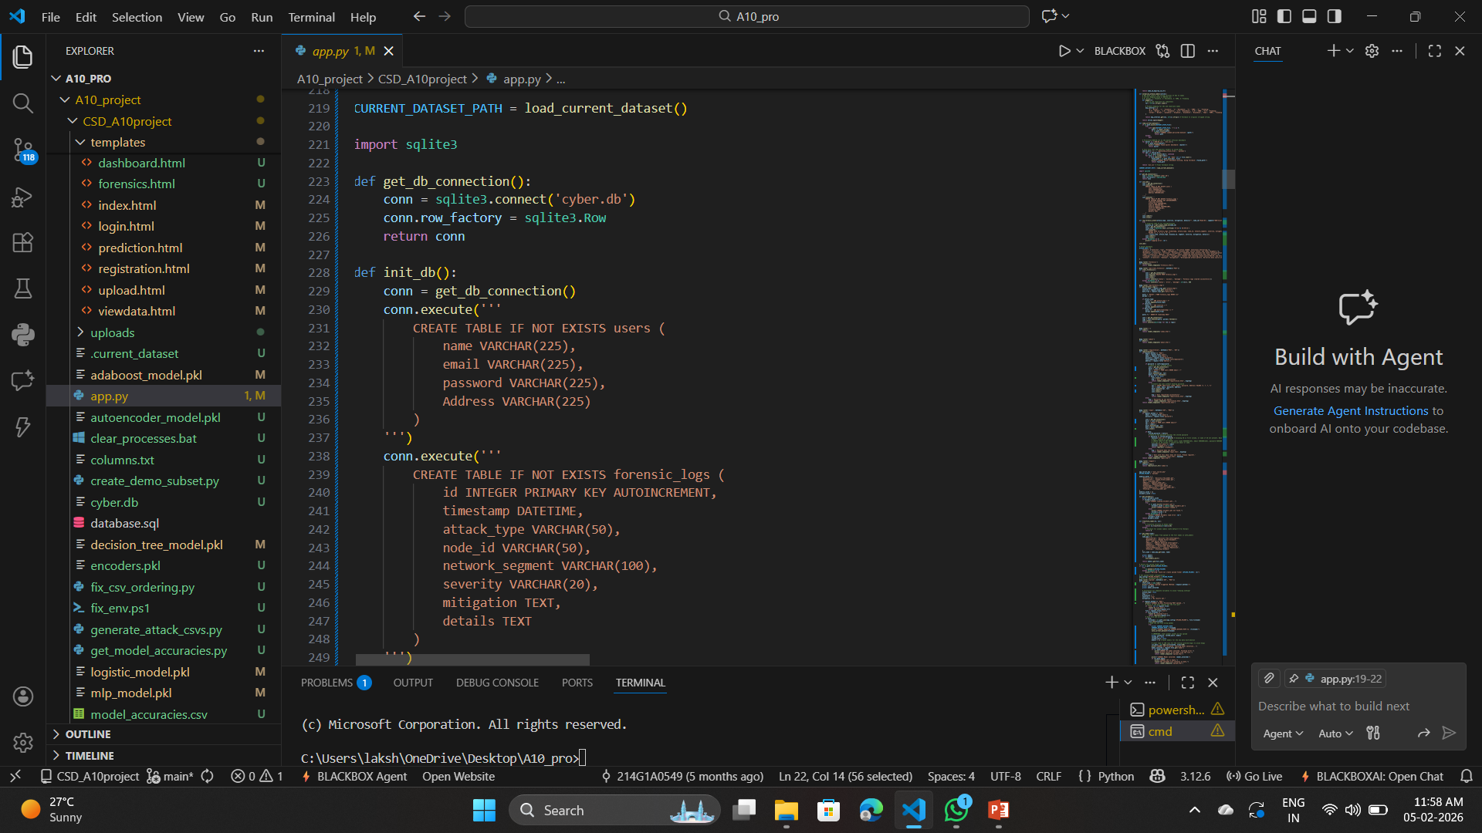
Sample Code

Slide 23
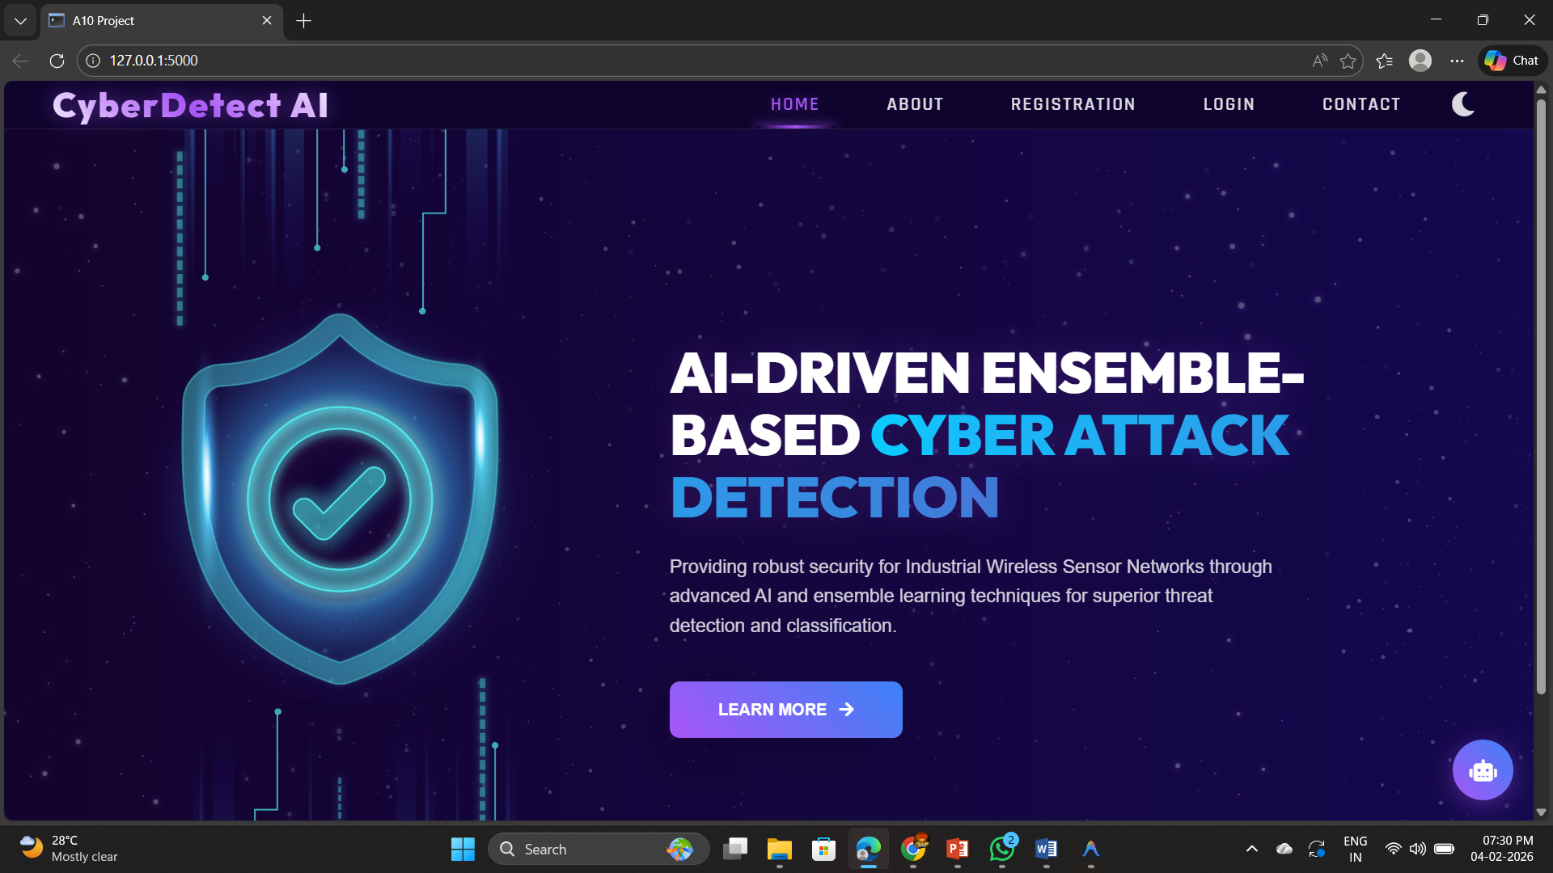
Output Screens
Homepage

Slide 24
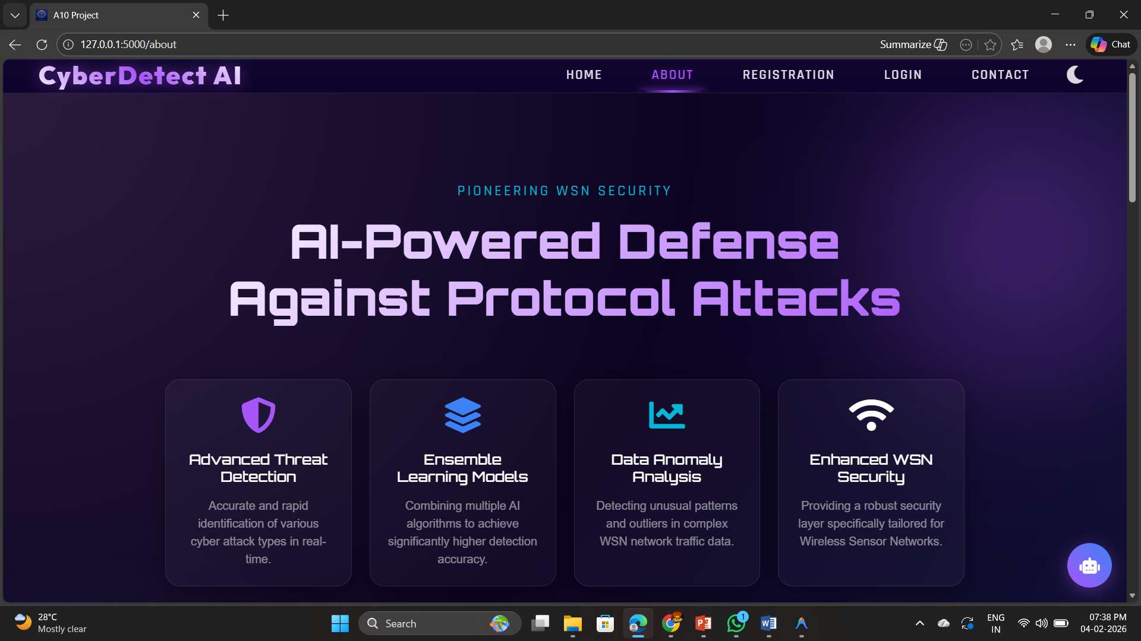
Output Screens
About page

Slide 25
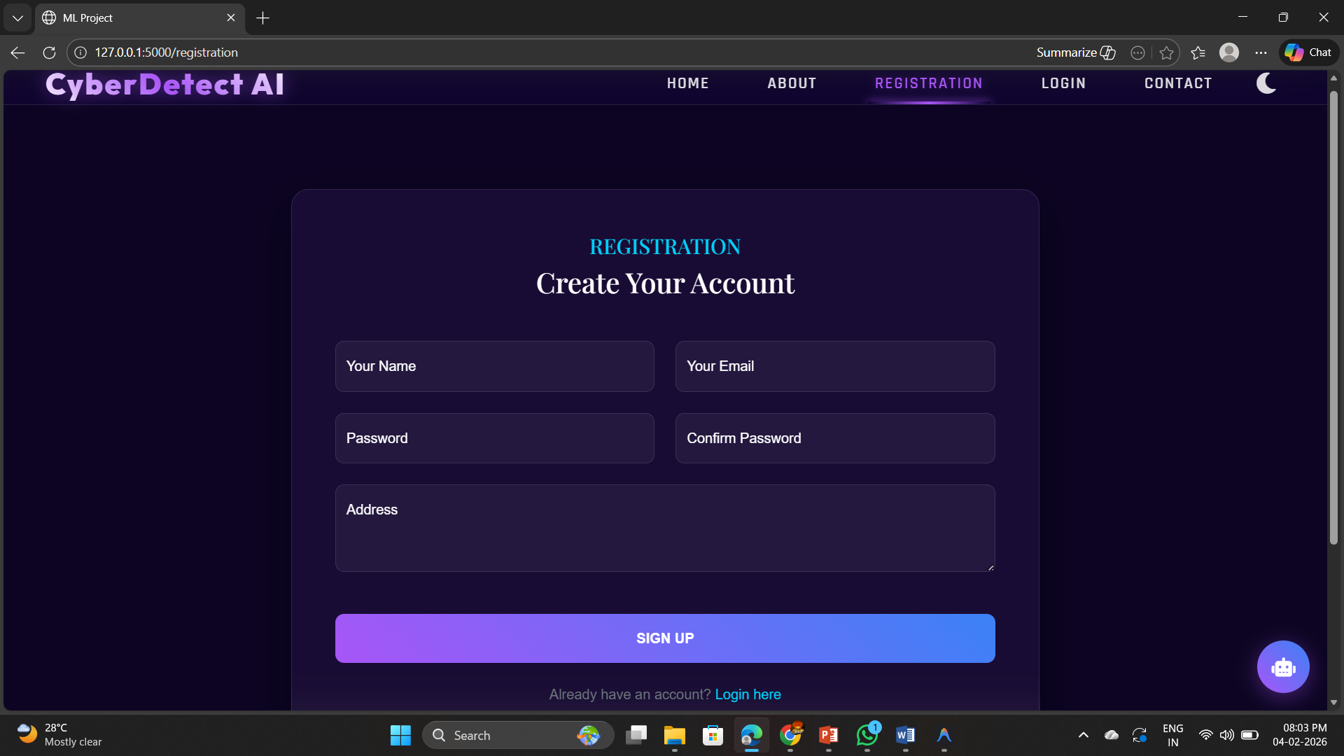
Output Screens
Signup: Create user account by providing the details

Slide 26
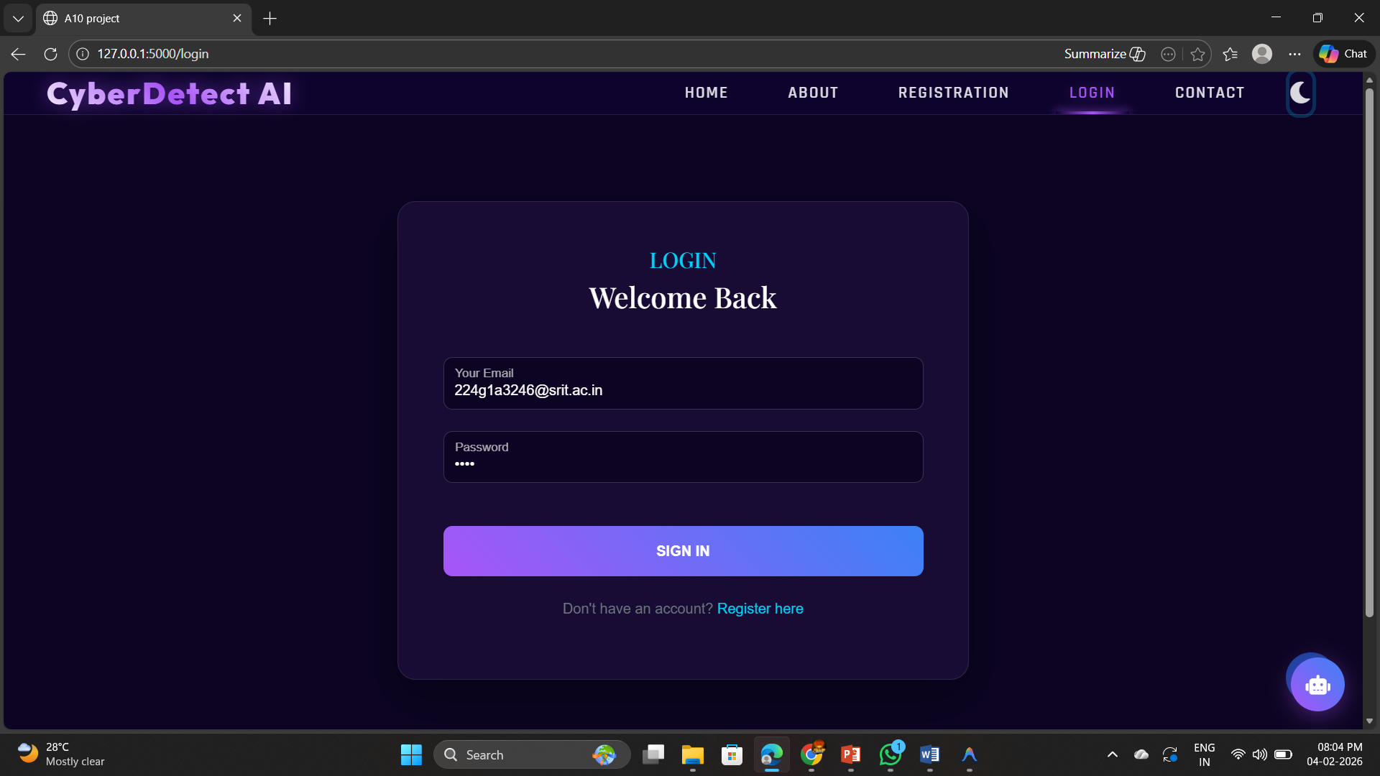
Output Screens
Login page

Slide 27
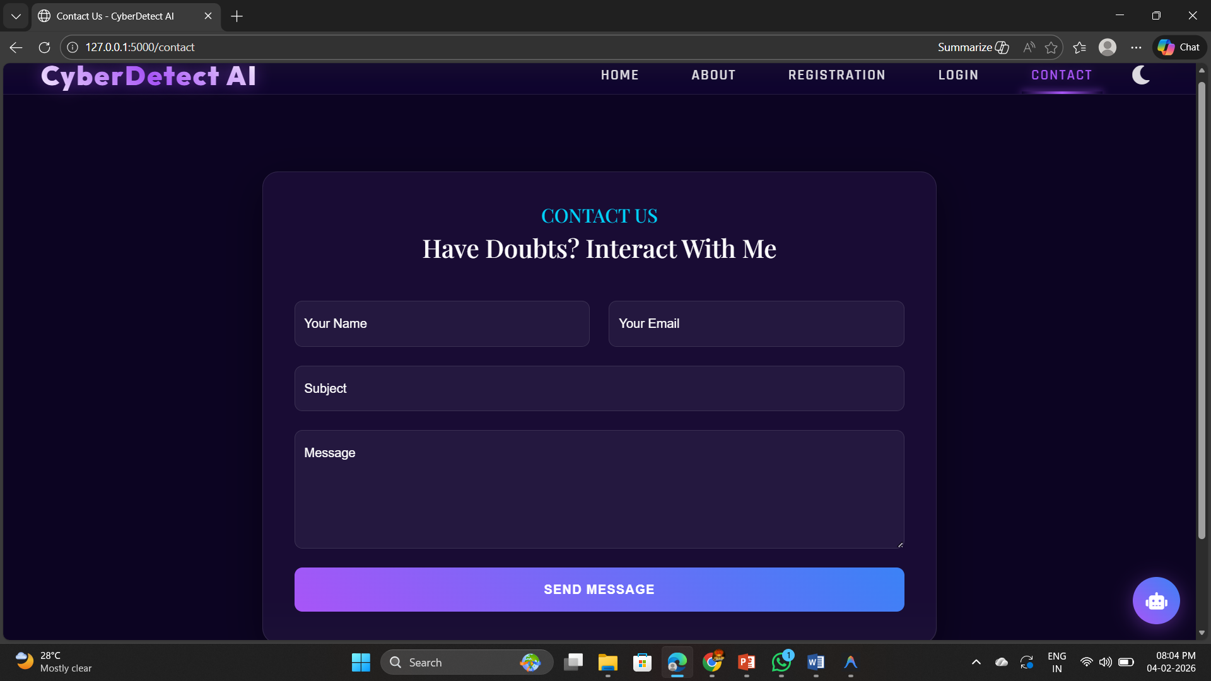
Output Screens
Contact Page

Slide 28
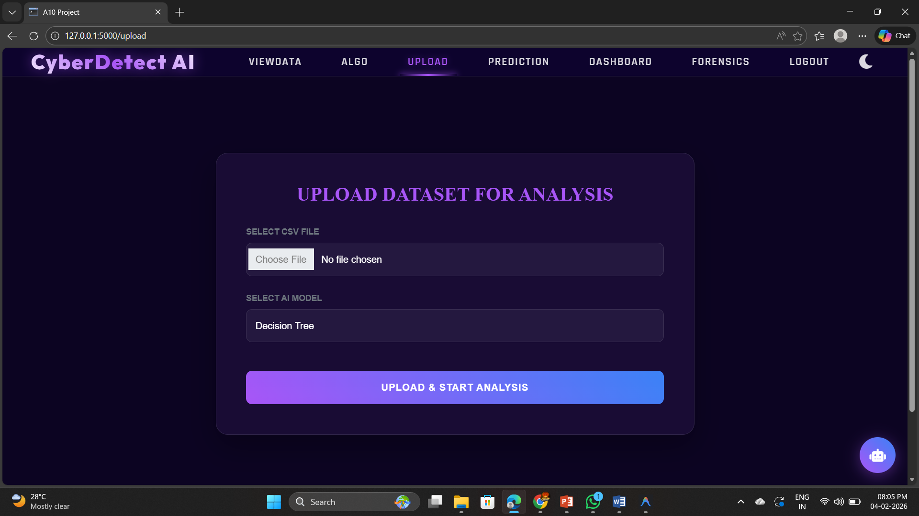
Output Screens
Datasets uploading page

Slide 29
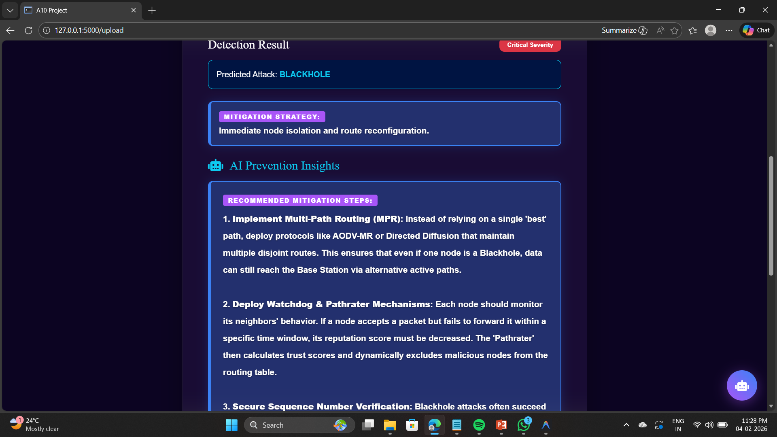
Output Screens
Prevention methods and attack classification

Slide 30
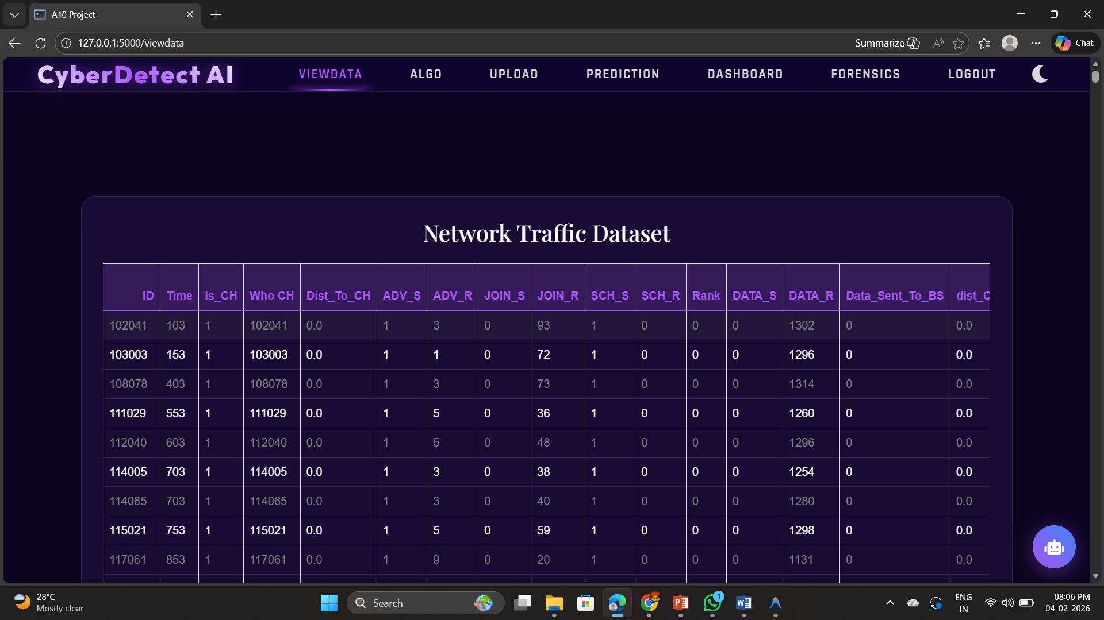
Output Screens
View Data Page

Slide 31
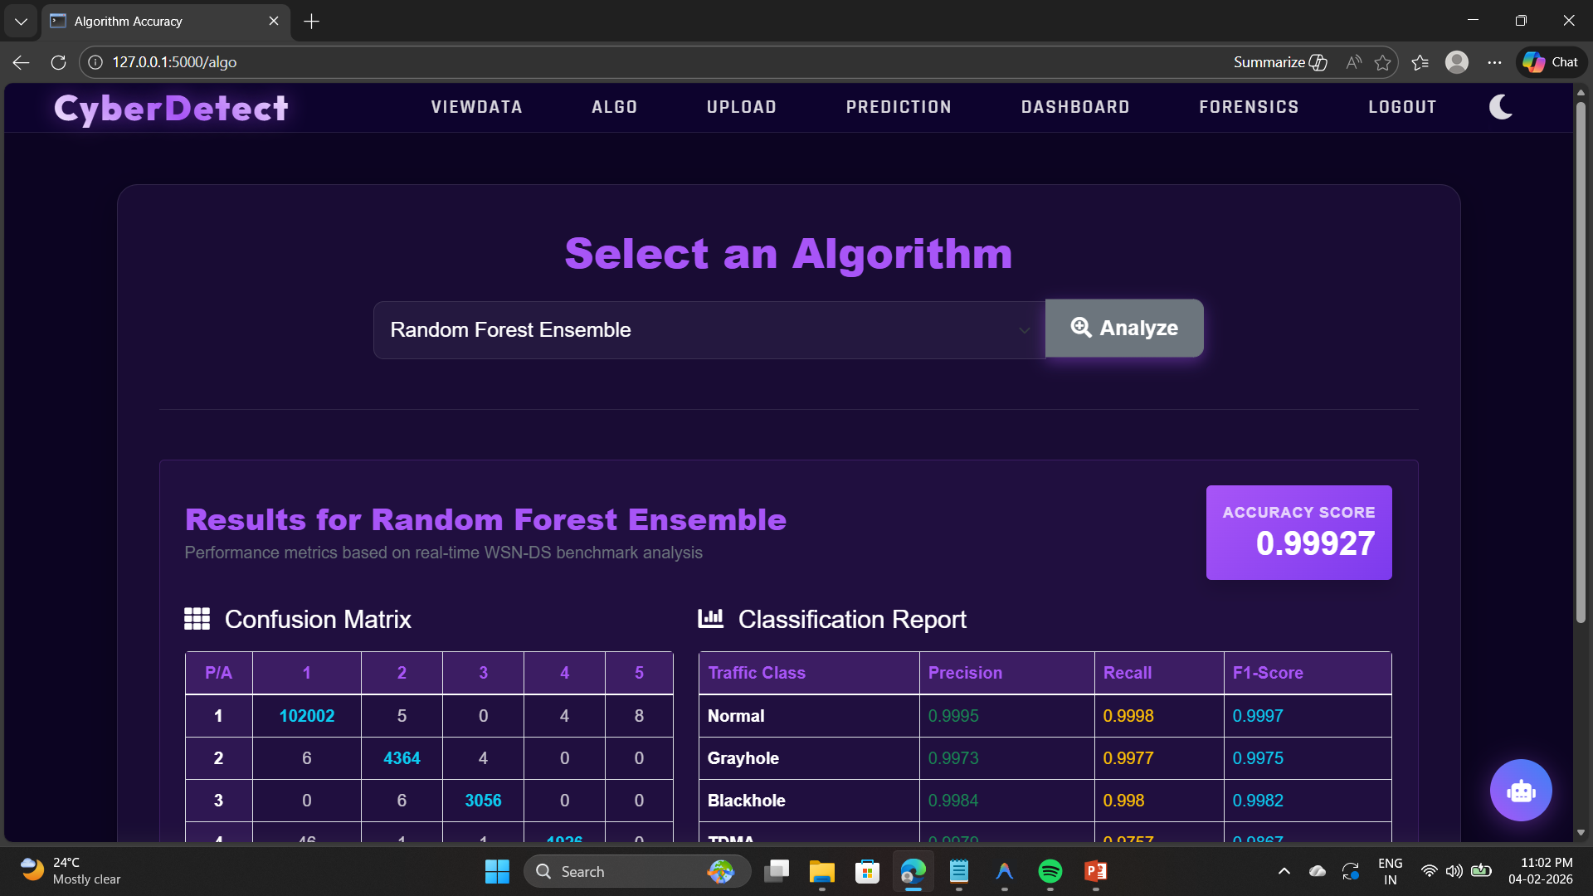
Output Screens
Algorithm Accuracy Page

Slide 32
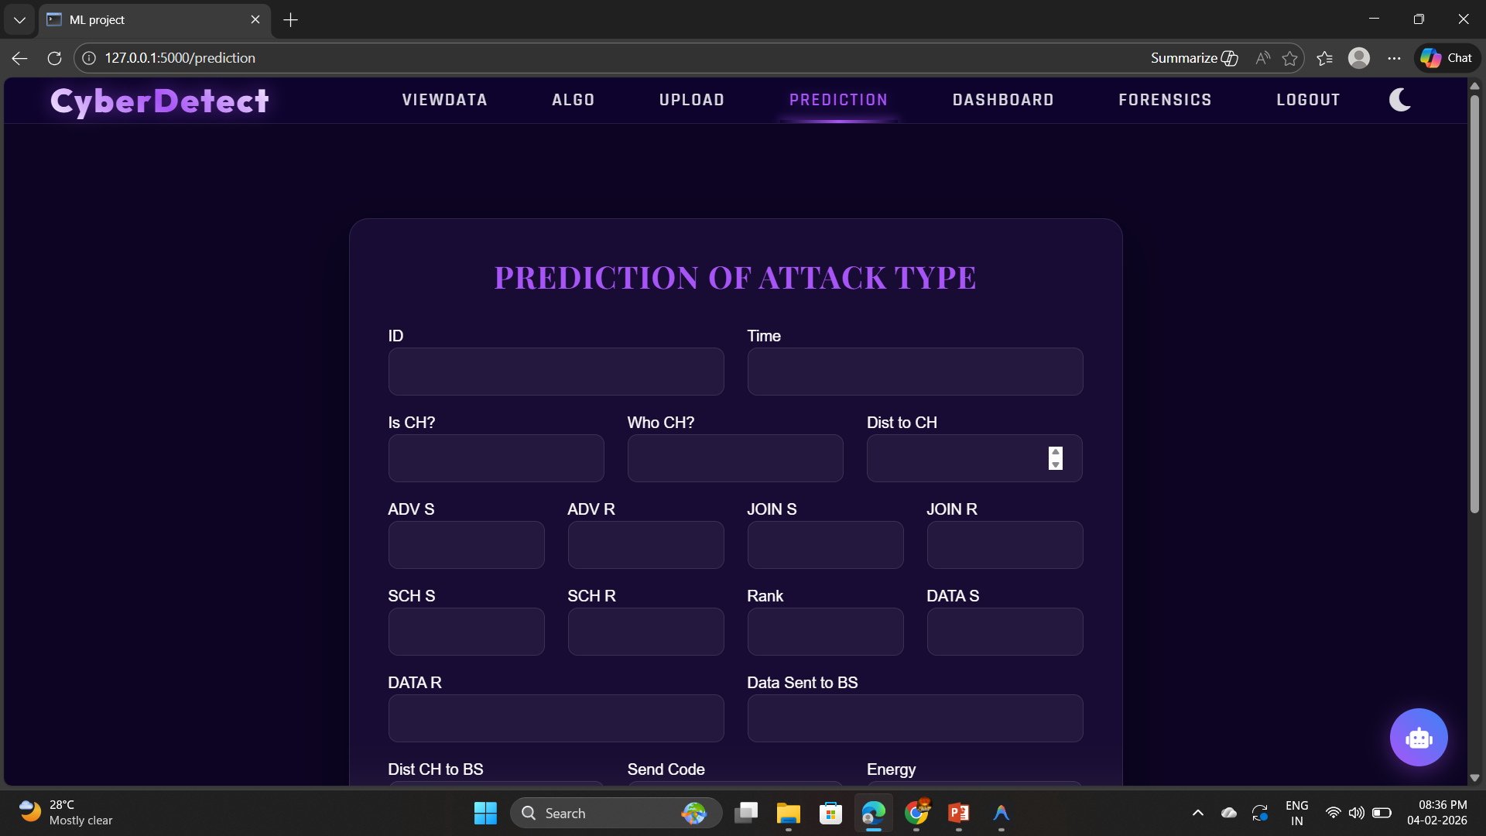
Output Screens
Prediction Page

Slide 33
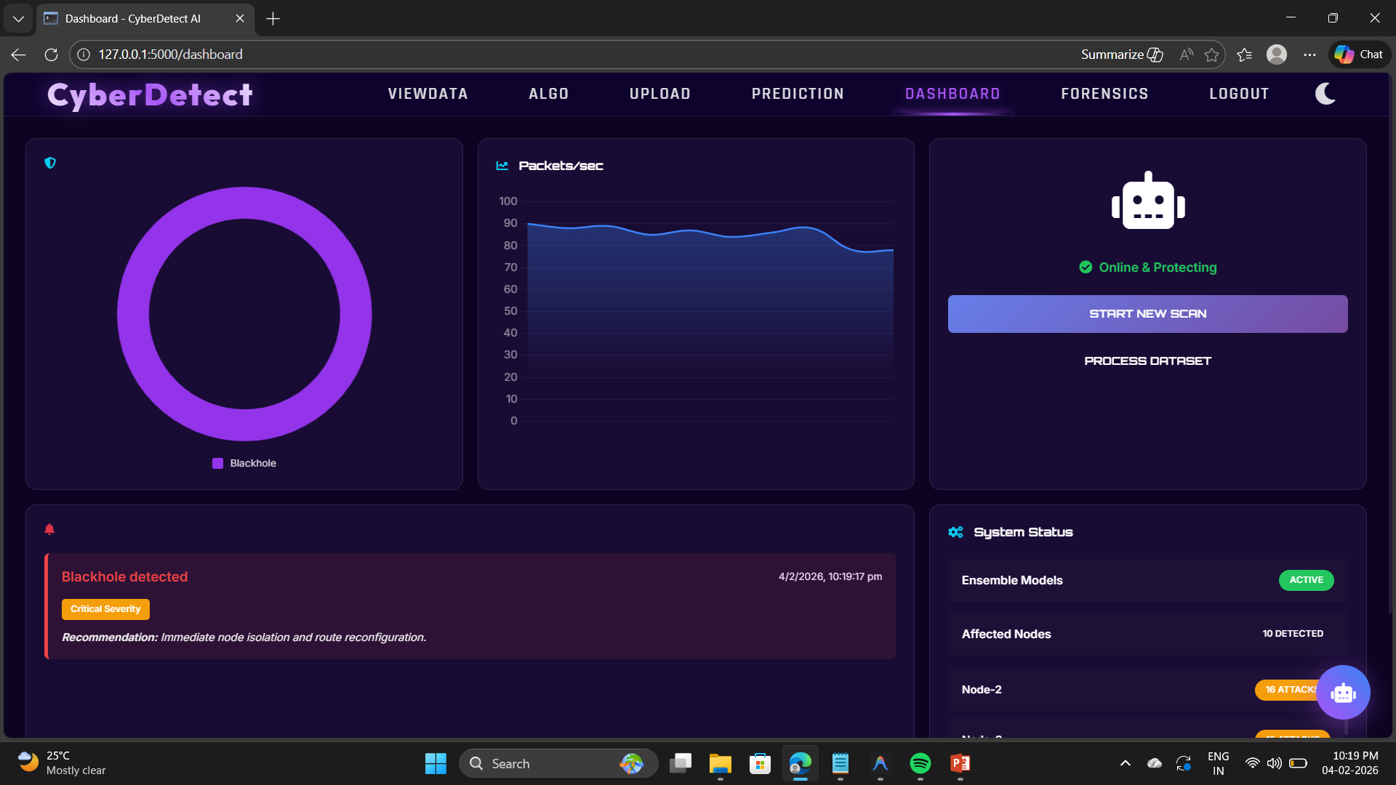
Output Screens
Dashboard

Slide 34
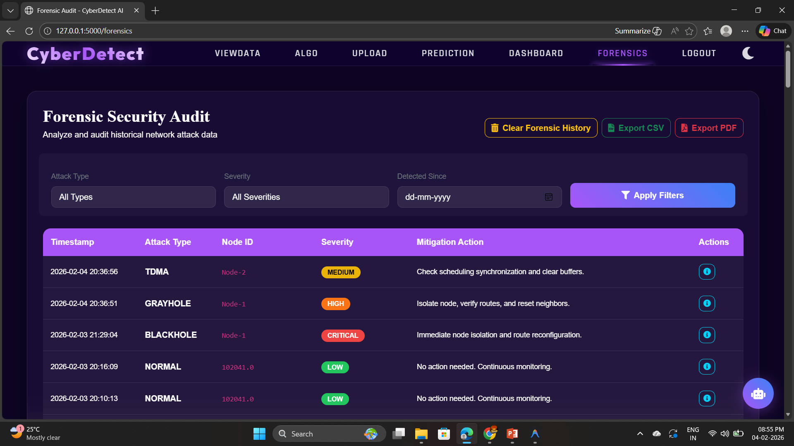
Output Screens
Forensic Report

Slide 35
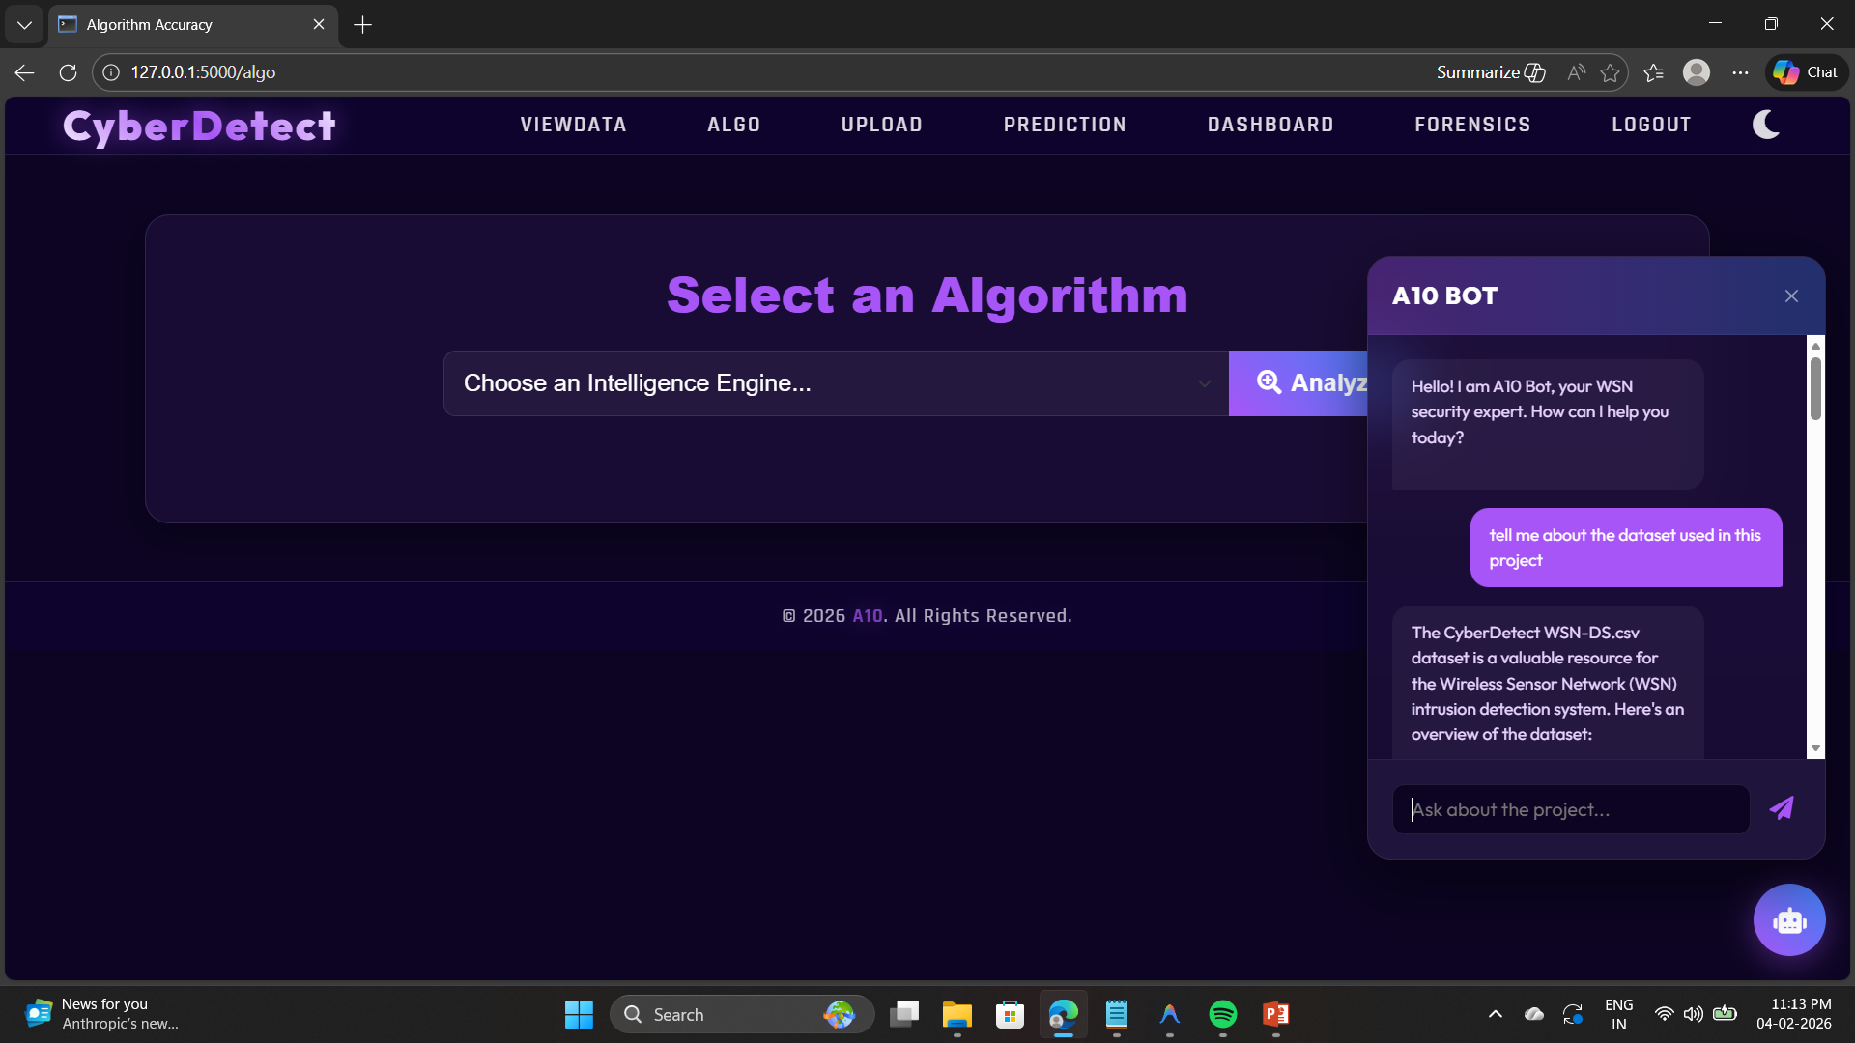
Output Screens
Chatbot

Slide 36
References
[1]. S. Karthikeyan, R. Kumar, and P. Rajesh, “Machine Learning-Based Cyber-Attack Detection in Wireless Sensor Networks,” International Journal of Research in Engineering and Technology, vol. 12, pp. 45–50, 2025.
[2]. M. Al-Akhras, M. Al-Kasasbeh, and I. Almomani, “Evaluation of Machine Learning Algorithms for Intrusion Detection in Wireless Sensor Networks,” International Journal of Advanced Computer Science and Applications, vol. 12, pp. 300–308, 2021.
[3]. A. A. Al-Quayed, M. Al-Hubaishi, and S. A. Khan, “A Situation-Based Predictive Approach for Cybersecurity Intrusion Detection and Prevention Using Machine Learning and Deep Learning Algorithms in Wireless Sensor Networks of Industry 4.0,” IEEE Access, vol. 12, pp. 1–15, 2024.
[4]. R. Hawi, J. Karam, and H. Nassar, “Unveiling the Hidden Threat: How Wireless Networks Fuel Serious Cyber Attacks,” Journal of Information Security and Applications, vol. 78, pp. 1–10, 2024.
[5]. T. Zhukabayeva, A. Buja, and M. Pacolli, “Detecting Network Security Incidents in Wireless Sensor Networks Using Machine Learning,” Indonesian Journal of Electrical Engineering and Computer Science, vol. 37, no. 3, pp. 1650–1660, Mar. 2025.
A-10

Slide 37

GitHub Link
GITHUB link:
https://github.com/LakshmiMoksha/CSD-2025-2026-Batch-A-10

Slide 38
Thank You!!!

