Slide 1
ECO LIFESTYLE AGENT
CAPSTONE PROJECT
Presented By:
1. Muthavarapu Lakshmi-Hyderabad Institute Of Technology And Management-Computer Science(Data Science)

Slide 2
OUTLINE
Problem Statement (Should not include solution)
Proposed System/Solution
System Development Approach (Technology Used)
Algorithm & Deployment
Result (Output Image)
Conclusion
Future Scope
References

Slide 3
Problem Statement
Problem Statement No.6 – Eco Lifestyle Agent The Challenge – An Eco Lifestyle Agent, powered by RAG (Retrieval-Augmented Generation), empowers users to adopt a greener lifestyle through personalized, practical suggestions. It retrieves sustainable living tips, eco-friendly product recommendations, local recycling guidelines, and government schemes from trusted environmental sources. Users can ask natural language questions such as “How can I reduce plastic use at home?” or “What are eco-friendly travel options in my city?” and receive instant, actionable guidance. The agent promotes small daily actions with big environmental impact, making sustainability easy and accessible. This AI-driven assistant fosters eco-conscious decisions, raises awareness, and helps build a more sustainable future. Technology – Use of IBM Cloud Lite services / IBM Granite is mandatory.

Slide 4
Proposed Solution
The system aims to promote sustainable living through an AI-powered Eco Lifestyle Agent. It uses RAG (Retrieval-Augmented Generation) on IBM Cloud to provide personalized eco-friendly tips based on user preferences.
📥 Data Collection
Gather eco-related documents (e.g., sustainability tips, recycling rules, government schemes).
🧹 Data Preprocessing
Format content into question-answer pairs . Clean and structure documents for better retrieval.
🧠 Machine Intelligence (RAG)
Use IBM Watsonx Agent with LLaMA model and RAG approach.
Agent retrieves relevant answers from uploaded documents using context.
🚀 Deployment
Build and deploy entirely on IBM Cloud Lite using watsonx.ai Agent Lab . Provide web-based interface through chat preview or embed.
📊 Evaluation
Test responses for relevance and accuracy . Improve by refining documents and prompt instructions.
✅ Result
The AI agent answers queries like:> “How to reduce plastic at home ?”“ What are the eco-friendly travel options in my city ? ”“List Indian government schemes for a sustainable lifestyle.”
It encourages eco-conscious decision-making through relevant, personalized, and accessible suggestions.

Slide 5
System Approach
✅ System Prerequisites
IBM Cloud Lite subscription.
Access to watsonx.ai Agent Builder.
Support for RAG-enabled foundation models (e.g., LLaMA 3).
Reliable internet connectivity.
Prepared eco-knowledge base file (PDF/Word) for reference-based response generation.
📚 Libraries & Services Used
watsonx.ai Agent Lab (No-code)
LLaMA 3-70B-instruct (pre-loaded in IBM Agent Lab).
Built-in Google Search tool (optional for extended retrieval).
IBM Watsonx Discovery (alternative to file-based RAG).
File handling (Word/PDF upload)

Slide 6
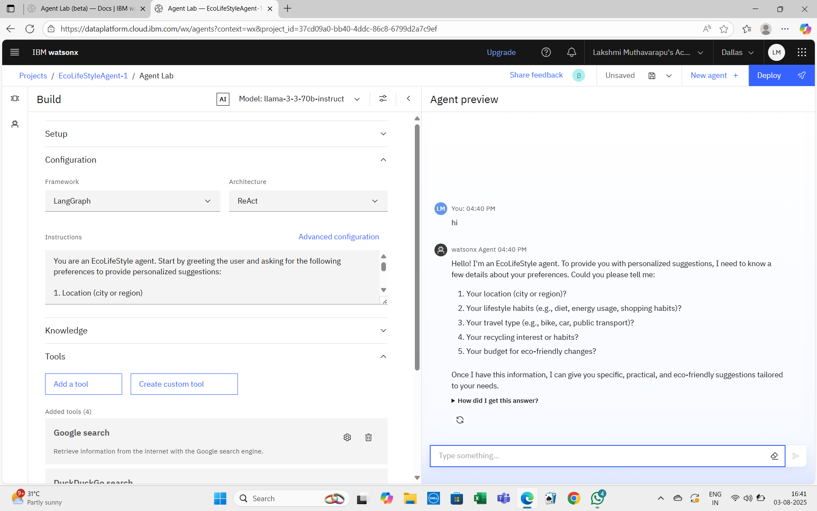
Result

Slide 7
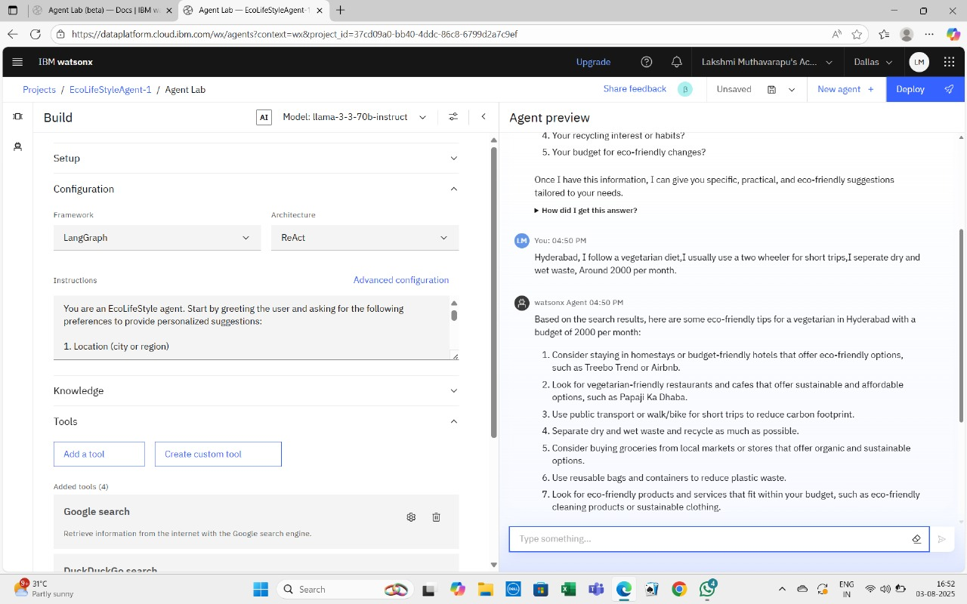

Slide 8
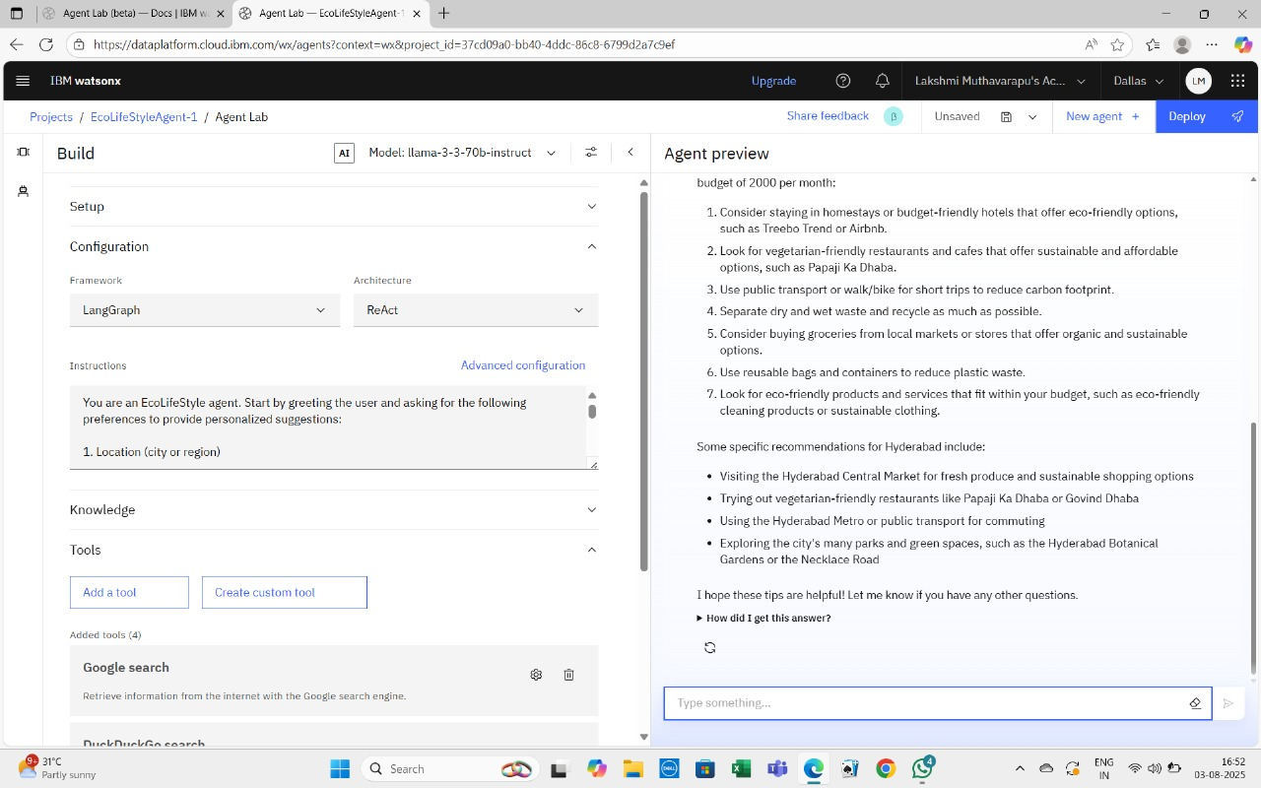

Slide 9
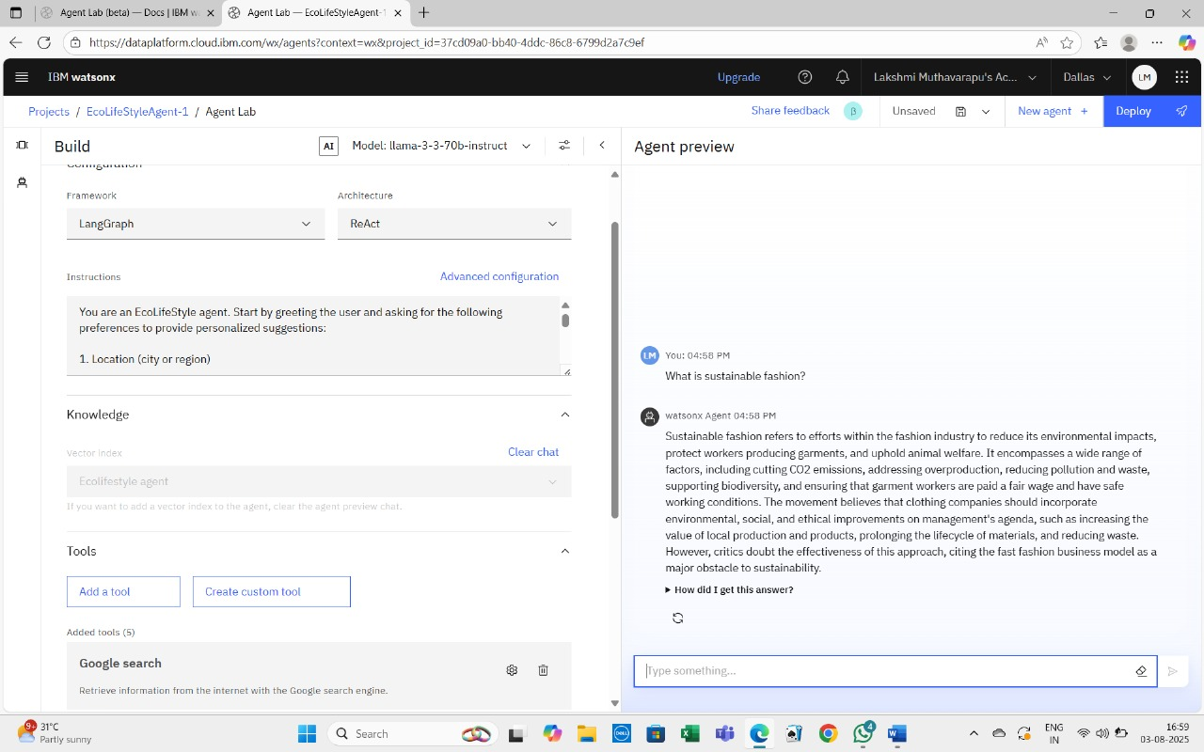

Slide 10
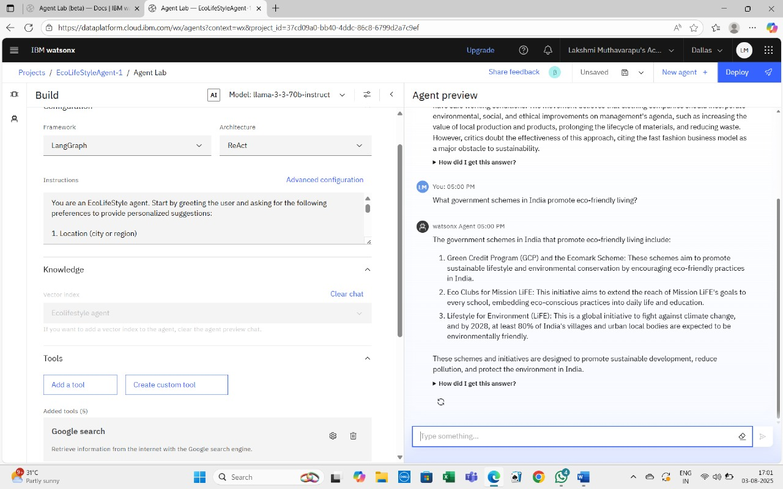

Slide 11
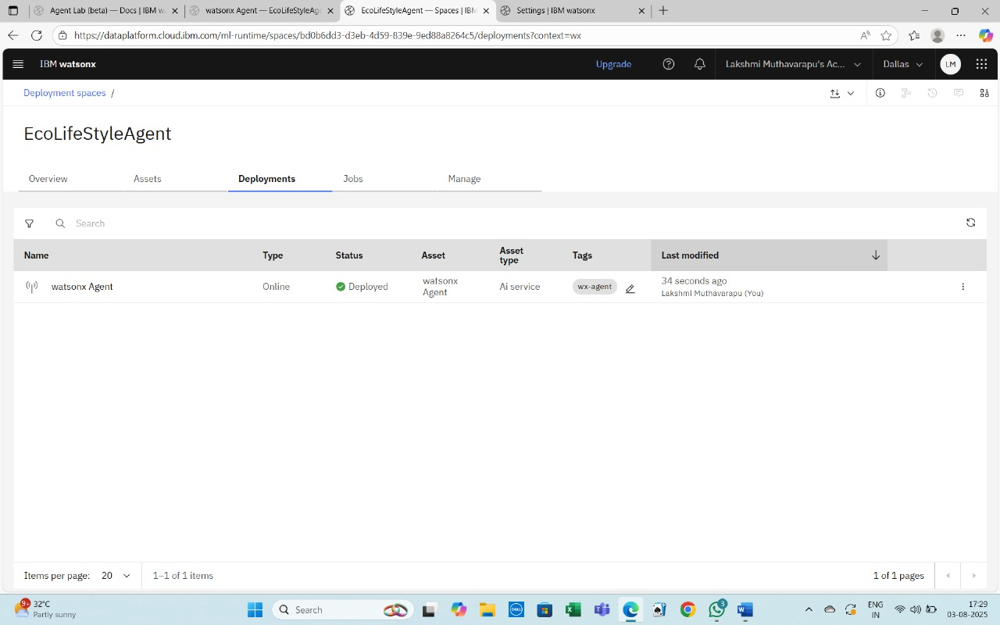

Slide 12
Conclusion
The Eco Lifestyle Agent is a smart AI assistant built using IBM watsonx.ai to promote sustainable and eco-friendly living. Without relying on Granite models, it effectively utilizes open-source models and Retrieval-Augmented Generation (RAG) to provide reliable, real-time answers from trusted sources.
This project proves that impactful AI solutions can be built using lightweight, cost-effective tools on the IBM Cloud Lite platform. By guiding users with personalized suggestions, the agent supports everyday green choices, encouraging an environmentally conscious lifestyle.
It highlights how AI can be leveraged responsibly to drive positive change — even without advanced paid models.

Slide 13
Future scope
🔮 Future Scope
Voice Assistant Integration for hands-free eco guidance.
User Profile Tracking to offer more personalized suggestions.
Mobile App Deployment for on-the-go access.
Gamification Features like eco-points to encourage sustainable actions.
Real-time Data Integration (e.g., live pollution, local events).
Multilingual Support to reach a wider audience.
Expanded Knowledge Base with updates from new environmental sources.

Slide 14
References
📚 References
IBM watsonx.ai Documentation – https://www.ibm.com/products/watsonx-ai
IBM watsonx Agent Builder – https://dataplatform.cloud.ibm.com
United Nations Environment Programme (UNEP) – https://www.unep.org
Ministry of Environment, Forest and Climate Change (India) – https://moef.gov.in
Central Pollution Control Board (India) – https://cpcb.nic.in
RAG Paper by Facebook AI – "Retrieval-Augmented Generation for Knowledge-Intensive NLP Tasks", 2020.
Eco-friendly product recommendations – https://www.ecowatch.com
IBM Watsonx Runtime Documentation – https://cloud.ibm.com/docs/watsonx-runtime

Slide 15
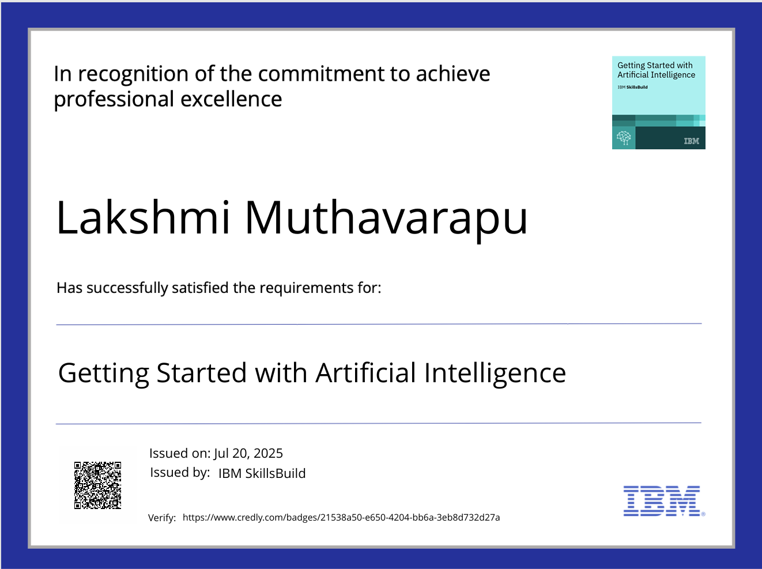
IBM Certifications
Screenshot/ credly certificate( getting started with AI)

Slide 16
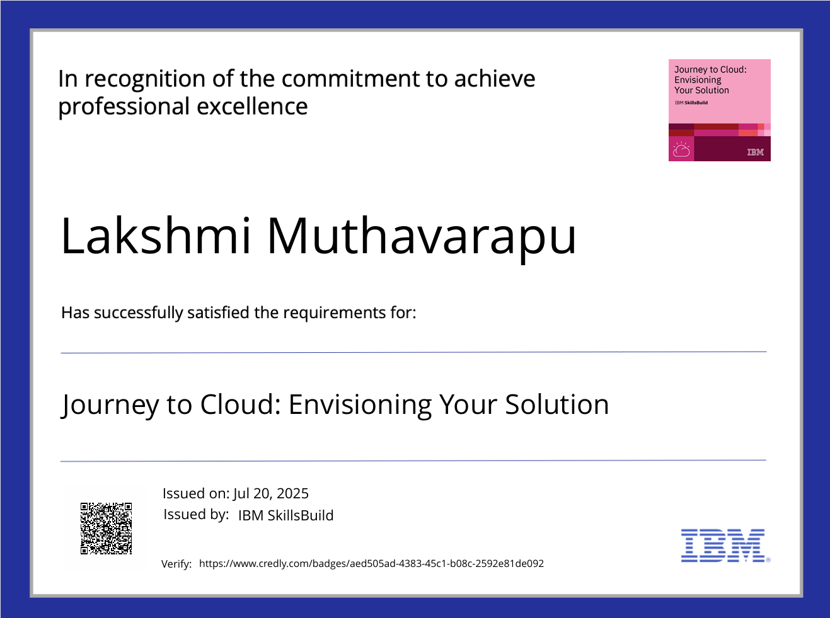
IBM Certifications
Screenshot/ credly certificate( Journey to Cloud)

Slide 17
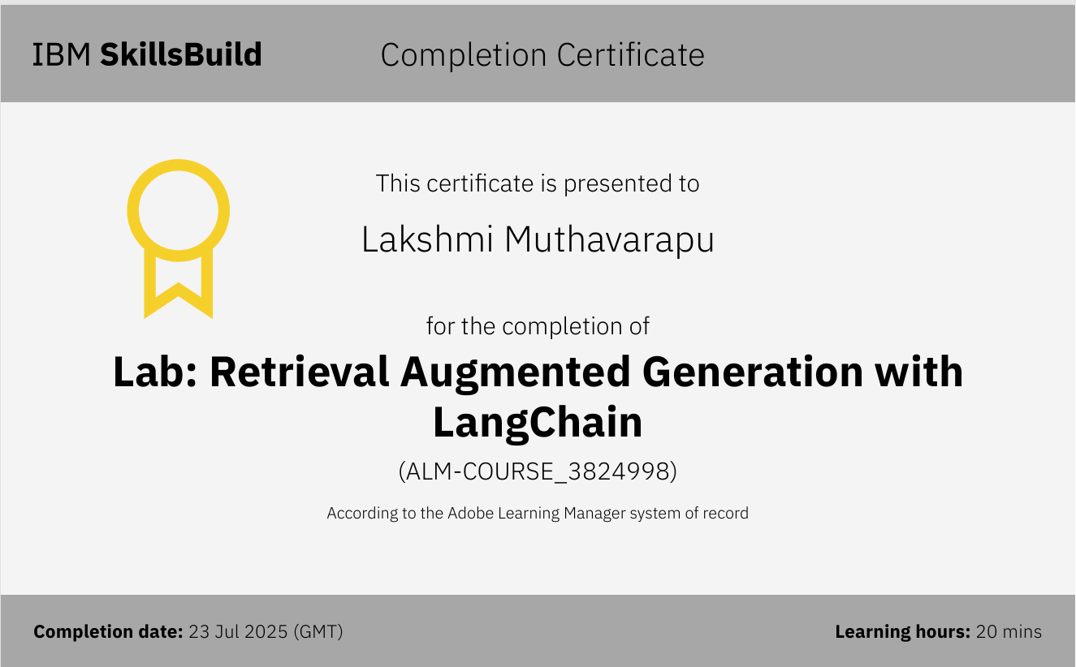
IBM Certifications
Screenshot/ credly certificate( RAG Lab)

Slide 18
GitHub Link:https://github.com/LakshmiMuthavarapu/IBM-CLOUD-PROJECT.git

Slide 19
THANK YOU

