Slide 1

DATA SCIENCE
“study of the extraction of knowledge from data”
P.Lakshmi Narayana Reddy,174G1A0531
R.Madhan Mohan Reddy,174G1A0536
M.Mohan Krishna,174G1A0542
College:Srinivasa Ramanujan Institute
of Technology,Anantapur.

Slide 2

About DataScience
01
Study of data.
03
Related to data mining and big data
04
An inter-disciplinary field that uses scientific methods, processes, algorithms and systems to extract knowledge and insights from many structural and unstructured data.
02
Involves developing
methods of recording,storing and analysing data effectively to extract useful information.

Slide 3

Some stuff about Modules
used in DataScience
NUMPY
PANDAS
MATPLOTLIB
SEABORN

Slide 4
About Numpy:
01
Python package which stands for 'Numerical Python'.
03
Used as an efficient multi-dimensional container for generic data.
02
Core library for scientific computing, which contains a powerful n-dimensional array object, provide tools for integrating C, C++ etc.
04

Slide 5
About Pandas:
01
In computer programming , pandas is a software library written for the python programming language for the data manipulation and analysis.
02
It offers datastructures and operations for manipulating numerical tables and time series.

Slide 6
About Matplotlib:
01
A plotting library for the Python programming language and its numerical mathematics extension NumPy.
02
It provides an object-oriented API for embedding plots into applications using general-purpose GUI toolkits like Tkinter, wxPython, Qt, or GTK+.

Slide 7
About Seaborn:
01
A library for making statistical graphics in Python.
03
Seaborn aims to make visualization a central part of exploring and understanding data.
02
04
Its dataset-oriented plotting functions operate on dataframes and arrays containing whole datasets and internally perform the necessary semantic mapping and statistical aggregation to produce informative plots.
It is built on top of matplotlib and closely integrated with pandas data structures.

Slide 8

COMPUTER SCIENCE
MATHEMATICAL STATISTICS
HACKING SKILLS
DL,ML,AI
DATASCIENCE

Slide 9
DIABETES PREDICTION USING DIFFERENT
MODELS AND FIND HIGH ACCURACY MODEL
BUSINESS
BUSINESS
BUSINESS
Please enter text here.Please enter text here.Please enter text here.Please enter text here
Please enter text here.Please enter text here.Please enter text here.Please enter text here
Please enter text here.Please enter text here.Please enter text here.Please enter text here

Slide 10
Steps:
Loading Dataset
Data Visualization
Spliting Data set in to training and testing sets
Fitting the training set in to each model and predicted labels
Calculating Accuracy of each model and finding the highest accuracy

Slide 11
LOADING DATASET:
DATA SET : A data set (or dataset) is a collection of data. In the case of tabular data, a data set corresponds to one or more database tables, where every column of a table represents a particular variable, and each row corresponds to a given record of the data set in question. The data set lists values for each of the variables, such as height and weight of an object, for each member of the data set. Each value is known as a datum. Data sets can also consist of a collection of documents or files.
For this project data set is collected from UCI machine learning respository. Named as Diabetes.csv. The data set is in the csv format.
In order to read the data set import the module pandas
Along with pandas import numpy , sklearn , matplotlib
If in case this libraries are not install with command pip install pandas or conda install pandas , similary for other libraries just change the name.

Slide 12
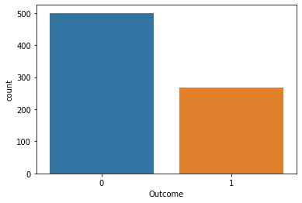
Analyzing and Visualizing Dataset:
[Counter plot of the outcome]
Pregnancies | Glucose | BloodPressure | SkinThickness | Insulin | BMI | DiabetesPedigreeFunction | Age | Outcome
count | 768.000000 | 768.000000 | 768.000000 | 768.000000 | 768.000000 | 768.000000 | 768.000000 | 768.000000 | 768.000000
mean | 3.845052 | 120.894531 | 69.105469 | 20.536458 | 79.799479 | 31.992578 | 0.471876 | 33.240885 | 0.348958
std | 3.369578 | 31.972618 | 19.355807 | 15.952218 | 115.244002 | 7.884160 | 0.331329 | 11.760232 | 0.476951
min | 0.000000 | 0.000000 | 0.000000 | 0.000000 | 0.000000 | 0.000000 | 0.078000 | 21.000000 | 0.000000
25% | 1.000000 | 99.000000 | 62.000000 | 0.000000 | 0.000000 | 27.300000 | 0.243750 | 24.000000 | 0.000000
50% | 3.000000 | 117.000000 | 72.000000 | 23.000000 | 30.500000 | 32.000000 | 0.372500 | 29.000000 | 0.000000
75% | 6.000000 | 140.250000 | 80.000000 | 32.000000 | 127.250000 | 36.600000 | 0.626250 | 41.000000 | 1.000000
max | 17.000000 | 199.000000 | 122.000000 | 99.000000 | 846.000000 | 67.100000 | 2.420000 | 81.000000 | 1.000000

Slide 13
TRAIN/TEST SPLIT:
K NEAREST
NEIGHBOURS
* To Train/Test the Dataset,we use four different classification models
LOGISTIC
REGRESSION
SUPPORT VECTOR MACHINE
DECISION TREES
\

Slide 14
K NEARSET NEIGHBOURS CLASSFICATION:
K-nearest neighbors (KNN) algorithm is a type of supervised ML algorithm
which can be used for both classification as well as regression predictive problems.However, it is mainly used for classification predictive problems in industry.

Slide 15
Working of K nearest neighbors algorithm:
K-nearest neighbors (KNN) algorithm uses ‘feature similarity’ to predict the values
of new datapoints which further means that the new data point will be
assigned a value based on how closely it matches the points in the training set. We
can understand its working with the help of following steps −
Step 1 − For implementing any algorithm, we need dataset. So during the first step of KNN, we must load the training as well as test data.
Step 2 − Next, we need to choose the value of K i.e. the nearest data points. K can be any integer.
Step 3 − For each point in the test data do the following −
3.1 − Calculate the distance between test data and each row of training data with the help of any of the method namely: Euclidean, Manhattan or Hamming distance. The most commonly used method to calculate distance is Euclidean.
3.2 − Now, based on the distance value, sort them in ascending order.
3.3 − Next, it will choose the top K rows from the sorted array.
3.4 − Now, it will assign a class to the test point based on most frequent class of these rows.

Slide 16
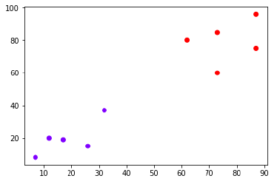
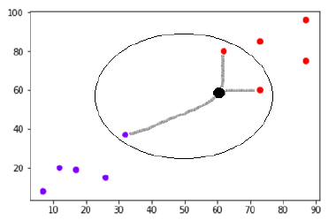
Example:
The following is an example to understand the concept of K and working of KNN algorithm −
Suppose we have a dataset which can be plotted as follows :
Now, we need to classify new data point with black dot (at point 60,60) into blue or red class. We are assuming K = 3 i.e. it would find three nearest data points. It is shown in the next diagram −

Slide 17
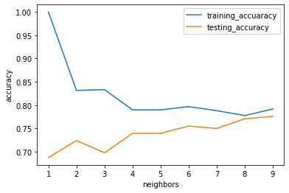
Implementing this K nearest neighbors algorithm with python gives the following for the different K values gave the following output:
From the above graph we can observe that at around the point k = 8 -9 the both training and testing dataset got approximately equal accuracy, hence taking value of k = 8 or 9 gives the best prediction on the data set . Hence by taking k value 9 , the data set is trained and tested. Finally calculated the accuracy.
* Accuracy of the on training set is 0.7916666666666666
* Accuracy of the on testing set is 0.7760416666666666

Slide 18
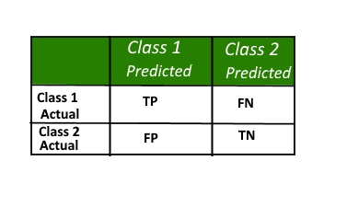
CONFUSION MATRIX:
A confusion matrix is a summary of prediction results on a classification problem. The number of correct and incorrect predictions are summarized with count values and broken down by each class. This is the key to the confusion matrix. The confusion matrix shows the ways in which your classification model is confused when it makes predictions. It gives us insight not only into the errors being made by a classifier but more importantly the types of errors that are being made.
Here, Class 1 : Positive Class 2 : Negative
Positive (P) : Observation is positive (for example: is an apple).
Negative (N) : Observation is not positive (for example: is not an apple).
True Positive (TP) : Observation is positive, and is predicted to be positive.
False Negative (FN) : Observation is positive, but is predicted negative.
True Negative (TN) : Observation is negative, and is predicted to be negative.
False Positive (FP) : Observation is negative, but is predicted positive

Slide 19
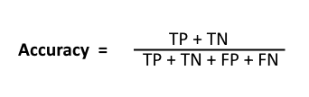


High recall, low precision: This means that most of the positive examples are correctly recognized (low FN) but there are a lot of false positives.
Low recall, high precision: This shows that we miss a lot of positive examples (high FN) but those we predict as positive are indeed positive (low FP)
F-measure:
Since we have two measures (Precision and Recall) it helps to have a measurement that represents both of them. We calculate an F-measure which uses Harmonic Mean in place of Arithmetic Mean as it punishes the extreme values more.
The F-Measure will always be nearer to the smaller value of Precision or Recall.

Slide 20
The following confusion matrix is obtained when the data set is trained with the K – nearest neghbors classification by taking k =9
Confusion Matrix
[[105 20]
[ 23 44]]
Report
precision recall f1-score support
0 0.82 0.84 0.83 125 1 0.69 0.66 0.67 67 accuracy 0.78 192 macro avg 0.75 0.75 0.75 192 weighted avg 0.77 0.78 0.77 192

Slide 21
LOGISTIC REGRESSION:
Logistic regression is another technique borrowed by machine learning from the field of statistics.It is the go-to method for binary classification problems (problems with two class values). In this post you will discover the logistic regression algorithm for machine learning.
After reading this post you will know:
The many names and terms used when describing logistic regression (like log odds and logit).
The representation used for a logistic regression model.
Techniques used to learn the coefficients of a logistic regression model from data.
How to actually make predictions using a learned logistic regression model.
Where to go for more information if you want to dig a little deeper.
This post was written for developers interested in applied machine learning,
specifically predictive modeling. You do not need to have a background in linear
algebra or statistics.
Logistic Function
Logistic regression is named for the function used at the core of the method, the logistic function.
The logistic function also called the sigmoid function was developed by statisticians to describe properties of population growth in ecology, rising quickly and maxing out at the carrying capacity of the environment. It’s an S-shaped curve that can take any real-valued number and map it into a value between 0 and 1, but never exactly at those limits.
1 / (1 + e^-value)
Where e is the base of the natural logarithms (Euler’s number or the EXP() function in your spreadsheet) and value is the actual numerical value that you want to transform. Below is a plot of the numbers between -5 and 5 transformed into the range 0 and 1 using the logistic function.

Slide 22
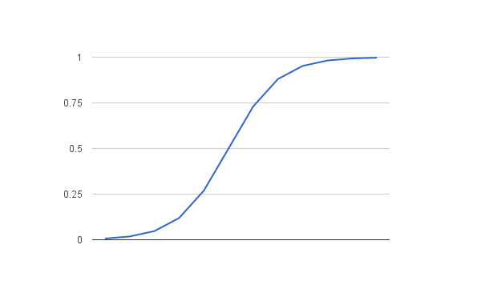
Representation Used for Logistic Regression:
Logistic regression uses an equation as the representation, very much like linear regression.
Input values (x) are combined linearly using weights or coefficient values (referred to as the Greek capital letter Beta) to predict an output value (y). A key difference from linear regression is that the output value being modeled is a binary values (0 or 1) rather than a numeric value.
Below is an example logistic regression equation:
y = e^(b0 + b1*x) / (1 + e^(b0 + b1*x))
Where y is the predicted output, b0 is the bias or intercept term and b1 is the coefficient for the single input value (x). Each column in your input data has an associated b coefficient (a constant real value) that must be learned from your training data.
The actual representation of the model that you would store in memory or in a file are the coefficients in the equation (the beta value or b’s).

Slide 23
By fitting the Data set in to the Logistic regression model,the accuracy , confusion matrix and the report is as follows:
Accuracy of Logistic_Regression on training set is 0.78125 Accuracy of Logistic_Regression on testing set is 0.7708333333333334 Confusion Matrix [[110 15]
[ 29 38]]
Report
precision recall f1-score support 0 0.79 0.88 0.83 125 1 0.72 0.57 0.63 67
accuracy 0.77 192 macro avg 0.75 0.72 0.73 192 weighted avg 0.77 0.77 0.76 192

Slide 24
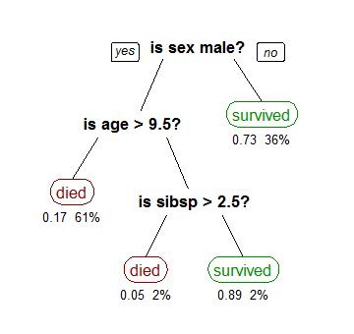
DECISION TREES MODEL:
A tree has many analogies in real life, and turns out that it has influenced a wide area of machine learning, covering both classification and regression. In decision analysis, a decision tree can be used to visually and explicitly represent decisions and decision making. As the name goes, it uses a tree-like model of decisions. Though a commonly used tool in data mining for deriveng a strategy to reach a particular goal, its also widely used in machine learning,
Although, a real dataset will have a lot more features and this will just be a branch in a much bigger tree, but you can’t ignore the simplicity of this algorithm. The feature importance is clear and relations can be viewed easily. This methodology is more commonly known as learning decision tree from data and above tree is called Classification tree as the target is to classify passenger as survived or died. Regression trees are represented in the same manner, just they predict continuous values like price of a house. In general, Decision Tree algorithms are referred to as CART or Classification and Regression Trees.
So, what is actually going on in the background? Growing a tree involves deciding on which features to choose and what conditions to use for splitting, along with knowing when to stop. As a tree generally grows arbitrarily, you will need to trim it down for it to look beautiful. Lets start with a common technique used for splitting.

Slide 25
By fitting the Data set in to the Logistic regression model,the accuracy , confusion matrix and the report is as follows:
Accuracy of Decision Trees on training set is 0.7725694444444444
Accuracy of Decision Trees on testing set is 0.7395833333333334
Confusion Matrix
[[105 20]
[ 23 44]]
Report:
precision recall f1-score support
0 0.82 0.84 0.83 125 1 0.69 0.66 0.67 67
accuracy 0.78 192 macro avg 0.75 0.75 0.75 192 weighted avg 0.77 0.78 0.77 192

Slide 26
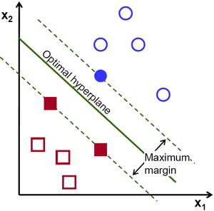
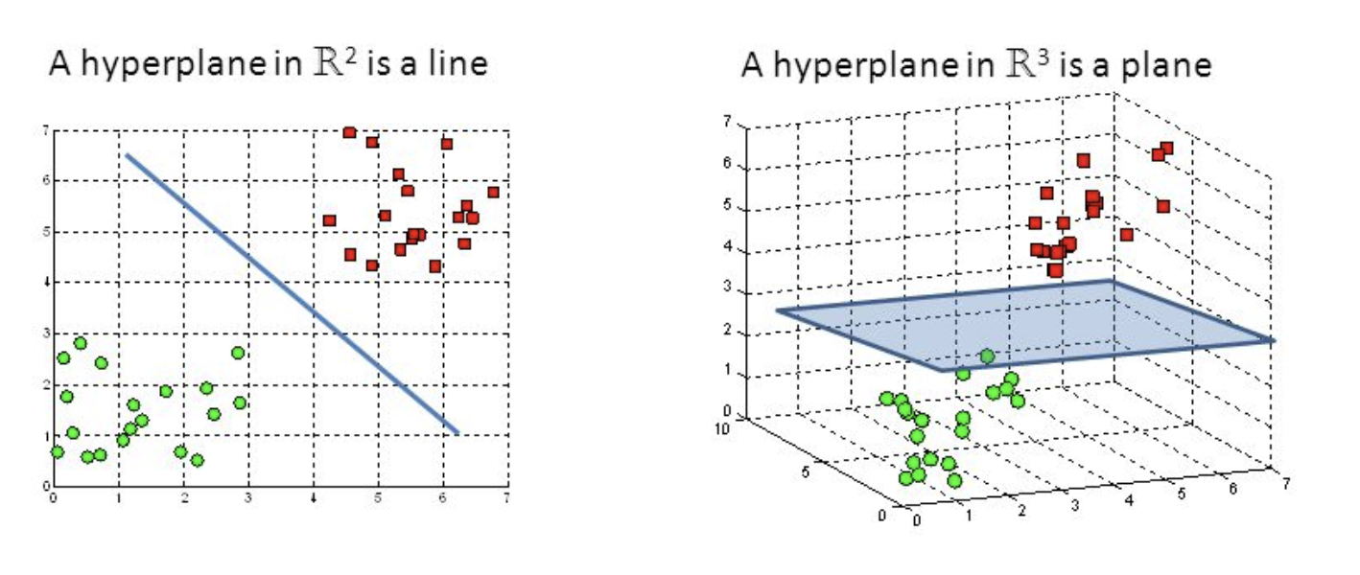
SUPPORT VECTOR:
The objective of the support vector machine algorithm is to find a hyperplane in an N-dimensional space(N — the number of features) that distinctly classifies the data points.
To separate the two classes of data points,
there are many possible hyperplanes that could be chosen.
Our objective is to find a plane that has the maximum margin,
i.e the maximum distance between data points of both classes.
Maximizing the margin distance provides some reinforcement
so that future data points can be classified with more confidence.

Slide 27
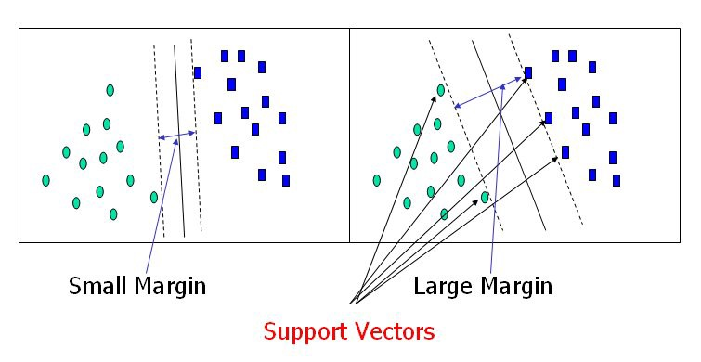
Hyperplanes are decision boundaries that help classify the data points.Data points falling on either side of the hyperplane can be attributed to different classes. Also, the dimension of the hyperplane depends upon the number of features. If the number of input features is 2, then the hyperplane is just a line. If the number of input features is 3, then the hyperplane becomes a two-dimensional plane. It becomes difficult to imagine when the number of features exceeds 3.

Slide 28
By fitting the Data set in to the Logistic regression model, the accuracy , confusion matrix and the report is as follows:
Accuracy on training set: 0.790
Accuracy on test set: 0.797
Confusion Matrix
[[105 20]
[ 23 44]]
Report
precision recall f1-score support
0 0.82 0.84 0.83 125 1 0.69 0.66 0.67 67
accuracy 0.78 192 macro avg 0.75 0.75 0.75 192 weighted avg 0.77 0.78 0.77 192

Slide 29
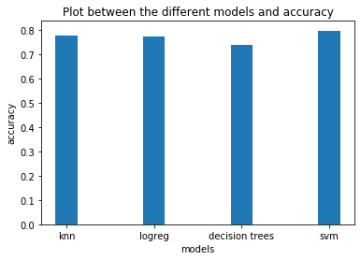

Slide 30
CONCLUSION:
Thus the Diabetes dataset is fitted in to the different classification models, predicted labels , confusion matrix, precision, recall, accuracy of model.Finally comparing the accuracies of all models,the Support Vector Machine got the highest accuracy with 0.797 among other models which are used in this project.

Slide 31
THANK YOU

