Slide 1
PIZZA SALES
REVENUE
ORDERS
PIZZAS
817,860
21,350
49,574
ANALYSIS PROJECT
Problem statement → KPIs → Visual analysis → Insights → Recommendations → Conclusion
Source: 2015 pizza sales dataset + supplied SQL queries + requirement screenshots
Professional analytical presentation

Slide 2
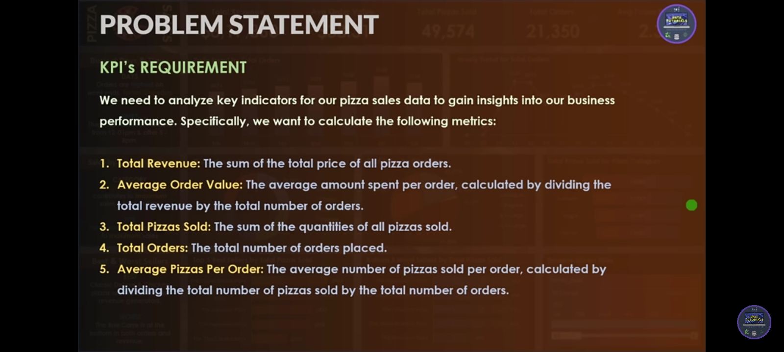
Problem statement
WHY THIS ANALYSIS
The project requirement is to visualize pizza sales performance and identify patterns that support business decisions.
• Measure overall business performance using five KPIs.
• Understand order trends across weekdays and months.
• Measure revenue contribution by pizza category and pizza size.
• Identify best-selling and underperforming pizzas using revenue, quantity, and orders.
• Translate the analysis into actionable business insights.
Source requirement image
The screenshots supplied with the project define the required KPI and chart outputs. The analysis and deck structure below follow those requirements.
PIZZA SALES ANALYSIS • 2015
2

Slide 3
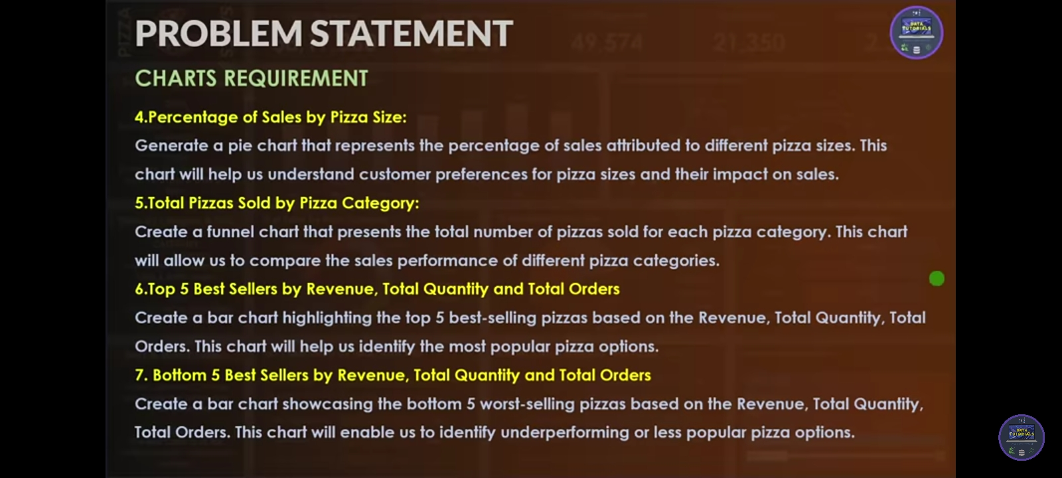
KPI requirements
FIVE REQUIRED BUSINESS METRICS
1
Total Revenue
2
Average Order Value
3
Total Pizzas Sold
Sum of total_price
Total revenue ÷ distinct orders
Sum of quantity
817,860.05
38.31
49,574
4
Total Orders
5
Average Pizzas / Order
Distinct order_id count
Total pizzas ÷ distinct orders
21,350
2.32
PIZZA SALES ANALYSIS • 2015
3

Slide 4
Chart requirements
VISUALS REQUESTED IN THE SUPPLIED PROBLEM STATEMENT
01
Daily trend for total orders
Bar chart. The supplied SQL implements this as distinct orders by day of week.
02
Monthly trend for total orders
Line chart across Jan–Dec.
03
Percentage of sales by pizza category
Pie chart using revenue share.
04
Percentage of sales by pizza size
Pie chart using revenue share.
05
Total pizzas sold by pizza category
Funnel chart.
06
Top 5 best sellers
Bar charts for revenue, quantity and total orders.
07
Bottom 5 best sellers
Bar charts for revenue, quantity and total orders.
PIZZA SALES ANALYSIS • 2015
4

Slide 5
Data & analytical approach
HOW THE REQUIREMENTS WERE IMPLEMENTED
SOURCE DATA
CALCULATION LOGIC
• 48,620 order-line records
• 2015-01-01 to 2015-12-31
• 12 fields including order, date/time, price, size, category and pizza name
• 32 distinct pizza varieties
• Revenue = SUM(total_price)
• Orders = DISTINCTCOUNT(order_id)
• Quantity = SUM(quantity)
• AOV = Revenue ÷ Orders
• Average pizzas/order = Quantity ÷ Orders
QUALITY / INTERPRETATION
The workbook supports descriptive sales analysis. It does not contain cost, margin, discount, customer, or marketing fields, so the findings describe sales performance rather than profitability or causal drivers.
PIZZA SALES ANALYSIS • 2015
5

Slide 6
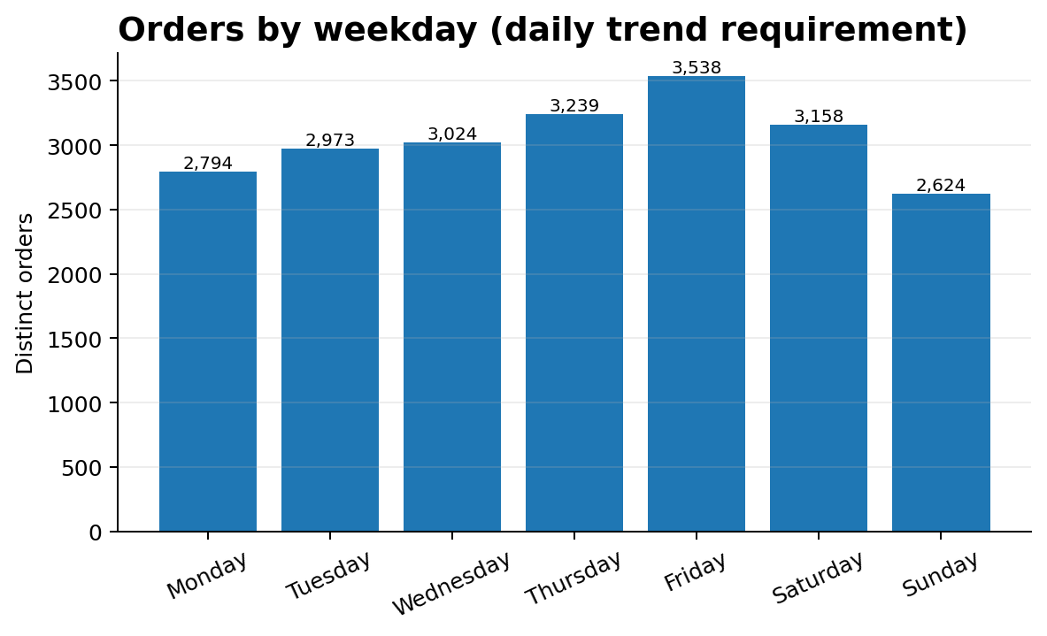
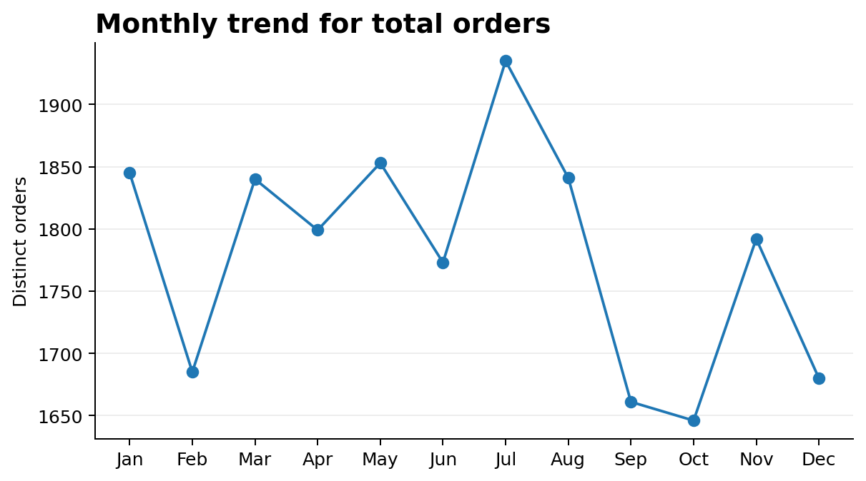
Order trends
DAILY / WEEKDAY AND MONTHLY PERFORMANCE
Friday is the busiest weekday with 3,538 orders; Sunday is the quietest with 2,624.
July is the strongest month by order volume (1,935 orders), while October is the lowest (1,646).
PIZZA SALES ANALYSIS • 2015
6

Slide 7
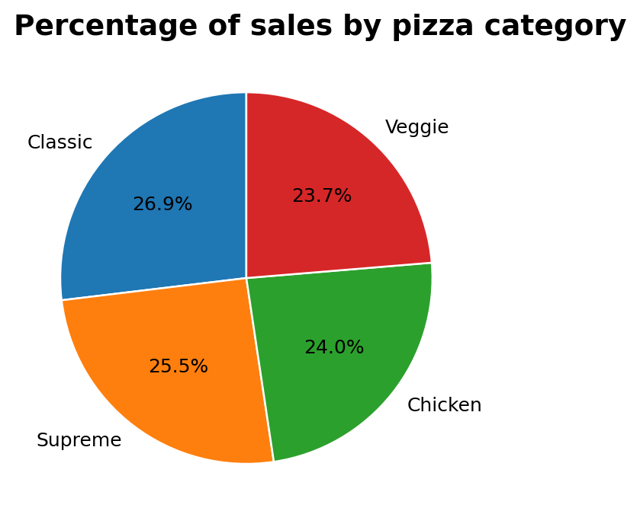
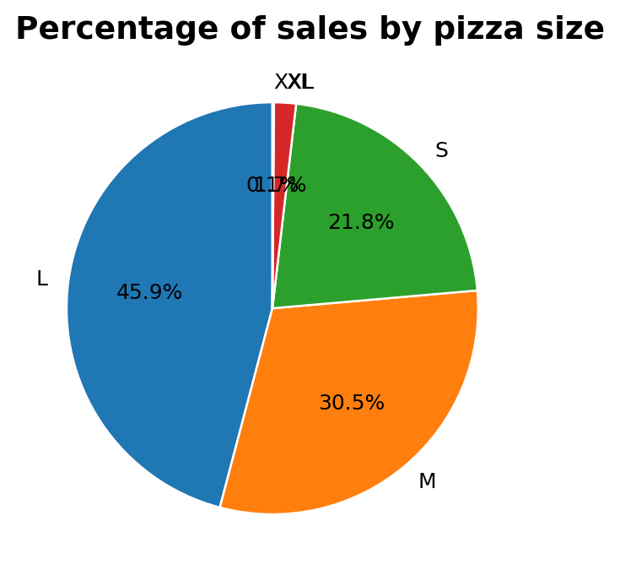
Sales mix
REVENUE CONTRIBUTION BY CATEGORY AND SIZE
Classic leads category revenue at 26.9% (220,053). The four categories are relatively balanced.
Large pizzas dominate size revenue at 45.9%. XL + XXL together contribute only 1.8%.
PIZZA SALES ANALYSIS • 2015
7

Slide 8
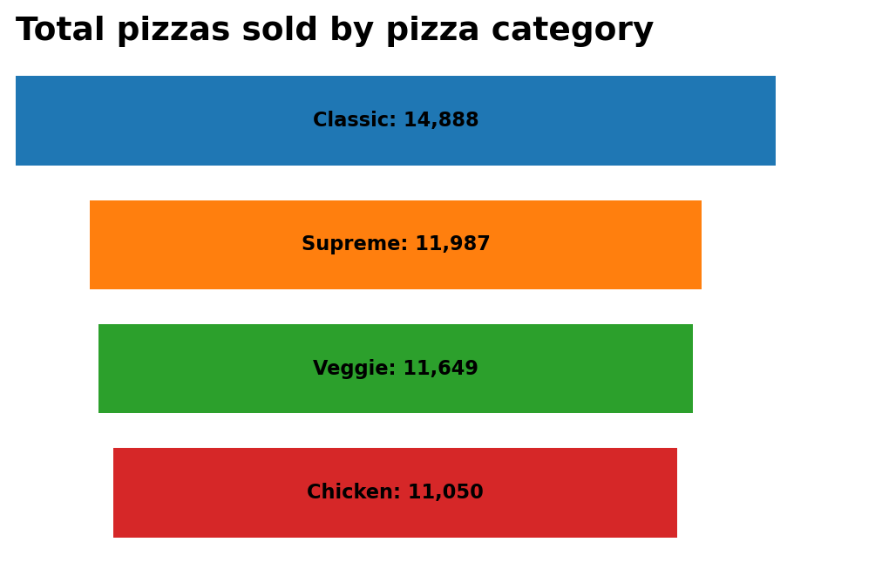
Category volume
TOTAL PIZZAS SOLD BY PIZZA CATEGORY
Volume ranking
• Classic: 14,888
• Supreme: 11,987
• Veggie: 11,649
• Chicken: 11,050
Interpretation
Classic has the highest pizza volume, while Chicken has the lowest among the four categories. The gap is meaningful but not extreme, indicating a diversified category mix.
PIZZA SALES ANALYSIS • 2015
8

Slide 9
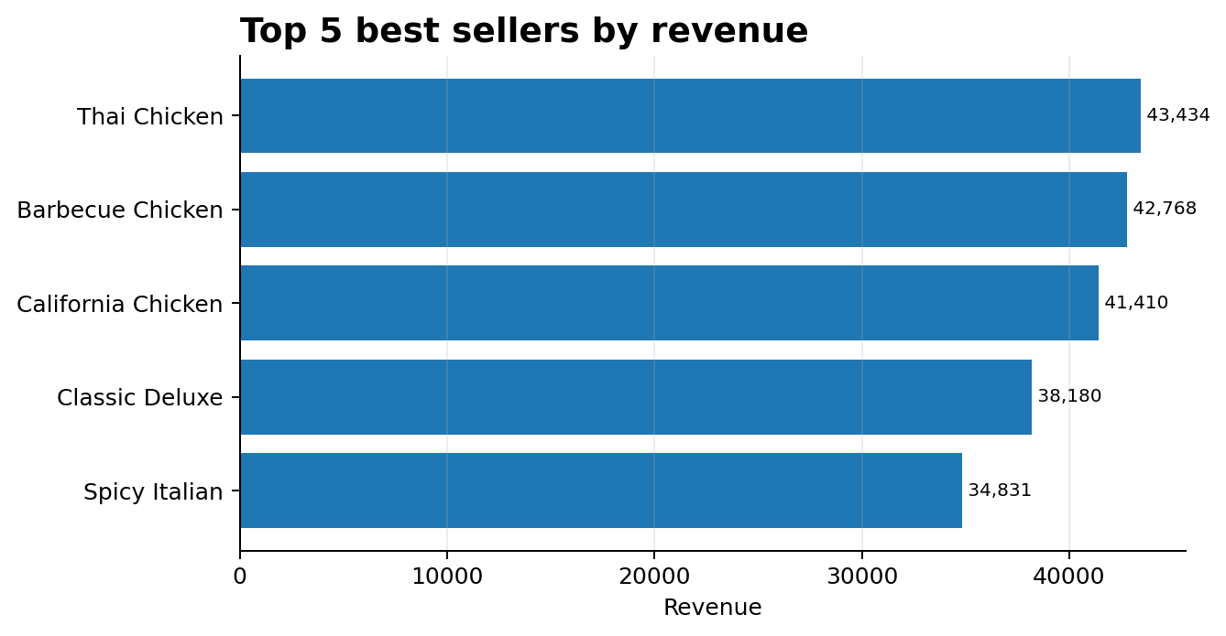
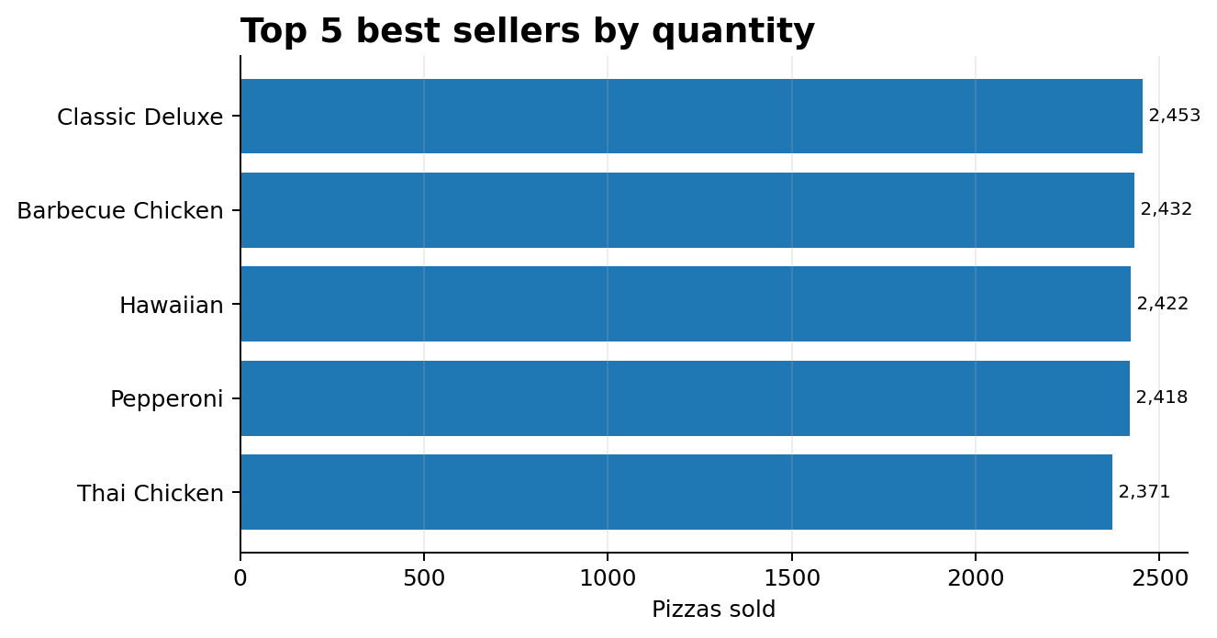
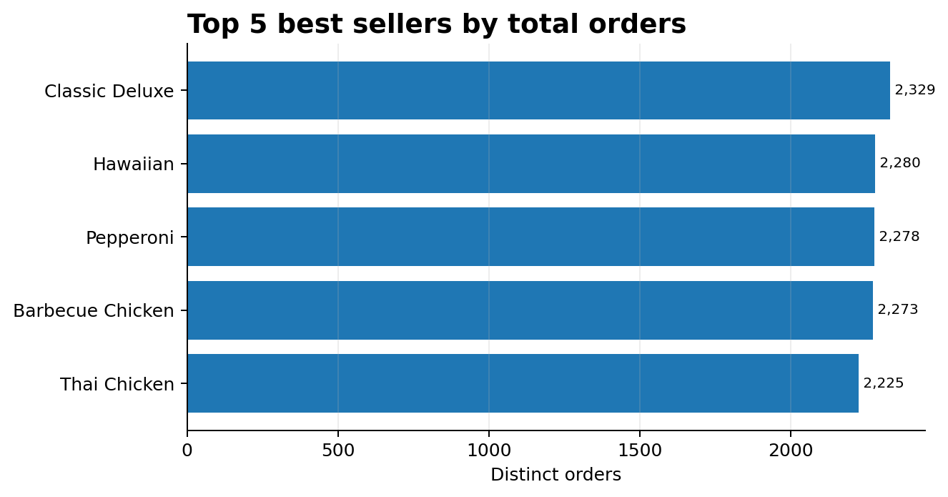
Top 5 best sellers
REQUIRED RANKING BY REVENUE, QUANTITY AND TOTAL ORDERS
Top revenue: Thai Chicken (43,434)
Top quantity: Classic Deluxe (2,453)
Top orders: Classic Deluxe (2,329)
PIZZA SALES ANALYSIS • 2015
9

Slide 10
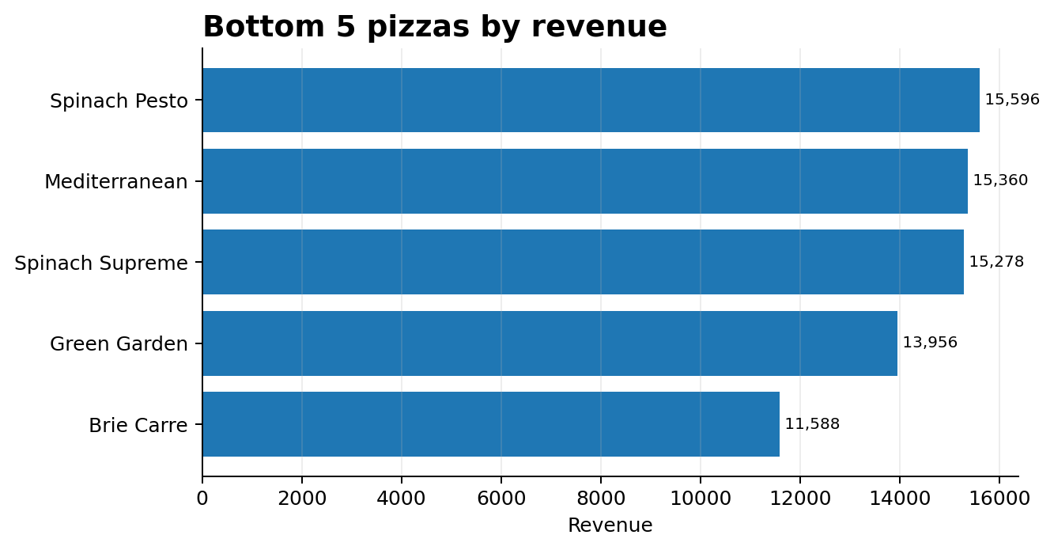
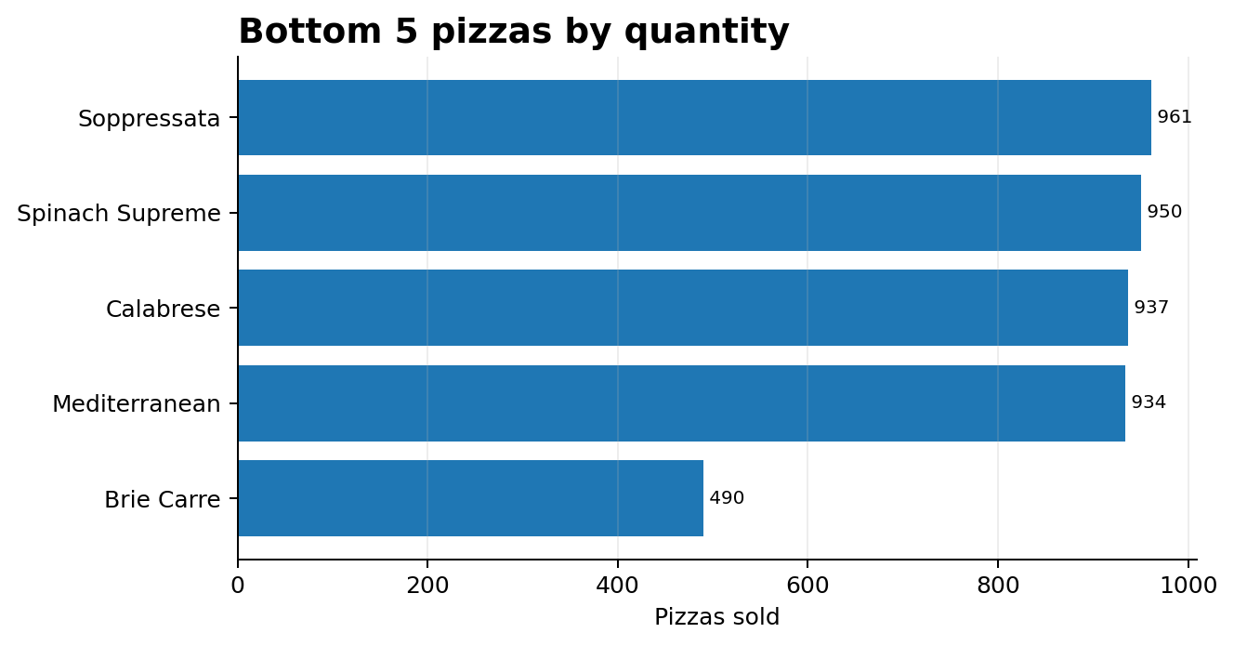
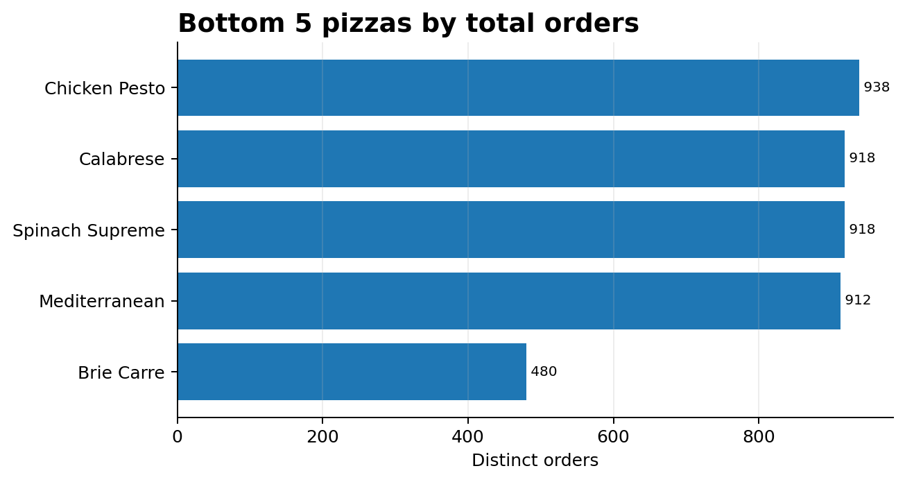
Bottom 5 performers
REQUIRED RANKING BY REVENUE, QUANTITY AND TOTAL ORDERS
Lowest revenue: Brie Carre (11,588)
Lowest quantity: Brie Carre (490)
Lowest orders: Brie Carre (480)
PIZZA SALES ANALYSIS • 2015
10

Slide 11
Executive findings
WHAT THE ANALYSIS SAYS
• Revenue reached 817,860.05 across 21,350 distinct orders, with an average order value of 38.31.
• Friday is the busiest weekday, indicating a practical opportunity for staffing and preparation planning.
• July leads order volume, while September–October show the weakest monthly order counts.
• Classic is the largest revenue category (26.9%), but category revenue is broadly distributed across four categories.
• Large pizzas generate 45.9% of revenue, making size mix an important inventory and pricing consideration.
• Thai Chicken leads revenue; Classic Deluxe leads quantity and distinct orders, showing that 'best seller' depends on the metric.
PIZZA SALES ANALYSIS • 2015
11

Slide 12
Business recommendations
TURNING DESCRIPTIVE ANALYSIS INTO ACTION
01
Plan for Friday demand
Use weekday order patterns as a staffing and prep baseline; validate with hourly data before changing schedules.
02
Investigate July vs. Sep–Oct
Compare promotions, holidays, campaigns and operational factors to determine whether the pattern repeats.
03
Protect high-performing products
Monitor availability of Thai Chicken, Barbecue Chicken, California Chicken and other high-revenue items.
04
Review low performers carefully
Evaluate Brie Carre, Green Garden and other low performers using margin, food cost and customer feedback—not revenue alone.
05
Use size mix for planning
Large pizzas dominate revenue; align ingredient purchasing and capacity planning accordingly.
PIZZA SALES ANALYSIS • 2015
12

Slide 13
Limitations & next steps
WHAT THIS DATASET CANNOT ANSWER
LIMITATIONS
NEXT ANALYTICAL LAYER
• One calendar year: recurring seasonality is not proven.
• No ingredient cost, labor cost or discount data: profitability cannot be calculated.
• No customer identifier: retention and customer-level behavior cannot be measured.
• No marketing/campaign fields: causes of peaks and dips cannot be established.
• Add hourly order trends.
• Add gross margin / contribution margin.
• Analyze promotions and campaign periods.
• Compare multiple years for seasonality.
• Build a profitability-aware menu matrix.
PIZZA SALES ANALYSIS • 2015
13

Slide 14
CONCLUSION
Pizza sales are strong and diversified,
with clear opportunities in demand planning, product focus and deeper profitability analysis.
817,860 revenue • 21,350 orders • 49,574 pizzas • 38.31 AOV
The required KPI and chart framework has been implemented from the supplied problem statement and source data.

