Slide 1

By
M.Lakshmi Prasanna
N.Sindhuja

Slide 2
Outline
Introduction
Need of 3D searching
Methodology
Examples
Advantages and Limitations
Conclusion

Slide 3
Introduction
3D searching is a new method used to search 3D objects in a data house in the base of our submitted query.
A search system which is capable of retrieving similar 3D models based on their shape is known as 3D search engine.

Slide 4
Need of 3D searching
When objects are not annotated( Eg: B19745.wrl)
When objects are annotated with unspecific or derivative keywords( e.g.,“yellow.wrl” or “sindhu.wrl”)
when all related keywords are so common that the query result contains a flood of irrelevant matches
When relevant keywords are unknown to the user
In these cases and others, a 3D search engine is needed[1]

Slide 5
Methodology
Methodology used involves the following steps
Query Formulation
Search Process
Search Result

Slide 6
Query Formulation
True 3D search systems offer two principal ways to formulate a query
User can select objects from a catalog of images
User can utilize a drawing program to create a picture of the object they are looking for.

Slide 7
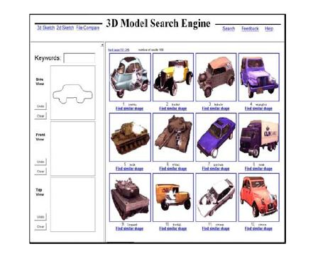
Fig-1: Interface of 3D search engine[2]

Slide 8
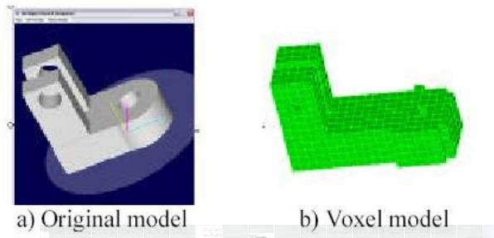
Search Process
Selected or drawn image based query will be converted into mathematical model called the voxel model by a process called voxelization.
The model is then searched with those in the repository.
Fig-2:Voxelization

Slide 9
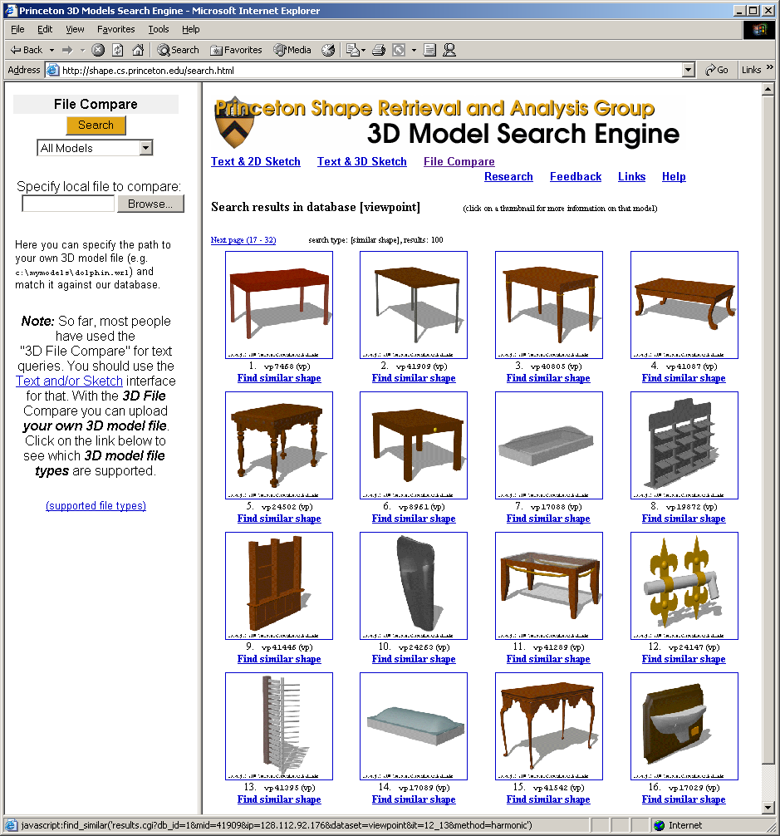
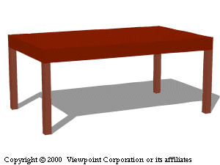
Search Result
If the match to the queried object is found then the 3D models of that object will be returned
Query
Fig-3: Result of a query

Slide 10
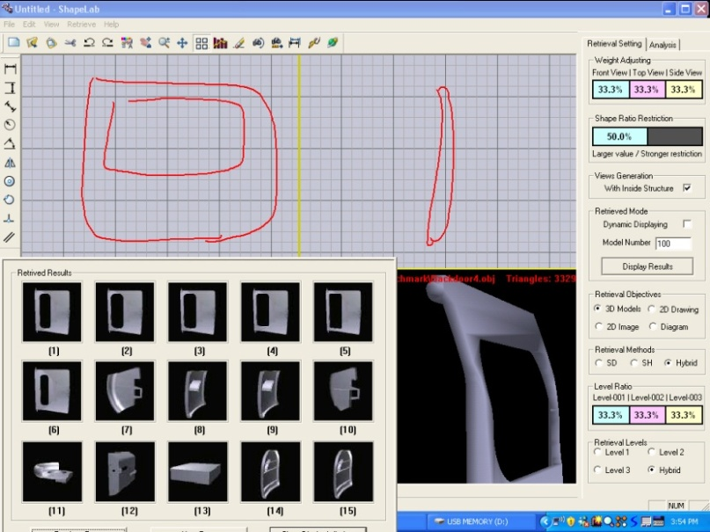
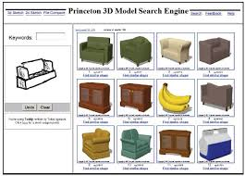
Examples
3DESS-3D Engineering Search System
Princeton University Search Engine
Fig-4: 3DESS
Fig-5: Princeton Search Engine

Slide 11
Advantages
Very effective in the search process of 3D objects
We can select any search process for searching our model
( Sketch query, Text query, Multi-model query)
Limitations
Better object matching methods
New modeling tools

Slide 12
Conclusion
3D search engine helps to have idea of 3D model of anything on the web
Today’s corporate world don’t conduct the type of searches that would justify paying for and learning to use sophisticated 3D search engines
However, within those markets, 3D search could prove useful and successful
References
“A Search Engine for 3D Models” ACM Transactions on Graphics, Vol. V, No. N, 10 202002.
Global Journal of Computer Science and Technology Volume 12 Issue 8 Version 1.0 April 2012.

