Slide 1

A Search Engine for 3D Models
THOMAS FUNKHOUSER, PATRICK MIN, MICHAEL KAZHDAN, JOYCE CHEN,
ALEX HALDERMAN, and DAVID DOBKIN
Princeton University
and
DAVID JACOBS
NEC Research Institute
ACM Transactions on Graphics, Vol. 22, No. 1, January 2003, Pages 83–105.

Slide 2
Introduction
Data retrieval and analysis have recently been a very active area of research, The most obvious examples are text search engines (e.g., Google, Yahoo, Bing), which have become part of our daily lives.
As the number of 3D models available on internet grows, there is an increasing need for a search engine to help people find them. Unfortunately, traditional text-based search techniques are not always effective for 3D data.
In this article, we investigate new shape-based search methods. The key challenges are:
Query methods : Simple enough for novice users
Matching algorithms : Robust enough to work for arbitrary polygonal models.
Notes:
隨著現在網路的普及搜尋引擎已經相當普遍，然而多數為text query
這篇文章中所提出的是一種新的使用shape-based query的方式
Novice can also use it easily

Slide 3
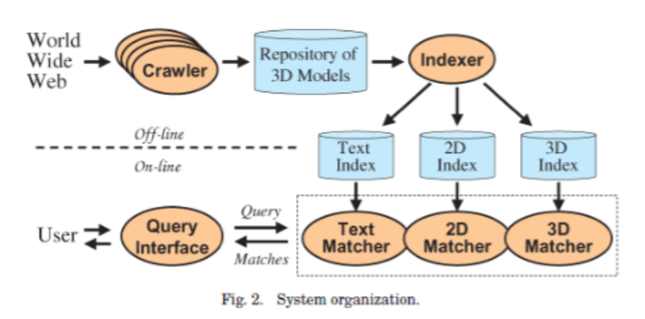


SYSTEM OVERVIEW
Crawling
We build a database of 3D models by crawling the Web. 3D data still represent a very small percentage of the Web, and high-quality models represent an equally small percentage of all 3D data. Using a crawler, we have downloaded 17,834 VRML models from the Web.
Notes:
Crawling 在建構資料庫之前蒐集資料，使用crawler蒐集了17834VRML(Virtual Reality Modeling Language) models
Indexing

Slide 4

SYSTEM OVERVIEW
Indexing
We compute indices to retrieve 3D models efficiently based on text and shape queries. In particular, we have developed a new 3D shape descriptor based on spherical harmonics that is descriptive, concise, efficient to compute, robust to model degeneracies, and invariant to rotations.

Slide 5

SYSTEM OVERVIEW
Querying
The system supports query methods based on text keywords, 2D sketching, 3D sketching, model matching, and iterative reﬁnement. We ﬁnd that methods based on both text and shape combine to produce better results than either one alone.
Notes:
混合文字和形狀的比對有較好的結果

Slide 6

SYSTEM OVERVIEW
Matching
For each user query, our Web server uses its index to return the sixteen 3D models that best match the query. Our method answers 3D shape queries in less than a quarter of a second for our repository; and, in practice, it scales sublinearly with the number of indexed models.
Notes:
系統會回應16個最佳的配對結果，在實際上測試的結果這個系統可以在1/4秒內回應所有的query，而理論上這個反應的時間應該會隨著系統存放的檔案數量成一個sublinear (complexity degree lower than problem instance size)的成長。

Slide 7
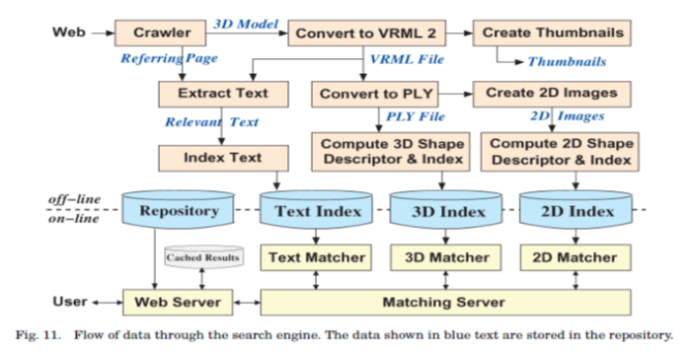
SYSTEM OVERVIEW
The main research issue at the heart of this system is how to provide shape-based query interfaces and matching methods that enable easy and efficient retrieval of 3D models from a large repository.
SHAPE QUERIES
SKETCH QUERIES
TEXT QUERIES
MULTIMODAL QUERIES

Slide 8

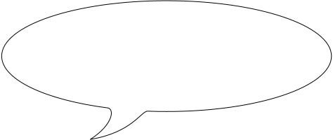
SHAPE QUERIES
The most straightforward shape-based query interface is to provide the search engine with an existing 3D model and ask it to retrieve similar ones.
Our search engine supports this strategy in the following ways.
By filename.
simple, but not always good.
3D shape-based similarity queries.
conceptually simple, but technically troublesome.
What are the problems?

Slide 9

SHAPE QUERIES
The main challenge in supporting these 3D shape-based similarity queries is to find a computational representation of shape (shape descriptor) for which an index can be built and geometric matching can be performed efficiently.
A shape descriptor should be
Have good discriminating power
Quick to compute
Concise to store
Easy to index
Invariant under similarity transformations
Insensitive to noise and small extra features
Robust
Somehow, we can hardly find a descriptor has all these properties.

Slide 10
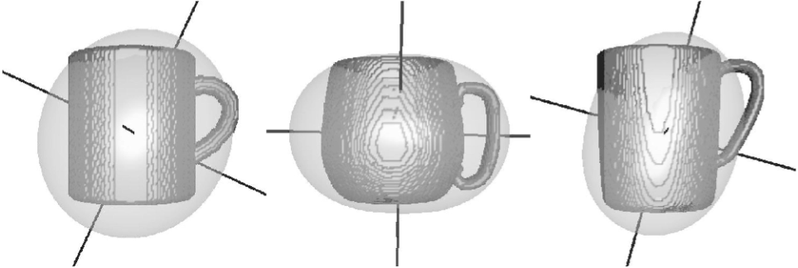
SHAPE QUERIES
Spherical harmonics method
The main idea is to decompose a 3D model into a collection of functions.
Use spherical harmonics to discard orientation information (phase) for each one.
This yields a shape descriptor that is both orientation invariant and descriptive.

Slide 11


Spherical harmonics method
Spherical harmonics method procedure
First, we rasterize the polygonal surfaces into a 2R x2R x2R voxel grid, assigning a voxel a value of 1 if it is within one voxel width of a polygonal surface, and assigning it a value of 0 otherwise.1 We usually choose R to be ~32, which provides adequate granularity for discriminating shapes while filtering out high-frequency noise in the original data.
Rasterize ?

Slide 12
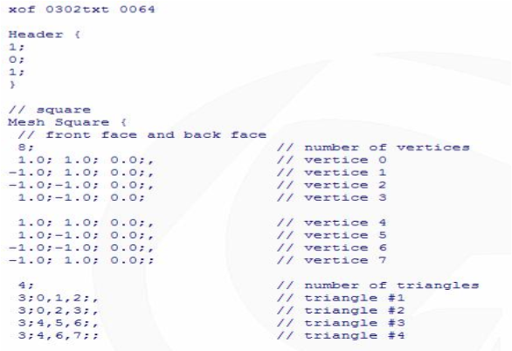
Spherical harmonics method
Rasterisation is the task of taking an image described in a vector graphics format (shapes) and converting it into a raster image (pixels or dots) for output on a video display or printer, or for storage in a bitmap file format.
Vector formats use drawing commands to store graphics as geometric objects. (3D models often stored this way)
A D3D model .x format file example
Notes:
1. Rasteize 基本上是一種將向量圖形轉變為點陣圖形的方式。由於3d的模型大多使用向量模式儲存(否則檔案將相當龐大)。在此要先將其轉換為點陣圖形格式則是因為要利用球諧函數的特性來計算descriptor，因此把檔案變為點陣格式之後每個點就可以視同為球座標上的一個點，如此一來便可以帶入球諧函數進行運算。

Slide 13
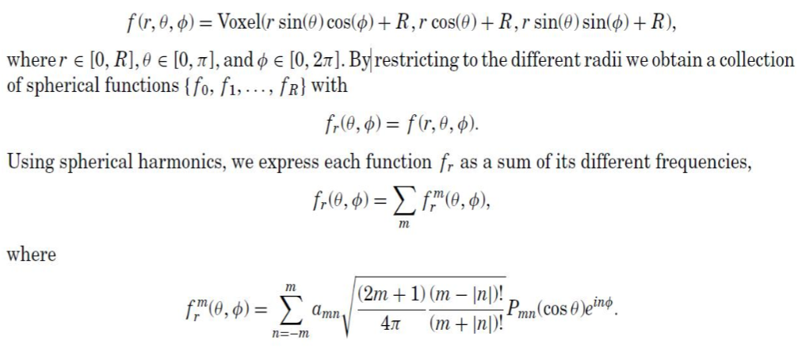
Spherical harmonics method
After the rasterization procedure. We treat the voxel grid as a (binary) real-valued function defined on the set of points with length less than or equal to R and express the function in spherical coordinates:

Slide 14


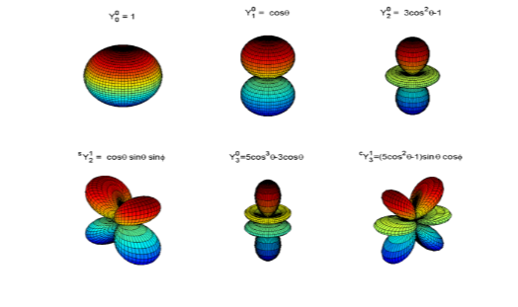



Spherical harmonics method
Spherical harmonics
In mathematics, the spherical harmonics are the angular portion of a set of solutions to Laplace's equation.
Represented in a system of spherical coordinates, Laplace's spherical harmonics are a specific set of spherical harmonics that forms an orthogonal system.

Slide 15



Spherical harmonics method
Noting that the different irreducible representations are ﬁxed under rotation, and noting that rotations do not change the L2 norm of functions, we observe that the value does not change if we rotate the function fr . We deﬁne a rotation invariant signature for fr as the collection of scalars { , , . . . }.
Combining these different signatures over the different radii, we obtain a two-dimensional rotation invariant spherical harmonics descriptor for the 3D model, with the value at index (r0 , m0 ) corresponding to the length of the m0th frequency of the restriction of f to the sphere with radius r0 .

Slide 16
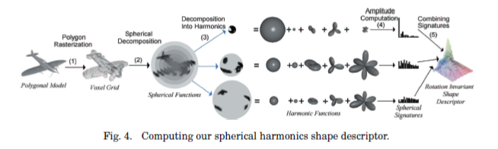
Spherical harmonics method
Comparison of descriptors
To compare two spherical harmonics descriptors, we simply compute the Euclidean distance between them. Retrieving the K best matches for a 3D query model is equivalent to solving the K nearest neighbors problem in a high-dimensional space.
In our implementation works we can build a search algorithm[Indyk and Motwani 1998] that works efficiently in practice by searching in multiple 1D spaces. In practice, a full comparison is required for a small subset of the database.

Slide 17
Sketch QUERIES
Of course, shape similarity queries are only possible when the user already has a representative 3Dmodel. In some cases, he will be able to find one by using a text search. However, in other cases, he will have to create it from scratch (at least to seed the search).
Rather than providing a tool with which a trained user can create models with exquisite detail and/or smoothness properties, our goal is to allow novice users to specify coarse 3D shapes quickly. In particular, the interface should be easy to learn for first-time visitors to a Web site.

Slide 18
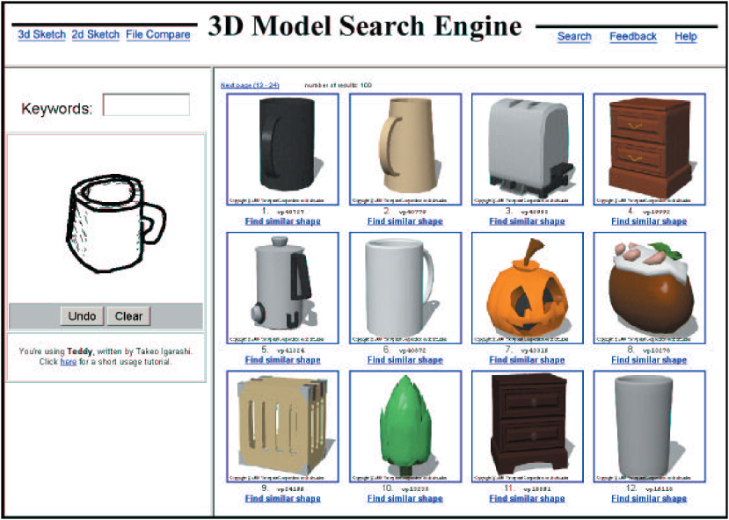
Sketch QUERIES
The first approach is to specify shape queries with a simple 3D sketching tool.
To investigate this approach, we have developed a query interface in which the user creates a simple 3D model. and then the system retrieves similar models using the matching algorithms described in the previous section.
Unfortunately, our early experiences suggest that even its simple gesture interface is still too hard for novice and casual users to learn quickly. Thus we were motivated to look for alternate sketching paradigms.

Slide 19
Sketch QUERIES
The Second approach is to draw 2D shapes with a pixel paint program and then have the system match the resulting image(s) to 2D projections of 3D objects.
The main advantage of this approach is that the interface is easy to learn. Of course, the main disadvantage is that 2D images generally have less shape information than 3D models. We compensate for this factor somewhat by allowing the user to draw multiple 2D projections of an object in order to better define its shape.
The main challenge in implementing this approach is to develop algorithms that match 2D sketches to 3D objects. This problem is significantly different from classical ones in computer vision because the 2D input is hand-drawn rather than photographic and the interface is interactive.

Slide 20
Sketch QUERIES
Thus, we must consider several new questions:
How do people draw shapes?
What viewpoints do they select?
How should the interface guide or constrain the user’s input?
What algorithms are robust enough to recognize human-drawn sketches?
We are interested in how untrained artists make quick sketches and how a computer can match them to 3D objects.
To investigate these questions, we first ran a pilot study in which 32 students from an introductory computer science class were instructed to “draw the shape of an <object>” for eight different objects.

Slide 21
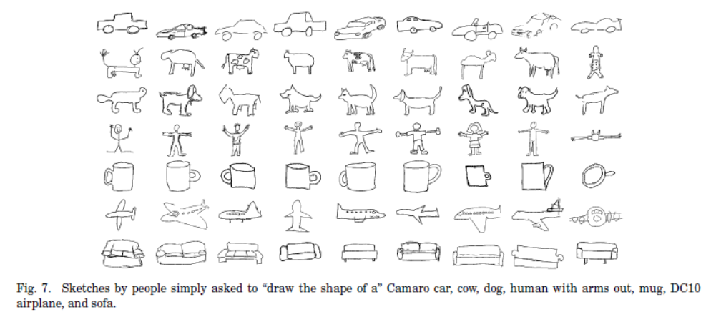
Sketch QUERIES

Slide 22
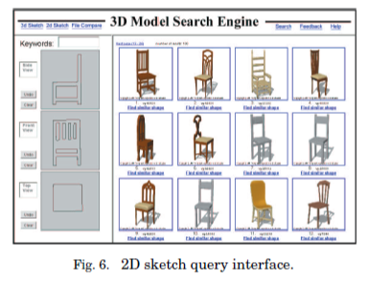
Sketch QUERIES
What have we found ?
People tend to sketch objects with fragmented boundary contours and few other lines, they are not very geometrically accurate, and they use a remarkably consistent set of view directions.
The most frequently chosen views were not characteristic views, but instead ones that were simpler to draw (front, side, and top views). We enhance this effect even further by labeling three sketch windows “Side View,” “Front View ,” and “Top View” in our system.

Slide 23
Sketch QUERIES
Methodology
During a preprocessing phase, we render thumbnail images with the boundary contours of each 3D object as seen from 13 orthographic view directions.
Then, for each query with m sketches, we compute the match score for any 3D object as the minimal sum of m (out of 13m) pair wise sketch-to-thumbnail dissimilarity scores, subject to the constraint that no thumbnail can be matched to more than one sketch.
This sampling ensures that any sketched view is within 22.5ﹾ of a sampled view. Moreover, it also takes advantage of the fact that some 3D models will be aligned with Cartesian axes, in which case our sampled views perfectly match the views preferred by users.
Notes:
此圖為六面體的四個頂點，個邊界，頂點。拿每個用於查詢的SKETCH對每個3D模型進行比較，然後得到一個相似度的分數

Slide 24
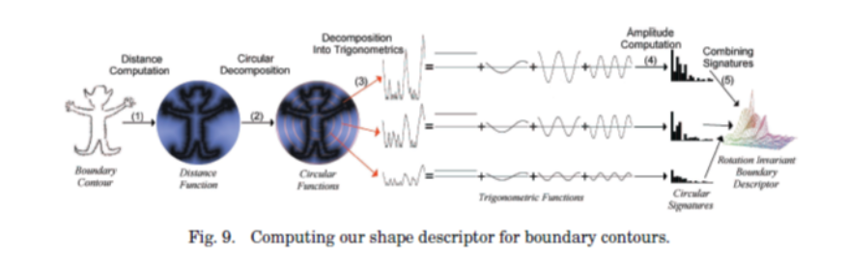
Sketch QUERIES
Methodology
For cases where 3D models are arbitrarily oriented, the image matching method must be robust to reflections and rotations in the image plane. To address this issue, we use a 2D analogue of the spherical harmonics method described in the previous section.
Notes:
此圖為六面體的四個頂點，個邊界，頂點。拿每個用於查詢的SKETCH對每個3D模型進行比較，然後得到一個相似度的分數

Slide 25
TEXT QUERIES
Our system also supports searching for 3D models by matching keywords in their textual descriptions. To support this feature, we construct a representative document for each 3D model. The text in that document includes the model filename, the anchor and nearby text parsed from its referring Web page, and ASCII labels parsed from inside the model file. For instance, we include part names (e.g., “DEF” nodes in VRML), texture file names, and informational fields (e.g., the “WorldInfo” node in VRML)

Slide 26
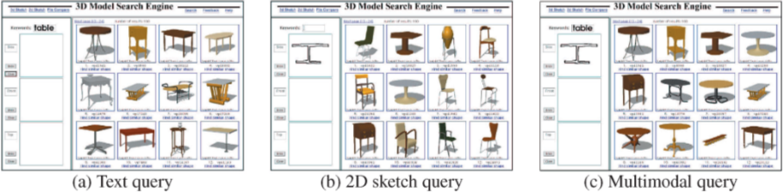
Multimodal QUERIES
Since text and shape queries can provide orthogonal notions of similarity corresponding to function and form, our search engine allows them to be combined.
We support this feature in two ways: text keywords and 2D/3D sketches may be entered in a single multimodal query, and text and shape information entered in successive queries can be combined so that a user can refine search terms adaptively.

Slide 27
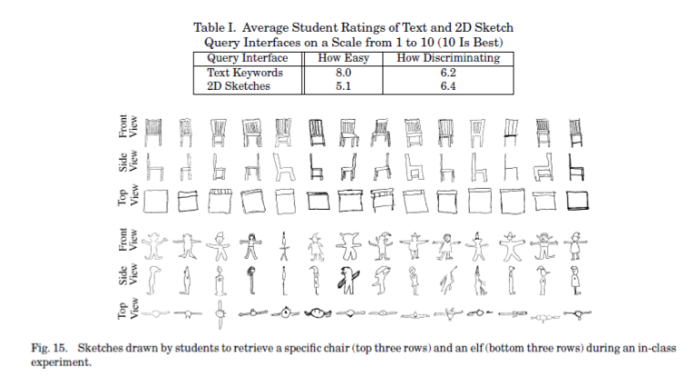
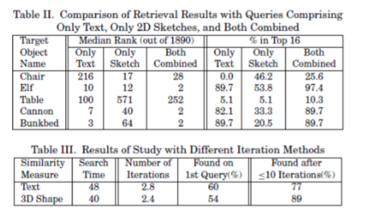
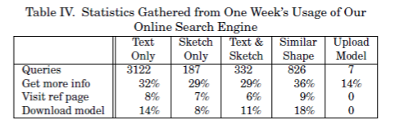
Results
Notes:
Random: this method ranks all models in random order. It provides a baseline for evaluation of the
other methods.
—Moments: this method characterizes the moments of inertia for points (x, y, z) on the surface S
of an object (mpqr D
R
S x p yqzr dx dy dz). The first two moments (center of mass and principal axes)
were used to register the models in a common coordinate system, and then the moments up to a sixth
order were compared using a component-by-component L2 difference (up to sixth-order moments were
chosen because they produce the best results for the test database). Our implementation follows the
description in Elad et al. [2001].
—Extended Gaussian Images (EGI): this method characterizes a 3D model in terms of its distribution
of surface normal vectors [Horn 1984]. We aligned the EGI for each model based on its principal
axes, and we compared two aligned EGIs by computing their L2 difference.
—Shape Histograms: this method characterizes the area of intersection with a collection of concentric
spheres. The distribution of areas is normalized so that the overall volume is 1 and two distributions
are compared by computing their L2 difference (as in Ankerst et al. [1999a]).
—D2 Shape Distributions (D2): this method represents the shape of a 3D model by the distribution
of Euclidean distances between pairs of points on its surface. The distribution for every model is
normalized for scale by dividing by its mean, and two distributions are compared by computing their
L1 difference (as in Osada et al. [2001]).

Slide 28
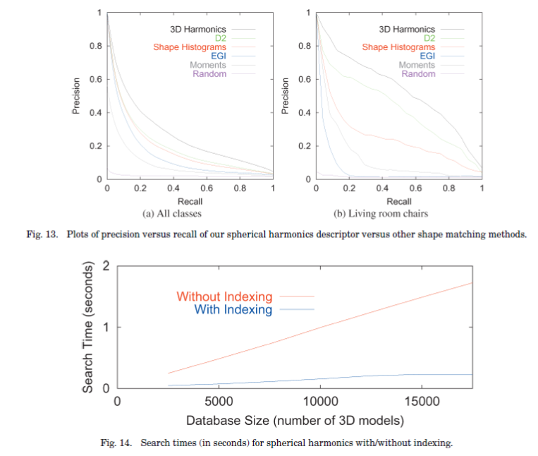
Results
For each target model in class C and any number K of top matches, “Recall” represents the ratio of models in class C returned within the top K matches, and “Precision” indicates the ratio of the top K matches that are members of class C.
Notes:
Random: this method ranks all models in random order. It provides a baseline for evaluation of the
other methods.
—Moments: this method characterizes the moments of inertia for points (x, y, z) on the surface S
of an object (mpqr D
R
S x p yqzr dx dy dz). The first two moments (center of mass and principal axes)
were used to register the models in a common coordinate system, and then the moments up to a sixth
order were compared using a component-by-component L2 difference (up to sixth-order moments were
chosen because they produce the best results for the test database). Our implementation follows the
description in Elad et al. [2001].
—Extended Gaussian Images (EGI): this method characterizes a 3D model in terms of its distribution
of surface normal vectors [Horn 1984]. We aligned the EGI for each model based on its principal
axes, and we compared two aligned EGIs by computing their L2 difference.
—Shape Histograms: this method characterizes the area of intersection with a collection of concentric
spheres. The distribution of areas is normalized so that the overall volume is 1 and two distributions
are compared by computing their L2 difference (as in Ankerst et al. [1999a]).
—D2 Shape Distributions (D2): this method represents the shape of a 3D model by the distribution
of Euclidean distances between pairs of points on its surface. The distribution for every model is
normalized for scale by dividing by its mean, and two distributions are compared by computing their
L1 difference (as in Osada et al. [2001]).

Slide 29
Thank you for your attention!!
&
Have a nice weekend!

