Slide 1


Evaluating
Sketch Query Interfaces for a 3D Model Search Engine
Patrick Min
Joyce Chen, Tom Funkhouser
Princeton Workshop on
Shape-Based Retrieval and Analysis of 3D Models
Tuesday October 30, 2001

Slide 2
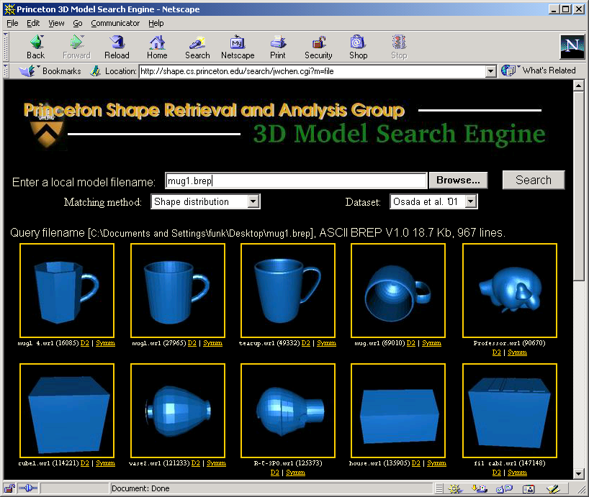
Goal
Shape-based search engine for 3D models on Web

Slide 3
3D Model Search Engine
Analysis
3D Model
Database
Shape Signatures
User
Query
Analysis
Shape
Signature
Compare
Query
Result

Slide 4
File Query Demo

Slide 5
Challenges
Web crawling
  directed search
Shape indexing
  shape distributions
  symmetry descriptors
  etc.
Query interface
  text
  sketch
  etc.

Slide 6
Challenges
Web crawling
  directed search
Shape indexing
  shape distributions
  symmetry descriptors
  etc.
Query interface
  text
  sketch
  etc.

Slide 7
Challenges
Web crawling
  directed search
Shape indexing
  shape distributions
  symmetry descriptors
  etc.
Query interface
  text
  sketch
  etc.

Slide 8
Challenges
Web crawling
  directed search
Shape indexing
  shape distributions
  symmetry descriptors
Query interface
  text
  sketch
  etc.

Slide 9
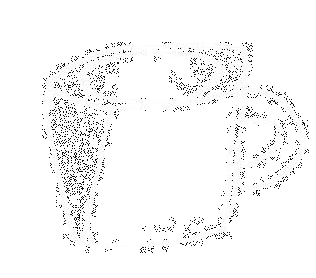
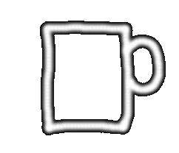
Sketch Query Interface Spectrum
3D Sketch
2D Sketch
More descriptive Easier input

Slide 10
Sketch Query Demo

Slide 11
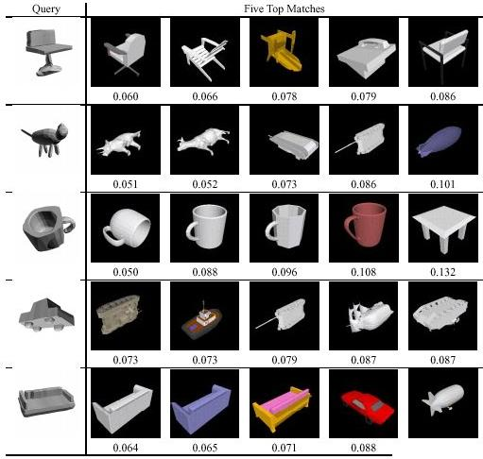
3D Sketch Example Results

Slide 12
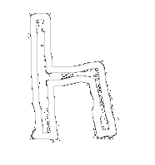
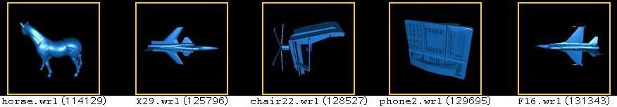
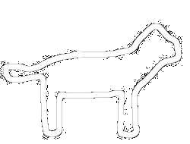
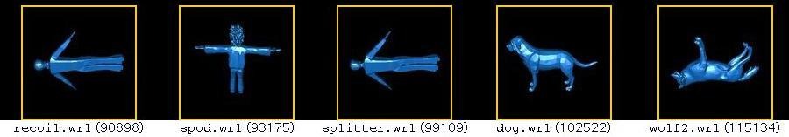
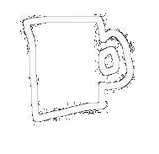
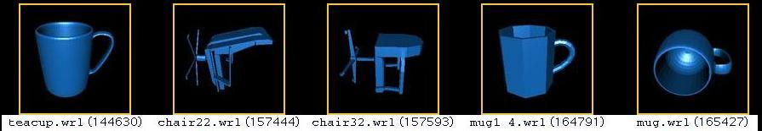
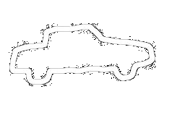
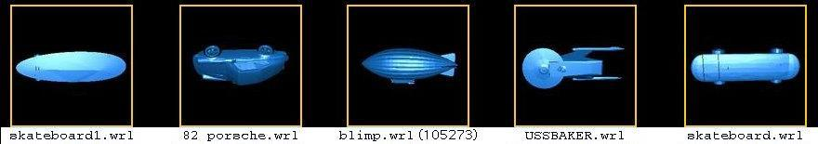
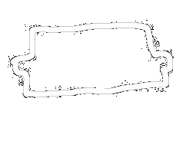
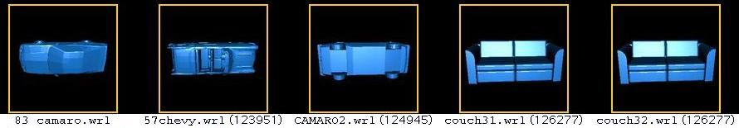
2D Sketch Example Results

Slide 13
Which Sketch Interface is “Better”
User study (future)
  Log behavior of users with 2D and 3D interfaces
  Required to assess “ease of input”
  In preparation
Initial study without users
  Use 3D models themselves as 3D queries
  Use projections of 3D models as 2D queries
  Compare discriminating power
Can 2D queries be as discriminating as 3D queries?

Slide 14
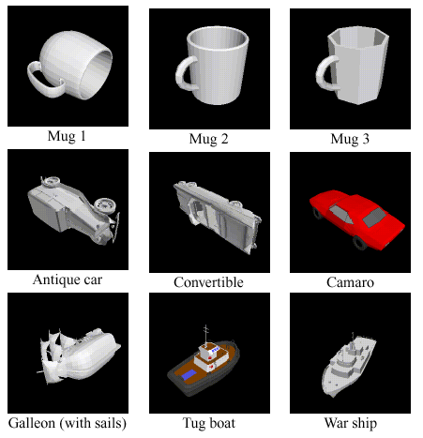
Evaluation Method
133 models classified into 25 categories
Same dataset as Osada et al.
4 Mugs
6 Cars
Matching 3D Models with Shape Distributions
Osada et al., I3D 2001
3 Boats

Slide 15

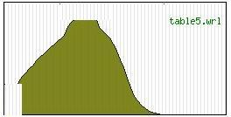
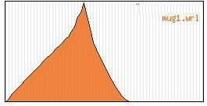
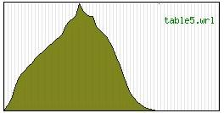
3D Comparison Method
Query object
Database with D2 distributions
Query D2 distribution
Compare
Query
Result

Slide 16
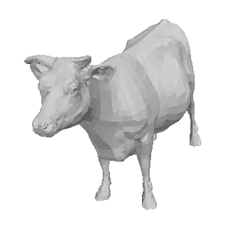
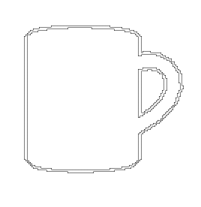
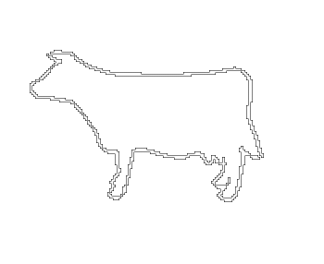
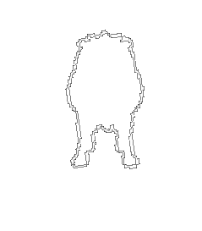
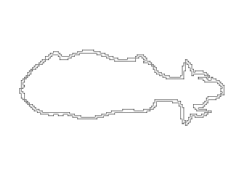
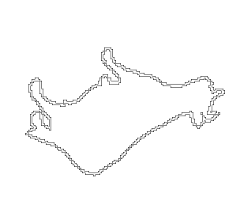
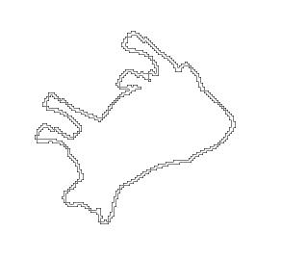
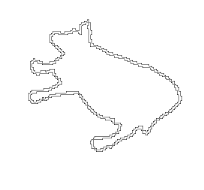
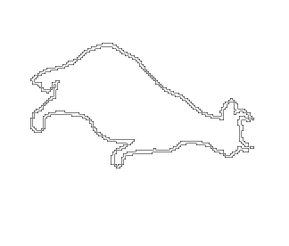
2D Comparison Method
5
3
6
4
7
1
2
Query projection
7 Database projections per model

Slide 17
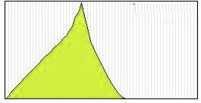
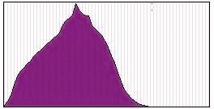
2D Comparison Method
5
3
6
4
7
1
2
Query 2D distribution
7 Database D2 distributions per model
Compare

Slide 18
Results

Slide 19
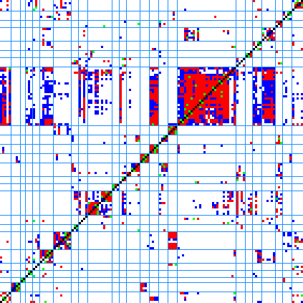
3D Similarity Matrix
diagonal
nearest neighbor
first tier
first two tiers
nearest neighbor
66 %
first tier
51 %
first two tiers
66 %
query models
matches

Slide 20
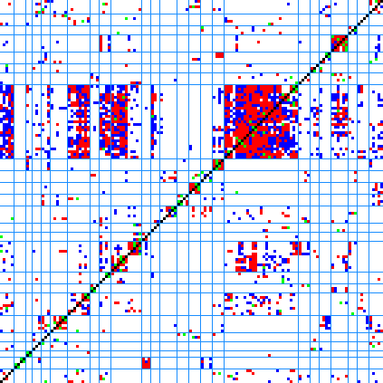
2D Similarity Matrix
diagonal
nearest neighbor
first tier
first two tiers
nearest neighbor
48 %
first tier
32 %
first two tiers
44 %
query models
matches

Slide 21
3D Similarity Matrix
diagonal
nearest neighbor
first tier
first two tiers
nearest neighbor
66 %
first tier
51 %
first two tiers
66 %
query models
matches

Slide 22
2D Similarity Matrix
diagonal
nearest neighbor
first tier
first two tiers
nearest neighbor
48 %
first tier
32 %
first two tiers
44 %
query models
matches

Slide 23
Multiple 2D Projections Query
3
5
3
6
4
7
1
1
2
2
Query 2D distribution
Database D2 distributions
Compare

Slide 24
Example: 3 Projection Query
stored views:
 | 1 | 2 | 3 | 4 | 5 | 6 | 7
1 | 12 | 7 | 22 | 9 | 1 | 11 | 30
2 | 3 | 15 | 8 | 14 | 20 | 12 | 5
3 | 3 | 18 | 6 | 16 | 14 | 8 | 6
query views:

Slide 25
Example: 3 Projection Query
minimize sum of similarity scores
stored views:
 | 1 | 2 | 3 | 4 | 5 | 6 | 7
1 | 12 | 7 | 22 | 9 | 1 | 11 | 30
2 | 3 | 15 | 8 | 14 | 20 | 12 | 5
3 | 3 | 18 | 6 | 16 | 14 | 8 | 6
query views:

Slide 26
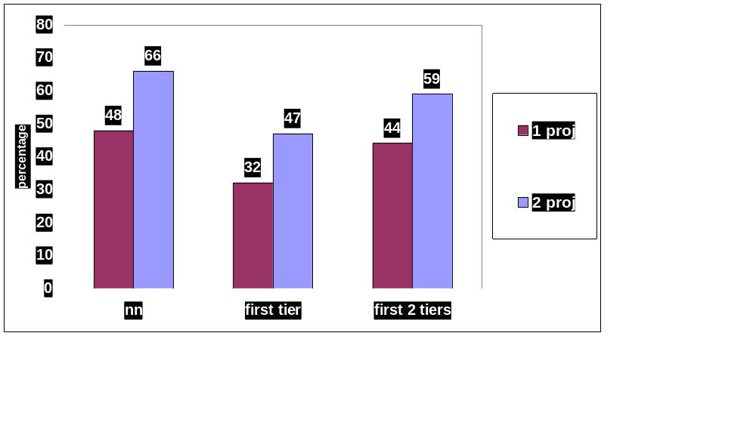
1 vs. 2 Query Projections
3D

Slide 27
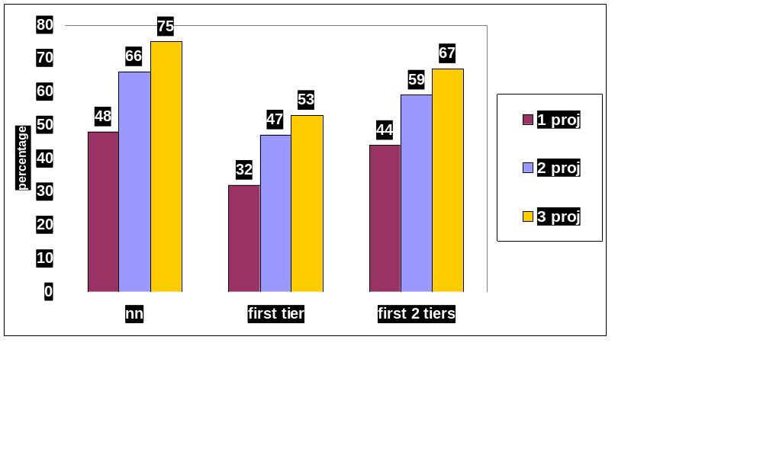
1 vs. 2 vs. 3 Query Projections
3D

Slide 28
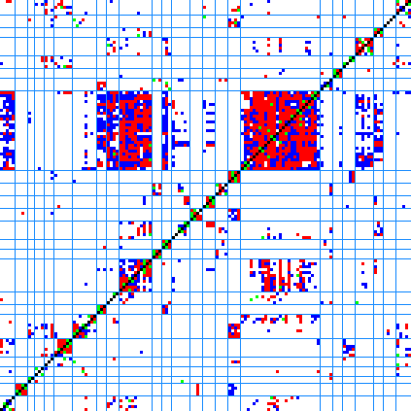
3D vs. Three Projections
query models
3D
Three 2D Projections

Slide 29
3D vs. Three Projections
query models
3D
Three 2D Projections

Slide 30
Multiple 2D Sketch Demo

Slide 31
Conclusion, Future work
2D outline query interface looks promising
Different and/or additional input, 2D:
  skeletons
  silhouette edges
Evaluation
  comparison with text query
  user study
  better model database

Slide 32
Acknowledgements
Princeton Shape Analysis Group
csstaff@cs, CS department technical staff
NSF
http://shape.cs.princeton.edu/search

Slide 33
Search Engine Website
initial 48 hr. crawl resulted in 23,000+ VRML models
2,000 have been processed, about 20-25 % are single objects (some duplicates)
rest is terrains, visualizations, VEs, too simple, molecules, etc.
they are cached and available for download

