Slide 1
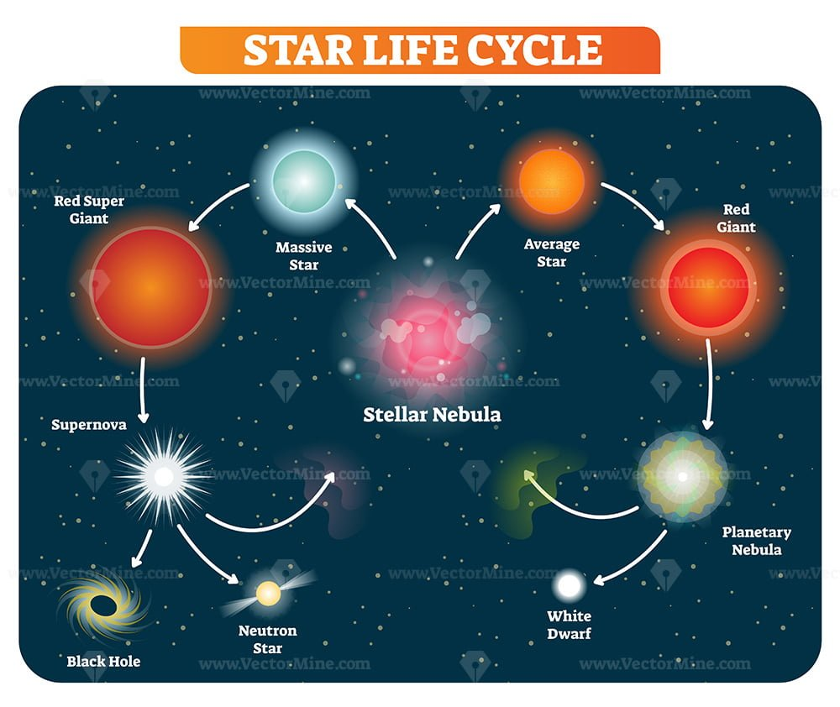
Life Cycle of a Star
A star is born from a giant cloud of gas and dust called a nebula.
Stars go through different stages, including protostar, main sequence, and red giant.
Eventually, a star runs out of fuel and dies, often in a supernova explosion.

Slide 2
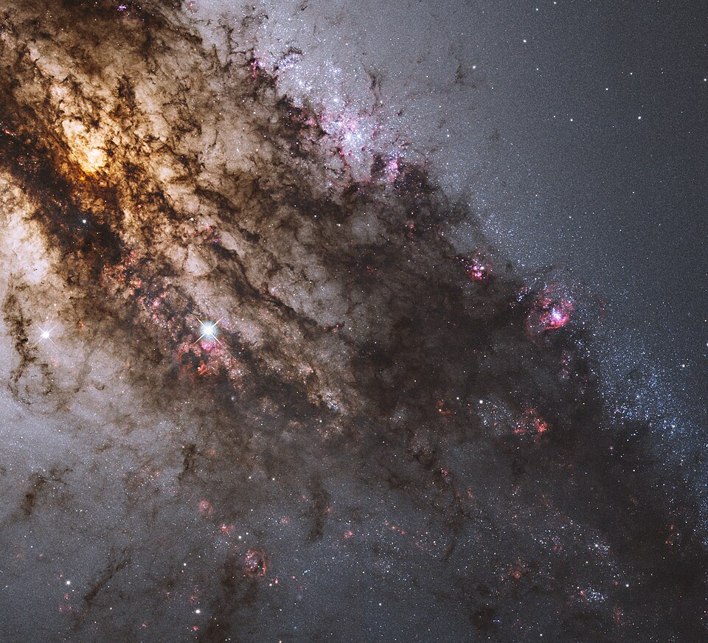
Birth of a Star
A star is born from a giant cloud of gas and dust called a nebula.
The nebula collapses under its own gravity, causing the gas and dust to spin faster and faster.
As the nebula collapses, it begins to flatten into a disk shape, with the star forming at the center.

Slide 3
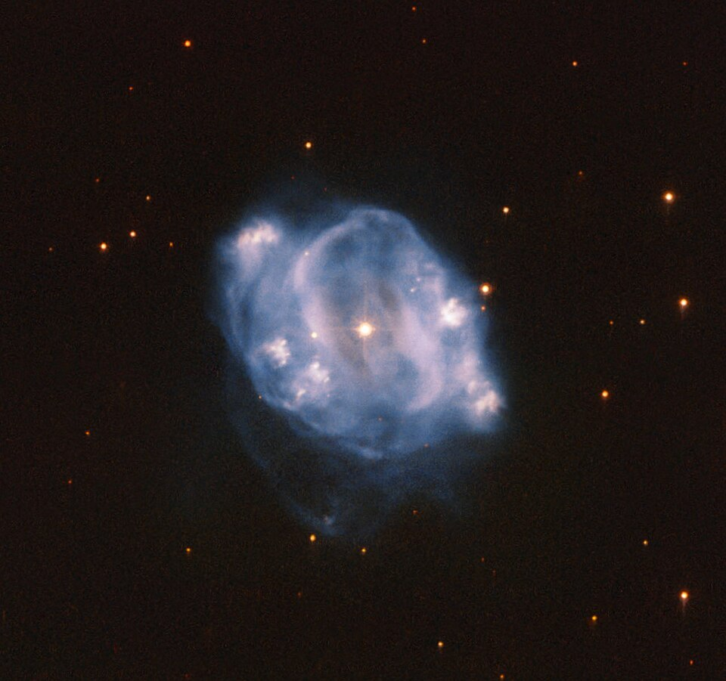
Main Stages of a Star's Life
Protostar: The star forms from the collapse of the nebula and begins to spin faster and faster.
Main Sequence: The star fuses hydrogen into helium in its core, releasing energy in the form of light and heat.
Red Giant: The star runs out of hydrogen fuel and expands to become a red giant, fusing helium into heavier elements.

Slide 4
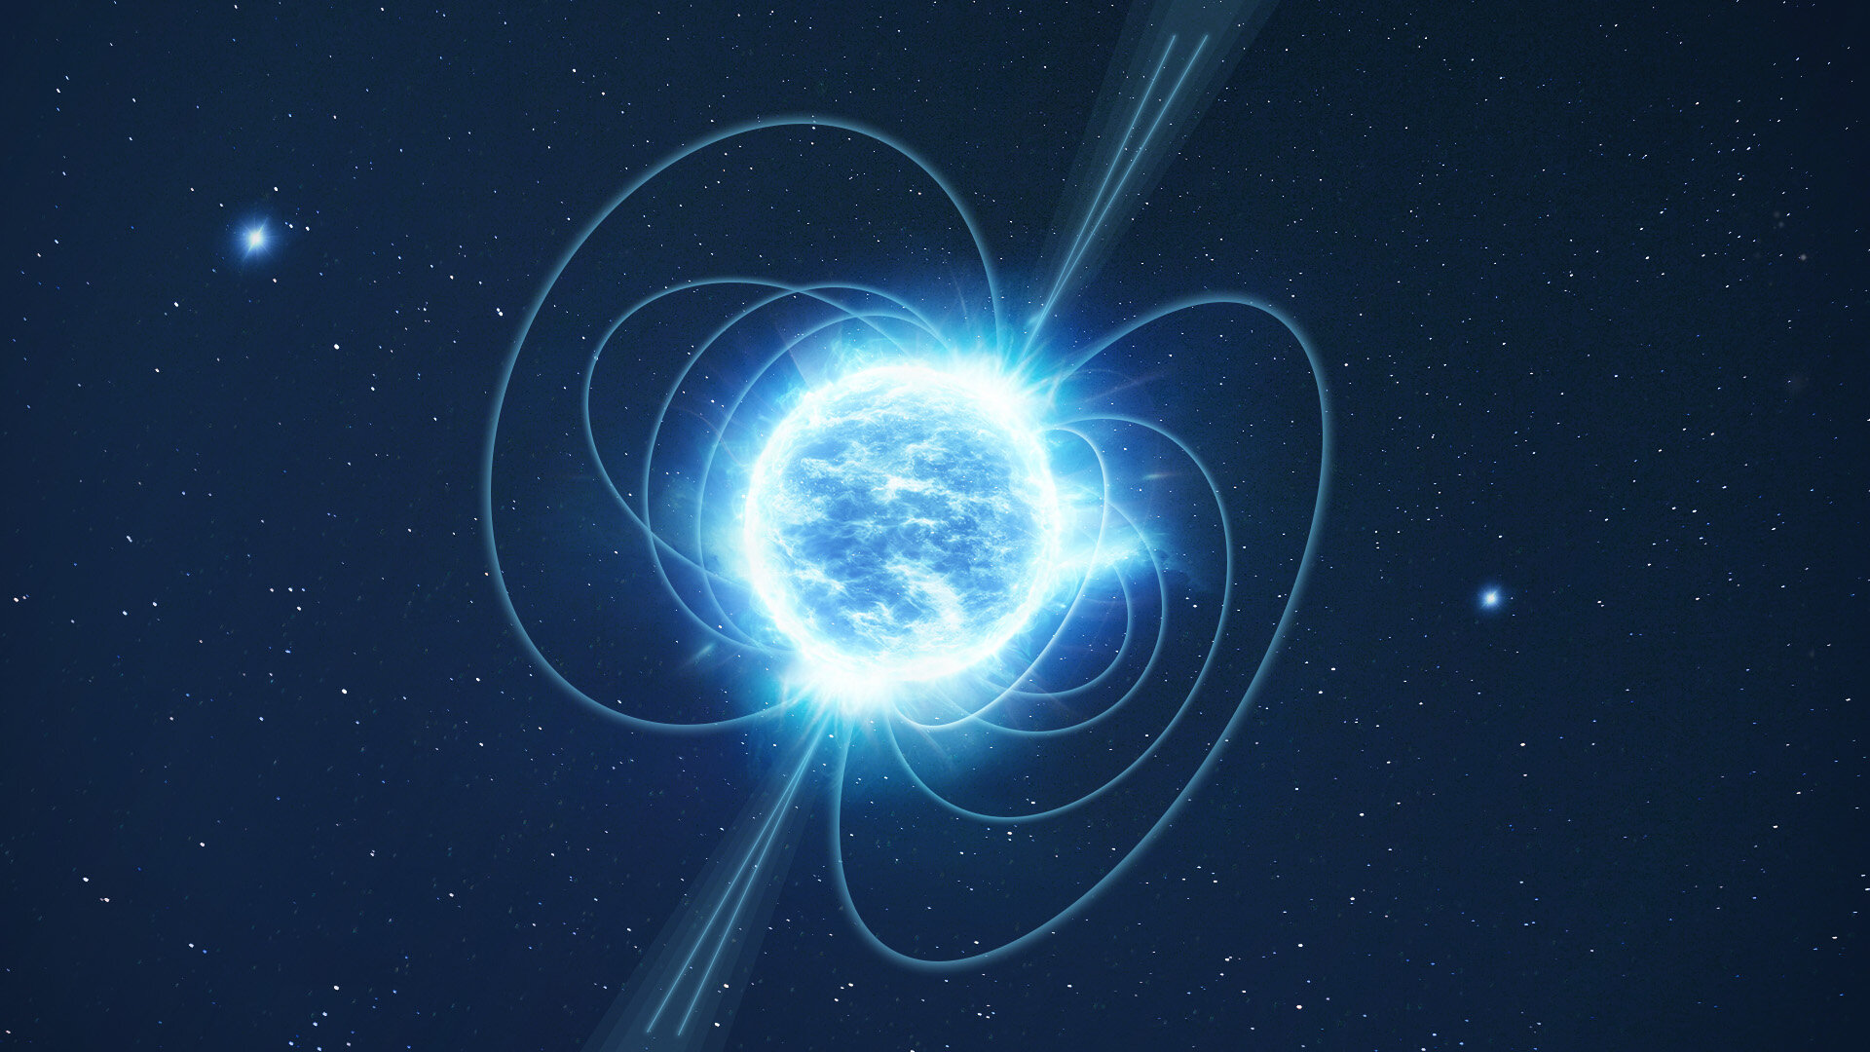
Death of a Star
A star runs out of fuel and dies, often in a supernova explosion.
The star's core collapses, causing a massive explosion that expels the star's outer layers into space.
The remaining core can either collapse into a black hole or form a neutron star.

Slide 5
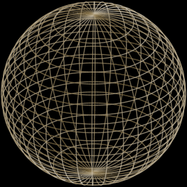
Summary of the Life Cycle of a Star
A star is born from a giant cloud of gas and dust called a nebula.
It goes through different stages, including protostar, main sequence, and red giant.
Eventually, a star runs out of fuel and dies, often in a supernova explosion.

