Slide 1

HARDWARE

Slide 2
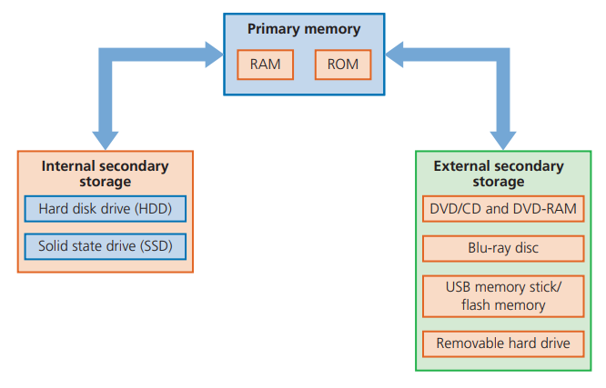
DATA STORAGE
Primary memory/memory is usually referred to as the internal devices used to store data that the computer can access directly.
Storage devices allow users to store applications, data and files. The user’s data is stored permanently and they can change it or read it as they wish.
Memory and storage devices can be split up into two distinct groups- primary memory and secondary storage.

Slide 3
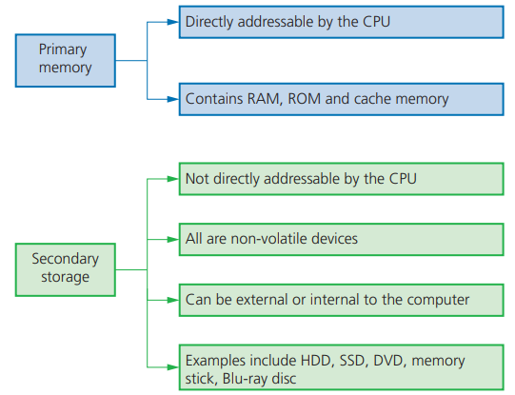
DIFFERENCES BETWEEN PRIMARY MEMORY AND SECONDARY STORAGE

Slide 4
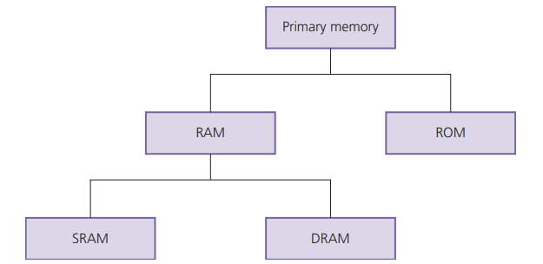
PRIMARY MEMORY
Primary memory is the part of the computer memory which can be accessed directly from the CPU; this includes random access memory (RAM) and read-only memory (ROM) memory chips.

Slide 5
RANDOM ACCESS MEMORY (RAM)
These memory devices are not really random; this refers to the fact that any memory location in RAM can be accessed independent of which memory location was last used.
Features of RAM include:
can be written to or read from, and the data can be changed by the user or the computer
used to store data, files, part of an application or part of the operating system currently in use
it is volatile, which means memory contents are lost when powering off the computer.
There are currently two types of RAM technology - dynamic RAM (DRAM) and static RAM (SRAM).

Slide 6
DYNAMIC RAM (DRAM) AND STATIC RAM (SRAM)
DRAM | SRAM
consists of a number of transistors and capacitors | uses flip flops to hold each bit of memory
needs to be constantly refreshed | doesn’t need to be constantly refreshed
less expensive to manufacture than SRAM | has a faster data access time than DRAM
has a higher memory capacity than SRAM | CPU memory cache makes use of SRAM
main memory is constructed from DRAM
consumes less power than SRAM

Slide 7
READ-ONLY MEMORY (ROM)
Another form of primary memory is read-only memory (ROM). The main difference is that it cannot be changed or written to.
It’s features include:
they are non-volatile
they are permanent memories
the contents can only be read
they are often used to store data that the computer needs to access when powering up for the first time

Slide 8
DIFFERENCES BETWEEN RAM AND ROM
RAM | ROM
temporary memory device | permanent memory device
volatile memory | non-volatile memory device
can be written to and read from | data stored cannot be altered
used to store data, files, programs, part of OS currently in use | always used to store BIOS and other data needed at start up
can be increased in size to improve operational speed of a computer

Slide 9
SECONDARY STORAGE
Secondary (and off-line) storage includes storage devices that are not directly addressable by the CPU.
They are non-volatile devices that allow data to be stored as long as required by the user.
This type of storage can store more data than primary memory, but data access time is considerably longer than with RAM or ROM.
Secondary (and off-line) storage falls into three categories according to the technology used: magnetic, solid state and optical.

Slide 10
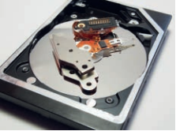
MAGNETIC STORAGE- HARD DISK DRIVE (HDD)
Data is stored in a digital format on the magnetic surfaces of the disks (or platters).
The hard disk drive will have a number of platters that can spin at about 7000 times a second.
Read-write heads consist of electromagnets that are used to read data from or write data to the platters.
Platters can be made from aluminum, glass or a ceramic material.
Normally each platter will have two surfaces which can be used to store data. These read-write heads can move very quickly.

Slide 11
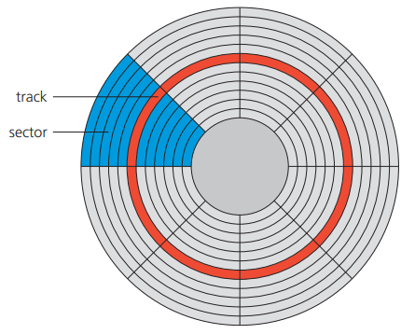
HARD DISK DRIVE (HDD) (CONTD.)
Data is stored on the surface in sectors and tracks.
A sector on a given track will contain a fixed number of bytes.
Many applications require the read-write heads to constantly look for the correct blocks of data.
The effects of latency then become very significant.
Latency is defined as the time it takes for a specific block of data on a data track to rotate around to the read-write head.

Slide 12
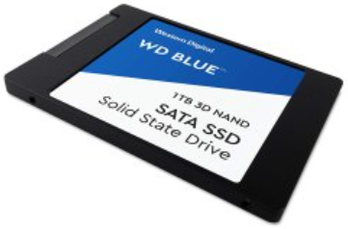
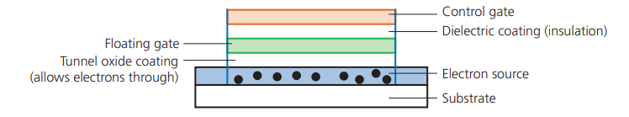
SOLID STATE STORAGE-SOLID STATE DRIVE (SSD)
Solid state drives (SSD) remove the issue of latency considerably since they have no moving parts and all data is retrieved at the same rate.
The data is stored as 0s and 1s in millions of tiny transistors (at each junction one transistor is called a floating gate and the other is called a control gate) within the chip.
Floating gate and control gate transistors use CMOS (complementary metal oxide semi-conductor) NAND technology
A dielectric coating separates the two transistors, which allows the floating gate transistor to retain its charge.
The floating gate transistor has a value of 1 when it is charged and a value of 0 when it isn’t.

Slide 13
BENEFITS AND DRAWBACKS OF SOLID STATE DRIVES (SSD)
BENEFITS | DRAWBACKS
They are more reliable | The main drawback of SSD is the longevity of the technology
They are considerably lighter | Most solid state storage devices are conservatively rated at only 20GB of write operations
They don’t have to ‘get up to speed’ before they work properly | For this reason, SSD technology is still not used in all servers.
They have a lower power consumption
They run much cooler than HDDs
Because of no moving parts, they are very thin
Data access is considerably faster than HDD.

Slide 14
MEMORY STICKS/ FLASH MEMORIES (PEN DRIVES)
They usually connect to the computer through the USB port.
Their main advantage is that they are very small, lightweight devices, which make them very suitable as a method for transferring files between computers.
They can also be used as small back-up devices for music or photo files.
Complex or expensive software, such as financial planning software, often uses memory sticks as a dongle.

Slide 15
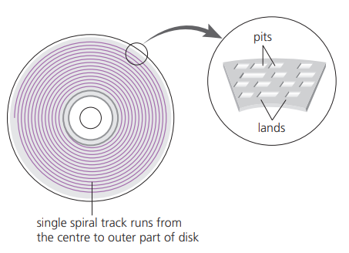
OPTICAL STORAGE-CD/DVD DISKS
CDs and DVDs are described as optical storage devices.
Red laser light is used to read and write data to and from the surface of the disk.
Both CDs and DVDs use a thin layer of metal alloy or light-sensitive organic dye to store the data.
Both systems use a single, spiral track which runs from the centre of the disk to the edge.
When a disk spins, the optical head moves to the point where the laser beam ‘contacts’ the disk surface.
It follows the spiral track from the centre outwards.
A CD/DVD is divided into sectors allowing direct access to data. The data is stored in ‘pits’ and ‘lands’ on the spiral track.

Slide 16
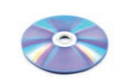
OPTICAL STORAGE- BLU RAY DISCS
Blu-ray discs are another example of optical storage media.
With Blu-ray, it is possible to:
record high definition television programs
skip quickly to any part of the disc
create playlists of recorded movies and television programmes
edit or re-order programmes recorded on the disc
automatically search for empty space on the disc to avoid over-recording
access websites and download subtitles and other interesting features.

Slide 17
DIFFERENCES BETWEEN CD, DVD AND BLU-RAY DISCS
Disk type | Laser colour | Wavelength of laser light | Disk construction | Track pitch (distance between tracks)
CD | Red | 780 nm | single 1.2 mm polycarbonate layer | 1.60μm
DVD (dual-layer) | Red | 650 nm | two 0.6 mm polycarbonate layers | 0.74μm
Blu-ray (single layer) | Blue | 405mm | single 1.2 mm polycarbonate layer | 0.30 μm
Blu-ray (dual-layer) | Blue | 405nm | two 0.6 mm polycarbonate layers | 0.30 μm

Slide 18
VIRTUAL MEMORY
One of the problems associated with memory management is the case when processes run out of RAM. If the amount of available RAM is exceeded due to multiple programs running, it is likely to cause a system crash.
This can be solved by utilizing the hard disk drive (or SSD) if we need more memory. This is the basis behind virtual memory. Essentially RAM is the physical memory, while virtual memory is RAM + swap space on the hard disk or SSD.
To execute a program, data is loaded into memory from HDD (or SSD) whenever required.

Slide 19
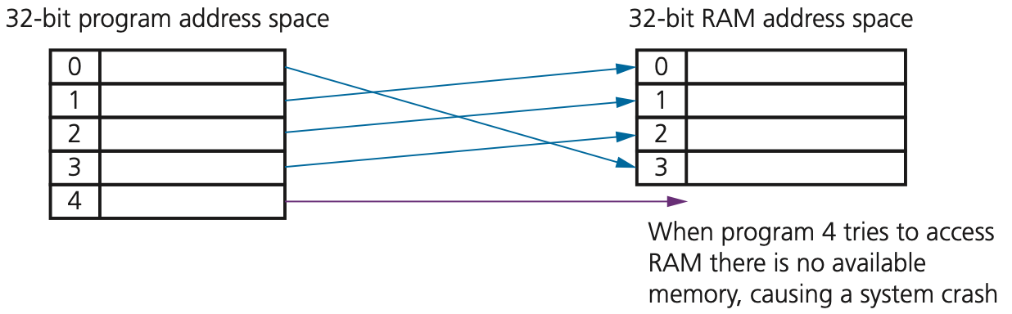
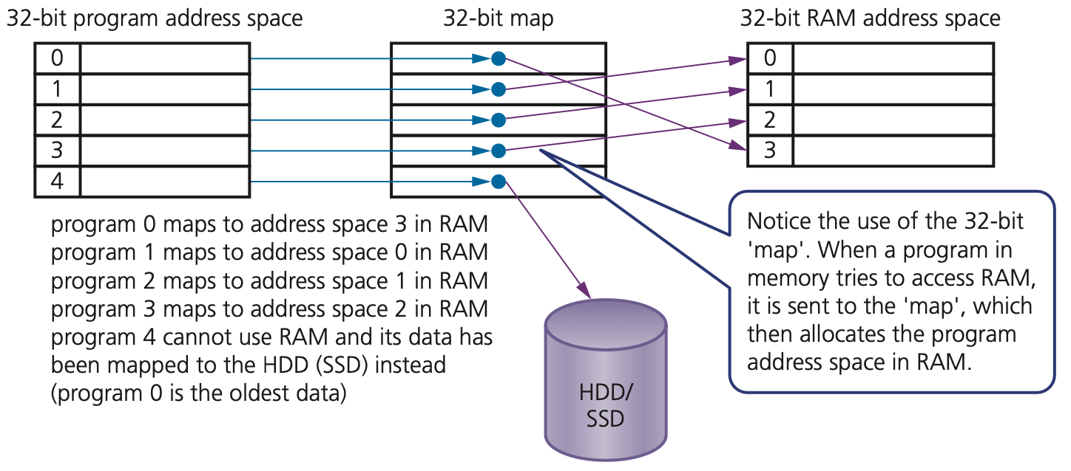
VIRTUAL MEMORY (CONTD.)
Without virtual memory
Suppose we have five programs (numbered 0 to 4) that are in memory, all requiring access to RAM.
The first diagram shows what would happen without virtual memory being used (i.e. the computer would run out of RAM memory space)
With virtual memory
This will require moving data out of RAM into HDD/SSD and then allowing other data to be moved out of HDD/SSD into RAM

Slide 20
CLOUD STORAGE
Cloud storage is a method of data storage where data is stored on remote servers.
The same data is stored on more than one server in case of maintenance or repair, allowing clients to access data at any time. This is known as data redundancy.
There are three common systems:
Public cloud – this is a storage environment where the customer/client and cloud storage provider are different companies
Private cloud – this is storage provided by a dedicated environment behind a company firewall.
Hybrid cloud – this is a combination of the two above environments.

Slide 21
CLOUD STORAGE (CONTD.)
Benefits of using cloud storage | Drawbacks of using cloud storage
customer/client files stored on the cloud can be accessed at any time from any device anywhere in the world provided internet access is available | if the customer/client has a slow or unstable internet connection, they would have many problems accessing or downloading their data/files
there is no need for a customer/client to carry an external storage device with them, or even use the same computer to store and retrieve information | costs can be high if large storage capacity is required; it can also be expensive to pay for high download/upload data transfer limits with the customer/client internet service provider (ISP)
the cloud provides the user with remote back-up of data with obvious benefits to alleviate data loss/disaster recovery | the potential failure of the cloud storage company is always possible – this poses a risk of loss of all back-up data
if a customer/client has a failure of their hard disk or back- up device, cloud storage will allow recovery of their data
the cloud system offers almost unlimited storage capacity

Slide 22
ASSESSMENT
Quiz 3 ( Data storage) - https://forms.gle/caYf7EizKYGm22Qa7

