Slide 1

HARDWARE

Slide 2
COMPUTER ARCHITECTURE
The Central Processing Unit (CPU)/microprocessor
Von Neumann architecture
Arithmetic and logic unit (ALU), control unit (CU) and registers
Control bus, address bus, data bus
Cores, cache and the internal clock
Fetch–Decode–Execute cycle
Instruction set for a CPU
Embedded systems

Slide 3
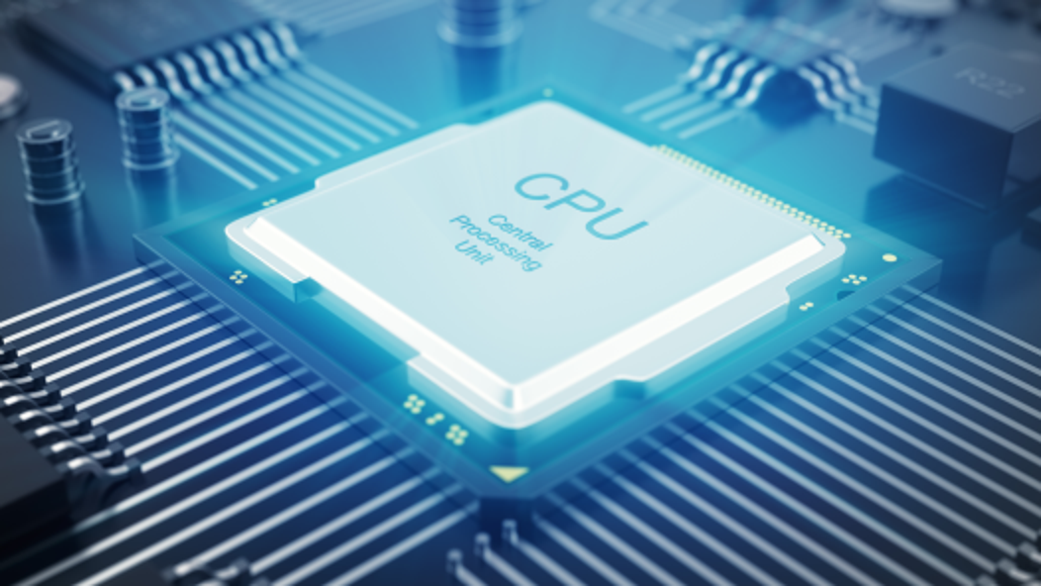
THE CENTRAL PROCESSING UNIT (CPU)/MICROPROCESSOR
The central processing unit (CPU) is central to all modern computer systems (including tablets and smartphones).
The CPU is very often installed as an integrated circuit on a single microchip.

Slide 4
VON NEUMANN ARCHITECTURE
The von Neumann architecture has the following main features:
the concept of a CPU which was able to access the memory directly
computer memories could store programs as well as data
stored programs were made up of instructions which could be executed in sequential order.

Slide 5
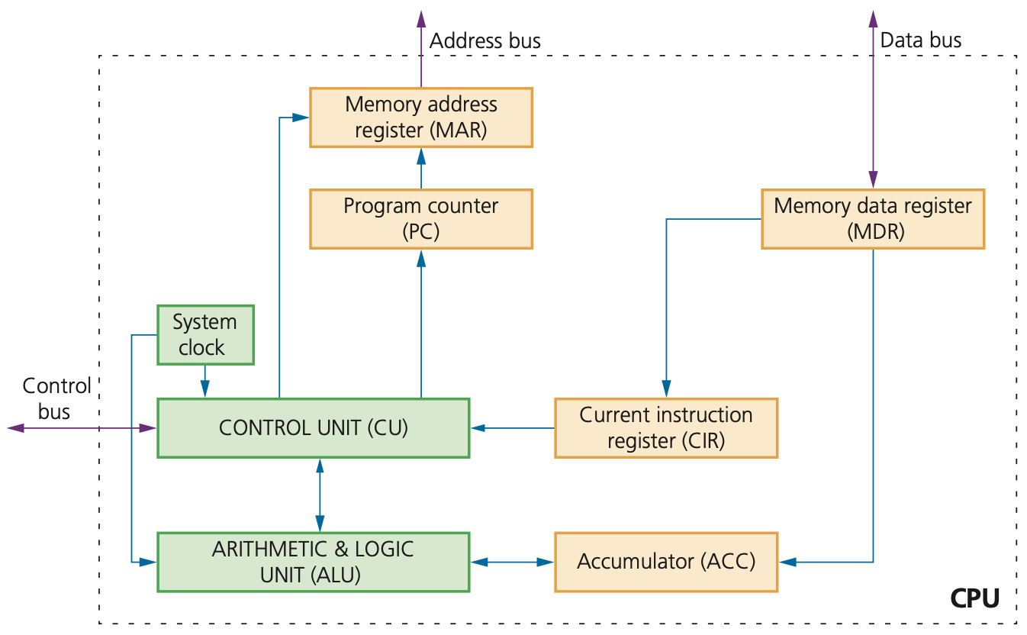

Slide 6
ARITHMETIC AND LOGIC UNIT (ALU), CONTROL UNIT (CU) AND REGISTERS
The Arithmetic & Logic Unit (ALU) allows the required arithmetic (e.g. +, - and shifting) or logic (e.g. AND, OR) operations to be carried out while a program is being run.
The control unit (CU) reads an instruction from memory. The address of the location where the instruction can be found is stored in the Program Counter (PC).

Slide 7
ARITHMETIC AND LOGIC UNIT (ALU), CONTROL UNIT (CU) AND REGISTERS (CONTD.)
Registers:
One of the most fundamental components of the von Neumann system are the registers.
Registers can be general or special purpose. We will only consider the special purpose registers.
Specific purpose registers

Slide 8
Register | Abbreviation | Function/purpose of register
current instruction register | CIR | this register stores the current instruction being decoded and executed
accumulator | ACC | this register is used when carrying out ALU calculations; it stores data temporarily during the calculations
memory address register | MAR | this register stores the address of the memory location currently being read from or written to
memory data/ buffer register | MDR | this register stores data which has just been read from memory or data which is about to be written to memory
program counter | PC | this register stores the address where the next instruction to be read can be found

Slide 9
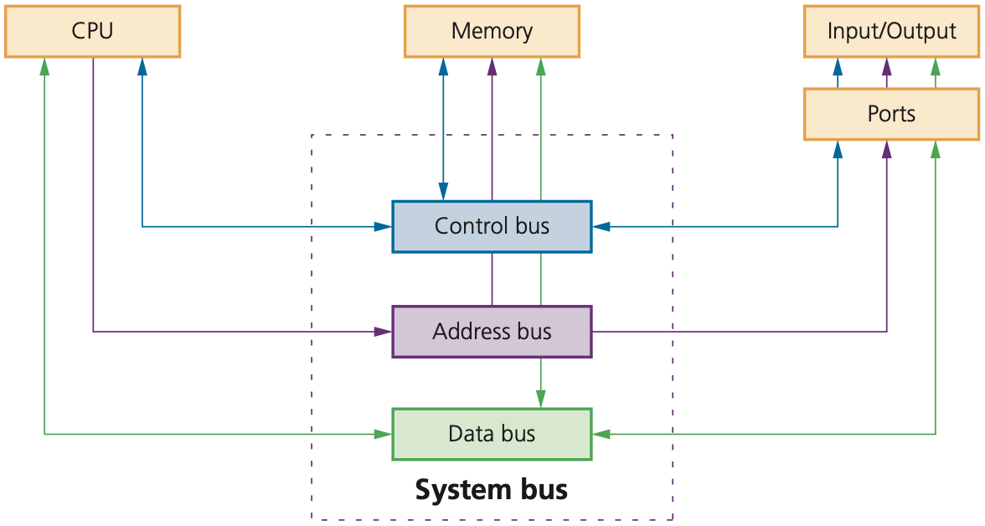
CONTROL BUS, ADDRESS BUS, DATA BUS
System buses are used in computers as parallel transmission components; each wire in the bus transmits one bit of data. There are three common buses used in the von Neumann architecture known as: address bus, data bus and control bus.
The address bus carries addresses throughout the computer system.
The data bus is bidirectional. This means data can be carried from CPU to memory (and vice versa) and to and from input/output devices.
The control bus is also bidirectional. It carries signals from the control unit (CU) to all the other computer components. It is usually 8-bits wide.

Slide 10
CORES, CACHE AND THE INTERNAL CLOCK
The clock defines the clock cycle that synchronizes all computer operations
The control bus transmits timing signals ensuring everything is fully synchronized
By increasing clock speed, the processing speed of the computer is also increased.
The use of cache memories can also improve CPU performance. cache memory is located within the CPU itself, which means it has much faster data access times than RAM.

Slide 11

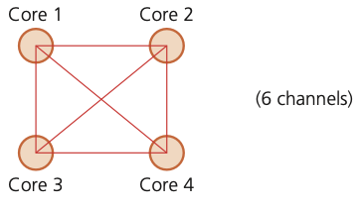
CORES, CACHE AND THE INTERNAL CLOCK (CONTD.)
The use of a different number of cores can improve computer performance. One core is made up of an ALU, a control unit and the registers.
Many computers are dual core (the CPU is made up of two cores) or quad core (the CPU is made up of four cores).

Slide 12
FETCH–DECODE–EXECUTE CYCLE
In the Fetch–Decode–Execute cycle, the next instruction is fetched from the memory address stored in the MAR and the instruction is stored in the MDR.
The instruction is then decoded so that it can be interpreted in the next part of the cycle.
The CPU passes the decoded instruction as a set of control signals to the appropriate components within the computer system. This allows each instruction to be executed in its logical sequence.

Slide 13
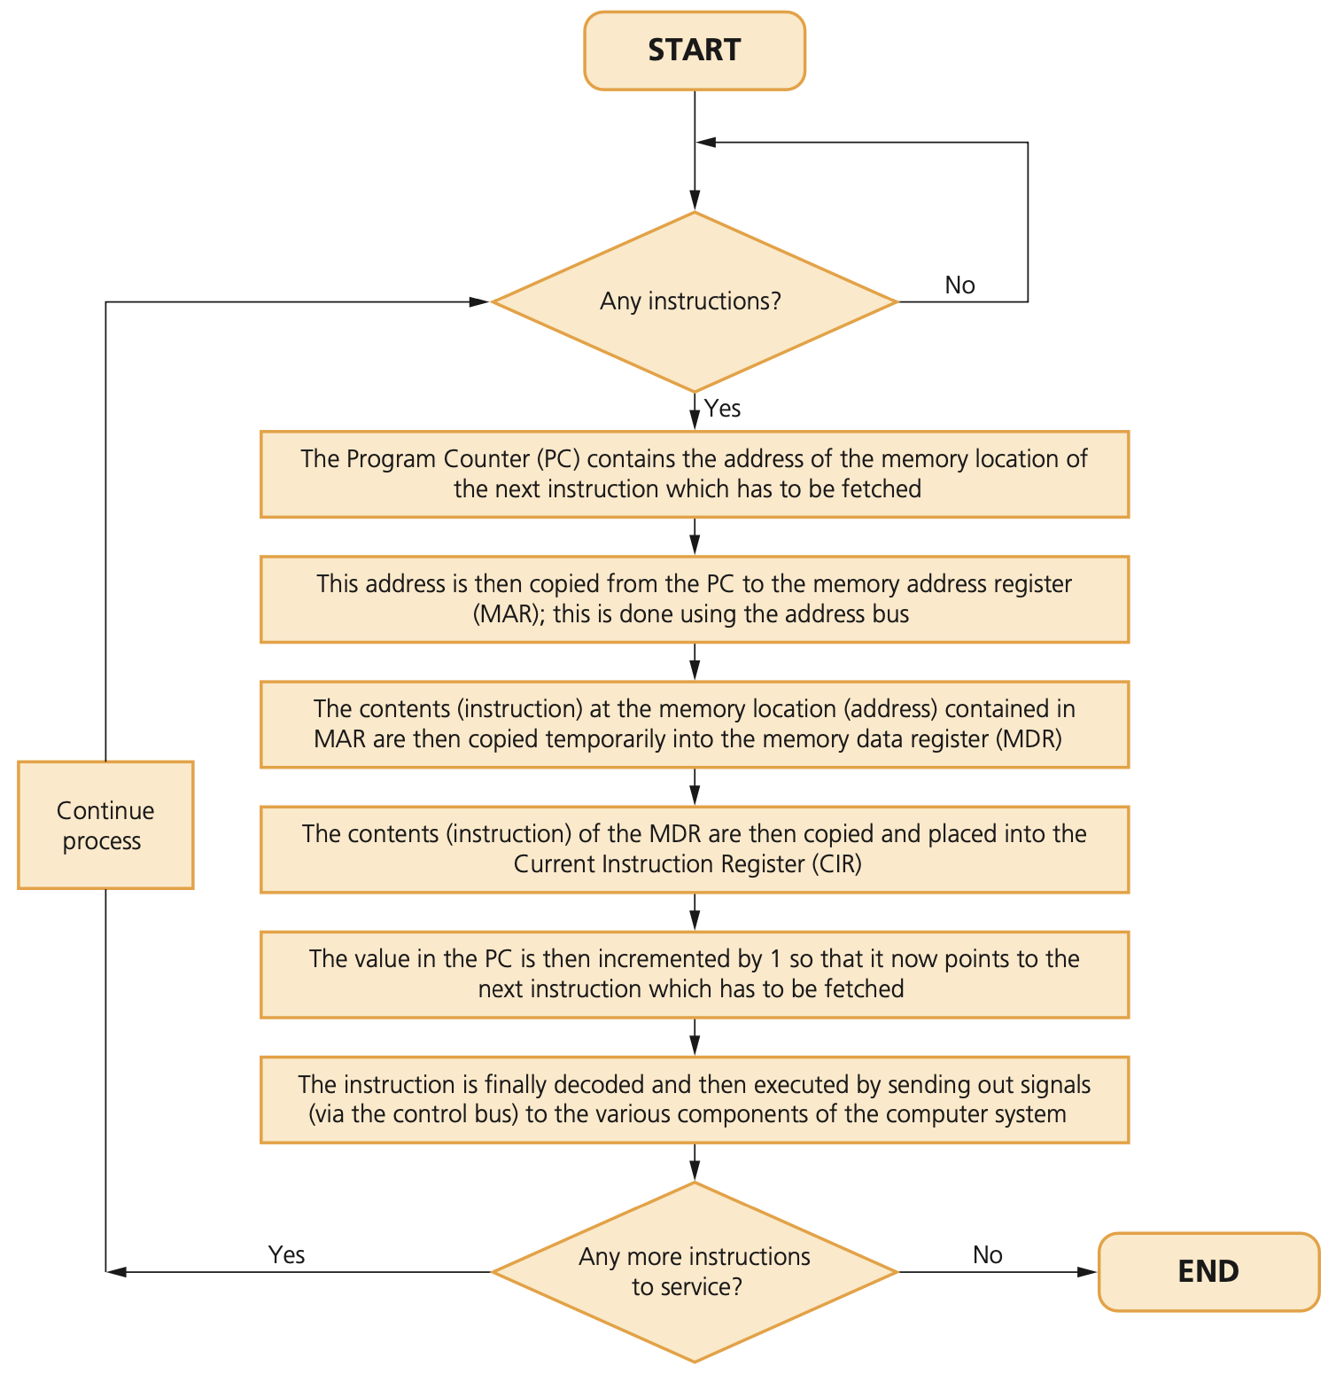

Slide 14
INSTRUCTION SET FOR A CPU
In a computer system, instructions are a set of operations which are decoded in sequence.
Each operation will instruct the ALU and CU.
An operation is made up of an opcode and an operand.
The opcode informs the CPU what operation needs to be done
The operand is the data which needs to be acted on or it can refer to a register in the memory
Since the computer needs to understand the operation to be carried out, there is actually a limited number of opcodes that can be used; this is known as the instruction set.

Slide 15
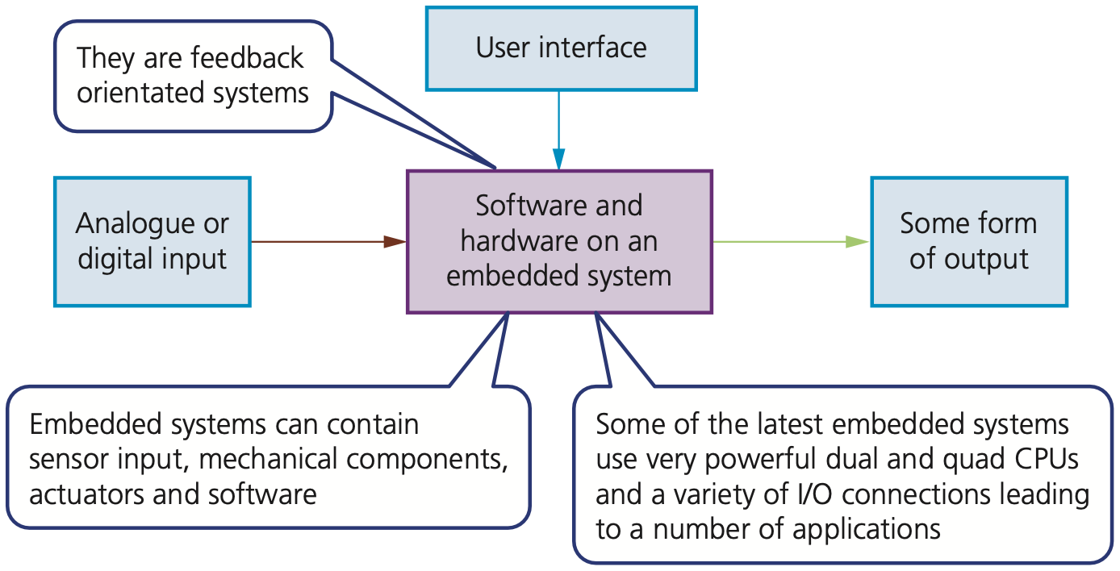
EMBEDDED SYSTEMS
An embedded system is a combination of hardware and software which is designed to carry out a specific set of functions. The hardware is electronic, electrical or electro-mechanical.
Embedded systems can be based on:
Microcontrollers: this has a CPU in addition to some RAM and ROM and other peripherals all embedded onto one single chip (together they carry out a specific task)
Microprocessor: integrated circuit which only has a CPU on the chip (there is no RAM, ROM or peripherals – these need to be added)
System on Chips (SoC): this may contain a microcontroller as one of its components (they almost always will include CPU, memory, input/output (I/O) ports and secondary storage on a single microchip)

Slide 16
EMBEDDED SYSTEMS (CONTD.)
Benefits | Drawbacks
they are small in size and therefore easy to fit into devices | it can be difficult to upgrade some devices to take advantage of new technology
compared to other systems, they are relatively low cost to make | troubleshooting faults in the device becomes a specialist task
they are usually dedicated to one task allowing simple interfaces and often no requirement for an operating system | although the interface can appear to be more simple (e.g. a single knob) in reality it can be more confusing (e.g. changing the time on a cooker clock can require several steps!)
they consume very little power | any device that can be accessed over the internet is also open to hackers, viruses, etc.
they can be controlled remotely using a mobile phone, for example | due to the difficulty in upgrading and fault finding, devices are often just thrown away rather than being repaired (very wasteful)
very fast reaction to changing input (operate in real time and are feedback orientated) | can lead to an increase in the ‘throw away’ society if devices are discarded just because they have become out-of-date
with mass production comes reliability

Slide 17
INPUT AND OUTPUT DEVICES
Input devices: barcode and QR code scanners, digital cameras, keyboards, microphones, mouse, 2D/3D scanners and touch screens
Output devices: actuators, light projectors, inkjet and laser printers, LED and LCD screens, speakers and 3D printers
Sensors and their use in control and monitoring

Slide 18
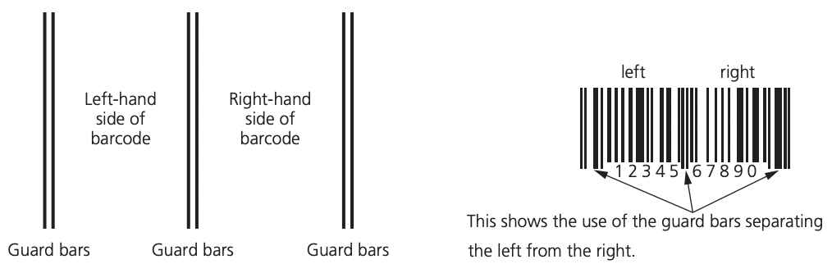
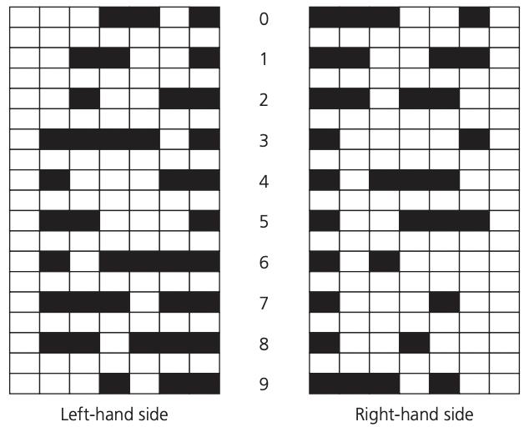
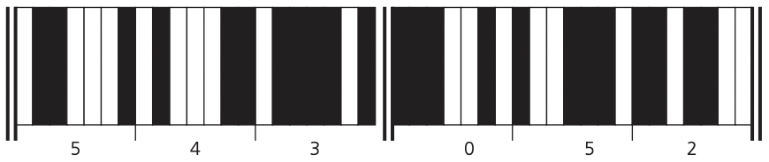
INPUT DEVICES – BARCODE SCANNERS
A barcode is a series of dark and light parallel lines of varying thickness. The numbers 0 to 9 are each represented by a unique series of lines. Various barcode methods for representing these digits exist.

Slide 19
BARCODE SCANNERS
The barcode is first of all read by a red laser or red LED (light emitting diode)
Light is reflected back off the barcode; the dark areas reflect little or no light, which allows the bars to be read
The reflected light is read by sensors (photoelectric cells)
As the laser or LED light is scanned across the barcode, a pattern is generated, which is converted into digital data – this allows the computer to understand the barcode
For example: the digit ‘3’ on the left generates the pattern: L D D D D L D (where L = light and D = dark), this has the binary equivalent of: 0 1 1 1 1 0 1 (where L = 0 and D = 1).

Slide 20

QUICK RESPONSE (QR) CODES
Another type of barcode is the quick response (QR) code.
This is made up of a matrix of filled-in dark squares on a light background.
For example, the QR code on the left, is a website advertising rock music merchandise. It includes a web address in the code.
QR codes can hold considerably more information than the more conventional barcodes.

Slide 21
QUICK RESPONSE (QR) CODES
Advantages
They can hold much more information
There will be fewer errors;
QR codes are easier to read; they don’t need expensive laser or LED (light emitting diode) scanners like barcodes – they can be read by the cameras on smartphones or tablets
It is easy to transmit QR codes either as text messages or images
It is also possible to encrypt QR codes which gives them greater protection than traditional barcodes.
Disadvantages
More than one QR format is available
QR codes can be used to transmit malicious codes – known as attagging.

Slide 22
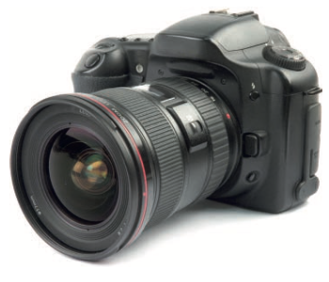
DIGITAL CAMERAS
These cameras are controlled by an embedded system which can automatically carry out the following tasks:
adjust the shutter speed
focus the image automatically
operate the flash gun automatically
adjust the aperture size
adjust the size of the image
remove ‘red eye’ when the flash gun has been used

Slide 23
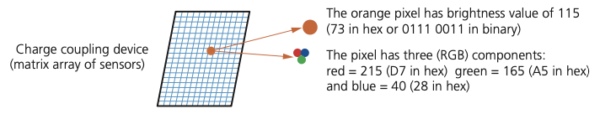
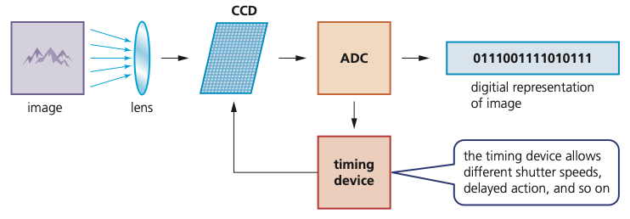
DIGITAL CAMERAS (CONTD.)
What happens when a photograph is taken
The image is captured when light passes through the lens on to a light-sensitive cell.
The image is converted into tiny electric charges which are then passed through an analogue to digital converter (ADC) to form a digital image array.
The sensors measure color which produces another binary pattern.
The number of pixels determines the size of the file used to store the photograph
The quality of the image depends on the recording device, the number of pixels used, the levels of light and how the image is stored .

Slide 24
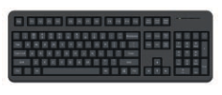
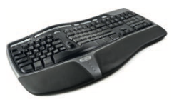
KEYBOARDS
Keyboards are by far the most common method used for data entry.
The keyboard is connected to the computer either by using a USB connection or by wireless connection. In the case of tablets and mobile phones, the keyboard is often virtual or a type of touch screen technology.
They are a relatively slow method of data entry and are also prone to errors, however keyboards are probably still the easiest way to enter text into a computer.
Unfortunately, frequent use of these devices can lead to injuries, such as repetitive strain injury (RSI) in the hands and wrists.

Slide 25
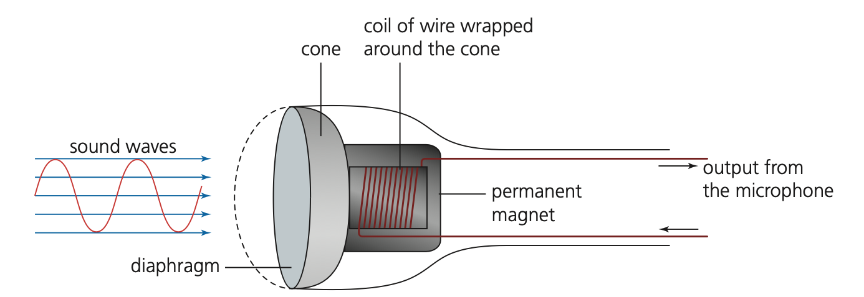
MICROPHONES
Microphones are either built into the computer or are external devices connected through the USB port or using Bluetooth connectivity.
When sound is created, it causes the air to vibrate.
When a diaphragm in the microphone picks up the air vibrations, the diaphragm also begins to vibrate.
A copper coil is wrapped around the cone which is connected to the diaphragm. As the diaphragm vibrates, the cone moves in and out causing the copper coil to move backwards and forwards.
This forwards and backwards motion causes the coil to cut through the magnetic field around the permanent magnet, inducing an electric current.
The electric current is then either amplified or sent to a recording device.
The electric current is analogue in nature.
The electric current output from the microphone can also be sent to a computer where a sound card converts the current into a digital signal which can then be stored in the computer.

Slide 26
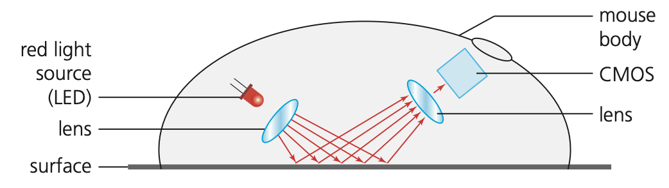
An optical mouse is an example of a pointing device.
OPTICAL MOUSE
Benefits
There are no moving parts, therefore it is more reliable.
Dirt can’t get trapped in any of the mechanical components.
There is no need to have any special surfaces.
Most optical mice use Bluetooth connectivity.
A wired mouse has the following advantages:
No signal loss since there is a constant signal pathway (wire)
Cheaper to operate (no need to buy new batteries or charge batteries)
Fewer environmental issues (no need to dispose of old batteries).

Slide 27
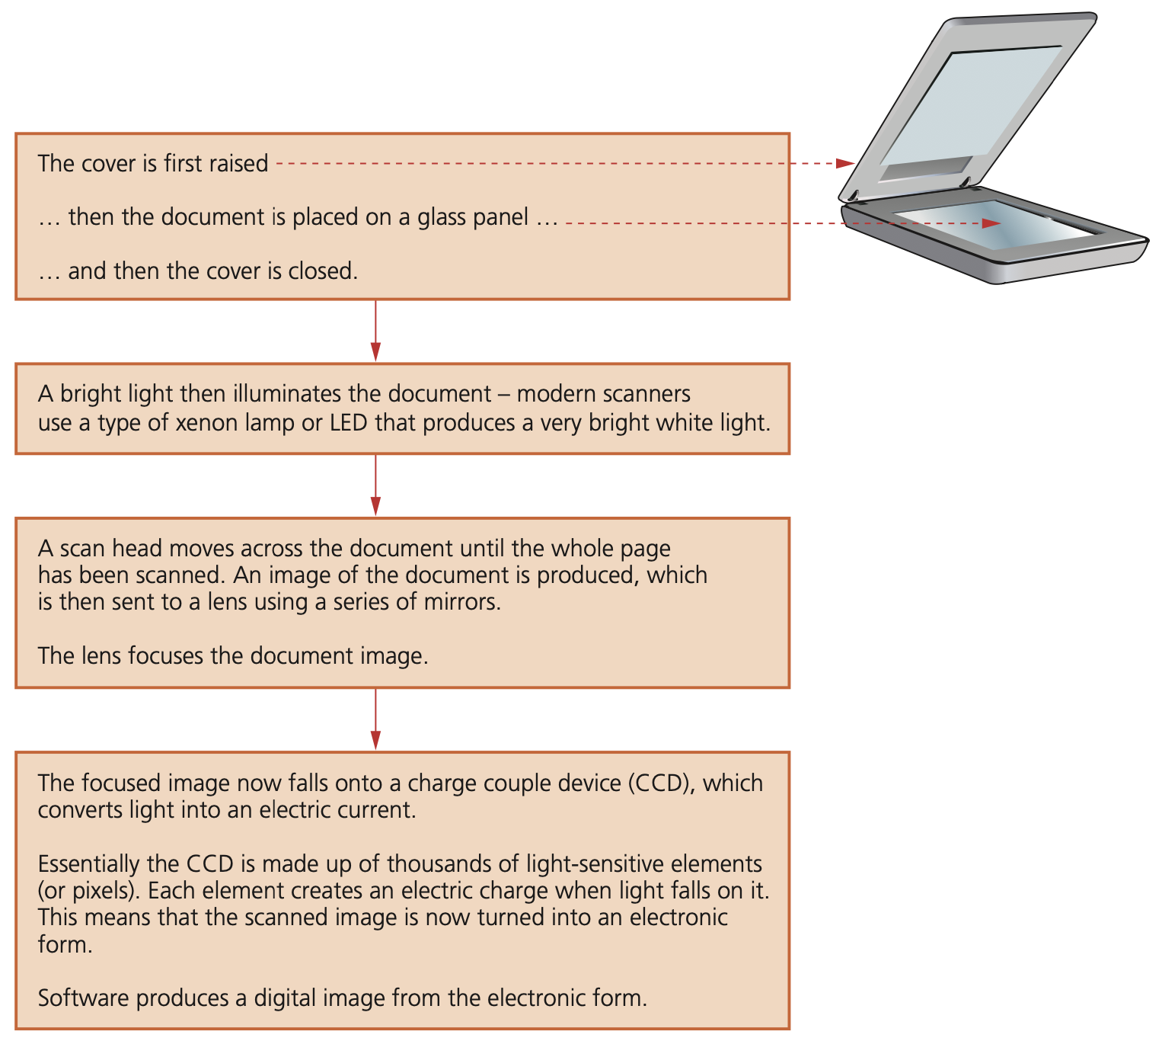
2D AND 3D SCANNERS

Slide 28
TOUCH SCREENS
Touch screens are now a very common form of input device.
There are three common types of touch screen technologies.
Capacitive
Infrared
Resistive (most common method at the moment)

Slide 29
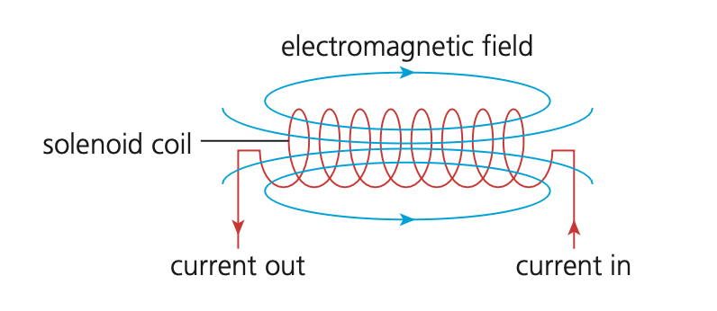
OUTPUT DEVICES - ACTUATORS
An actuator is a mechanical or electromechanical device such as a relay, solenoid or motor.
If a plunger is placed inside the coil, it will move when a current is applied to the coil. This would allow the solenoid to operate a valve or a switch, for example.
There are also examples of rotary solenoids where a cylindrical coil is used. In this case, when a current is supplied to the coil, it would cause a rotational movement of the plunger.

Slide 30
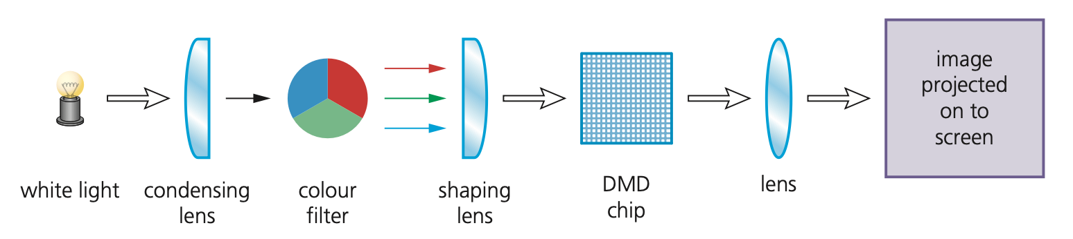
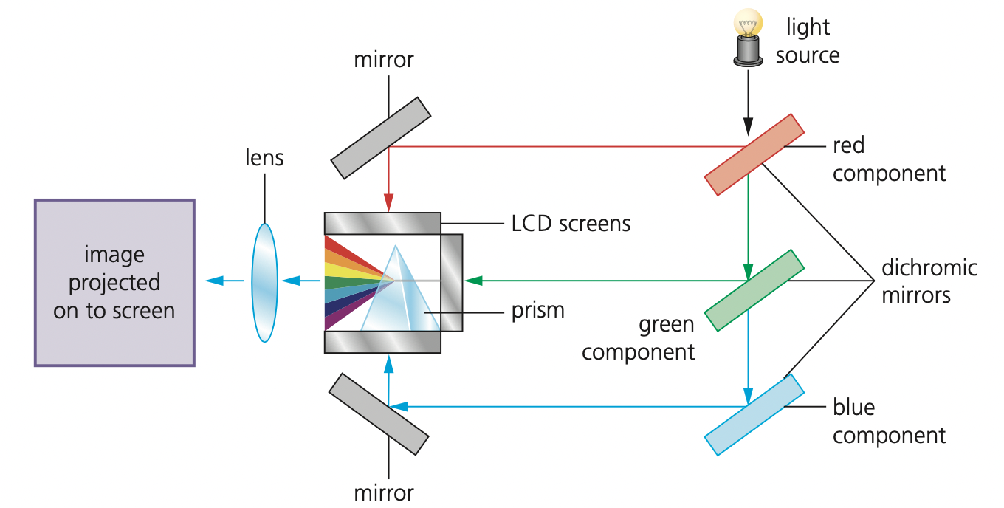
LIGHT PROJECTORS
There are two common types of light projectors:
digital light projector (DLP)
liquid crystal display (LCD) projector.
Projectors are used to project computer output onto larger screens or even onto interactive whiteboards.
They are often used in presentations and in multimedia applications.
Digital Light Projector

Slide 31
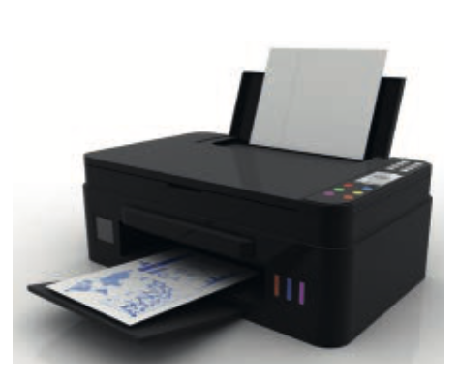
INKJET PRINTERS
Stage in process | Description of what happens
1 | the data from the document is sent to a printer driver
2 | the printer driver ensures that the data is in a format that the chosen printer can understand
3 | a check is made by the printer driver to ensure that the chosen printer is available to print (e.g. is it busy, is it off- line, is it out of ink, and so on)
4 | the data is then sent to the printer and it is stored in a temporary memory known as a printer buffer
5 | a sheet of paper is then fed into the main body of the printer; a sensor detects whether paper is available in the paper feed tray – if it is out of paper (or the paper is jammed) then an error message is sent back to the computer
6 | as the sheet of paper is fed through the printer, the print head moves from side to side across the paper printing the text or image; the four ink colours are sprayed in their exact amounts to produce the desired final colour
7 | at the end of each full pass of the print head, the paper is advanced very slightly to allow the next line to be printed; this continues until the whole page has been printed
8 | if there is more data in the printer buffer, then the whole process from stage 5 is repeated until the buffer is finally empty
9 | once the printer buffer is empty, the printer sends an interrupt to the CPU in the computer; this is a request for more data to be sent to the printer; the whole process continues until the whole of the document has been printed

Slide 32
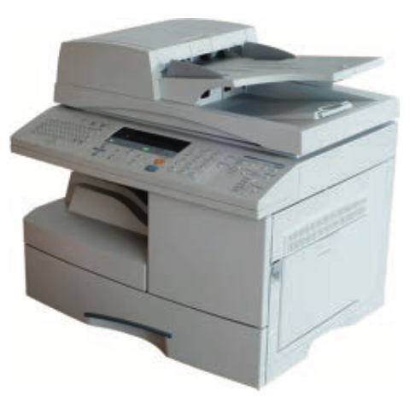
LASER PRINTERS
Stage in process | Description of what happens
1 | the data from the document is sent to a printer driver
2 | the printer driver ensures that the data is in a format that the chosen printer can understand
3 | a check is made by the printer driver to ensure that the chosen printer is available to print (e.g. is it busy, is it off-line, is it out of ink, and so on)
4 | the data is then sent to the printer and it is stored in a temporary memory known as a printer buffer
5 | the start of the printing process involves a printing drum being given a positive charge; as this drum rotates, a laser beam is scanned across it removing the positive charge in certain areas; this leaves negatively charged areas that exactly match the text/images of the page to be printed
6 | the drum is then coated with positively charged toner (powdered ink); since the toner is positively charged, it only sticks to the negatively charged parts of the drum
7 | a negatively charged sheet of paper is then rolled over the drum
8 | the toner on the drum now sticks to the paper to produce an exact copy of the page sent to the printer
9 | to prevent the paper sticking to the drum, the electric charge on the paper is removed after one rotation of the drum
10 | the paper finally goes through a fuser which is a set of heated rollers; the heat melts the ink so that it fixes permanently to the paper
11 | at the very end, a discharge lamp removes all the electric charge from the drum making it ready to print the next page

Slide 33
LED AND LCD SCREENS
LEDs have become increasingly more popular, as the method of back lighting, due to a number of advantages over older CCFL technology:
LEDs reach their maximum brightness almost immediately
LEDs give a whiter light that sharpens the image and makes the colors appear more vivid; CCFL had a slightly yellowish tint
Monitors using LED technology are much thinner
LEDs last indefinitely; this makes the technology more reliable and makes for a more consistent product
LEDs consume very little power which means they produce less heat as well as using less energy.

Slide 34
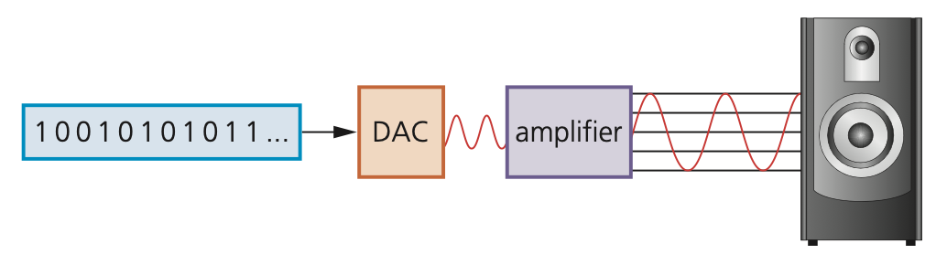
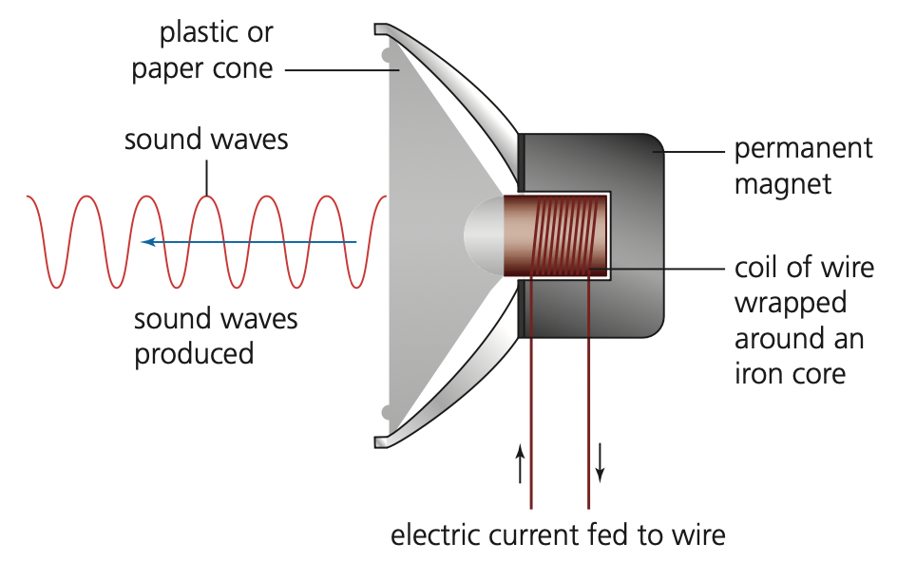
Loudspeakers are output devices that produce sound. When connected to a computer system, digitized sound stored on a file needs to be converted into sound as follows:
The digital data is first passed through a digital to analogue converter (DAC) where it is changed into an electric current.
This is then passed through an amplifier (since the current generated by the DAC will be very small); this creates a current large enough to drive a loudspeaker.
This electric current is then fed to a loudspeaker where it is converted into sound.
The schematic on the left shows how this is done.
(LOUD) SPEAKERS

Slide 35
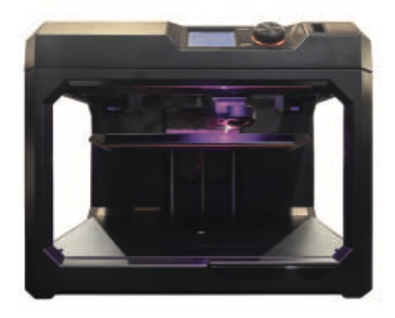
Used to produce solid objects that actually work.
Direct 3D printing uses inkjet technology; a print head can move left to right as in a normal printer. However, the print head can also move up and down to build up the layers of an object.
Binder 3D printing is similar to direct 3D printing. However, this method uses two passes for each of the layers; the first pass sprays dry powder and then on the second pass a binder (a type of glue) is sprayed to form a solid layer.
Newer technologies are using lasers and UV light to harden liquid polymers;
3D PRINTERS

Slide 36
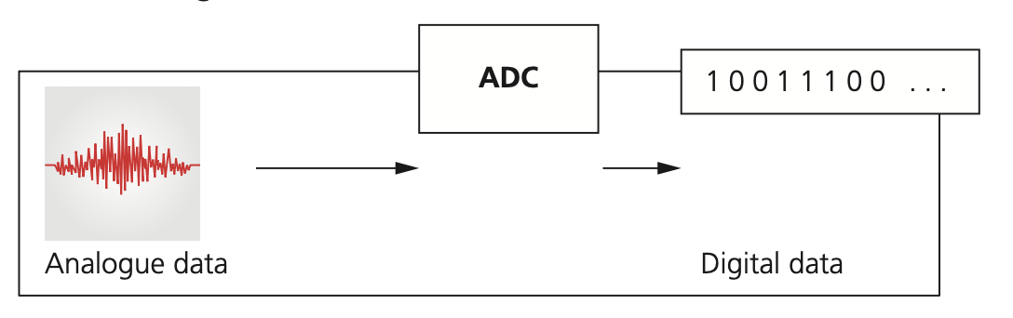
Sensors are input devices which read or measure physical properties from their surroundings. Examples include temperature, pressure, acidity level and length (there are many others).
Analogue to digital converter (ADC) converts physical values into discrete digital values.
SENSORS

Slide 37
ASSESSMENT
Quiz 1 (Computer architecture) -https://forms.gle/Ati128ot8WFYrvAh8

