Slide 1

HARDWARE

Slide 2
NETWORK HARDWARE
Network Systems
NIC
MAC Address
IP Address
Routers

Slide 3
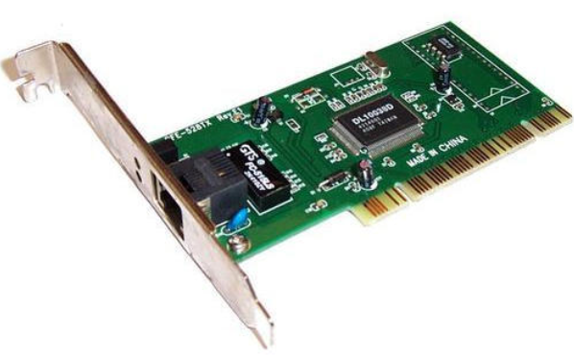
NETWORK INTERFACE CARD
A network interface card (NIC) is needed to allow a device to connect to a network (such as the internet).
It is usually part of the device hardware and contains the Media Access Control (MAC) address generated at the manufacturing stage.
Wireless network interface cards/controllers (WNICs) are the same as NICs but they use wireless connectivity utilizing an antenna to communicate with networks via microwaves.

Slide 4
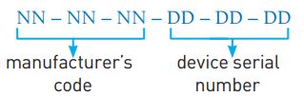
MEDIA ACCESS CONTROL (MAC)
A MAC address is made up of 48 bits which are shown as six groups of hexadecimal digits with the general format:
If the NIC card is replaced, the MAC address will also change.
There are two types of MAC address: the Universally Administered MAC Address (UAA) and the Locally Administered MAC Address (LAA).
The UAA is by far the most common type of MAC address and this is the one set by the manufacturer at the factory.

Slide 5
MEDIA ACCESS CONTROL (MAC) (CONTD.)
There are some occasions when a user or organization wishes to change their MAC address such as:
Certain software used on mainframe systems need all the MAC addresses of devices to fall into a strict format
It may be necessary to bypass a MAC address filter on a router or a firewall
To get past certain types of network restrictions it may be necessary to emulate unrestricted MAC addresses;

Slide 6
INTERNET PROTOCOL (IP) ADDRESS
When a device connects to a private network, a router assigns a private IP address to it.
That IP address is unique on that network, but might be the same as an IP address on a separate network.
When a router connects to the internet it is given a unique public IP address. This is usually supplied by the internet service provider (ISP). No other device on the internet has the same public IP address.
Because the operation of the internet is based on a set of protocols (rules), it is necessary to supply an IP address.
Protocols define the rules that must be agreed by senders and receivers of data communicating through the internet.

Slide 7
INTERNET PROTOCOL (IP) ADDRESS (CONTD)
There are two versions of IP: IPv4 and IPv6. IPv4 is based on 32 bits and the address is written as four groups of eight bits (shown in denary format); for example, 254.25.28.77.
The use of only 32 bits considerably reduces the potential number of devices and routers used on the internet at any one time.
IPv6 uses 128-bit addresses that take the form of eight groups of hex digits; for example, A8FB:7A88:FFF0:0FFF:3D21:2085:66FB:F0FA.
The main advantages of IPv6 over IPv4 are:
removes the risk of IP address collisions
has built-in authentication checks
allows for more efficient packet routes.

Slide 8
DIFFERENCES BETWEEN MAC AND IP ADDRESSES
MAC addresses | IP addresses
identifies the physical address of a device on the network | identifies the global address on the internet
unique for device on the network | may not necessarily be unique
assigned by the manufacturer of the device and is part of the NIC | dynamic IP addresses are assigned by ISP using DHCP each time the device connects to the internet
they can be universal or local | dynamic IP addresses change every time a device connects to the internet; static IP addresses don’t change
when a packet of data is sent and received, the MAC address is used to identify the sender’s and recipient’s devices | used in routing operations as they specifically identify where the device is connected to the internet
use 48 bits | use either 32 bits (IPv4) or 128 bits (IPv6)
can be UAA or LAA | can be static or dynamic

Slide 9
STATIC AND DYNAMIC IP ADDRESSES
Static IP addresses are permanently assigned to a device by the internet service provider (ISP); they don’t change each time a device logs onto the internet.
Static IP addresses are usually assigned to remote servers which are hosting a website, an online database or a File Transfer Protocol (FTP) server.
Dynamic IP addresses are assigned by the ISP each time a device logs onto the internet. This is done using Dynamic Host Configuration Protocol (DHCP).
A computer on the internet, configured as a DHCP server, is used by the ISP to automatically assign an IP address to a device.

Slide 10
DIFFERENCES BETWEEN STATIC AND DYNAMIC IP ADDRESSES
Dynamic IP addresses | Static IP addresses
greater privacy since they change each time a user logs on | since static IP addresses don’t change, they allow each device to be fully traceable
dynamic IP addresses can be an issue when using, for example, VoIP since this type of addressing is less reliable as it can disconnect and change the IP address causing the VoIP connection to fail | allow for faster upload and download speeds
 | more expensive to maintain since the device must be constantly running so that information is always available

Slide 11
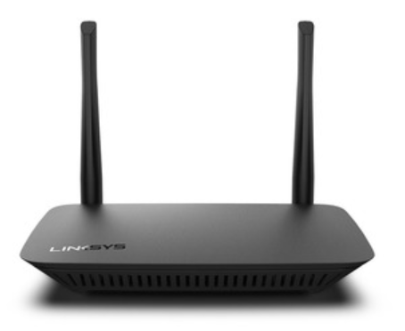
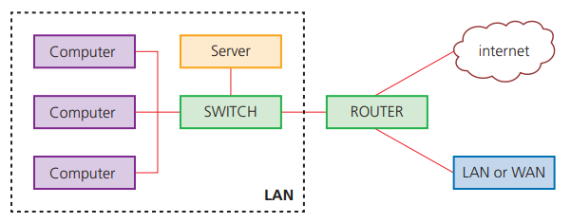
ROUTERS
Routers enable data packets to be routed between different networks, for example, to join a LAN to a WAN.
The router takes data transmitted in one format from a network (which is using a particular protocol) and converts the data to a protocol and format understood by another network, thereby allowing them to communicate.
A router would typically have an internet cable plugged into it and several cables connecting to computers and other devices on the LAN.

Slide 12
ROUTERS (CONTD.)
Broadband routers sit behind a firewall. The firewall protects the computers on a network.
The router’s main function is to transmit internet and transmission protocols between two networks and also allow private networks to be connected together.
Routers inspect the data package sent to it from any computer on any of the networks connected to it.
Since every computer on the same network has the same part of an internet protocol (IP) address, the router is able to send the data packet to the appropriate switch, and the data will then be delivered to the correct device using the MAC destination address.
If the MAC address doesn’t match any device connected to the switch, it passes on to another switch on the same network until the appropriate device is found.
Routers can be wired or wireless devices.

Slide 13
ASSESSMENT
Quiz 4 (Network hardware) - https://forms.gle/iysjZjbbd9Cn5g3Z7

