Slide 1

Internet
Internet is the worldwide collection of networks that use the Internet Protocol Suite(TCP/IP)
WWW
Is the collection of web pages hosted on the web servers.
You access the WWW using the HTTP Protocol
Internet - is the Hardware
Web is the resources on the Internet
URL
In order to access a certain resource on the internet, you need its URL - UNiform Resource Locator.
First comes the protocol, followed by the domain name and then the path to the resource that is to be accessed

Slide 2
HTTP and HTTPS
The first part of the url is either http/ https: Hyper Text Transfer Protocol is a set of rules that have to be obeyed when transferring files across the internet. When the same is done securely using SSL or TLS, it converts to https.

Slide 3
Web Browser
Browsers are softwares that help us to access the web pages and see them on the device screen. They take the HTML from the web pages and renders them on the device screen

Slide 4
HTML
IP Address
DNS
HTML (HyperText Markup Language) is a language used to display content on browsers. All websites are written in HTML and hosted on a web server that has its own IP address. To retrieve pages from a website your browser needs to know this IP address.
It identifies the unique address of any device on the internet and defines where it is located geographically
The Domain Name Server (DNS) (also known as domain name system) is a system for finding IP addresses for a domain name given in a URL. URLs and domain name servers eliminate the need for a user to memorise IP addresses. The DNS process involves converting a URL (such as www.hoddereducation.co.uk) into an IP address the computer can understand (such as 107.162.140.19). The DNS process involves more than one server.

Slide 5

DNS
To load a website, you need to enter the IP address of the web server.
Eg :
However you dont do that , as it is difficult to remember numbers. Activity - open cmd and type ipconfig/ ifconfig on Unix
A domain name is much better.
The Domain Name System translates between the two
The system contains of many DNSs(Domain Name Servers) which contains a database of various IP addresses and the corresponding Domain names

Slide 6
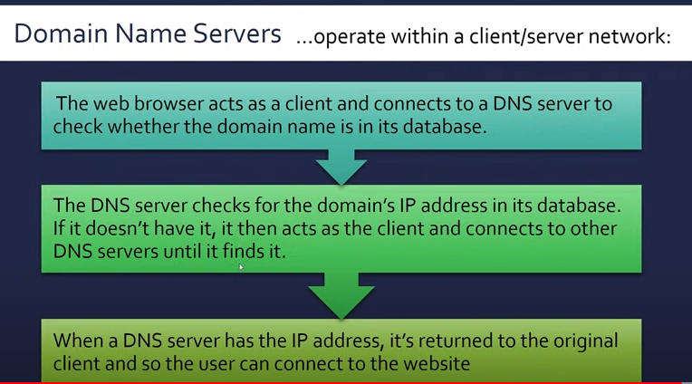

Slide 7
Cookies
Cookies are small files or code stored on a user’s computer. They are sent by a web server to a browser on a user’s computer. Each cookie is effectively a small look-up table containing pairs of (key, data) values. Cookies track data about users, such as IP addresses and browsing activity
Every time a user visits a website, it checks if it has set cookies on their browser before. If so, the browser reads the cookie which holds key information on the user’s preferences such as language, currency and previous browsing activity.

Slide 8
Types of cookies
There are two types of cookie:
» session cookie
» persistent (or permanent) cookie.
If a cookie doesn’t have an expiry date associated with it, it is always considered to be a session cookie.
Session Cookie
Session cookies are used, for example, when making online purchases. They keep a user’s items in a virtual shopping basket. This type of cookie is stored in temporary memory on the computer, doesn’t actually collect any information from the user’s computer and doesn’t personally identify a user. Hence, session cookies cease to exist on a user’s.

Slide 9
Persistent (permanent) cookies
Persistent cookies remember a user’s log in details (so that they can authenticate the user’s browser). They are stored on the hard drive of a user’s computer until the expiry date is reached or the user deletes it. These cookies remain in operation on the user’s computer even after the browser is closed or the website session is terminated.

Slide 10
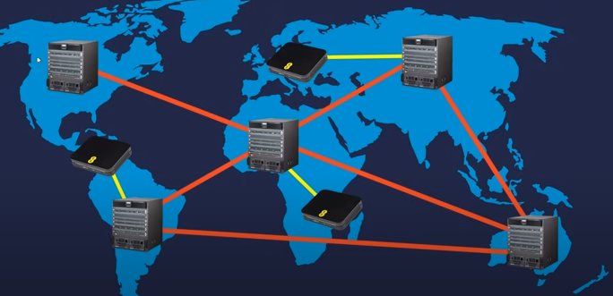
Data flows through the internet using routers . The unit of information that gets transferred is called a packet and this method of data transmission is called Switching
The router uses the IP address of the packet to identify where to send the packet and routing algorithms to determine the best router to get there.

