Slide 1

360° Patient Care & Assistance
Management System — Customer Solution Presentation
One coordinator. One Case. One journey — from first call to follow-up.
Coordinate
Track
Bill & settle
Real-time
people, vehicles, hospitals & care
every event on one Case ID
quotes, payments, payouts
live map, live sync, mobile apps
Customer Demonstration Deck · Mapped to the 84-Point Product Blueprint · Developed by pvalr

Slide 2
What this presentation covers
AGENDA
1
Executive Summary
2
Business Challenges
3
Solution Overview
4
End-to-End Workflow
5
Core Business Diagrams
6
Feature Walkthrough
7
System Architecture
8
Business Benefits & KPIs
9
Conclusion
360° Patient Care & Assistance · Developed by pvalr

Slide 3
Executive Summary
OVERVIEW
A single coordination platform for the entire non-clinical patient journey — before, during and after hospital treatment.
Patient Care Coordination
Patient Transportation
Healthcare Coordination
The whole non-clinical journey, managed in one place.
Move patients safely, with verified custody.
Hospitals, doctors & records around the Case.
Registration & consent
Pickup & drop scheduling
Hospital & doctor directory
Service requests & triage
Ambulance dispatch (PTV / BLS / ALS)
Appointment booking
Case management
OTP-verified handover
Medicines & vitals record
Care services & follow-up
Live GPS tracking
Consent-gated clinical data
✓ One Case ID ties it all together
✓ Every handover is OTP-verified
✓ Medical data stays protected
360° Patient Care & Assistance · Developed by pvalr

Slide 4
Business Challenges — why this platform
THE PROBLEM
✗ Fragmented systems
The 360° answer
Patients, transport, hospitals & billing live in separate tools — no single view.
✓ One Case ID links every event, party and payment
✗ No traceability
Events are not linked; hard to answer 'what happened on this case?'
✓ Case-oriented, not module-oriented — one journey
✗ Manual coordination
✓ Command Centre dispatches with controlled assignment
Phone calls & spreadsheets to dispatch agents, book beds, chase payments.
✓ Live map + live feed = real-time operational picture
✗ Blind operations
No live picture of agents, ambulances, emergencies or SLA breaches.
✓ Patient & Agent apps keep everyone in sync, consent-gated
✗ Patient anxiety
Families travelling alone have no visibility into who is helping and when.
360° Patient Care & Assistance · Developed by pvalr

Slide 5
Solution Overview — the Case ID hub
SOLUTION
Every operational, clinical, communication & financial event connects to one Patient Case ID.
Patient
Notifications
Service Request
PATIENT
CASE ID
CASE-2026-000145
Care Services
Quote & Pay
Hospital / Doctor
Dispatch
Ambulance
360° Patient Care & Assistance · Developed by pvalr

Slide 6
01
End-to-End Workflow
How the whole journey connects under one Case ID
360° Patient Care & Assistance · Developed by pvalr

Slide 7
End-to-End Business Flow — the patient journey
WORKFLOW
From first request to case closure — one continuous, auditable journey
1. Register
create patient profile & consent
2. Service Request
patient states the help needed
3. Triage
prioritize & assess urgency
4. Quote
price the requested services
5. Consent & Pay
approve & pay the advance
6. Case Created
one Case ID for the journey
7. Dispatch
assign the right agent / ambulance
8. Pickup + OTP
verify the patient pickup
9. Hospital + Handover
safe transfer, OTP confirmed
10. Appointment
book doctor / consultation
11. Treatment
clinical care is delivered
12. Medicines & Care
record meds, vitals & caretaker
13. Final Billing
settle the full charges
14. Discharge
patient is released
15. Follow-up & Close
check-in, then close the case
Everything below the line is automatic:
• Every step writes a Case timeline event with who/when audit
• Emergencies auto-escalate to the emergency path
• Payments trigger notifications (WhatsApp/SMS)
• Portal & apps update live in both directions
360° Patient Care & Assistance · Developed by pvalr

Slide 8
User Role Flow — who does what
ROLE-BASED
Role-based access; each actor sees only their part of the journey
Patient / Guardian
Book service
Track case
Pay balance
Get updates
Command Centre (Admin)
Review & triage
Create case
Quote
Dispatch
Close case
Care Agent (field)
Accept job
En route + GPS
Pickup OTP
Handover OTP
EMT / Ambulance
Readiness check
Dispatch
Transport
Hospital arrival
Doctor / Hospital
Appointment
Consultation
Prescription
Follow-up
Finance
Payments
Settlements
Reconciliation
360° Patient Care & Assistance · Developed by pvalr

Slide 9
Request-to-Service-Delivery Flow
WORKFLOW
From a booking to delivered, verified services
1
Patient books
services
2
Command Centre
reviews & triages
3
Package & Quote
prepared
4
Patient accepts
& pays advance
5
Resources
assigned
6
Agent/Ambulance
delivers (OTP)
7
Care & clinical
services delivered
8
Final billing
& closure
Verified delivery: pickup & hospital handover are confirmed by OTP; every service is logged on the Case with cost and status.
360° Patient Care & Assistance · Developed by pvalr

Slide 10
Case & Request Life Cycle
WORKFLOW
Controlled state machine with exception paths
New
Under Review
Triage
Quote Sent
Accepted
Payment
Confirmed
In Progress
Completed
Closed
Exception transitions (available from active states):
Cancelled
Rejected
Expired
On Hold
Emergency Escalated
Business rules enforced
• Illegal transitions are rejected by the state machine (e.g. cannot skip backwards).
• On Hold & Emergency Escalated are recoverable — an operator can resume the journey.
• Every transition is written to the Case timeline with the acting user and timestamp.
• Emergency at any point triggers the configurable escalation path (never a substitute for 112).
360° Patient Care & Assistance · Developed by pvalr

Slide 11
02
Core Business Diagrams
The models and flows that run the platform
360° Patient Care & Assistance · Developed by pvalr

Slide 12
Master Data Relationship Diagram
DATA MODEL
Every entity connects to exactly one Case
PEOPLE
Patient · Guardian · Consent
GOVERNANCE
Notification · Complaint
Timeline / Audit
REQUEST & FINANCE
Service Request · Quote
Payment · Settlement
CASE
single source
of truth
CARE
Caretaker · Accommodation
Food / Transport
TRANSPORT
Agent · Ambulance · Driver/EMT
CLINICAL
Hospital · Doctor
Appointment · Medicine
360° Patient Care & Assistance · Developed by pvalr

Slide 13
Approval Workflows
GOVERNANCE
Quote acceptance · Settlement payout · Complaint SLA
Quote / Payment
Draft
Sent
Accepted
Paid
Settlement Payout
Earnings
Pending
Approved
Paid
Complaint SLA
Open
Assigned
Investigating
Resolved
Closed
Controls & SLA
• Configurable SLA per priority sets response & resolution due-dates; breaches are flagged.
• Settlements bundle unsettled earnings; payout requires approval then payment reference.
• Every approval/step is audit-logged; complaints retain full communication history.
360° Patient Care & Assistance · Developed by pvalr

Slide 14
Patient Onboarding Flow
CUSTOMER JOURNEY
Guided registration wizard — validated, consent-first
1
Account
2
Personal
3
Contact
4
Medical
5
Documents
6
Guardian & Consent
7
Review & Submit
Captured
Medical (as provided)
Consent-first
Validated
Demographics, contact, emergency contact, language, identity/insurance
Problem, chronic conditions, allergies, blood group, medicines
Who can access what, for what purpose, from when to when — revocable
Required fields & formats checked at each step; progress shown
Business benefit: faster, error-free onboarding with built-in consent & audit — the patient's medical data is protected from day one and never exposed to operational roles by default.
360° Patient Care & Assistance · Developed by pvalr

Slide 15
Real-Time Sync Process Flow
REAL-TIME
Two-way live sync between apps and the Command Centre
Mobile Apps
(Patient / Agent)
action / GPS
Backend
Event Hub
SSE push (live)
Command Centre
Portal
auto-poll sync
dispatch / quote
App → Portal (instant)
Portal → App (auto-sync)
• Patient books a service → appears in Requests live
• Job dispatched → shows in Agent app automatically
• Agent goes Available → marker moves on the live map
• Quote sent → Patient app shows payable balance
• Agent accepts / OTP → case timeline & dispatch update
• Status changes → Patient 'My Care' updates live
• Patient pays → Finance panel & dashboard update
• No manual refresh anywhere
360° Patient Care & Assistance · Developed by pvalr

Slide 16
System Integration Diagram
INTEGRATION
Open, governed APIs — connect the surrounding ecosystem as needed
ABDM / ABHA
Insurance / TPA
Payment Gateway
360° API
Layer
Government / 112
WhatsApp / SMS / Email
Accounting / Tally / ERP
Hospital HIS / Beds
Maps & GPS / ETA
Integrations are optional & consent-based; the platform is architected so each can be added safely without re-work.
360° Patient Care & Assistance · Developed by pvalr

Slide 17
Reporting & Dashboard Flow
INSIGHTS
From live events to operational intelligence
Events
(all modules)
Case Timeline
& Audit Log
Aggregation
& KPIs
Live Dashboard
& Ops Map
SLA / Finance
Reports
Command Centre KPI snapshot
24
2
5
2/3
96%
₹1.4L
Open Cases
Emergencies
Avail. Agents
Ambulances Ready
SLA On-time
Revenue Coordinated
Cases by stage
Coverage of 84-point blueprint
82 / 84 delivered
· ABDM & live AI on roadmap
Open
In progress
On hold
Closed
360° Patient Care & Assistance · Developed by pvalr

Slide 18
03
Feature Walkthrough
Every feature — objective, flow, screen, rules, benefits
360° Patient Care & Assistance · Developed by pvalr

Slide 19
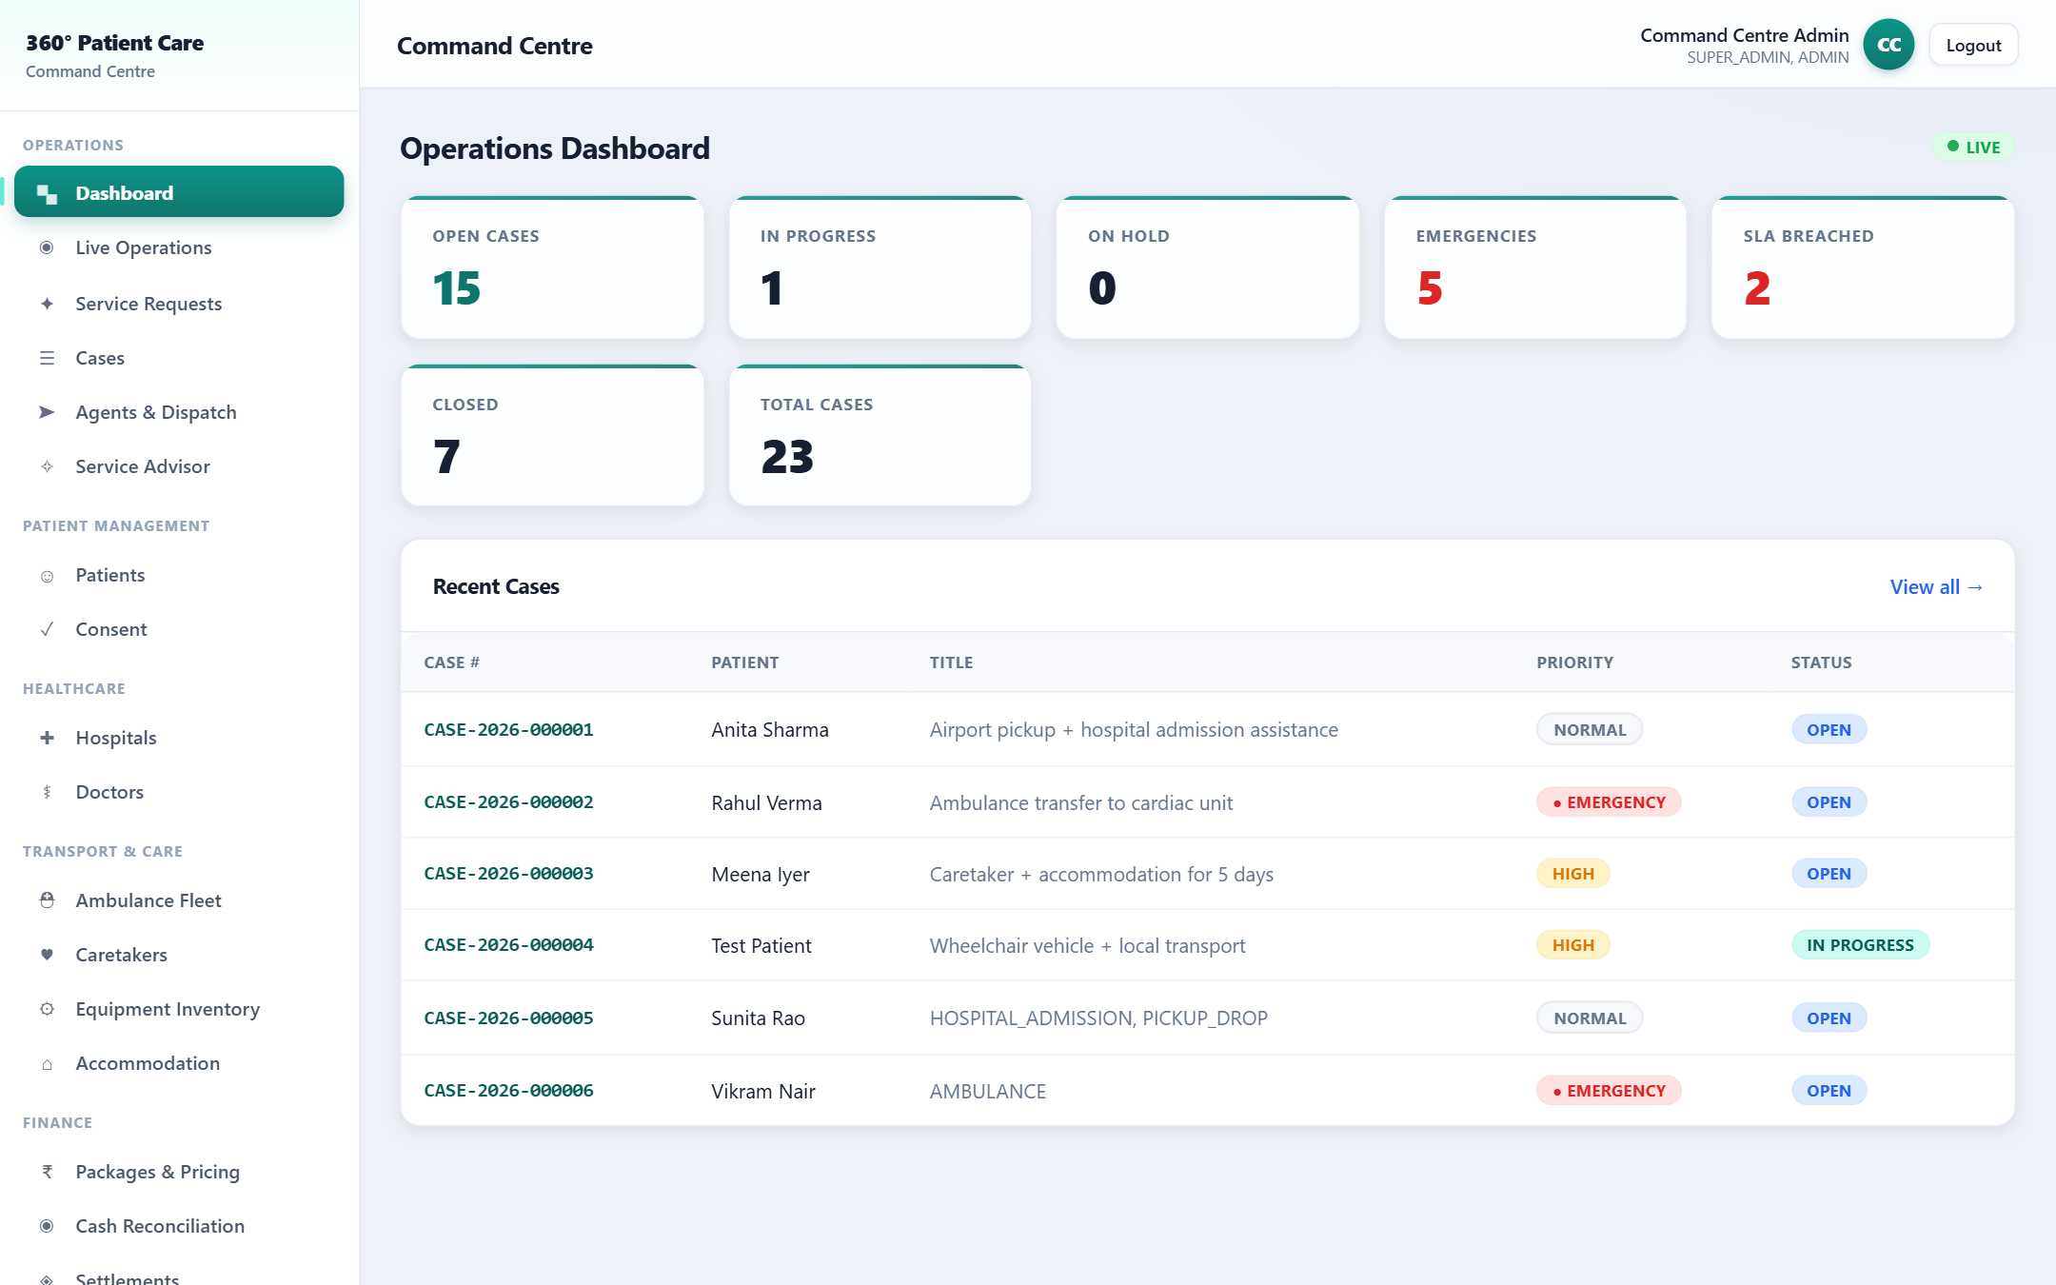
Operations Dashboard
PORTAL
Blueprint
6
Process Flow
1. Sign in
2. Dashboard
3. Live tiles
4. Drill into case
Business Objective
Give the Command Centre a live, operational picture — not just a menu.
Validation Rules
Role-based; only permitted data shown. Counts computed server-side.
Business Benefits
Faster decisions; emergencies & delays surfaced instantly.
Key Highlights
Auto-refreshes live; one click into any case.
360° Patient Care & Assistance · Developed by pvalr

Slide 20
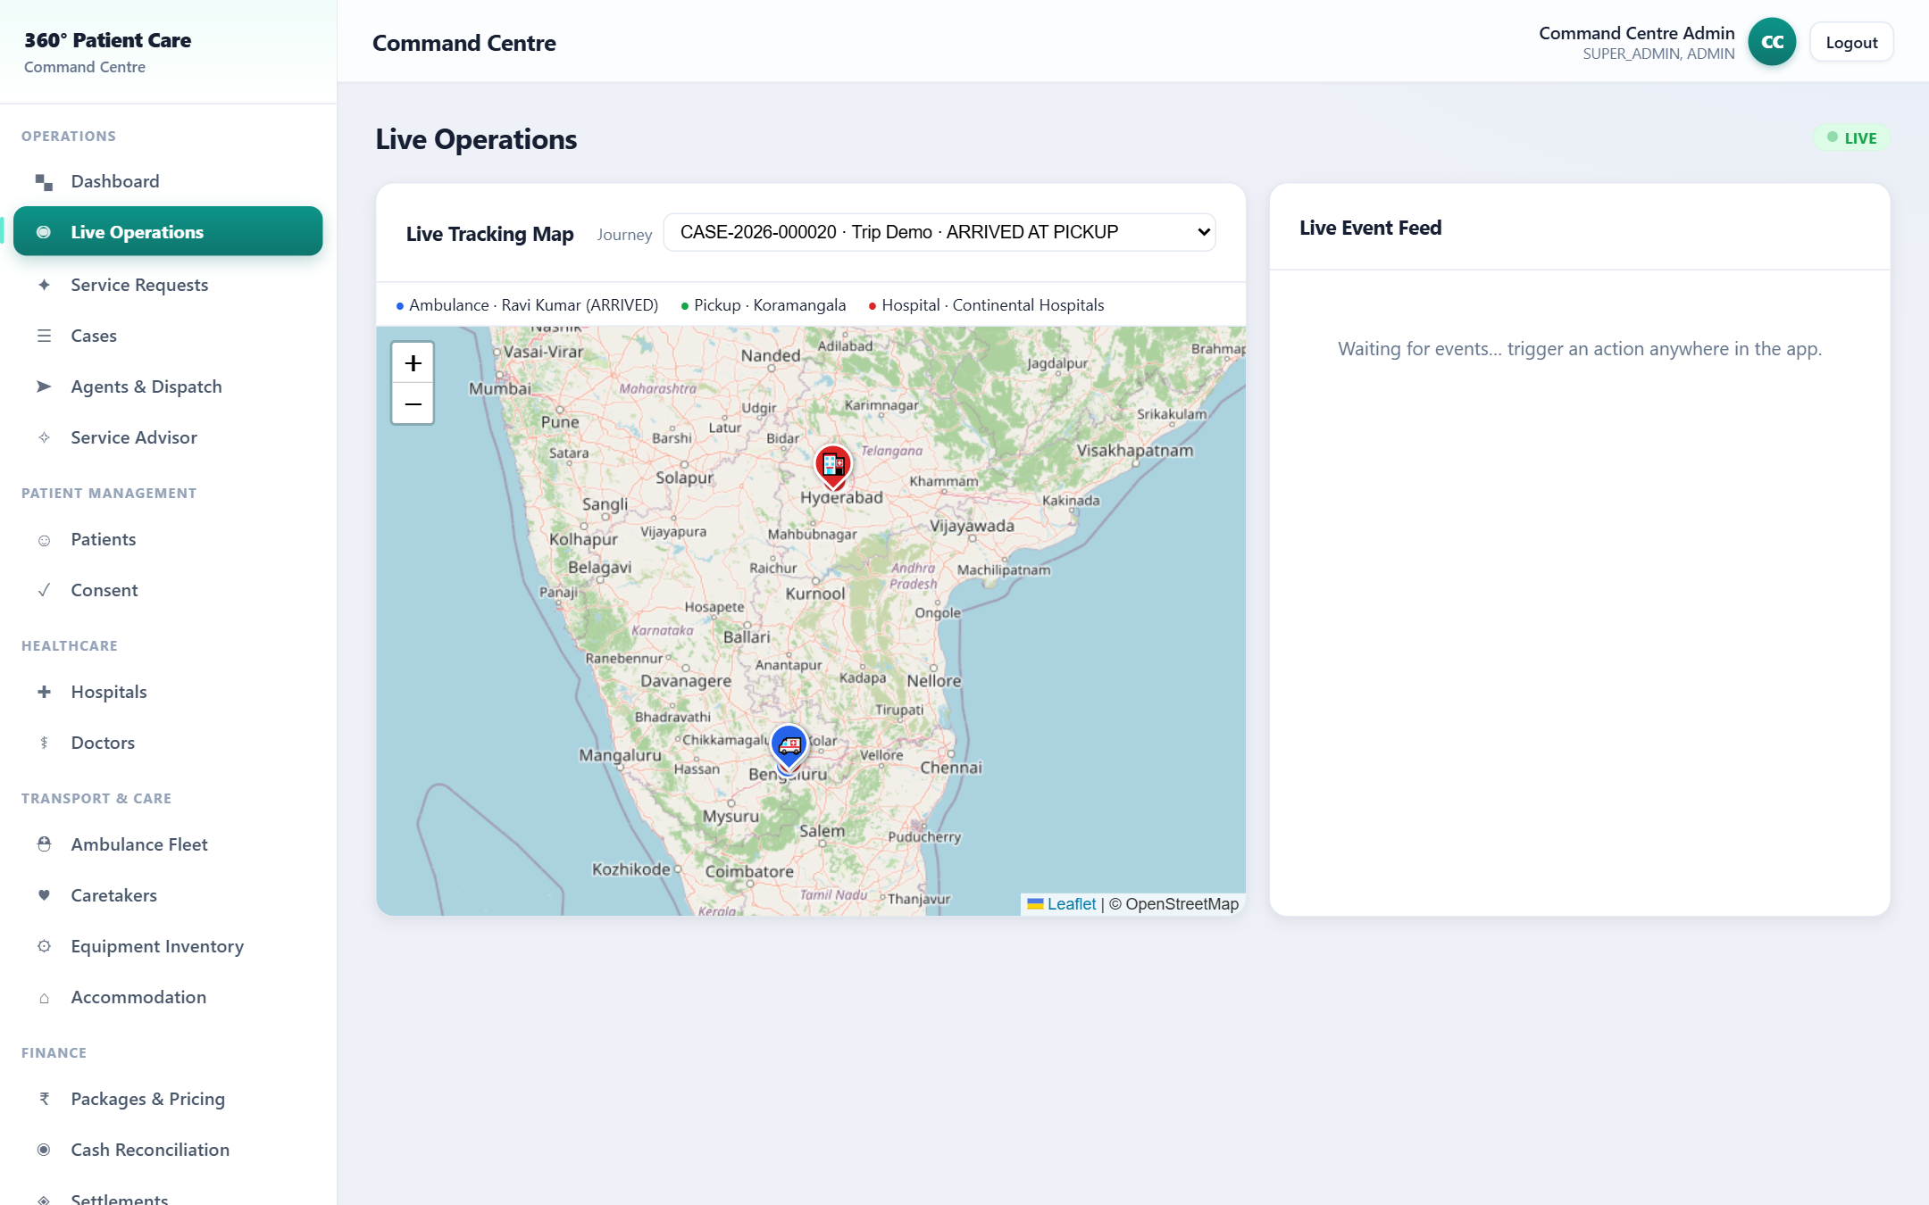
Live Operations — Map & Feed
PORTAL
Blueprint
6
30
63
Process Flow
1. Subscribe (SSE)
2. GPS in
3. Map updates
4. Feed streams
Business Objective
See agents, ambulances and events moving in real time.
Validation Rules
Only authorised staff; emergencies flagged red.
Business Benefits
Ride-hailing-style visibility; proactive control.
Key Highlights
Live map (OpenStreetMap) + streaming event feed.
360° Patient Care & Assistance · Developed by pvalr

Slide 21
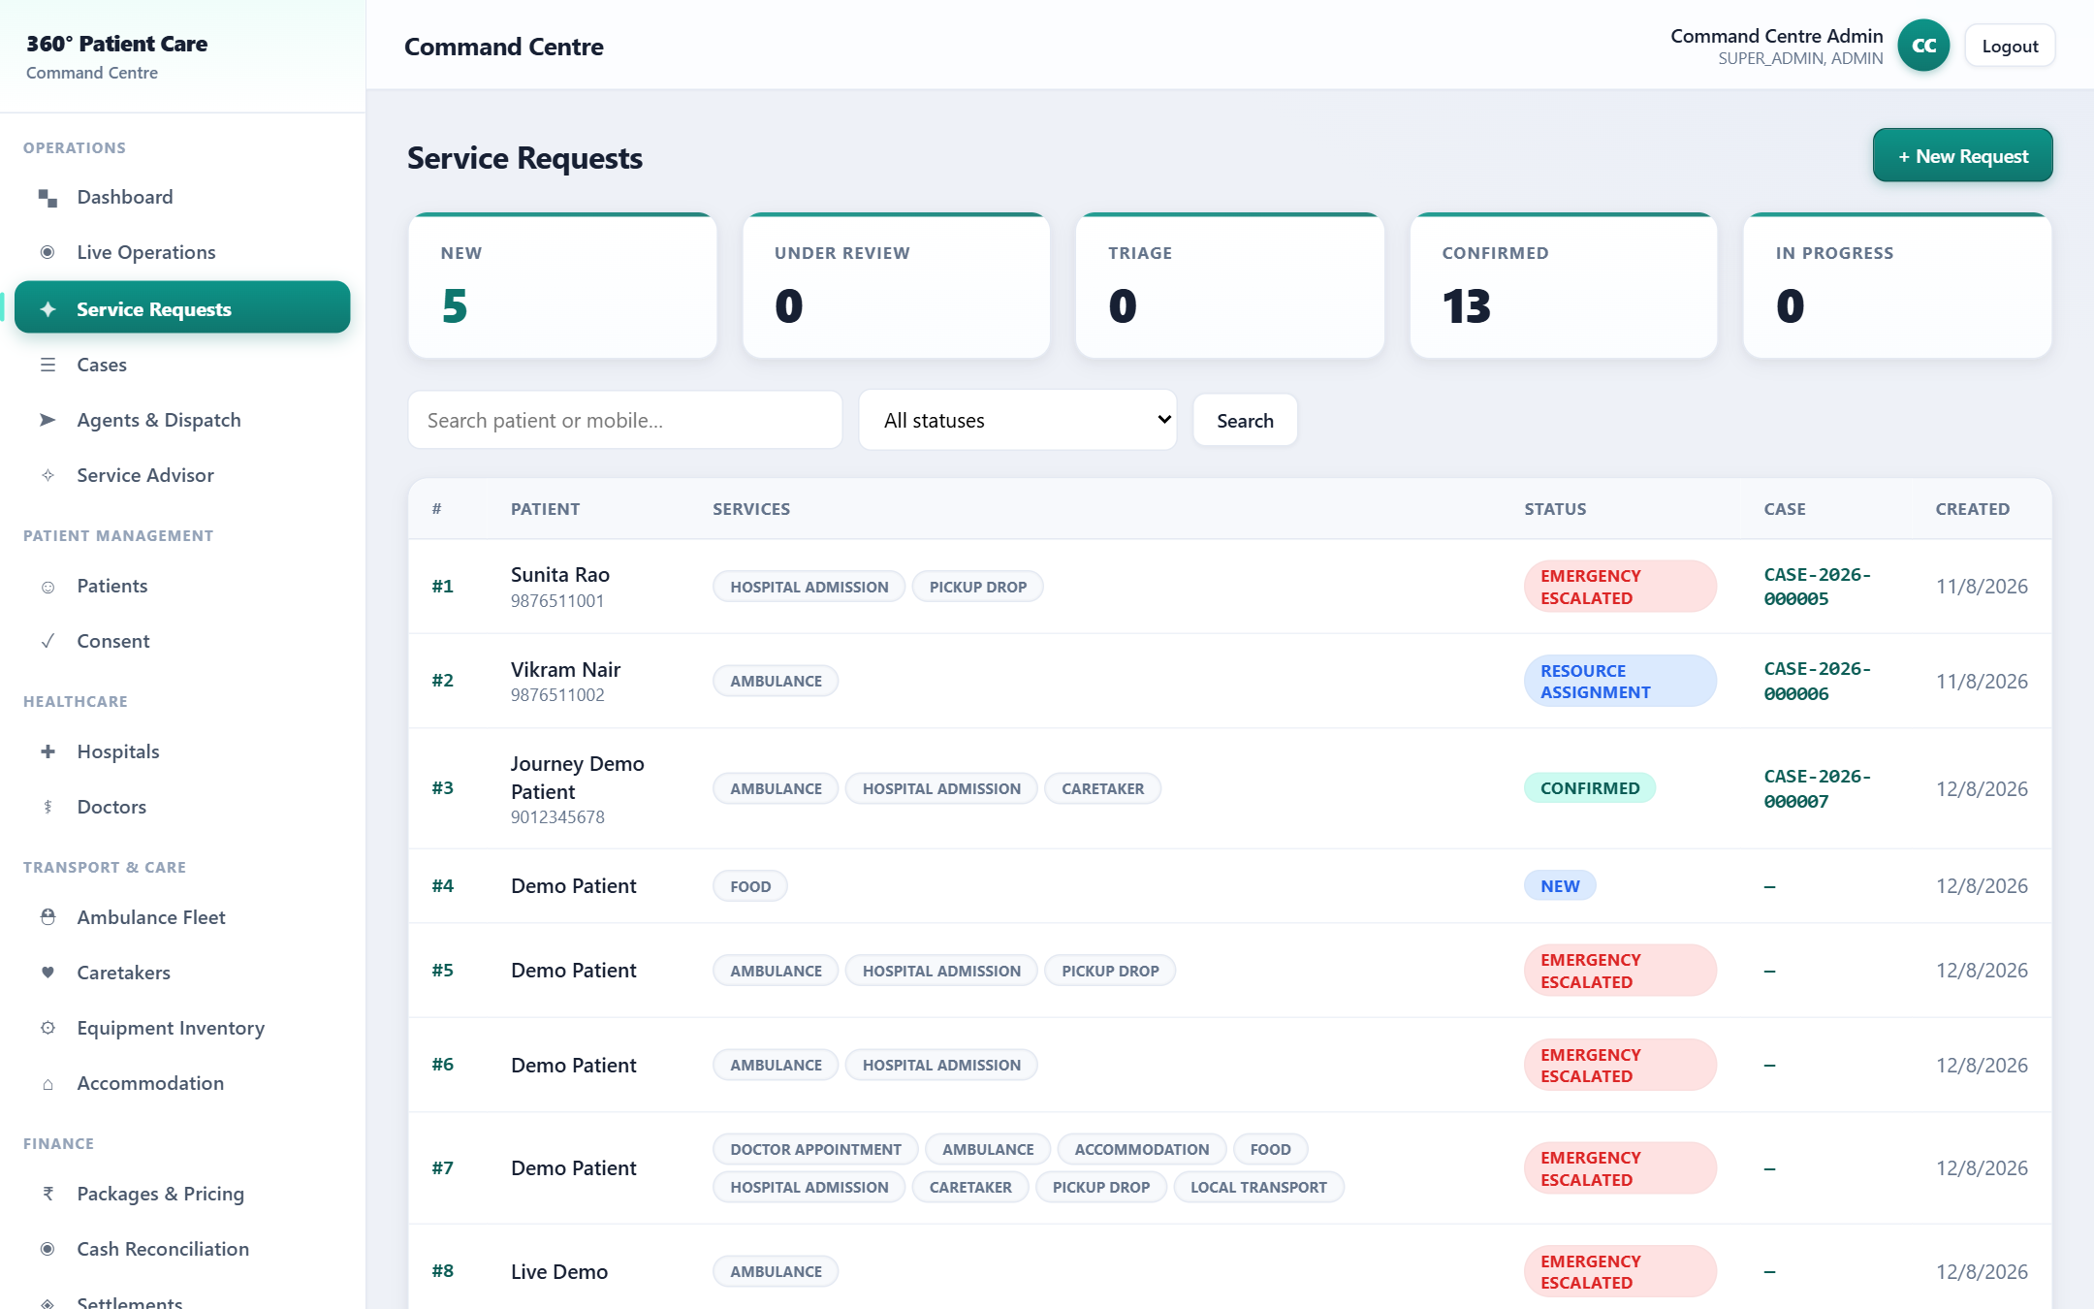
Service Requests
PORTAL
Blueprint
7
8
9
10
13
Process Flow
1. Book
2. Review
3. Triage
4. Convert to Case
Business Objective
Turn a patient's request into a controlled, trackable case.
Validation Rules
Illegal lifecycle transitions blocked; emergency must be assessed.
Business Benefits
No lost requests; clear ownership & SLA from minute one.
Key Highlights
Multi-service, pickup & destination capture; live intake.
⚕ Emergency flag directs to 112 — never a substitute for emergency medical care.
360° Patient Care & Assistance · Developed by pvalr

Slide 22
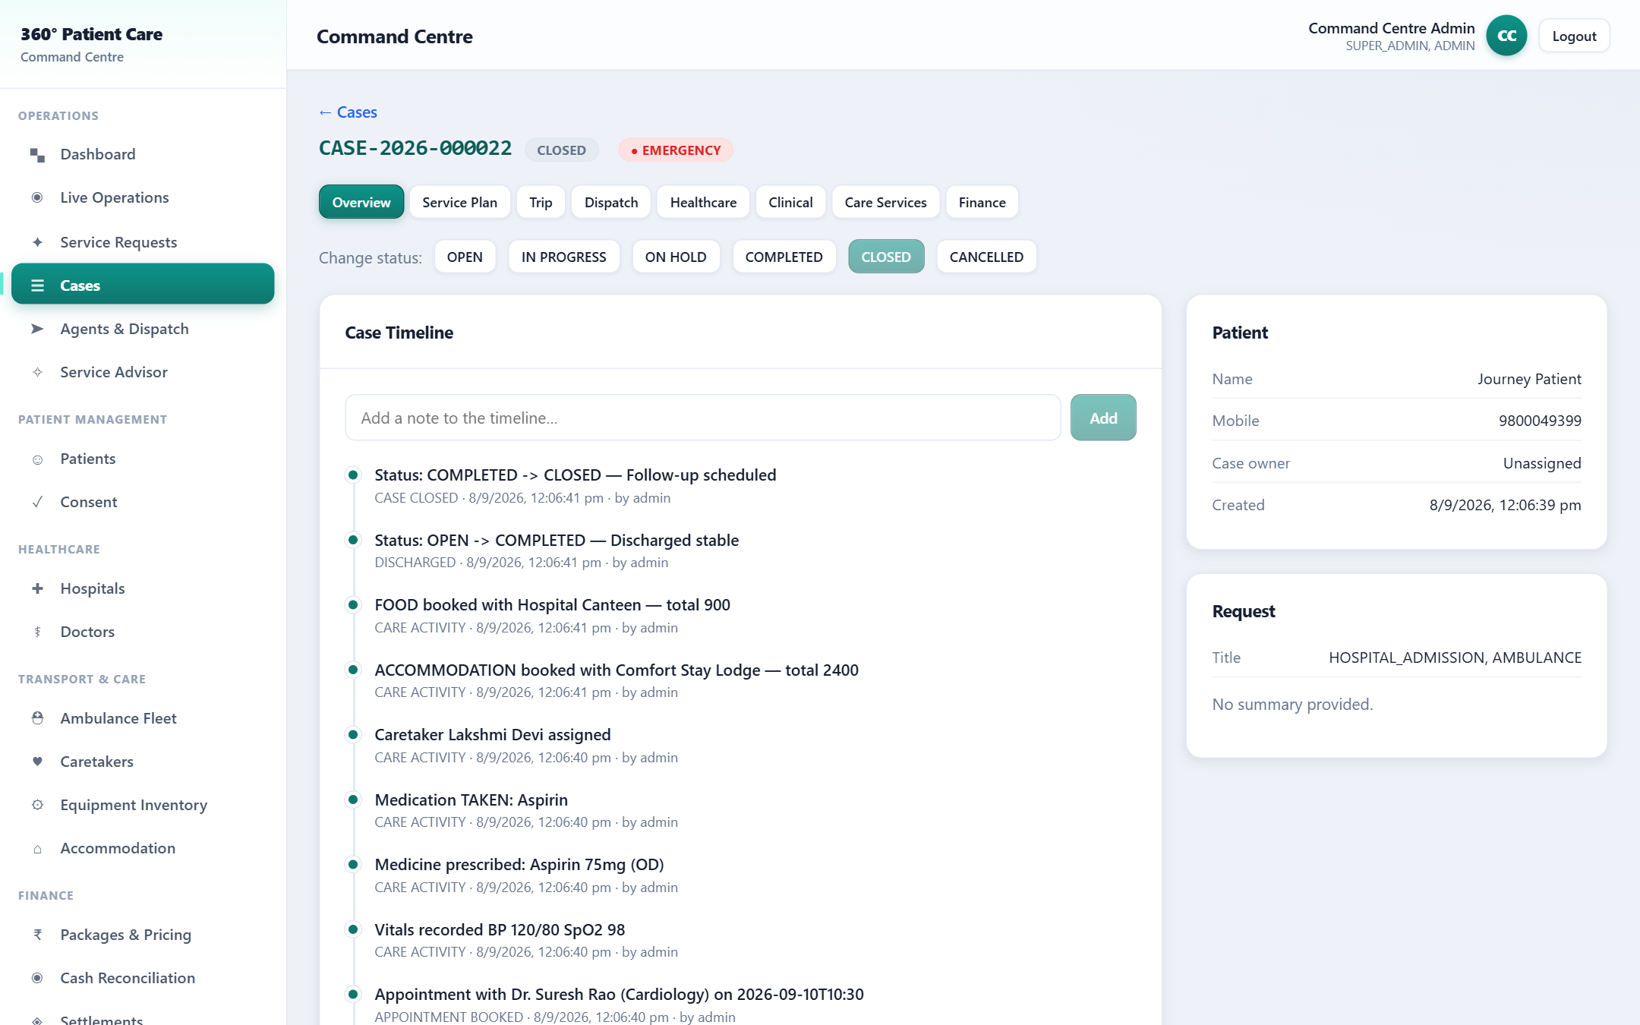
Case 360° Workspace
PORTAL
Blueprint
50
49
67
Process Flow
1. Open case
2. Tabs
3. Service Plan
4. Timeline
Business Objective
One workspace for the entire patient journey.
Validation Rules
Consent-gated medical data; full audit on every action.
Business Benefits
Everyone works from one source of truth per Case.
Key Highlights
Overview · Plan · Dispatch · Healthcare · Clinical · Care · Finance.
360° Patient Care & Assistance · Developed by pvalr

Slide 23
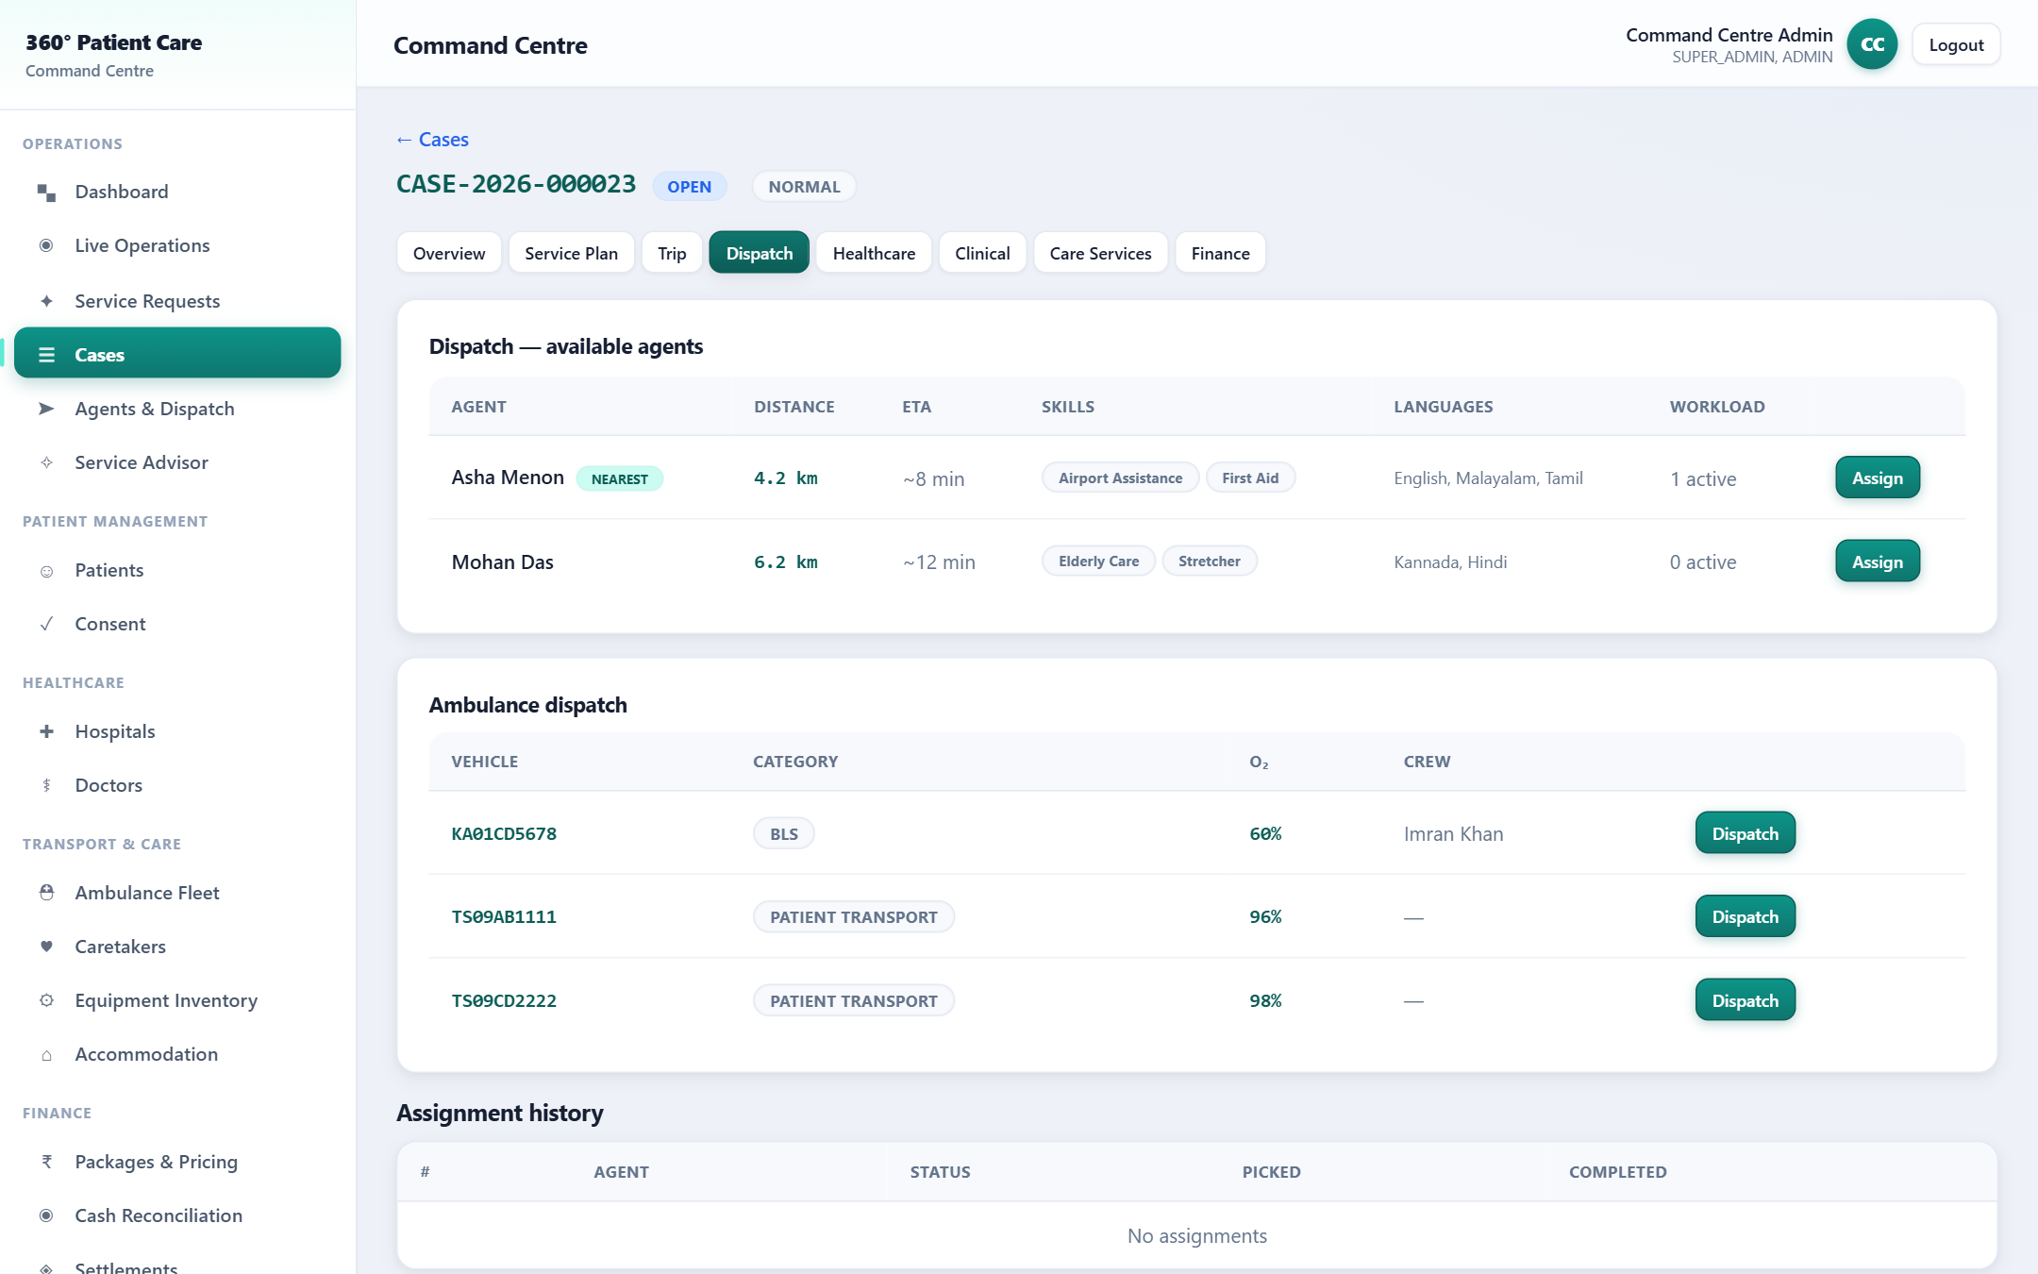
Dispatch & Pickup (OTP)
PORTAL
Blueprint
21
23
64
65
Process Flow
1. Assign
2. En route
3. Pickup OTP
4. Handover OTP
Business Objective
Assign the right agent/ambulance and verify safe pickup & handover.
Validation Rules
Readiness & oxygen thresholds gate ambulance dispatch.
Business Benefits
Right resource, verified custody, auditable handover.
Key Highlights
Controlled assignment; live GPS; OTP handshake.
360° Patient Care & Assistance · Developed by pvalr

Slide 24
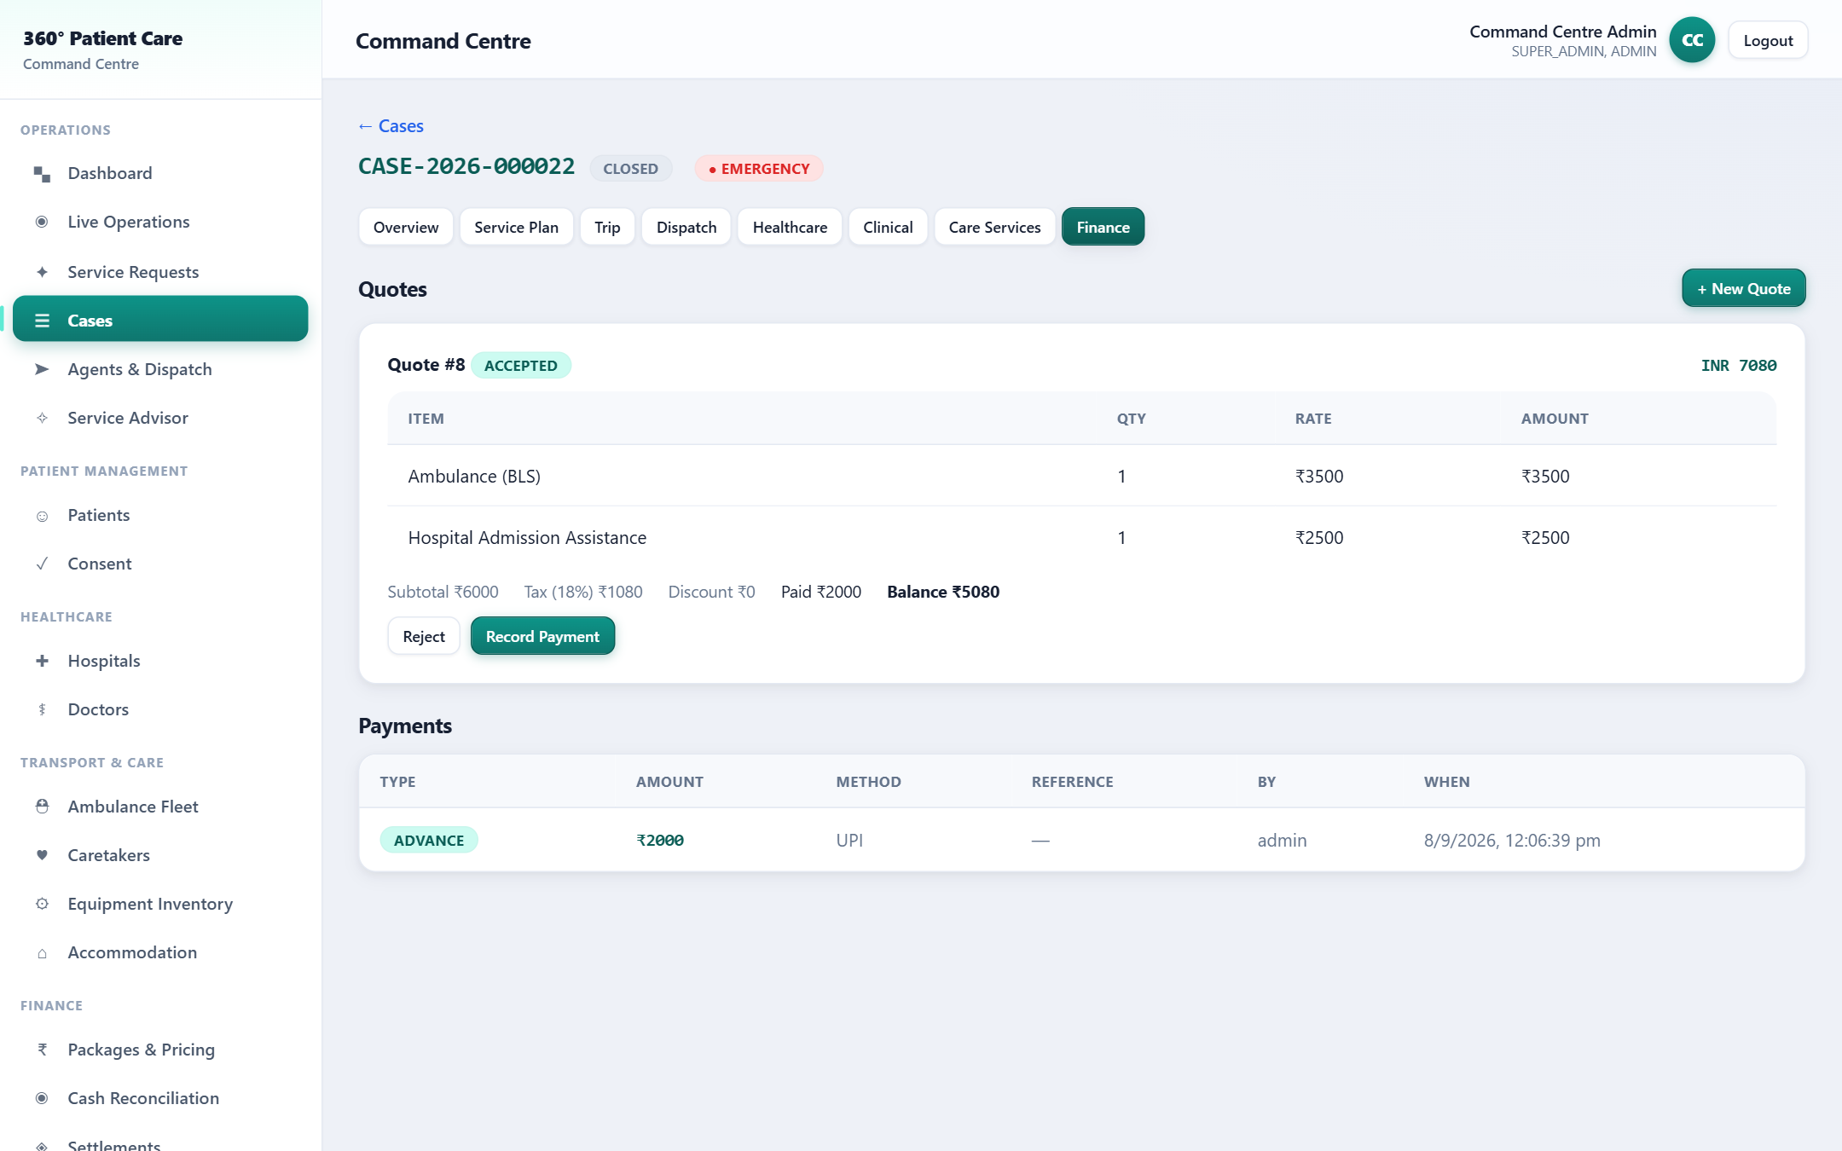
Billing — Quote to Payment
PORTAL
Blueprint
16
17
18
45
Process Flow
1. Package
2. Quote
3. Send
4. Accept & Pay
Business Objective
Transparent, rule-based pricing and clean payment tracking.
Validation Rules
Amounts computed from rate cards; balance can't go negative.
Business Benefits
Clear quotes, faster payment, auditable finances.
Key Highlights
Configurable pricing engine; advance/balance; live updates.
360° Patient Care & Assistance · Developed by pvalr

Slide 25
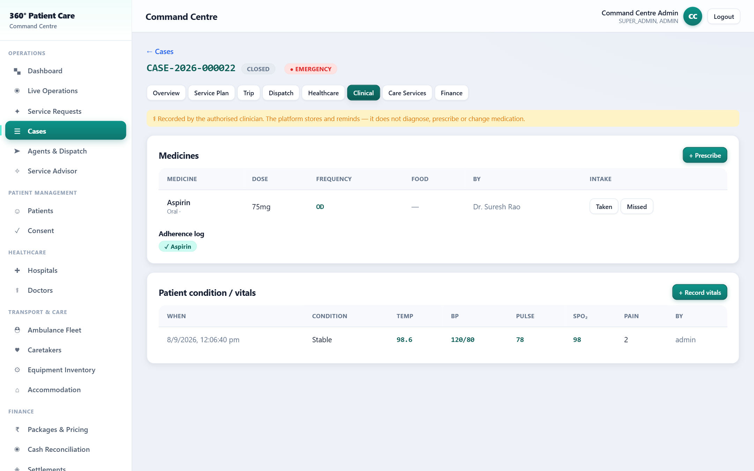
Healthcare & Clinical
PORTAL
Blueprint
31
33
34
38
41
Process Flow
1. Book appt
2. Confirm
3. Consultation
4. Medicine & Vitals
Business Objective
Coordinate appointments and record medicines & vitals safely.
Validation Rules
Recorded by authorised clinician; audit metadata auto-filled.
Business Benefits
Complete, safe clinical record within the coordination journey.
Key Highlights
Appointment workflow; medicine, intake, vitals.
⚕ Platform stores & coordinates; it does not diagnose or prescribe.
360° Patient Care & Assistance · Developed by pvalr

Slide 26
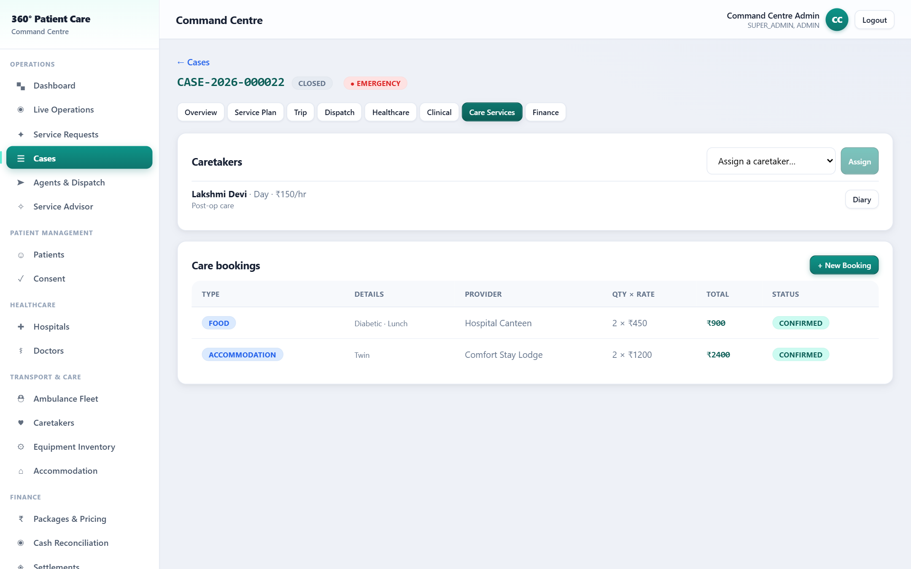
Care Services
PORTAL
Blueprint
35
36
37
42
43
44
Process Flow
1. Assign caretaker
2. Diary
3. Book stay/food
4. Transport
Business Objective
Coordinate caretakers, accommodation, food & local transport.
Validation Rules
Caretaker is a separate verified workforce; totals auto-calc.
Business Benefits
Complete 'complete-care' package around the patient.
Key Highlights
Daily activity diary; unified bookings on the Case.
360° Patient Care & Assistance · Developed by pvalr

Slide 27
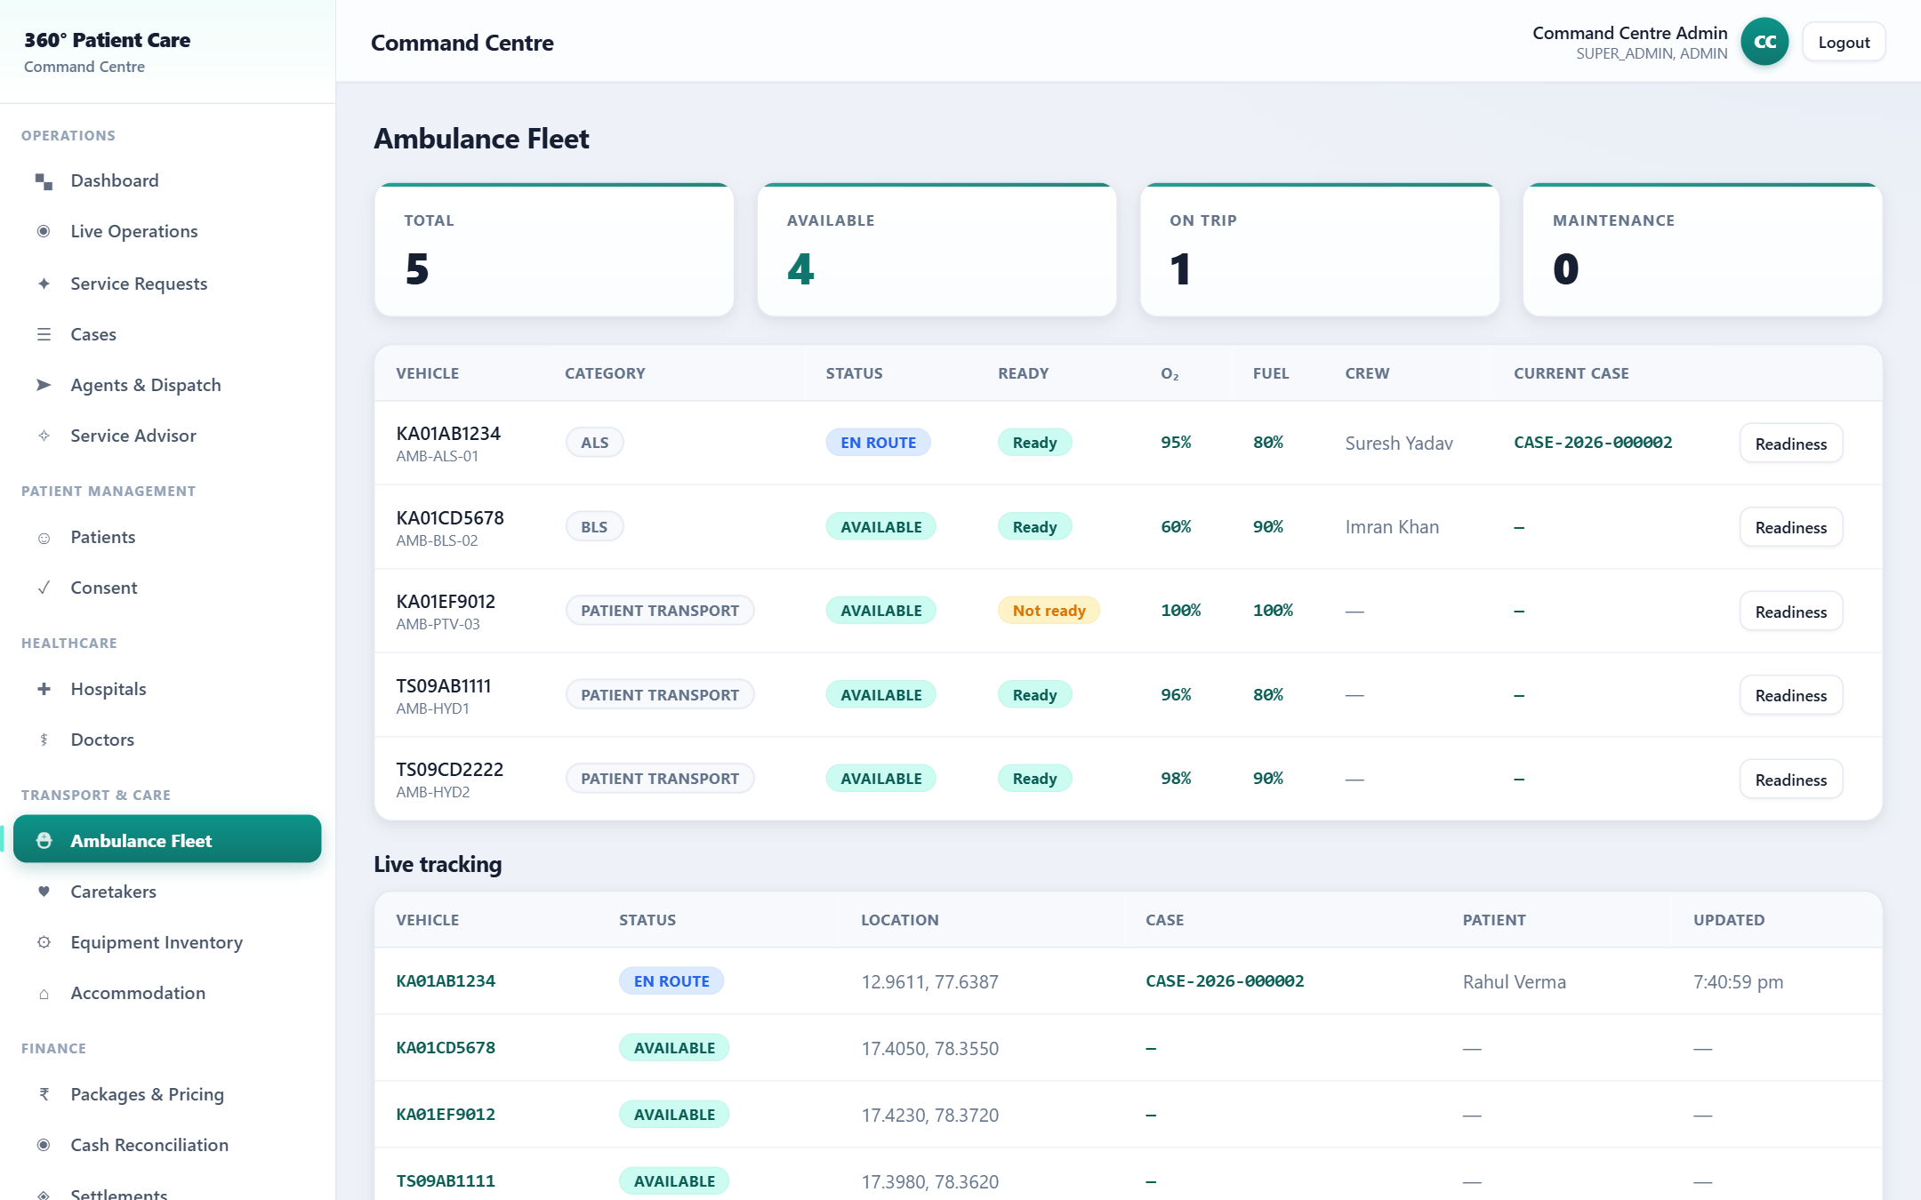
Ambulance Fleet
PORTAL
Blueprint
24
25
26
27
28
30
Process Flow
1. Register
2. Readiness check
3. Gate dispatch
4. Live track
Business Objective
Dispatch only safe, ready, capability-matched ambulances.
Validation Rules
Category-aware checklist; low-O₂/unchecked vehicles blocked.
Business Benefits
Safer transport; fewer failed dispatches; compliance ready.
Key Highlights
PTV/BLS/ALS; crew registry; live GPS tracking.
360° Patient Care & Assistance · Developed by pvalr

Slide 28
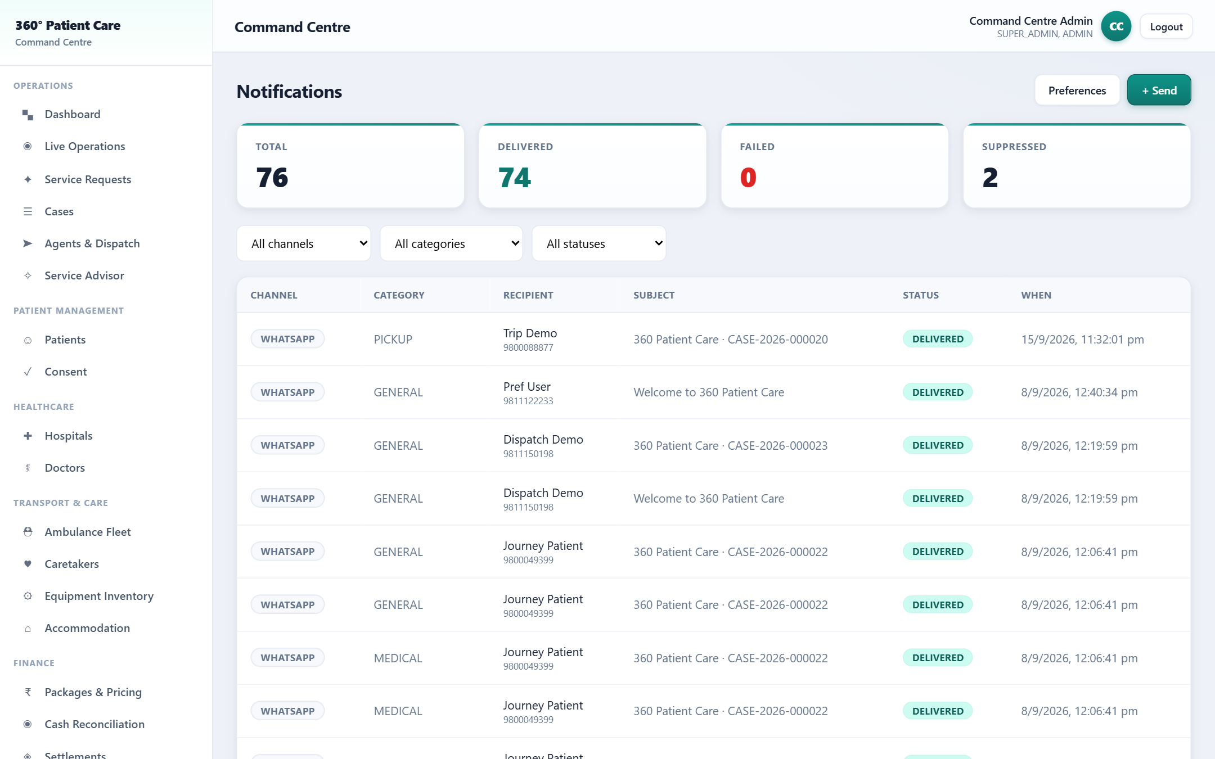
Notifications
PORTAL
Blueprint
47
48
Process Flow
1. Event
2. Check consent
3. Deliver
4. History
Business Objective
Keep patients & staff informed on their chosen channels.
Validation Rules
Consent gating; marketing opt-in; emergency always delivers.
Business Benefits
Timely updates; fewer calls; full communication log.
Key Highlights
WhatsApp/SMS/Email/Push; event-driven; delivery stats.
360° Patient Care & Assistance · Developed by pvalr

Slide 29
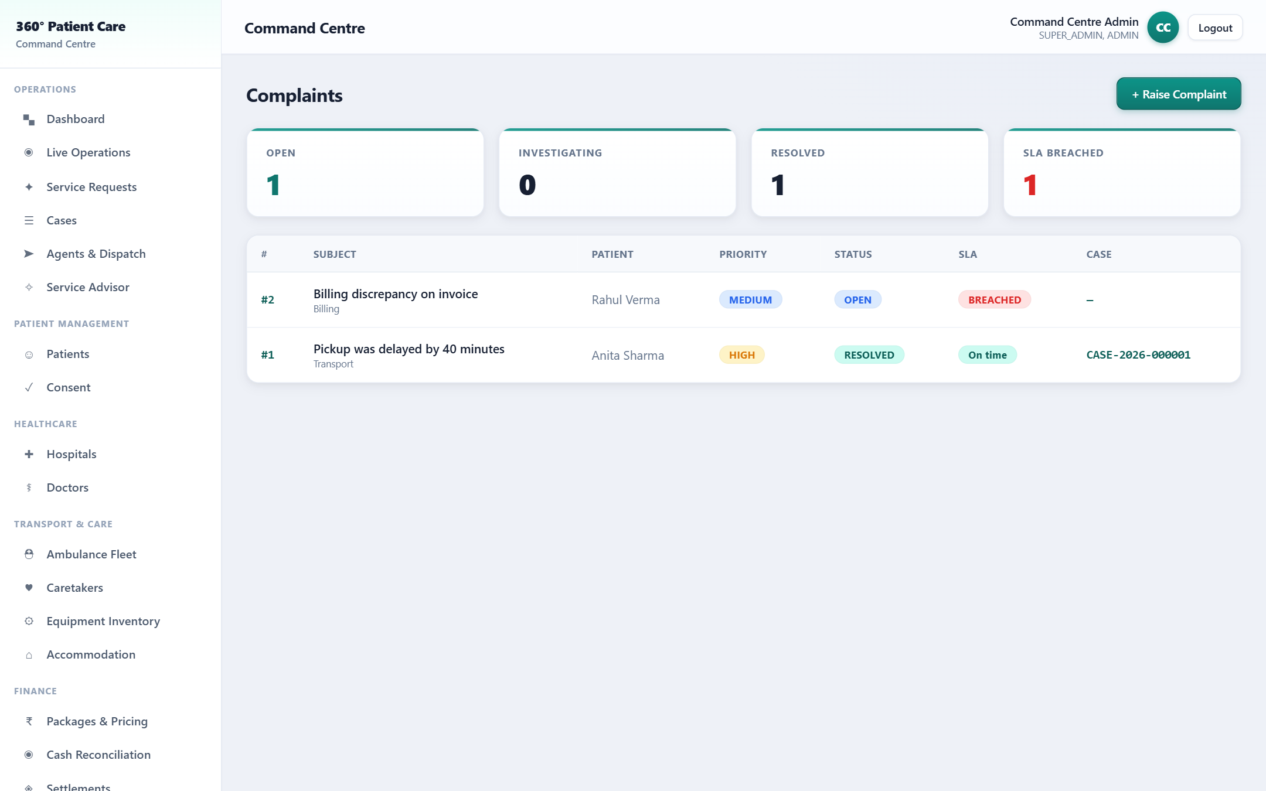
Complaints & SLA
PORTAL
Blueprint
77
68
Process Flow
1. Raise
2. Assign
3. Investigate
4. Resolve
Business Objective
Resolve grievances on time with full accountability.
Validation Rules
SLA due-dates per priority; breaches flagged automatically.
Business Benefits
Higher trust; measurable service quality.
Key Highlights
Full comment history; reopen; breach tracking.
360° Patient Care & Assistance · Developed by pvalr

Slide 30
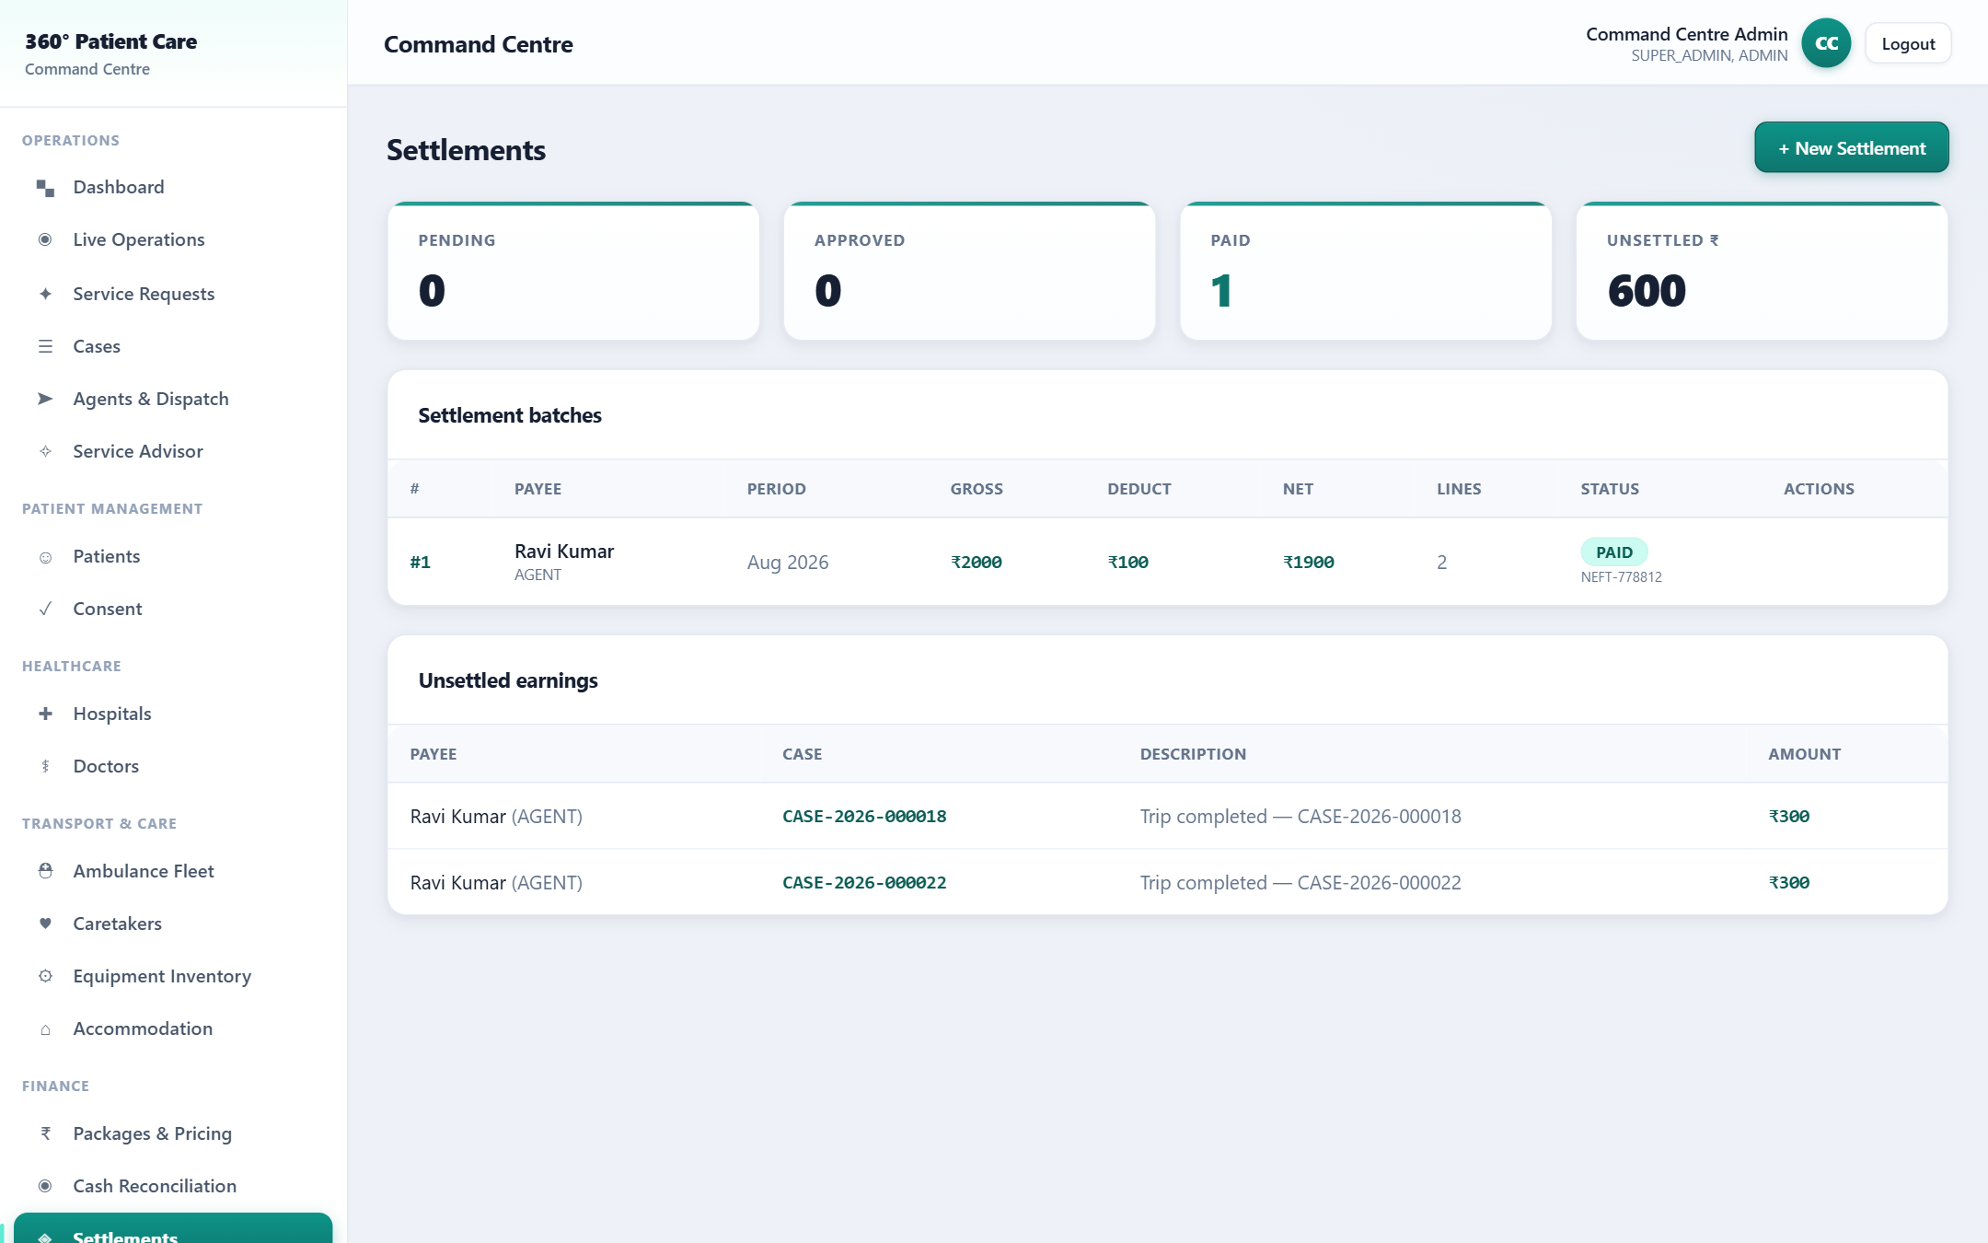
Finance — Settlements
PORTAL
Blueprint
45
46
72
Process Flow
1. Accrue
2. Batch
3. Approve
4. Pay
Business Objective
Pay agents & partners accurately with reconciliation.
Validation Rules
Payout requires approval + reference; earnings can't double-settle.
Business Benefits
Accurate payouts; clean books; partner trust.
Key Highlights
Earnings ledger; gross/deductions/net; auditable.
360° Patient Care & Assistance · Developed by pvalr

Slide 31
Patient App — Book & Track
PATIENT APP
Blueprint
8
51
52
53
Process Flow
1. Login
2. Book
3. My Care
4. Pay
Business Objective
360 Patient Care
Let patients request help and follow their own journey.
Emergency · Book · Records
Validation Rules
Scoped to own account only; consent respected.
Book assistance (chips)
Care packages ₹
Business Benefits
Convenience, transparency, faster payment.
My Care — my cases
Pay balance
Key Highlights
Bottom nav; live case status; pay balance in-app.
Home
My Care
Profile
360° Patient Care & Assistance · Developed by pvalr

Slide 32
Care Agent App — Field Jobs
AGENT APP
Blueprint
22
23
20
Process Flow
1. Login
2. Available
3. Accept
4. OTP steps
Business Objective
360 Care Agent
Give field agents a simple, guided job console.
Available · Offline · GPS
Validation Rules
Only job-necessary info shown; OTP-verified custody.
Assigned / Active / Done
Job: Accept
Business Benefits
Faster, error-free field execution; live GPS to control room.
En route + GPS
Pickup / Handover OTP
Key Highlights
Duty toggles; job cards; pickup/handover OTP; earnings & settlement.
Jobs
360° Patient Care & Assistance · Developed by pvalr

Slide 33
04
Extended Modules — 84-point completion
The capabilities added to close every blueprint gap
360° Patient Care & Assistance · Developed by pvalr

Slide 34
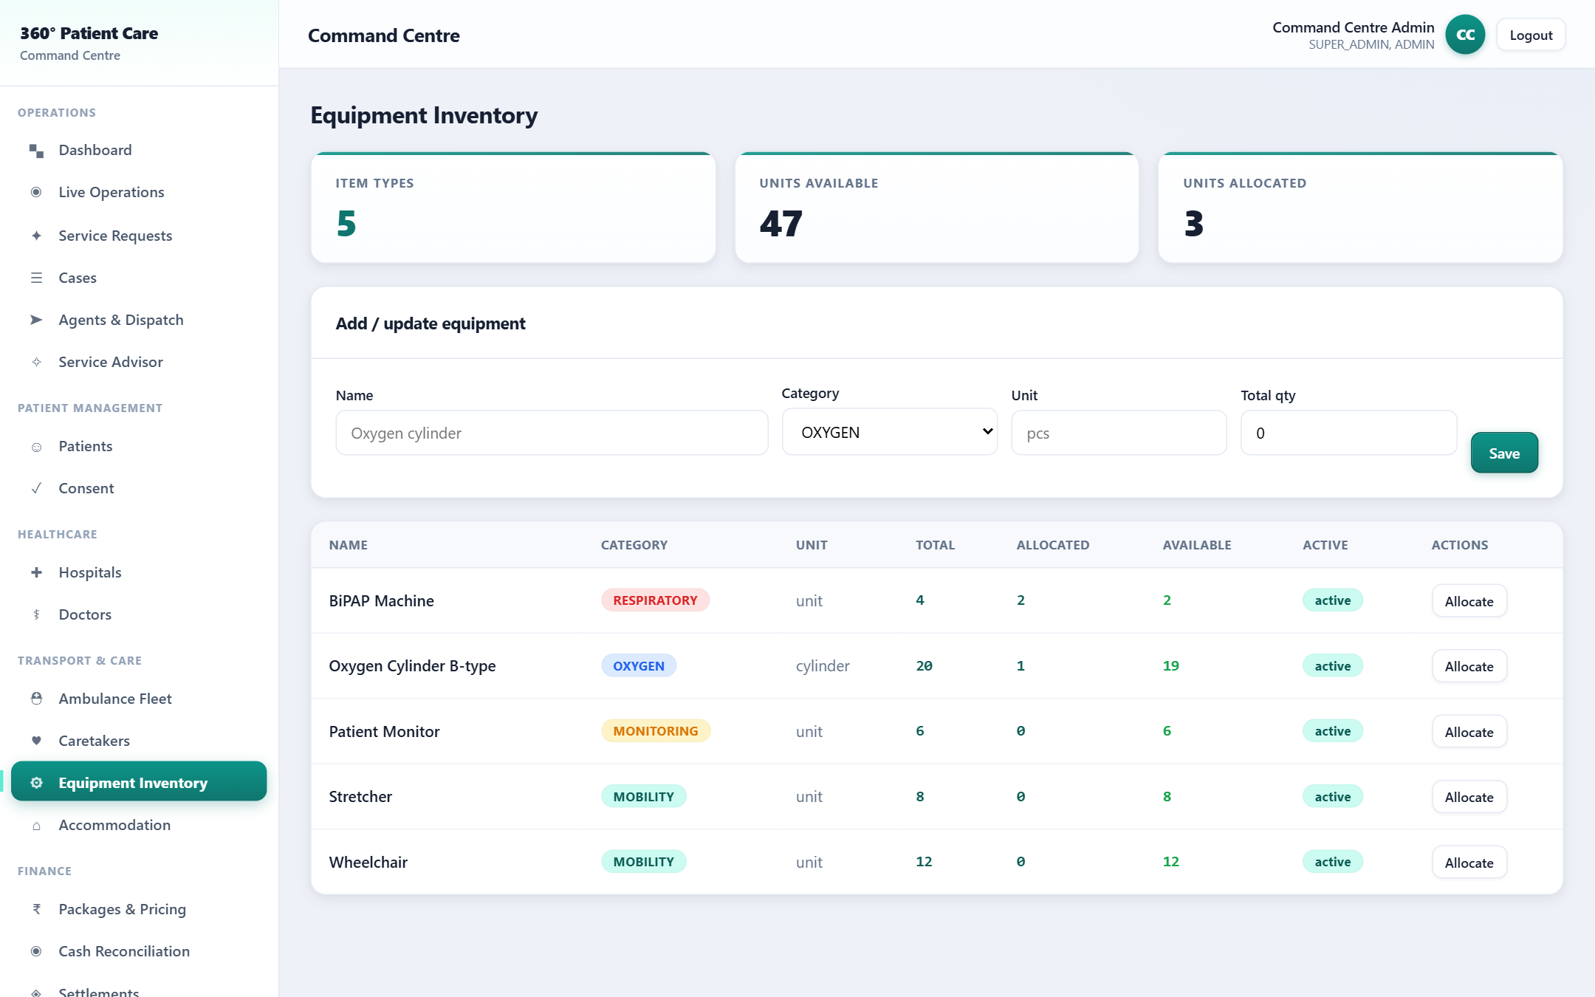
Equipment Inventory
PORTAL
Blueprint
27
Process Flow
1. Add stock
2. Check availability
3. Allocate
4. Return
Business Objective
Track medical-equipment stock and allocate it to a case/trip.
Validation Rules
Stock-guarded — cannot over-allocate; capability thresholds gate dispatch.
Business Benefits
No shortages mid-case; equipment cost traceable to a Case.
Key Highlights
Oxygen, wheelchair, stretcher, monitor — live available vs allocated.
360° Patient Care & Assistance · Developed by pvalr

Slide 35
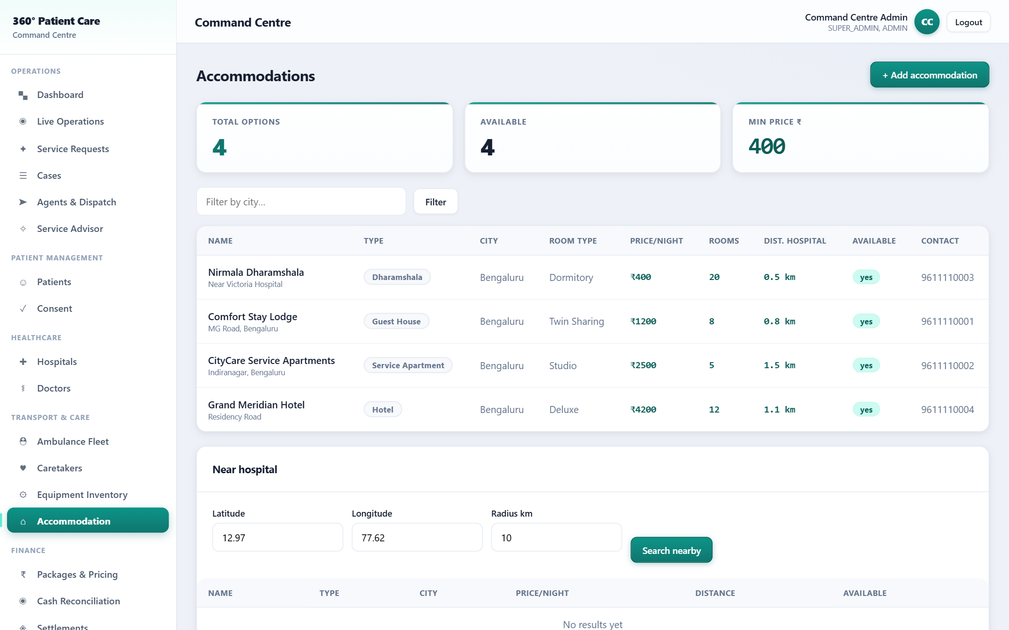
Accommodation Master
PORTAL
Blueprint
42
Process Flow
1. List / filter
2. Nearby (GPS)
3. Book to case
Business Objective
A reusable catalogue of partner stays near hospitals.
Validation Rules
Active options only; distance computed from the hospital.
Business Benefits
Fast, consistent lodging for out-station patients & guardians.
Key Highlights
Hotels / guest houses / dharamshala — price, rooms, distance.
360° Patient Care & Assistance · Developed by pvalr

Slide 36
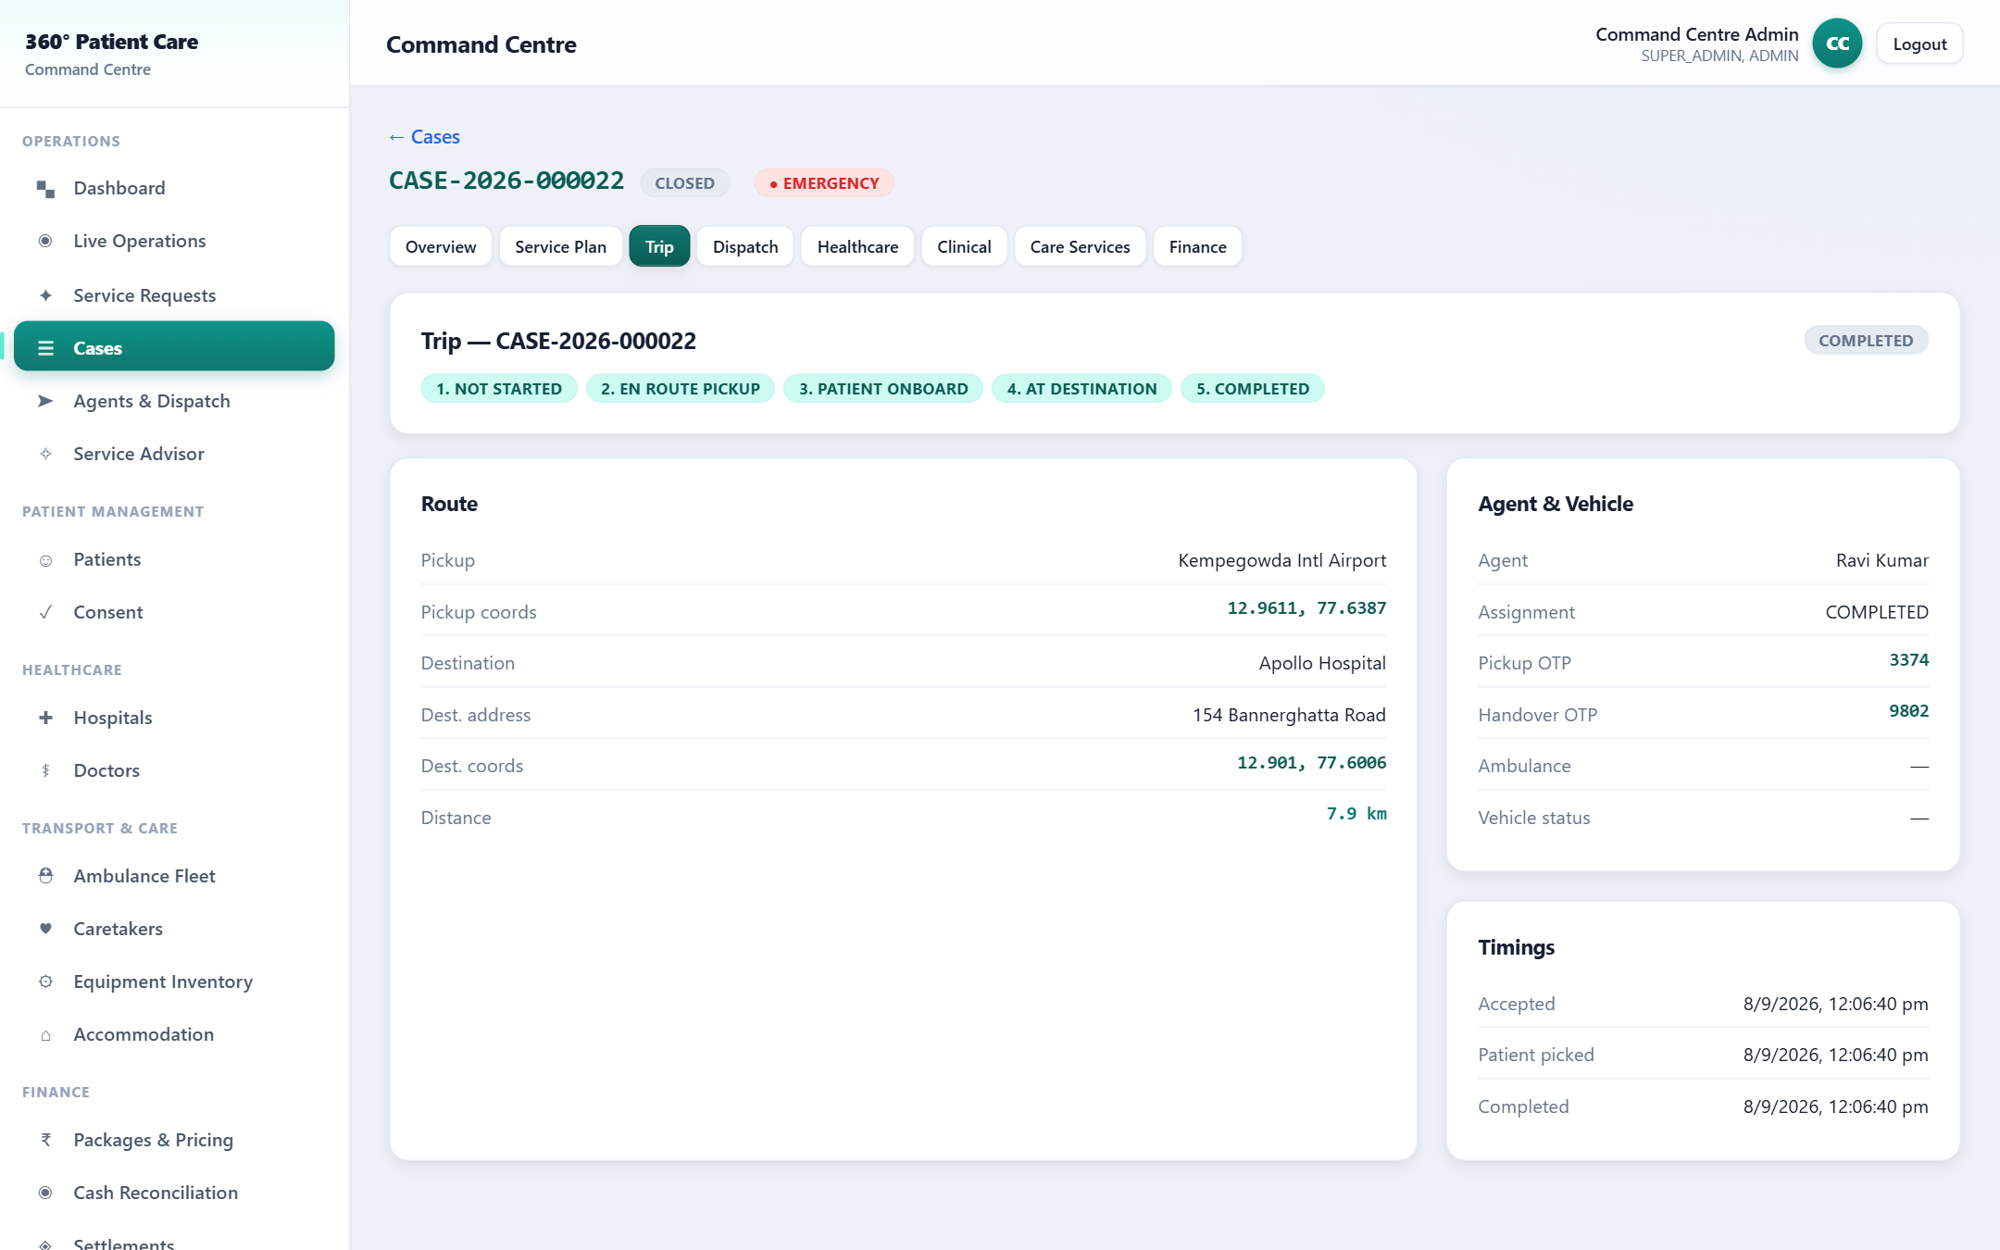
Unified Trip View
PORTAL
Blueprint
44
76
Process Flow
1. Pickup
2. En route
3. Onboard
4. At hospital
5. Complete
Business Objective
One trip object linking pickup, destination, agent, vehicle & distance.
Validation Rules
Phase derived from live status; distance from pickup → hospital.
Business Benefits
Every transport leg in one auditable view with timings.
Key Highlights
Agent, ambulance, OTPs, distance & journey phase together.
360° Patient Care & Assistance · Developed by pvalr

Slide 37
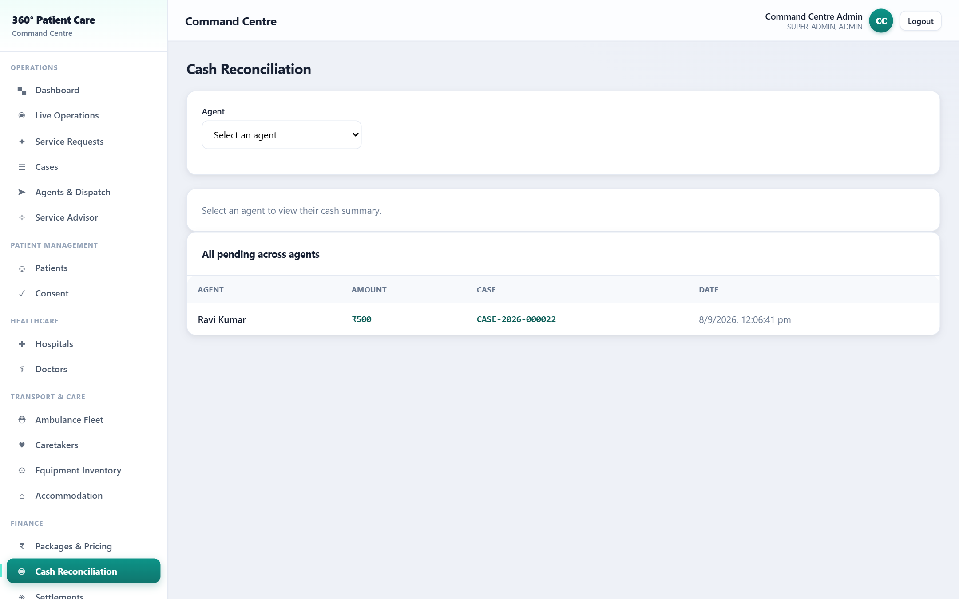
Cash Reconciliation
FINANCE
Blueprint
46
Process Flow
1. Collect
2. Cash-in-hand
3. Deposit
4. Reconcile
Business Objective
Track cash collected by agents and reconcile deposits.
Validation Rules
No untracked cash — every collection tied to agent + case.
Business Benefits
Clean books; zero informal collection; auditable deposits.
Key Highlights
Per-agent cash-in-hand; one-click deposit-all with reference.
360° Patient Care & Assistance · Developed by pvalr

Slide 38
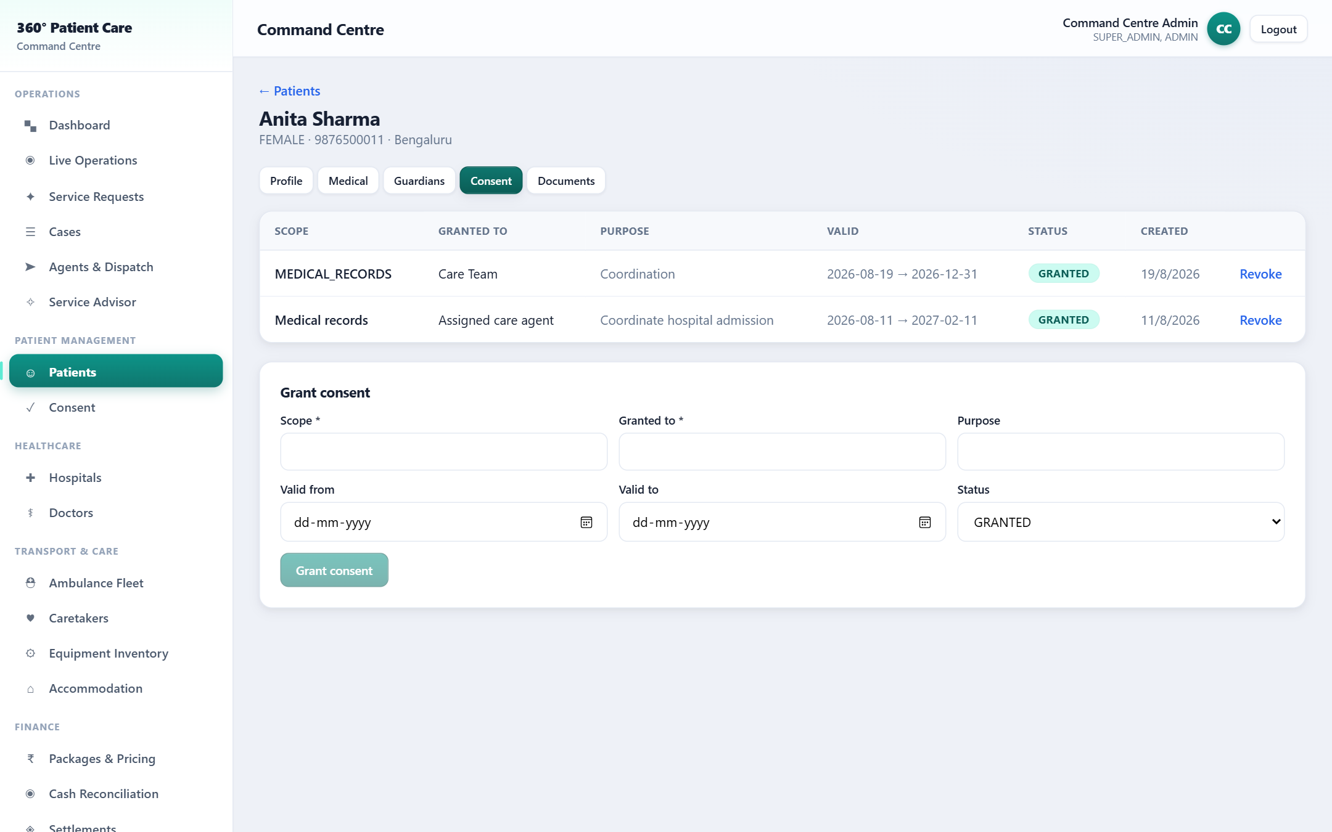
Consent & Access Audit
PORTAL
Blueprint
14
15
Process Flow
1. Grant consent
2. Scope & expiry
3. Access logged
4. Revoke
Business Objective
Granular, revocable consent with a document access trail.
Validation Rules
Least-privilege; who / what / purpose / until; every document view audited.
Business Benefits
Privacy-by-design; DPDP-aligned; defensible access history.
Key Highlights
Grant / revoke per scope; document download access-log.
360° Patient Care & Assistance · Developed by pvalr

Slide 39
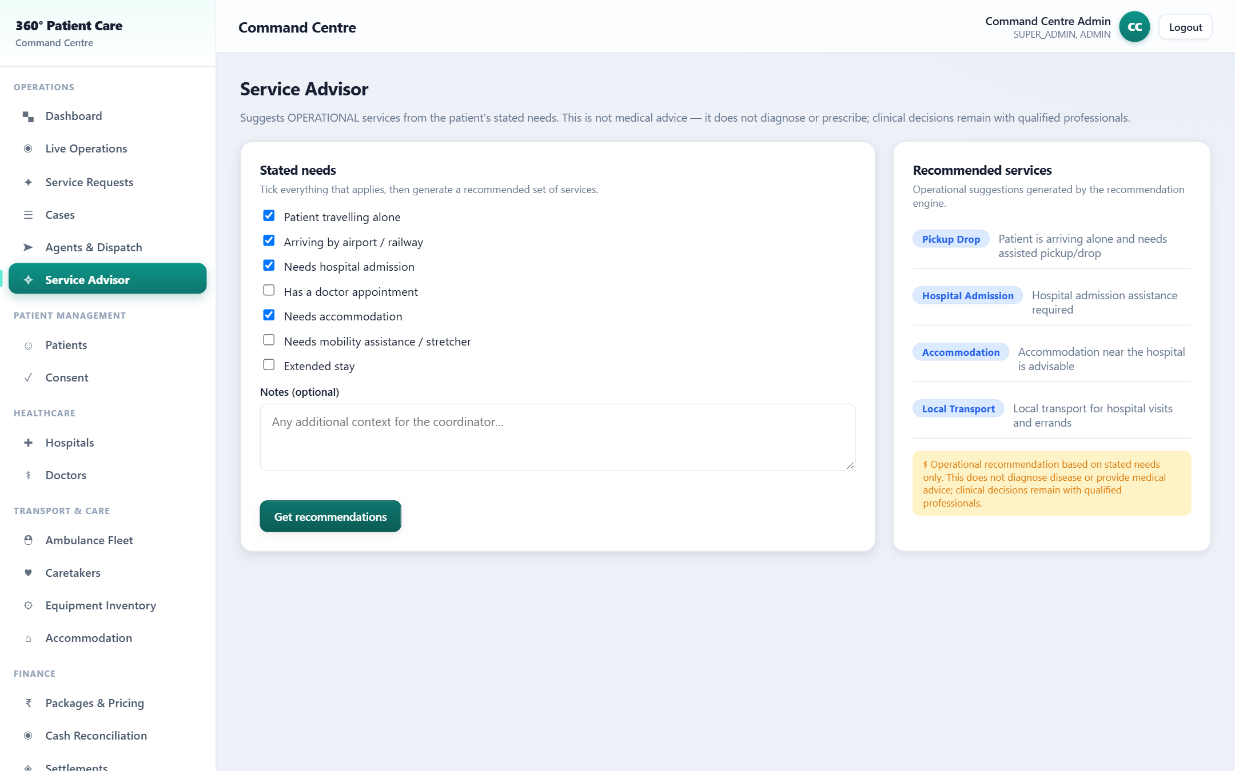
Service Advisor
PORTAL
Blueprint
55
56
Process Flow
1. Enter needs
2. Recommend
3. Add to booking
Business Objective
Recommend the right operational services from stated needs.
Validation Rules
Operational only — never diagnoses or advises clinically.
Business Benefits
Right services bundled for travelling-alone / out-station patients.
Key Highlights
Pickup, admission, accommodation, caretaker, transport — with reasons.
⚕ Operational recommendation only — not medical advice.
360° Patient Care & Assistance · Developed by pvalr

Slide 40
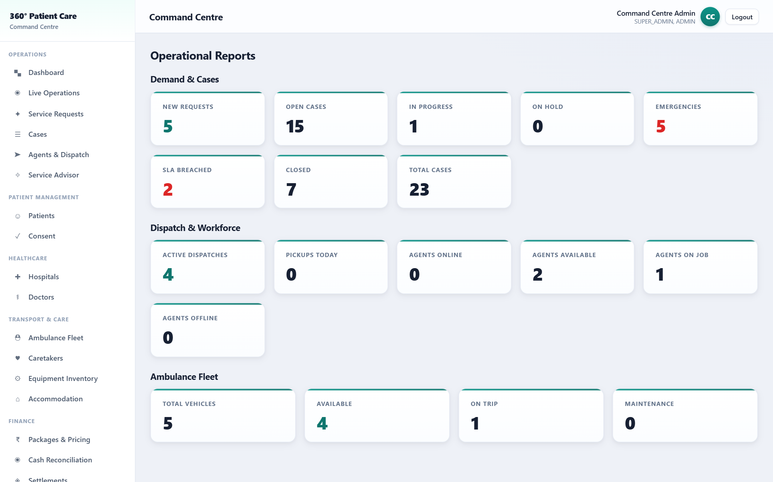
Operational Reports & SLA
PORTAL
Blueprint
6
68
Process Flow
1. Live events
2. Aggregate
3. Report
4. Act on breaches
Business Objective
Command-Centre KPIs and response-SLA tracking in one place.
Validation Rules
SLA target set by priority; breaches counted & surfaced.
Business Benefits
Data-driven ops; delays & SLA breaches visible instantly.
Key Highlights
Demand, dispatch, workforce & fleet KPIs; SLA-breach tile.
360° Patient Care & Assistance · Developed by pvalr

Slide 41
Business Benefits
VALUE
✓
Single source of truth
✓
Faster coordination
✓
Real-time control
One Case ID links every event, party & payment
Dispatch, book, bill from one console — minutes not hours
Live map & feed; emergencies & SLA breaches surfaced
✓
Verified & auditable
✓
Better patient experience
✓
Revenue integrity
OTP custody + full audit on every action
Transparency, updates and in-app payments
Rule-based pricing, clean payments & partner settlements
360° Patient Care & Assistance · Developed by pvalr

Slide 42
Key KPIs the platform improves
MEASURABLE
↓ 60%
100%
↑
Coordination time per case
Events traceable to a Case
Dispatch accuracy (skill/GPS-matched)
SLA
0
Live
Response & resolution tracked
Untracked cash / informal collection
Fleet & agent utilisation
360° Patient Care & Assistance · Developed by pvalr

Slide 43
One trusted coordinator, one Case, one journey.
The patient explains what help is needed — the platform coordinates the right people, vehicles, hospitals, doctors, care, payments and follow-up, with a complete, auditable, real-time journey.
1. Requirements workshop
2. MVP backlog sign-off
3. Integrations (ABDM/Payment)
4. Security hardening & go-live
Thank you · Developed by pvalr

