Slide 1
Lending Club Case Study
Lakshmi Reddy Motati

Slide 2
Objective
The Objective of this case study is to implement EDA technique on a Lending Club Data
Benefits of the case study:
Gives a idea about how EDA is useful to solve business problems.
How the data is used to minimize loss of money while lending it to clients.
It improves our understating of visualization and what charts to use for real life data.

Slide 3
Business Understanding
The business objective is to take a decision whenever they receive a loan application whether to reject or approve based on certain variables.
Dataset Details:
The data given below contains information about past loan applicants and whether they ‘defaulted’ or not. Data has details regarding approved loan not the rejected ones. It has 3 status of loan which is Fully Paid, Current and Charged-Off.
Data Clean-up and preparation process:
Importing The Libraries & Data
Removing Null Values Columns
Removing Duplicate Data
Data Conversion
Deriving New Columns
Analyse The Columns Using Proper Plots

Slide 4
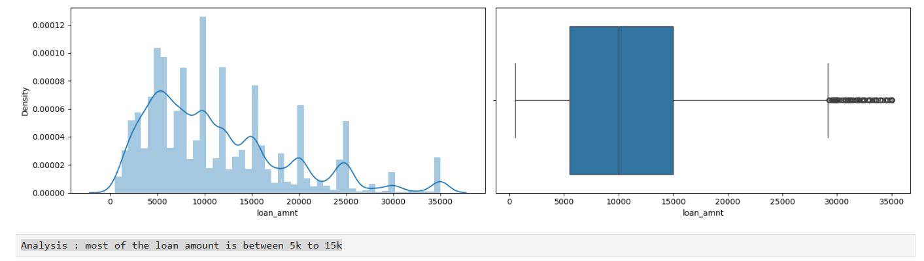
Loan Amount

Slide 5
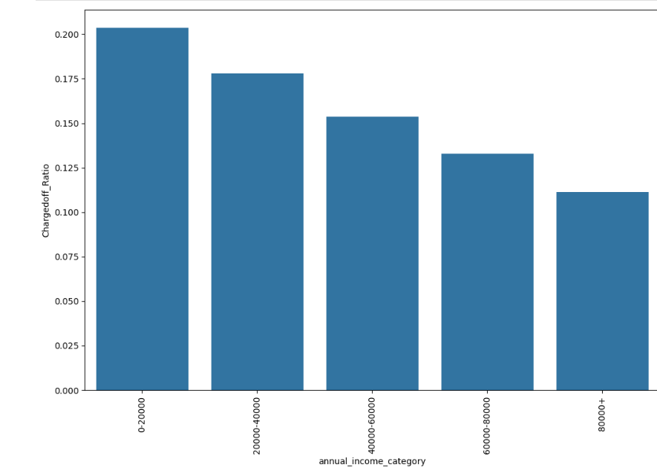
Loan Status VS Income

Slide 6
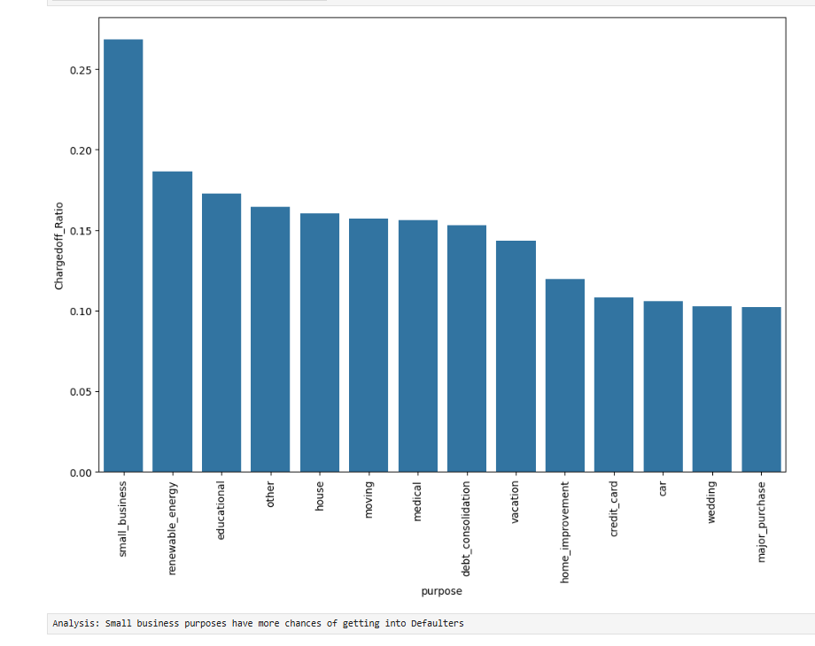
Loan Status VS Purpose Of Loan

Slide 7
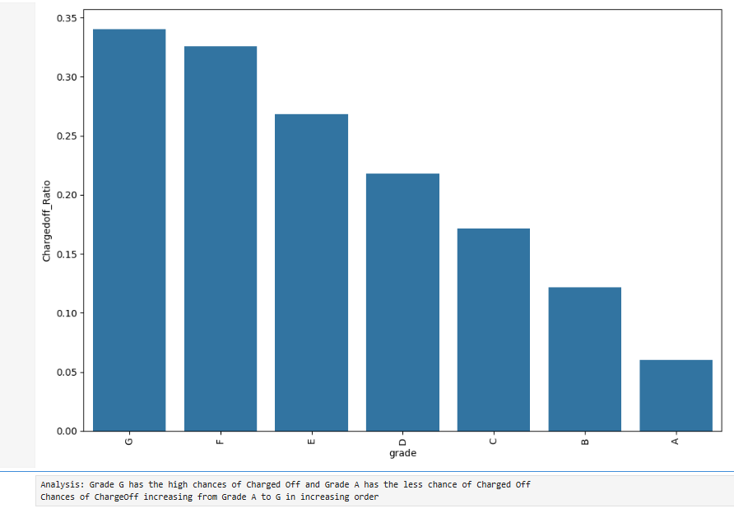
Grade VS Loan Status

Slide 8
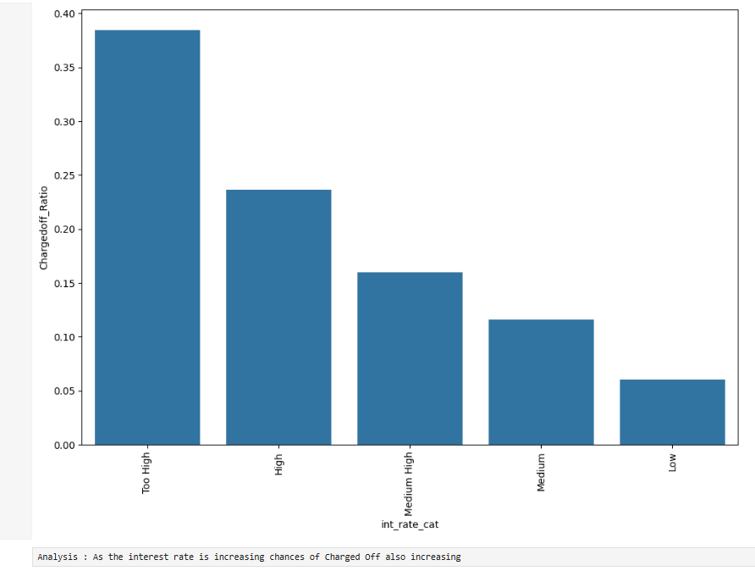
Interest Rate VS Loan Status

Slide 9
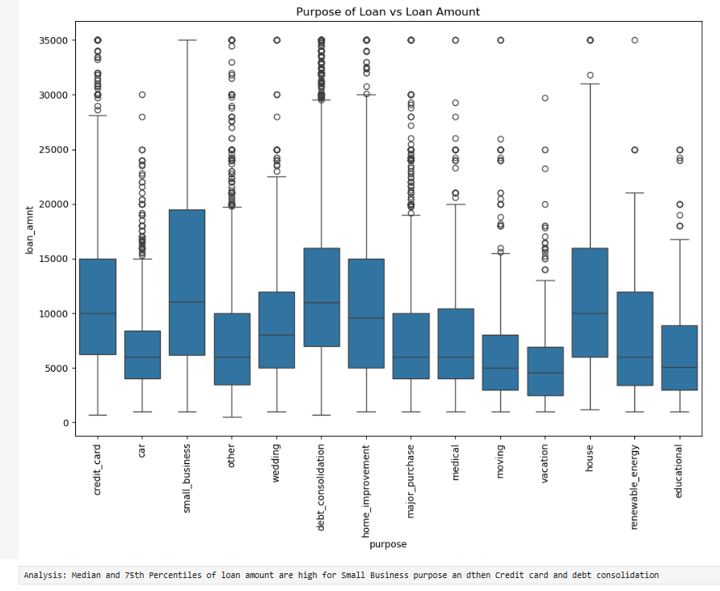
Purpose VS Loan Amount

Slide 10
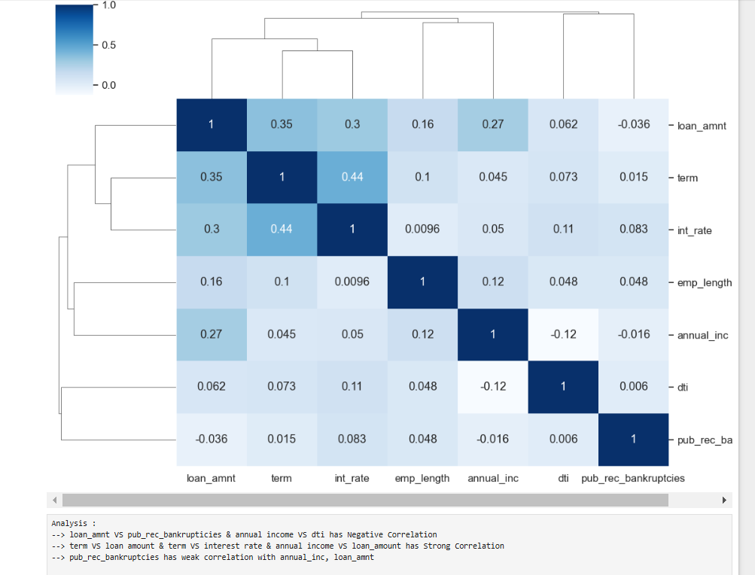
Correlation Plot

