Slide 1




AUTOMATION PROJECT
-N Lakshmi Deepak

Slide 2


PERSONAL BACKGROUND
NAME : N LAKSHMI DEEPAK
QUALIFICATION : B-TECH
BRANCH : ECE
EXPERIENCE : FRESHER

Slide 3
Problem Statement of the Capstone Project:
Overview: The goal of this project is to automate key functionalities and processes on the NOPCommerce demo website (https://demo.nopcommerce.com/). NOPCommerce is an open-source eCommerce solution, and this demo site is frequently used to showcase the platform’s capabilities. Manual testing of the demo.nopcommerce e-commerce website is time-consuming and prone to errors, especially with frequent updates and feature changes. The project aims to automate key functionalities like user registration, login, product search, add to cart, and checkout using Java and Selenium Web Driver. Automation helps improve test accuracy, reduce testing time, and ensure consistent validation across multiple test cycles. The challenge includes handling dynamic elements, implementing waits, managing test data, and generating reports to support efficient and reliable testing.
Objective: To automate the critical features of the NOPCommerce demo website to ensure comprehensive testing and efficient operation. The automation will cover:
Functional Tests: Automated checks for user registeration, login, product search, cart functionality, checkout process, and order placement.
Cross-Browser Testing: Ensure the website performs consistently across different browsers (Chrome, Firefox, Edge, Safari).
Load Testing: Automate performance tests to assess how the website handles multiple concurrent users and transactions.
Proposed Automation Tools and Technologies:
Selenium (for web automation).
TestNG (for test management and reporting).

Slide 4
Challenges in Manual Testing:
Takes a Lot of Time: Manually repeating tests This becomes especially time-consuming when testing multiple scenarios after every update.
Human Mistakes: Testers may accidentally skip steps or enter incorrect data. This can lead to inaccurate results and missed bugs.
Hard to Keep Track: As more features are added, updating a growing number of test cases becomes difficult. This can result in overlooked or incomplete tests.
Challenges in Automation (Using Selenium and TestNG):
Dealing with Changing Elements: Web elements (buttons, product listings, etc.) often change dynamically. Writing flexible scripts that work despite these changes is tricky.
Waiting for Things to Load: Automation scripts need to wait for elements to load before interacting. If done incorrectly, tests may fail due to slow loading times.
Managing Test Data: Test data must be well-organized, especially when testing with multiple users or products. Keeping this data accurate is challenging.
Testing on Different Browsers: The website must work across multiple browsers (Chrome, Firefox, etc.).
Generating Reports: After running automated tests, generating clear and comprehensive reports is essential. Customizing these reports to show useful insights requires additional effort.

Slide 5
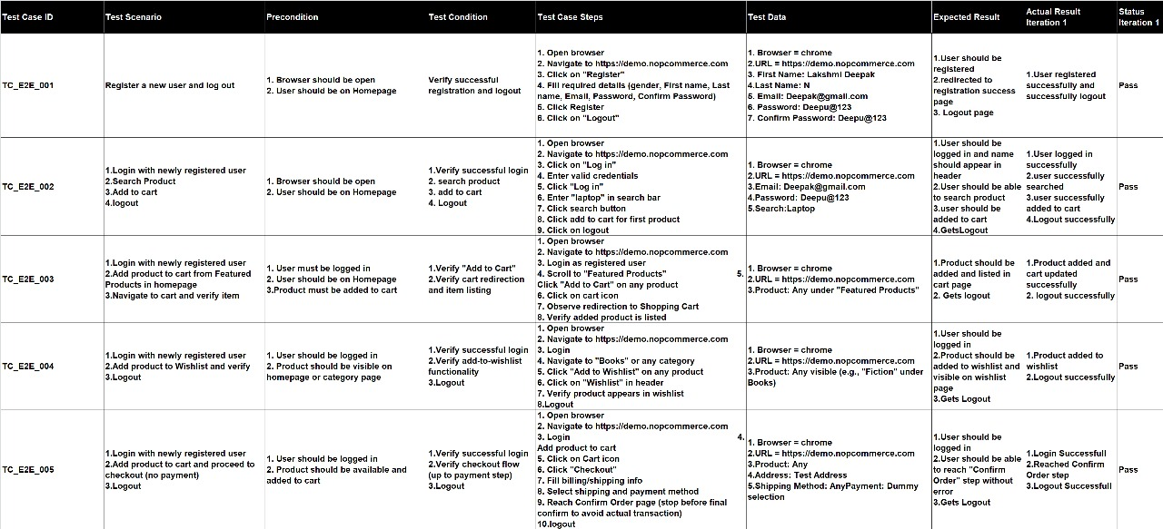
Manual Test Cases for End To End Test Cases

Slide 6
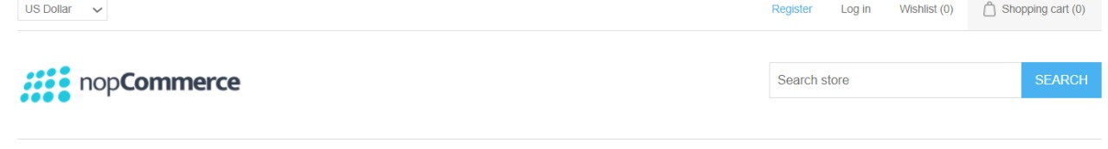
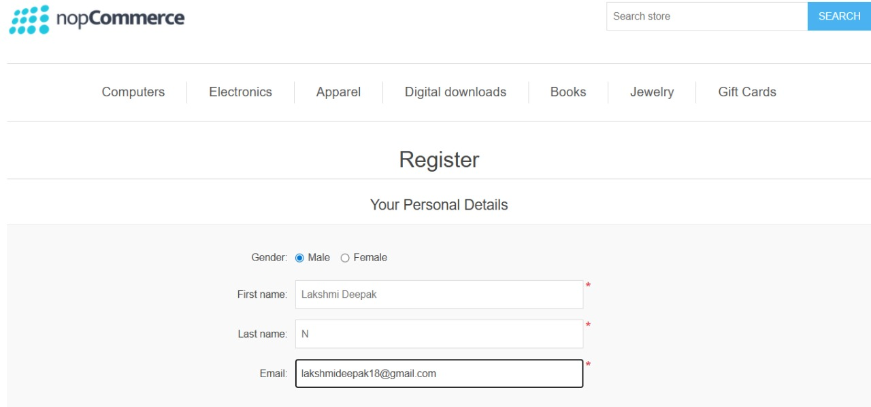
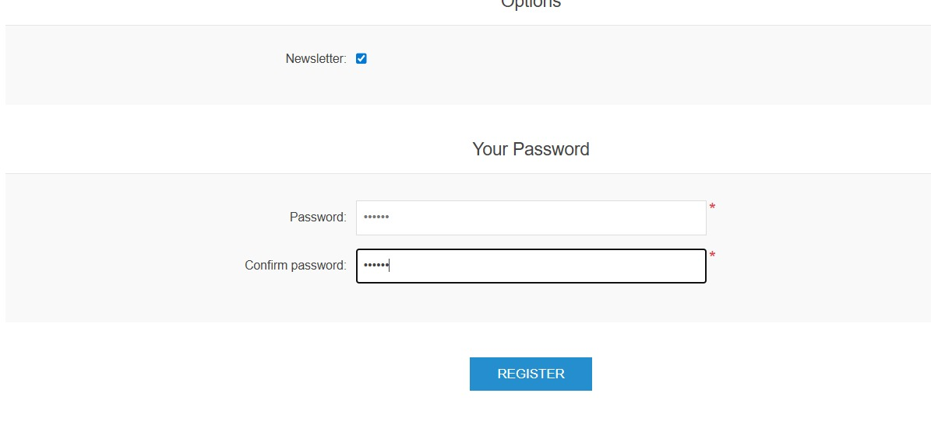
Test Case 1

Slide 7
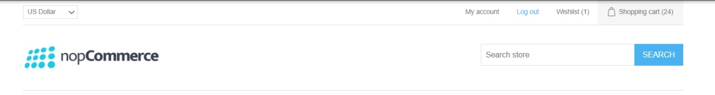
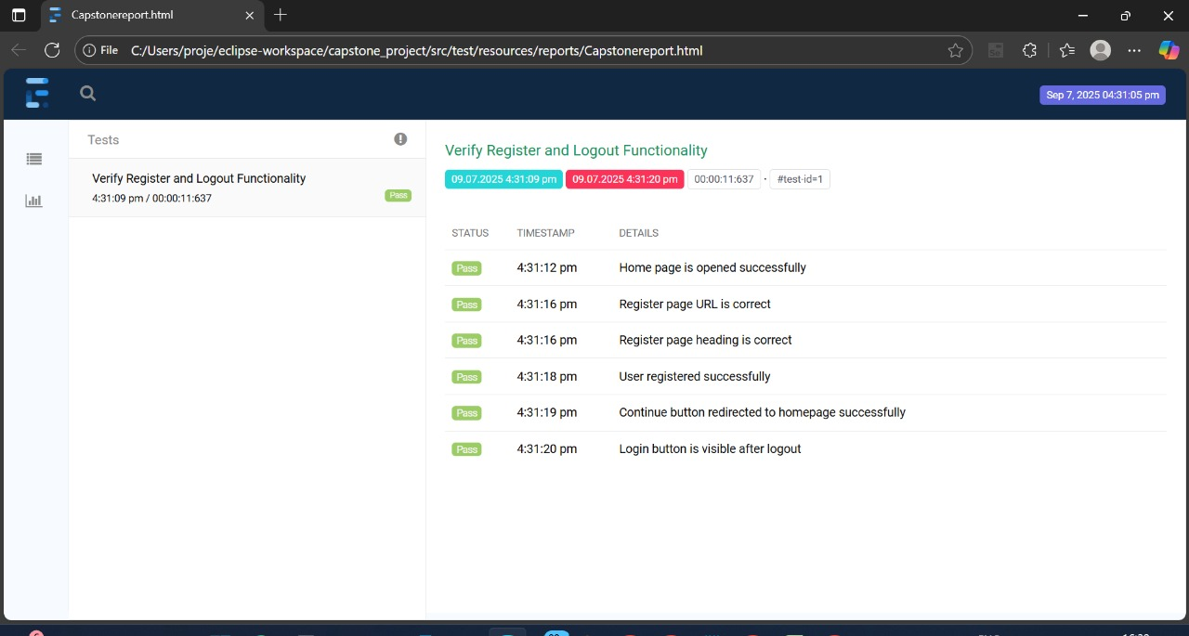
Generated Reports

Slide 8
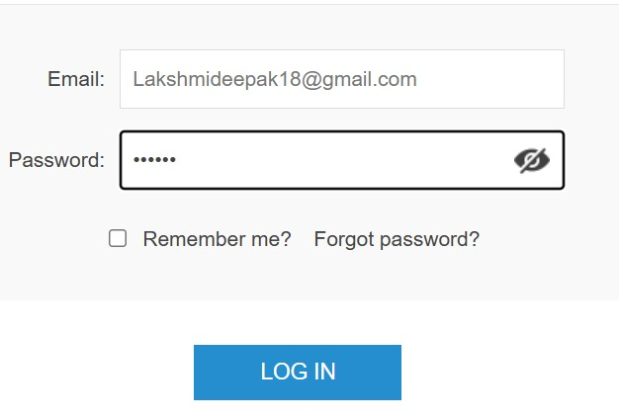
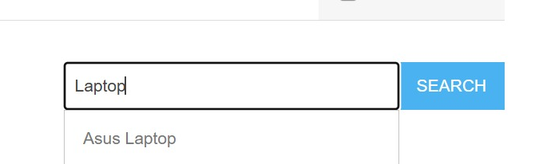
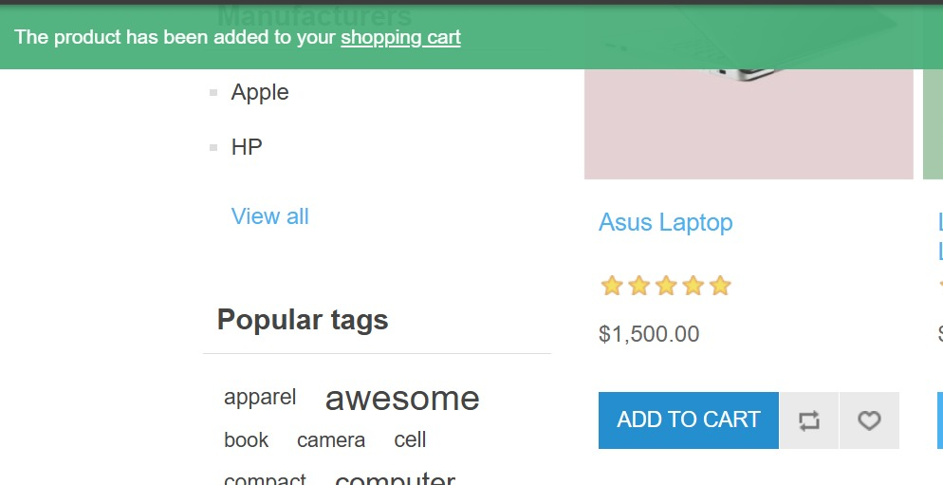
Test Case 2

Slide 9
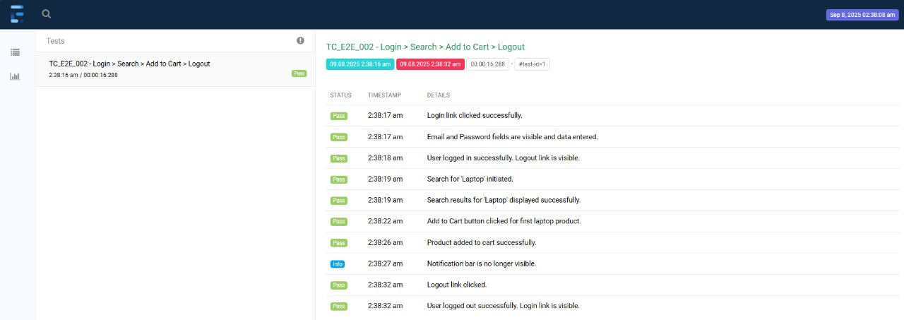
Generated Reports

Slide 10
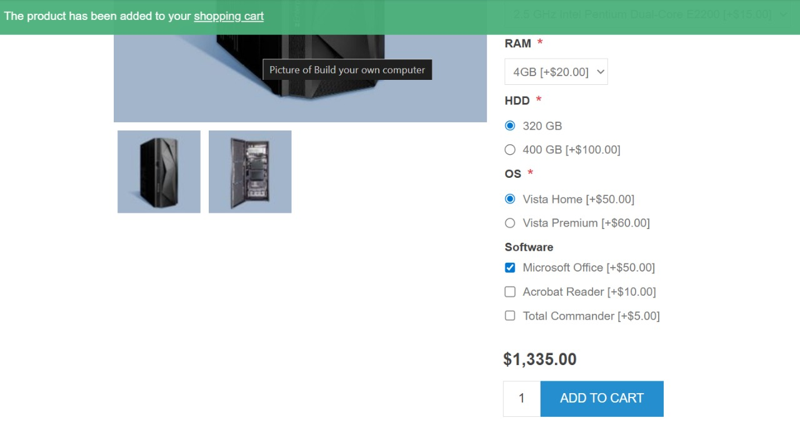
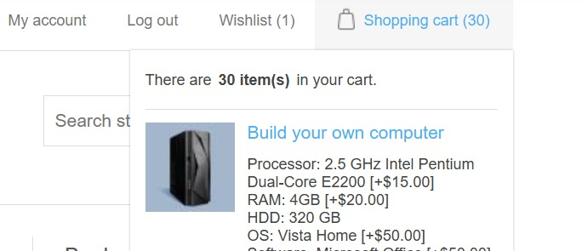
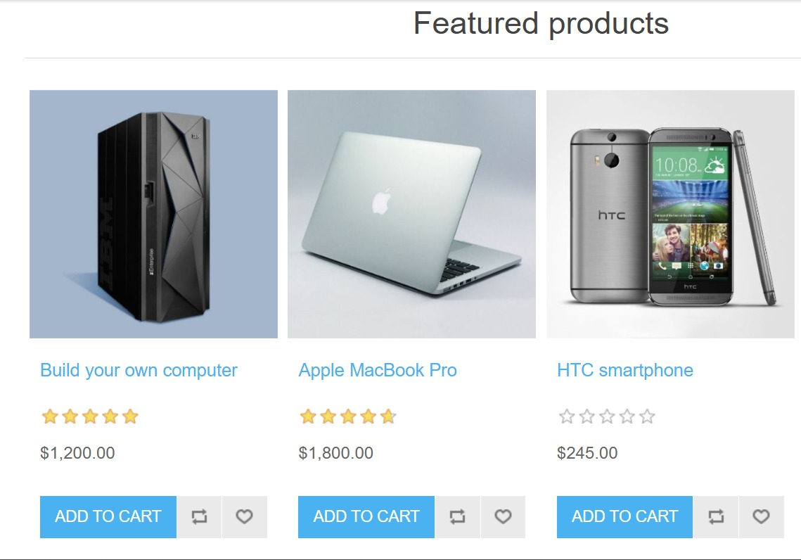
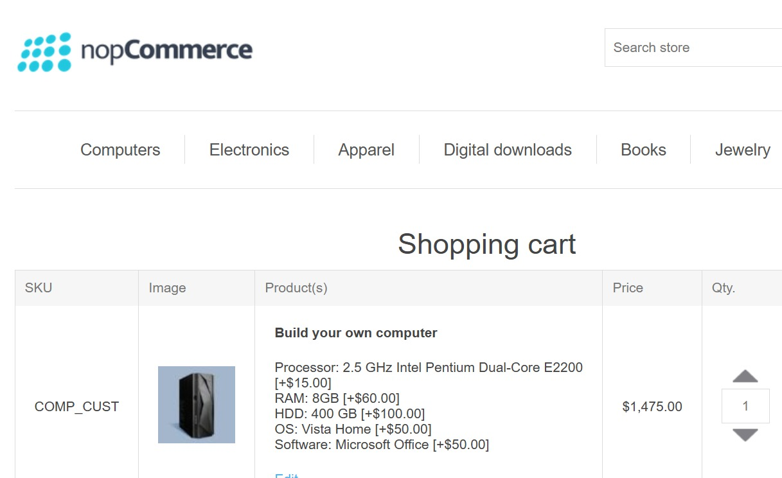
Test Case 3

Slide 11
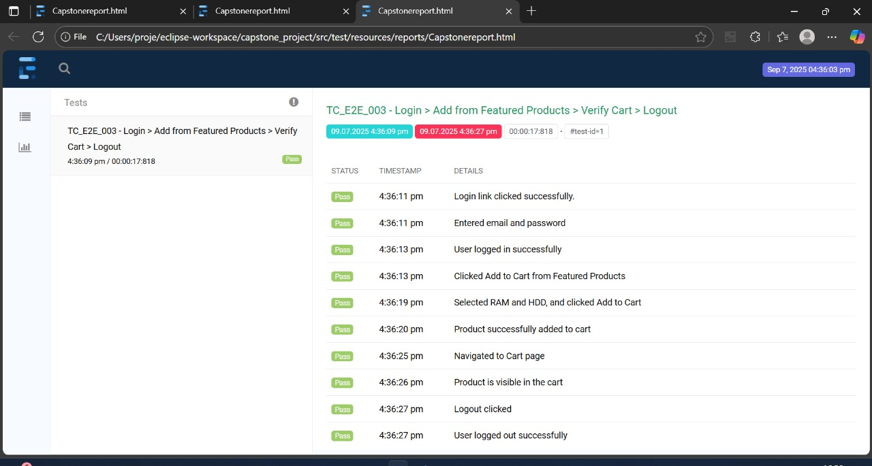
Generated Reports

Slide 12
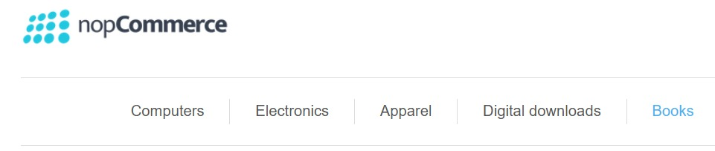
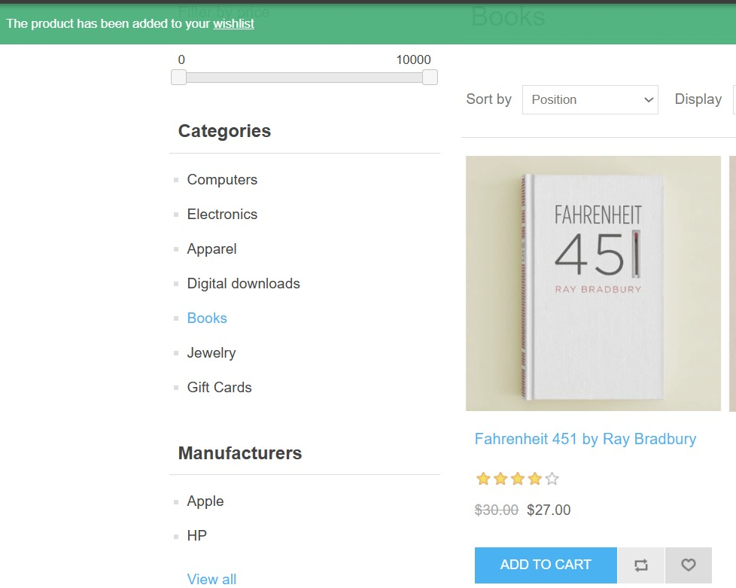
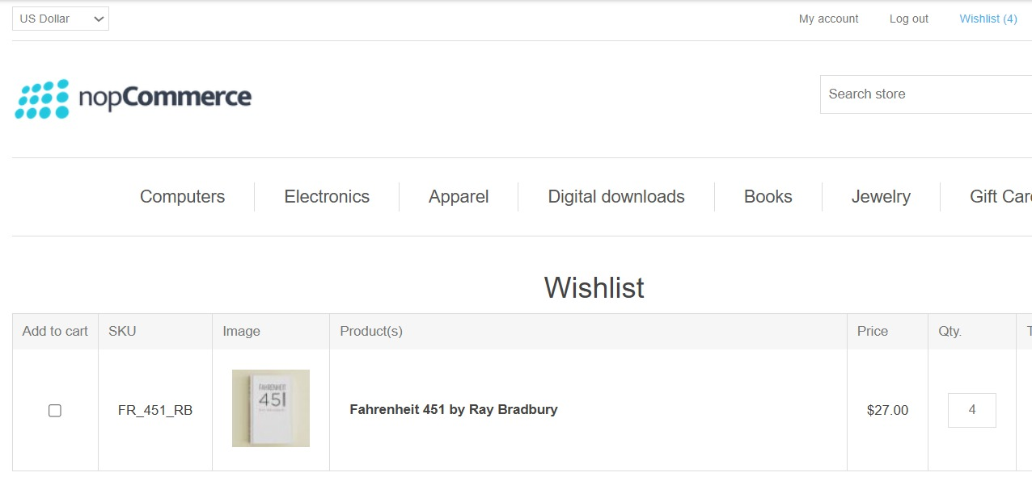
Test Case 4

Slide 13
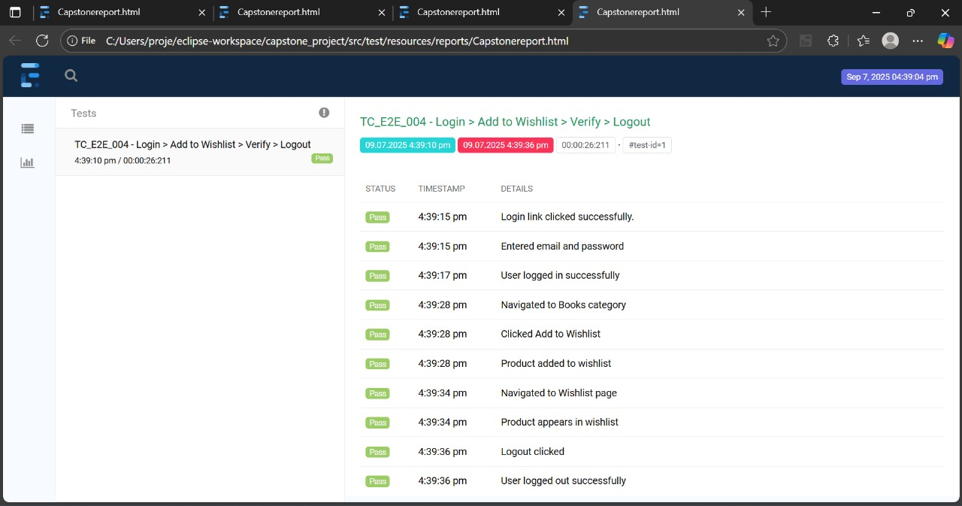
Generated Reports

Slide 14
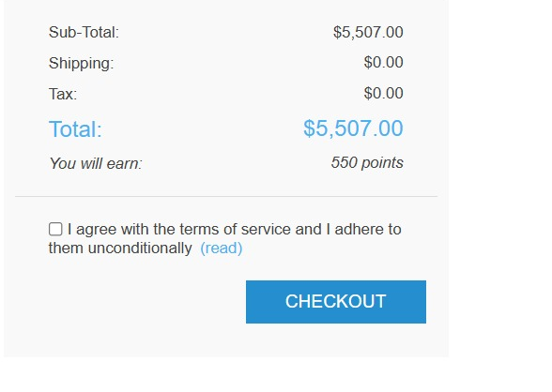
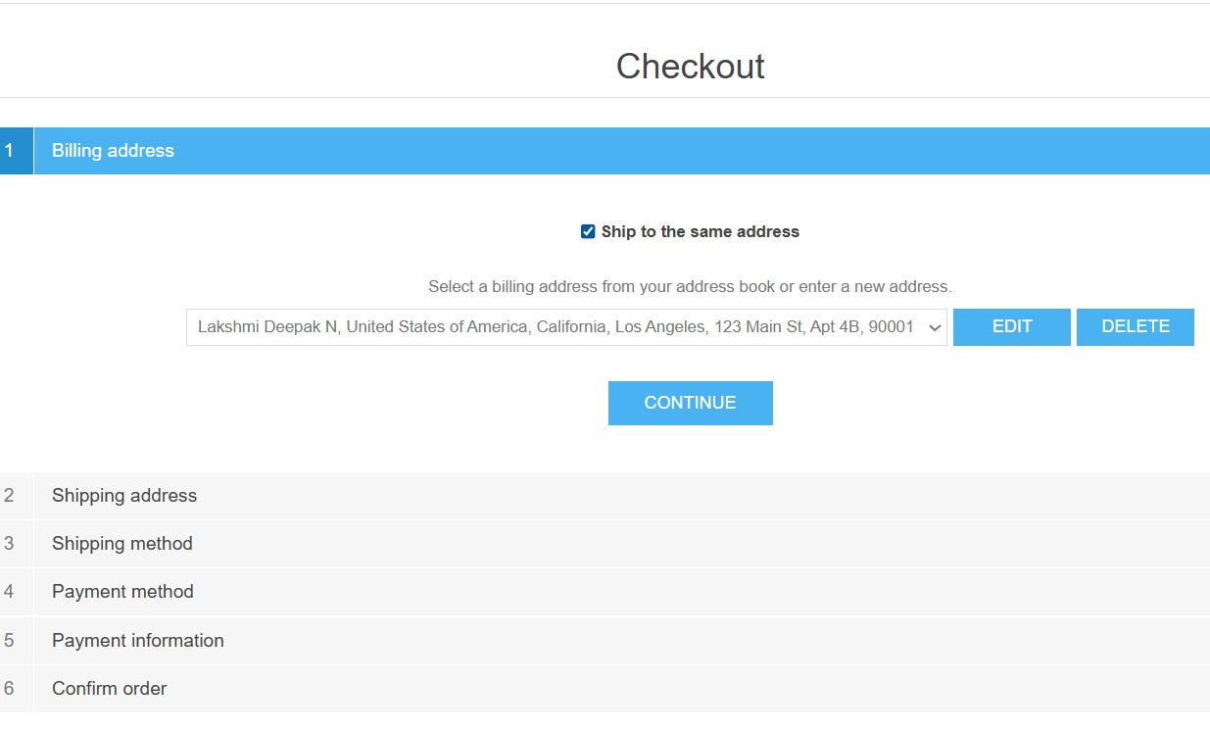
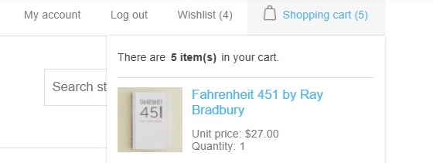
Test Case 5

Slide 15
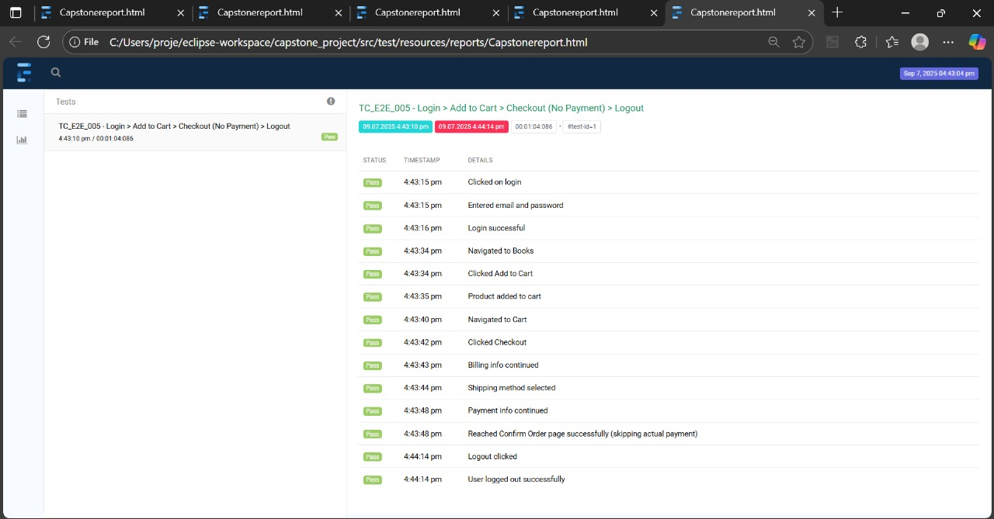
Generated Reports

Slide 16
Conclusion
This project successfully automated essential features of the NOPCommerce demo website using Selenium WebDriver and TestNG, covering actions such as user registration, login, product search, adding items to the cart, and the checkout process.
Key achievements include:
Efficient Test Execution: Automation reduced the time needed for repetitive tasks, and TestNG provided structured test management and detailed reporting, helping to identify issues early.
Comprehensive Test Coverage: The test suite covered key scenarios, ensuring consistent functionality across browsers like Chrome, Firefox, and Safari.
Scalability & Reusability: The automation framework is scalable, allowing for easy additions of new test cases. The use of Excel for data management enhanced the efficiency of data-driven testing.
Accurate Results: Automated tests provided reliable, consistent results with minimal errors, while TestNG reports made it easy to track and resolve issues.
Improved Quality Assurance: Automation ensured continuous testing of critical actions, contributing to the overall quality assurance process.
In conclusion, automation with Selenium WebDriver and TestNG improved the efficiency, accuracy, and scalability of testing for the NOPCommerce demo website. This approach reduced testing time and maintained high-quality standards, ensuring consistent validation as the website evolves.

Slide 17
Thank You

