Slide 1

RFID SCAN SYSTEM
PRESENTED BY :
Kushal M S (E 49)
Labish Jaishi(E 50)
Lakshmi I (E 51)
Faculty Guide: Prof.Ashuthosh
Notes:
1

Slide 2
INTRODUCTION
Radio Frequency Identification (RFID) is a wireless technology used to identify and verify objects or individuals using radio waves.
An RFID Scan System consists of an RFID reader, RFID tags/cards, and a microcontroller to process the scanned data.
When a tag is brought near the reader, the system detects the unique ID (UID) and performs an action such as granting access, activating indicators, or recording attendance.
RFID systems are widely used in automation, security, asset tracking, access control, and contactless identification.

Slide 3
Literature Survey
Early RFID systems were primarily used in supply chain tracking and inventory management, relying on low-frequency tags with limited range.
Modern RFID technologies now support high-frequency and ultra-high-frequency communication, enabling faster detection and improved accuracy.
Research shows that RFID provides faster authentication compared to barcode systems, as it doesn’t require line-of-sight scanning.
Studies highlight the importance of RFID in access control systems for schools, offices, industry, and IoT-based automation.
Recent advancements integrate RFID with Arduino, IoT modules, and cloud platforms, improving real-time monitoring and security.

Slide 4
OBJECTIVES
To design a simple and reliable RFID scan system for identifying valid and invalid RFID tags.
To implement a system that provides instant visual or audio feedback using indicators (relay lights, buzzer, LEDs).
To ensure quick and contactless authentication using RFID technology.
To demonstrate the working principle of RFID communication between reader and tag.
To create a low-cost, efficient setup suitable for academic and project applications.

Slide 5
METHODOLOGY
1. Component Selection
RFID RC522 reader module
RFID tags/cards
Arduino microcontroller
Relay indicators / LEDs / buzzer
2. System Design
Connect the RFID module to the Arduino using SPI communication.
Program the Arduino to read the UID from the RFID tag.

Slide 6
3. Data Processing
Compare the scanned UID with stored registered UIDs.
Decide whether access is valid or invalid.
4. Output Response
For valid tag → Green indicator/relay ON or buzzer short beep.
For invalid tag → Red indicator flicker + buzzer alert.
5. Testing & Validation
Scan multiple tags to verify accuracy and response time.
Adjust delays, sensitivity, and output signals for clear feedback

Slide 7
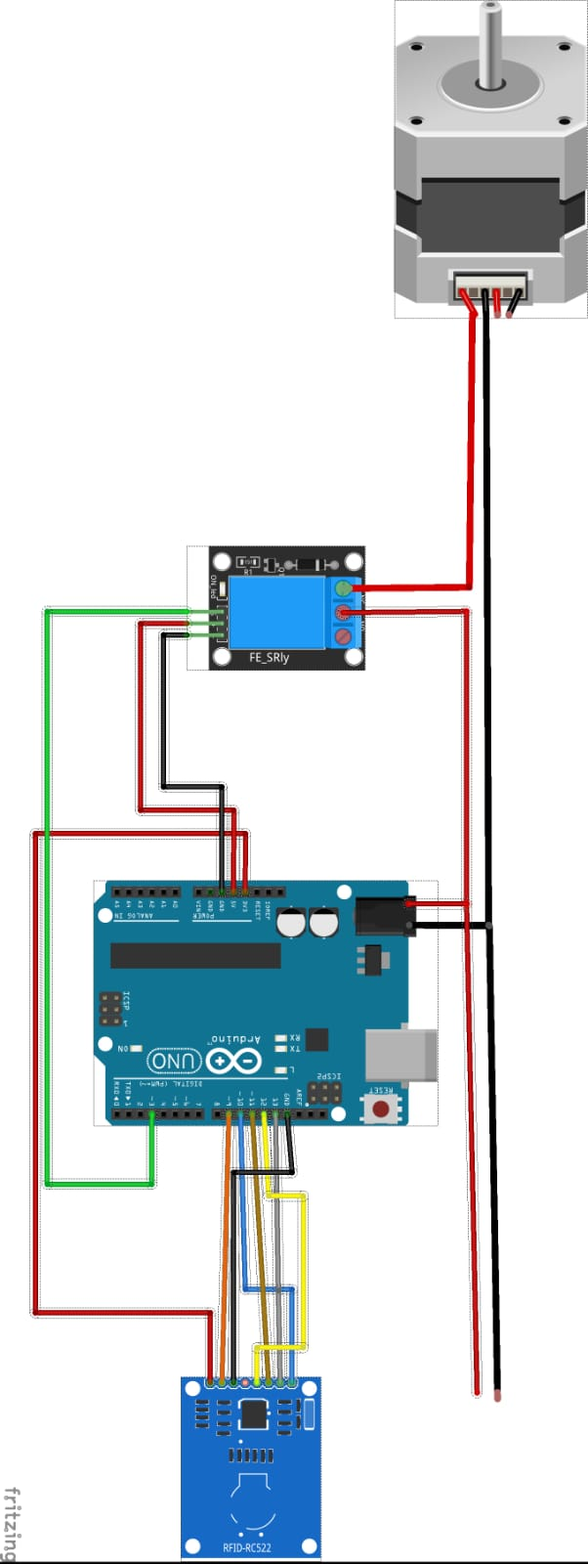
CIRCUIT DIAGRAM

Slide 8
EXPERIMENTATION AND ANALYSIS
The RFID reader was connected to the Arduino, and various RFID tags were scanned to observe UID accuracy.
Multiple trials showed that the system could detect tags within 2–5 cm range consistently.
Valid UIDs triggered the correct indicator response with minimal delay (<1 second).
Invalid UIDs consistently activated the red indicator flicker and buzzer alert, confirming accurate differentiation.
The relay indicators provided a clear visual representation of accepted or denied access.
System performance was stable, demonstrating reliable UID detection and fast processing.

Slide 9
CONCLUSION
The RFID Scan System successfully demonstrates efficient, contactless identification using RFID technology.The project shows how RFID can be used for secure access verification with quick output responses.The setup is low-cost, easy to build, and suitable for access control, attendance, automation, and security applications.With further enhancements such as IoT connectivity or database integration, the system can be expanded for real-time monitoring and advanced security solutions.

