Slide 1
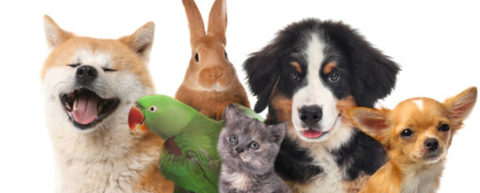
Pet Adoption Trends
Lakshmi Jayachandran

Slide 2
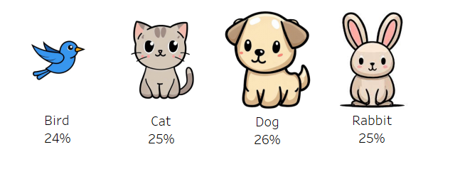
Overview of Pet Types

Slide 3
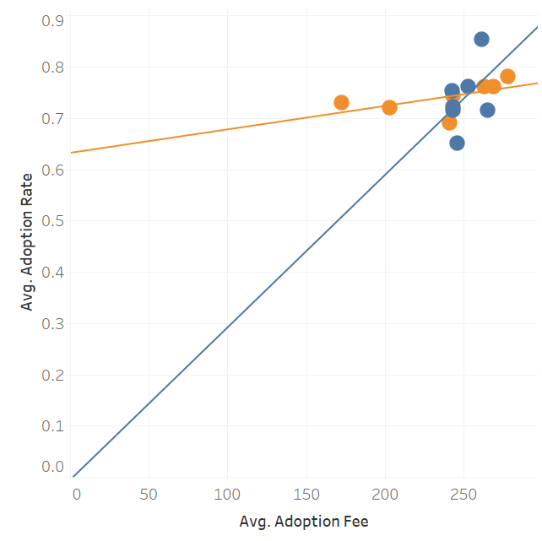

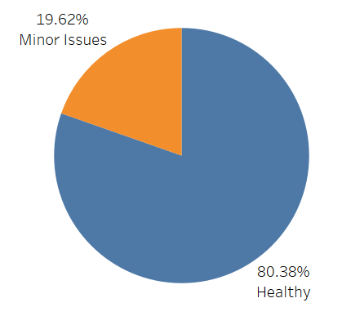
Health and Fees: Their Role in Adoption Rates

Slide 4
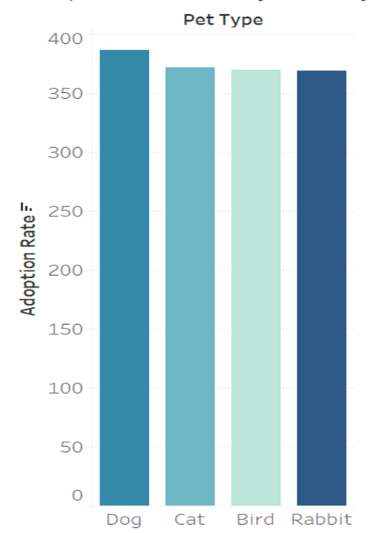
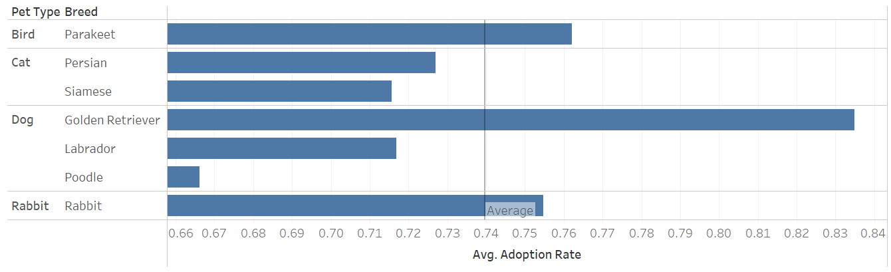
Adoption Rates by Pet Type and Breed

Slide 5

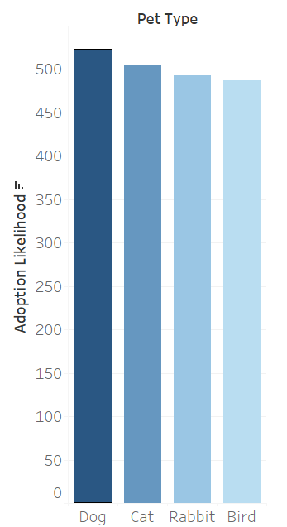
Adoption Likelihood By Pet Type

Slide 6

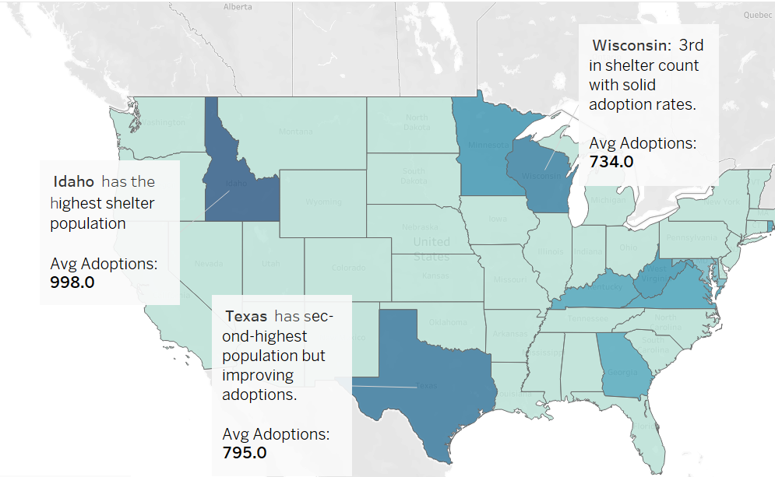
Shelter Populations by State

Slide 7
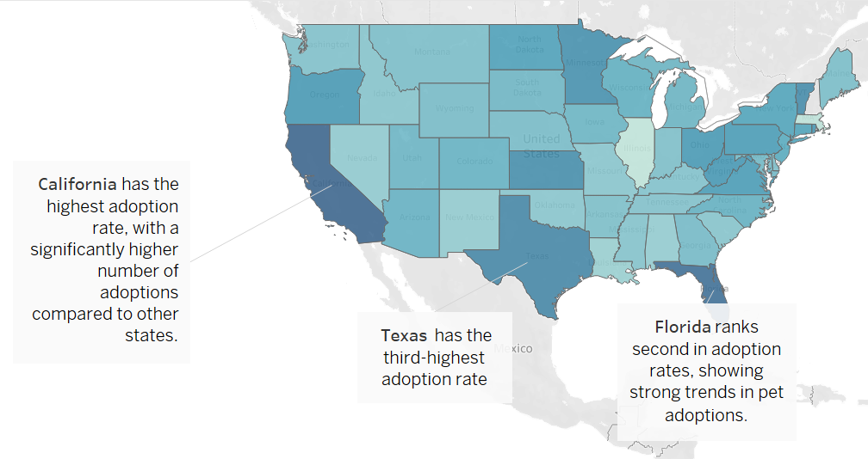
Adoption Trends by State

Slide 8

Recommendations
Boost Awareness Campaigns in High-Shelter States
Focus on Idaho and similar states with high shelter populations.
Collaborate with local organizations to promote adoption events.
Reduce Adoption Barriers
Lower or waive adoption fees for harder-to-adopt pets.
Provide incentives like starter pet supplies for new adopters.
Support Animal Health and Wellness
Invest in health care for shelter animals to improve adoption chances.
Highlight minor health issues as manageable for adopters.
Leverage Technology
Use social media and adoption platforms to connect pets with potential adopters.
Provide virtual meet-and-greets to increase engagement.
Community Involvement
Encourage fostering programs to temporarily reduce shelter overcrowding.
Educate communities about responsible pet ownership.

Slide 9
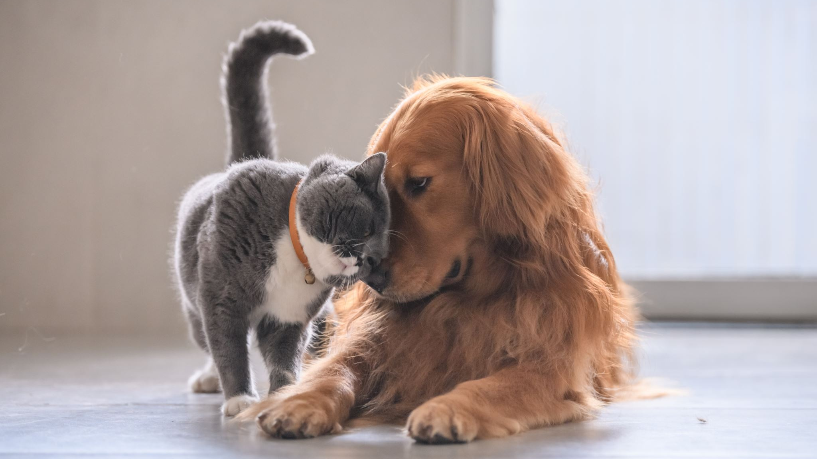
Thank you

