Slide 1
Mid-Curve Swaptions
v0.08 30 March 2026
Lakshmi Krishnamurthy

Slide 2
Product Definition
Definition of a Mid-curve Swaption: Mid-curve swaption is a European interest rate swaption that allows the option holder the right to enter into a forward-starting swap at expiry based on a strike rate that is pre-defined at trade inception
Difference with European Swaptions: While European swaptions have the underlying swap starting at the option expiry, the mid-curve option allows the option holder to enter into a swap whose start date is further away from option expiry.
Distance between Option Expiry and Swap Effective Dates: It is this difference between the option expiry and the underlying swap effective date that introduces the correlation between swap rate of different swaps

Slide 3
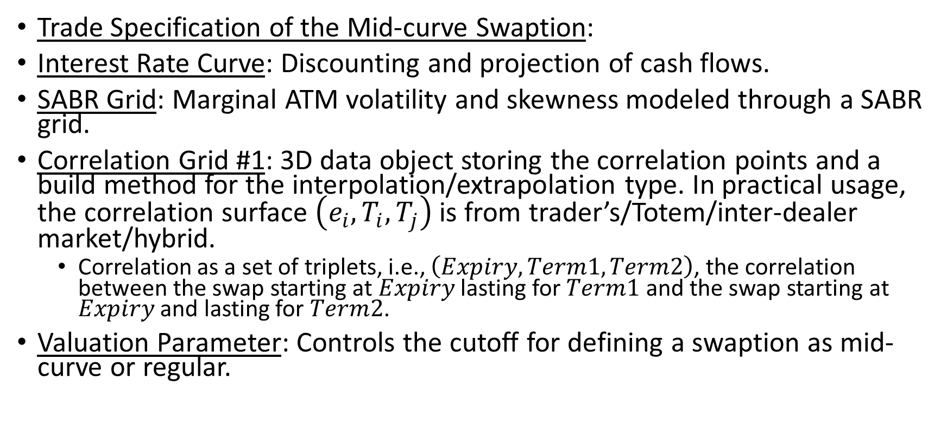
Model Inputs
Trade Specification of the Mid-curve Swaption:
Interest Rate Curve: Discounting and projection of cash flows.
SABR Grid: Marginal ATM volatility and skewness modeled through a SABR grid.
Correlation Grid #1: 3D data object storing the correlation points and a build method for the interpolation/extrapolation type. In practical usage, the correlation surface $\left(e_{i}, T_{i}, T_{j}\right)$ is from trader’s/Totem/inter-dealer market/hybrid.
Correlation as a set of triplets, i.e., $\left(Expiry, Term1, Term2\right)$, the correlation between the swap starting at $Expiry$ lasting for $Term1$ and the swap starting at $Expiry$ and lasting for $Term2$.
Valuation Parameter: Controls the cutoff for defining a swaption as mid-curve or regular.

Slide 4
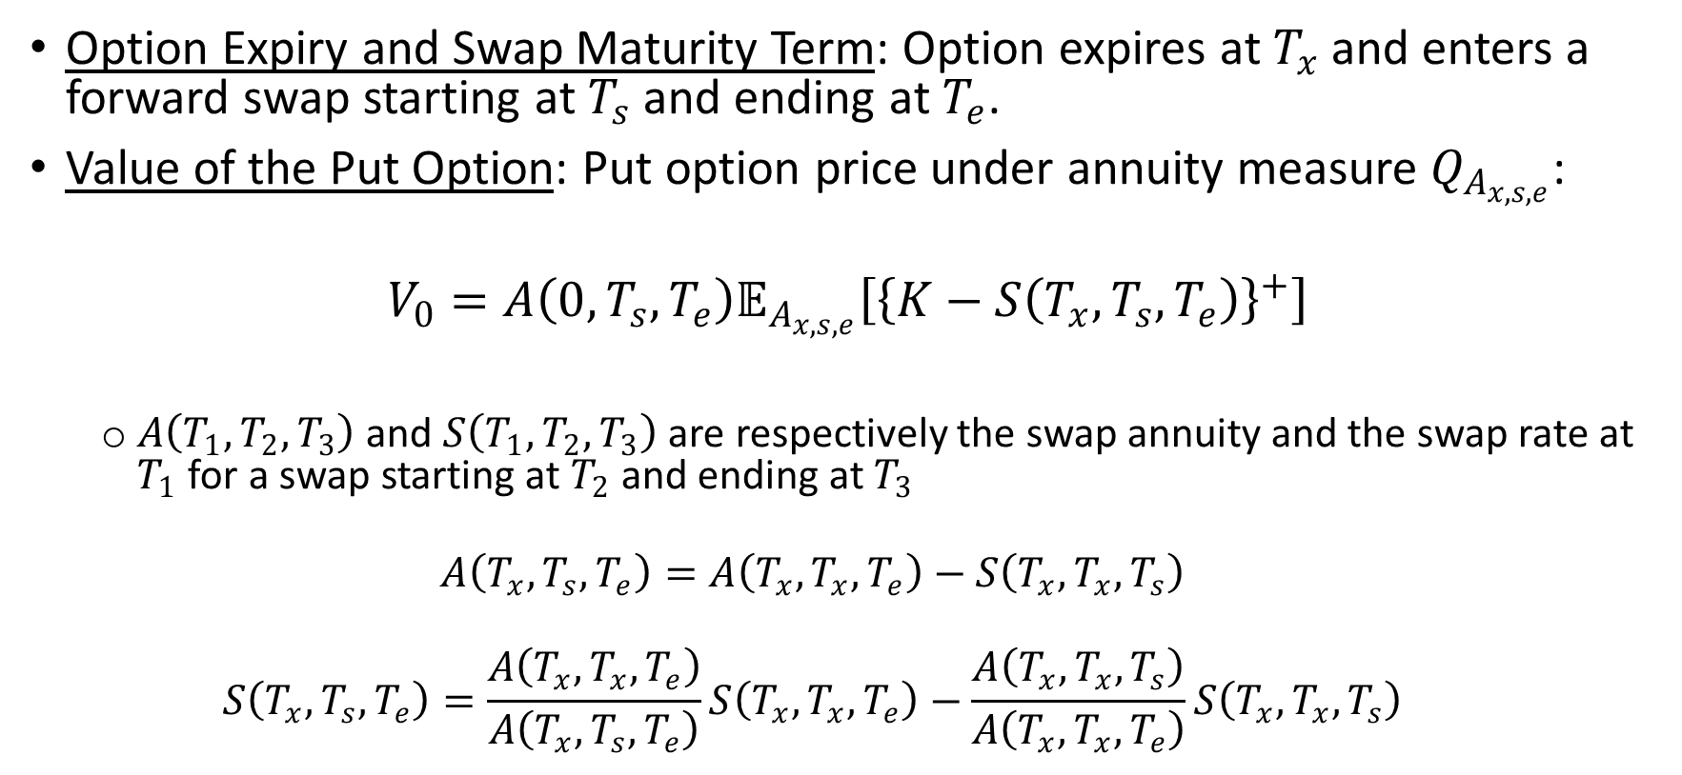
Model Design and Assumption
Option Expiry and Swap Maturity Term: Option expires at $T_{x}$ and enters a forward swap starting at $T_{s}$ and ending at $T_{e}$.
Value of the Put Option: Put option price under annuity measure $Q_{A_{x, s, e}}$:
$$V_{0}=A\left(0, T_{s}, T_{e}\right)𝔼_{A_{x, s, e}}\left[{\left\{K−S\left(T_{x}, T_{s}, T_{e}\right)\right\}}^{+}\right]$$
$A\left(T_{1}, T_{2}, T_{3}\right)$ and $S\left(T_{1}, T_{2}, T_{3}\right)$ are respectively the swap annuity and the swap rate at $T_{1}$ for a swap starting at $T_{2}$ and ending at $T_{3}$
$$A\left(T_{x}, T_{s}, T_{e}\right)=A\left(T_{x}, T_{x}, T_{e}\right)−S\left(T_{x}, T_{x}, T_{s}\right)$$
$$S\left(T_{x}, T_{s}, T_{e}\right)=\frac{A\left(T_{x}, T_{x}, T_{e}\right)}{A\left(T_{x}, T_{s}, T_{e}\right)}S\left(T_{x}, T_{x}, T_{e}\right)−\frac{A\left(T_{x}, T_{x}, T_{s}\right)}{A\left(T_{x}, T_{x}, T_{e}\right)}S\left(T_{x}, T_{x}, T_{s}\right)$$

Slide 5
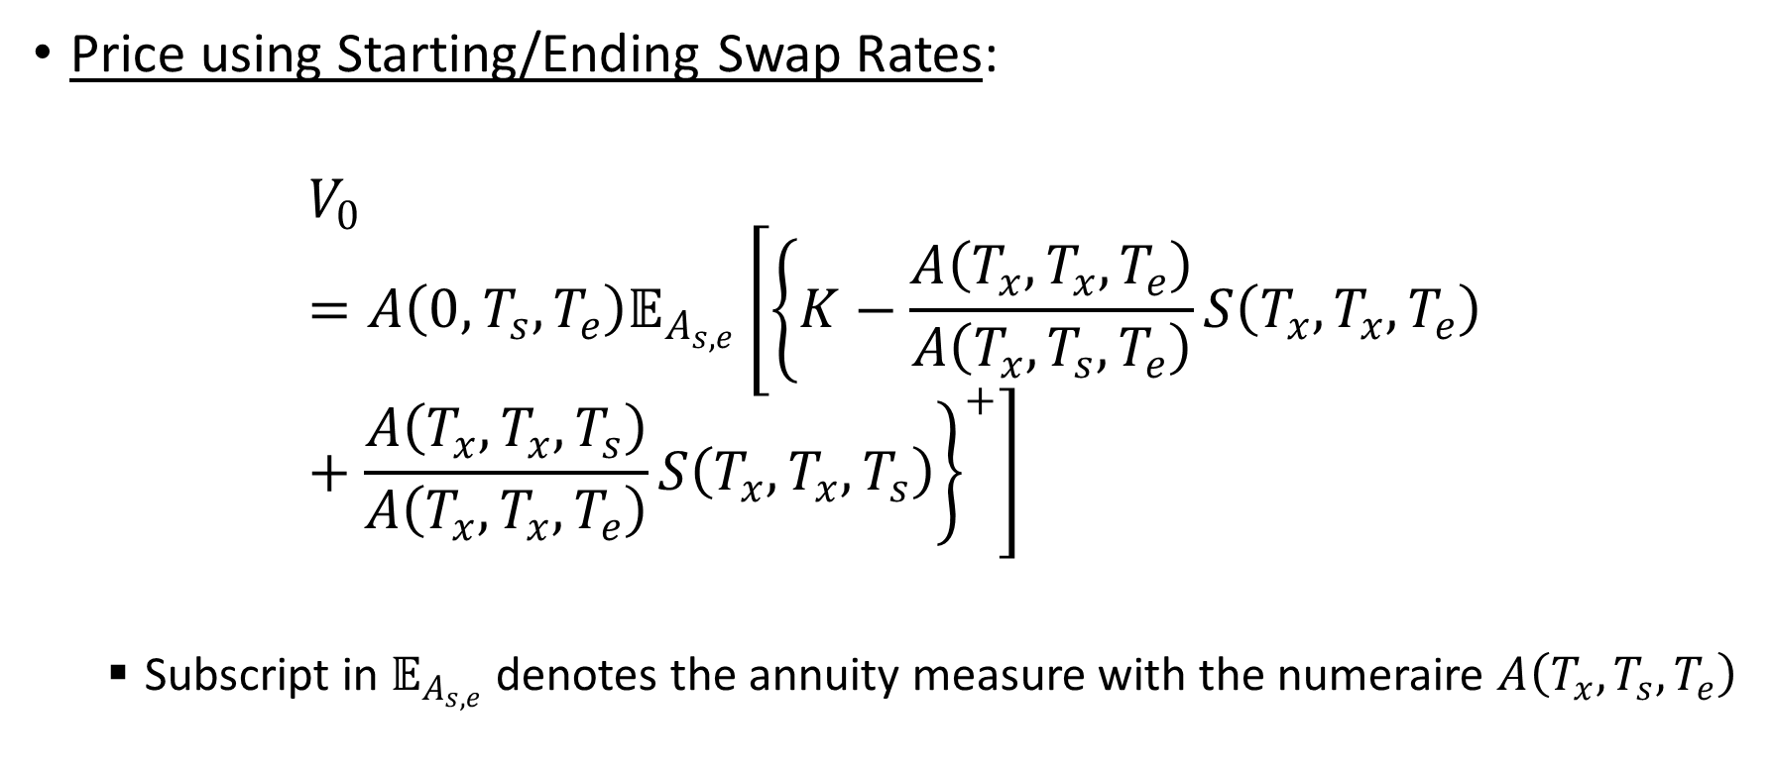
Model Design and Assumption (continued)
Price using Starting/Ending Swap Rates:
$$V_{0}=A\left(0, T_{s}, T_{e}\right)𝔼_{A_{s, e}}\left[{\left\{K−\frac{A\left(T_{x}, T_{x}, T_{e}\right)}{A\left(T_{x}, T_{s}, T_{e}\right)}S\left(T_{x}, T_{x}, T_{e}\right)+\frac{A\left(T_{x}, T_{x}, T_{s}\right)}{A\left(T_{x}, T_{x}, T_{e}\right)}S\left(T_{x}, T_{x}, T_{s}\right)\right\}}^{+}\right]$$
Subscript in $𝔼_{A_{s, e}}$ denotes the annuity measure with the numeraire $A\left(T_{x}, T_{s}, T_{e}\right)$

Slide 6

Model Design and Assumption (continued)
Ratio of Forward Annuities:
$$w_{s}=\frac{A\left(T_{x}, T_{x}, T_{e}\right)}{A\left(T_{x}, T_{s}, T_{e}\right)}$$
$$w_{e}=\frac{A\left(T_{x}, T_{x}, T_{s}\right)}{A\left(T_{x}, T_{x}, T_{e}\right)}$$
$$V_{0}=A\left(0, T_{s}, T_{e}\right)𝔼_{A_{s, e}}\left[{\left\{K−w_{s}∙S\left(T_{x}, T_{x}, T_{e}\right)+w_{e}∙S\left(T_{x}, T_{x}, T_{s}\right)\right\}}^{+}\right]$$

Slide 7
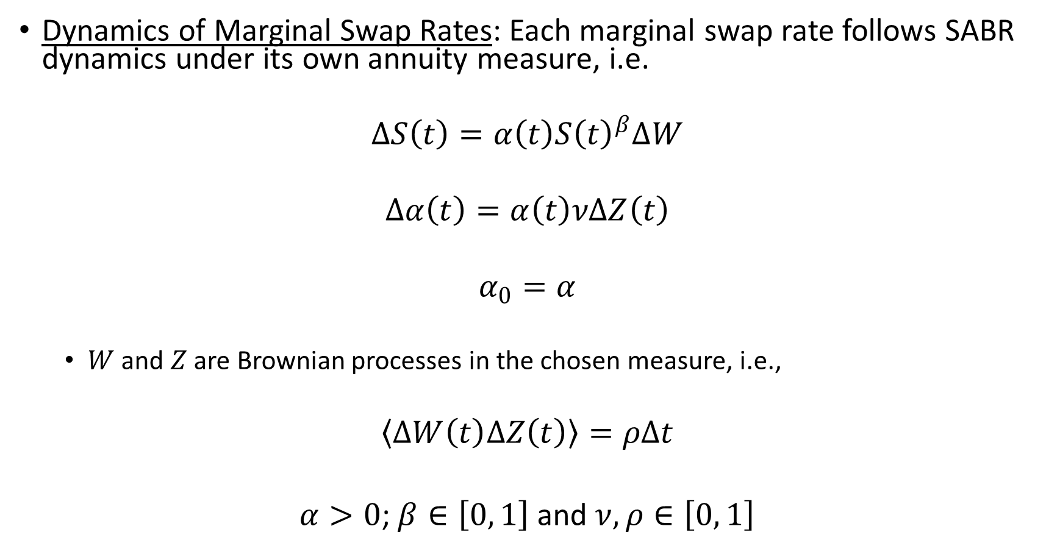
Model Design and Assumption (continued)
Dynamics of Marginal Swap Rates: Each marginal swap rate follows SABR dynamics under its own annuity measure, i.e.
$$∆S\left(t\right)=α\left(t\right){S\left(t\right)}^{β}∆W$$
$$∆α\left(t\right)=α\left(t\right)νΔZ\left(t\right)$$
$$α_{0}=α$$
$W$ and $Z$ are Brownian processes in the chosen measure, i.e.,
$$〈ΔW\left(t\right)ΔZ\left(t\right)〉=ρΔt$$
$α>0$;$β∈\left[0, 1\right]$ and $ν, ρ∈\left[0, 1\right]$

Slide 8

Model Design and Assumption (continued)
Correlated SABR Swap Rate: Joint swap rates follow a multi-dimensional SABR dynamic on two assets
$$S_{i}\left(t\right)∶=S\left(t, T_{x}, T_{i}\right)$$
where $T_{i}$ is either $T_{s}$ or $T_{e}$.
Cross-correlation dynamics under the forward swap annuity measure are as follows:
$$∆S_{i}\left(t\right)=α_{i}\left(t\right)S_{i}{\left(t\right)}^{β_{i}}∆W_{i}\left(t\right)$$
$$∆α\left(t\right)=α_{i}\left(t\right)ν_{i}ΔZ_{i}\left(t\right)$$
$$α_{i}\left(t_{0}\right)=α_{i}$$
$$〈ΔW_{i}\left(t\right)ΔW_{j}\left(t\right)〉=γ_{ij}Δt$$
$$〈ΔZ_{i}\left(t\right)ΔZ_{j}\left(t\right)〉=η_{ij}Δt$$
$$〈ΔZ_{i}\left(t\right)ΔW_{j}\left(t\right)〉=ρ_{ij}Δt$$
$$〈ΔZ_{i}\left(t\right)ΔW_{i}\left(t\right)〉=ρ_{i}Δt$$

Slide 9
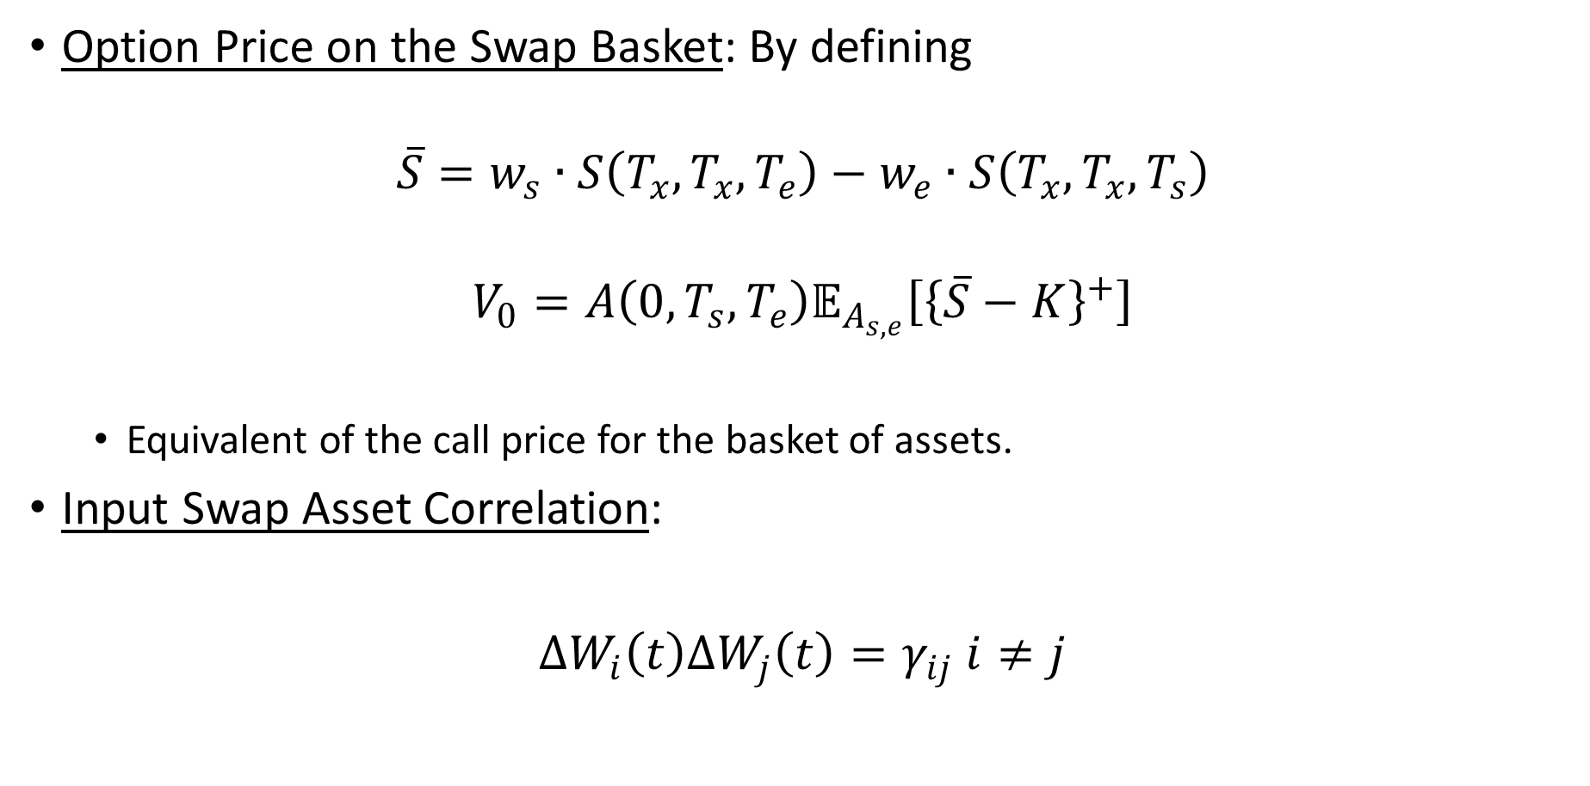
Model Design and Assumption (continued)
Option Price on the Swap Basket: By defining
$$\overline{S}=w_{s}∙S\left(T_{x}, T_{x}, T_{e}\right)−w_{e}∙S\left(T_{x}, T_{x}, T_{s}\right)$$
$$V_{0}=A\left(0, T_{s}, T_{e}\right)𝔼_{A_{s, e}}\left[{\left\{\overline{S}−K\right\}}^{+}\right]$$
Equivalent of the call price for the basket of assets.
Input Swap Asset Correlation:
$ΔW_{i}\left(t\right)ΔW_{j}\left(t\right)=γ_{ij}$ $i≠j$

Slide 10
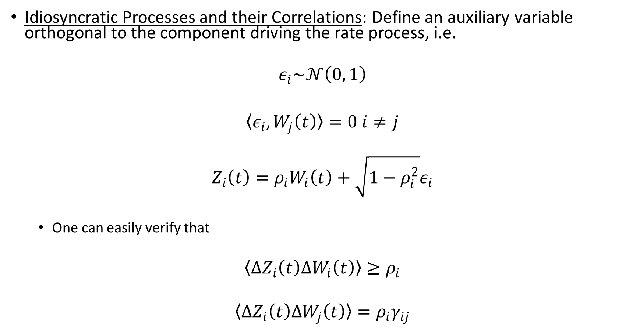
Model Design and Assumption (continued)
Idiosyncratic Processes and their Correlations: Define an auxiliary variable orthogonal to the component driving the rate process, i.e.
$$ε_{i}\sim 𝒩\left(0, 1\right)$$
$〈ε_{i}, W_{j}\left(t\right)〉=0$ $i≠j$
$$Z_{i}\left(t\right)=ρ_{i}W_{i}\left(t\right)+\sqrt{1−ρ_{i}^{2}}ε_{i}$$
One can easily verify that
$$〈ΔZ_{i}\left(t\right)ΔW_{i}\left(t\right)〉≥ρ_{i}$$
$$〈ΔZ_{i}\left(t\right)ΔW_{j}\left(t\right)〉=ρ_{i}γ_{ij}$$

Slide 11
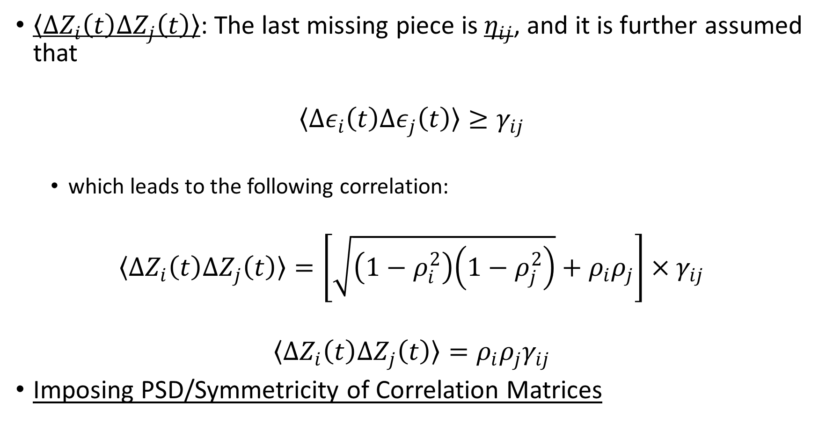
Model Design and Assumption (continued)
$〈ΔZ_{i}\left(t\right)ΔZ_{j}\left(t\right)〉$: The last missing piece is $η_{ij}$, and it is further assumed that
$$〈Δε_{i}\left(t\right)Δε_{j}\left(t\right)〉≥γ_{ij}$$
which leads to the following correlation:
$$〈ΔZ_{i}\left(t\right)ΔZ_{j}\left(t\right)〉=\left[\sqrt{\left(1−ρ_{i}^{2}\right)\left(1−ρ_{j}^{2}\right)}+ρ_{i}ρ_{j}\right]×γ_{ij}$$
$$〈ΔZ_{i}\left(t\right)ΔZ_{j}\left(t\right)〉=ρ_{i}ρ_{j}γ_{ij}$$
Imposing PSD/Symmetricity of Correlation Matrices

Slide 12
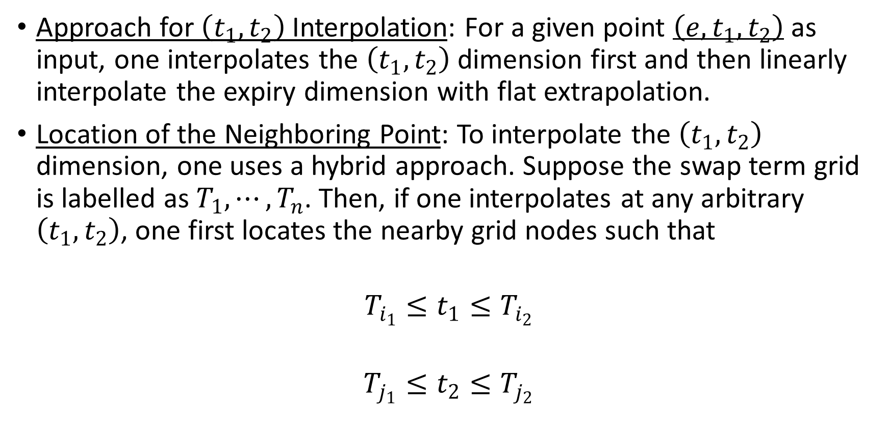
Model Design and Assumption (continued)
Approach for $\left(t_{1}, t_{2}\right)$ Interpolation: For a given point $\left(e, t_{1}, t_{2}\right)$ as input, one interpolates the $\left(t_{1}, t_{2}\right)$ dimension first and then linearly interpolate the expiry dimension with flat extrapolation.
Location of the Neighboring Point: To interpolate the $\left(t_{1}, t_{2}\right)$ dimension, one uses a hybrid approach. Suppose the swap term grid is labelled as $T_{1}, ⋯, T_{n}$. Then, if one interpolates at any arbitrary $\left(t_{1}, t_{2}\right)$, one first locates the nearby grid nodes such that
$$T_{i_{1}}≤t_{1}≤T_{i_{2}}$$
$$T_{j_{1}}≤t_{2}≤T_{j_{2}}$$

Slide 13
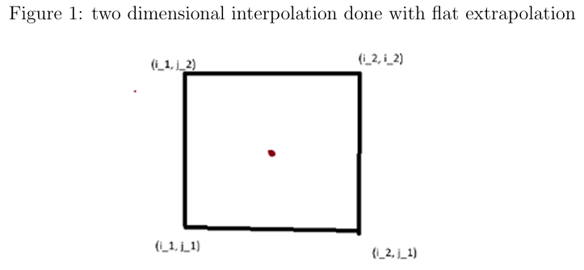

Model Design and Assumption (continued)
Case 1: $\left(i_{2}, j_{2}\right)$ and $\left(i_{1}, j_{1}\right)$ are not a diagonal point. That is, all four nearby points are used in the interpolation. In this case, a usual 2D interpolation is done with flat interpolation.
Case 1 Illustration:

Slide 14
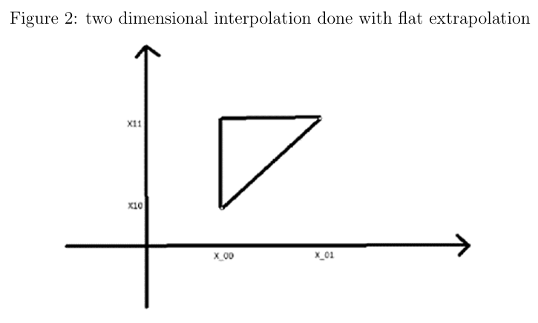
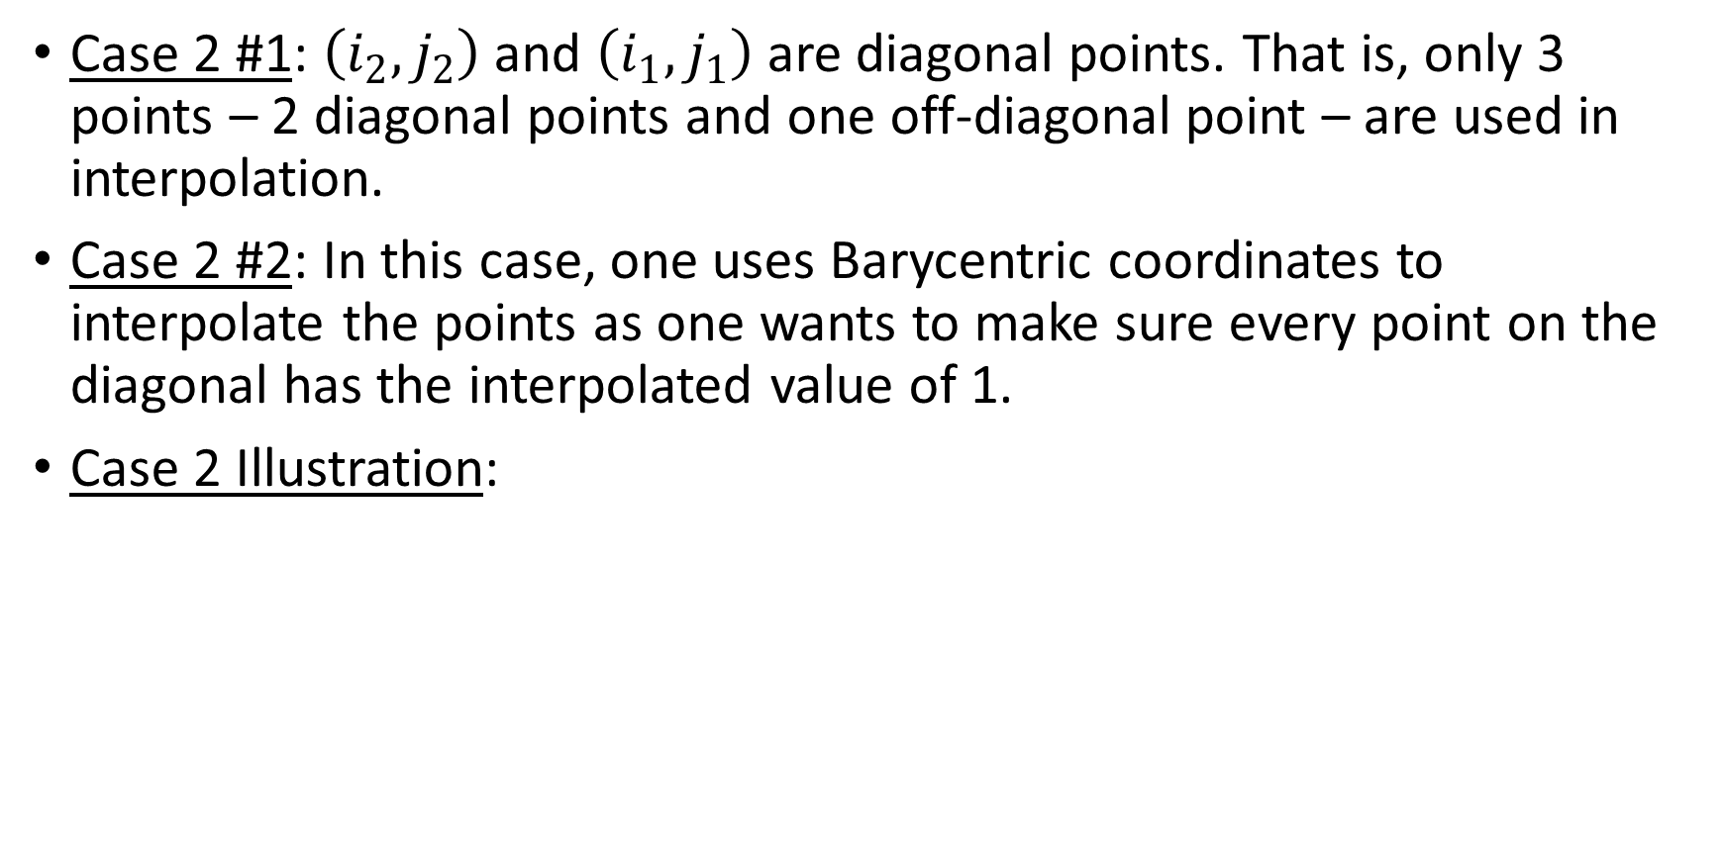
Model Design and Assumption (continued)
Case 2 #1: $\left(i_{2}, j_{2}\right)$ and $\left(i_{1}, j_{1}\right)$ are diagonal points. That is, only 3 points – 2 diagonal points and one off-diagonal point – are used in interpolation.
Case 2 #2: In this case, one uses Barycentric coordinates to interpolate the points as one wants to make sure every point on the diagonal has the interpolated value of 1.
Case 2 Illustration:

Slide 15
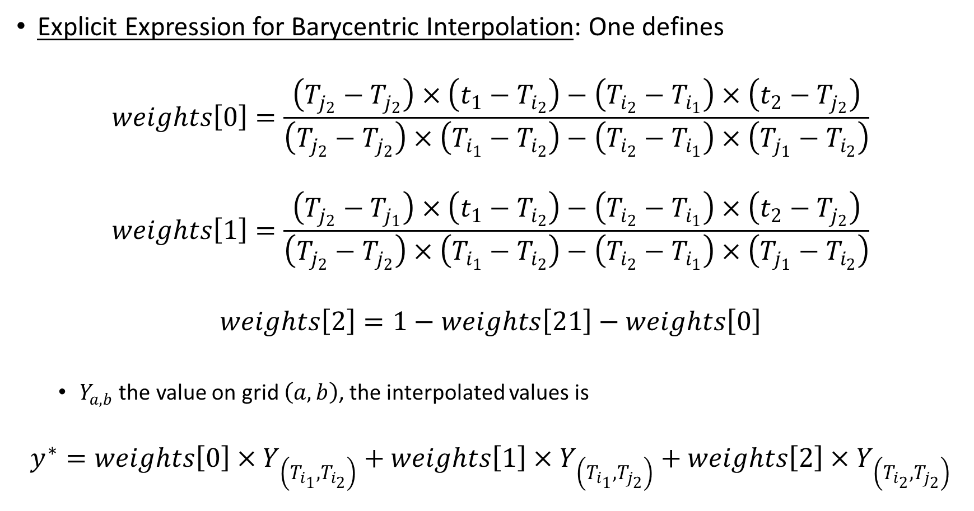
Model Design and Assumption (continued)
Explicit Expression for Barycentric Interpolation: One defines
$$weights\left[0\right]=\frac{\left(T_{j_{2}}−T_{j_{2}}\right)×\left(t_{1}−T_{i_{2}}\right)−\left(T_{i_{2}}−T_{i_{1}}\right)×\left(t_{2}−T_{j_{2}}\right)}{\left(T_{j_{2}}−T_{j_{2}}\right)×\left(T_{i_{1}}−T_{i_{2}}\right)−\left(T_{i_{2}}−T_{i_{1}}\right)×\left(T_{j_{1}}−T_{i_{2}}\right)}$$
$$weights\left[1\right]=\frac{\left(T_{j_{2}}−T_{j_{1}}\right)×\left(t_{1}−T_{i_{2}}\right)−\left(T_{i_{2}}−T_{i_{1}}\right)×\left(t_{2}−T_{j_{2}}\right)}{\left(T_{j_{2}}−T_{j_{2}}\right)×\left(T_{i_{1}}−T_{i_{2}}\right)−\left(T_{i_{2}}−T_{i_{1}}\right)×\left(T_{j_{1}}−T_{i_{2}}\right)}$$
$$weights\left[2\right]=1−weights\left[21\right]−weights\left[0\right]$$
$Y_{a, b}$ the value on grid $\left(a, b\right)$, the interpolated values is
$$y^{∗}=weights\left[0\right]×Y_{\left(T_{i_{1}}, T_{i_{2}}\right)}+weights\left[1\right]×Y_{\left(T_{i_{1}}, T_{j_{2}}\right)}+weights\left[2\right]×Y_{\left(T_{i_{2}}, T_{j_{2}}\right)}$$

Slide 16
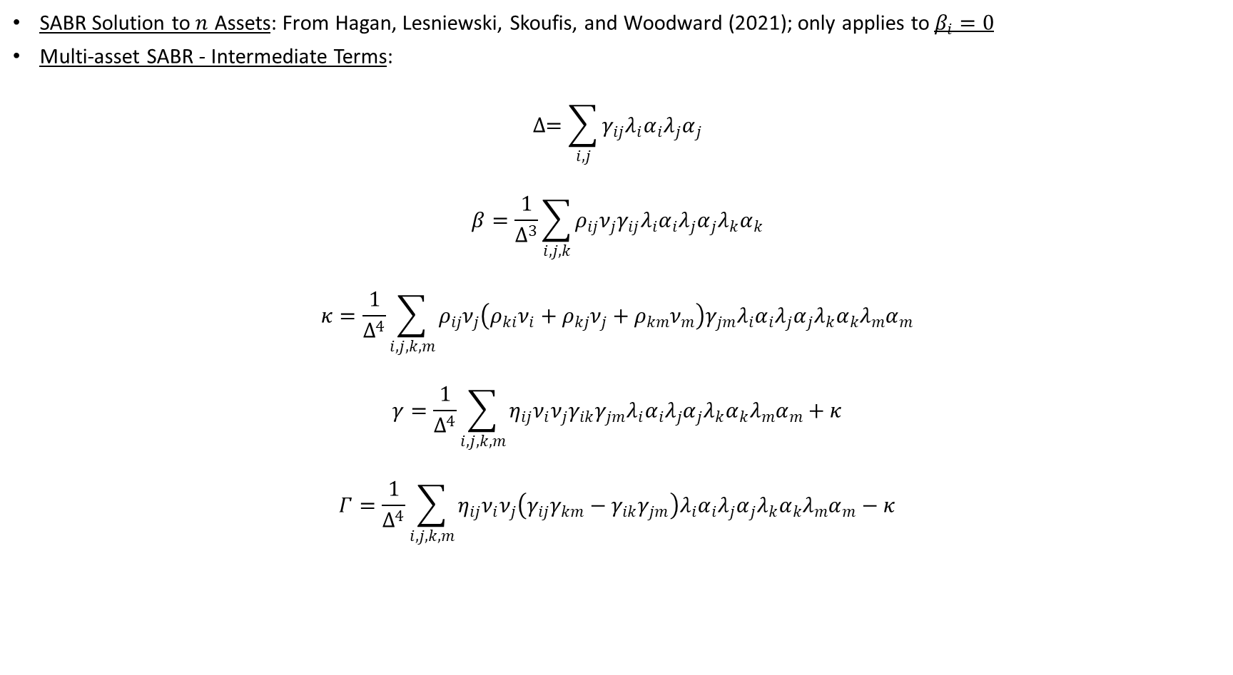
Model Design and Assumption (continued)
SABR Solution to $n$ Assets: From Hagan, Lesniewski, Skoufis, and Woodward (2021); only applies to $β_{i}=0$
Multi-asset SABR - Intermediate Terms:
$$∆=\sum_{i, j}{γ_{ij}λ_{i}α_{i}λ_{j}α_{j}}$$
$$β=\frac{1}{Δ^{3}}\sum_{i, j, k}{ρ_{ij}ν_{j}γ_{ij}λ_{i}α_{i}λ_{j}α_{j}λ_{k}α_{k}}$$
$$κ=\frac{1}{Δ^{4}}\sum_{i, j, k, m}{ρ_{ij}ν_{j}\left(ρ_{ki}ν_{i}+ρ_{kj}ν_{j}+ρ_{km}ν_{m}\right)γ_{jm}λ_{i}α_{i}λ_{j}α_{j}λ_{k}α_{k}λ_{m}α_{m}}$$
$$γ=\frac{1}{Δ^{4}}\sum_{i, j, k, m}{η_{ij}ν_{i}ν_{j}γ_{ik}γ_{jm}λ_{i}α_{i}λ_{j}α_{j}λ_{k}α_{k}λ_{m}α_{m}}+κ$$
$$Γ=\frac{1}{Δ^{4}}\sum_{i, j, k, m}{η_{ij}ν_{i}ν_{j}\left(γ_{ij}γ_{km}−γ_{ik}γ_{jm}\right)λ_{i}α_{i}λ_{j}α_{j}λ_{k}α_{k}λ_{m}α_{m}}−κ$$

Slide 17

Model Design and Assumption (continued)
Asset Indexes $i, j, k, m$: Setting the $dimension=2$ $i, j, k, m$ ranges from 0 to 1 – results in effective SABR parameter on the 2-asset case.
“Effective” SABR Parameters: New set of SABR parameters $α_{eff}$, $ρ_{eff}$, $ν_{eff}$, and a SABR model defined using a new set of SABR parameters, that is
$$Δ\tilde{S}\left(t\right)=\tilde{A}\left(t\right)ΔW\left(t\right)$$
$$Δ\tilde{A}\left(t\right)=ν_{eff}\tilde{A}\left(t\right)ΔZ\left(t\right)$$
$$ΔZ\left(t\right)ΔW\left(t\right)=ρ_{eff}Δt$$
$${\tilde{A}}_{0}=α_{eff}$$
$$α_{eff}=\frac{Δ}{\sqrt{C}}≡∆e^{\frac{1}{4}Γτ_{A}}$$
$$ρ_{eff}=\frac{β}{\sqrt{γ}}$$
$$ν_{eff}=\sqrt{γ}$$

Slide 18
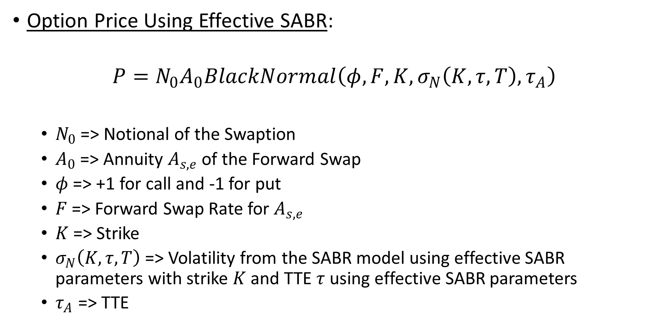
Model Design and Assumption (continued)
Option Price Using Effective SABR:
$$P=N_{0}A_{0}BlackNormal\left(φ, F, K, σ_{N}\left(K, τ, T\right), τ_{A}\right)$$
$N_{0}$ => Notional of the Swaption
$A_{0}$ => Annuity $A_{s, e}$ of the Forward Swap
$φ$ => +1 for call and -1 for put
$F$ => Forward Swap Rate for $A_{s, e}$
$K$ => Strike
$σ_{N}\left(K, τ, T\right)$ => Volatility from the SABR model using effective SABR parameters with strike $K$ and TTE $τ$ using effective SABR parameters
$τ_{A}$ => TTE

Slide 19
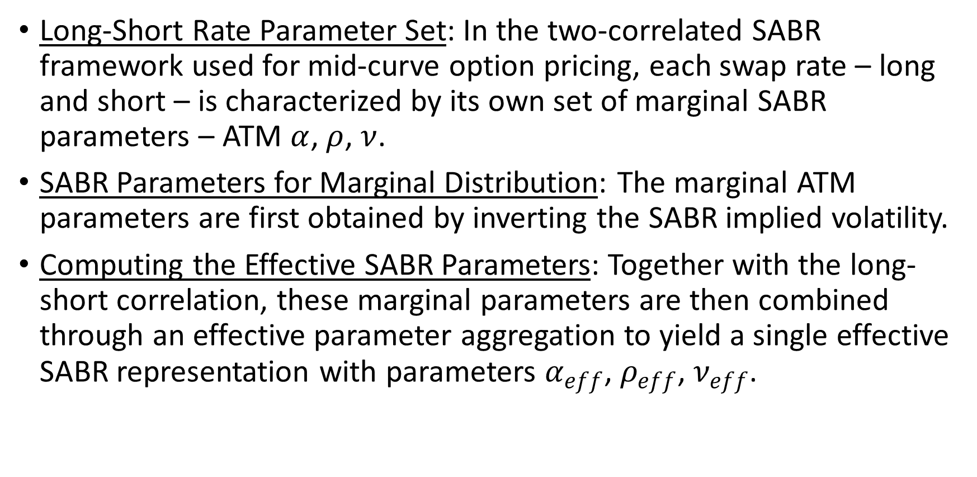
Model Design and Assumption (continued)
Long-Short Rate Parameter Set: In the two-correlated SABR framework used for mid-curve option pricing, each swap rate – long and short – is characterized by its own set of marginal SABR parameters – ATM $α$, $ρ$, $ν$.
SABR Parameters for Marginal Distribution: The marginal ATM parameters are first obtained by inverting the SABR implied volatility.
Computing the Effective SABR Parameters: Together with the long-short correlation, these marginal parameters are then combined through an effective parameter aggregation to yield a single effective SABR representation with parameters $α_{eff}$, $ρ_{eff}$, $ν_{eff}$.

Slide 20
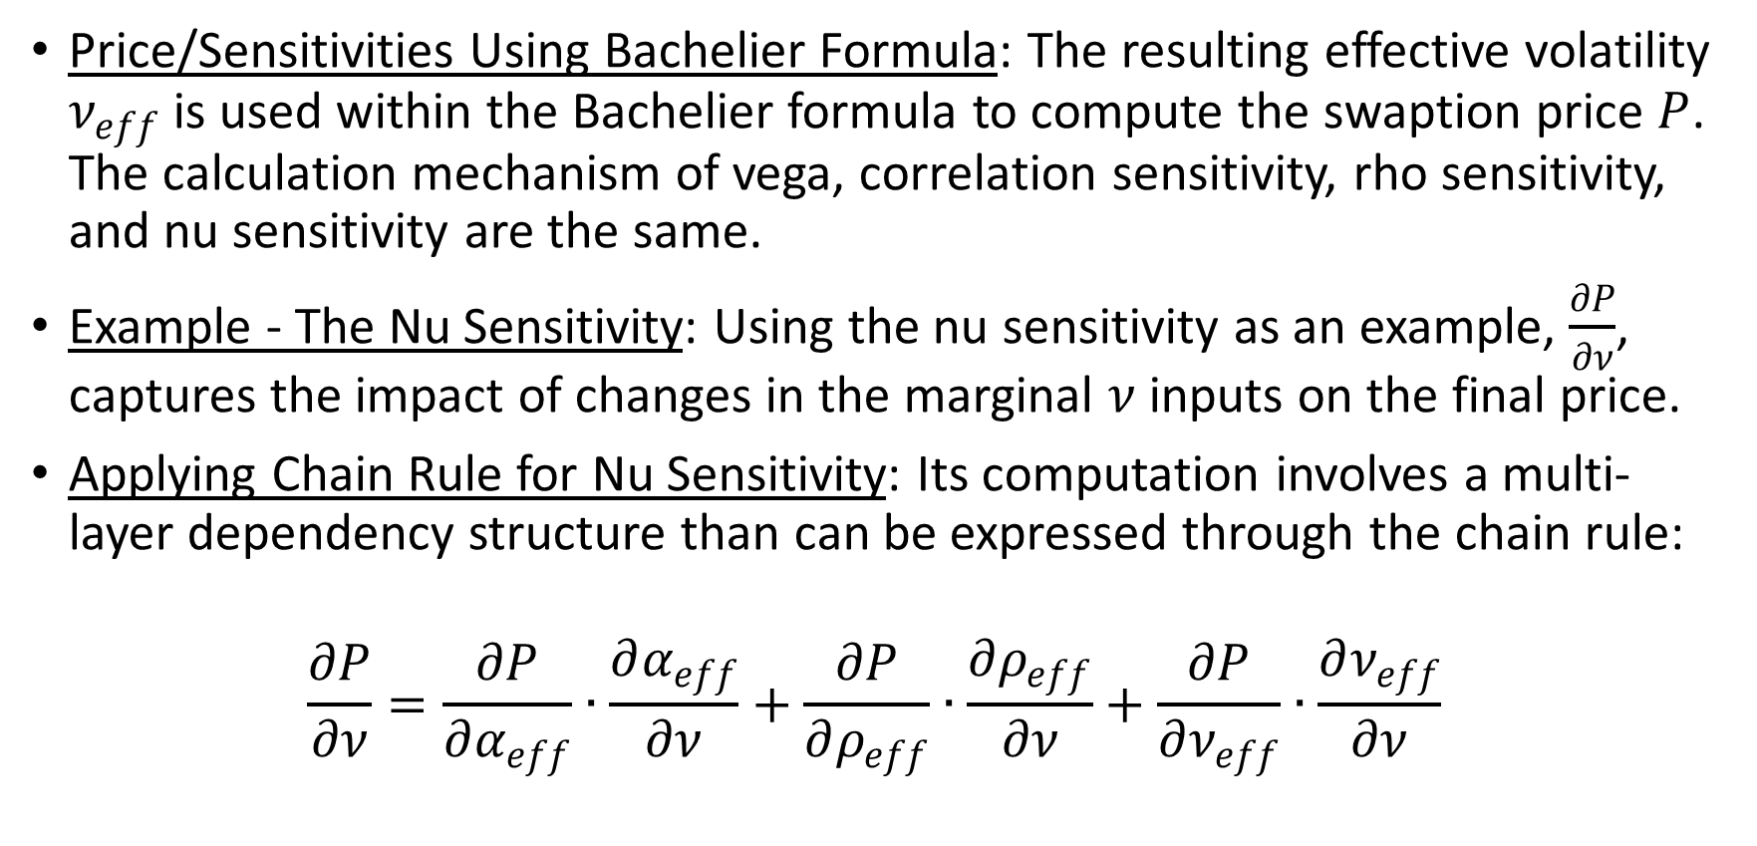
Model Design and Assumption (continued)
Price/Sensitivities Using Bachelier Formula: The resulting effective volatility $ν_{eff}$ is used within the Bachelier formula to compute the swaption price $P$. The calculation mechanism of vega, correlation sensitivity, rho sensitivity, and nu sensitivity are the same.
Example - The Nu Sensitivity: Using the nu sensitivity as an example, $\frac{∂P}{∂ν}$, captures the impact of changes in the marginal $ν$ inputs on the final price.
Applying Chain Rule for Nu Sensitivity: Its computation involves a multi-layer dependency structure than can be expressed through the chain rule:
$$\frac{∂P}{∂ν}=\frac{∂P}{∂α_{eff}}∙\frac{∂α_{eff}}{∂ν}+\frac{∂P}{∂ρ_{eff}}∙\frac{∂ρ_{eff}}{∂ν}+\frac{∂P}{∂ν_{eff}}∙\frac{∂ν_{eff}}{∂ν}$$

Slide 21
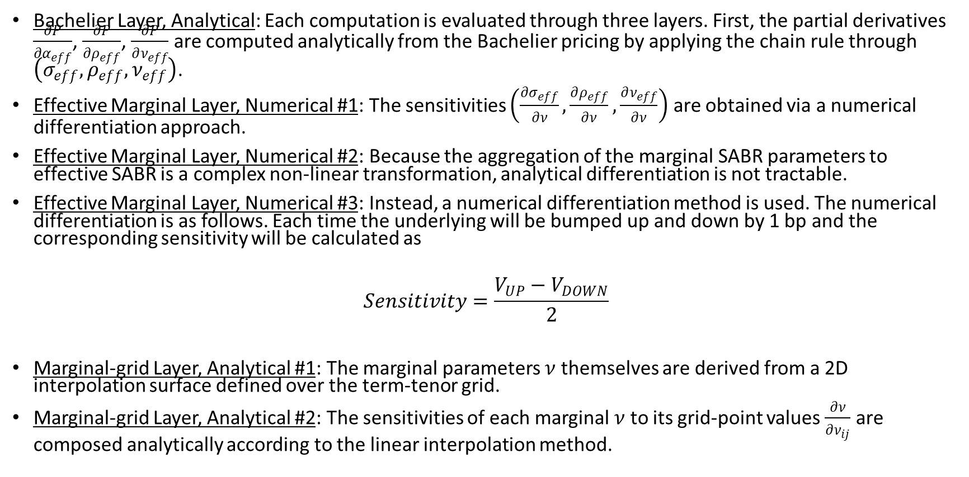
Model Design and Assumption (continued)
Bachelier Layer, Analytical: Each computation is evaluated through three layers. First, the partial derivatives $\frac{∂P}{∂α_{eff}}$, $\frac{∂P}{∂ρ_{eff}}$, $\frac{∂P}{∂ν_{eff}}$ are computed analytically from the Bachelier pricing by applying the chain rule through $\left(σ_{eff}, ρ_{eff}, ν_{eff}\right)$.
Effective Marginal Layer, Numerical #1: The sensitivities $\left(\frac{∂σ_{eff}}{∂ν}, \frac{∂ρ_{eff}}{∂ν}, \frac{∂ν_{eff}}{∂ν}\right)$ are obtained via a numerical differentiation approach.
Effective Marginal Layer, Numerical #2: Because the aggregation of the marginal SABR parameters to effective SABR is a complex non-linear transformation, analytical differentiation is not tractable.
Effective Marginal Layer, Numerical #3: Instead, a numerical differentiation method is used. The numerical differentiation is as follows. Each time the underlying will be bumped up and down by 1 bp and the corresponding sensitivity will be calculated as
$$Sensitivity=\frac{V_{UP}−V_{DOWN}}{2}$$
Marginal-grid Layer, Analytical #1: The marginal parameters $ν$ themselves are derived from a 2D interpolation surface defined over the term-tenor grid.
Marginal-grid Layer, Analytical #2: The sensitivities of each marginal $ν$ to its grid-point values $\frac{∂ν}{∂ν_{ij}}$ are composed analytically according to the linear interpolation method.

Slide 22
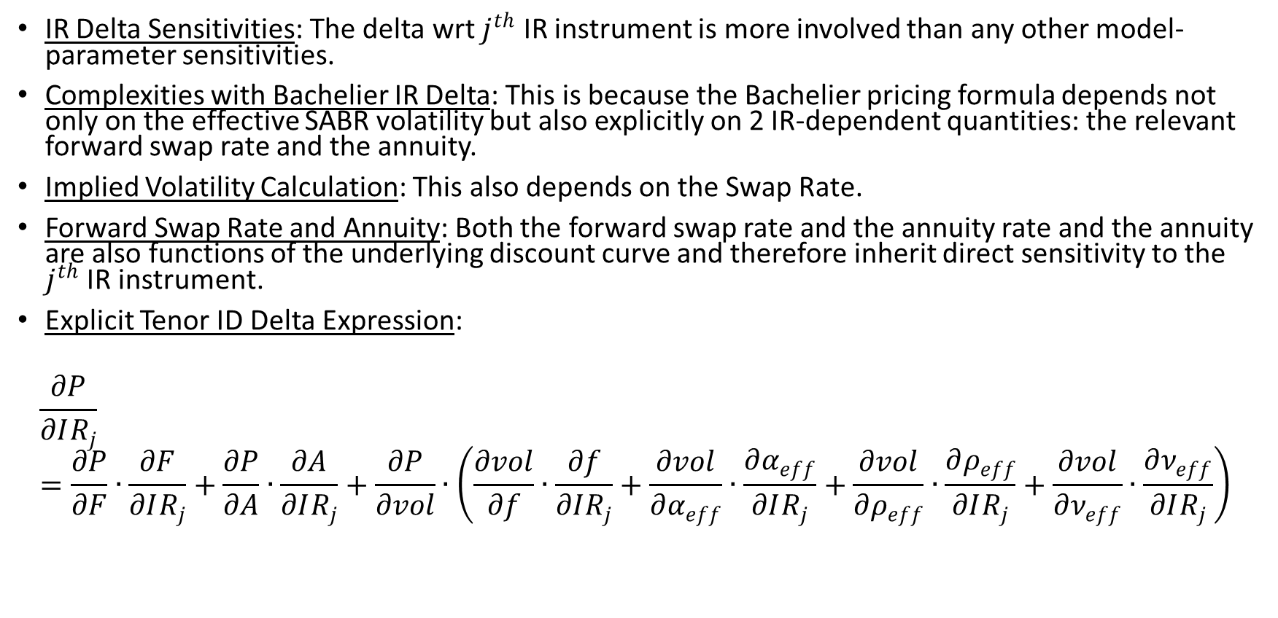
Model Design and Assumption (continued)
IR Delta Sensitivities: The delta wrt $j^{th}$ IR instrument is more involved than any other model-parameter sensitivities.
Complexities with Bachelier IR Delta: This is because the Bachelier pricing formula depends not only on the effective SABR volatility but also explicitly on 2 IR-dependent quantities: the relevant forward swap rate and the annuity.
Implied Volatility Calculation: This also depends on the Swap Rate.
Forward Swap Rate and Annuity: Both the forward swap rate and the annuity rate and the annuity are also functions of the underlying discount curve and therefore inherit direct sensitivity to the $j^{th}$ IR instrument.
Explicit Tenor ID Delta Expression:
$$\frac{∂P}{∂IR_{j}}=\frac{∂P}{∂F}∙\frac{∂F}{∂IR_{j}}+\frac{∂P}{∂A}∙\frac{∂A}{∂IR_{j}}+\frac{∂P}{∂vol}∙\left(\frac{∂vol}{∂f}∙\frac{∂f}{∂IR_{j}}+\frac{∂vol}{∂α_{eff}}∙\frac{∂α_{eff}}{∂IR_{j}}+\frac{∂vol}{∂ρ_{eff}}∙\frac{∂ρ_{eff}}{∂IR_{j}}+\frac{∂vol}{∂ν_{eff}}∙\frac{∂ν_{eff}}{∂IR_{j}}\right)$$

