Slide 1
Municipal Curve Construction and Callable Bond Pricer
v1.09 9 September 2026
Lakshmi Krishnamurthy

Slide 2
Contents
Section 1: Kalotay, Williams, and Fabozzi (1993) Model
Section 2: Interest Rate Lattice – Implementation Overview
Section 3: AAA Municipal Curve
Section 4: Evaluating Callable Municipal Bonds
Section 5: Nelder-Mead Method
Section 6: Himmelblau Function
Section 7: Rosenbrock Function

Slide 3
Section 1 - Kalotay, Williams, and Fabozzi (1993) Model

Slide 4
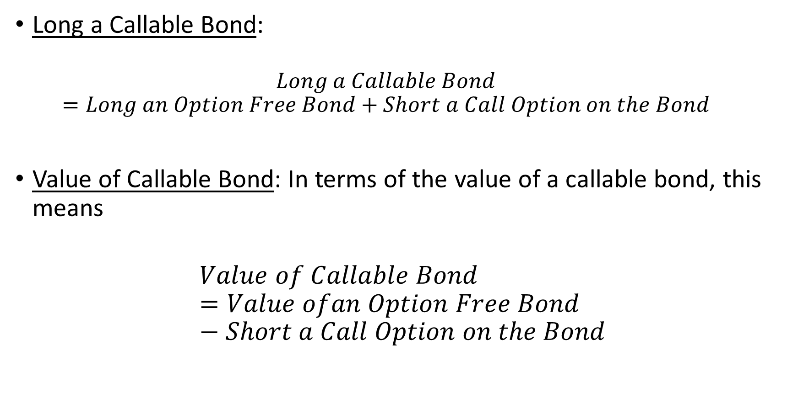
Background
Long a Callable Bond:
  $$Long a Callable Bond=Long an Option Free Bond+Short a Call Option on the Bond$$
Value of Callable Bond: In terms of the value of a callable bond, this means
$$Value of Callable Bond=Value ofan Option Free Bond−Short a Call Option on the Bond$$

Slide 5
Interest Rate Volatility
Binomial Interest Rate Tree: Once one allows for embedded options, consideration must be given to interest-rate volatility. This can be done by introducing a binomial interest rate tree.
One Period Discount Rate Evolution: This tree is nothing more than a discrete representation of the possible evolution over time of the one-period rate based on some assumption about interest rate volatility.

Slide 6
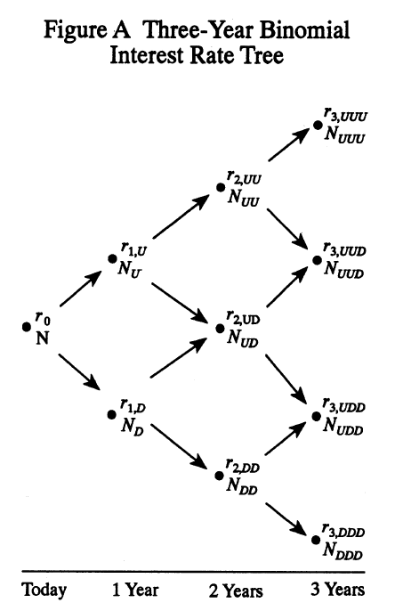
Binomial Interest Rate Tree

Slide 7
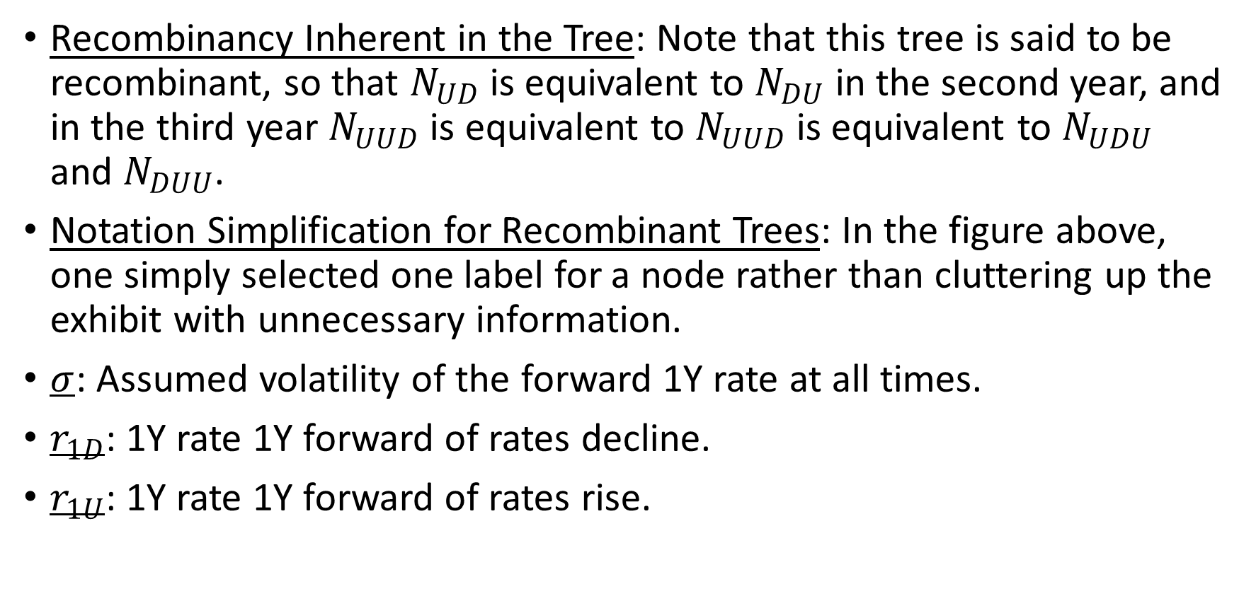
Binomial Interest Rate Tree (continued)
Recombinancy Inherent in the Tree: Note that this tree is said to be recombinant, so that $N_{UD}$ is equivalent to $N_{DU}$ in the second year, and in the third year $N_{UUD}$ is equivalent to $N_{UUD}$ is equivalent to $N_{UDU}$ and $N_{DUU}$.
Notation Simplification for Recombinant Trees: In the figure above, one simply selected one label for a node rather than cluttering up the exhibit with unnecessary information.
$σ$: Assumed volatility of the forward 1Y rate at all times.
$r_{1D}$: 1Y rate 1Y forward of rates decline.
$r_{1U}$: 1Y rate 1Y forward of rates rise.

Slide 8
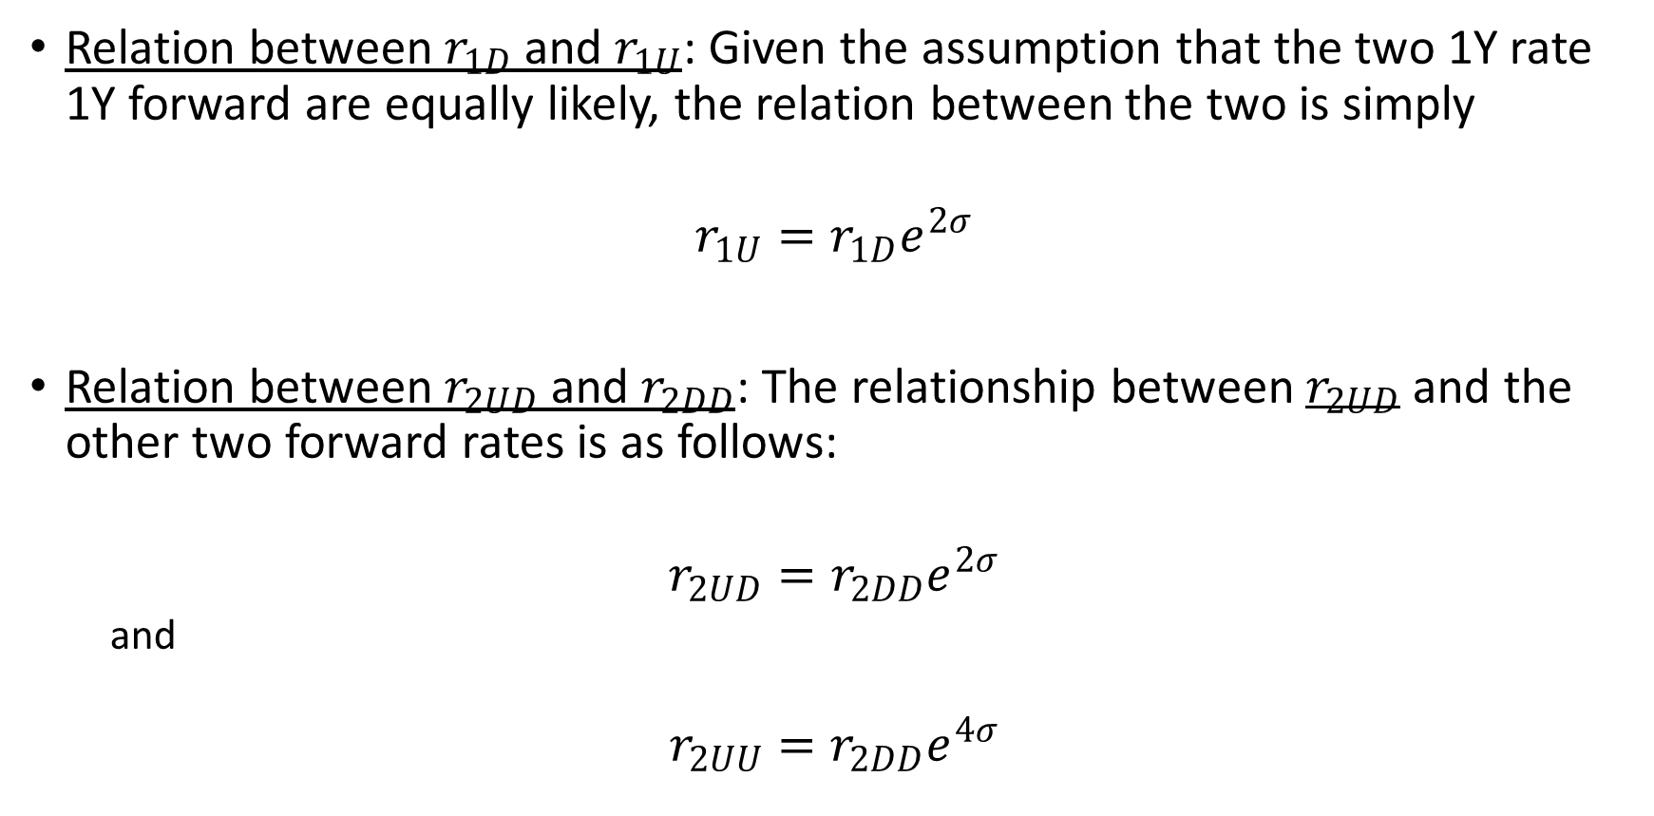
Binomial Interest Rate Tree (continued)
Relation between $r_{1D}$ and $r_{1U}$: Given the assumption that the two 1Y rate 1Y forward are equally likely, the relation between the two is simply
$$r_{1U}=r_{1D}e^{2σ}$$
Relation between $r_{2UD}$ and $r_{2DD}$: The relationship between $r_{2UD}$ and the other two forward rates is as follows:
$$r_{2UD}=r_{2DD}e^{2σ}$$
  and
$$r_{2UU}=r_{2DD}e^{4σ}$$

Slide 9
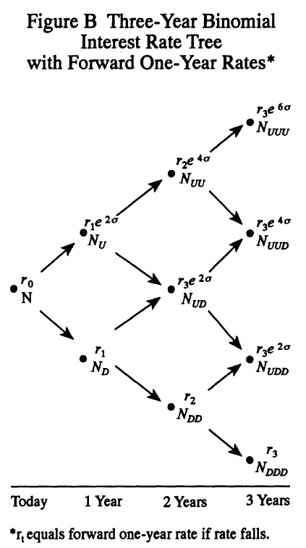
Binomial Interest Rate Tree (continued)

Slide 10
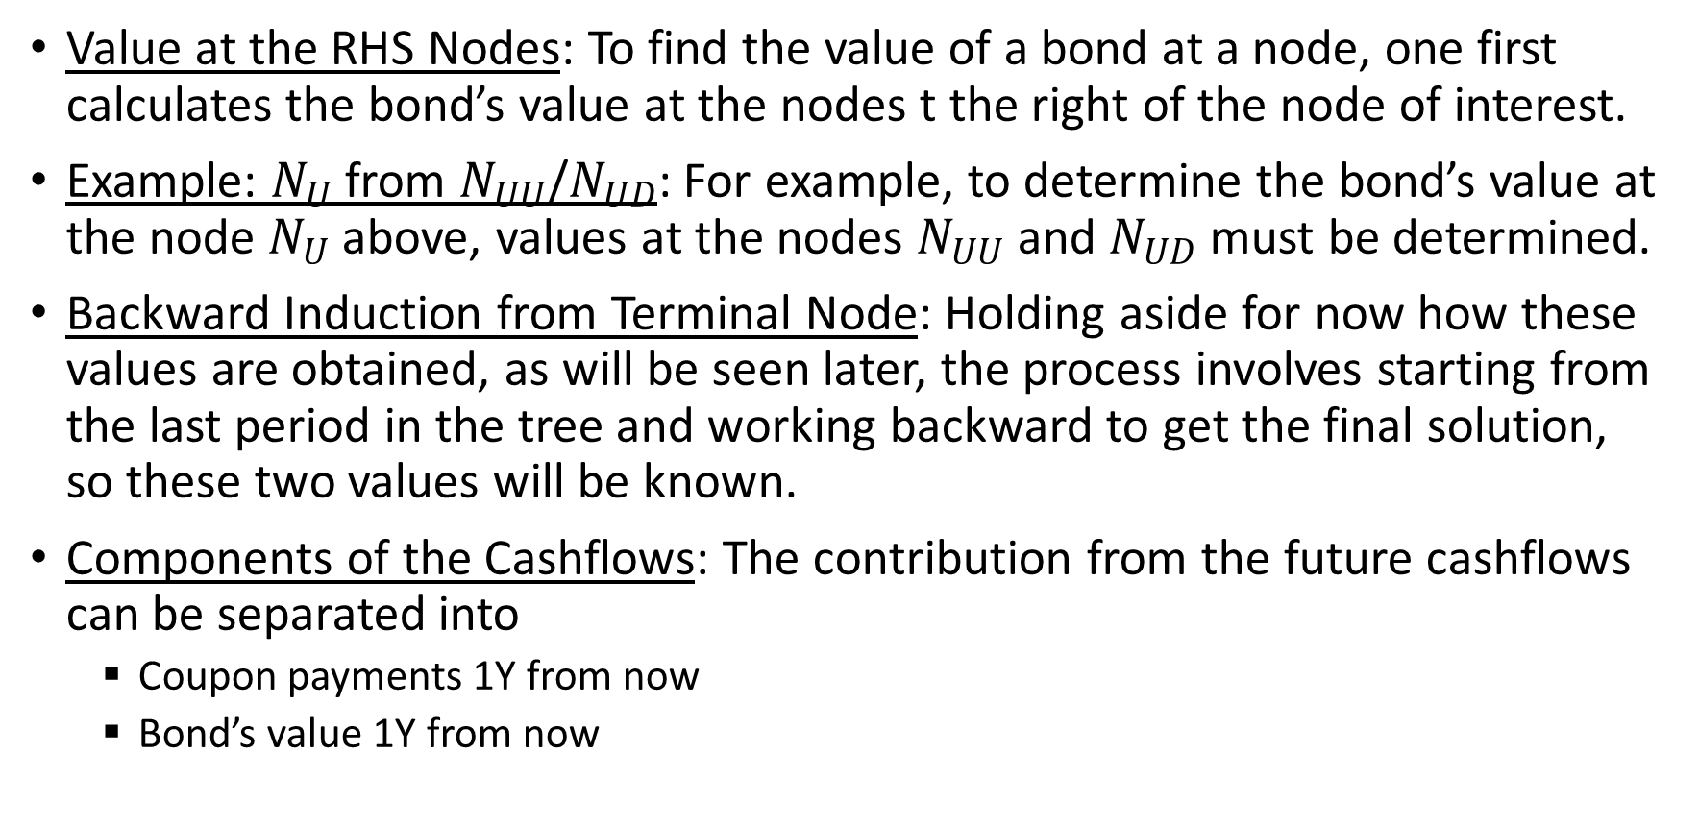
Determining the Value at a Node
Value at the RHS Nodes: To find the value of a bond at a node, one first calculates the bond’s value at the nodes t the right of the node of interest.
Example: $N_{U}$ from $N_{UU}$/$N_{UD}$: For example, to determine the bond’s value at the node $N_{U}$ above, values at the nodes $N_{UU}$ and $N_{UD}$ must be determined.
Backward Induction from Terminal Node: Holding aside for now how these values are obtained, as will be seen later, the process involves starting from the last period in the tree and working backward to get the final solution, so these two values will be known.
Components of the Cashflows: The contribution from the future cashflows can be separated into
  Coupon payments 1Y from now
  Bond’s value 1Y from now

Slide 11
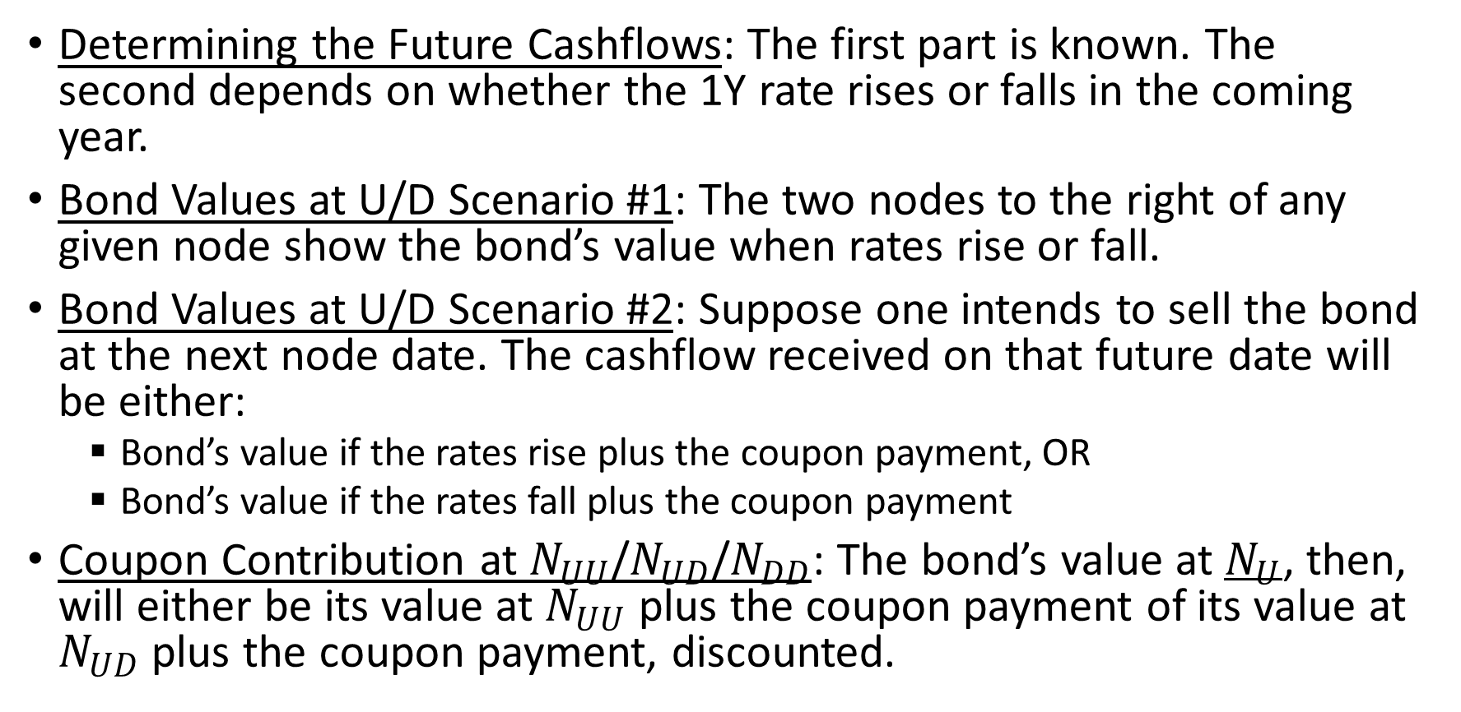
Determining the Value at a Node (continued)
Determining the Future Cashflows: The first part is known. The second depends on whether the 1Y rate rises or falls in the coming year.
Bond Values at U/D Scenario #1: The two nodes to the right of any given node show the bond’s value when rates rise or fall.
Bond Values at U/D Scenario #2: Suppose one intends to sell the bond at the next node date. The cashflow received on that future date will be either:
  Bond’s value if the rates rise plus the coupon payment, OR
  Bond’s value if the rates fall plus the coupon payment
Coupon Contribution at $N_{UU}$/$N_{UD}$/$N_{DD}$: The bond’s value at $N_{U}$, then, will either be its value at $N_{UU}$ plus the coupon payment of its value at $N_{UD}$ plus the coupon payment, discounted.

Slide 12
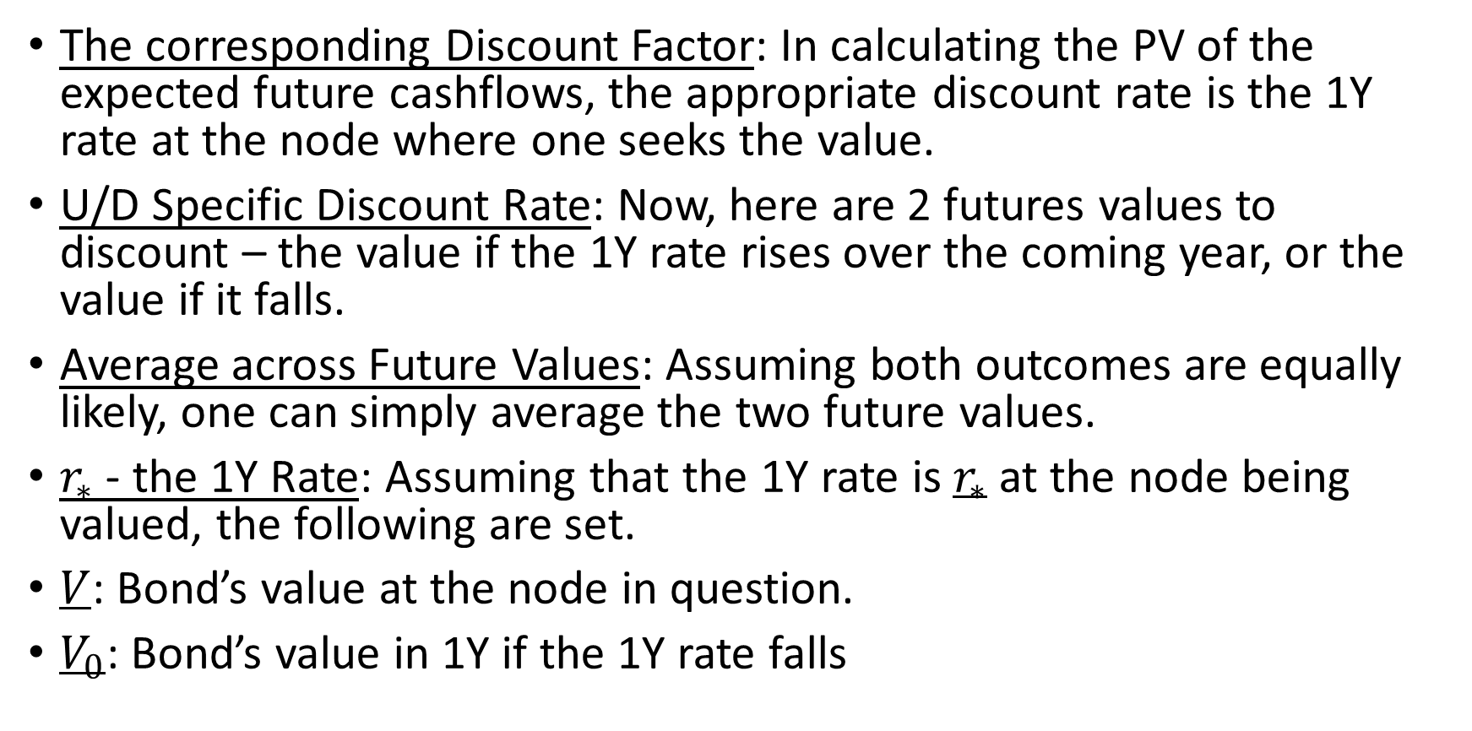
Determining the Value at a Node (continued)
The corresponding Discount Factor: In calculating the PV of the expected future cashflows, the appropriate discount rate is the 1Y rate at the node where one seeks the value.
U/D Specific Discount Rate: Now, here are 2 futures values to discount – the value if the 1Y rate rises over the coming year, or the value if it falls.
Average across Future Values: Assuming both outcomes are equally likely, one can simply average the two future values.
$r_{∗}$ - the 1Y Rate: Assuming that the 1Y rate is $r_{∗}$ at the node being valued, the following are set.
$V$: Bond’s value at the node in question.
$V_{0}$: Bond’s value in 1Y if the 1Y rate falls

Slide 13
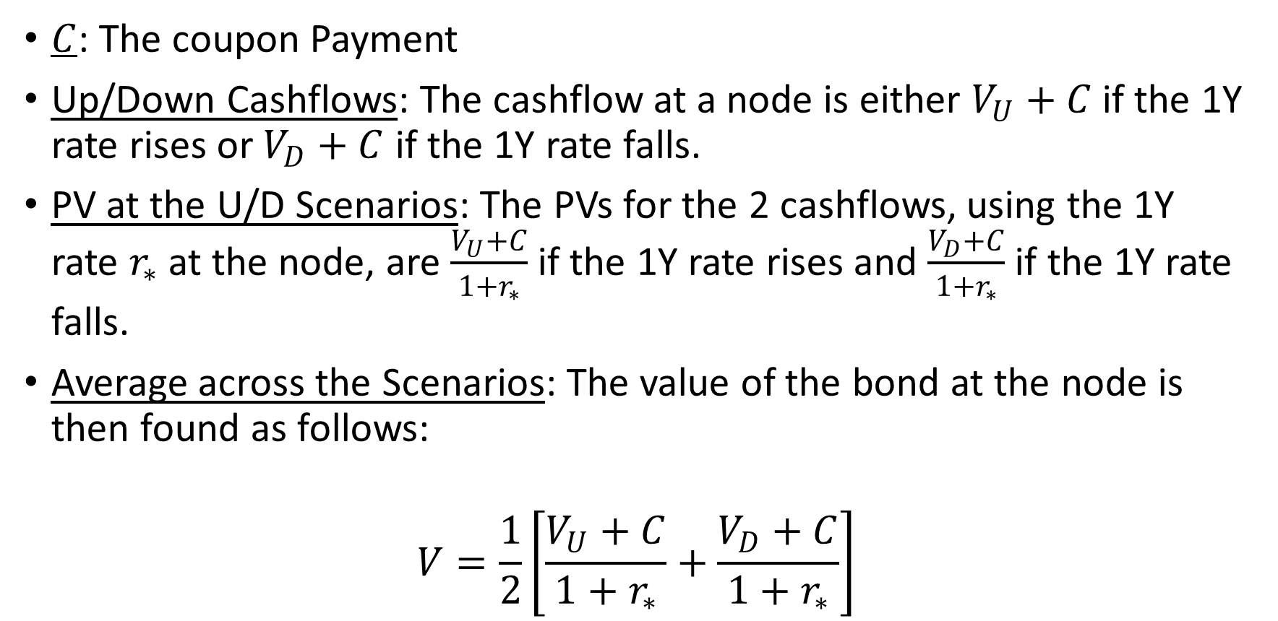
Determining the Value at a Node (continued)
$C$: The coupon Payment
Up/Down Cashflows: The cashflow at a node is either $V_{U}+C$ if the 1Y rate rises or $V_{D}+C$ if the 1Y rate falls.
PV at the U/D Scenarios: The PVs for the 2 cashflows, using the 1Y rate $r_{∗}$ at the node, are $\frac{V_{U}+C}{1+r_{∗}}$ if the 1Y rate rises and $\frac{V_{D}+C}{1+r_{∗}}$ if the 1Y rate falls.
Average across the Scenarios: The value of the bond at the node is then found as follows:
$$V=\frac{1}{2}\left[\frac{V_{U}+C}{1+r_{∗}}+\frac{V_{D}+C}{1+r_{∗}}\right]$$

Slide 14
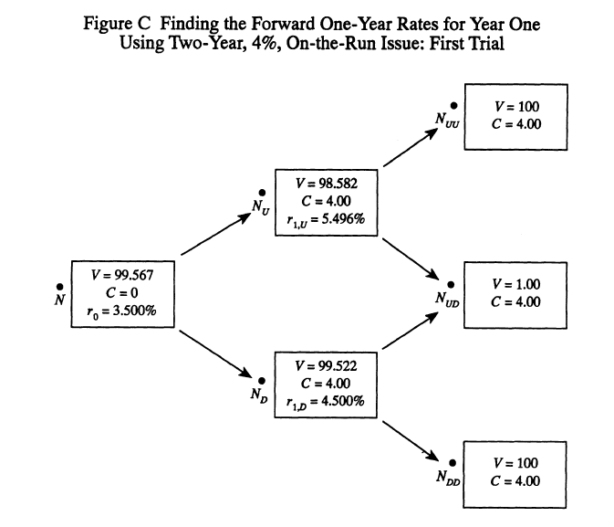
Constructing a Binomial Interest Rate Tree

Slide 15
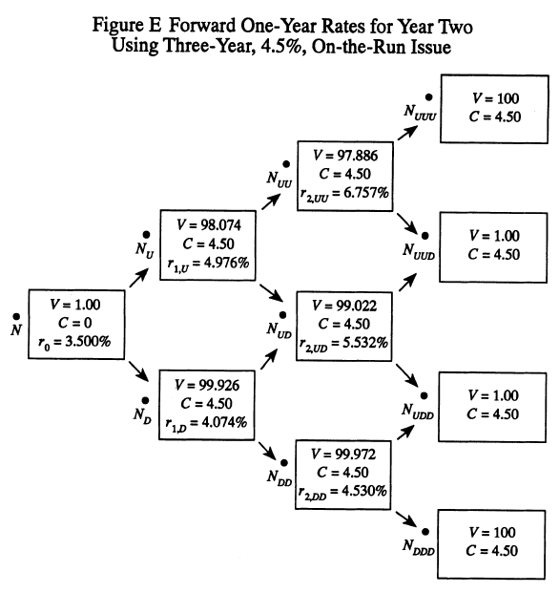
Constructing a Binomial Interest Rate Tree (continued)

Slide 16
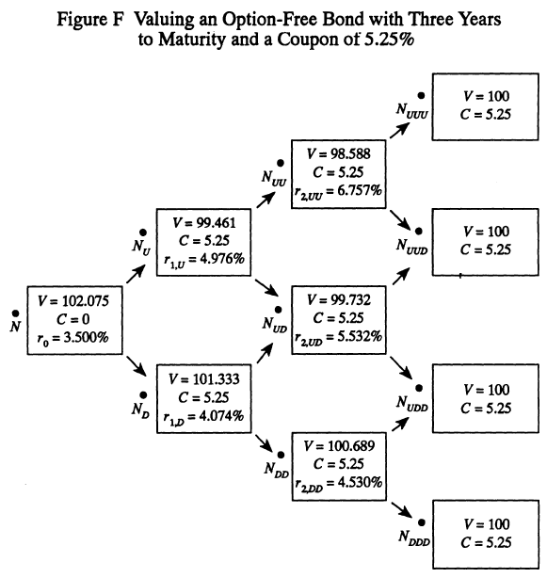
Using the Binomial Tree

Slide 17
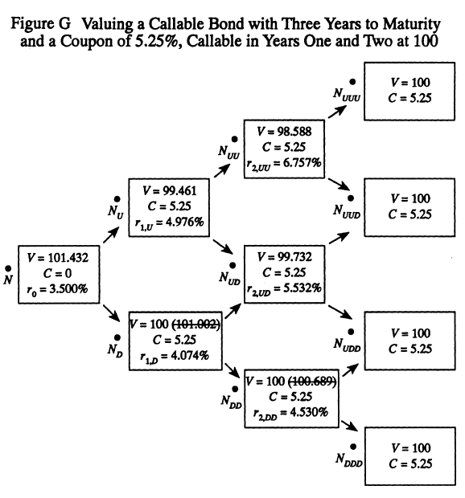
Valuing a Callable Bond

Slide 18
Transaction Costs
Refinancing Costs on a Call: When an issuer calls a bond, the debt is generally refinanced. The issuer will, in general, incur transaction costs in the refinancing.
Incorporating these Costs in the Tree: These costs may be injected into the valuation model by scaling up the call price appropriately.
The Corresponding Call Economics: It would be imprudent for an issuer to exercise a call option unless the NPV savings realized by calling the bond represented a substantial fraction of the forfeited option value, i.e., unless the intrinsic value of the call option dominated its incremental time value.
Transaction Costs at Every Call: By including transaction costs in every option-exercise decision, one obtains an option-adjusted value that does not penalize re-funding.

Slide 19
Transaction Costs (continued)
Debt Refinancing at Maturity: One must consider, however, what will happen at the final maturity. Debt is rarely extinguished at maturity; it is generally refinanced, again with transaction expenses.
Need to Incorporate this Refinancing: Failure to include these costs at maturity will penalize the decision to exercise the call option on a bond close to maturity.

Slide 20
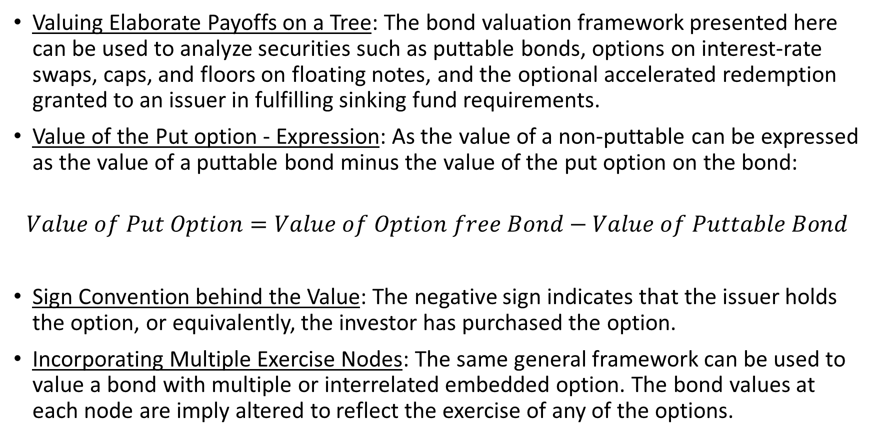
Other Embedded Options
Valuing Elaborate Payoffs on a Tree: The bond valuation framework presented here can be used to analyze securities such as puttable bonds, options on interest-rate swaps, caps, and floors on floating notes, and the optional accelerated redemption granted to an issuer in fulfilling sinking fund requirements.
Value of the Put option - Expression: As the value of a non-puttable can be expressed as the value of a puttable bond minus the value of the put option on the bond:
$$Value of Put Option=Value of Option free Bond−Value of Puttable Bond$$
Sign Convention behind the Value: The negative sign indicates that the issuer holds the option, or equivalently, the investor has purchased the option.
Incorporating Multiple Exercise Nodes: The same general framework can be used to value a bond with multiple or interrelated embedded option. The bond values at each node are imply altered to reflect the exercise of any of the options.

Slide 21
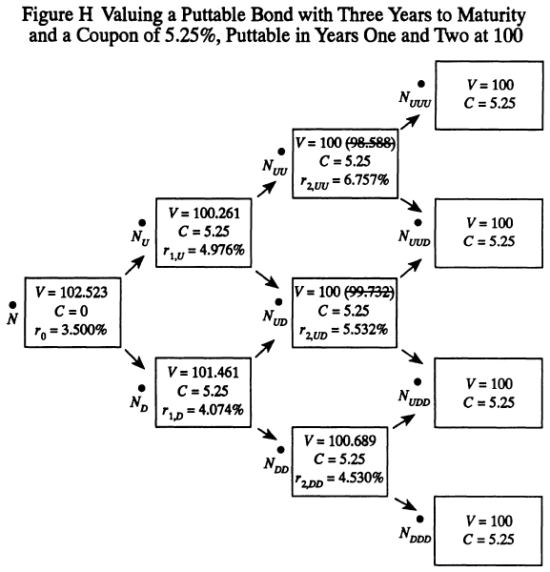
Other Embedded Options (continued)

Slide 22
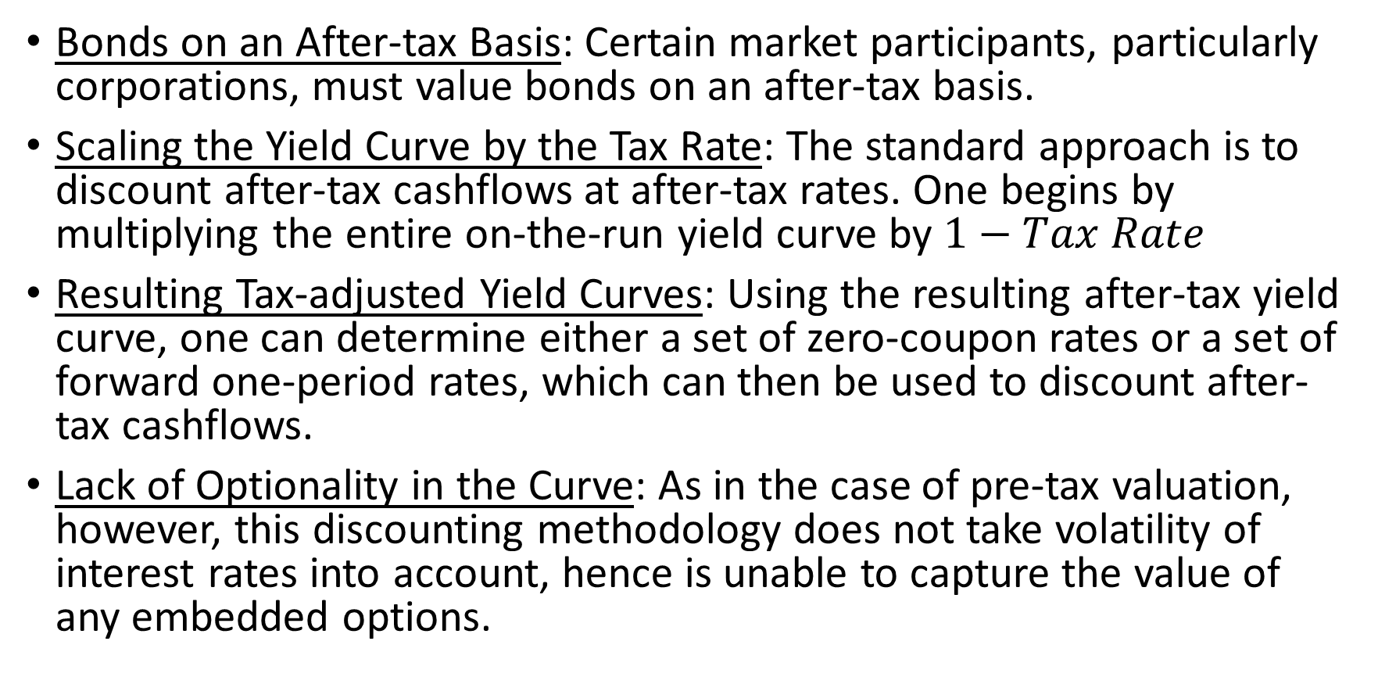
After-tax Valuation
Bonds on an After-tax Basis: Certain market participants, particularly corporations, must value bonds on an after-tax basis.
Scaling the Yield Curve by the Tax Rate: The standard approach is to discount after-tax cashflows at after-tax rates. One begins by multiplying the entire on-the-run yield curve by $1−Tax Rate$
Resulting Tax-adjusted Yield Curves: Using the resulting after-tax yield curve, one can determine either a set of zero-coupon rates or a set of forward one-period rates, which can then be used to discount after-tax cashflows.
Lack of Optionality in the Curve: As in the case of pre-tax valuation, however, this discounting methodology does not take volatility of interest rates into account, hence is unable to capture the value of any embedded options.

Slide 23
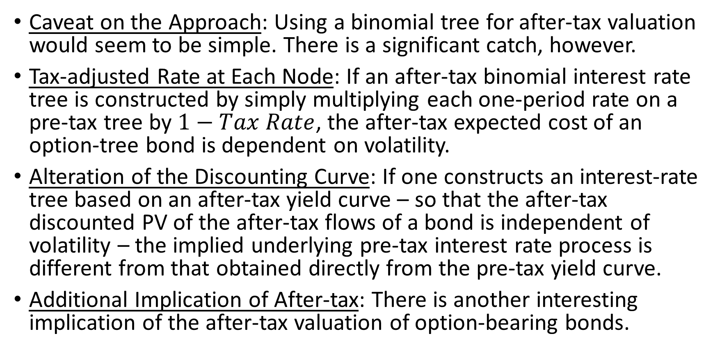
After-tax Valuation (continued)
Caveat on the Approach: Using a binomial tree for after-tax valuation would seem to be simple. There is a significant catch, however.
Tax-adjusted Rate at Each Node: If an after-tax binomial interest rate tree is constructed by simply multiplying each one-period rate on a pre-tax tree by $1−Tax Rate$, the after-tax expected cost of an option-tree bond is dependent on volatility.
Alteration of the Discounting Curve: If one constructs an interest-rate tree based on an after-tax yield curve – so that the after-tax discounted PV of the after-tax flows of a bond is independent of volatility – the implied underlying pre-tax interest rate process is different from that obtained directly from the pre-tax yield curve.
Additional Implication of After-tax: There is another interesting implication of the after-tax valuation of option-bearing bonds.

Slide 24
After-tax Valuation (continued)
Objective of the Exercise Scheme: The valuation process described here is essentially optimization procedure designed to produce the lowest possible for the investor or, equivalently, the lowest possible expected cost of servicing the outstanding debt for the issuer.
Option Increases Value to Investor: It follows, then, that any other set of option-exercise decisions can only increase the value of the bond to the invest
Valuation Objective to Minimize Tax: But that the valuation process is carried out so as to minimize the issuer’s after-tax, cost of servicing the debt.or – who, it is assumed, is not a tax-payer.

Slide 25
The Challenge of Implementation
Fine-graining for American Options: Spacing of the node lines in the tree must be much finer, particularly if American options are to be valued.
Challenges with Fine-graining: However, if fine spacing required to value short-dated securities becomes computationally inefficient if one seeks to value, say, 30Y bonds.
Challenges with Time-dependent Spacing: While one can introduce time-dependent node spacing, caution is required; it is easy to distort the term structure of volatility.
Cashflows between Nodes: Other practical difficulties include the management of cashflows that fall between two node lines.

Slide 26
Section 2 - Interest Rate Lattice – Implementation Overview

Slide 27
Purpose and High-level Concept
InterestRateLattice is a binomial interest-rate tree (log-normal short-rate lattice) used to price fixed-income instruments — both callable and non-callable. It follows the methodology described in Kalotay, Williams, and Fabozzi (1993)
Core Idea:
  Calibrate the lattice so it reproduces observed market prices for a set of reference instruments (e.g., par bonds at various maturities)
  Price novel instruments (including those with embedded call options) by backward-induction through the tree
  Compute analytics (OAS, effective duration, effective convexity) by perturbing the lattice and re-pricing

Slide 28
Lattice Structure - Geometry
The lattice is a recombining binomial tree with num_levels levels (levels 0 through num_levels - 1). Level L contains L + 1 nodes
  Total node count: num_levels * (num_levels + 1) / 2
  Node spacing: Each level represents a fixed time step. Default: NODE_SPACING_YEARS = 1.0 year.
  Node indexing: Within level L, nodes are indexed 0..L. Index 0 is the lowest short rate; index L is the highest

Slide 29
Lattice Structure - Node Values (Short Rates)
Each node stores a short rate (1-period interest rate). Rates within a level are related log-normally:
  rate(lvl, idx) = median_short_rate(lvl) * exp(2 * offset * volatility)
where offset is the signed distance from the median node index:
  For even levels: offset = idx - lvl/2
  For odd levels: offset = idx - lvl/2 - 0.5 (since there is no exact middle node)
Equivalently, adjacent nodes differ by a constant multiplicative factor:
  adjacent_node_scale_factor = exp(2 * volatility)
  rate(lvl, idx+1) = rate(lvl, idx) * adjacent_node_scale_factor

Slide 30
Lattice Structure – Rate Bounds
Short rates are clamped to:
  Minimum: MIN_LATTICE_SHORT_RATE = 1e-7
  Maximum: MAX_LATTICE_SHORT_RATE = 1.0 (i.e., 100%)

Slide 31
Lattice Structure – Storage Layout
All node values are stored in a single flat std::vector<double>. The position of node (lvl, idx) is:
  position = lvl * (lvl + 1) / 2 + idx

Slide 32
Lattice Structure – Data Members
Member | Type | Description
num_levels_ | int | Number of levels in the lattice
node_values_ | vector<double> | Flat array of short rates
volatility_ | double | Assumed log-normal volatility (decimal, e.g., 0.20 = 20%)
adjacent_node_scale_factor_ | double | exp(2 * volatility) — cached for performance

Slide 33
Calibration – Two Stage Process
Calibration is the process of finding median short rates at each level such that the lattice reproduces observed market prices for input instruments.
  calibrate(instruments, prices, assumed_volatility) → InterestRateLattice
Stage 1: Bootstrap (Levels 1–10)
  Applies to the first 10 instruments (maturities 1Y through 10Y).
  Constraints:
    Must be sequential integer maturities starting at 1Y (one per level).
    Must be non-callable.
    Must be sorted by ascending maturity.
  Algorithm: Iterative univariate root-finding. For each level L:
    Assume all previously solved median short rates are fixed.
    Find the median short rate at level L such that pricing the L-year instrument on the partial lattice yields the target price.
    Uses bisection/Brent's method on the interval [1e-7, 1e6] with tolerance 0.001 bond points.

Slide 34
Calibration – Two Stage Process (continued)
Stage 2: Optimization (Levels beyond 10)
  Applies to instruments with maturities > 10 years (callable instruments are allowed here).
  Algorithm: Nelder-Mead simplex minimization.
    Objective function: Sum of squared pricing errors across all stage-2 instruments.
    Initial guess: Last bootstrapped median short rate, repeated for all new levels.
    Bounds on median short rates: Clamped to [0.005, 0.5] (i.e., 0.5% to 50%).
    Initial step size: 0.1
    Convergence: Nelder-Mead tolerance 1e-6; early termination if objective < 1e-4.
    Max iterations: 100,000.
  The number of free parameters equals the lattice level of the longest-maturity instrument minus 10 (the bootstrap count).

Slide 35
Calibration – Volatility
Volatility is an input parameter to calibration — it is assumed constant across all levels.
It is not solved for; it must be supplied externally (typically from market-implied volatility estimates).

Slide 36
Instrument Representation – Aligned Instrument Properties
Since instrument maturities and call dates rarely fall exactly on lattice level boundaries, the model uses bilinear interpolation between four "aligned" approximations of each instrument
Each aligned approximation consists of:
Field | Type | Description
maturity_level | int | Lattice level of final maturity
maturity_value | double | Price at maturity (typically 100)
coupon | double | Annual coupon rate in decimal (e.g., 0.05 = 5%)
call_schedule | AlignedCallSchedule | Call options aligned to lattice levels

Slide 37
Instrument Representation – Approximation Schemes
For an instrument whose maturity falls between levels L and L+1, and whose first call date falls between levels C and C+1:
  lower_maturity_lower_call — maturity at L, calls shifted down
  upper_maturity_upper_call — maturity at L+1, calls shifted up
  lower_maturity_upper_call — maturity at L, calls shifted up
  upper_maturity_lower_call — maturity at L+1, calls shifted down

Slide 38
Instrument Representation – Interpolation Coefficients
maturity_interpolation_coefficient ∈ [0, 1]: Fraction of the way from the lower to the upper maturity level.
call_interpolation_coefficient ∈ [0, 1]: Fraction of the way from the lower to the upper call level.

Slide 39
Instrument Representation – Call Schedule Alignment
Each call option in the bond's call schedule is mapped to the nearest lattice levels (floor and ceiling). The AlignedCallSchedule provides O(1) lookup by level via a pre-sized vector indexed by level number
struct AlignedCallOption {
int exercise_level; // Lattice level where the option is exercisable
double strike_price; // Strike price of the call
};

Slide 40
Instrument Representation – Initialization Methods
Method | Use Case
init_from_munibondinfo(bond_info, trade_date) | Full municipal bond with real market data
init_from_reference_data(...) | Generic instrument from disaggregated reference data
init_noncallable(years_to_maturity, maturity_value, coupon) | Simple non-callable instrument
init_callable_continuous_par(years_to_maturity, maturity_value, coupon, years_to_call) | Par-callable instrument

Slide 41
Pricing Algorithm – Backward Induction (Core Engine)
price_aligned_instrument(instrument) → price
This is the performance-critical inner loop. It prices a single aligned instrument via backward induction:
  Initialize leaf nodes (level = maturity_level - 1):
    price[idx] = (maturity_value + coupon_payment) / (1 + short_rate[lvl, idx])
    price[idx] = min(price[idx], call_strike) // if callable at this level
  Roll back from maturity_level - 2 down to level 0:
    price[idx] = 0.5 * ((price_up + coupon_payment) / (1 + rate) + (price_down + coupon_payment) / (1 + rate))
    price[idx] = min(price[idx], call_strike) // if callable at this level
    where price_up and price_down are the prices at the two successor nodes.
  Result: price[0] at level 0 is the model price.
Key details:
  Coupon payment = coupon * maturity_value (applied at every level as an approximation of semi-annual payments accruing proportionally).
  Call exercise: At any level where a call option exists, the price is capped at the call strike (the issuer exercises if it's advantageous).
  Memory: Uses a single stack-allocated array of size MAX_MATURITY_LEVEL = 64 (in-place overwrite, no allocation).
  Performance: Iterates via raw pointer arithmetic on the flat node_values_ array for cache efficiency

Slide 42
Pricing Algorithm – Interpolated Pricing
price_instrument(instr_properties) → price
Handles non-aligned instruments:
  Maturity aligned, call aligned: Price the single lower_maturity_lower_call approximation directly.
  Maturity aligned, call not aligned: Linear interpolation between lower-call and upper-call prices using call_interpolation_coefficient.
  Maturity not aligned: Bilinear interpolation over all four approximations using both coefficients:
    price = bilinear_interpolate(maturity_coeff, call_coeff, price_LL, price_LU, price_UL, price_UU)

Slide 43
Analytics – Option-Adjusted Spread (OAS)
compute_oas(instrument, trade_price) → spread (decimal)
Algorithm: Find the constant spread s such that, when added to every median short rate in the lattice, the resulting lattice prices the instrument at trade_price.
  Implemented as univariate root-finding on: price_on_shifted_lattice(s) - trade_price = 0
  Search interval: [-1.0, +1.0] (±10,000 basis points)
  Tolerance: 0.000001 (< 0.01 bps precision)
  The spread is applied via add_median_rate_offset(s), which recomputes all nodes at each level from the shifted median

Slide 44
Analytics – Effective Duration
compute_effective_duration(instrument) → duration
Algorithm (parallel shift method):
  Δy = 0.0001 (1 basis point)
  P₀ = price(instrument)
  P₊ = price_on_lattice_shifted_up_by(Δy)
  P₋ = price_on_lattice_shifted_down_by(Δy)
  duration = (P₋ - P₊) / (2 * P₀ * Δy)

Slide 45
Analytics – Effective Convexity
compute_effective_convexity(instrument) → convexity
Algorithm:
  Δy = 0.0100 (100 basis points)
  P₀ = price(instrument)
  P₊ = price_on_lattice_shifted_up_by(Δy)
  P₋ = price_on_lattice_shifted_down_by(Δy)
  convexity = (P₋ - 2*P₀ + P₊) / (P₀ * Δy² * 100)

Slide 46
Lattice Mutation
add_median_rate_offset(offset)
Shifts the entire term structure by a fixed amount:
  For each level L:
    new_median = current_median_node_value(L) + offset
    Recompute all nodes at level L from new_median using log-normal spacing
This is used internally for OAS computation, duration/convexity calculations, and can be used externally to apply scenario shifts

Slide 47
Implementation Notes – Numerical Methods Required
Univariate root-finding (e.g., Brent's method) — used in bootstrap and OAS.
Nelder-Mead simplex optimization — used in stage 2 calibration.
Linear and bilinear interpolation — used in pricing non-aligned instruments

Slide 48
Implementation Notes – Performance Considerations
The price_aligned_instrument inner loop is the hot path. It uses:
  A stack-allocated array (no heap allocation per price call).
  Raw pointer arithmetic on the flat node array.
  No branching in the inner loop (call check is a simple min).
The adjacent_node_scale_factor_ is precomputed to avoid repeated exp() calls.
Node values are stored contiguously for cache locality

Slide 49
Implementation Notes – Assumptions and Limitations
Log-normal short rate model: Negative rates are not natively supported. Rates are floored at 1e-7.
Constant volatility: The same volatility applies to all levels (no term structure of vol).
Annual time steps: NODE_SPACING_YEARS = 1.0. Instruments between levels are handled via interpolation rather than sub-annual time steps.
Simplified coupon model: Coupons are treated as a constant coupon * maturity_value applied at each level (not exact semi-annual cash flow modeling).
American-style calls: The call exercise decision is made independently at each level (greedy optimal exercise from the issuer's perspective).

Slide 50
Section 3 - AAA Municipal Curve

Slide 51
Overview
Curves are constructed using instruments for each year for 30 years, and a smoothing extrapolation technique is applied in the absence of quality pricing in the longer duration tenors (TradeWeb (2024)).

Slide 52
Constituent Selection
Corpus of AAA Muni Bonds: The TradeWeb AAA Municipal Curve is constructed by selecting AAA-rated General Obligation GO and certain revenue bonds that meet robust criteria metrics in order to qualify as a constituent.
Additional Qualifications to be Met:
  Has a 5% coupon and a minimum call protection of at least 4 years.
  Rated as AAA-grade by both by S&P and Moody’s rating agencies.
  Issued as either a GO-bond or as a revenue bond with the use of proceeds for Education, General Purpose, and Public Improvement and Utilities – including electricity and power, water, sewer – projects.
  The issue has at least one customer buy with a quantity size greater than on equal to 50,000 notional size in the last 3 months.

Slide 53
Section 4 – Evaluating Callable Municipal Bonds

Slide 54
Overview
Callability in Fixed-rate Munis: Fixed-rate municipal bonds are often sold with an optional redemption feature giving the issuers the right to call the bonds prior to maturity
Problems with No arbitrage Models: This section outlines the theoretical and the practical problems with no-arbitrage models employed for the purpose of analyzing embedded options in municipal bonds.
Expected Present Value Savings Approach: It also highlights recent research in yield curve modeling and shows an example of a real-world approach to analyzing municipal bond options which introduces the concept of Expected Present Value – EPV – savings.

Slide 55
Introduction
Outstanding Callable Munis Market Value: Of the $3.7 trillion in municipal and tax-exempt bonds outstanding (Report of the Municipal Securities Market, U. S. Securities and Exchange Commission), approximately $1.54 trillion (Bloomberg, August 2013), or 4.16%, are long-term, fixed-rate, unrefunded, and subject to redemption prior to maturity at the option of the issuer.
Funding the Optional Redemption Feature: These optional redemption features are call options purchased by the issuer at the inception of a bond transaction. Issuers usually fund an optional redemption through a re-financing issue called a re-funding.
The Two Types of Refunding: Per the current tax code, i.e., Section 148 of the Internal Revenue Code that covers the rules governing tax-exempt bond issuance include re-financings, there are two types of re-fundings – current and advance.
The Advance Refunding Type: The latter occurs more than 90 days in advance of the call date and involves using the proceeds from the refunding issue to purchase a portfolio of eligible securities – State and Local Government Securities SLGS, US Treasuries, or Agency securities – designed to match the cash flows of the refunded bonds to their respective first optional redemption dates.

Slide 56
Introduction (continued)
The Advance Refunding Option ARO: The Advance Refunding Option – ARO – is intimately tied to the call option. In the absence of a call option, ARO has no economic value.
Lock-in of the Refund: An advance refunding locks in the call exercise – an issue that is advance refunded will be called at the first date – at the previously set call price. The value of the ARO should therefore be measured incrementally above that of the call option.
Discounting Based on the Exercise Date: Finding this value entails finding the optimal exercise rule – by solving an optimal stopping problem – and computing the expected discounted payoff of the option under this rule.
Solution to Optimal Stopping Problem: The challenges are:
  How to solve the optimal stopping problems in practice, and
  How to select when to Refund bonds

Slide 57
Introduction (continued)
Heuristics Used to Determine Refunding: Many issuers use long-standing heuristics to determine whether or not to refund a bond such as present value interest cost savings – PV savings – as a percentage of the par amount of the refunded bonds.
Breach of the Par Threshold: Once this percentage exceeds a specified threshold, usually between 2% and 6%, the bonds are deemed to be candidates to be included in a refunding bond issue.

Slide 58
Types of Term-structure Models and their Roles - Deterministic
Deterministic models are a special case of a more complete term structure model, i.e., they simply display zero volatility. As an example, in order to create a forecast of principal and interest for variable rate demand obligations – VRDOs – a public finance analyst must employ an interest rate model, usually of the deterministic variety. The rate selected is often constant and is frequently a simple historic average of short-term yields over some period.

Slide 59
Pricing Models – Problems Specific to the Municipal Market
High-to-low Interest Refunding: Though an issuer may exercise optimal redemption for a variety of reasons including retiring bonds with restrictive covenants, replacing insured bonds, or simply applying excess revenues to shrink the balance sheet, the most common objective is to achieve interest cost saving through financing with lower interest rates. This is called a high-to-low refunding. This last motive is the one on focus here.
Impracticality of Conventional Hedge Strategies: Traditional no-arbitrage bond option models rely on the existence of a non-callable underlying equivalent bond which can be traded in a continuous fashion with unfettered ability to be bought or sold. In the municipal bond market this situation simply does not exist.
Ability of Issuers to Arbitrage: Municipal issuers are unable to arbitrage the mispricing of market discount bonds. IRC §148 specifically prohibits arbitrage across municipal bonds and other types of bonds, for example, treasury and corporate bonds – by tax-exempt institutions.

Slide 60
Pricing Models – Problems Specific to the Municipal Market (continued)
Shorting Municipal Bonds #1: Unlike treasury bonds, shorting municipal bonds is very hard because only tax-exempt authorities and institutions can pay tax-exempt interest.
Taxable Nature of the Dealer Repo: An investor lending a municipal bond to a dealer would receive a taxable dividend because that dividend is paid by a dealer, not a tax-exempt institution.
Lack of Fungibility: Even if an active muni repo market existed, it may be hard to locate a suitable municipal bond as a hedge because of the sheer number of municipal securities.
Shorting Municipal Bonds #2: Shorting related interest rate securities, like treasuries and corporate bonds, opens up potentially large basis risk.

Slide 61
Quantitative Municipal Hedge Strategy Formulation
Market Input #1: Option-free tax-exempt yields for the issuer.
Market Input #2: Implied volatilities for the yields in market input #1
Market Input #3: Market yield curve for escrow securities – SGLS or other
Market Input #4: Implied volatilities for escrow yields in market input #3
Market Input #5: Option free taxable yields for the issuer – for callable, non-advance refundable bonds
Market Input #6: Implied volatilities for the taxable yield curve in market input #5
Market Input #7: Implied correlations between option-free tax-exempt yields and the escrow yields

Slide 62
Quantitative Municipal Hedge Strategy Formulation (continued)
Market Input #8: Implied correlations between option-free taxable yields and escrow yields
Market Input #9: Implied correlations between tax-exempt and taxable issuer yields.
Implying Volatilities for Escrow Yields: Few of these items are observed directly as traded instruments. SLGS are published at the end of each trading day on the treasury’s website. Given that the SLGS are designed to be a basis point lower than US treasury yields, one might imply market input #4 from the prices of traded treasury options, though at present no study exists comparing the two markets or the validity of that assumption.
Estimating Taxable and Tax-free Yields #1: One might try to estimate market inputs #1 and #5 using secondary market data and a methodology like the one described in Nelson and Siegel (1987), though this data is choppy at best and frequently entirely unobservable, specially for market input #5

Slide 63
Quantitative Municipal Hedge Strategy Formulation (continued)
Estimating Taxable and Tax-free Yields #2: Volatilities in market inputs #2 and #6 depend upon an active market or accurate option pricing which, as discussed in this section, presents an interesting chicken-or-egg problem. How should one imply volatilities without market-tested, reliable, trading-based models?
Correlations across the Three Prices: Correlations for the market input #7-#9 simply do not exist in any market as an implied quantity.
Inadequacy of a Single-factor Model: Given the importance of both the replacement yield of the new bond, which usually matches closely to that of the refunded bond, and the yield on the escrow, which is to the call date, any single factor model is inadequate for this.

Slide 64
Characteristics of a Good Model for Analyzing Municipal Bond Call Features
Positive Nominal Rates
Full Term Structure Dynamics: Including volatilities and correlations for at least three markets: tax-exempt, taxable, and escrow instruments.
Control on Yield Curve Shapes: While allowing for variation of slopes, bumps, and twists
Recovering Historical Yield Curve Change Distributions
Replication of Historical Yield Correlations: Both within and across Markets
Distribution Tails for the Yields: Low high end and fat low end
Accurate Analytic Approximations of Yield Distributions
Evaluating Exercise and Refunding Criterion: With a market model fitting the above criterion, one could analyze and evaluate different exercise criteria currently in practice as well as ultimately establish refunding criteria to determine value.

Slide 65
Expected Present Value – EPV – Savings
Simulating the Interdependent Yield Curves: Simulations of 3 interdependent yield curve markets over 40 years using daily yield curve data
Starting + Infinite Horizon Yield Curve: Inputs include a starting yield curve as well as infinite horizon yields towards which yields will revert over the analytic horizon.
Deriving the Infinite Horizon Yields: The latter are usually derived from a forecast or long-term average for each tenor in the yield curve over a historical period deemed relevant

Slide 66
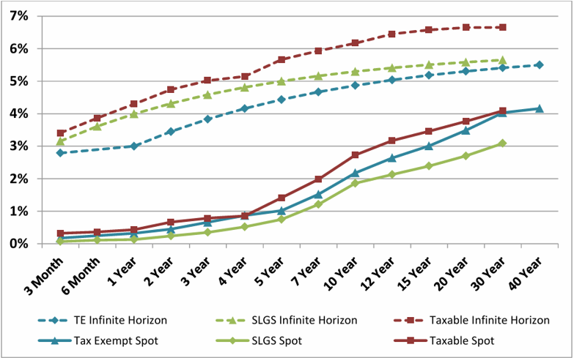
Expected Present Value – EPV – Savings (continued)

Slide 67
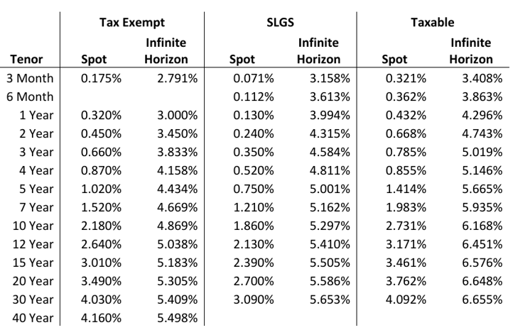
Expected Present Value – EPV – Savings (continued)

Slide 68
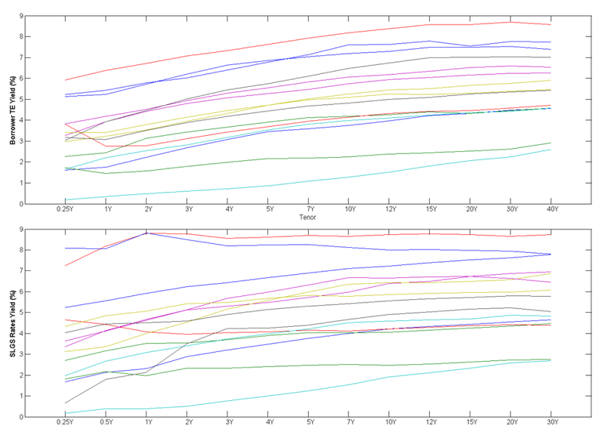
Expected Present Value – EPV – Savings (continued)
Components of a Full Simulation: Each simulated environment contains a complete set of correlated, tax-exempt, taxable, and escrow yield curves

Slide 69
Expected Present Value – EPV – Savings (continued)
Quarterly Refunding of Candidate Bonds: Though the simulations are performed daily to capture real yield curve dynamics, one calculates the value of refunding bonds on a quarterly basis using an assumption of one percent for costs of bond issuance.
Negative Arbitrage: Occurs when the yield on the escrow is lower than the refunding bond yield.
Section §148 of Internal Revenue Code: Precludes issuers from earning a higher yield on the escrow than the arbitrage yield on tax-exempt refunding bonds.
Net Present Value Savings Calculation: The NPV savings calculation reflects negative arbitrage where it exists and ensures that the escrow yield is no greater than the bond yield for tax-exempt re-fundings

Slide 70
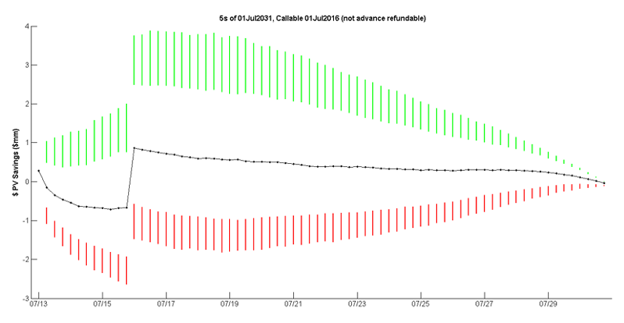
Expected Present Value – EPV – Savings (continued)
NPV Savings in Simulations: The objective is to create a standard NPV savings value in each simulated environment akin to an option payoff.
NPV Savings Distribution for a 5% Bond #1: As an example, the graph below shows the distribution of NPV savings for a 5% bond maturing July 1, 2031 callable on July 1, 2016

Slide 71
Expected Present Value – EPV – Savings (continued)
90-Day Advance Call: The bond in then figure above is callable but not eligible for refunding on a tax-exempt basis until 90 days in advance of the call date.
Taxable vs Tax-exempt Advance Refunding: Note that prior to the call date the taxable advance refunding leads to lower NPV savings overall relative to when the tax-exempt refunding is possible starting 90-days prior to the call date.
NPV Savings vs Rates: One also sees the initial average reduction in NV savings as rates rise on average within the model.
Refinancing Rate Impact with Time: Lastly, the reference rate rolls down the simulated yield curve as the bond approaches maturity. This last fact explains why there is declining savings variability as one approaches maturity

Slide 72
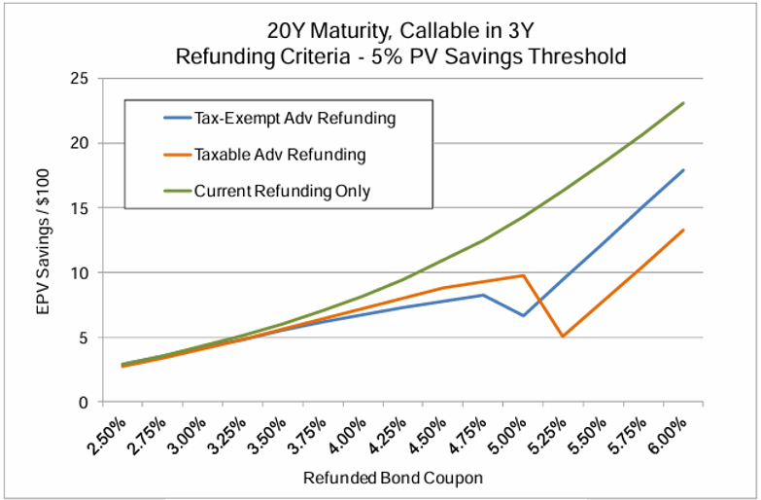
Expected Present Value – EPV – Savings (continued)
Assuming that the borrower refunds the bonds at a 5% NPV savings threshold – common in practice – one can calculate the expected present value – EPV – by appropriately discounting and averaging across all simulated environments

Slide 73
Expected Present Value – EPV – Savings (continued)
EPV Savings for different Bonds: The figure above shows the EPV savings for 3 different bond types: one that can be advance refunded only taxably; one allowing for tax-exempt refunding; one that may be refunded on a current basis, i.e., no more than 90 days in advance of the first call date.
EPV Savings at Lower Coupon: At lower coupon levels, EPV savings for all bond types is similar indicating that refunding is happening at similar times, in this case close to maturity.
EPV Savings at Higher Coupon: In the coupon range over 5.25%, exercise happens very quickly or even immediately. In this case, the taxable advance refunding fares poorly relative to either the tax-exempt advance refunding or waiting for the current refunding near the call date.
EPV Savings at Intermediate Coupons: In the middle region, however, with a coupon between 4.75% and 5.25%, the refunding criteria of 5% PV savings impacts EPV savings in unintuitive ways

Slide 74
Expected Present Value – EPV – Savings (continued)
Behavior of EPV Savings: Despite higher coupons, EPV savings actually falls in certain cases because the refunding decision in the lower coupons is delayed such that NPV savings at a later time is higher, perhaps due to less negative arbitrage in the escrow.
Impact of Advance Refundings: As such, there is little one resolve dispositively about these three bonds or their embedded options. For instance, it would be incorrect to take these results as proof that either re-fundings always destroy values, or alternatively that it is always more advantageous to wait until the call date to refund.
Assessing the Optimal Exercise: Without optimal exercise criterion, these assessments cannot be made accurately.

Slide 75
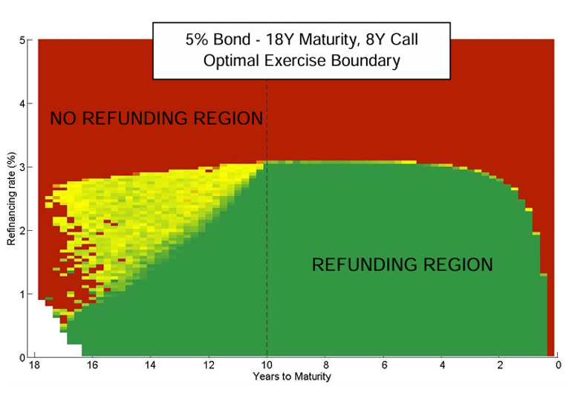
Expected Present Value – EPV – Savings (continued)

Slide 76
Expected Present Value – EPV – Savings (continued)
Optimal Exercise Chart #1: The chart above provides a visualization of an optimal exercise boundary for a municipal bond option given a certain set of decision criteria.
Optimal Exercise Chart #2: The coloring of the chart shows the percentage of simulated markets where certain optimal refunding criteria have been satisfied.
Optimal Exercise Chart #3: Refinancings are bucketed such that if 100% of the refinancing rates in a rate bucket for a given time bucket correlate to satisfying the refunding criteria, then the rectangle is green. If in turn, the number of rates satisfying the refunding criteria is 0%, the rectangle is red. A color gradient corresponds to the intermediate values.

Slide 77
Expected Present Value – EPV – Savings (continued)
Zones of Low Refunding: Note that the greater the time to the call remaining, the greater the area wither yellow or red, indicating little or no refunding. This results from the role of the other important variable not directly observed in this chart, the escrow yield.
Regions of Low Refinancing Rate: Negative arbitrage is significant in those areas where, despite a very low refinancing rate – even below 2% - the region is still not one where refunding occurs frequently. This region shrinks as one moves closer to the call date.
Post Call Relationship between Refinancing and Savings: After the call, there is a clear distinction as the escrow yield is no longer a factor and there is a direct correspondence between refinancing rate and savings.

Slide 78
Section 5 – Nelder-Mead Method

Slide 79
Introduction
What is Nelder-Mead Method? Also called downhill simplex method, amoeba method, or polytope method – is a numerical method used to find a local minimum of maximum of an objective function in a multi-dimensional space
Direct Search Based on Functional Optimization: Direct search method – based on function comparison – applied to non-linear optimization problems for which derivatives may not be known.
Heuristic Convergence to Non-stationary Points: However, the Nelder-Mead technique is a heuristic search method that can converge to non-stationary point on problems that can be solved by alternative methods.

Slide 80
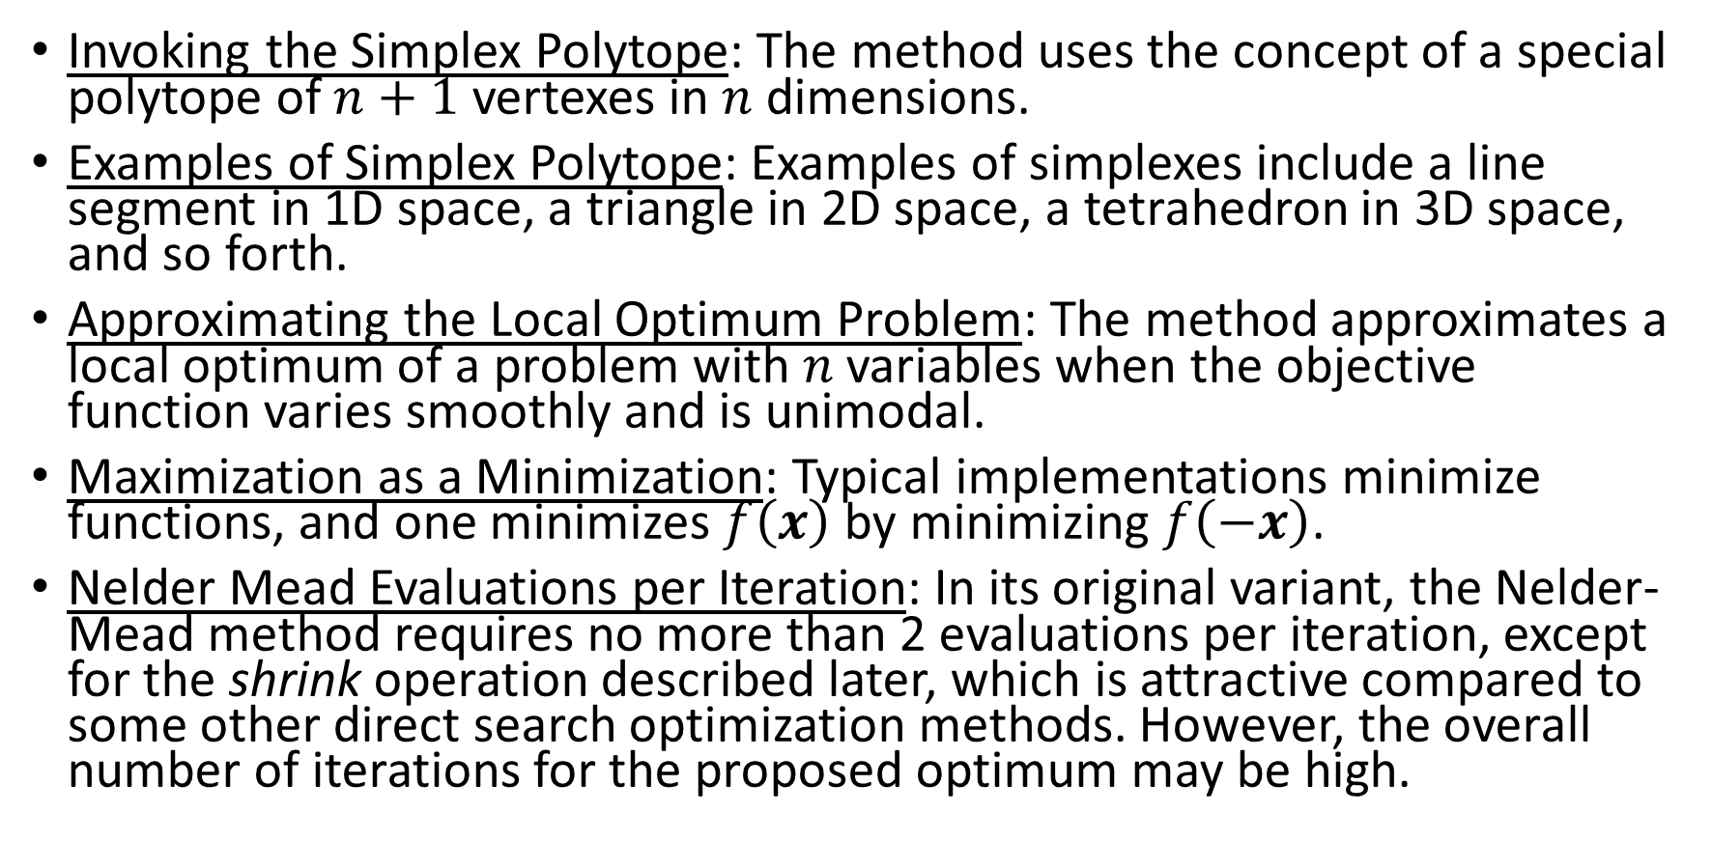
Overview
Invoking the Simplex Polytope: The method uses the concept of a special polytope of $n+1$ vertexes in $n$ dimensions.
Examples of Simplex Polytope: Examples of simplexes include a line segment in 1D space, a triangle in 2D space, a tetrahedron in 3D space, and so forth.
Approximating the Local Optimum Problem: The method approximates a local optimum of a problem with $n$ variables when the objective function varies smoothly and is unimodal.
Maximization as a Minimization: Typical implementations minimize functions, and one minimizes $f\left(x\right)$ by minimizing $f\left(−x\right)$.
Nelder Mead Evaluations per Iteration: In its original variant, the Nelder-Mead method requires no more than 2 evaluations per iteration, except for the shrink operation described later, which is attractive compared to some other direct search optimization methods. However, the overall number of iterations for the proposed optimum may be high.

Slide 81
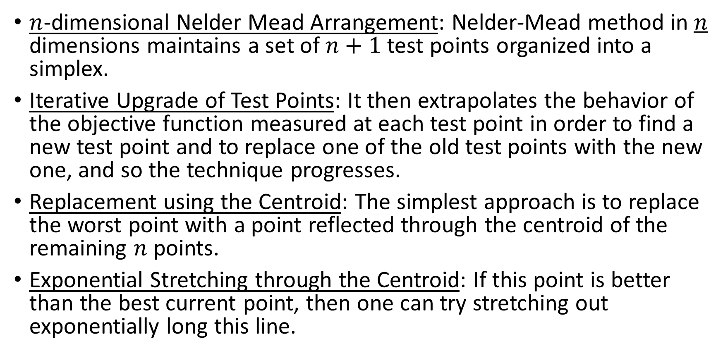
Overview (continued)
$n$-dimensional Nelder Mead Arrangement: Nelder-Mead method in $n$ dimensions maintains a set of $n+1$ test points organized into a simplex.
Iterative Upgrade of Test Points: It then extrapolates the behavior of the objective function measured at each test point in order to find a new test point and to replace one of the old test points with the new one, and so the technique progresses.
Replacement using the Centroid: The simplest approach is to replace the worst point with a point reflected through the centroid of the remaining $n$ points.
Exponential Stretching through the Centroid: If this point is better than the best current point, then one can try stretching out exponentially long this line.

Slide 82
Overview (continued)
Shrinking Towards a Better Point: On the other hand, if this new point isn’t much better than the previous value, one is stepping cross valley, so one shrinks the simplex towards a better point.
Step #1 - Movement across the Opposite Face: The downhill simplex method takes a series of steps, most steps just moving the point of the simples where the function is largest – “highest point” – through the opposite face of simplex to a lower point.
Step #2 - The Reflection Step: These steps are called reflections, and they are constructed to conserve the volume of the simplex, and hence maintain its non-degeneracy.
Step #3 - Larger Step Expansion: When it can do so, the method expands the simplex in one direction or the other to take larger steps.

Slide 83
Overview (continued)
Step #4 - Valley Line Contraction: When it reaches a valley floor, the method contracts itself in the transverse direction and tries to ooze down the valley.
Step #5 - Lowest Point Contraction: If there is a situation where the simplex is trying to pass through the eye of a needle, it contracts itself on all directions, pulling itself around its lowest – best – point.
Convergence to a Non-stationary Point: Unlike modern optimization methods, the Nelder-Mead heuristic can converge to a non-stationary point, unless the problem satisfies stronger conditions that are necessary for modern methods.
The Steepest Descent Variant: Many variations exist depending on the actual nature of the problem being solved. A common variant uses a constant size, small simplex that roughly follows the gradient direction – which gives the steepest descent.

Slide 84
Overview (continued)
Flexible Polyhedron Method: Visualize a small triangle on an elevation map flip-flopping its way down a valley to a local bottom. This method is also known as the flexible polyhedron method.
Drawbacks of Steepest Descent Proxy: This, however, tends to perform poorly against the method described above because it makes unnecessary steps in areas of little interest.

Slide 85
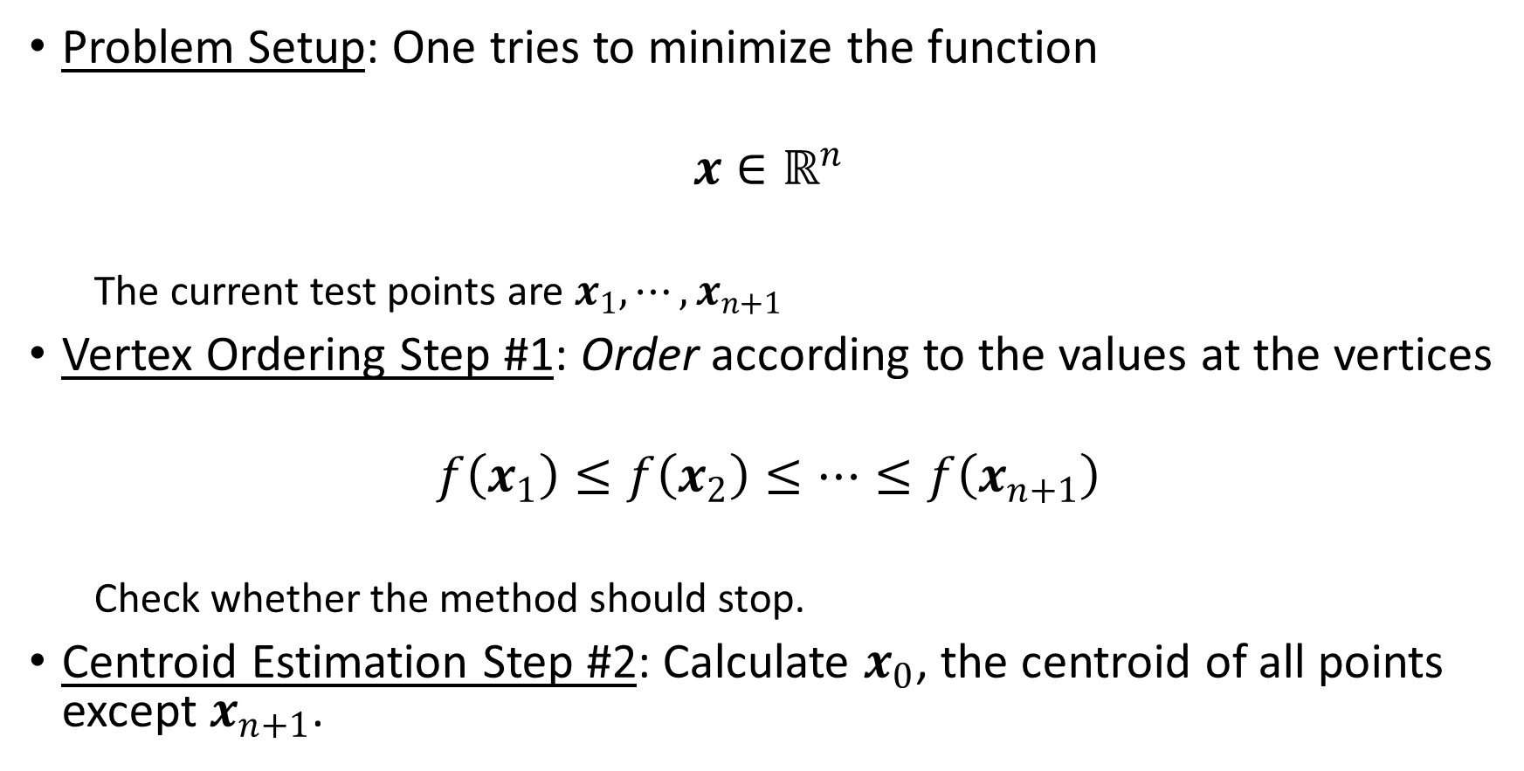
One Variation of the Nelder-Mead Algorithm
Problem Setup: One tries to minimize the function
$$x∈ℝ^{n}$$
  The current test points are $x_{1}, ⋯, x_{n+1}$
Vertex Ordering Step #1: Order according to the values at the vertices
$$f\left(x_{1}\right)≤f\left(x_{2}\right)≤⋯≤f\left(x_{n+1}\right)$$
  Check whether the method should stop.
Centroid Estimation Step #2: Calculate $x_{0}$, the centroid of all points except $x_{n+1}$.

Slide 86
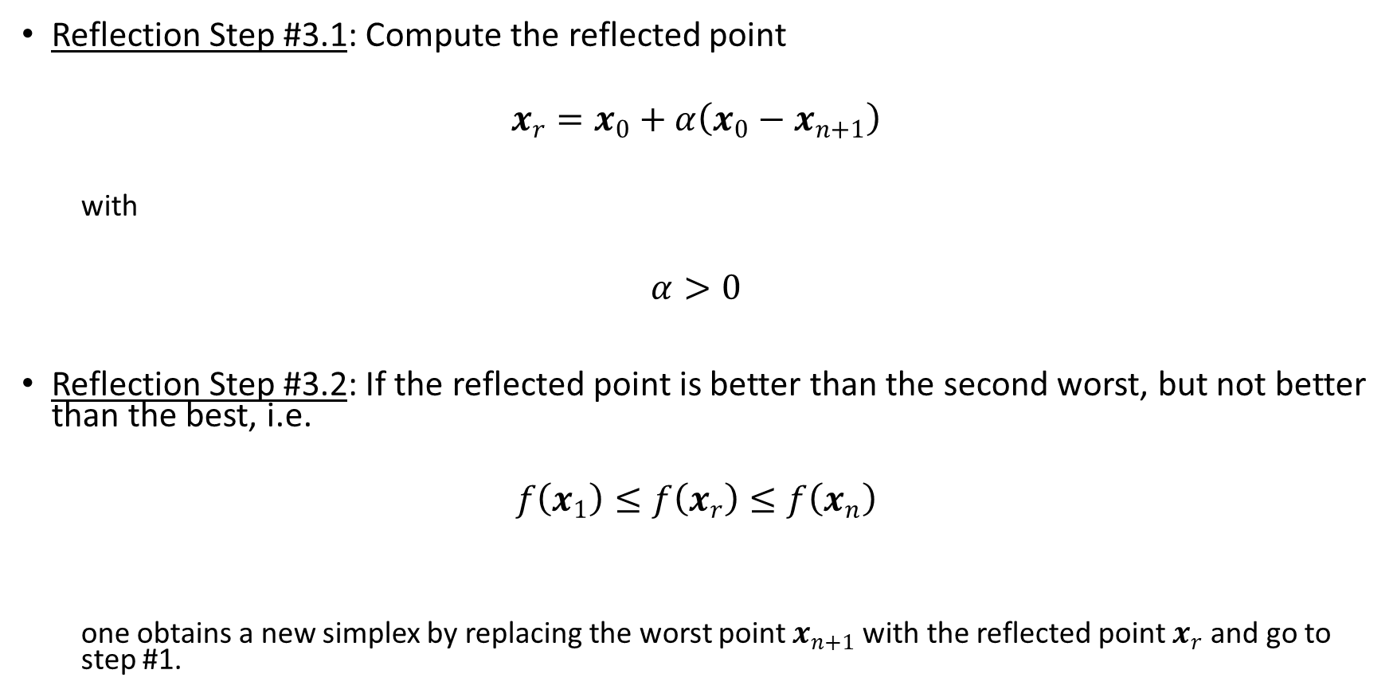
One Variation of the Nelder-Mead Algorithm (continued)
Reflection Step #3.1: Compute the reflected point
$$x_{r}=x_{0}+α\left(x_{0}−x_{n+1}\right)$$
  with
$$α>0$$
Reflection Step #3.2: If the reflected point is better than the second worst, but not better than the best, i.e.
$$f\left(x_{1}\right)≤f\left(x_{r}\right)≤f\left(x_{n}\right)$$
  one obtains a new simplex by replacing the worst point $x_{n+1}$ with the reflected point $x_{r}$ and go to step #1.

Slide 87

One Variation of the Nelder-Mead Algorithm (continued)
Expansion Step #4.1: If the reflected point is the best so far
$$f\left(x_{r}\right)<f\left(x_{1}\right)$$
  one computes the expanded point
$$x_{e}=x_{0}+γ\left(x_{r}−x_{0}\right)$$
  with
$$γ>1$$

Slide 88
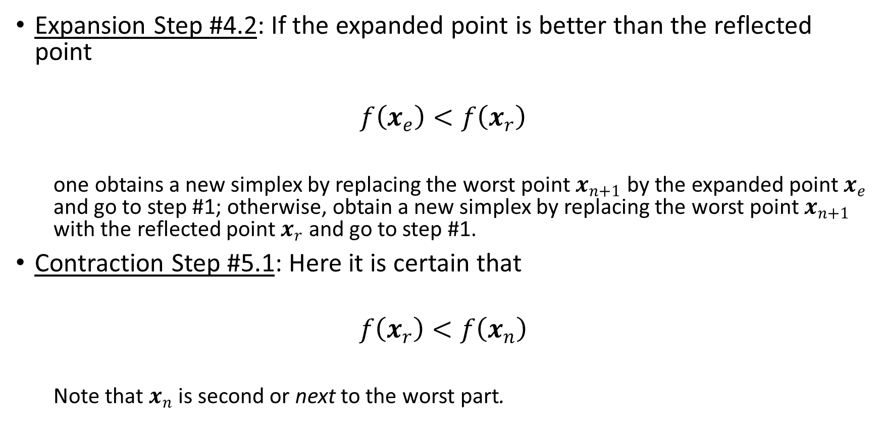
One Variation of the Nelder-Mead Algorithm (continued)
Expansion Step #4.2: If the expanded point is better than the reflected point
$$f\left(x_{e}\right)<f\left(x_{r}\right)$$
  one obtains a new simplex by replacing the worst point $x_{n+1}$ by the expanded point $x_{e}$ and go to step #1; otherwise, obtain a new simplex by replacing the worst point $x_{n+1}$ with the reflected point $x_{r}$ and go to step #1.
Contraction Step #5.1: Here it is certain that
$$f\left(x_{r}\right)<f\left(x_{n}\right)$$
  Note that $x_{n}$ is second or next to the worst part.

Slide 89

One Variation of the Nelder-Mead Algorithm (continued)
Contraction Step #5.2: If
$$f\left(x_{r}\right)<f\left(x_{n+1}\right)$$
  one computes the contracted point on the outside
$$x_{c}=x_{0}+ρ\left(x_{r}−x_{0}\right)$$
  with
$$0<ρ≤0.5$$

Slide 90
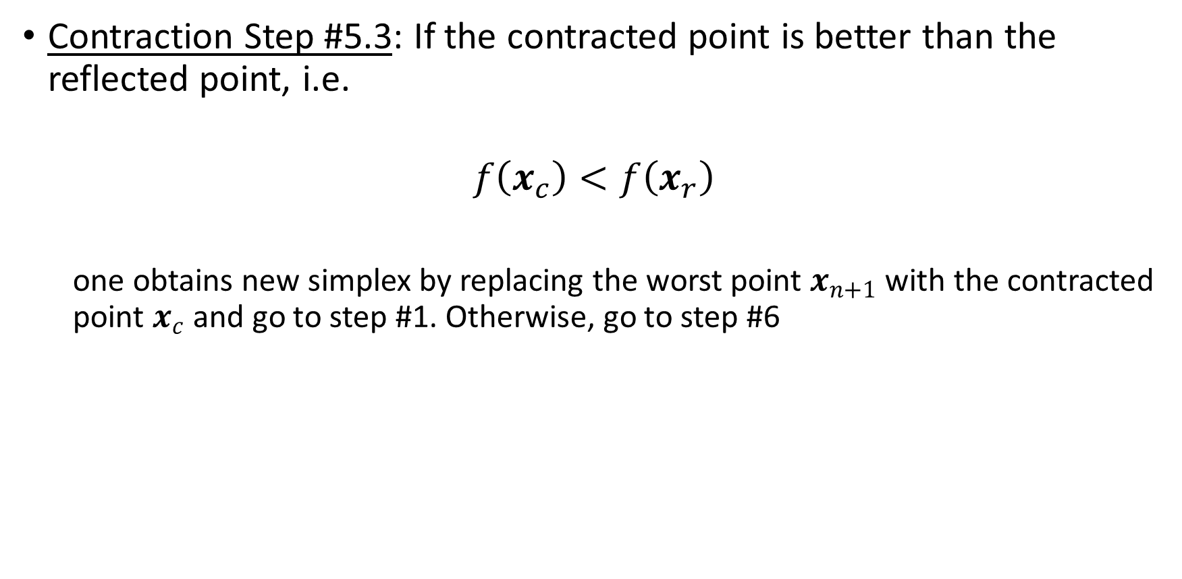
One Variation of the Nelder-Mead Algorithm (continued)
Contraction Step #5.3: If the contracted point is better than the reflected point, i.e.
$$f\left(x_{c}\right)<f\left(x_{r}\right)$$
  one obtains new simplex by replacing the worst point $x_{n+1}$ with the contracted point $x_{c}$ and go to step #1. Otherwise, go to step #6

Slide 91

One Variation of the Nelder-Mead Algorithm (continued)
Contraction Step #5.4: If
$$f\left(x_{r}\right)<f\left(x_{n+1}\right)$$
  one computes the contracted point on the outside
$$x_{c}=x_{0}+ρ\left(x_{n+1}−x_{0}\right)$$
  with
$$0<ρ≤0.5$$

Slide 92
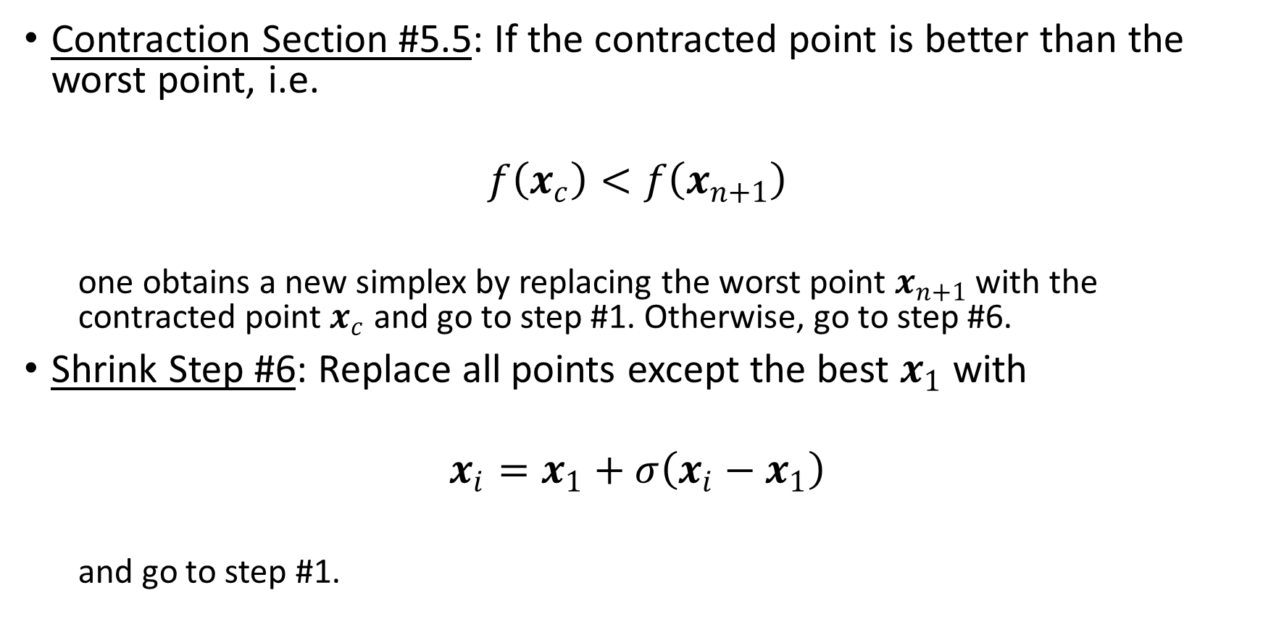
One Variation of the Nelder-Mead Algorithm (continued)
Contraction Section #5.5: If the contracted point is better than the worst point, i.e.
$$f\left(x_{c}\right)<f\left(x_{n+1}\right)$$
  one obtains a new simplex by replacing the worst point $x_{n+1}$ with the contracted point $x_{c}$ and go to step #1. Otherwise, go to step #6.
Shrink Step #6: Replace all points except the best $x_{1}$ with
$$x_{i}=x_{1}+σ\left(x_{i}−x_{1}\right)$$
  and go to step #1.

Slide 93

One Variation of the Nelder-Mead Algorithm (continued)
Standard Values for the Coefficients: Note that $α$, $γ$, $ρ$, and $σ$ are respectively the reflection, the expansion, the contraction, and the shrink coefficients. Standard values are
$$α=1$$
$$γ=2$$
$$ρ=\frac{1}{2}$$
  and
$$σ=\frac{1}{2}$$

Slide 94
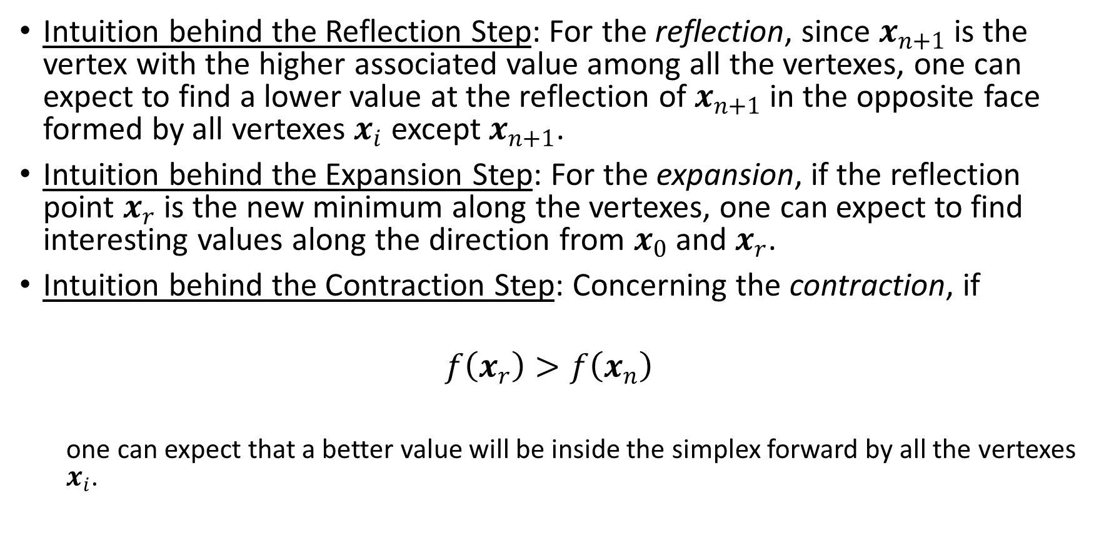
One Variation of the Nelder-Mead Algorithm (continued)
Intuition behind the Reflection Step: For the reflection, since $x_{n+1}$ is the vertex with the higher associated value among all the vertexes, one can expect to find a lower value at the reflection of $x_{n+1}$ in the opposite face formed by all vertexes $x_{i}$ except $x_{n+1}$.
Intuition behind the Expansion Step: For the expansion, if the reflection point $x_{r}$ is the new minimum along the vertexes, one can expect to find interesting values along the direction from $x_{0}$ and $x_{r}$.
Intuition behind the Contraction Step: Concerning the contraction, if
$$f\left(x_{r}\right)>f\left(x_{n}\right)$$
  one can expect that a better value will be inside the simplex forward by all the vertexes $x_{i}$.

Slide 95
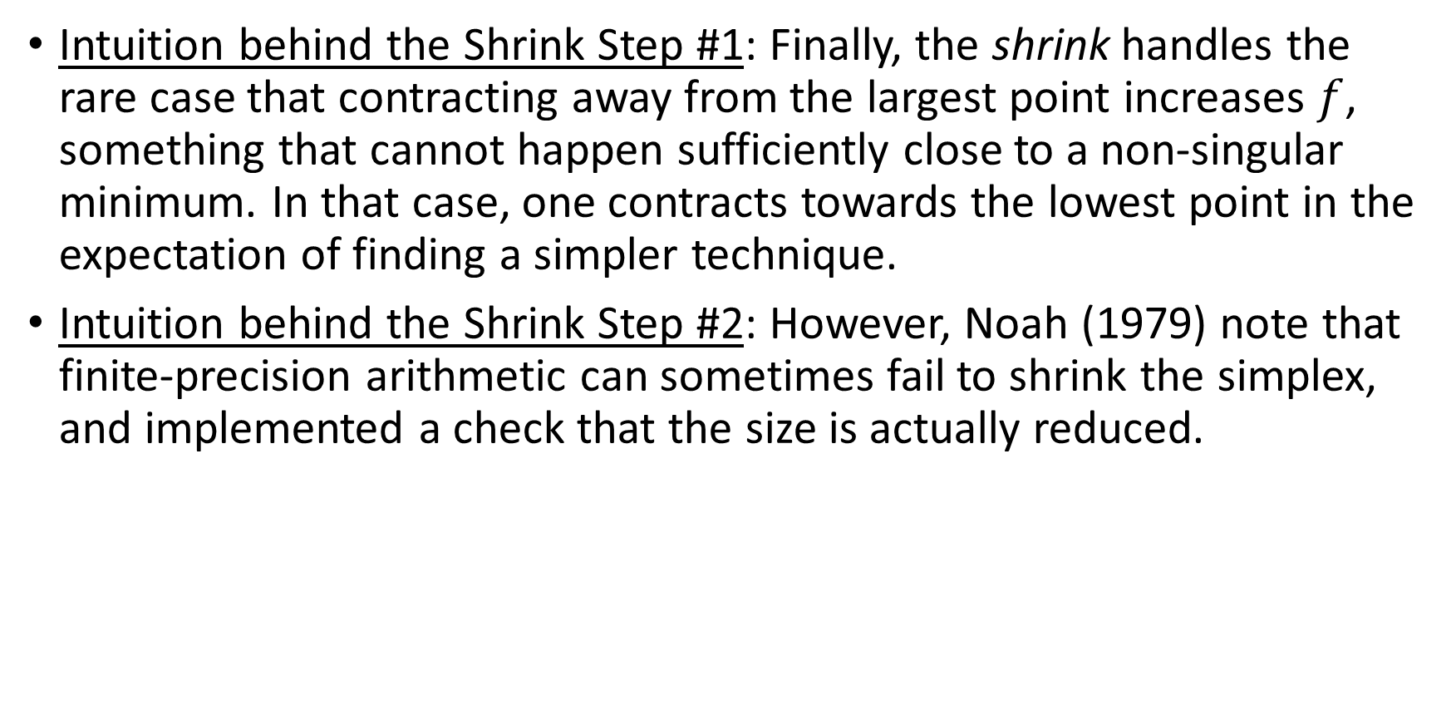
One Variation of the Nelder-Mead Algorithm (continued)
Intuition behind the Shrink Step #1: Finally, the shrink handles the rare case that contracting away from the largest point increases $f$, something that cannot happen sufficiently close to a non-singular minimum. In that case, one contracts towards the lowest point in the expectation of finding a simpler technique.
Intuition behind the Shrink Step #2: However, Noah (1979) note that finite-precision arithmetic can sometimes fail to shrink the simplex, and implemented a check that the size is actually reduced.

Slide 96
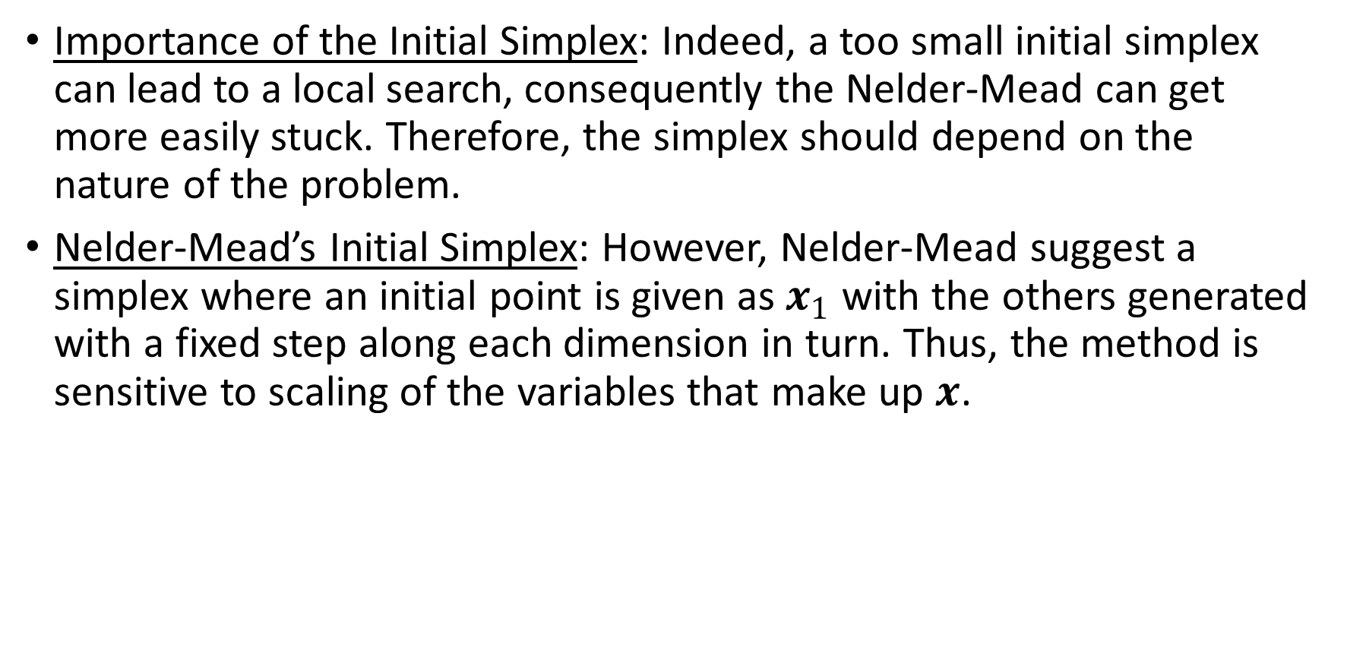
Initial Simplex
Importance of the Initial Simplex: Indeed, a too small initial simplex can lead to a local search, consequently the Nelder-Mead can get more easily stuck. Therefore, the simplex should depend on the nature of the problem.
Nelder-Mead’s Initial Simplex: However, Nelder-Mead suggest a simplex where an initial point is given as $x_{1}$ with the others generated with a fixed step along each dimension in turn. Thus, the method is sensitive to scaling of the variables that make up $x$.

Slide 97
Termination
Nelder-Mead Termination Criterion #1: Criteria are needed to break the iterative cycle, Nelder and Mead used the sample standard deviation of the function values of the current simplex.
Nelder-Mead Termination Criterion #2: If it falls below some tolerance, the cycle is stopped and the lowest point in the simplex is returned as a proposed optimum.
Inadequacies of Nelder-Mead Criterion: Note that a very flat function may have almost equal function values over a large domain, so the solution will be sensitive to the tolerance.
Nash’s Augmented Termination Criterion: Nash (1979) adds the test for shrinkage as another termination criterion.

Slide 98
Section 6 – Himmelblau Function

Slide 99

Specification
Test Function for Optimization Algorithms:
$$f\left(x, y\right)={\left(x^{2}+y−11\right)}^{2}+{\left(x+y^{2}−7\right)}^{2}$$

Slide 100

Specification (continued)
Local Extrema: It has local maximum at
$$x=−0.270845$$
  and
$$y=−0.923039$$
  where
$$f\left(x, y\right)=181.617$$
  and four identical local minima (Wikipedia (2026)):
$$f\left(3.0, 2.0\right)=0.0$$
$$f\left(−2.805118, 3.131312\right)=0.0$$
$$f\left(−3.779310, −3.283186\right)=0.0$$
$$f\left(3.584428, −1.848126\right)=0.0$$

Slide 101
Section 7 – Rosenbrock Function

Slide 102
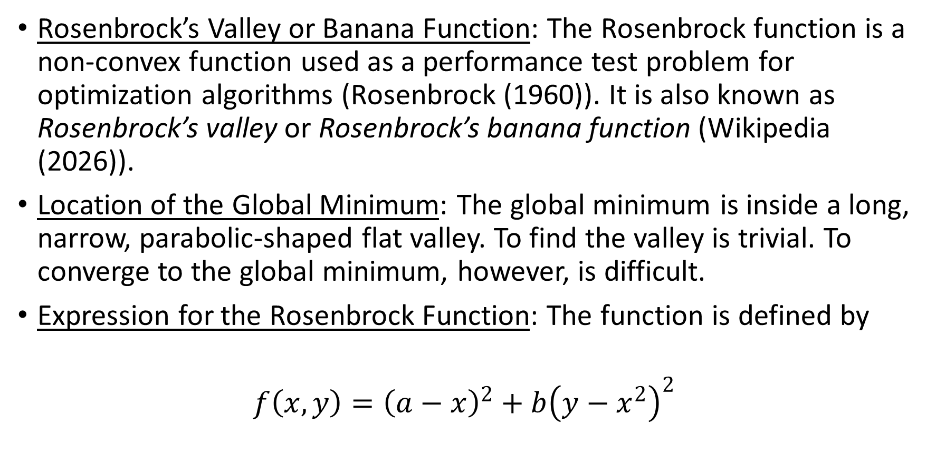
Overview
Rosenbrock’s Valley or Banana Function: The Rosenbrock function is a non-convex function used as a performance test problem for optimization algorithms (Rosenbrock (1960)). It is also known as Rosenbrock’s valley or Rosenbrock’s banana function (Wikipedia (2026)).
Location of the Global Minimum: The global minimum is inside a long, narrow, parabolic-shaped flat valley. To find the valley is trivial. To converge to the global minimum, however, is difficult.
Expression for the Rosenbrock Function: The function is defined by
$$f\left(x, y\right)={\left(a−x\right)}^{2}+b{\left(y−x^{2}\right)}^{2}$$

Slide 103

Overview (continued)
Characteristics of the Function: It has a global minimum
$$\left(x, y\right)=\left(a, a^{2}\right)$$
  where
$$f\left(x, y\right)=0$$
  Usually, these parameters are set such that
$$a=1$$
  and
$$b=100$$
  Only in the trivial case where
$$a=0$$
  the function is symmetric and the minimum is at the origin.

Slide 104
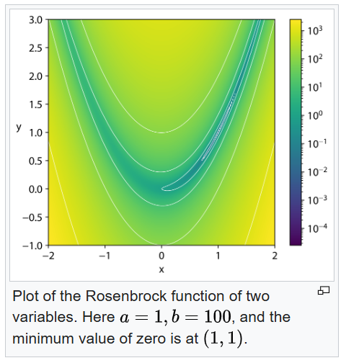
Overview (continued)
2D Rosenbrock Plot:

Slide 105
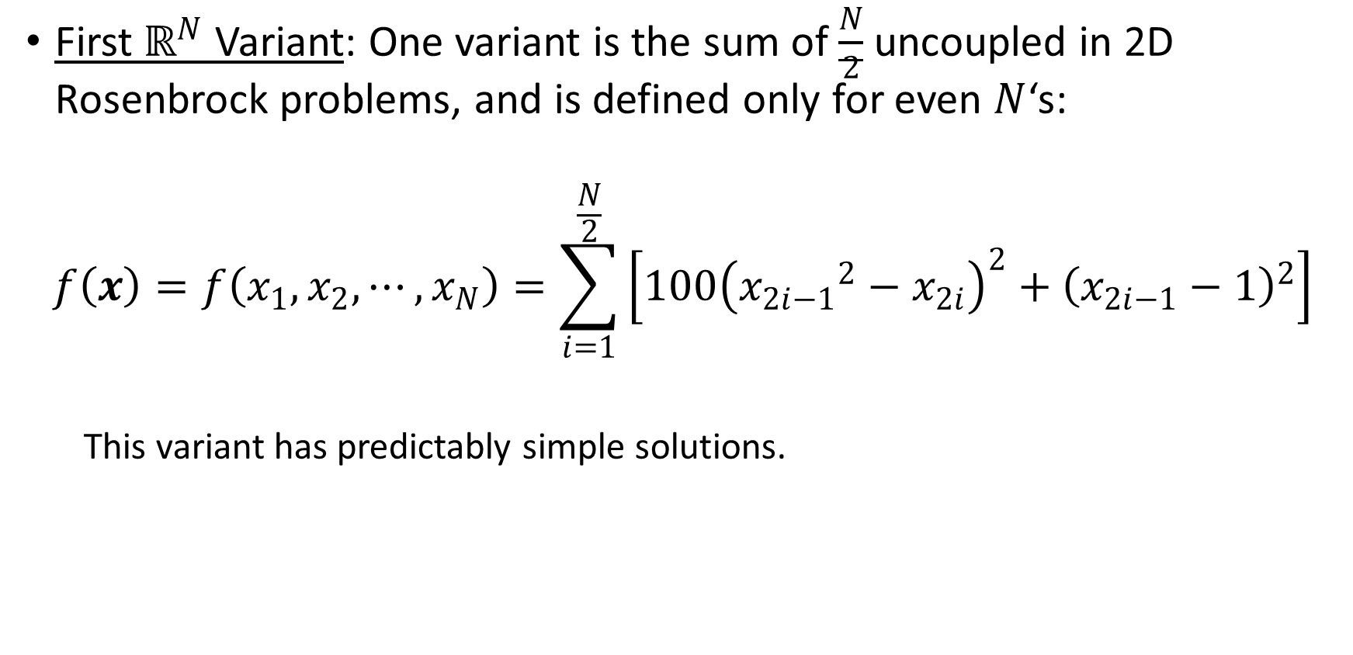
Multidimensional Generalizations
First $ℝ^{N}$ Variant: One variant is the sum of $\frac{N}{2}$ uncoupled in 2D Rosenbrock problems, and is defined only for even $N$‘s:
$$f\left(x\right)=f\left(x_{1}, x_{2}, ⋯, x_{N}\right)=\sum_{i=1}^{\frac{N}{2}}{\left[100{\left({x_{2i−1}}^{2}−x_{2i}\right)}^{2}+{\left(x_{2i−1}−1\right)}^{2}\right]}$$
  This variant has predictably simple solutions.

Slide 106

Multidimensional Generalizations (continued)
Second $ℝ^{N}$ Variant: A second, more involved variant is:
$$f\left(x\right)=f\left(x_{1}, x_{2}, ⋯, x_{N}\right)=\sum_{i=1}^{N−1}{\left[100{\left(x_{i+1}−x_{i}^{2}\right)}^{2}+{\left(1−x_{i}\right)}^{2}\right]}$$
  where
$$x=\left(x_{1}, x_{2}, ⋯, x_{N}\right)∈ℝ^{N}$$
  has exactly one minimum for
$$N=3$$
  at $\left(1, 1, ⋯, 1\right)$ and exactly two minima for
$$4≤N<7$$
  the global minimum at $\left(1, 1, ⋯, 1\right)$ a local minimum near
$$\hat{x}=\left(−1, 1, ⋯, 1\right)$$

Slide 107
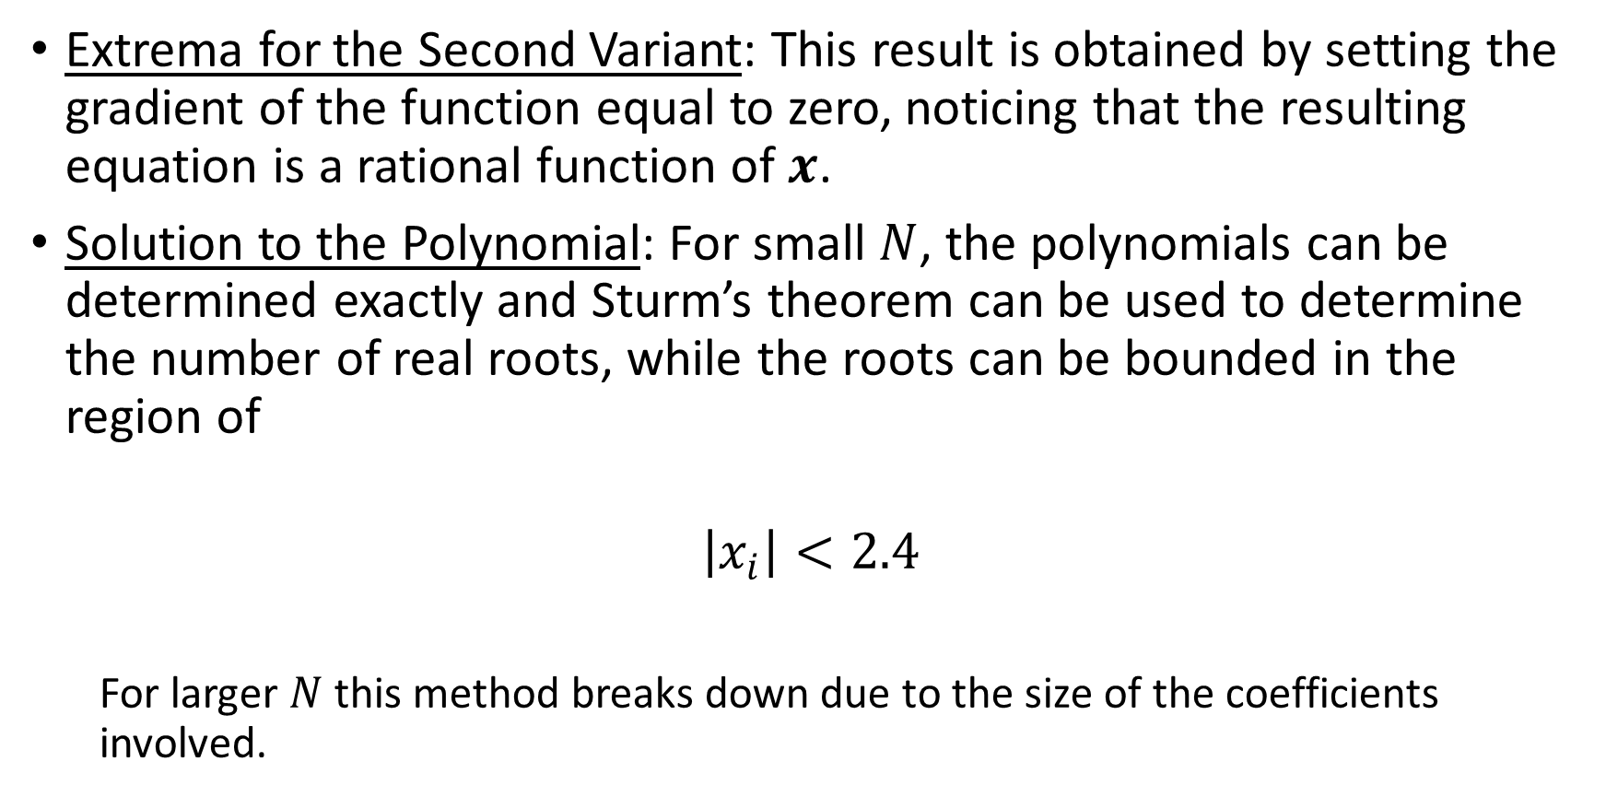
Multidimensional Generalizations (continued)
Extrema for the Second Variant: This result is obtained by setting the gradient of the function equal to zero, noticing that the resulting equation is a rational function of $x$.
Solution to the Polynomial: For small $N$, the polynomials can be determined exactly and Sturm’s theorem can be used to determine the number of real roots, while the roots can be bounded in the region of
$$\left|x_{i}\right|<2.4$$
  For larger $N$ this method breaks down due to the size of the coefficients involved.

Slide 108
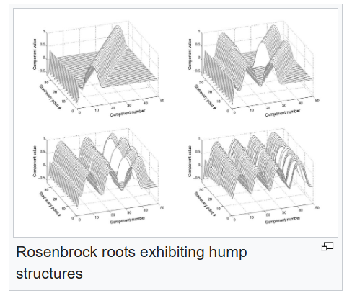
Stationary Points
Rosenbrock Hump Structure:

Slide 109
Stationary Points (continued)
Patterns Inherent in the Function: Many of the stationary points of the function exhibit a regular pattern when plotted. This structure can be exploited to locate them.

