Slide 1
IBM University Engagement Project Submission
“Exploring the Power of Agentic AI with IBM Granite and IBM Bob”

Slide 2

Project Tile – [Intelligent Market Research Assistant ]
Domain of Project – [Business & Finance]
Student Name | Recent Passport Photo | Email ID | Mobile number [WhatsApp]
Lakshmi kala Vemana |  | lakshmikalav4@gmail.com | 9392722062

Slide 3
Problem Statement -
Problem Statement :Intelligent Market Research Assistant
The Challenge
Organizations and startups often struggle with fragmented and rapidly changing market data— customer feedback, competitor moves, industry reports, and social media trends. This information is scattered across multiple sources, time-consuming to analyze, and often outdated by the time insights are generated. The challenge is not just to collect information but to synthesize, predict, and present actionable insights for smarter decision-making.
The Objective
Build an agentic AI application that acts as an intelligent market research assistant. The solution should:
1. Fuse Disparate Sources: Collect real-time data from news sites, analyst reports, social media, and customer reviews, and synthesize into clear, concise market snapshots.
2. Enable Multimodal Analysis: Accept inputs such as text, charts, or voice notes from users and refine them into structured insights, competitor comparisons, or market trends.
3. Create a Predictive & Agentic Layer: Analyze patterns to forecast market shifts (e.g., rising demand in a product segment) and generate alerts on competitor activities or customer sentiment changes.
4. Visualize the Market Pulse: Provide a dashboard with trend analysis, competitor mapping, sentiment tracking, and demand forecasts to guide data-driven business strategies.

Slide 4
Proposed Solution -
Proposed Solution: AI-Powered Intelligent Market Research Assistant
The proposed solution is an Agentic AI-powered Intelligent Market Research Assistant built using IBM Granite Models, IBM Langflow/Orchestrate, Flask, and a web dashboard.
The system automatically gathers and analyzes market information from multiple sources, including news articles, customer reviews, competitor information, and industry trends. Instead of manually searching through different websites, users can ask questions in natural language and receive structured market insights.
The application provides:
AI-powered market research chat
Competitor analysis and comparison
Market trend forecasting
Customer sentiment analysis
Quick market insights
Interactive dashboard with visual reports
Automated report generation for business decision-making
The AI agent continuously processes available information, identifies important trends, predicts future market opportunities, and presents actionable recommendations to businesses and startups.

Slide 5
Technology Used
IBM Bob platform -For designing and orchestrating multi-agent workflows visually
IBM Granite model - for eg – ibm-granite-3-2-8b – For natural language understanding, reasoning, and personalization
IBM Cloud – It provides the infrastructure to build, deploy, and scale the Nutrition Agent efficiently. IBM Cloud enables a reliable, secure, and scalable environment for deploying the Nutrition Agent.

Slide 6
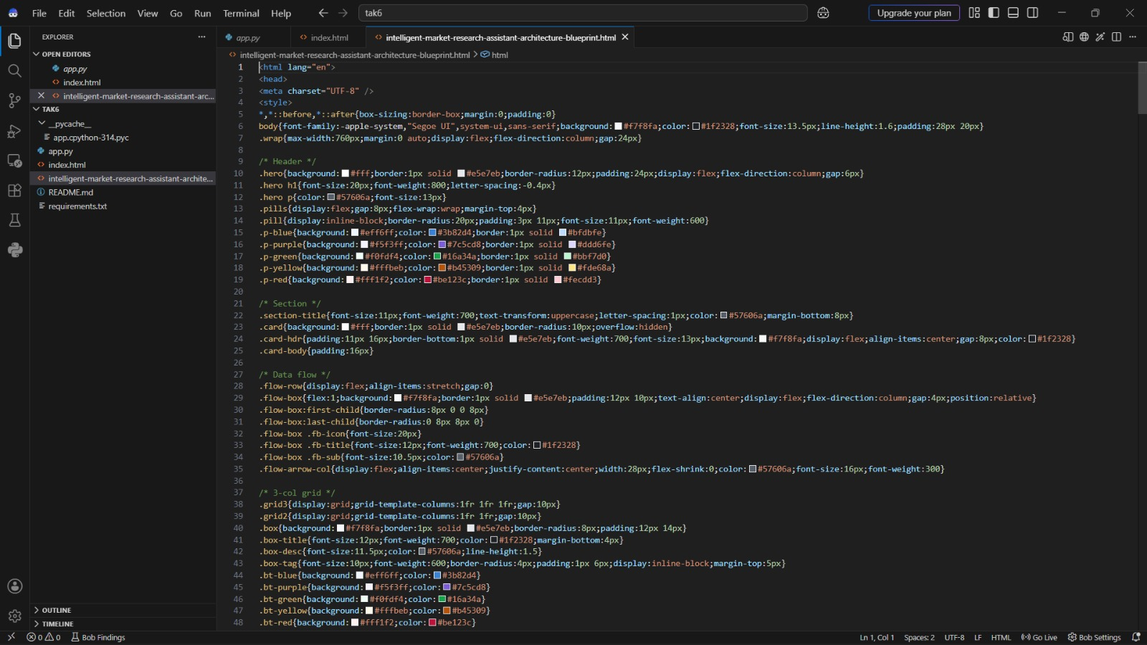
Required Files created using IBM bob -
App.py
Index.html

Slide 7
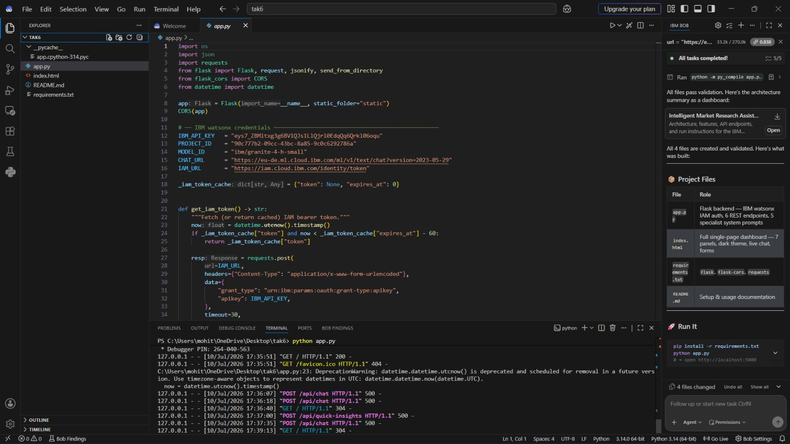
IBM Bob Screenshots:

Slide 8
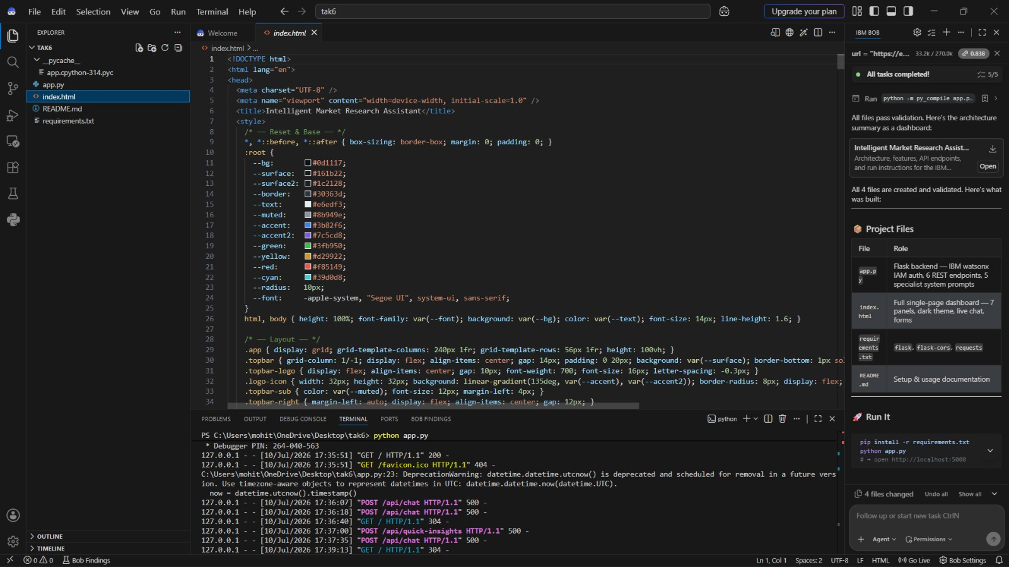

Slide 9
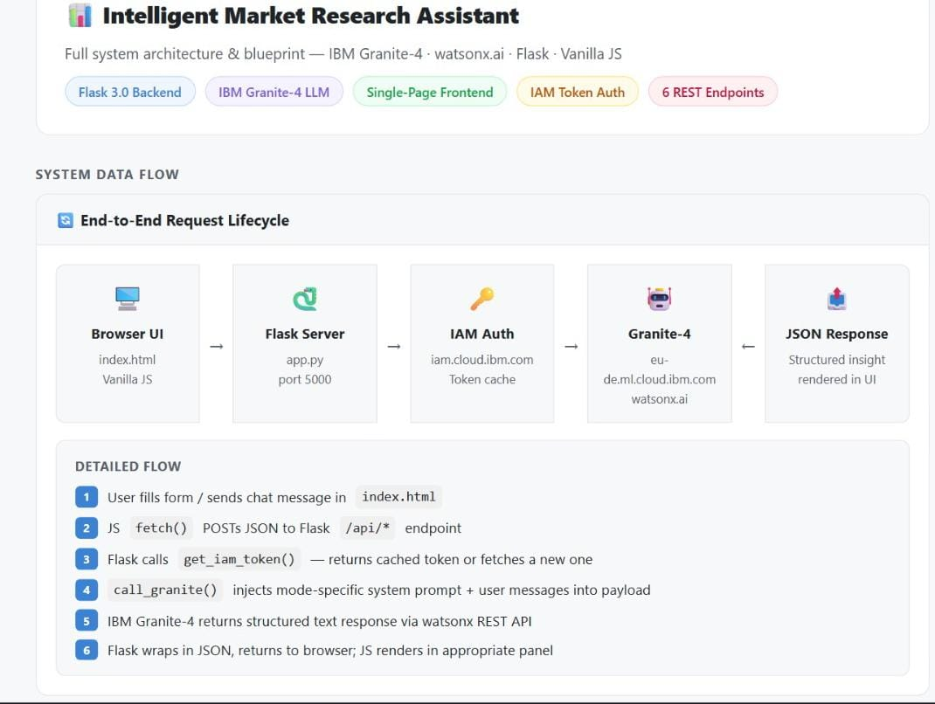
Architecture blueprint for IBM bob:

Slide 10

Role of Agentic AI in the solution
Role of Agentic AI in Intelligent Market Research Assistant
The Agentic AI acts as an intelligent market research assistant by performing tasks autonomously without constant user intervention.
Its major roles include:
Collects market information from multiple sources.
Understands user queries using natural language.
Analyzes competitors and identifies market opportunities.
Performs customer sentiment analysis.
Predicts future market trends using AI reasoning.
Generates business reports automatically.
Provides strategic recommendations for better decision-making.
Continuously monitors market changes and updates insights.
.

Slide 11
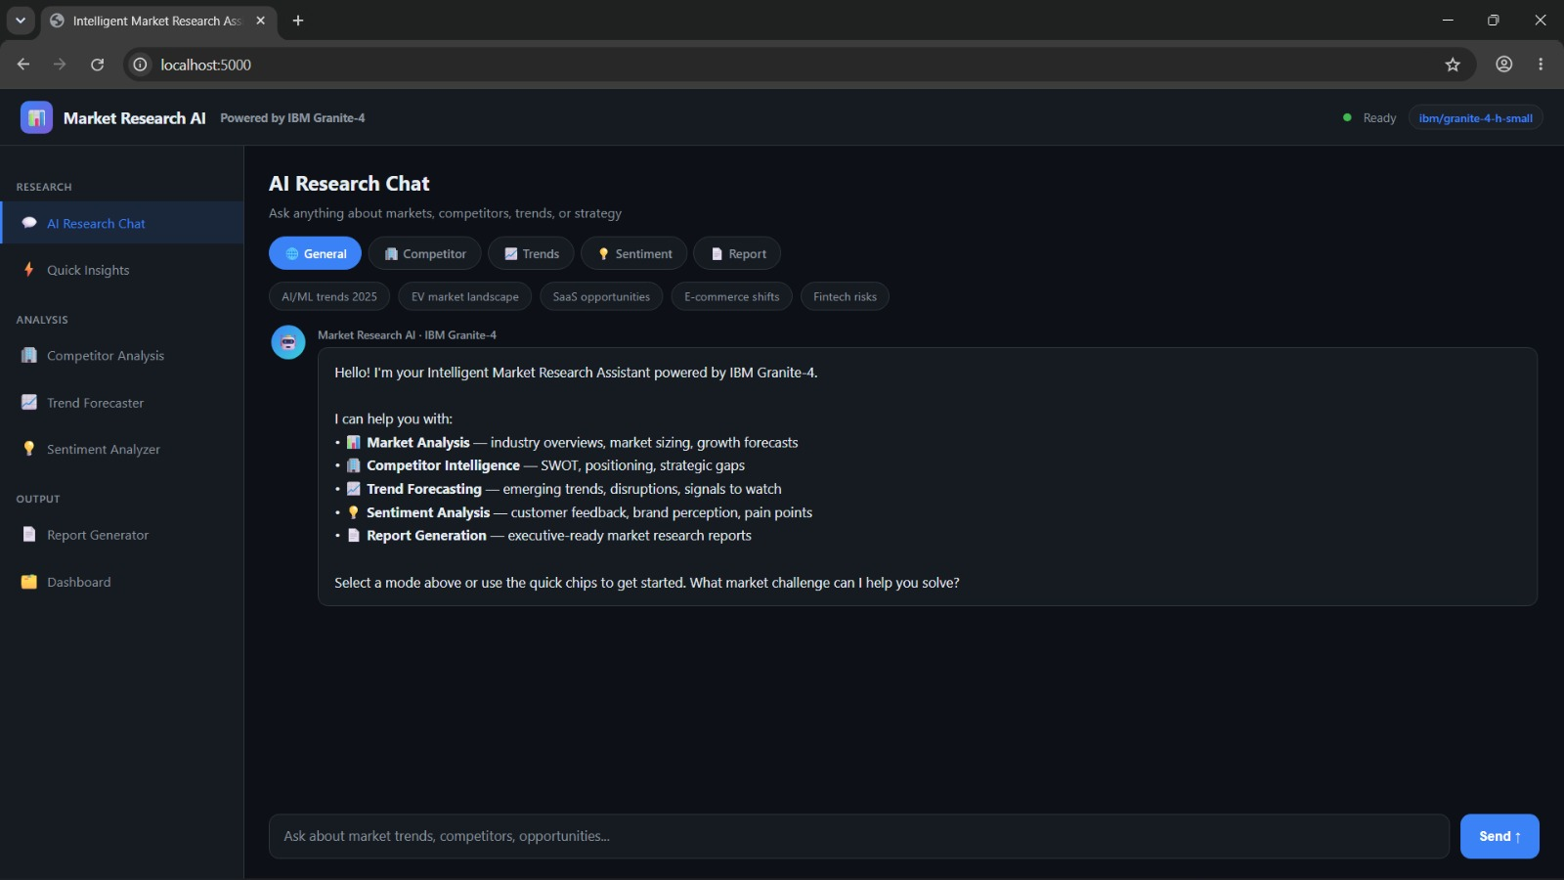
Project Output Screenshot
Please put IBM Bob output screenshots with 2-3 prompts.
You can take 2-3 more slides for each screenshot
·
·
·

Slide 12
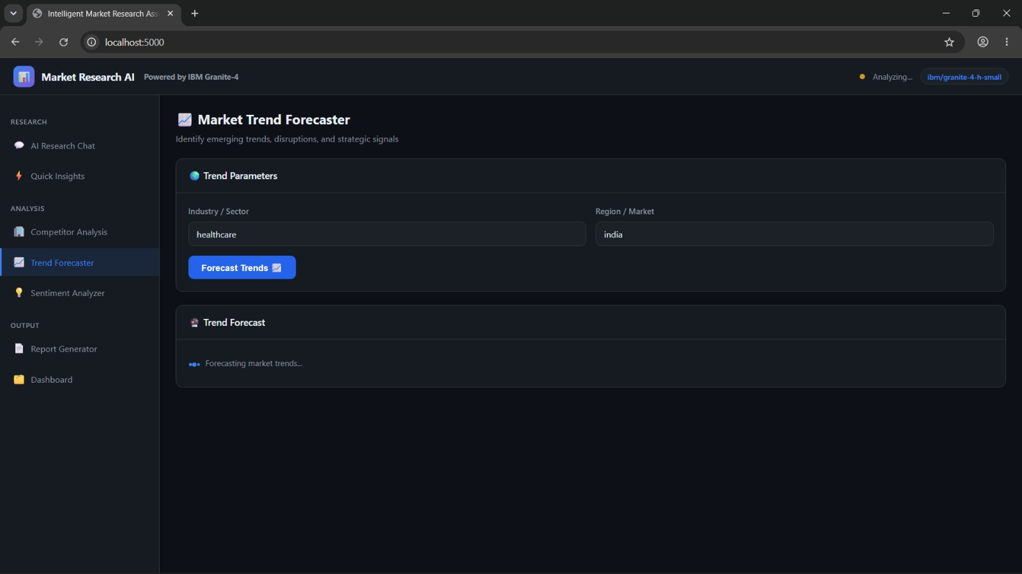
Project Output Screenshot
Please put IBM Bob output screenshots with 2-3 prompts.
You can take 2-3 more slides for each screenshot
·
·
·

Slide 13
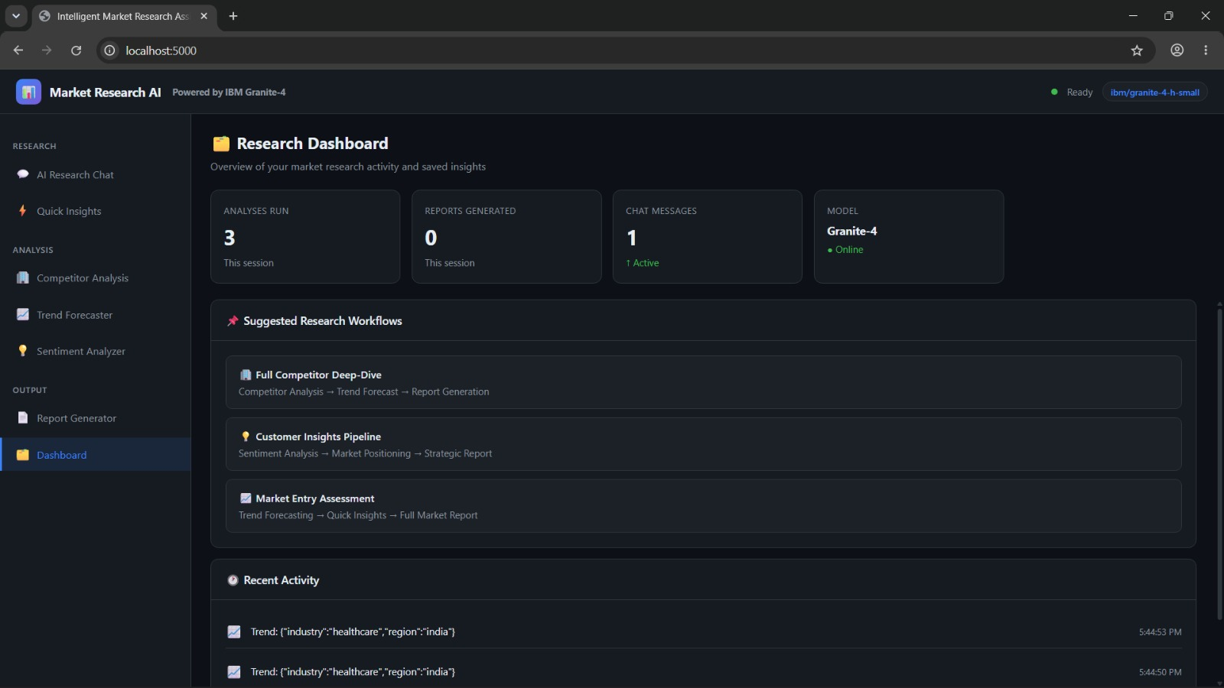
Project Output Screenshot
Please put IBM Bob output screenshots with 2-3 prompts.
You can take 2-3 more slides for each screenshot
·
·
·

Slide 14
Novelty and Uniqueness
The proposed Intelligent Market Research Assistant stands out by combining Agentic AI, IBM Granite Models, predictive analytics, and automated market intelligence into a single smart platform.
Multi-Agent Intelligence – Multiple AI agents collaborate to perform market research, competitor analysis, trend forecasting, sentiment analysis, and report generation instead of relying on a single chatbot.
Real-Time Market Intelligence – Continuously gathers and synthesizes information from news, industry reports, customer reviews, and other market sources to provide up-to-date insights.
Predictive Market Forecasting – Uses AI to identify emerging trends, predict future market shifts, and detect business opportunities before competitors.
Competitor & Sentiment Analysis – Automatically compares competitors, analyzes customer opinions, identifies strengths and weaknesses, and provides actionable business recommendations.
Interactive AI Dashboard – Presents market trends, competitor insights, sentiment scores, and forecasts through an easy-to-understand dashboard for faster decision-making.
Natural Language Research Assistant – Allows users to ask business questions in plain English and instantly receive structured, AI-generated market insights and reports.
Automated Report Generation – Converts complex market analysis into concise, business-ready reports, reducing manual effort and saving valuable time.
Scalable & Enterprise-Ready – Built using IBM watsonx.ai, IBM Granite Models, and IBM
This makes the solution an intelligent, proactive, and AI-driven Market Research Assistant that not only analyzes current market conditions but also predicts future opportunities, enabling faster and smarter business decisions.

Slide 15
Git Hub Link
https://github.com/Lakshmikala43/Intelligent_Market_Research_Assistant/tree/main
·
·
·

Slide 16
Future Scope
The system can be further enhanced with advanced AI capabilities such as:
Real-time integration with social media platforms (X, LinkedIn, Reddit).
Live news and financial market monitoring.
Voice-based market research assistant.
Image and chart analysis using multimodal AI.
Personalized business recommendations based on industry.
Automated competitor alerts and notifications.
Sales forecasting using machine learning models.
Integration with CRM and ERP platforms.
Mobile application for on-the-go market intelligence.
Multi-language support for global businesses.
These enhancements will transform the application into a complete AI-powered business intelligence platform capable of providing real-time, predictive, and data-driven market insights.
·
·
·

Slide 17
Certificates Earned:

Slide 18
Certificates Earned:​

Slide 19
Thank You!

