Slide 1
GapWise
Understand every gap. Trust every finding.
An AI agent that checks whether a financial platform actually holds the money it owes its users, and explains why when it does not, with evidence for every claim.
Track 02 · The Agent That Can Explain Why | Zetaris · Meterless Nightshift + H-MEM · NVIDIA Nemotron
Notes:
GapWise investigates why reserves and liabilities differ on a real platform (Strike Finance), using 5+ data sources. Independent project, not affiliated with Strike Finance.

Slide 2
A ratio tells you there is a gap, never why
3
3,487
$20,866
ledgers to read
(Ethereum, Solana, Cardano)
user accounts owed money
via the platform API
gap on 27 Oct, 12:47 UTC
(+1.22% reserves above owed)
Who needs the answer
Users of the platform: is my money really there?
The platform: which ledger, price or account moved the gap?
Auditors: show me the evidence, not a summary.
Notes:
By hand, one question took days (docs/GAP-INVESTIGATION.md, 23 Oct). The sources are fragmented: three ledgers, a trading API, vault depositor lists, price feeds and an external market-maker account.

Slide 3
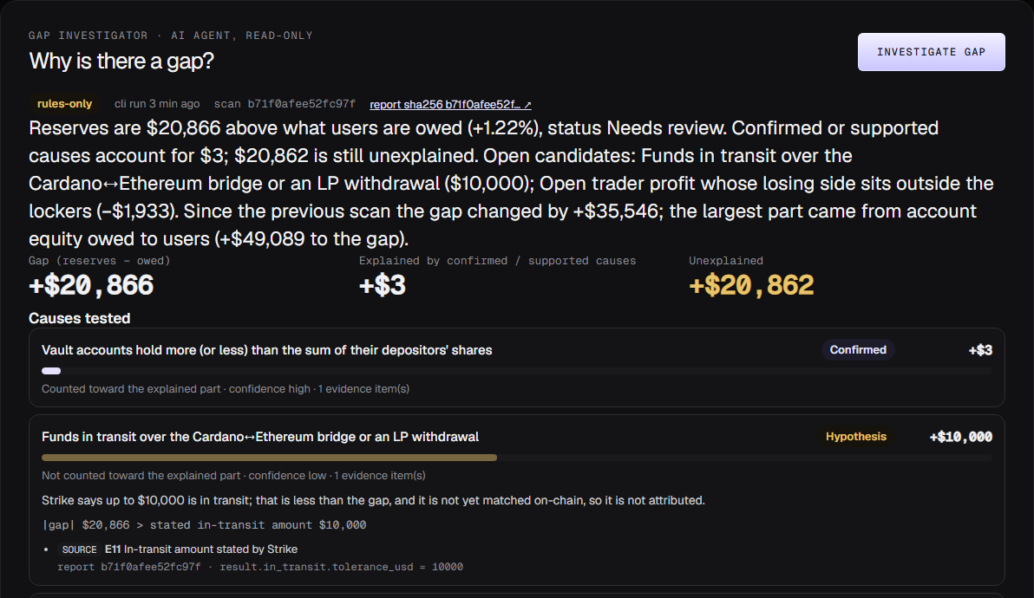
It investigates, explains and proves
1
Investigates
13 possible causes, each tested in code and labelled confirmed, supported, hypothesis, unresolved or ruled out
2
Explains
NVIDIA Nemotron writes the plain-language verdict through Meterless Nightshift
3
Proves
Dashboard · API (POST /run) · Telegram alerts
Every claim cites evidence: SQL, tx hash, report field. The unexplained amount is never forced to zero

Slide 4
Five agents, one feedback loop
PlannerAgent
EvidenceAgent
MemoryAgent
plans the run, picks sources
Zetaris SQL, ledgers, tests 13 causes in code
Meterless H-MEM: recalls past cases, saves new
evidence pack
ExplainerAgent
ValidatorAgent
Nemotron via Nightshift, read-only tools
rejects unknown evidence, invented $, "fully explained"
critique → revise (logged as needs_revision, retry 1)
Notes:
Every step is written as JSON lines to logs/<investigation_id>.jsonl, including the model that served each Nightshift request. Example traces are in output_examples/.

Slide 5
Check the AI, never just believe it
+$20,866
+$3
+$20,862
gap (reserves − owed)
explained by confirmed causes
still unexplained, shown honestly
Live run, 27 Oct 2026, 15:09 UTC
Guarantees in code
Nemotron (via Nightshift) wrote 3 SQL queries; Zetaris ran them. One used a column that does not exist: the error went back to the model.
Its answer, "the gap is not fully explained… iUSD at a placeholder price", cited only known evidence, so ValidatorAgent accepted it.
All money arithmetic is deterministic code
Change since last scan reconciles exactly (remainder $0)
Prompt injection in source data is ignored (tested)
AI down → labelled rules-only, never faked

Slide 6
Sponsor technology doing real work
Zetaris
Data layer
Meterless Nightshift
Primary AI provider
Every scan is published as six SQL tables (scans, reserves, liabilities, prices, flows, safety events). The agent reads scan history and runs guarded, read-only SQL as a tool.
All model calls go through the local runtime (127.0.0.1:8088, OpenAI-compatible, tool calls). Route meterless/deep.
Meterless H-MEM
Engine in a feature
NVIDIA Nemotron
Reasoning model
Seeded with past confirmed findings; recalls similar cases before each investigation and saves each result. Unit-tested.
Served through Nightshift; the served model is logged per request and must name Nemotron for "Nemotron verified".

Slide 7
Built on a working monitor
Existed before 22 Oct (declared)
New in the hackathon window
ZeroGap monitor: collectors for 3 ledgers + platform API
Reserve ratio, liabilities, hashed reports
Dashboard and Telegram alerts
Gap Investigator: 5 agents, validator loop, traces
Zetaris data layer and read-only SQL tool
Nightshift client, Nemotron verification, H-MEM
"Why is there a gap?" panel, POST /run, SAMPLE_MODE
26 new tests (138 total passing)
Stack: TypeScript, Node 20, viem, Solana web3, Postgres, Docker

Slide 8
Next
Match bridge transfers by transaction to close the open $10,000 candidate
More platforms: the evidence model is not specific to one exchange
Scheduled investigations with alerts only when the explanation changes
github.com/Lakshmikanth-3/GapWise · Independent project, not affiliated with Strike Finance

