Slide 1
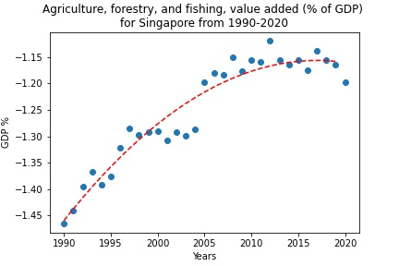
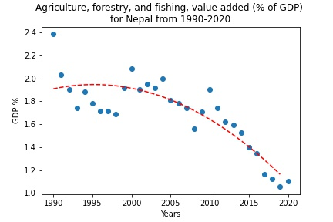
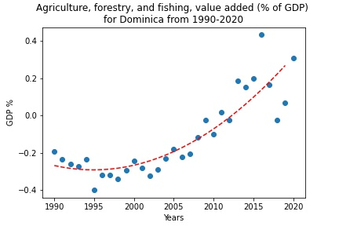
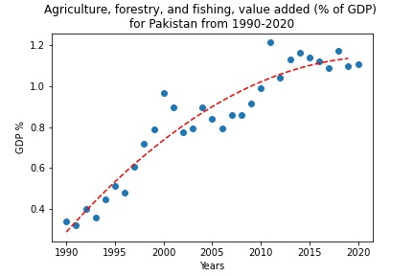
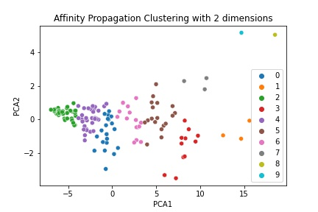
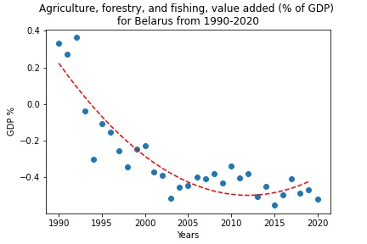
Value added GDP % of countries from 1990-2020
The poster presents 5 different countries which are being clustered using affinity propagation clustering algorithm. All countries belong to different clusters. Here, the value added GDP % is plotted from agriculture, forestry and fishing. For curve fitting, a polynomial second degree function is used for all the plots. From the plots, it can be seen that all countries have a non-linear variation. Although the objective function fits well, it is not the best fit in some cases.

