Slide 1
Data Engineering Pipeline on HPE Private Cloud AI
Lab 18 · Curriculum 3.1 Feature Engineering & ETL/DataOps
Airflow · Spark · EzPresto · CUDA-X (cuDF, cuML, cuVS) · MLflow · September 2026
Confidential | For training purposes only

Slide 2
Agenda
Business problem — who is about to cancel?
Technical problem — two systems, no training table
Technical solution — one tool per concept
Architecture on HPE Private Cloud AI
The pipeline, by row count · measured results
Deliverables and the value statement
Confidential | For training purposes only
2

Slide 3
Business problem
A subscription streaming service asks the question every subscription business asks
“Will this subscriber cancel in the next 30 days?”
200,000
active subscribers
Churn is silent. A subscriber who has already decided to leave looks like any other row in the billing system until the cancellation lands.
Retention only works before the decision. The retention team needs a ranked list of who is at risk this month, not a report of who left last month.
The signal exists, but not where the decision is made. Disengagement shows up in viewing behaviour weeks before it shows up in billing. Nobody joins those two systems today.
The ask: a repeatable, explainable way to rank every subscriber by 30-day cancellation risk, and to say which behaviours drive it.
11.9%
cancel within any 30-day window
23,796
cancellations in the labelled period
~100
viewing events per subscriber, never joined to billing
Confidential | For training purposes only
3

Slide 4
Technical problem
A model needs one row per person with the answer attached. That table does not exist.
Viewing log — the fact table
Customer records — the dimension table
180 daily CSV files · 849 MB
20,010,929 events, ~100 per person
who watched what, when, on which device
no outcome column
Postgres, owned by billing
200,000 rows, one per person
plan, tenure, tickets, payment, country
churned_next_30d — the only copy of the answer
Neither source can train anything alone. The whole engineering task is to shrink the first into one row per person and attach the answer from the second, without losing the people who matter most.
Scale
Separation
Silence
Repetition
20 million rows is too large for a laptop and too slow row-by-row. It needs distributed, columnar processing.
Two systems, two owners, two formats. The label may not be copied out of the database.
3,436 subscribers watched nothing in 30 days. 63% of them churned. A standard inner join deletes them with no error.
Thirty people must run the identical pipeline on their own outputs, with every run recorded and comparable.
Confidential | For training purposes only
4

Slide 5
Technical solution
One tool per concept, each appearing at the moment the problem makes it necessary
Airflow
Orchestration
One parameterised DAG, triggered per participant with a student number. Issues instructions, never touches a row.
Spark on the Spark Operator
Distributed curation
180 CSV files → 180 tasks. Dedupe (shuffle), filter, write day-partitioned Parquet. Same 20,010,929 rows, 3.66× smaller.
EzPresto
Federation
Query the billing database where it lives through a catalog. No export, no copy, read-only for everyone in the room.
RAPIDS cuDF · cuML · cuVS
GPU acceleration, same API
Aggregate 20 M events to one row per person on the GPU (12×), train a forest (2.4×), find look-alikes (85×) — accuracy checked before the clock.
XGBoost on GPU + MLflow
Model and registry
Held-out AUC 0.87. Every run logged with parameters, metric and model; registered as student-NN-churn, versioned.
Validation checklist
Trust before training
Nine executable checks on the training table, including the left join that keeps the silent subscribers.
Confidential | For training purposes only
5

Slide 6
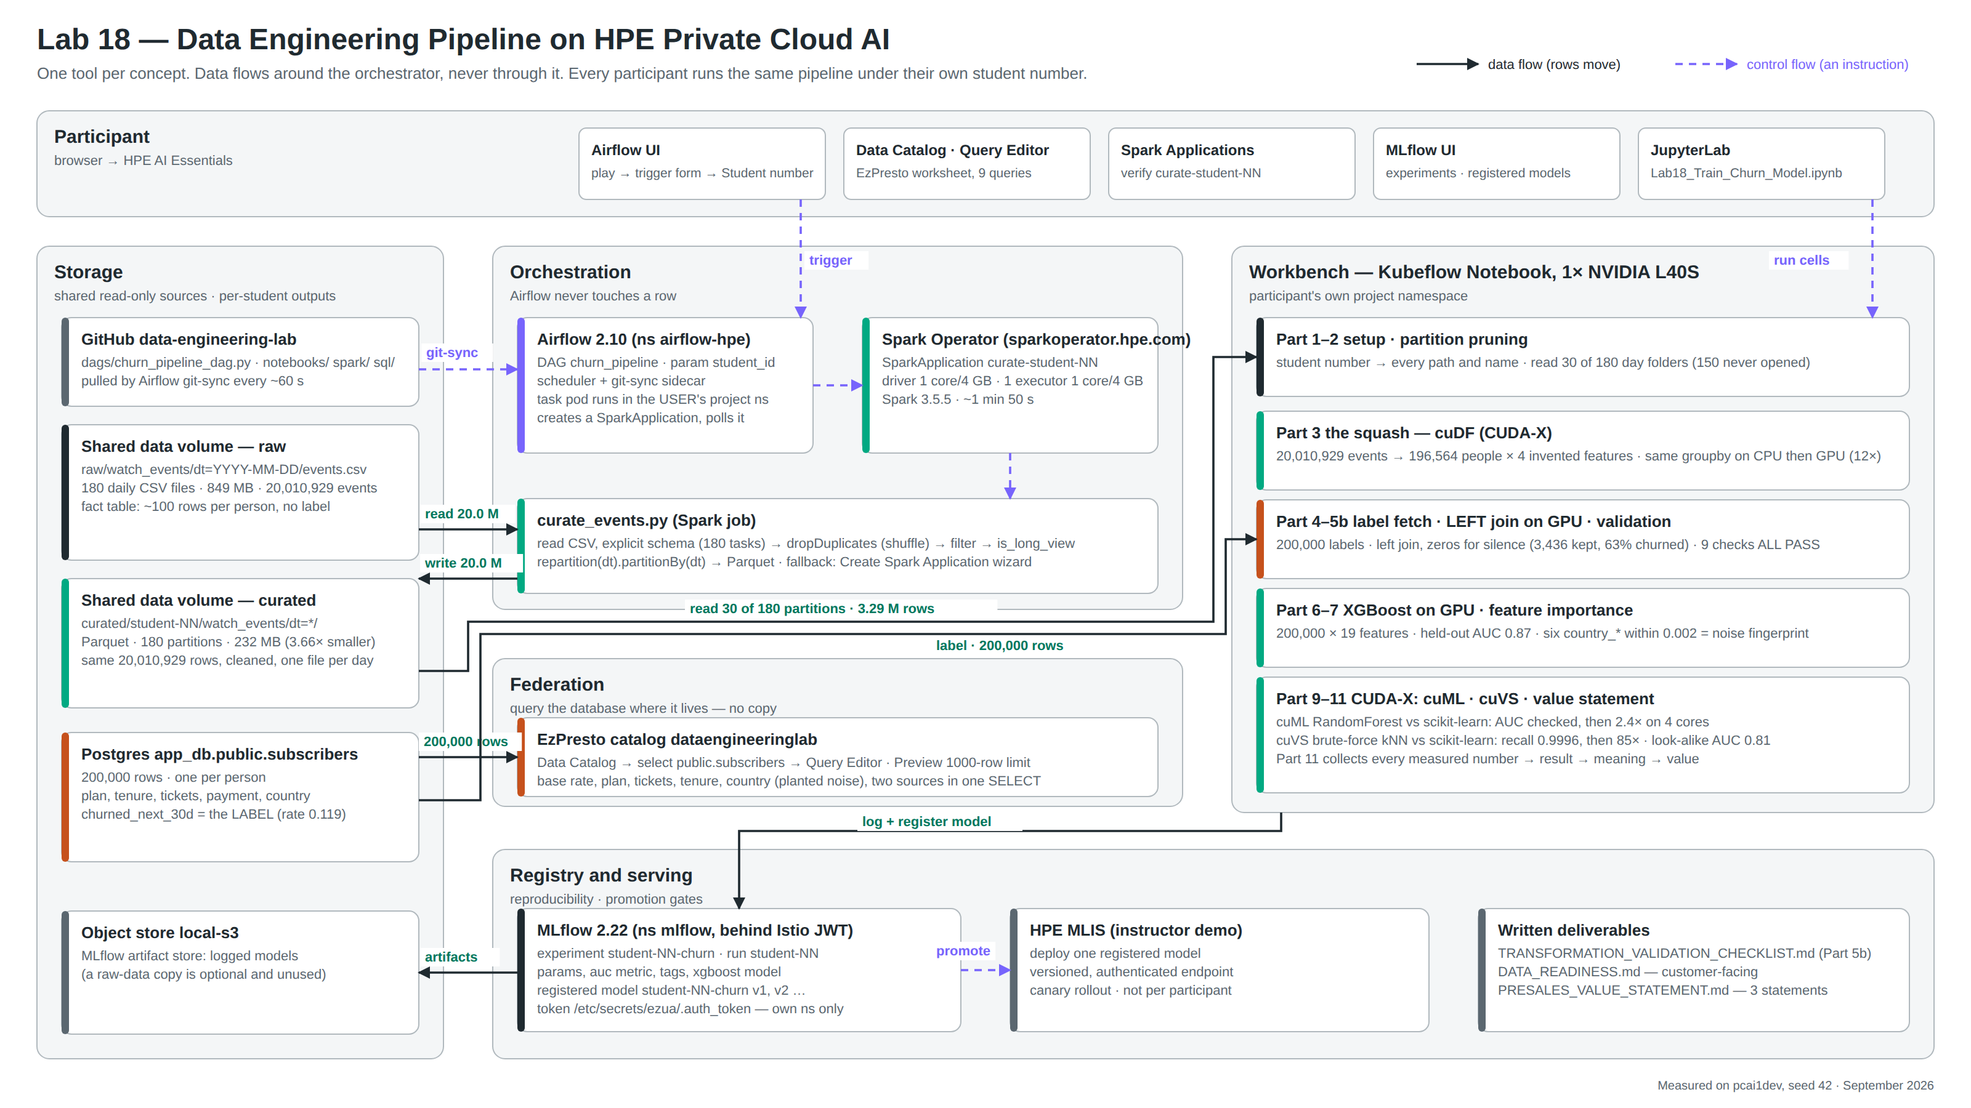
Architecture on HPE Private Cloud AI
Reading the diagram
Solid arrows carry rows; dashed arrows carry instructions.
Airflow sits on dashed paths only.
Storage is shared and read-only except each participant’s curated folder and MLflow experiment.
The notebook is where the two sources finally meet.
Every number on the diagram was measured on pcai1dev, seed 42.
Confidential | For training purposes only
6

Slide 7
The pipeline, by row count
Four steps. Watch the row count change — that change is the data engineering.
Raw events
Curated Parquet
The squash
Training table
Model
20,010,929
20,010,929
196,564
200,000 × 19
AUC 0.87
180 CSV files · 849 MB · no label
Spark · 180 partitions · 232 MB
cuDF groupby · 4 invented features
left join + label · zeros for silence
XGBoost on GPU · registered in MLflow
The number that teaches the most
196,564 ≠ 200,000. The 3,436 subscribers with no activity in the last 30 days have no row after the squash. 63% of them churned, against 11.9% overall.
An inner join drops them silently and deletes 2,172 churners — the strongest signal in the data — while looking completely correct. The pipeline uses a LEFT join from the customer table and fills their activity with zero. Absence of a record is itself information.
Confidential | For training purposes only
7

Slide 8
Measured results
Every number below was measured on the platform, seed 42. Nothing is quoted from a datasheet.
3.66×
12×
2.4×
smaller on disk
faster aggregation
faster RandomForest
CSV 849 MB → Parquet 232 MB, same 20,010,929 rows
cuDF 0.03 s vs pandas 0.39 s, identical output
cuML 1.69 s vs scikit-learn 4.02 s on 4 cores · AUC gap 0.0009
85×
0.87
0.002
faster nearest-neighbour search
held-out AUC
importance spread of the planted noise
cuVS 0.05 s vs scikit-learn 4.03 s · recall@10 0.9996
XGBoost on GPU · 200,000 × 19 · look-alike score alone 0.81
six country columns indistinguishable; real features differ 10×
Speed-ups are always stated against a named CPU core count. Vendor headline figures are ceilings; these are the honest numbers.
Confidential | For training purposes only
8

Slide 9
Deliverables and the value statement
What a participant leaves with, and how a measured result becomes a sentence a customer acts on
Working pipeline flow
Transformation & validation checklist
Customer-facing data-readiness page
Presales value statements
Raw events and a live database → validated training table → registered model, run end to end under the participant’s own student number.
Thirty rows across six stages; the notebook executes the table-side rows and prints PASS or FAIL for each.
A one-page template, filled with the participant’s own numbers, ending in a readiness verdict.
Three statements built from measured results, at least one about a data-engineering outcome rather than acceleration.
Result → meaning → value
Technical result
What it means
Value to the customer
The 20 M-row aggregation took 0.39 s on CPU and 0.03 s on the GPU, with identical output.
The feature-engineering loop is interactive, and the pandas code did not change.
Your data scientists try ten feature ideas in the time it used to take to try one, with the skills they already have.
Say only the third line to a customer. Have the first ready for when they ask “compared with what?”
Confidential | For training purposes only
9

Slide 10
Thank you
Lab 18 · Data Engineering Pipeline on HPE Private Cloud AI · guide, notebook, DAG and deliverables in the data-engineering-lab repository
Confidential | For training purposes only

