Slide 1
Welcome To
Django
Presented By:
Lakshmi Narayana

Slide 2
Agenda
Introduction​
History
Features
Database
Django Setup
Installation
Website Information
Architecture
Project
Mostly used Commands
Application
Advantage & Disadvantages
Conclusion

Slide 3
Introduction
Django framework is pure python language.it is used to develop web applications.
Django is portable that means we can run django application on any os.
Django is free and open-source .
Django is fast, Versatile, Scalable framework

Slide 4
History
In 2003,The project was started by Adian Holovaty and Simon Willison as an internal project at Lawrence Journal-World newspaper
In June 2008, it was announced that a newly formed Django Software Foundation (DSF) would maintain Django in the future.
29 July 2009,Django 1.1 version was released with features like Aggregates, transaction-based tests.
Django Latest version 4.2

Slide 5
Features
Security:
Cross-Site Request Forgery (CSRF)
Cross-Site Scripting (CSS)
Content Security Policy (CSP)
Versatility
Customizable Architecture
Database Support
Scalability
Can be used to build both large & small size applications
Portability
We can use Django in any other platform without changing code.
Packages Support
Django supports different packages to ease our work.

Slide 6
Databases
Django supports several different databases like below,
SQLite3
MySQL
PostgreSQL
Oracle

Slide 7
Django Setup
We can use Python, Django, MySQL all old versions or
Python, Django, MySQL all new versions.
We can use any database, default database is SQLite3
Old Versions
New Versions
Python → 3.6
Django → 2.0
MySQL → 5.0
Python → 3.11
Django → 4.0
MySQL → 8.0

Slide 8
Installation → We must install python software before installing django framework because django is a 3rd party module of python language → Open command prompt and install django like below → It will install the django latest version → It we required django previous versions then we have to specify the version number
C:\USER\HP>pip install django
C:\USER\HP>pip install django == 2.0

Slide 9
Website Information
Frontend
HTML
CSS
Backend
Model
Views
Database
SQLite
Bootstrap
JavaScript
Jquery
Controllers
Postgres
Mysql

Slide 10
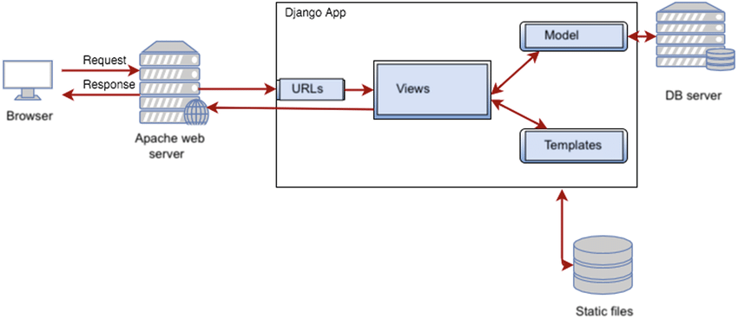
Architecture Diagram

Slide 11
Architecture
Generally all Framework Follow MVC Architecture,
Django follow MVT Architecture ​
Models → To Write Database Related Coding
[ Object-Relational-Mapping ]
Views → To Write Business logic’s related Coding
[ Python Programming Language ]
Templates → To Write Presentation Related Coding
[ Django-Templates-Language ]

Slide 12
Model
Models is a python class which contains models name fields and field types.
models.Model is base model for every user-define models.
Models is used to interact with databases like table creating ,types changing , fields renaming, ….
Eg: class Data(models.Model):
id = model.IntegerField()
name = models.CharField(max_length=100)
Views
A view is python function which taken HttpRequest as input execute the views body and return HttpResponse to the user
We can python def keyword to define django views.
HttpResponse(): it will return the HttpRequest as HttpsResponse to the browser.
render(): it will return HttpRequest from views to templates
redirect(): it will return HttpRequest from one views to another view
FunctionBaseViews: it mostly used in django application
ClassBasedViwes: it mostly used in REST API
Templates
Templates is a HTML file which is used to write DTL
We write the presentation code by using DTL
DTL is almost same as html with minor changes
Templates folder must be configured in setting,py file

Slide 13
Project
Open Main Folder Django and type cmd in file path and click enter
It will open command prompt with current location
Create a project with name djangoproject by using django-admin file and startproject command, like below
Change the path
Create an application with name djangoprojectapp by using mana.py file and startapp command, like below
C:\USER\HP\Django>
C:\USER\HP\Django>django-admin startproject djangoproject
C:\USER\HP\Django> cd djangoproject
C:\USER\HP\Django\djangoproject> python manage.py startapp djangoprojectapp

Slide 14
Now, We Create Django Project With One Application, It Will Have The Following Files And Folders
Django > djangoproject > djangoprojectapp
> djangoproject > __init__.py > migrations > migrations
> djangoprojectapp > asgi.py > __init__.py > __init__.py
> manage.py > settings.py > admin.py
> urls.py > apps.py
> wsgi.py > models.py
> tests.py
> views.py

Slide 15
Mostly Used Commands
1.Makemigrations
It will convert the ORM code of models.py file in sql code and it will save sql code in one migration file in migration’s folder
2.Migrate
It will copy the sql code of the latest migration file from migrations folder and executes the same sql code in database
3.Createsuperuser
It will used to create admin, email, password.
4.Changepassword
It will used to already create admin password changing.
5.Runserver
It will used to start the development server for a Django project. starts the server at the default address http://127.0.0.1:8000/

Slide 16
Applications
Instagram
Disqus
Pinterest
Mozilla Firefox
Spotify
YouTube

Slide 17
Advantage & Disadvantages
Advantage Disadvantages
1.Implementation in python 1.Not Suitable for small-sizes projects
2.Suitable any web application 2.Monolithic
3.Secured
4.Simple and fast

Slide 18
Conclusion
In conclusion, Django is a powerful web framework for Python that offers many advantages, including rapid development, clean and design, scalability, security, and community support.
Django is a rapid web development framework and if you want to get your application built fast within a few days, there is no better framework than Django Web Framework. Django gives all the features included, also called “Batteries Included Framework”. It has a built-in admin interface which makes it easy to work with it. easy to work with it.

Slide 19
Thank
you

