Slide 1
SDLD Software Development Life Cycle

Slide 2
Why to Learn SDLC?
Software Development Life Cycle (SDLC) is a process used by the software industry to design, develop and test high quality software's. The SDLC aims to produce a high-quality software that meets or exceeds customer expectations, reaches completion within times and cost estimates.
SDLC is a process followed for a software project, within a software organization. It consists of a detailed plan describing how to develop, maintain, replace and alter or enhance specific software. The life cycle defines a methodology for improving the quality of software and the overall development process.
SDLC is the acronym of Software Development Life Cycle.
It is also called as Software Development Process.
SDLC is a framework defining tasks performed at each step in the software development process

Slide 3
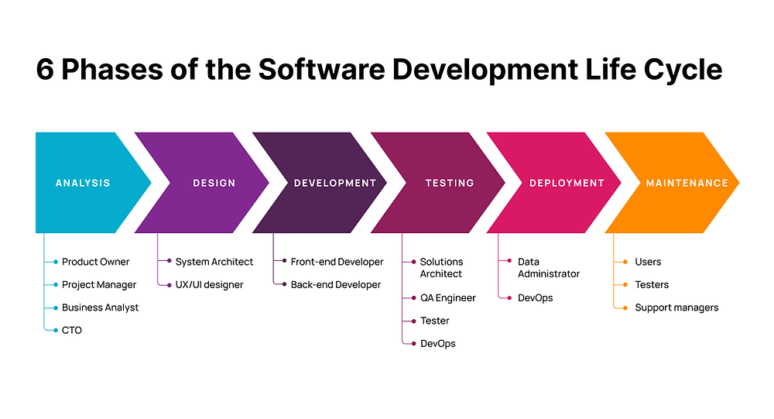

Slide 4
