Slide 1
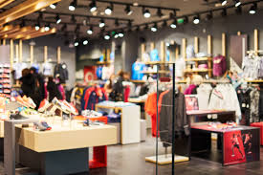
CUSTOMER SEGMENTATION OF RETAIL STORE

Slide 2
PRESENTED BY
Lakshmi Narayanan R
MENTORED BY
Ms. Vidhya Kannaiah

Slide 3
PROBLEM STATEMENT
Analyze a comprehensive retail dataset containing customer demographics, purchase behaviors, products, transactions, and feedback to uncover trends, patterns, and insights that inform business strategies and decisions.

Slide 4
DATA DESCRIPTION
The dataset represents retail transactional data. It contains information about customers, their purchases, products, and transaction details.
No of rows : 302010
No of columns : 30
There are 10 Numerical columns and 20 Categorical columns

Slide 5
DATA CLEANING
Data consist of 4 duplicate rows
There are 8098 rows with null values.
Imputed null values in 15 columns.
Dropped 12 columns.
Derived few other columns - Feature engineering

Slide 6
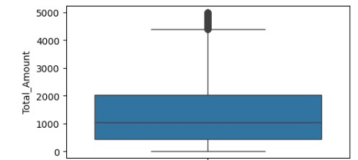
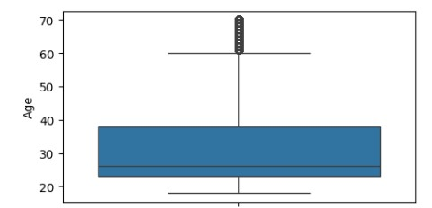
EXPLORATORY DATA ANALYSIS FINDING OUTLIERS
There are outliers present only in Total Amount column, which needs to be transformed later.

Slide 7
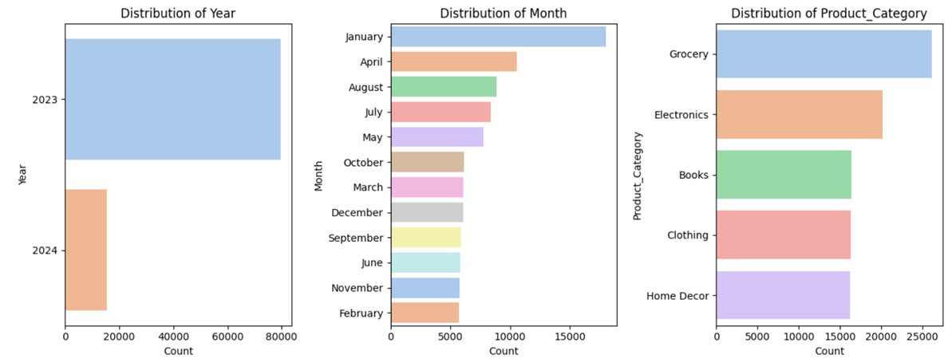
UNIVARIATE ANALYSIS
Yearly Trend: 2023 shows more data points than 2024, indicating a longer data collection period or higher activity​.
Seasonal Patterns: January is the highest activity month, while traditional holiday months (Nov-Dec) show lower activity​.
Product Category Insights: Grocery dominates sales, followed by Electronics, suggesting diverse consumer interest​.

Slide 8
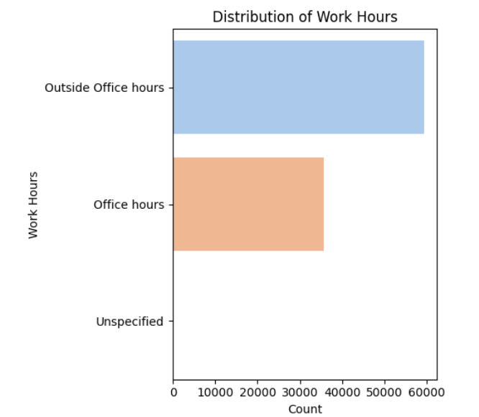
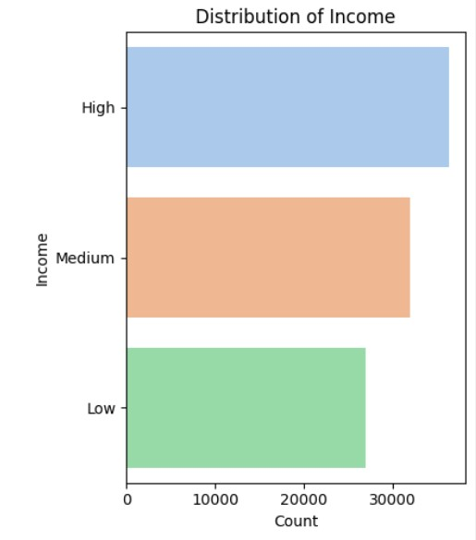
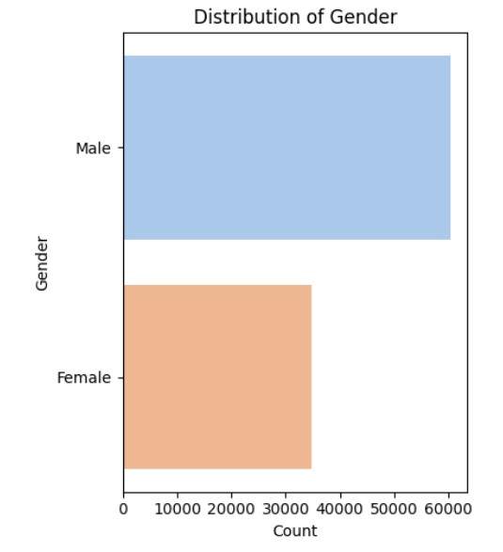
UNIVARIATE ANALYSIS
Work Hours Distribution: Majority of work is done outside regular office hours, indicating flexibility or non-standard work environments​.
Gender Distribution: Males outnumber females by nearly 2:1, indicating a potential gender marketing bias​.
Income Distribution: High-income individuals dominate, suggesting a relatively affluent customer base​.

Slide 9
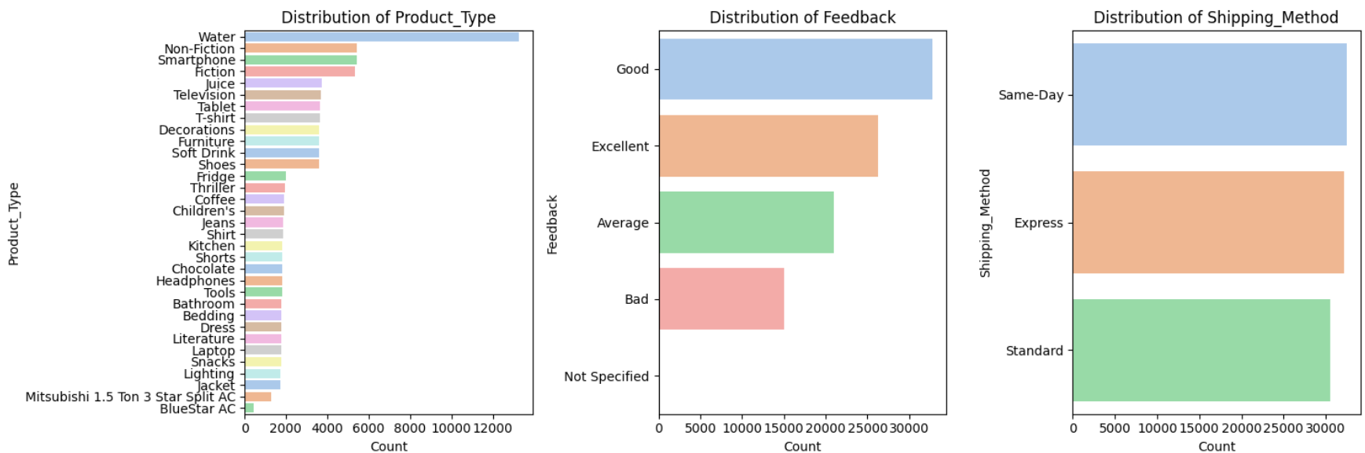
UNIVARIATE ANALYSIS
Product Type, Feedback, Shipping Method: Water and Non-Fiction are popular, feedback is positive, and Same-Day delivery is preferred​.

Slide 10
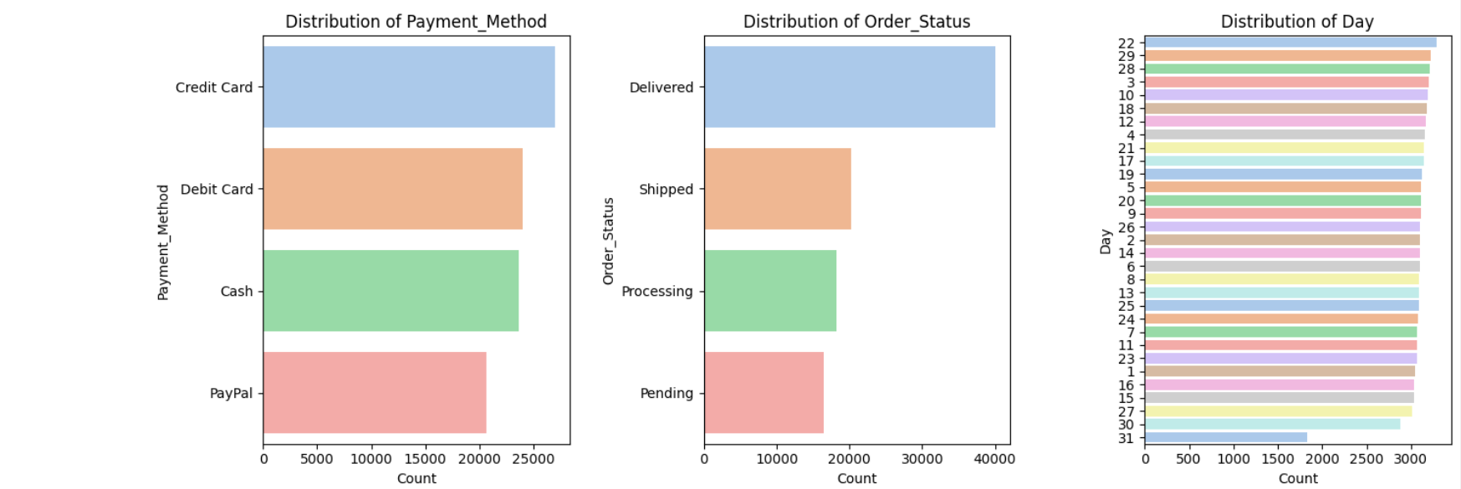
UNIVARIATE ANALYSIS
Payment Method, Order Status, Day: Credit cards are most popular, orders are efficiently delivered, and purchases are evenly spread across days​.

Slide 11
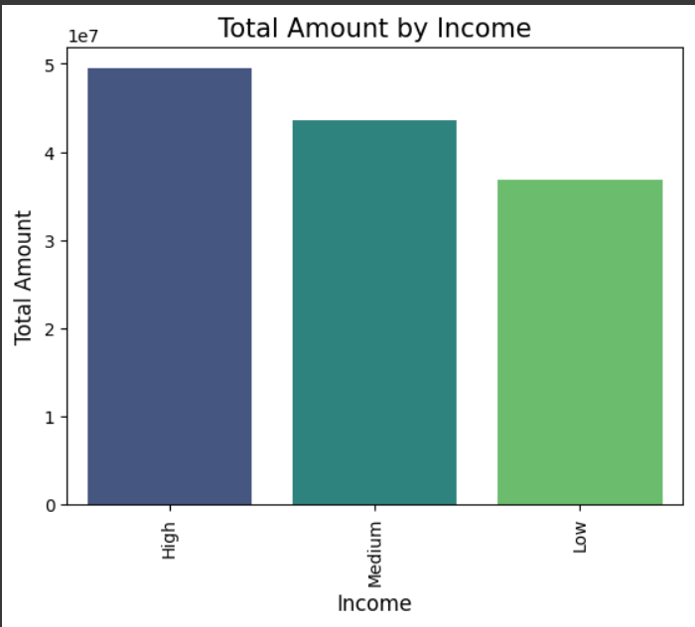
BIVARIATE ANALYSIS INCOME-BASED CONSUMER BEHAVIOUR
Total Amount by Income: Higher income correlates with significantly higher spending​.

Slide 12
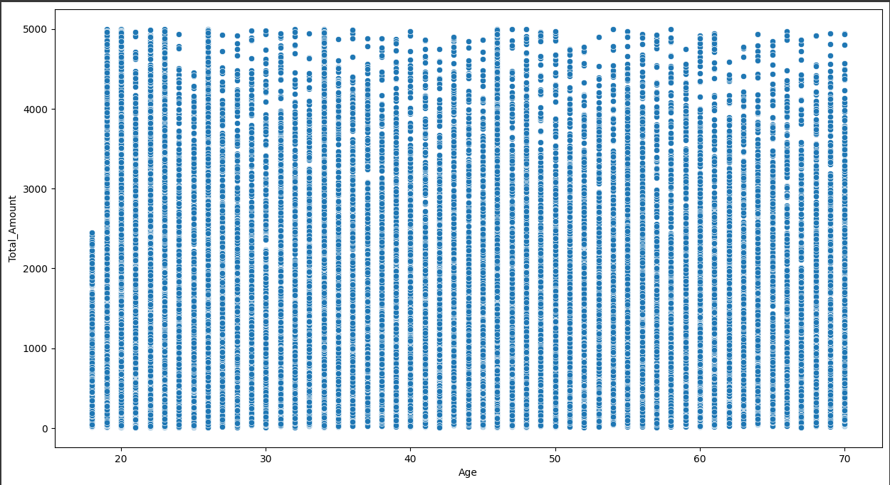
AGE-BASED CONSUMER BEHAVIOUR
Total Amount vs Age: No strong age-based spending pattern, though older customers may spend more​.

Slide 13
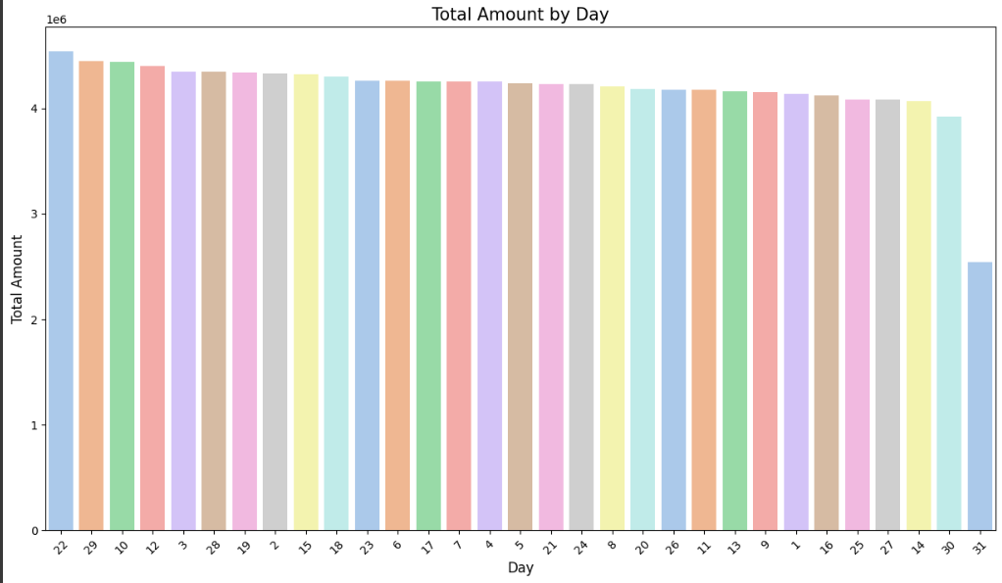
TREND ANALYSIS
Total Amount by Day: Consistent spending across days with slight peaks around the beginning and end of the month​.

Slide 14
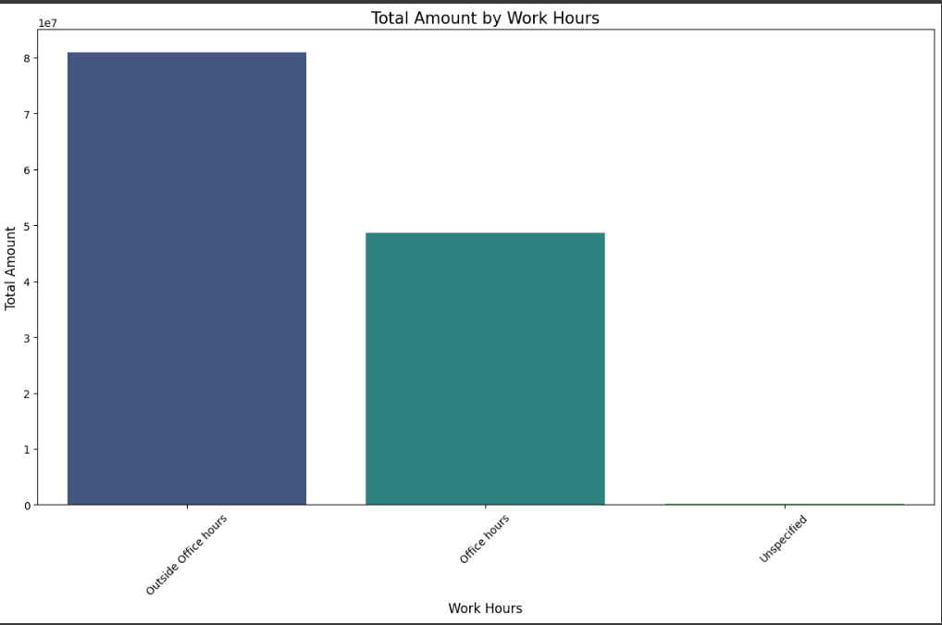
TREND ANALYSIS
Total Amount by Work Hours: Spending is significantly higher outside office hours, indicating non-standard shopping behavior​.

Slide 15
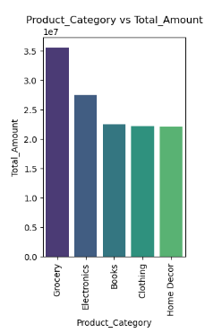
PRODUCT ANALYSIS
Product category v/s Total Amount:- For each category, total amount varies significantly. ‘Grocery’ has the highest total amount whereas ‘Home Décor’ has least total amount

Slide 16
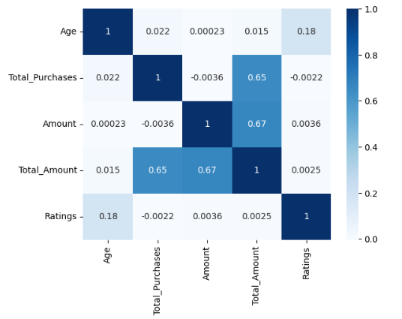
MULTIVARIATE ANALYSIS
Correlation Matrix: Positive correlations between spending variables, but age has weak influence on spending behavior​.

Slide 17
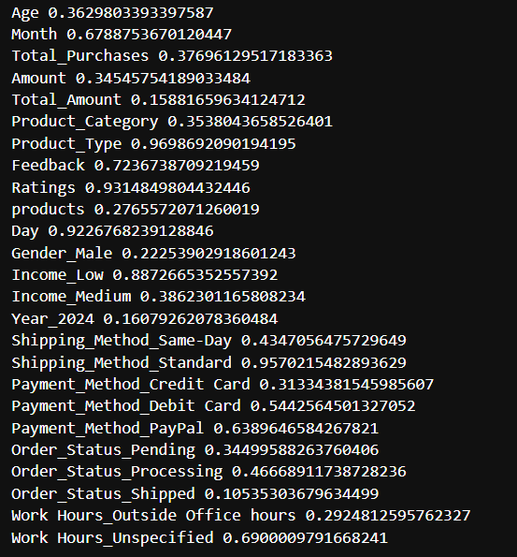
STATISTICAL TESTS
TTEST_IND :- A t-test compares the means of two groups to determine if they are statistically different from each other.
H0: Both train and test data represent overall data
Ha: Both train and test data do not represent overall data
Considering alpha=0.05
Since all the P-Values are greater than alpha, we infer that both train and test data represent overall data

Slide 18
DATA PREPROCESSING
Encoding:-
States- divided into 5 categories
Label Encoding:- ‘Month’, ’Product_Type’, ’Product_Category’, ’Feedback’, ’Products.
One-hot Encoding:- ‘Region’, ‘Gender’, ‘Income’, ‘Year’, ‘Shipping_Method’, ‘Payment_Method’, ‘Order_Status’, ‘Work_Hours’.
Standard Scaling:- Scaled all the columns before doing Principal Component Analysis(PCA).

Slide 19
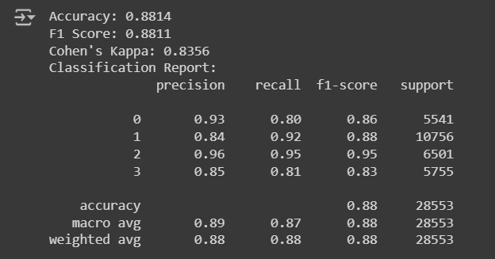
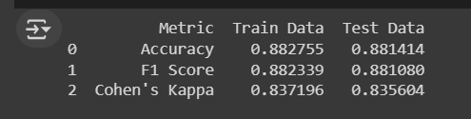
BASE MODEL
Base model – “LogisticRegression”

Slide 20
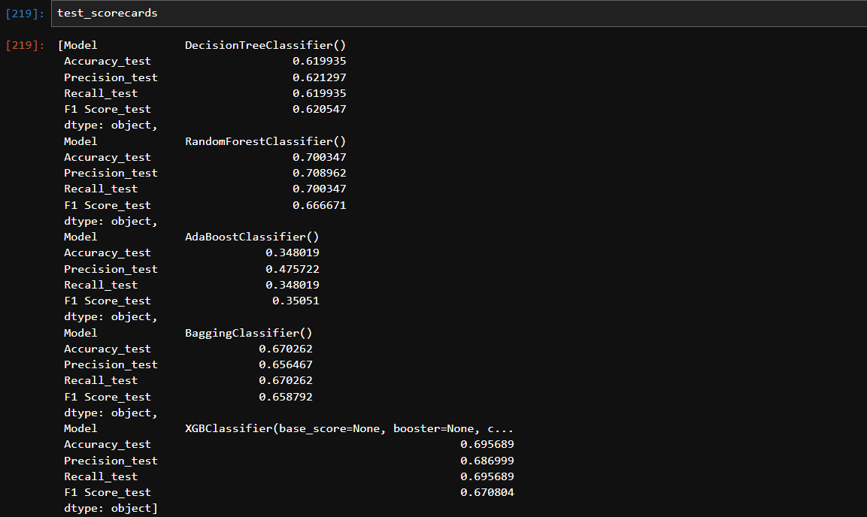
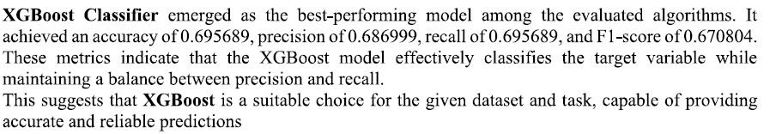
COMPARING DIFFERENT MODELS

Slide 21
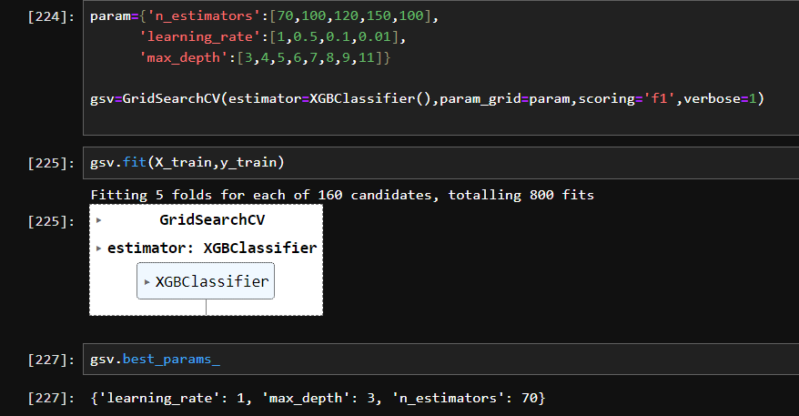
HYPERPARAMETER TUNING

Slide 22
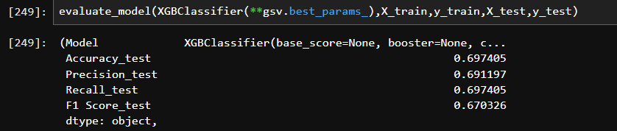
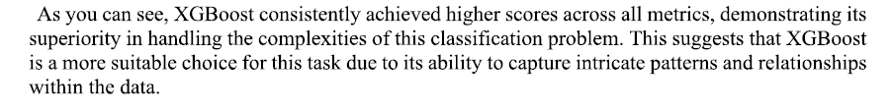
FINAL MODEL & CONCLUSIONS

Slide 23
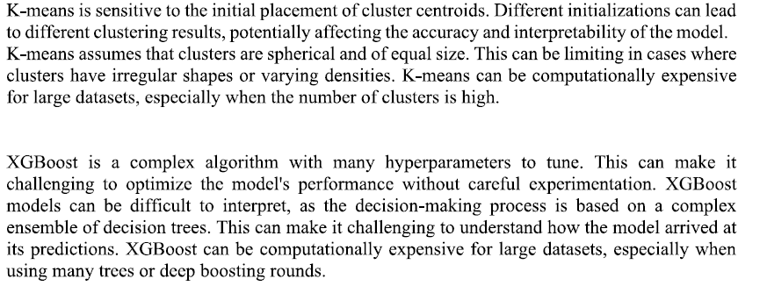
LIMITATIONS

Slide 24
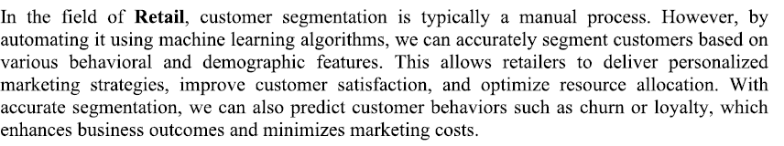
IMPLICATIONS

Slide 25
THANK YOU
Reference:
https://www.kaggle.com/datasets/sahilprajapati143/retail-analysis-large-dataset/code

