Slide 1

Occupancy-Aware Smart Library Seat Reservation with Predictive Demand Analytics
CSA0925-Java programming
Presented by
Under the Guidness of
JayaKannan L(192525376)(AI&ML)
Dr. C. Sivasankar
E .Lakshmi Narayanan (192524249)( AI&DS)

Slide 2

Module Design
Data Flow
Module | Purpose
1. Smart Library Seat Reservation & Occupancy Management | To reserve seats and manage real-time seat availability and occupancy.
2. Predictive Demand Analytics & Smart Recommendation | To predict busy periods and recommend suitable seats and time slots.
3. Tracking, Mentor Feedback & Communication | To track usage, collect feedback, and communicate updates with users.
USER INPUT
↓
Login / Seat Selection / Booking
↓
Reservation & Occupancy Data
↓
DATABASE
↓
Historical & Current Data
↓
Predictive Analysis
↓
Demand Prediction & Recommendations
↓
Reports / Notifications / Feedback
↓
USER / ADMIN
Interfaces used
User Interface | Reservation & Occupancy Interface | Analytics & Recommendation Interface | Admin Interface

Slide 3
Module | Algorithm | Purpose
1. Smart Library Seat Reservation & Occupancy Management | Greedy Seat Allocation Algorithm | Assigns the best available seat quickly
 | Hash Map / Hash Table | Maintains real-time seat availability and occupancy
 | FCFS (First Come First Serve) | Handles reservation requests fairly

Slide 4
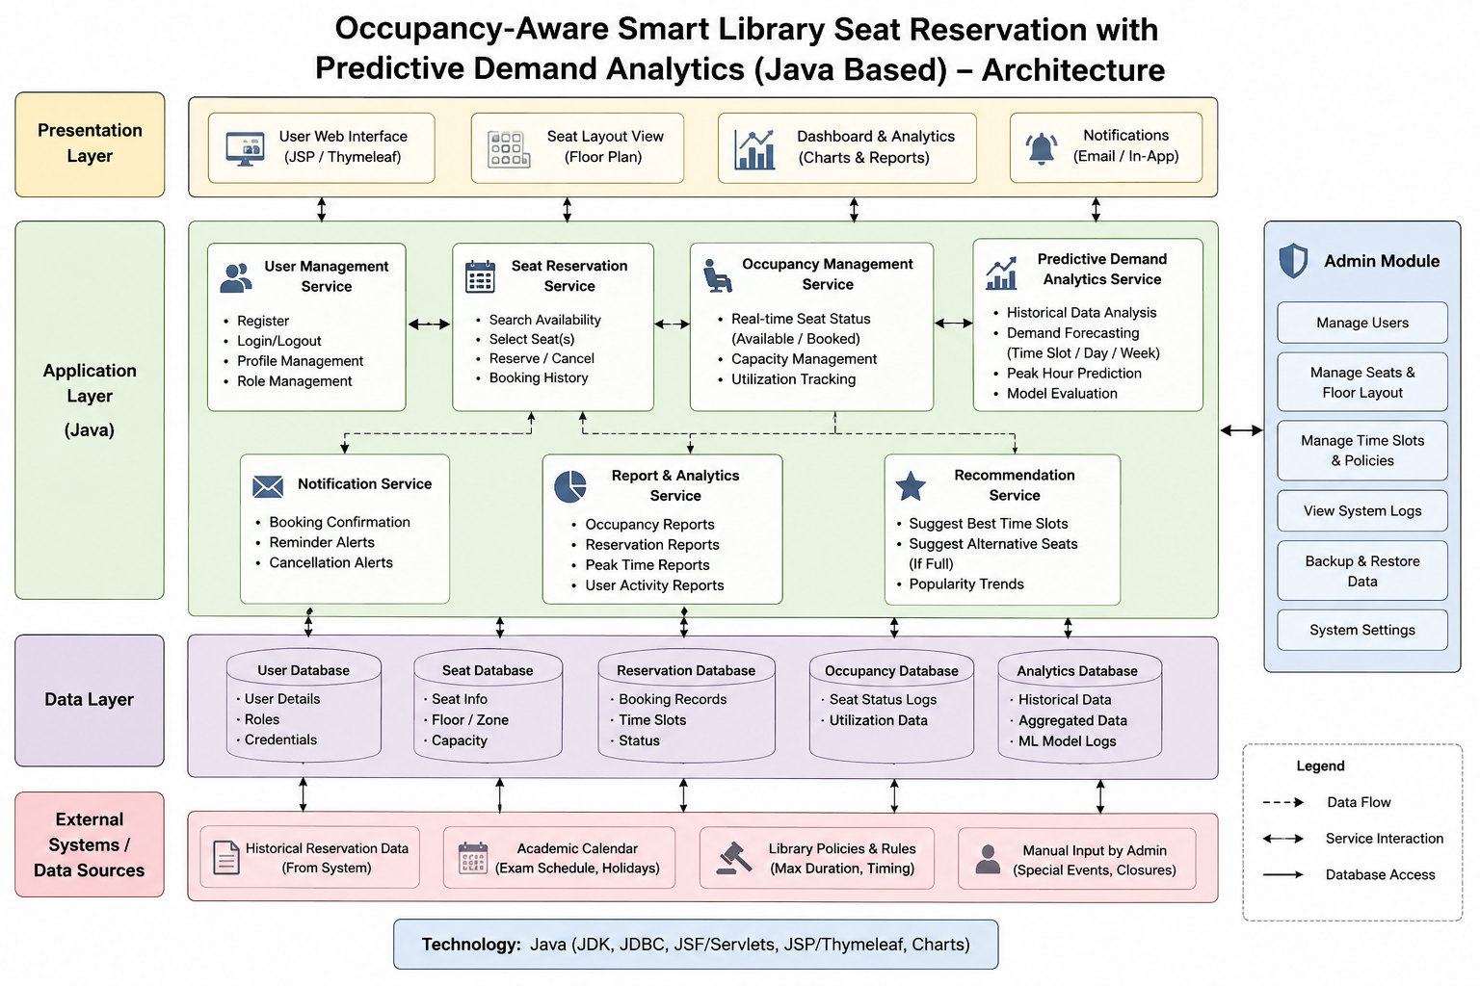
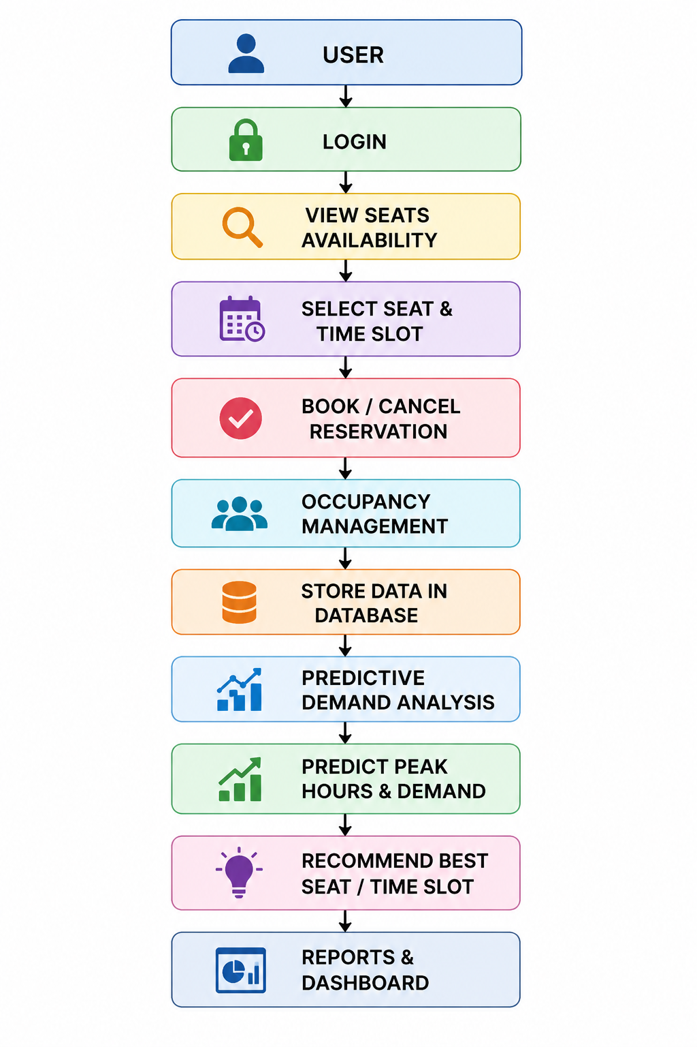
Updated Architecture
Final Module Flow

Slide 5
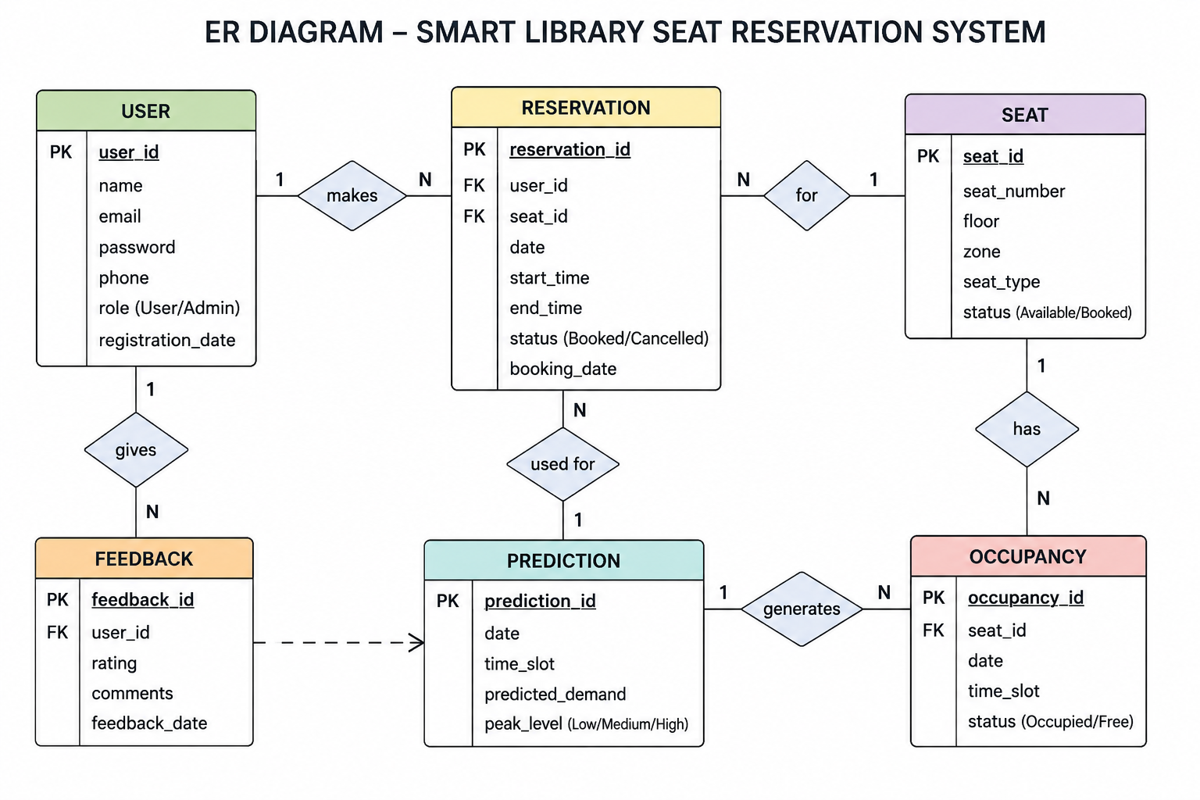
UML & DB
Use Case
Actors: User, Admin Main Use Cases: Login, View Seats, Book Seat, Cancel Booking, View Prediction, Get Recommendation, Manage Seats, View Reports.
Sequence
User → Login → View Seats → Select Seat → Book
→ Database → Confirmation
User
↓
Reservation
↓
Seat
↓
Occupancy
↓
Prediction
↓
Recommendation
↓
Feedback

Slide 6
Technology Stock
Languages
Java
SQL
HTML,JS(front design)
Frameworks
Java Swing / JavaFX
JDBC
Libraries
MySQL Connector/J
JFreeChart
Hardware
Computer/Laptop
Server
No IoT devices

Slide 7
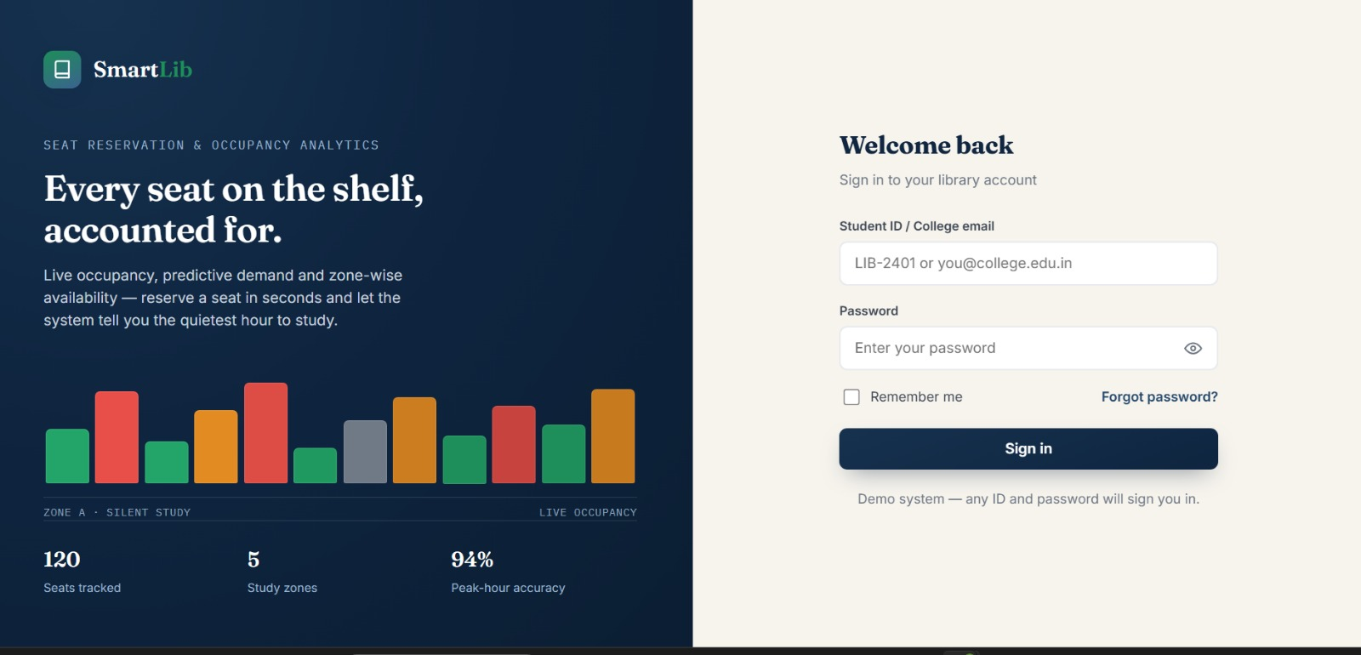
IMPLEMENTATION
Code summary
A Java-based library seat reservation system that manages bookings, tracks occupancy, and stores data in a database. The system uses historical reservation data to predict demand and recommend suitable seats and time slots.

Slide 8
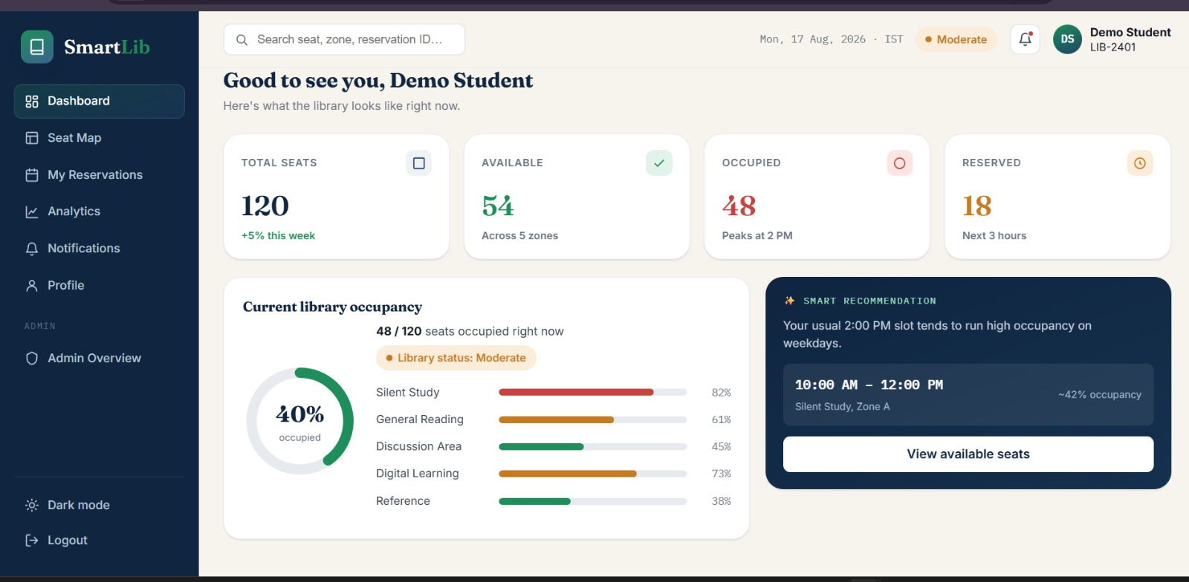
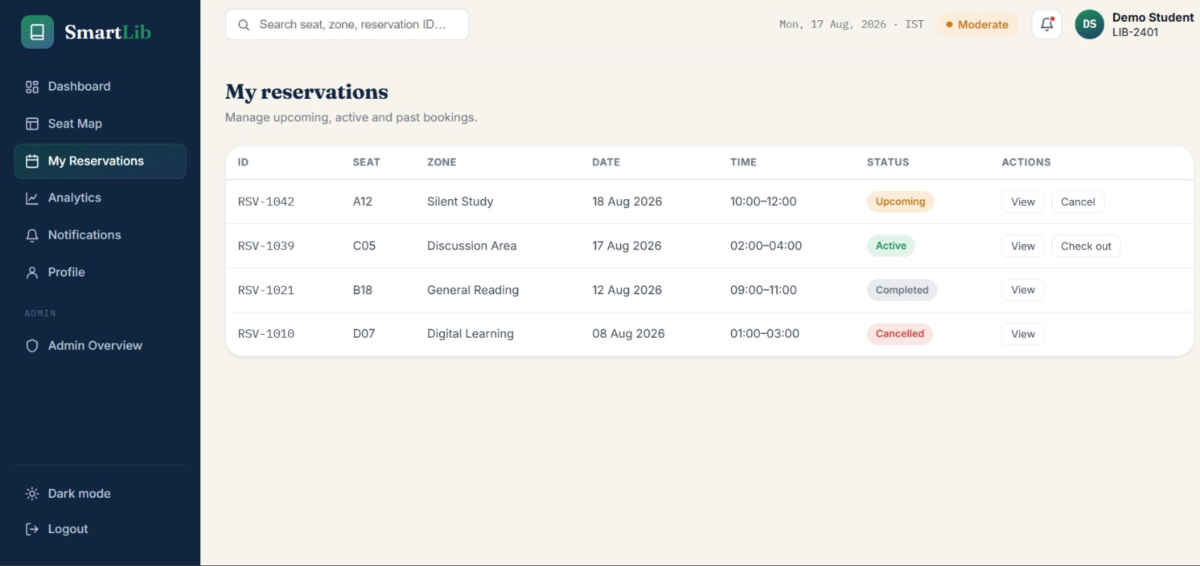
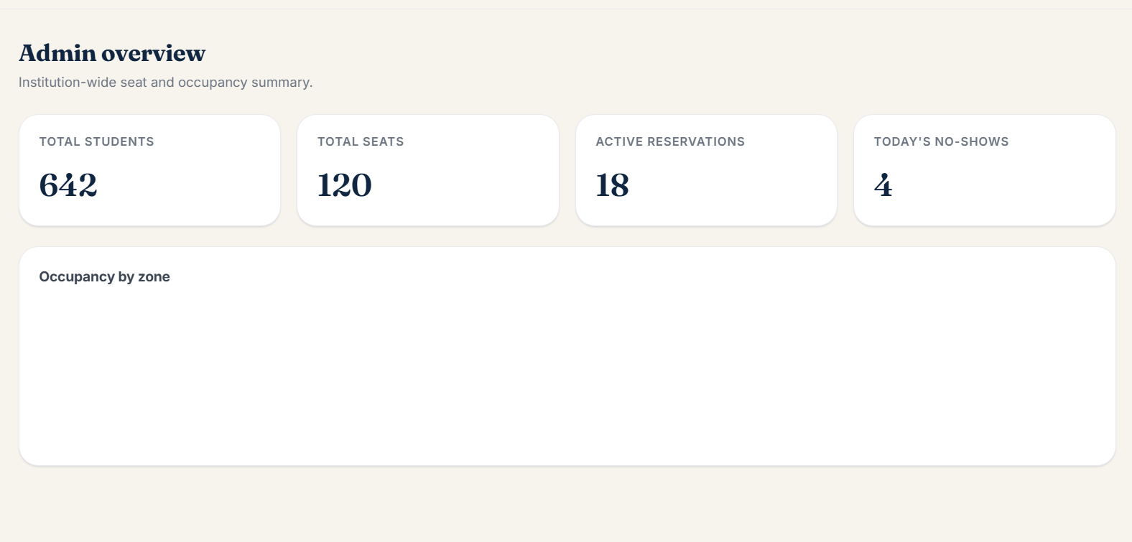
IMPLEMENTATION

Slide 9
TESTING
Unit Tests
Test login and user registration.
Test seat booking and cancellation.
Test occupancy and prediction calculations.
Integration Tests
Check Java application ↔ MySQL database.
Check reservation ↔ occupancy updates.
Check prediction ↔ recommendation flow.
Outputs
Successful login/registration
Seat booking confirmation
Updated seat availability
Demand prediction and recommendations
Reports and notifications

Slide 10
CHALLENGES
Next Plan
Improve prediction accuracy.
Add more analytics and reports.
Improve the user interface.
Add more recommendation features.
Issues
Managing seat availability and booking conflicts.
Collecting accurate occupancy data without IoT.
Predicting demand from limited historical data.
Solutions
Use database validation to avoid double booking.
Use reservation and manual check-in/check-out data.
Use historical data for demand prediction.

Slide 11
Thank You

