Slide 1

scholarsphere
Lakshminath - Group 20

Slide 2
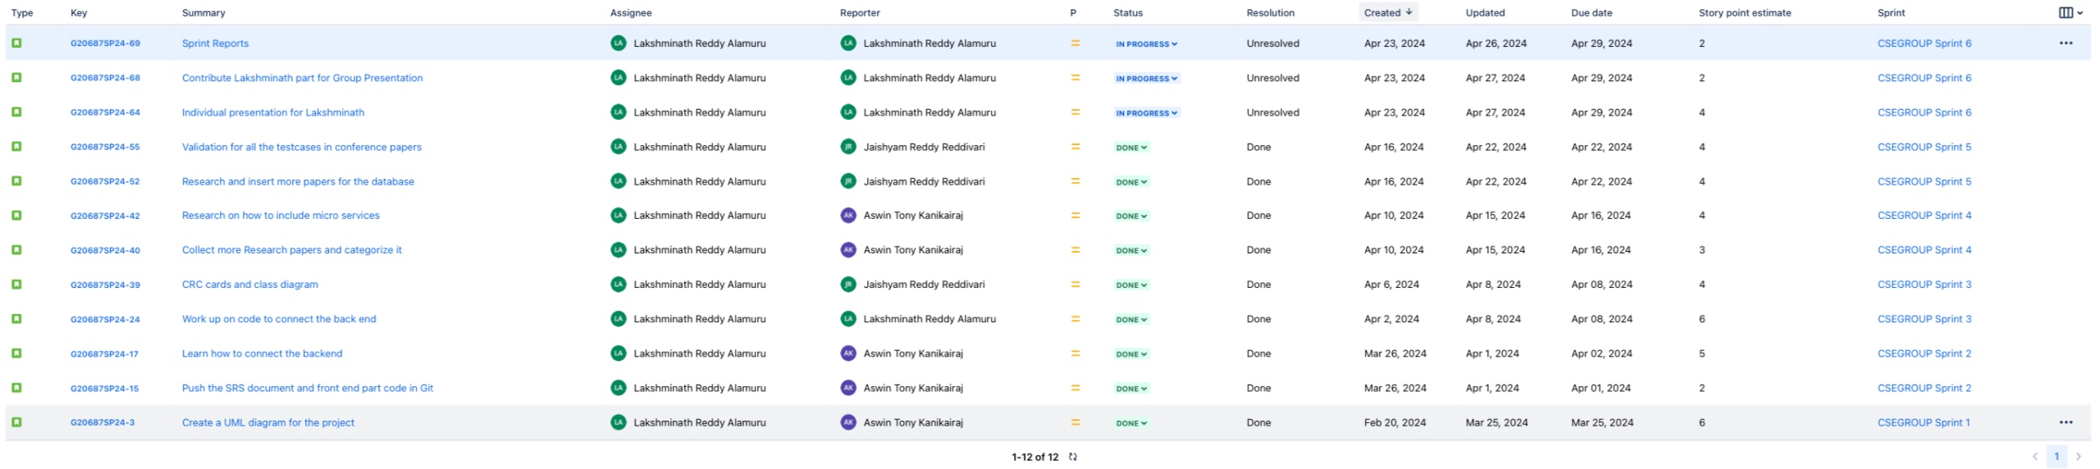
Overall Sprint Issues

Slide 3
Sprint Overview
Sprint | Number of stories closed | Number of stories rolled over | Story points
Sprint 1 | 1 | 0 | 6
Sprint 2 | 2 | 0 | 7
Sprint 3 | 1 | 0 | 6
Sprint 4 | 2 | 0 | 7
Sprint 5 | 2 | 0 | 8
Sprint 6 | 2 | 0 | 6
Sprint 7
The average number of closed stories per sprint are 1.6.
The average number of stories rolled over are 0.
The total number of story points that the team has logged are 40.

Slide 4
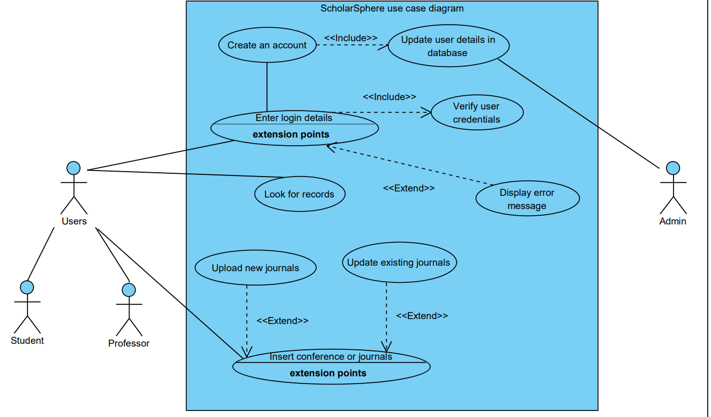
UML Diagram for ScholarSphere

Slide 5

Jira Link For Project
Scholarsphere_project_Link

Slide 6

Github Link For Project
https://github.com/LakshminathAlamuru/Project_OOD_Group20

