Slide 1

scholarsphere
Lakshminath Reddy Alamuru(367982169) - Group 20

Slide 2
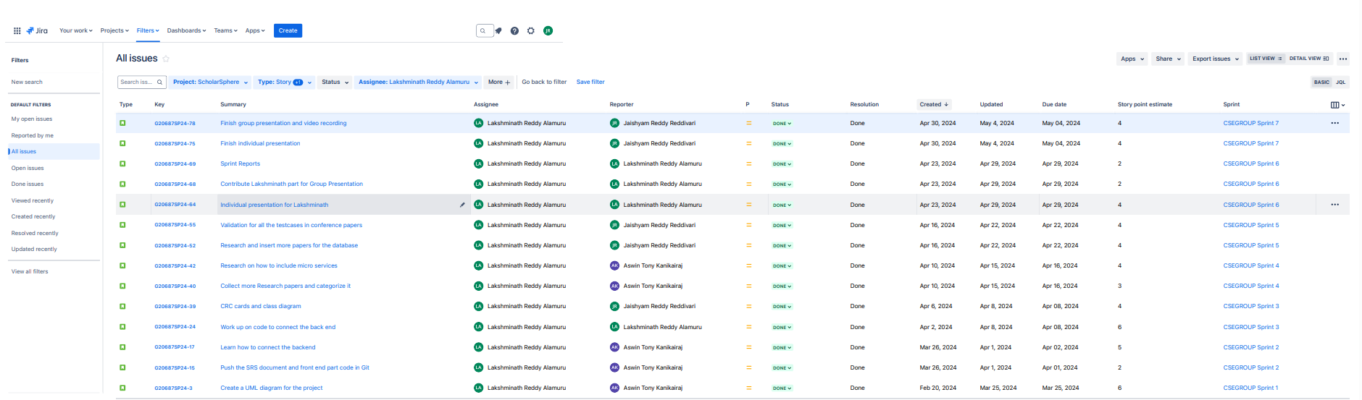
Overall Sprint Issues

Slide 3
Sprint Overview
Sprint | Number of stories closed | Number of stories rolled over | Story points
Sprint 1 | 1 | 0 | 6
Sprint 2 | 2 | 0 | 7
Sprint 3 | 1 | 0 | 6
Sprint 4 | 2 | 0 | 7
Sprint 5 | 2 | 0 | 8
Sprint 6 | 3 | 0 | 8
Sprint 7 | 2 | 0 | 8
The average number of closed stories per sprint are 1.85.
The average number of stories rolled over are 0.
The total number of story points that the team has logged are 50.

Slide 4
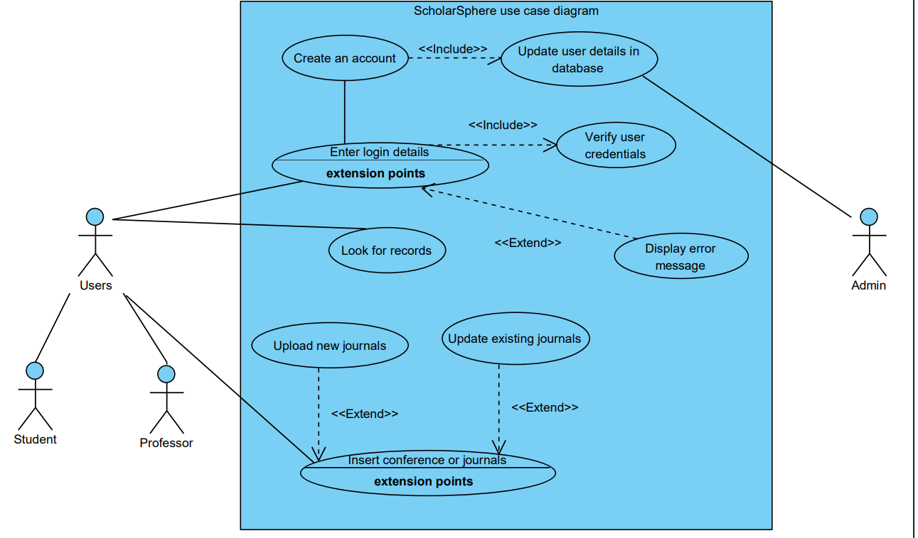
UML Diagram for ScholarSphere

Slide 5
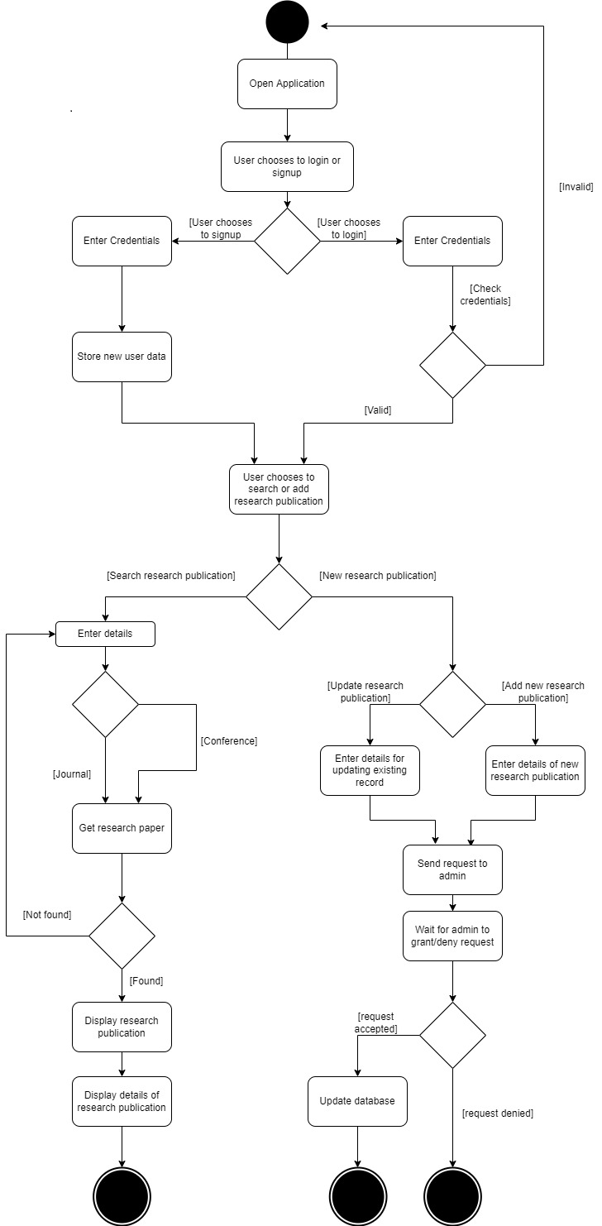
Activity Diagram for the scholarsphere

Slide 6
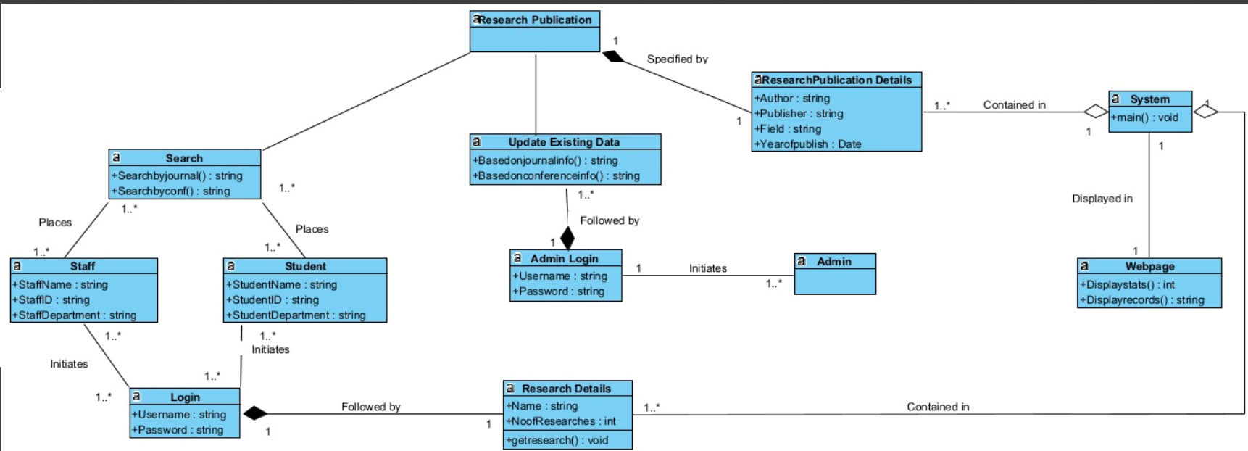
CLASS Diagram for ScholarSphere
Mentioned the classes and it’s attributes in the diagram in detailed

Slide 7
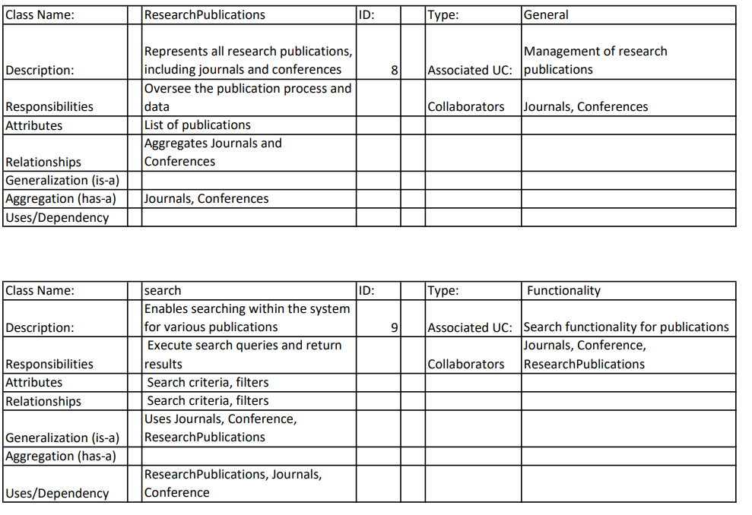
CRC for ScholarSphere
CRC for ResearchPublications
CRC for search

Slide 8
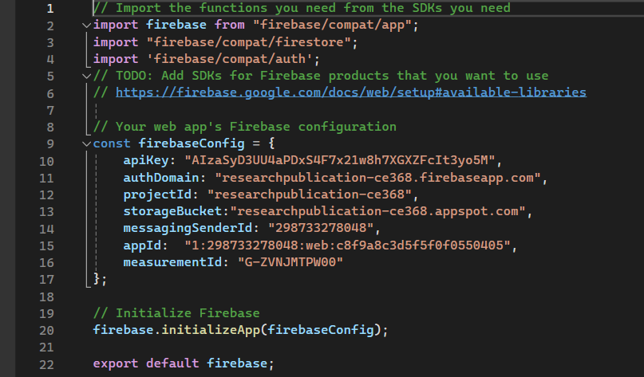
Backend code connection with UI, Used Firebase as a backend

Slide 9
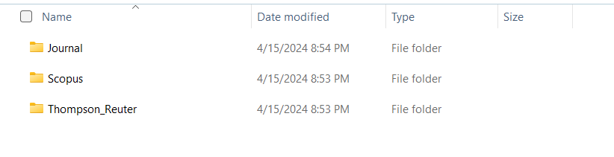
Research Papers in the database with the below separations

Slide 10

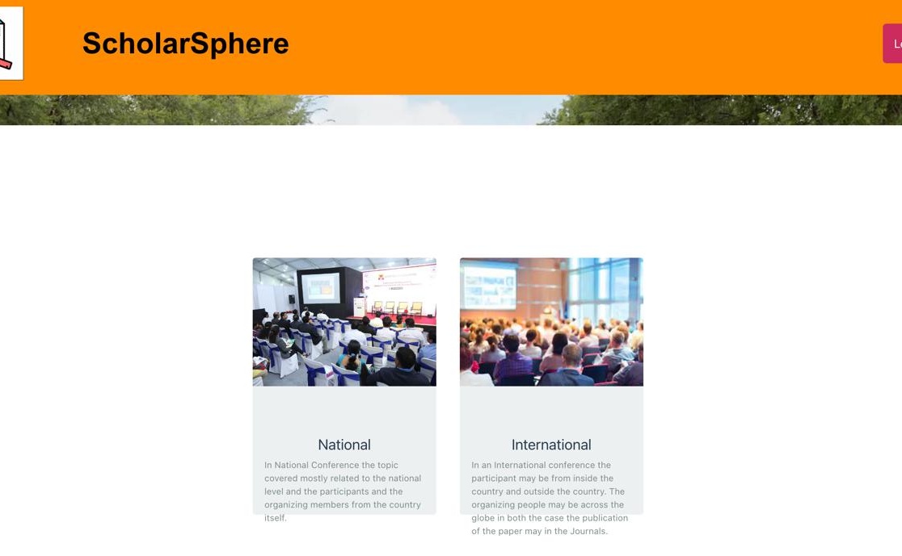
Test Case Validation for Conference Usecases
Above screenshots are UI page interaction with users for different papers.

Slide 11
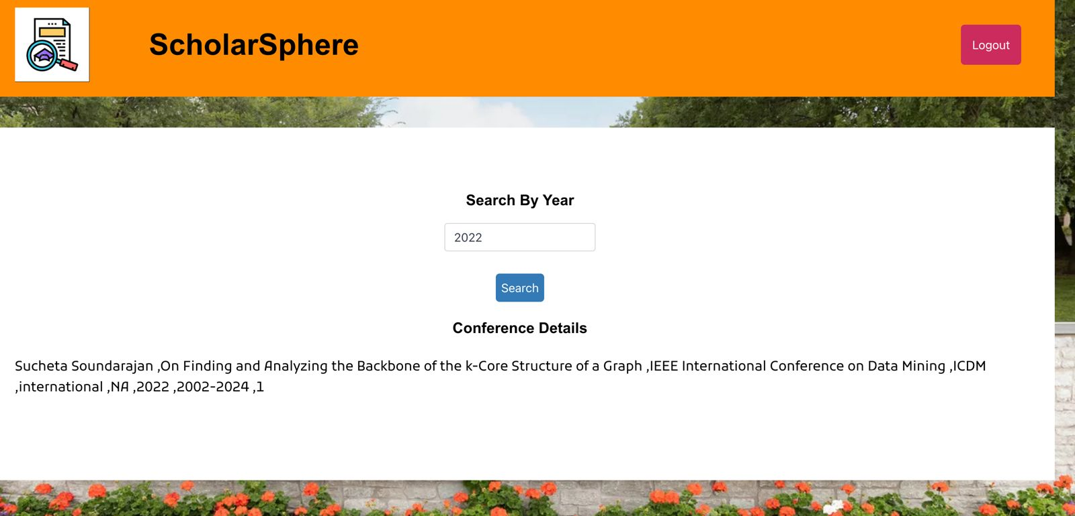
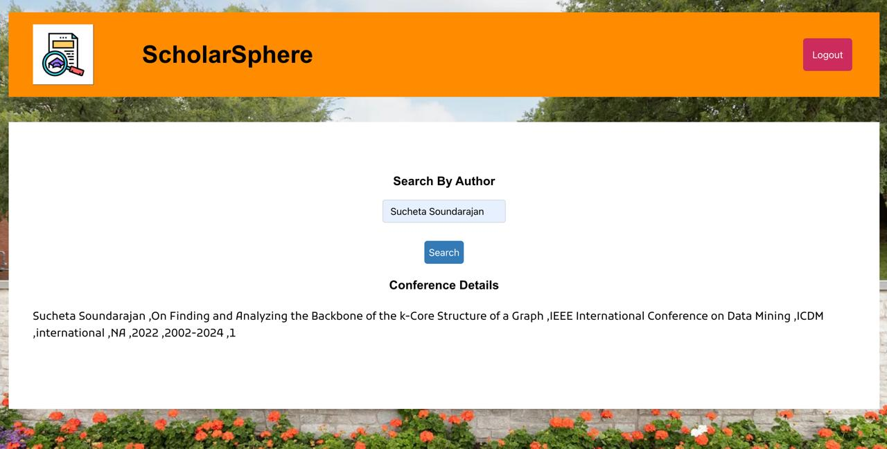
Test Case Validation for Conference Usecases
Above Screenshots are UI search by options based on year or author etc..

Slide 12

Jira Link For Project
Scholarsphere_project_Link

Slide 13

Github Link For Project
https://github.com/LakshminathAlamuru/Project_OOD_Group20

Slide 14
Thank YOU

