Slide 1
Farmer Disease Diagnostic /Reporting Portal
FARMER DISEASE DIAGNOSTIC /REPORTING PORTAL
BY
Ms. V. Swapna 21BQ1A6160
Ms. Md. Sifa Minaaj 21BQ1A6138
Mr. K. Kiran Sai Nagendra 22BQ5A6102
Ms. P. Padmaja 21BQ1A6146
UNDER THE GUIDANCE OF
Mrs. B. Lalitha Rajeswari (Assistant Professor)
Farmer Disease Diagnostic /Reporting Portal

Slide 2
Farmer Disease Diagnostic /Reporting Portal
Content | Slide Number
Introduction | 3
Problem statement, Over View & Objectives | 4,5,6
Existing Vs Proposed Systems & System Architecture | 7,8
Tech Stack | 9
Module-1 | 10-13
Module-2 | 14-19
Module-3 | 20-23
Expected Outputs | 24,25
Challenges, Future Scope & Conclusion | 26-28
Farmer Disease Diagnostic /Reporting Portal

Slide 3
Farmer Disease Diagnostic /Reporting Portal
Introduction:
Title:Farmer Disease Diagnostic /Reporting Portal
Content:
The project aims to assist farmers in detecting and managing crop diseases using deep learning.
Utilizes InceptionV3 for disease classification from crop images.
Multilingual chatbot offers real-time support and treatment recommendations.
Integrates SQLite3 for data storage and historical report generation.
Designed to be accessible, scalable, and user-friendly for farmers worldwide.
Focuses on improving productivity and sustainability through technology-driven solutions.
Farmer Disease Diagnostic /Reporting Portal

Slide 4
Farmer Disease Diagnostic /Reporting Portal
Problem Statement :
1: Early Detection of Crop Diseases
Crop diseases often go undetected until they reach an advanced stage, leading to significant losses in yield and quality. Traditional methods of detection are slow and heavily dependent on expert knowledge, which is not always readily available, especially in rural or remote areas.
2: Limited Access to Timely and Accurate Information
Farmers in many parts of the world, especially in rural communities, may not have access to timely, accurate, or language-appropriate information about crop diseases and treatments. This lack of accessibility leads to delayed interventions and, in some cases, ineffective treatment options.
3: Language Barriers in Agriculture
Many farmers speak local languages or dialects that are not supported by existing agricultural technology platforms. This limits their ability to effectively use available tools and receive recommendations in a language they understand.
4: Difficulty in Tracking Crop Health Over Time
Farmers struggle to monitor and track the health of their crops over extended periods. Without a system to store historical data, it’s difficult to assess the effectiveness of treatments or recognize recurring disease patterns.
Farmer Disease Diagnostic /Reporting Portal

Slide 5
Farmer Disease Diagnostic /Reporting Portal
Project Overview :
Project Aim:
The aim of the “Farmer Disease Diagnostic/Reporting Portal" system is to provide farmers with an innovative tool that combines machine learning, real-time assistance, and data tracking to address the challenges of crop disease management efficiently.
Key Features:
Crop Disease Detection: Utilizes the InceptionV3 deep learning model to classify crop diseases based on uploaded images, providing farmers with accurate and timely diagnoses.
Multilingual Chatbot: Integrated Perplexity API chatbot that offers disease-related information, treatment recommendations, and general guidance in multiple languages, making it accessible to a broader audience.
Report Generation: Enables farmers to track and manage the health of their crops over time, offering historical reports that summarize disease predictions, treatments, and progress.
Final Outcome:
To provide farmers with a user-friendly, efficient, and accessible system that improves early disease detection, offers actionable insights, and supports informed decision-making for better crop health management.
Farmer Disease Diagnostic /Reporting Portal

Slide 6
Farmer Disease Diagnostic /Reporting Portal
Project Objectives :
Objective 1: Early Detection of Plant Diseases
Developed an AI-based system for detecting plant diseases from images using deep learning techniques to assist farmers in timely intervention.
Objective 2: Improve Crop Health Monitoring
Implemented a real-time monitoring system that analyzes plant health conditions, providing farmers with actionable insights.
Objective 3: Develop an Interactive User Interface
Designed an intuitive and user-friendly interface to facilitate easy access to disease detection results and recommendations.
Objective 4: Ensure Model Accuracy and Efficiency
Trained and optimized machine learning models to achieve high accuracy in disease classification while maintaining computational efficiency.
Objective 5: Provide Multilingual Support for Farmers
Integrated multilingual support to ensure accessibility for farmers from diverse linguistic backgrounds.
Objective 6: Enhance Accessibility using Web
Developed the system to be accessible on web platform, ensuring ease of use for farmers in different environments.
Farmer Disease Diagnostic /Reporting Portal

Slide 7
Farmer Disease Diagnostic /Reporting Portal
Existing vs. Proposed Systems
Existing:
Manual Disease Detection: Farmers rely on physical inspections or experts, which are slow, costly, and prone to errors.
Language Barriers : Most agricultural advisory services are available only in a few languages, limiting accessibility for diverse farming communities..
Limited Accessibility: Most systems are available in limited languages, restricting access for farmers speaking regional dialects.
Proposed:
Automated Disease Prediction: Uses InceptionV3 for accurate, instant disease classification from crop images.
Multilingual Chatbot: Provides real-time, multilingual assistance for disease information and treatment recommendations.
Integrated Report Generation: Allows farmers to generate historical reports and track disease progression.
Scalable and User-Friendly: Designed for scalability, fast predictions, and accessibility in rural areas with limited internet.
Comprehensive Solution: Combines disease detection, multilingual support, and report generation into one seamless platform.
Farmer Disease Diagnostic /Reporting Portal

Slide 8
Farmer Disease Diagnostic /Reporting Portal
System Architecture :
+--------------------------------------+
| User Interface (UI) |
| <---> (Web/Mobile Application) |
+--------------------------------------+
|
v
+--------------------------------------+
| Image Upload & Preprocessing |
| (Crop Image Resizing & Scaling) |
+--------------------------------------+
|
v
+--------------------------------------+
| InceptionV3 Model for Disease |
| Classification & Prediction |
+--------------------------------------+
|
v
+--------------------------------------+
| Multilingual Chatbot (Perplexity API) |
| <---> Real-time User Support |
+--------------------------------------+
|
v
+--------------------------------------+
| Database (SQLite3) for Storing |
| Predictions, Reports & Data |
+--------------------------------------+
|
v
+--------------------------------------+
| Report Generation System |
| (Historical Data & Prediction) |
+--------------------------------------+
Farmer Disease Diagnostic /Reporting Portal

Slide 9
Farmer Disease Diagnostic /Reporting Portal
Technology Stack:
Frontend:
HTML, CSS, JavaScript (with Bootstrap)
Backend:
Django (Python)
Machine Learning Model:
InceptionV3 (for crop disease classification)
Chatbot API:
Perplexity API (for multilingual chatbot integration)
Database:
SQLite3 (for data storage)
Deployment:
Local server for testing, Web server for production (e.g., Apache, Nginx)
Farmer Disease Diagnostic /Reporting Portal

Slide 10
Farmer Disease Diagnostic /Reporting Portal
Module 1: User Interface – Overview
Purpose:
Provide an intuitive and user-friendly platform for farmers to easily interact with the system, upload crop images, and access disease predictions and treatment recommendations.
Built with:
HTML, CSS, JavaScript (with Bootstrap)
Integrated with Django templates for dynamic content rendering.
Key Sections:
Home Page: Central landing page with navigation to various features.
Image Upload: Section for uploading crop images for disease prediction.
Login and Registration: Secure user authentication via email OTP verification.
User Profile: Manage user information and view past predictions.
Disease Prediction Results Page: Displays classified results and treatment recommendations.
Report Generation Page: Allows users to generate and view historical reports.
Multilingual Chatbot Interface: Integrated chatbot for real-time support in multiple languages.
Farmer Disease Diagnostic /Reporting Portal

Slide 11
Farmer Disease Diagnostic /Reporting Portal
Module 1: UI – Section Details
Image Upload Interface
Farmers can easily upload images of their crops through a simple and intuitive interface. The system is designed to accept images in various formats and ensures they are properly pre-processed before being passed to the classification model.
Image Preprocessing
Before feeding the uploaded images into the InceptionV3 model, they undergo preprocessing to standardize their size, normalize pixel values, and enhance image quality for better prediction accuracy. This step ensures that the model receives the best possible input for classification.
Disease Prediction Using InceptionV3
The core of Module-1 is the InceptionV3 deep learning model, which classifies the processed crop images into specific disease categories or identifies them as healthy. The model has been fine-tuned on a dataset of crop diseases to ensure high accuracy and reliability.
Output and Results
After processing the image through the model, the system generates the results, displaying the disease prediction along with the confidence score. It also provides a detailed description of the identified disease and suggested treatments, ensuring that farmers can take immediate action.
Farmer Disease Diagnostic /Reporting Portal

Slide 12
Farmer Disease Diagnostic /Reporting Portal
UI – Upload Image :
Navigation Flow:
The user is presented with two main options:
Upload Image: The user selects an image file from their device, which is then analyzed for object detection.
Double-click Mechanism:
If the user wishes to analyze a specific image in more detail, they can double-click on the image to quickly get more detailed feedback or additional analysis for the detected objects.
Emphasis on Accessibility:
This feature ensures that the process is intuitive and accessible, with clear buttons and voice feedback to guide users, especially those with visual impairments. The real-time object detection ensures the user can easily interact with the system for an immersive experience.
Farmer Disease Diagnostic /Reporting Portal
Farmer Disease Diagnostic /Reporting Portal

Slide 13
Farmer Disease Diagnostic /Reporting Portal
User Authentication
Implemented using Django’s built-in authentication system.
Signup: New users create an account.
Login: Existing users access personalized recommendations.
Logout: Users can securely log out after their session.
Security Features: Secure password hashing, session management
Farmer Disease Diagnostic /Reporting Portal

Slide 14
Farmer Disease Diagnostic /Reporting Portal
Module 2: Multilingual Chatbot Integration
Purpose:
The purpose of Module-2 is to provide real-time support for farmers through a multilingual chatbot. This module helps farmers interact with the system in their preferred language, receive disease-related information, and get treatment recommendations instantly.
User Query Input
Chatbot interface where farmers input queries about crop diseases.
Language Detection & Translation
Automatically detects the language of the user’s query.
Real-Time Disease Information
The chatbot processes the input and provides real-time, context-aware disease-related information.
Follow-Up Support
The chatbot can handle follow-up questions related to treatments, disease spread, and other crop health queries.
Farmer Disease Diagnostic /Reporting Portal

Slide 15
Farmer Disease Diagnostic /Reporting Portal
Deployment & Integration Overview:
Cloud-Based Deployment:
The system is deployed on the cloud to ensure scalability, accessibility, and performance. Cloud deployment ensures that the application can handle increasing user demand and store large datasets efficiently.
API Integration (Perplexity API):
The multilingual chatbot is integrated with the Perplexity API for language detection and real-time response generation, enabling seamless interaction with the system in multiple languages.
Database Integration (SQLite3):
User data, disease predictions, and historical reports are stored in a SQLite3 database, ensuring quick data retrieval and management.
Why It Matters:
Scalability:
Cloud deployment allows the system to scale effortlessly, accommodating more users and larger datasets as the system grows.
Accessibility:
With cloud deployment, farmers can access the system from anywhere, even in remote areas, making it widely accessible.
Real-Time Performance:
Integration of the chatbot and prediction model ensures farmers get instant responses, improving the efficiency of crop disease management.
Data Management:
The database integration ensures that all historical data is well-organized, enabling farmers to track crop health over time and make informed decisions.
Farmer Disease Diagnostic /Reporting Portal

Slide 16
Farmer Disease Diagnostic /Reporting Portal
Module 2: Disease Prediction and Chatbot Integration
This module combines crop disease prediction through image uploads and the integration of a multilingual chatbot to assist users in understanding disease information and receiving real-time treatment recommendations. The system ensures easy interaction and enhanced accessibility, especially for users who speak different languages.
– Implementation
Technical Steps:
Input: The user uploads an image of their crop for disease detection.
Preprocessing: The uploaded image is resized and normalized to fit the input requirements of the InceptionV3 model for accurate prediction.
Disease Detection: The image is passed through the InceptionV3 model for classification. The model identifies the crop disease or indicates that the crop is healthy.
Chatbot Integration: The Perplexity API chatbot responds in real-time, offering disease-related information, treatment suggestions, and general advice in the user’s preferred language.
Display Results: The system shows the predicted disease or healthy status of the crop, along with care instructions and pesticide recommendations.
Error Handling: If the image cannot be processed or no disease is detected, an error message prompts the user to upload a valid image.
Multilingual Support: The chatbot provides answers and treatment recommendations in multiple languages, ensuring broader accessibility.
Farmer Disease Diagnostic /Reporting Portal

Slide 17
Farmer Disease Diagnostic /Reporting Portal
Object Detection Purpose:
The goal is to allow users to upload images or use their webcam to detect and identify vehicles and other objects in real-time.
It leverages the YOLOv3 (You Only Look Once) model to accurately detect objects, including cars, buses, trucks, and other vehicles, providing immediate feedback to users.
Object Detection Flow:
User Input: The user uploads an image or uses the webcam to capture live video.
Python Function: The uploaded image or live video is processed using the YOLOv3 object detection model to detect objects.
Object Detection: Detected objects are outlined with bounding boxes, and the objects are labeled (e.g., car, truck, bus).
Display Results: The detected objects are shown on the webpage with real-time detection results (e.g., object name and location).
Error Handling: If no objects are detected or if the input is invalid, appropriate error messages are shown to guide the user.
Real-time Updates: Continuous detection in live video allows for dynamic feedback, ensuring users receive up-to-date information.
Farmer Disease Diagnostic /Reporting Portal

Slide 18
Farmer Disease Diagnostic /Reporting Portal
Deployment & Integration
Choice of Platform:
The disease prediction system and UI are hosted on a cloud platform for easy access and maintenance, ensuring seamless operation and scalability.
Separate Mini-Apps:
Disease Prediction App: Hosted independently to allow quick updates and maintainability without affecting the core Django project.
User Interface (UI) App: Deployed as a standalone web app to handle image uploads, display results, and integrate the multilingual chatbot.
Embedding via Iframes:
The web applications are embedded within the main Django app using <iframe> tags, allowing users to interact with all functionalities seamlessly without additional navigation, providing a consistent experience.
Farmer Disease Diagnostic /Reporting Portal

Slide 19
Benefits:
Modularity: Each feature can be updated or redeployed independently, minimizing downtime for the rest of the platform.
Scalability: Hugging Face handles scaling aspects, so the mini-apps can handle more traffic without major reconfiguration.
Seamless Experience: By embedding the apps in iframes, users stay within the same look and feel, preserving brand identity and UI consistency.
Easy Debugging: If an issue arises in one module, it doesn’t break the entire application; you can isolate and fix it in the mini-app itself.

Slide 20
Module-3: Report Generation and Historical Data Tracking
Purpose:
The goal of Module-3 is to provide farmers with the ability to track their crop health over time by generating historical reports based on past disease predictions and treatment recommendations. This feature helps farmers assess the effectiveness of treatments, identify recurring issues, and make data-driven decisions for future crop management.
Data Storage and Retrieval
Stores disease predictions, treatment recommendations, and user data in an SQLite3 database.
Historical Data Analysis
Analyzes the historical data stored in the database to identify trends, such as recurring diseases or patterns of crop health over different seasons.
Report Generation
Generates detailed reports that summarize crop disease predictions, the treatment applied, and its outcomes.
User Interface for Reports
Simple and intuitive interface for farmers to view and download reports in their preferred language.

Slide 21
Farmer Disease Diagnostic /Reporting Portal
Deployment and Integration
Integrated into the cloud platform to ensure that the reports are accessible to farmers anytime, anywhere.
Seamlessly integrated with the existing system architecture, pulling historical data from the database and presenting it in a readable format.
Benefits
Tracking Crop Health
  Provides farmers with valuable insights into their crops' health over time, helping them make informed decisions about future care.
Informed Decision-Making
  Historical data helps farmers analyze the effectiveness of different treatments, enabling better decision-making for future crop management.
Multi-Language Support
  Reports are available in various languages, making the system accessible to a wider audience, regardless of location or language.
User Empowerment
  By offering a simple and efficient way to track and report crop health, the system empowers farmers with the tools they need to manage their crops effectively and sustainably.
Farmer Disease Diagnostic /Reporting Portal

Slide 22
Farmer Disease Diagnostic /Reporting Portal
Integration in Django:
Django as the Core Framework:
Django serves as the backbone of the project, handling the core aspects of the web application. It manages URL routing, user authentication, and the overall site structure.
Django ensures a consistent user experience from the login screens to the navigation menus, making sure that users have a seamless interaction with the platform.
Modular Embedding:
Module 1 (User Interface):
  This module is developed using Django templates and views, which handle the main landing pages and navigation menus. It provides the user with easy access to upload images for disease detection, view predictions, and interact with the system.
Module 2 (Multilingual Chatbot Integration):
  The multilingual chatbot module is deployed separately on platforms like Hugging Face Spaces but integrated into the Django framework using <iframe> components.
Module 3 (Report Generation):
  This module follows a similar embedding approach to integrate the historical report generation feature directly within the Django application. Users can track their crop health history, access past predictions, and generate reports all within the same interface.
Farmer Disease Diagnostic /Reporting Portal

Slide 23
Farmer Disease Diagnostic /Reporting Portal
Unified User Experience: Single sign-on with Django’s authentication system, allowing users to move seamlessly between career exploration, skill-gap analysis, real-time job searches, and the chatbot.
Consistent design elements and navigation structure provide a cohesive, professional look and feel.
Advantages:
Maintenance: Each module can be updated or deployed independently without breaking the core platform.
Scalability: Separate hosting for ML/AI-intensive parts means the Django app remains lightweight, while Hugging Face handles the heavy lifting for model inference.
Efficiency: Minimizes development overhead by letting Django orchestrate page routing and user sessions while offloading specialized tasks to dedicated mini-apps.
Farmer Disease Diagnostic /Reporting Portal

Slide 24
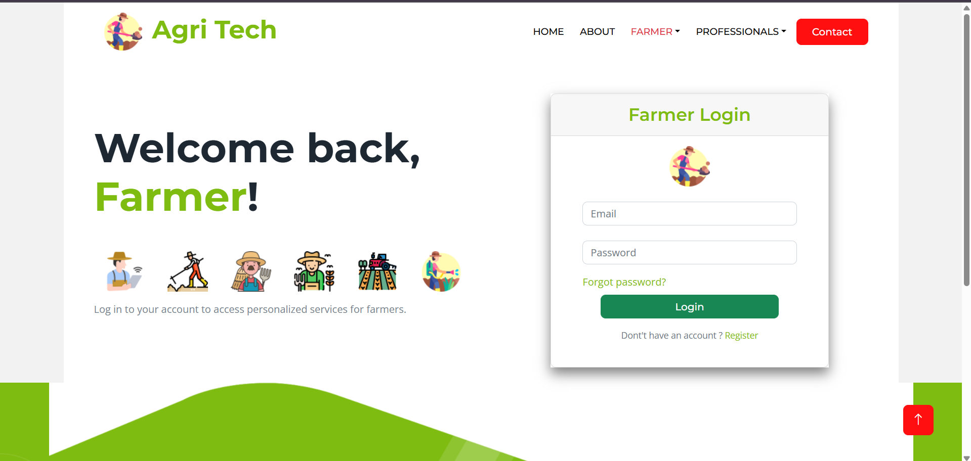
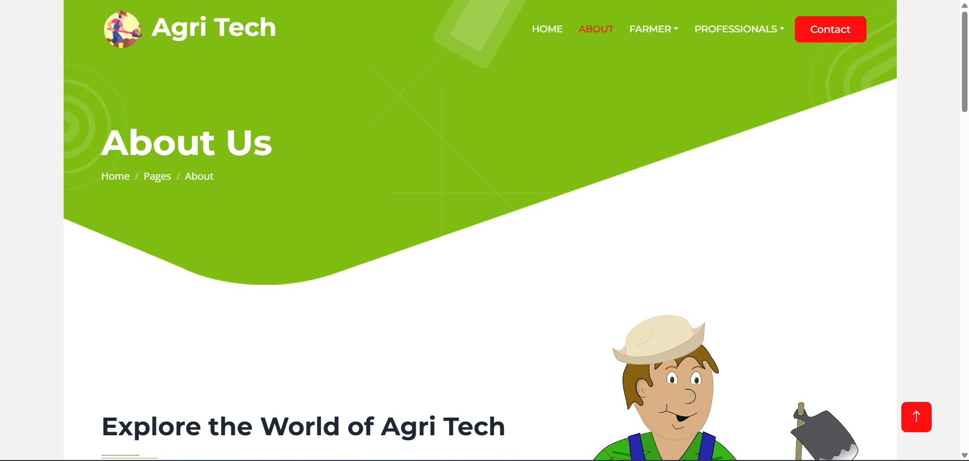
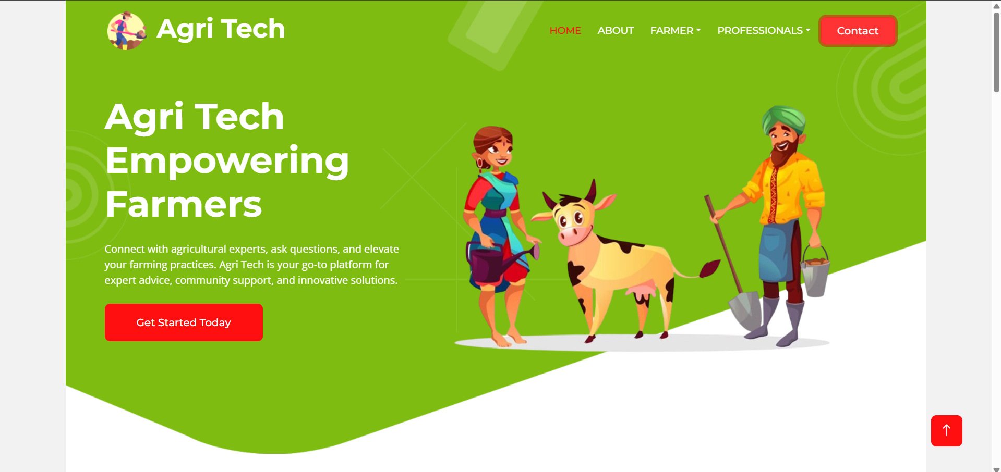
Farmer Disease Diagnostic /Reporting Portal
Expected Outputs:
Farmer Disease Diagnostic /Reporting Portal

Slide 25
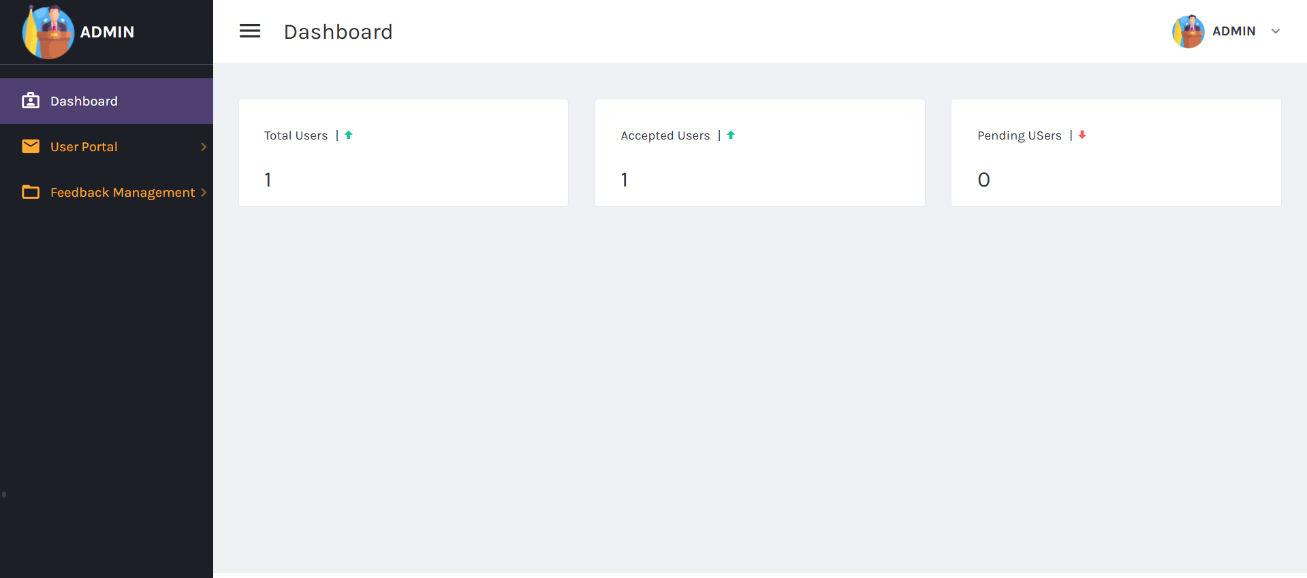
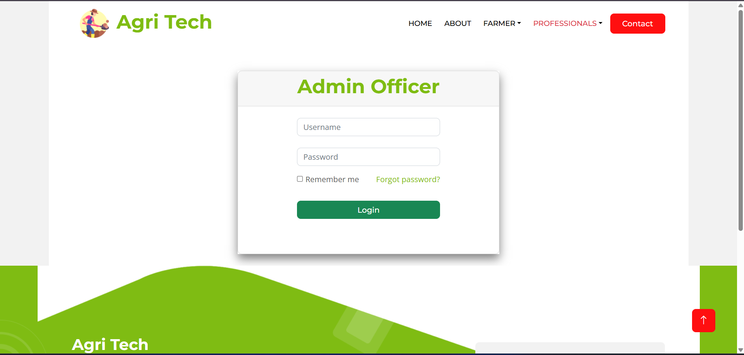
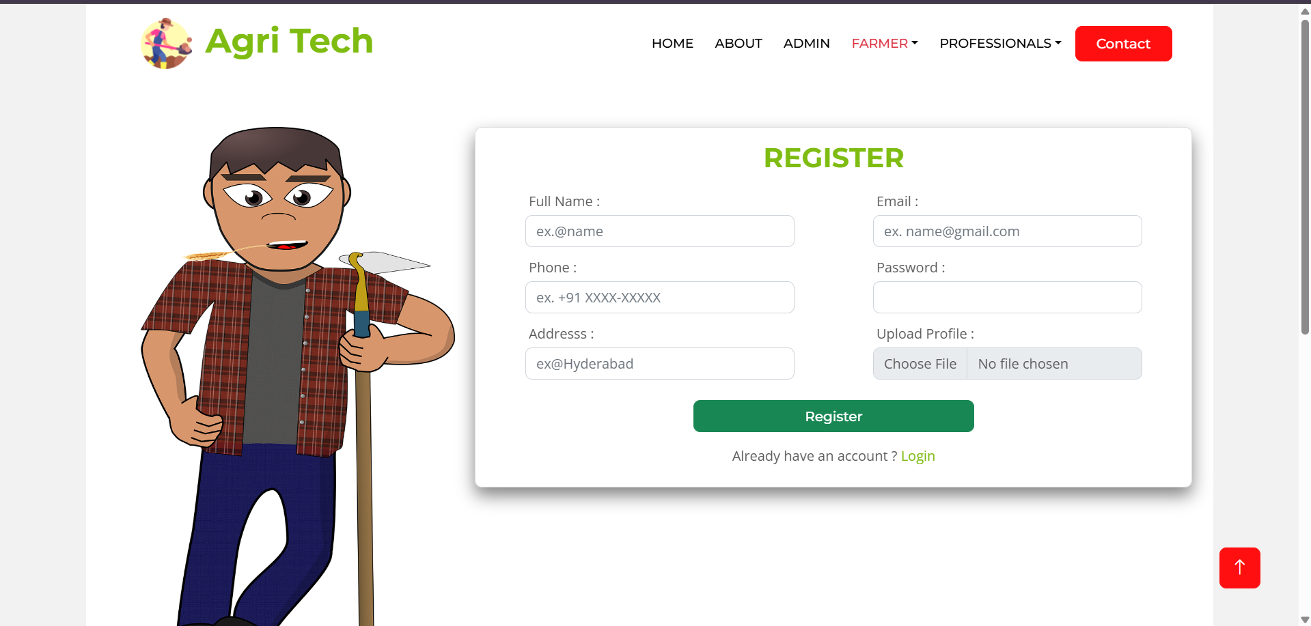
Farmer Disease Diagnostic /Reporting Portal
Expected Outputs:
Farmer Disease Diagnostic /Reporting Portal

Slide 26
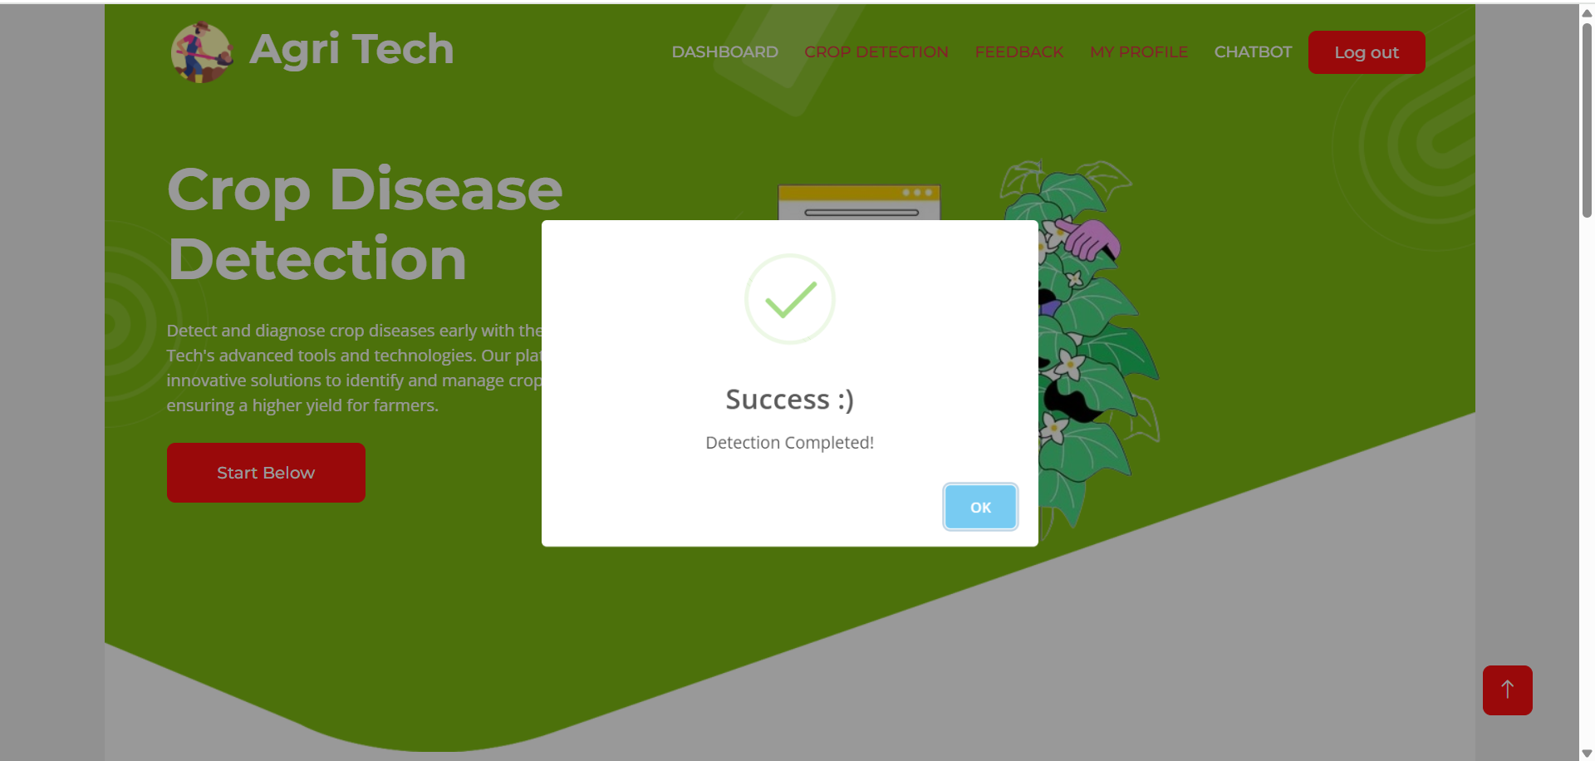
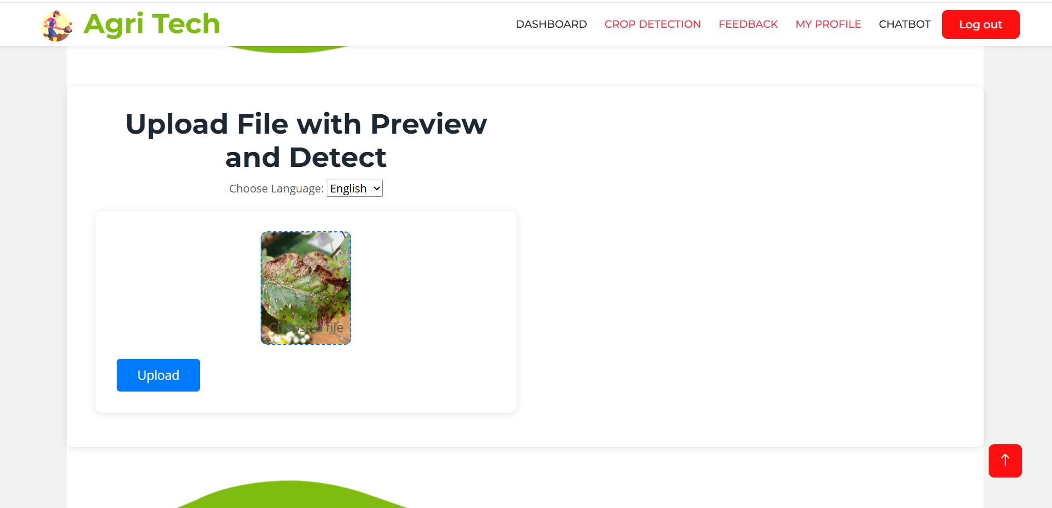
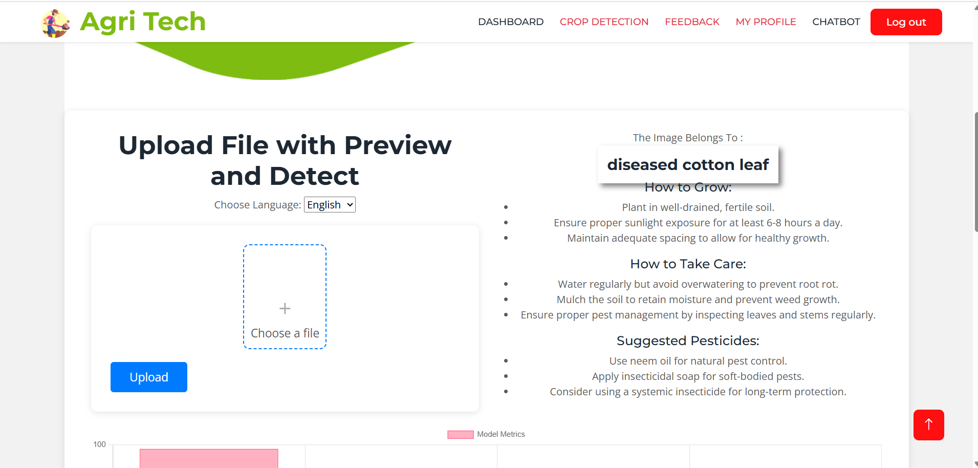
Farmer Disease Diagnostic /Reporting Portal
Expected Outputs:
Farmer Disease Diagnostic /Reporting Portal

Slide 27
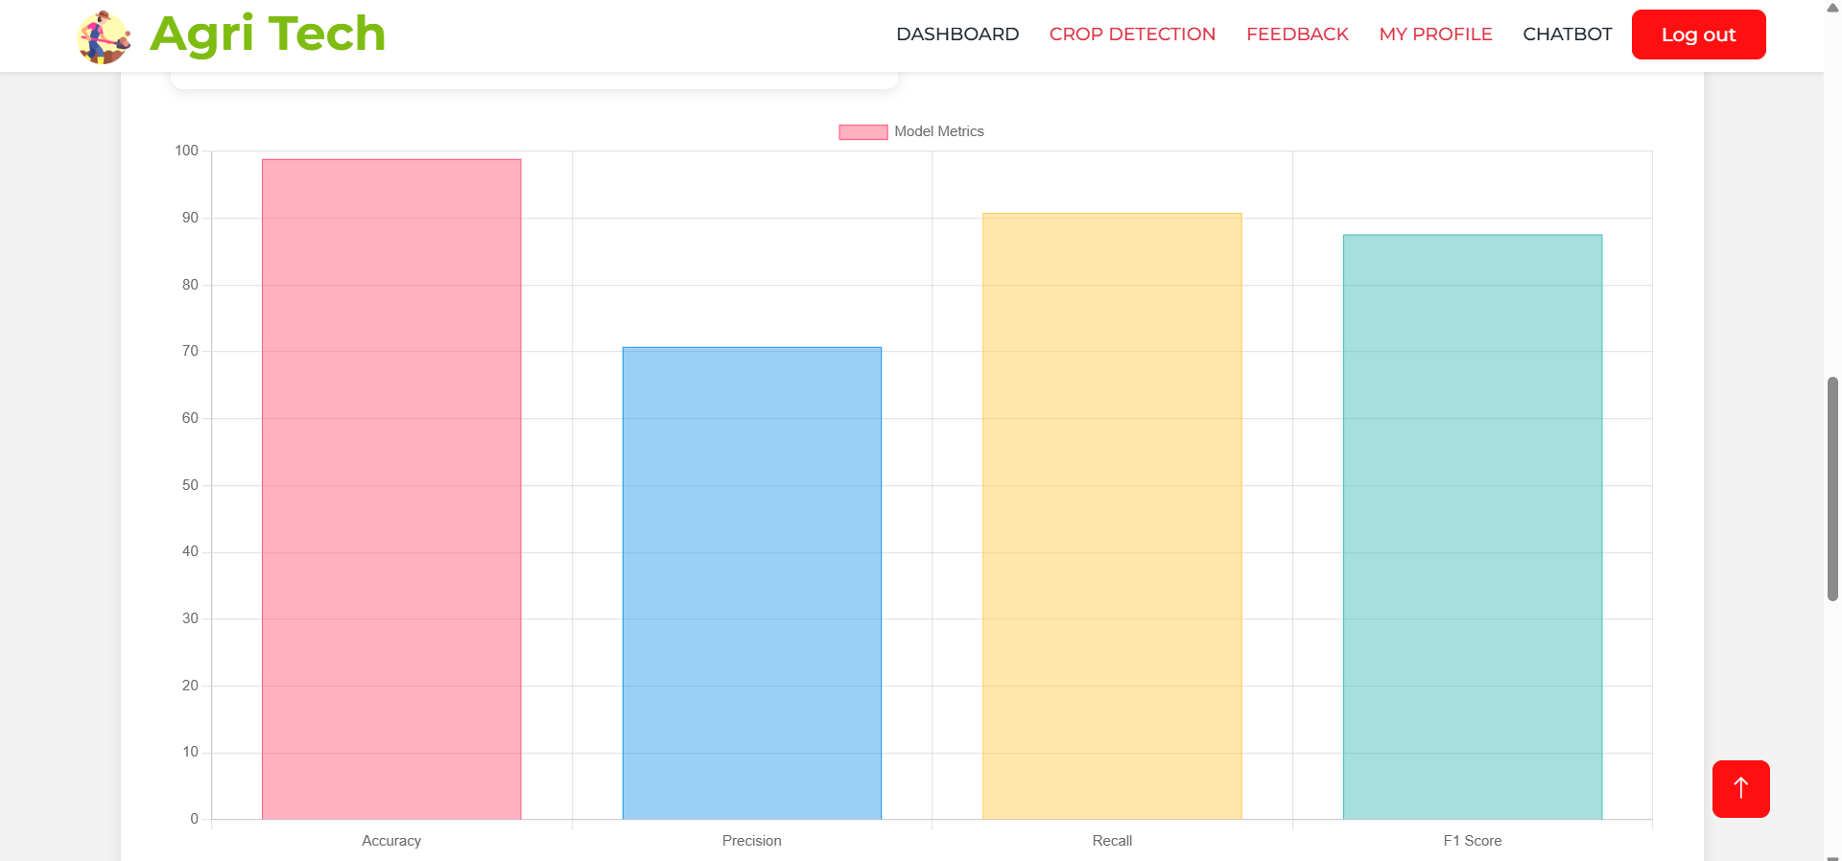
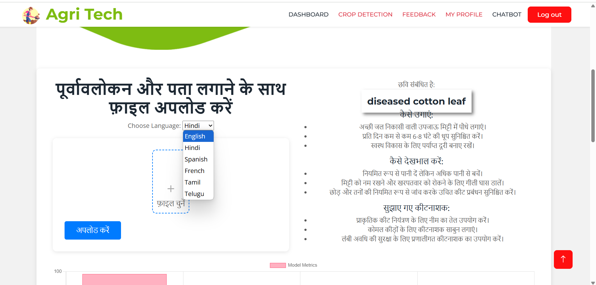
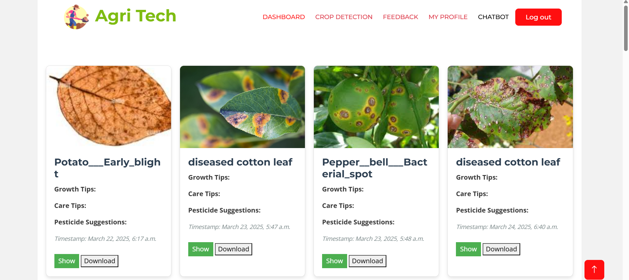
Farmer Disease Diagnostic /Reporting Portal
Expected Outputs:
Farmer Disease Diagnostic /Reporting Portal

Slide 28
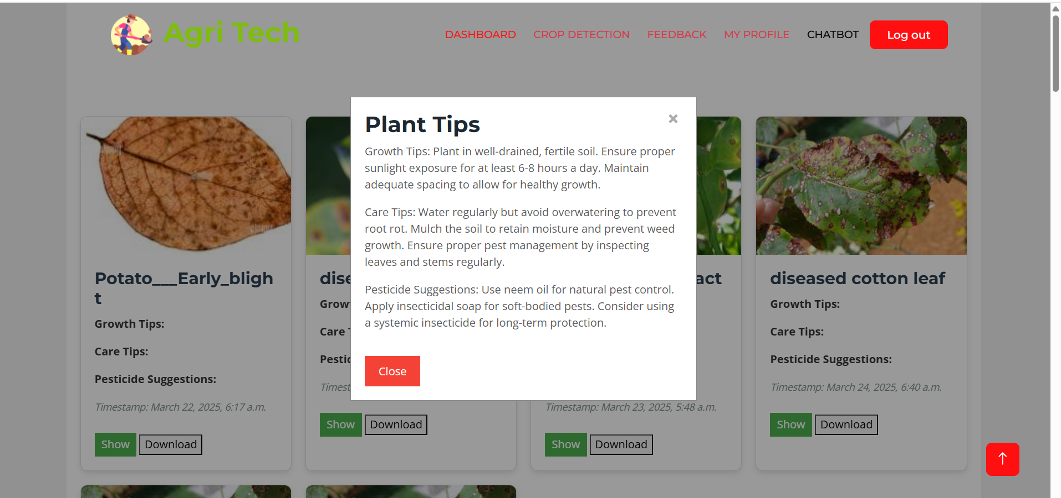
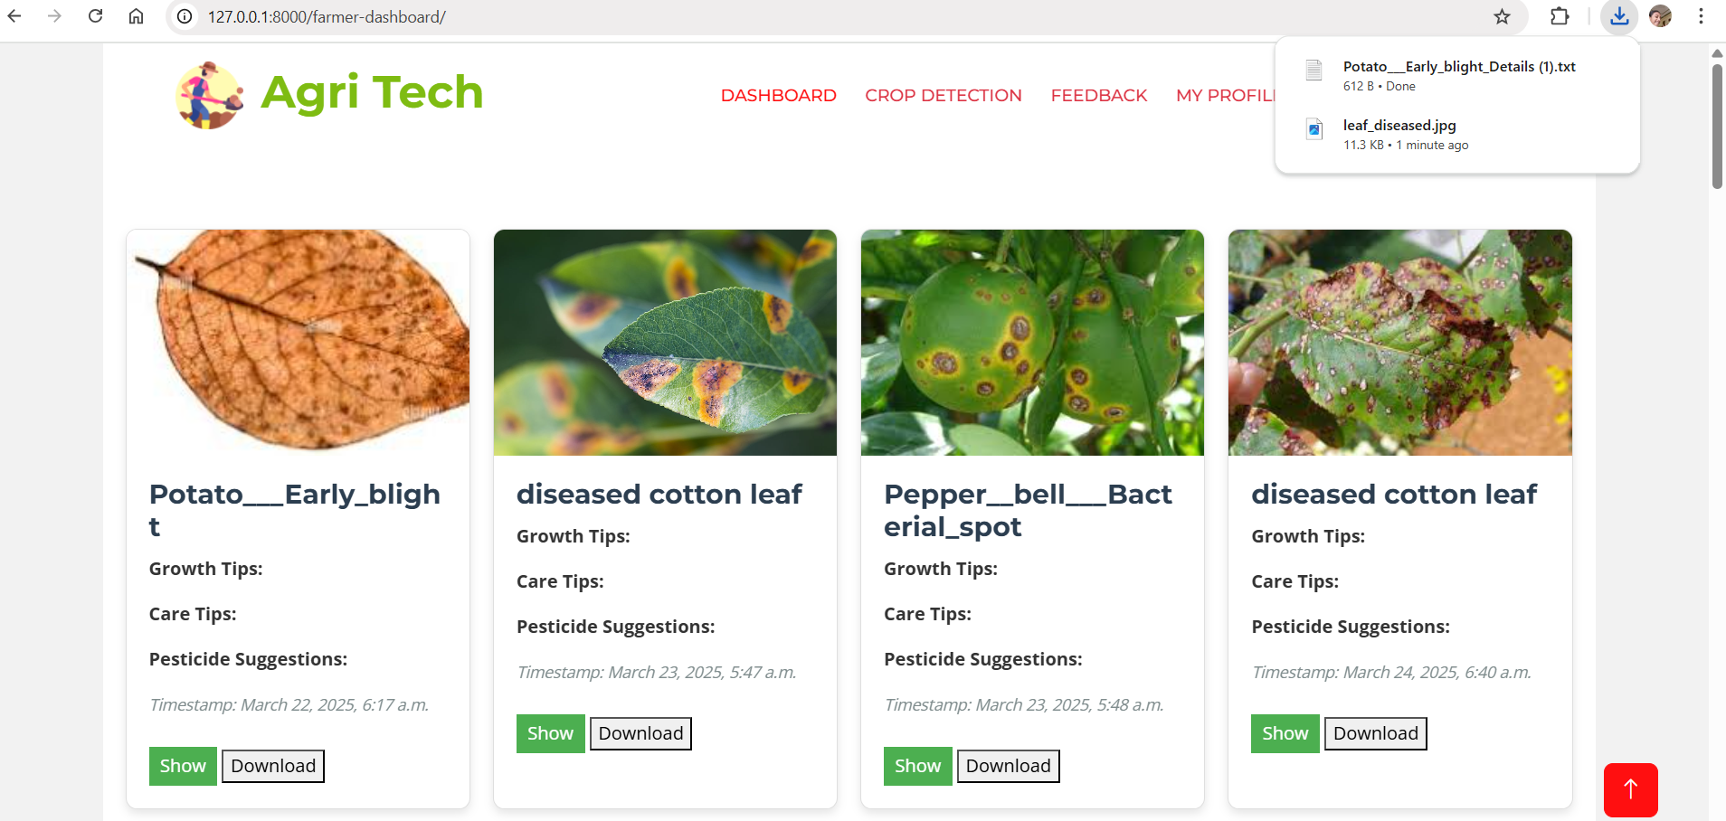
Farmer Disease Diagnostic /Reporting Portal
Expected Outputs:
Farmer Disease Diagnostic /Reporting Portal

Slide 29
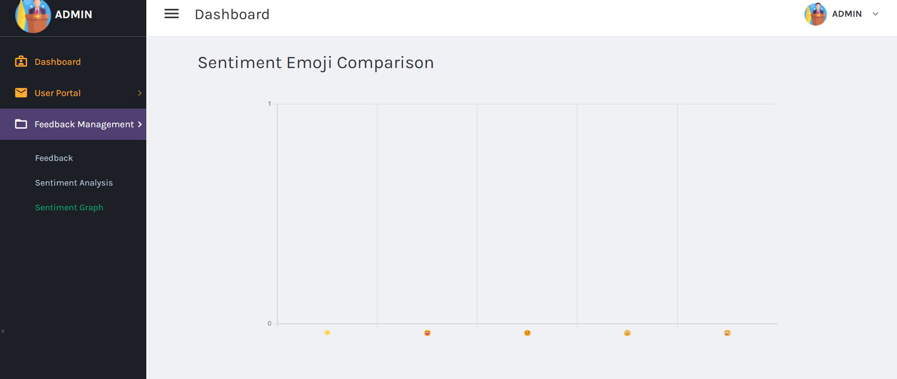
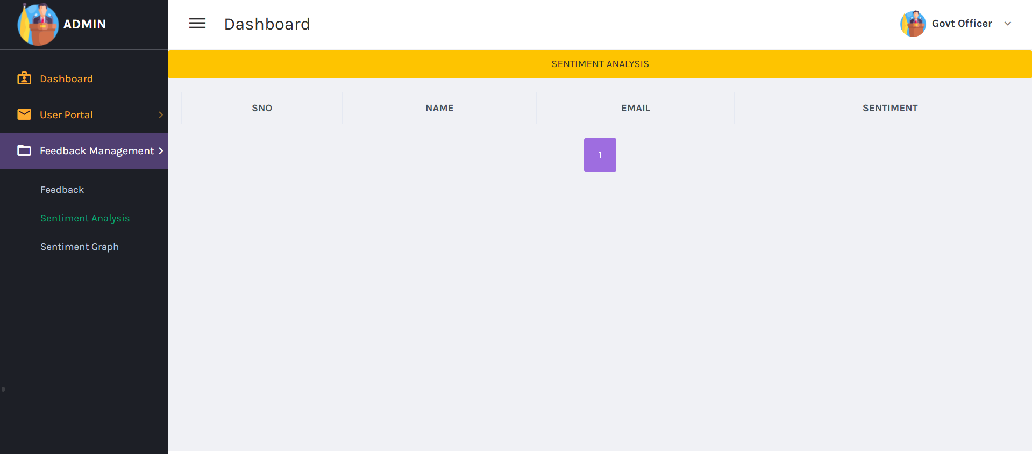
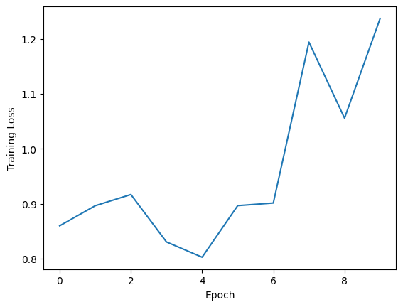
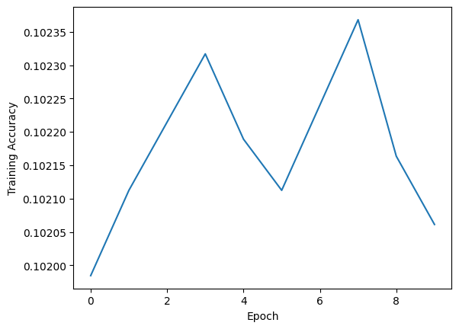
Farmer Disease Diagnostic /Reporting Portal
Farmer Disease Diagnostic /Reporting Portal

Slide 30
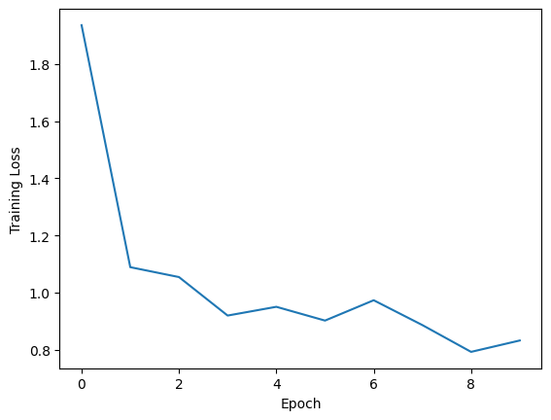
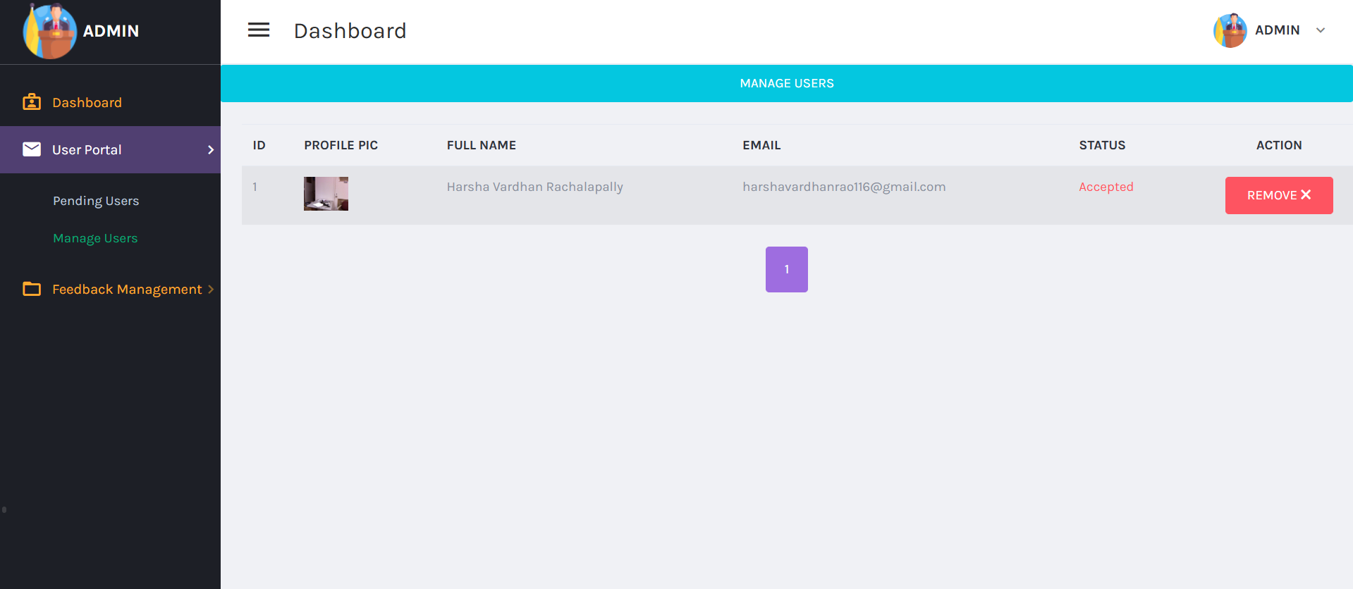
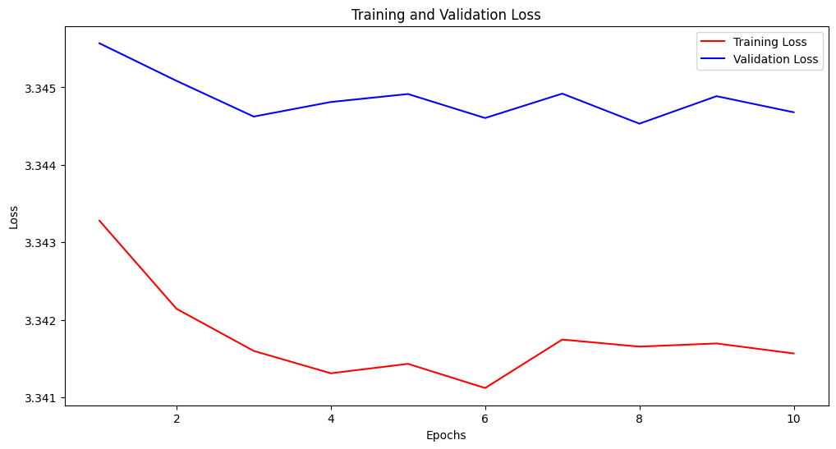
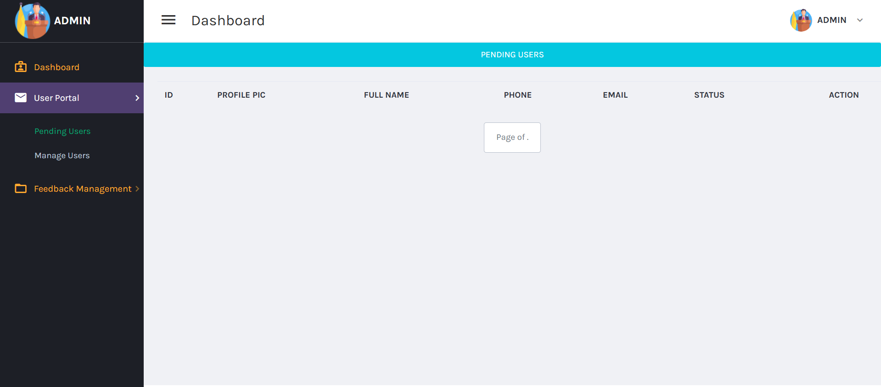
Farmer Disease Diagnostic /Reporting Portal
Farmer Disease Diagnostic /Reporting Portal

Slide 31
Farmer Disease Diagnostic /Reporting Portal
Challenges & Solutions
Challenge 1: Data Accuracy and Labeling
Solution:
Ensuring accurate and consistent data labeling for crop disease images was a significant challenge. To address this, we utilized a diverse dataset with proper labeling, ensuring the quality of the data. Additionally, a data validation process was implemented, where multiple experts reviewed the labeled data to guarantee accuracy before training the model.
Challenge 2: Multilingual Support Complexity
Solution:
Handling multiple languages and ensuring that the disease-related information and treatment recommendations were translated accurately posed a challenge. The solution involved integrating high-quality translation services like the Perplexity API. We also regularly fine-tuned the translation models based on user feedback to improve both the accuracy and cultural relevance of the translations.
Challenge 3: Real-Time Disease Prediction Accuracy
Solution:
Achieving high accuracy in real-time disease prediction was challenging due to variations in image quality and crop types. We overcame this by employing data augmentation techniques, such as rotation, flipping, and scaling, to train the model on diverse image types. The model was also continuously updated with new data to improve its accuracy over time.
Challenge 4: User Adoption in Rural Areas
Solution:
Farmers in rural areas may not be familiar with technology, and limited internet access can hinder adoption. We addressed this challenge by designing a simple, user-friendly interface that doesn’t require technical expertise. Additionally, the system was designed to work offline, allowing farmers with limited internet access to sync data when an internet connection is available.
Farmer Disease Diagnostic /Reporting Portal

Slide 32
Farmer Disease Diagnostic /Reporting Portal
Future Scope
Integration with IoT for Real-Time Data
Scope: Integrate IoT devices (e.g., soil moisture, temperature sensors) for real-time environmental data to improve disease predictions.
Benefit: Enhances prediction accuracy and provides weather-based treatment suggestions.
Expansion of Disease Database
Scope: Continuously add more crop types, diseases, and treatments to the database.
Benefit: Enables broader disease identification and better treatment recommendations.
Advanced AI Models for Disease Prediction
Scope: Integrate advanced models like ResNet and EfficientNet for improved accuracy, and use ensemble models for more robust predictions.
Benefit: Increases precision in classifying complex disease patterns.
User Behavior Analytics for Personalized Recommendations
Scope: Collect user interaction data to offer personalized disease management and treatment plans.
Benefit: Provides customized recommendations, improving engagement and outcomes.
Farmer Disease Diagnostic /Reporting Portal

Slide 33
Farmer Disease Diagnostic /Reporting Portal
Conclusion
Innovation in Agriculture:
The Crop Disease Prediction system with a multilingual chatbot and report generation offers an innovative solution to crop disease management. By combining deep learning with real-time tools like the chatbot, it provides farmers with accurate and timely information.
Efficiency and Accessibility:
The system detects diseases through images, offers multilingual treatment recommendations, and generates historical reports, making it a comprehensive tool. It addresses the need for quick disease detection and easy access to knowledge, improving decision-making for farmers.
Impact on Sustainability and Productivity:
Early disease detection and preventive measures reduce the use of harmful pesticides, promote sustainable farming practices, and enhance crop productivity, ultimately improving food security.
User-Centric Design:
The system is designed to be user-friendly for farmers with different technical skills. The multilingual support ensures accessibility, breaking down language barriers and expanding the reach of modern agricultural technologies.
Farmer Disease Diagnostic /Reporting Portal

