Slide 1
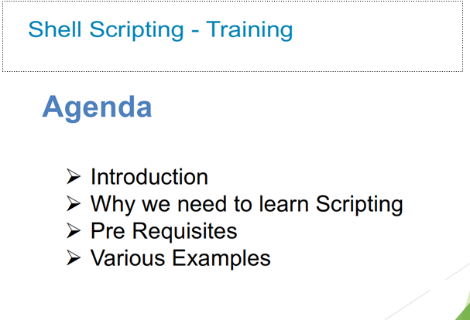

Slide 2
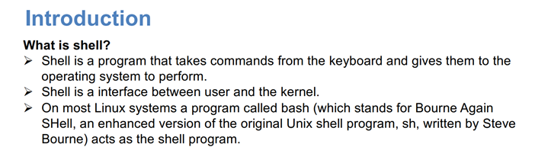

Slide 3
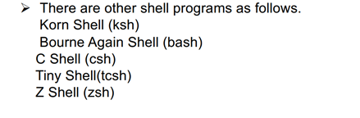

Shell types

Slide 4
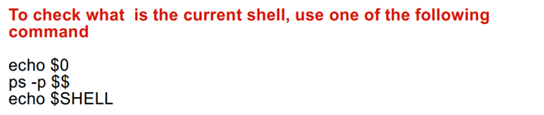
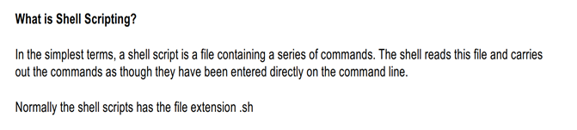

Slide 5
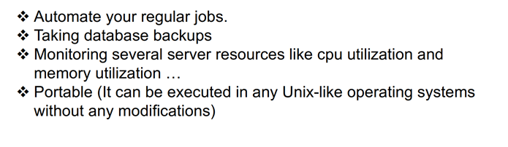
Why we need to Learn ShellScripting

Slide 6
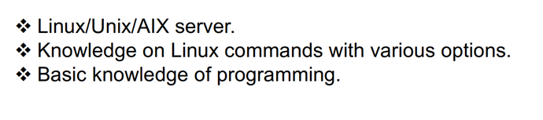
Pre-Requisites

Slide 7
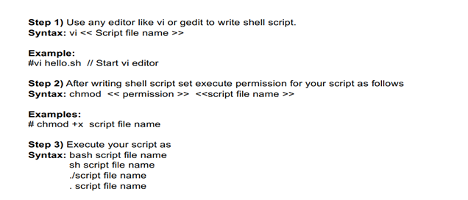
Steps to Write Shell Script

Slide 8
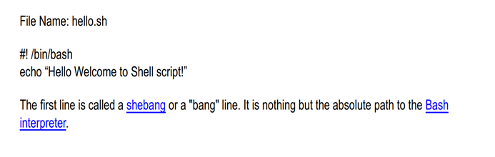
First shell script example

Slide 9
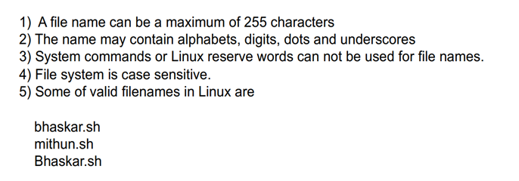
File Naming Conventions

Slide 10
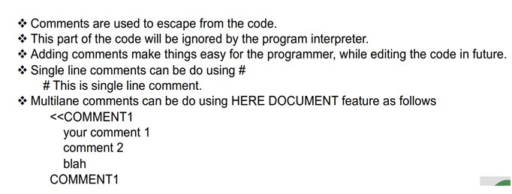
Comments in Shell script

Slide 11
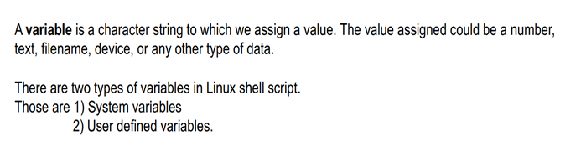
Variables in Shell Script

Slide 12
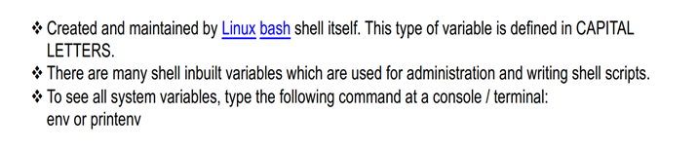
1.System Variables

Slide 13
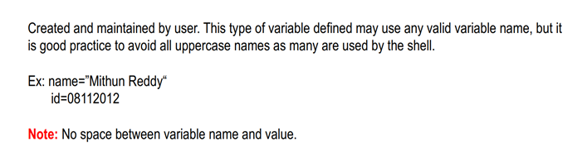
2.User Defined Variables

Slide 14
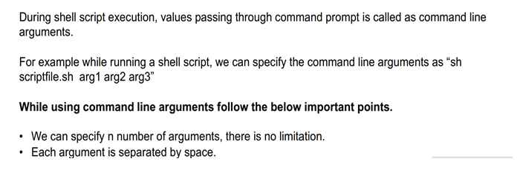
Command Line Arguments in Shell Script

Slide 15
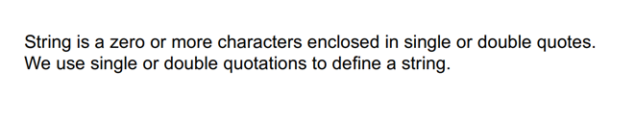
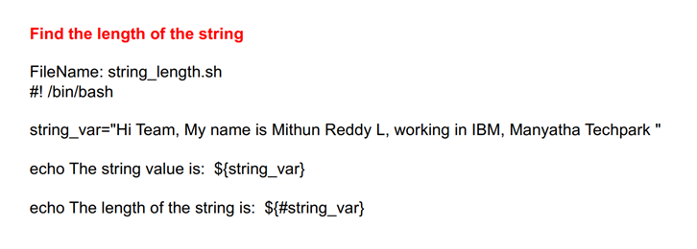
String In Shell Script

Slide 16
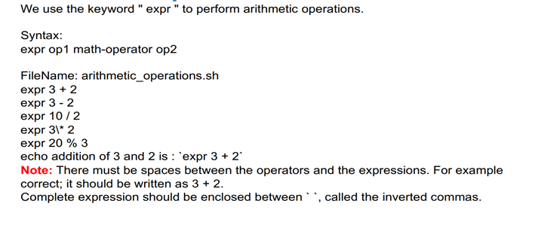
Arithmetic Operations In Shell Script

Slide 17
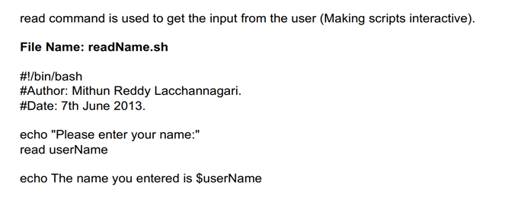

Read command in Shell Script

Slide 18

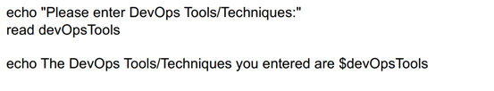

Slide 19
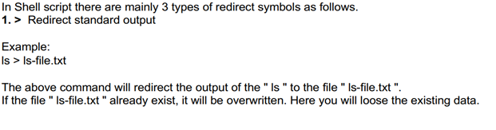
Input and Output Redirection

Slide 20
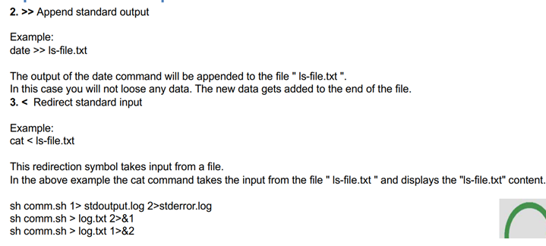

Slide 21
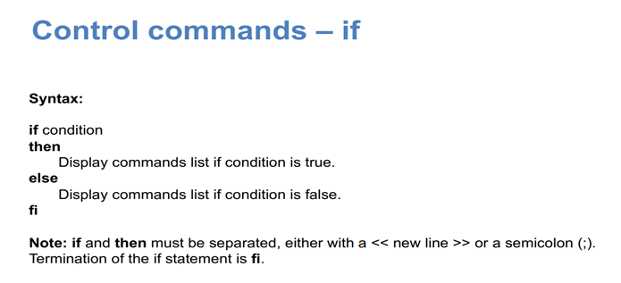
Control Commands in Shell Script

Slide 22
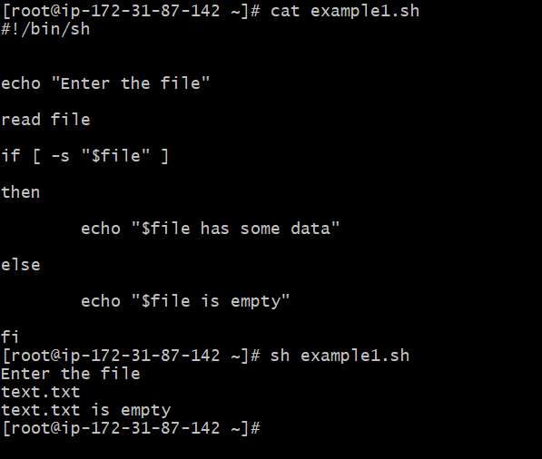

Slide 23
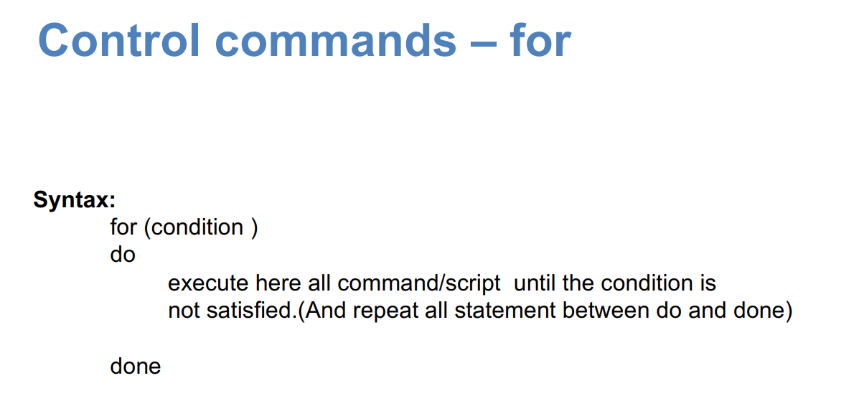

Slide 24
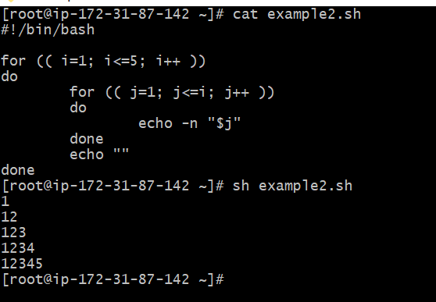

Slide 25
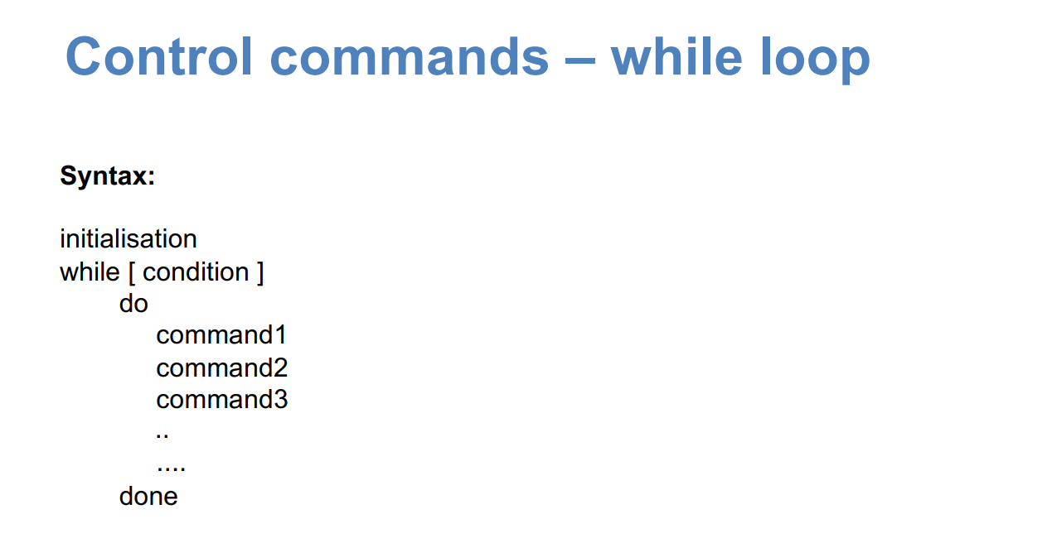

Slide 26
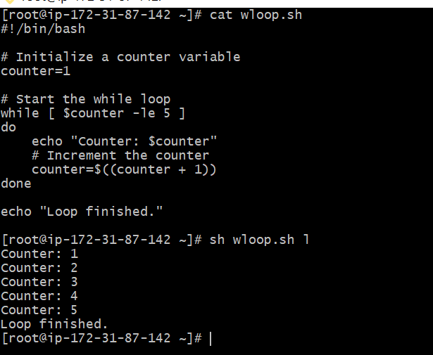

Slide 27
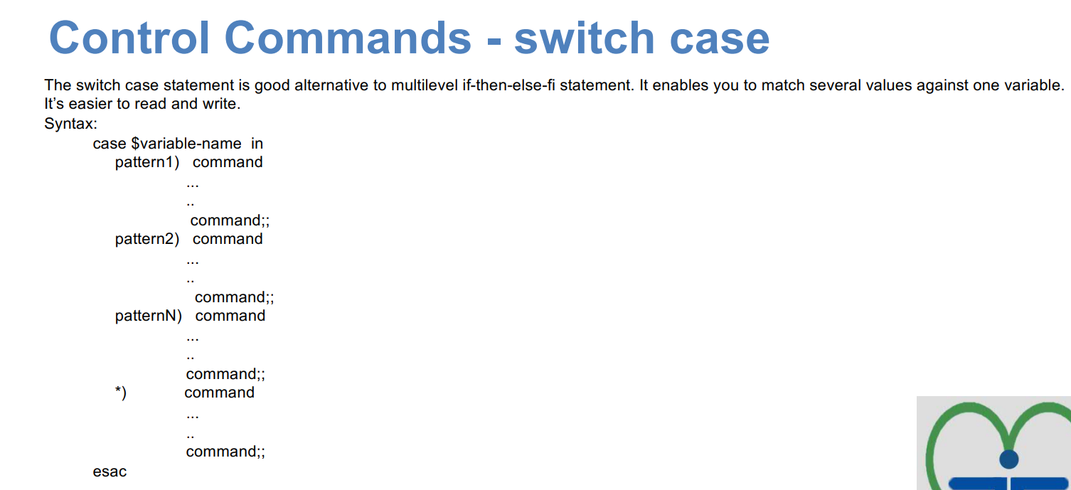

Slide 28
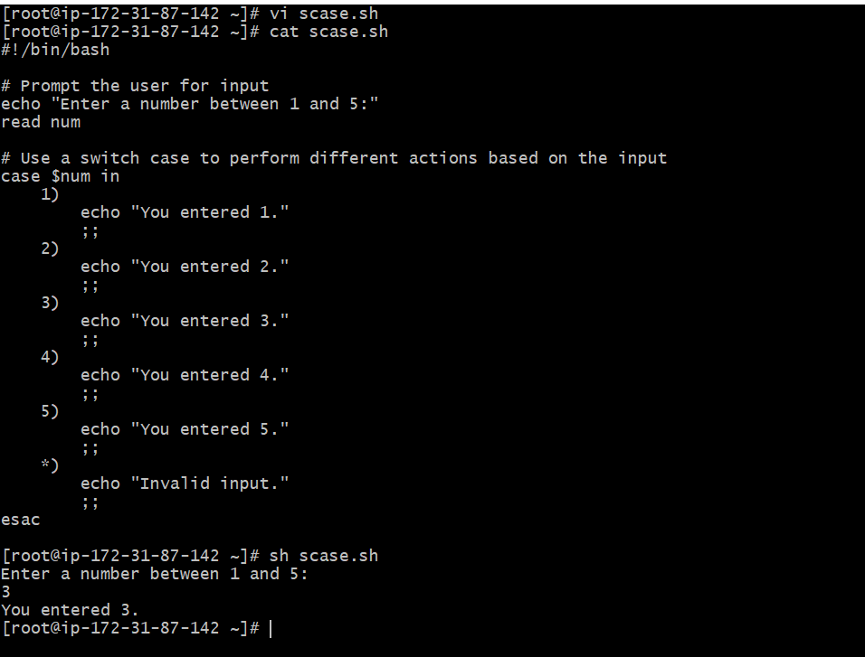

Slide 29
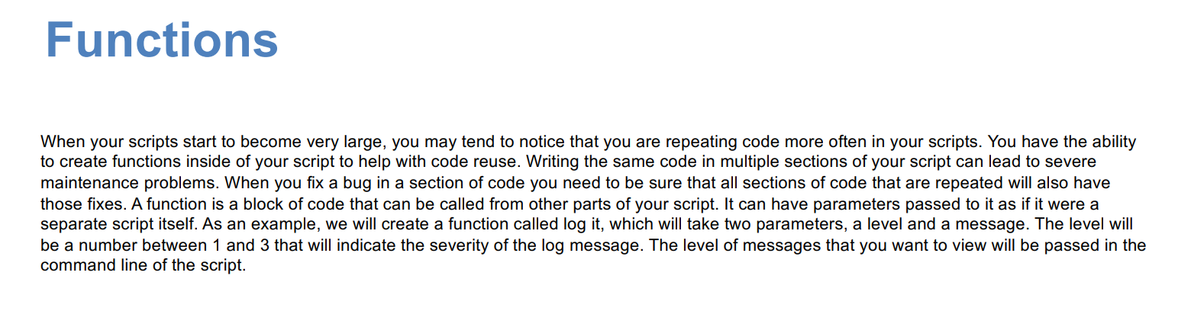
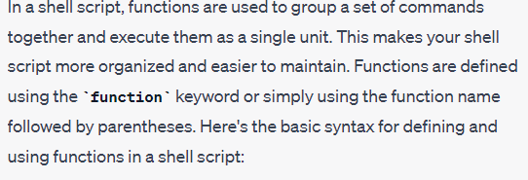
Functions in Shell Script

Slide 30
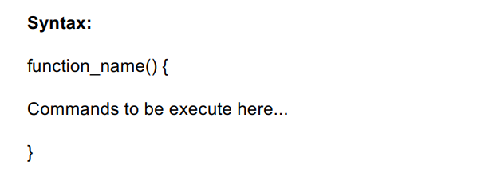

Slide 31
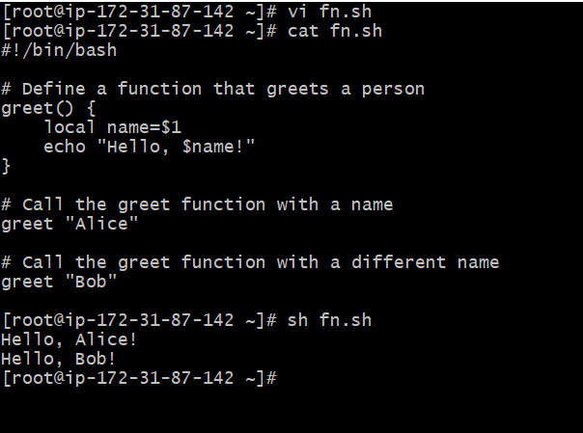

Slide 32
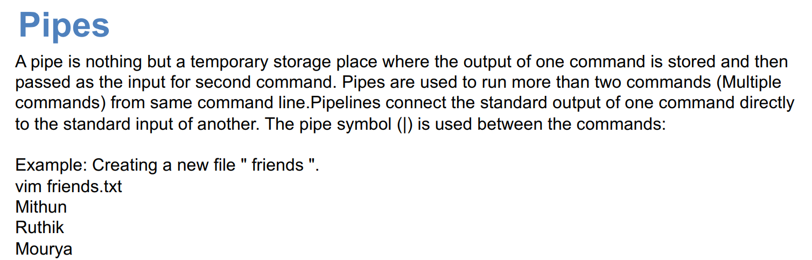
Pipes In Shell Script

Slide 33
Table 1: Built-in shell variables.
Variable Use
$# Stores the number of command-line arguments that were passed to the shell program.
$? Stores the exit value of the last command that was executed.
$0 Stores the first word of the entered command (the name of the shell program).
$* Stores all the arguments that were entered on the command line ($1 $2 ...).
"$@" Stores all the arguments that were entered on the command line, individually quoted ("$1" "$2" ...).

Slide 34


