Slide 1

Technical Hub Events Management System

Slide 2

Our Team
T. Harika
Y. Divya
T. Pavithra
A. Kavya Sri
R. Laxmi Pavani
N. Bhumika Reddy
Cloud Engineers : T. Harika , Y . Divya.
Full stack Developers: A. Kavya Sri , N. Bhumika Reddy,
R. Lakshmi Pavani , T . Pavithra

Slide 3
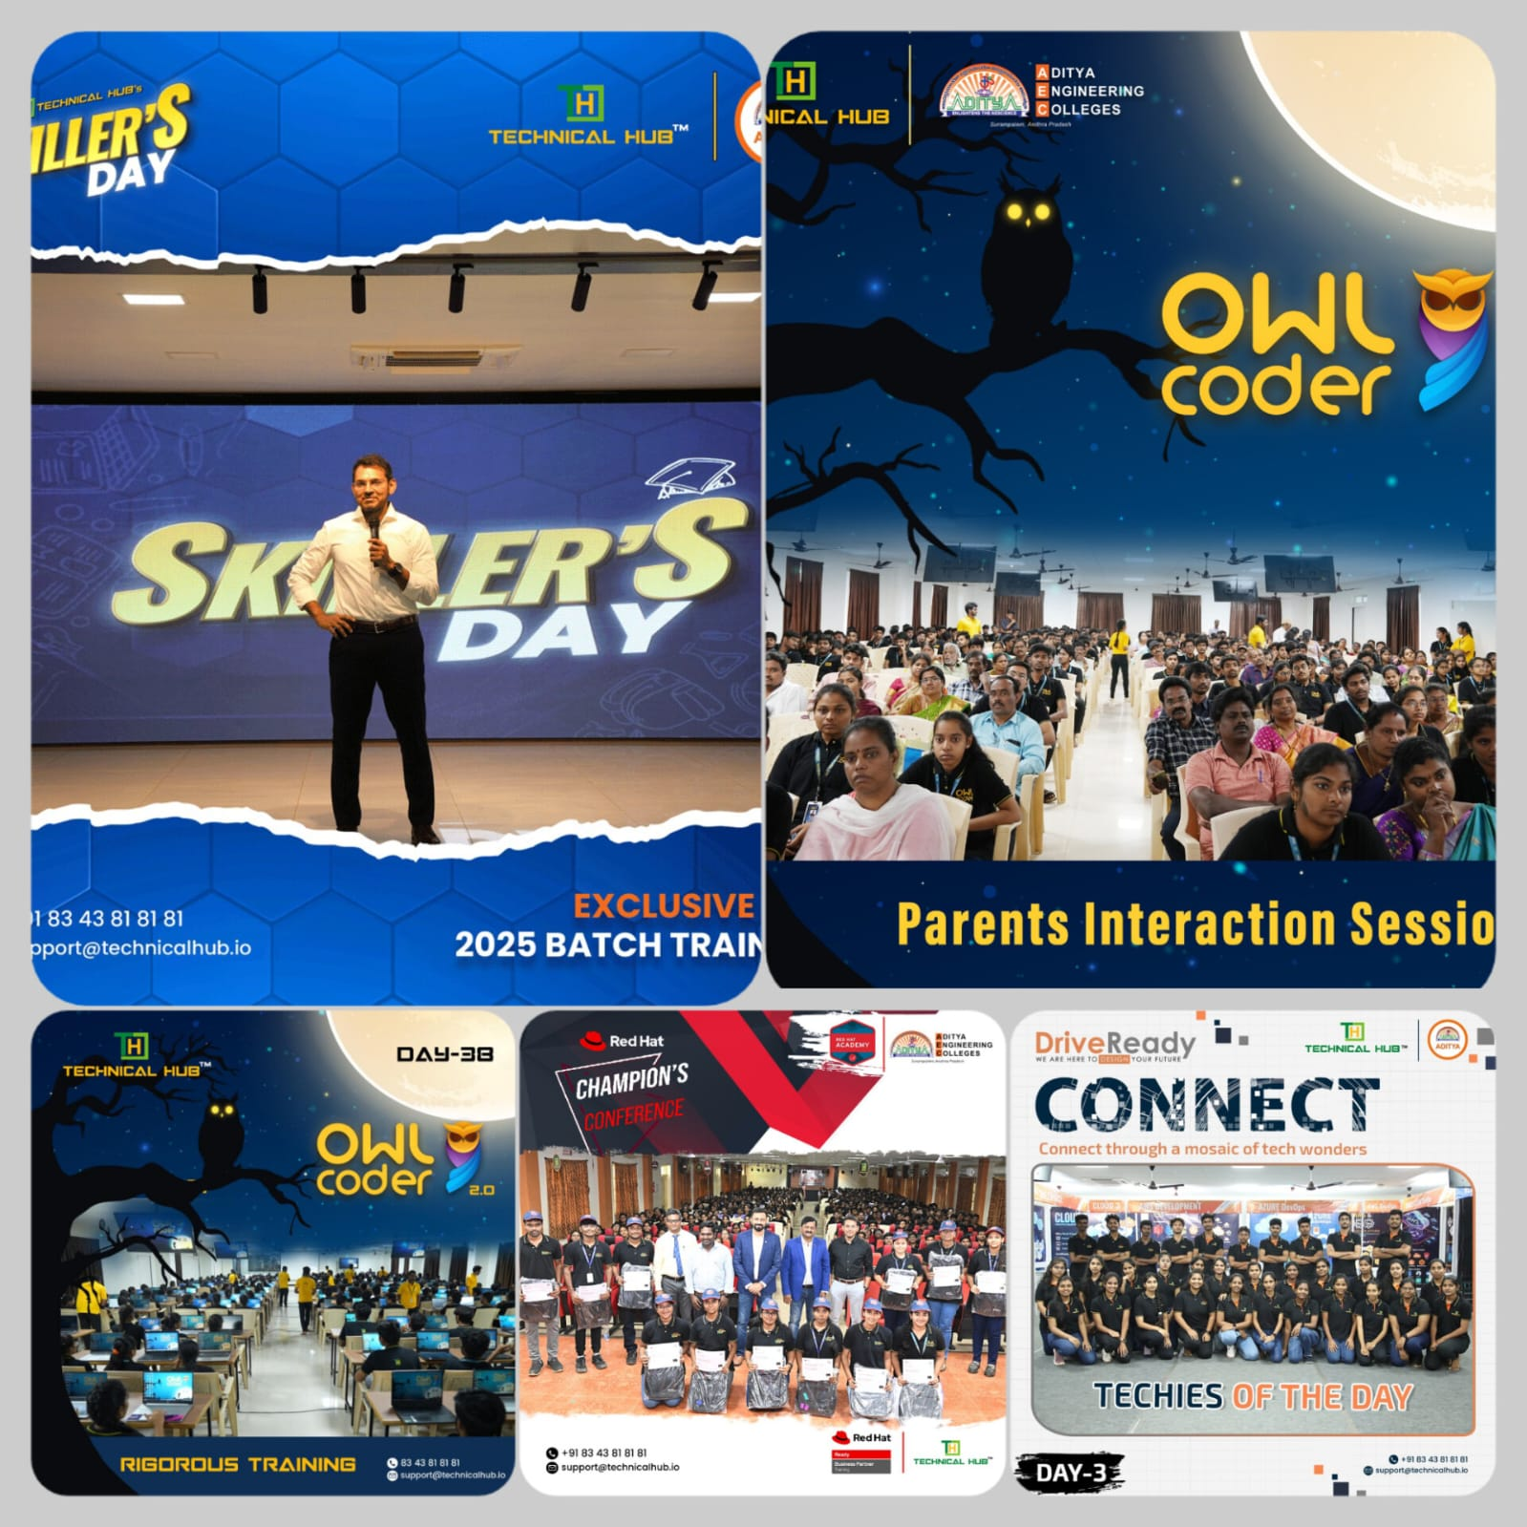
Project
Description
The project is majorly focus in helping the organization maintaining their database with no confusion .It will be benefit for the organization to understand the event list and compare their standards of organizing the events with past years.

Slide 4
To give the overview of Technical Hub and its role in organizing technical hub events.
Collect and analyze data related to events that are conducted on present, future and past.
What We Are Looking To Achieve
Build a scalable and flexible system that can accommodate the needs of technical hub as it grows and evolves.
Centralize event-related information for easy access and management

Slide 5
Technologies Used
FRONT END
Bootstrap
Cascading Style Sheet
React JS
COMPUTE SERVICE
BACK END
Inst - Ubuntu
Networking
Load Balenser
Mongo DB
Node JS
Express JS

Slide 6
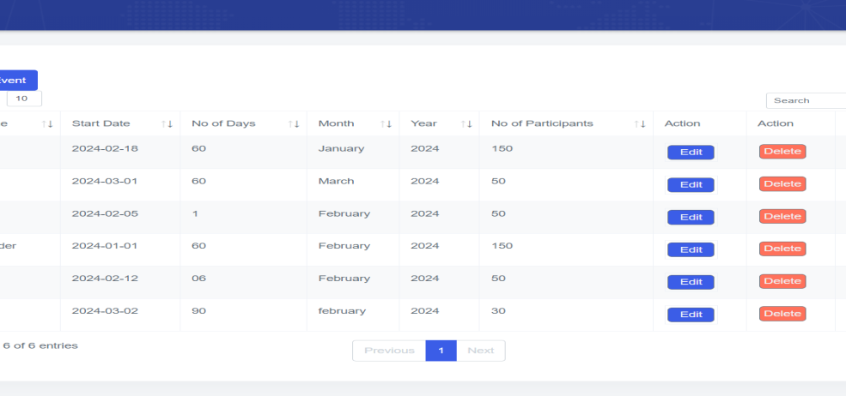
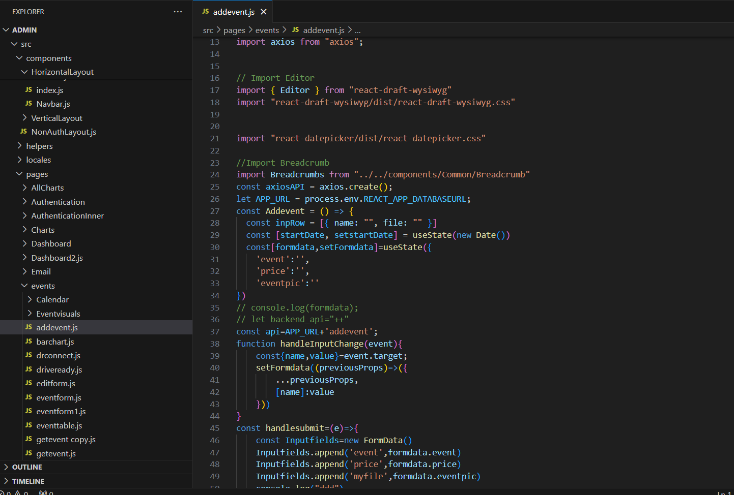

Main Key Features
Event Creation: Users can easily create new events, specifying details such as event title, date, time, location, and description.
Event Deletion: The app allows users to delete events effortlessly. Deleting an event removes it from the system, ensuring clean and clutter-free event lists.
Event Editing: Users have the flexibility to edit event details, providing them with the ability to make changes to event information as needed.
Responsive Design: The application is built with a responsive design approach, ensuring optimal user experience across various devices and screen sizes.
Our Project
.
Technical hub Event Management System

Slide 7
Results and Finding
.
While doing this project we came to know the real time data maintain nance through mongo db .
Through this project we
learned the storing data dynamically
.
We learned how to use the
multer concept in Backend

Slide 8
CONCLUSION
In conclusion, the creation of our Technical Hub Event Management System represents a significant step forward for our organization. This project simplifies tasks like maintaining their database with no confusion, understanding the events list, resource management, and feedback collection, making the entire process more efficient and effective.

