Slide 1
Employee Data Analysis using Excel
STUDENT NAME: S.P.LAKSHMI PRIYA
REGISTER NO: 312200857
DEPARTMENT:B.COM(General)3rd year
COLLEGE Pachaiyappa’s college for women

Slide 2
PROJECT TITLE
Employee Data Analysis using Excel

Slide 3


AGENDA
Problem Statement
Project Overview
End Users
Our Solution and Proposition
Dataset Description
Modelling Approach
Results and Discussion
Conclusion
3/21/2024 Annual Review

Slide 4

PROBLEM STATEMENT
Incomplete data: Missing values or incomplete records can hinder analysis. Inaccurate data: Errors, outliers, or inconsistencies may affect the accuracy of results.

Slide 5

PROJECT OVERVIEW
This analysis typically includes reviewing data on employee productivity, engagement, turnover rates, and demographics. The insights gained can help in optimizing recruitment strategies, enhancing employee satisfaction, and aligning workforce management with business goals

Slide 6

WHO ARE THE END USERS?
HR Professionals Managers
Team Leaders Executives and Leadership
Development Specialists

Slide 7

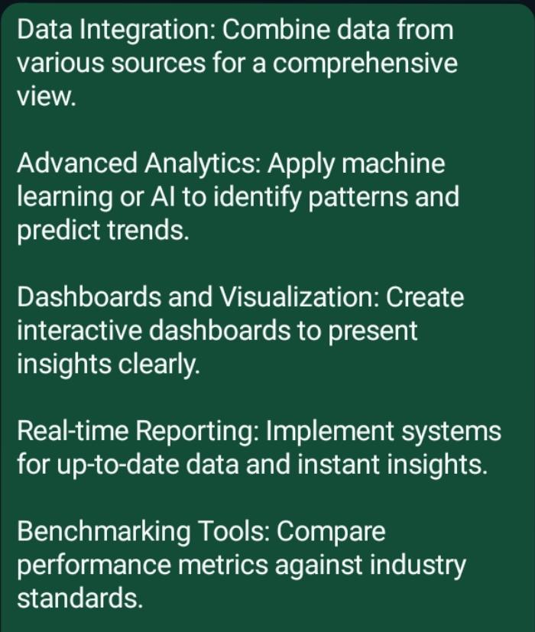
OUR SOLUTION AND ITS VALUE PROPOSITION

Slide 8
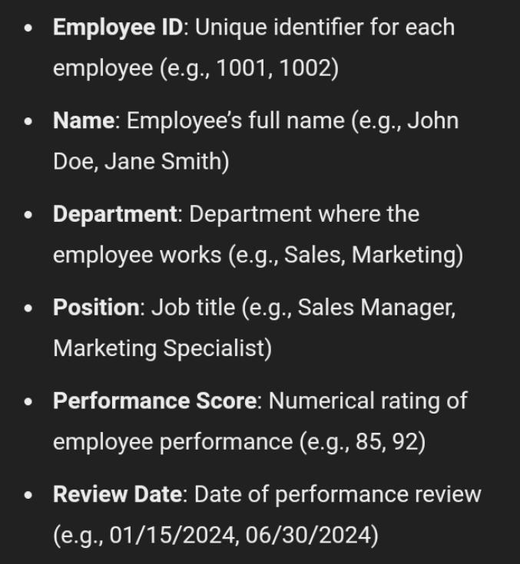
Dataset Description

Slide 9

THE "WOW" IN OUR SOLUTION
Advanced Filtering and Sorting
Dashboard creation
Trend analysis
Employee segmentation
Correlation analysis
3/21/2024 Annual Review
9

Slide 10
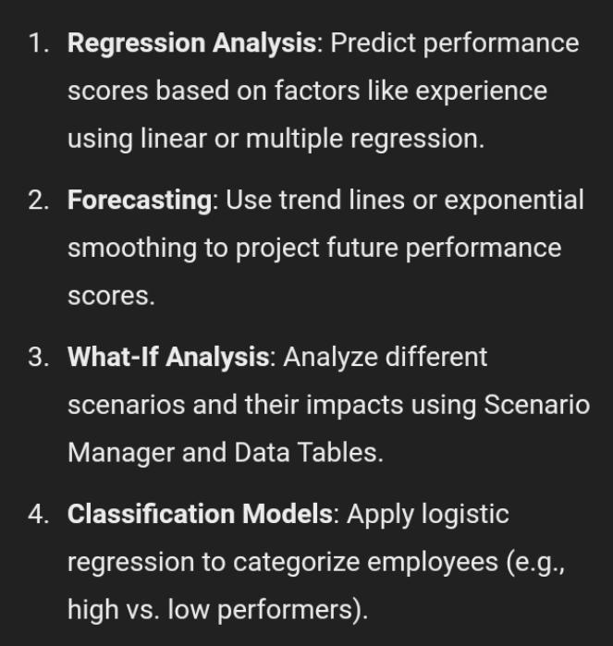
MODELLING
10

Slide 11
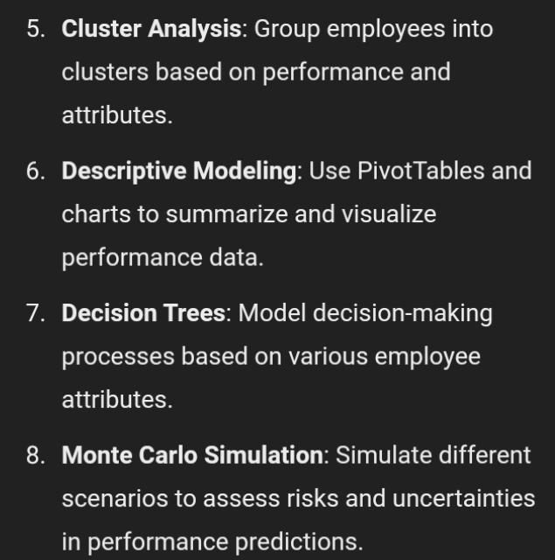
MODELLING

Slide 12
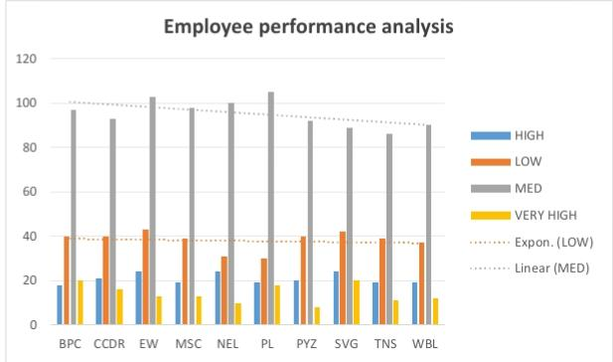
RESULTS
12

Slide 13
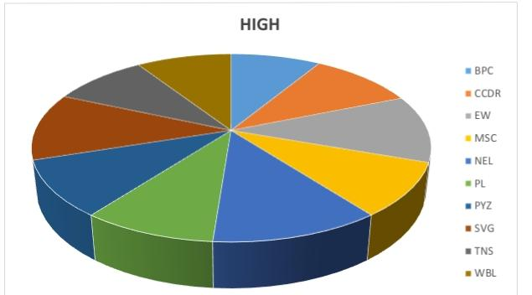
RESULTS
Pie chart

Slide 14
conclusion
In conclusion, employee data analysis using Excel provides valuable insights into workforce metrics, helping organizations make informed decisions. By leveraging Excel’s functions and tools, such as pivot tables, charts, and advanced formulas, businesses can effectively track performance, identify trends, and address issues related to productivity, retention, and satisfaction. This analytical approach enables more strategic planning and operational improvements, ultimately contributing to a more efficient and engaged workforce. For continued success, it's crucial to regularly update and review the data to adapt to changing organizational needs and ensure accuracy.

