Slide 1

ENGINEERING CAPSTONE PROJECT – 1
Project Review – 1
DocuMind AI: A RAG-Based Document Analytics System for Context-Aware Question Answering and Pattern Discovery
Team No: DSBDA35
2320030453 - Kalvakota Lakshmipriya
2320030439 - Peddirajugari Vishnu Vardhan Reddy
2320030452 - Mukku Dinesh Reddy
Under the Guidance of
Dr.N.Sirisha
Associate Professor
Department of Computer Science and Engineering
KONERU LAKSHMAIAH EDUCATION FOUNDATION

Slide 2

OUTLINE
1. Introduction
2. Problem Statement
3. Objectives
4. Literature Survey
5. Research Gap Identification
6. Innovation, Creativity, and Novelty
7. Feasibility and Project Plan
8. Conclusion & References

Slide 3
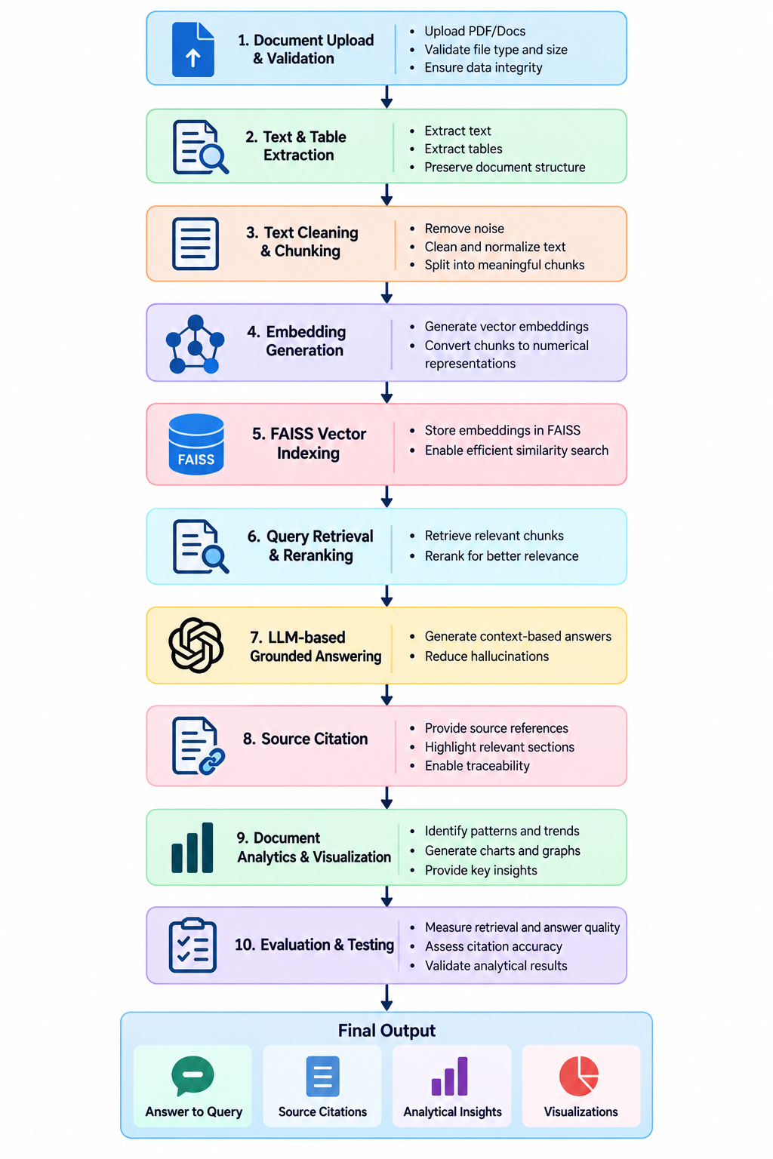
Introduction
Digital documents contain large amounts of unstructured information.
Finding useful information manually is time-consuming.
Traditional keyword search has limited semantic understanding.
LLMs can understand natural-language queries but may generate unsupported information.
RAG can retrieve relevant document content before generating an answer.
This project proposes an intelligent system for document-based question answering and analysis.
The system will also explore pattern identification and visualization from document data.
Applications:
Research papers
Academic documents
Business reports
Technical documents
Financial reports

Slide 4
Problem Statement
Existing document search and question-answering systems have limitations in understanding document context and providing reliable information. Most systems primarily focus on retrieving text or answering questions, while document-level analysis and visualization are often handled separately. Therefore, this project proposes an intelligent RAG-based system that will retrieve relevant information from uploaded documents and provide context-based answers, with an additional planned module for extracting data and identifying useful patterns and visual insights.

Slide 5
Objectives
To develop a document processing module using Python and PyMuPDF for uploading, validating, and extracting text and tabular information from documents.
To generate semantic embeddings using Sentence Transformers and use FAISS (Facebook AI Similarity Search) for efficient vector indexing and similarity-based document retrieval.
To design a query retrieval and reranking mechanism using LangChain to identify the most relevant document content for user queries.
To implement a RAG-based question answering module using Llama 3 that will generate context-grounded responses with supporting source citations.
To develop a document analytics module using Pandas for identifying significant patterns, trends, and relationships from extracted information, and use Plotly for visual representation.
To evaluate the proposed system using RAGAS based on retrieval accuracy, answer relevance, faithfulness, citation quality, and analytical performance.

Slide 6
Literature Survey
Sl.No | Year | Authors | Paper Title | Source | Objective | Techniques | Dataset | Parameters | Inference | Research Gap | DOI
1 | 2020 | Lewis et al. | Retrieval-Augmented Generation for Knowledge-Intensive NLP Tasks | NeurIPS | Improve knowledge-intensive QA | RAG, DPR, BART | KILT, NQ | Accuracy, Factuality | RAG improves grounded generation | No document analytics | 10.48550/arXiv.2005.11401
2 | 2020 | Karpukhin et al. | Dense Passage Retrieval for Open-Domain QA | EMNLP | Improve passage retrieval | DPR, Dual Encoder | NQ, TriviaQA | Retrieval, QA accuracy | Dense retrieval improves QA | Retrieval-focused | 10.18653/v1/2020.emnlp-main.550
3 | 2020 | Beltagy et al. | Longformer: The Long-Document Transformer | arXiv | Process long documents efficiently | Sparse Attention | WikiHop, TriviaQA | Context, Efficiency | Handles long contexts | No RAG analytics | 10.48550/arXiv.2004.05150
4 | 2020 | Xu et al. | LayoutLM: Text and Layout for Document Image Understanding | KDD | Improve document understanding | Transformer, Layout | FUNSD | Extraction, Classification | Layout improves understanding | No conversational analytics | 10.1145/3394486.3403172
5 | 2021 | Izacard & Grave | Leveraging Passage Retrieval with Generative Models | EACL | Improve open-domain QA | FiD, Retrieval | NQ, TriviaQA | QA accuracy | Multiple passages improve answers | No document analytics | 10.18653/v1/2021.eacl-main.74
6 | 2021 | Mathew et al. | DocVQA: Dataset for VQA on Document Images | WACV | QA over document images | VQA | DocVQA | QA accuracy | Visual structure aids QA | No pattern discovery | —

Slide 7
Literature Survey
Sl.No | Year | Authors | Paper Title | Source | Objective | Techniques | Dataset | Parameters | Inference | Research Gap | DOI
7 | 2021 | Appalaraju et al. | DocFormer: End-to-End Transformer for Document Understanding | ICCV | Improve visual document understanding | Multimodal Transformer | FUNSD, CORD | Extraction, VQA | Multimodal features improve results | No RAG analytics | —
8 | 2021 | Mao et al. | Generation-Augmented Retrieval for Open-Domain QA | ACL | Improve retrieval | GAR, BM25, DPR | NQ, TriviaQA | Retrieval, QA | Generated context improves retrieval | No document analysis | 10.18653/v1/2021.acl-long.316
9 | 2022 | Kim et al. | OCR-Free Document Understanding Transformer | ECCV | Understand documents without OCR | Donut, Transformer | CORD, DocVQA | Accuracy, Speed | Reduces OCR limitations | No RAG integration | 10.1007/978-3-031-19815-1_29
10 | 2022 | Huang et al. | LayoutLMv3: Pre-training for Document AI | ACM MM | Improve multimodal document understanding | Multimodal Transformer | FUNSD, CORD | VQA, Extraction | Text-image learning improves results | No analytics module | 10.1145/3503161.3548112
11 | 2022 | Masry et al. | ChartQA: QA about Charts with Visual and Logical Reasoning | ACL Findings | Enable chart reasoning | Visual + Logical Reasoning | ChartQA | QA, Reasoning | Supports chart understanding | Separate from RAG | 10.18653/v1/2022.findings-acl.177
12 | 2022 | Xu et al. | XFUND: Multilingual Visually Rich Form Understanding | ACL Findings | Improve multilingual forms | LayoutXLM | XFUND | Extraction, Accuracy | Layout aids multilingual understanding | No general analytics | 10.18653/v1/2022.findings-acl.253

Slide 8
Literature Survey
Sl.No | Year | Authors | Paper Title | Source | Objective | Techniques | Dataset | Parameters | Inference | Research Gap | DOI
13 | 2023 | Izacard et al. | Atlas: Few-shot Learning with Retrieval Augmented LMs | JMLR | Improve few-shot learning | RAG, Retrieval | MMLU, KILT | Accuracy | RAG supports few-shot tasks | Index quality dependency | —
14 | 2023 | Asai et al. | Self-RAG: Retrieve, Generate and Critique | arXiv | Improve RAG reliability | Self-RAG, Reflection | PopQA, TriviaQA | Factuality, QA | Reflection improves responses | Complex; no analytics | 10.48550/arXiv.2310.11511
15 | 2023 | Es et al. | RAGAS: Automated Evaluation of RAG | arXiv | Evaluate RAG systems | RAGAS Metrics | RAG datasets | Relevance, Faithfulness | Enables RAG evaluation | No document analytics | 10.48550/arXiv.2309.15217
16 | 2023 | Gao et al. | Retrieval-Augmented Generation for LLMs: A Survey | arXiv | Survey RAG methods | Naive, Advanced, Modular RAG | Multiple benchmarks | Retrieval, Generation | Identifies RAG challenges | Application integration needed | 10.48550/arXiv.2312.10997
17 | 2024 | Niu et al. | RAGTruth: A Hallucination Corpus | ACL | Study RAG hallucination | Hallucination Detection | RAGTruth | Hallucination rate | RAG may generate unsupported claims | Stronger verification needed | 10.18653/v1/2024.acl-long.585
18 | 2024 | Saad-Falcon et al. | ARES: Automated Evaluation Framework for RAG | NAACL | Automate RAG evaluation | LM Judges, Synthetic Data | KILT, SuperGLUE | Relevance, Faithfulness | Enables systematic evaluation | Focuses on evaluation only | 10.18653/v1/2024.naacl-long.20

Slide 9
Research Gap Identification
S.No. | Paper Title | Author Name(s) | Methodology / Model Used | Key Findings | Research Gap Identified
1 | Retrieval-Augmented Generation for Knowledge-Intensive NLP Tasks | Patrick Lewis et al. | RAG | Retrieval improves knowledge-grounded generation | Mainly focuses on knowledge-intensive NLP tasks; integrated document analytics is not addressed
2 | Dense Passage Retrieval for Open-Domain Question Answering | Vladimir Karpukhin et al. | Dense Passage Retrieval | Dense retrieval improves relevant passage selection | Focuses on retrieval rather than complete document analysis
3 | LayoutLM: Pre-training of Text and Layout for Document Image Understanding | Yiheng Xu et al. | Transformer + Text/Layout/Image | Combining layout and text improves document understanding | Focuses on document structure rather than conversational RAG analytics
4 | ChartQA: A Benchmark for Question Answering about Charts | Ahmed Masry et al. | Visual + Logical Reasoning | Enables reasoning over charts and numerical information | Chart reasoning is studied separately from document-level RAG
5 | Self-RAG: Learning to Retrieve, Generate, and Critique | Akari Asai et al. | Adaptive Retrieval + Self-Reflection | Improves factuality and citation accuracy | More complex architecture and does not integrate document analytics

Slide 10
Innovation, Creativity, and Novelty
INNOVATION
Proposed integration of RAG and document analytics.
Semantic retrieval for document-based queries.
Planned analytical insight generation.
CREATIVITY
Combining document interaction, QA and analytics in one platform.
Planned automatic pattern and visualization generation.
NOVELTY
Proposed integration of retrieval + QA + analytics + visualization.
Addresses the identified gap between document QA and document analytics.

Slide 11
Feasibility and Project Plan
Category | Proposed Resource
Programming | Python
Document Processing | PyMuPDF
NLP & Embeddings | Sentence Transformers
Vector Search | FAISS (Facebook AI Similarity Search)
RAG Framework | LangChain
Large Language Model | Llama 3
Data Analysis | Pandas
Data Visualization | Plotly
Web Application | Streamlit
RAG Evaluation | RAGAS (Retrieval Augmented Generation Assessment)
Version Control | GitHub

Slide 12
Project Timeline
Phase | Activity | Timeline
Phase 1 | Literature Survey & Problem Definition | Aug 2026
Phase 2 | System Design, RAG Architecture & Environment Setup | Aug-Sep 2026
Phase 3 | Document Processing, Text/Table Extraction & Chunking | Sep–Oct 2026
Phase 4 | Embedding Generation & FAISS Vector Indexing | Oct 2026
Phase 5 | Query Retrieval, Reranking & LLM Integration | Oct 2026
Phase 6 | RAG Pipeline, Grounded Answering & Source Citation | Oct–Nov 2026
Phase 7 | Pattern/Trend Analysis, Visualization & Web Application | Nov 2026
Phase 8 | RAG Evaluation, Testing, Documentation & Final Presentation | Nov 2026

Slide 13
Conclusion
The proposed project will develop an AI-powered RAG-based document analysis system that combines semantic retrieval, grounded question answering and source citation. It will further extend document interaction through pattern and trend analysis and visualization. The identified research gap provides the foundation for integrating these capabilities into a unified system. The next phase will focus on implementation, integration, testing and evaluation of the proposed solution.

Slide 14
References
Lewis, P. et al. (2020), “Retrieval-Augmented Generation for Knowledge-Intensive NLP Tasks,” NeurIPS.
Karpukhin, V. et al. (2020), “Dense Passage Retrieval for Open-Domain Question Answering,” EMNLP.
Reimers, N. & Gurevych, I. (2019), “Sentence-BERT: Sentence Embeddings using Siamese BERT-Networks,” EMNLP-IJCNLP.
Izacard, G. & Grave, E. (2021), “Leveraging Passage Retrieval with Generative Models for Open Domain Question Answering,” EACL.
Gao, Y. et al. (2023), “Retrieval-Augmented Generation for Large Language Models: A Survey,” arXiv.
Asai, A. et al. (2024), “Self-RAG: Learning to Retrieve, Generate, and Critique through Self-Reflection,” ICLR.
Es, S. et al. (2023), “RAGAS: Automated Evaluation of Retrieval Augmented Generation,” arXiv.
Johnson, J., Douze, M. & Jégou, H. (2021), “Billion-Scale Similarity Search with GPUs,” IEEE Transactions on Big Data.

Slide 15
THANK YOU!

