Slide 1


Placement Empowerment Program
Cloud Computing anñ DevOps Centre
BUILD AND RUN A CUSTOM DOCKER IMAGE
NAME: LAKSHMI PRIYA.P
DEPT: ECE

Slide 2
Introduction
Containerization has revolutionized the way applications are developed, deployed, and managed. Docker provides a lightweight and efficient way to package applications with all dependencies, ensuring consistency across different environments. In this POC, we will build and run a custom Docker image that serves a simple HTML web page using NGINX.
Overview
This POC demonstrates how to:
Create a Dockerized static website using NGINX.
Build a custom Docker image with an HTML file.
Run a Docker container to serve the HTML content.
Access the webpage via http://localhost:8080.
By the end of this exercise, you will have a functional web server running inside a Docker container.

Slide 3
Objectives
Understand the Dockerfile and key Docker commands (FROM, COPY, CMD).
Learn to build and run a Docker containerized application.
Gain hands-on experience in port mapping and container management.
Demonstrate how Docker simplifies deployment compared to traditional setups
Importance
Portability — Docker ensures the application runs identically across different environments.
Efficiency — Containers are lightweight and require minimal system resources.
Scalability — Containers make it easier to scale applications without dependency conflicts.
Faster Deployment — Eliminates the need for manual configurations and installations.
Step-by-Step Overview
Step 1:
Install Docker (lf Not Installed)
1. Open Command Prompt (cmd) and check if Docker is installed
docker - -version

Slide 4
lf not installed, download and install Docker from Docker's official website.
Ensure Docker Desktop is running before proceeding
Step 2:
Create a Project Directory
Open Command Prompt and run:
mkdir my-docker-html && cd my- docker-html
mkdir my-docker-html + Creates a new directory.
cd my-docker-html + Moves inside the
directory.

Slide 5
Step 3:
Create an HTML File (index.html)
Run this command to create an empty
index.html file:
type nul
index.html
Open the file in Notepad:
notepad index.html
Add the following content and save the file

Slide 6
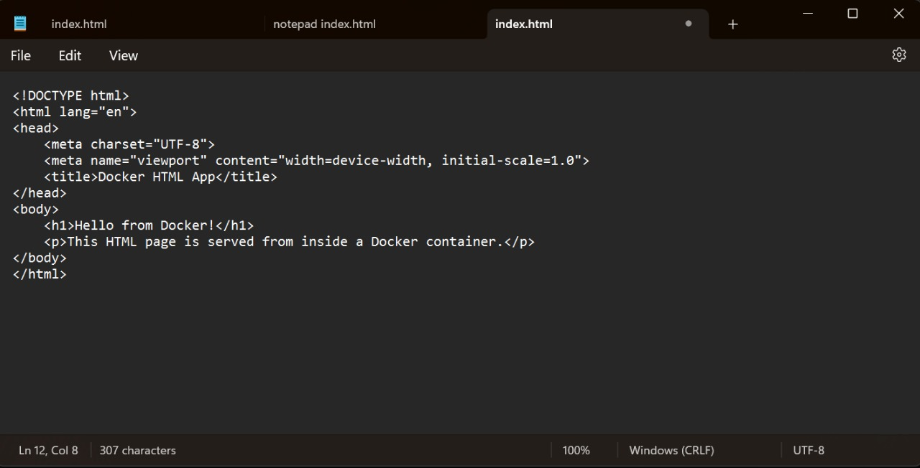


Step 4:
Create a Dockerfile
Run this command to create an empty Dockerfile:
type nuI
Dockerfile
Open the file in Notepad:
notepad Dockerfile
Add the following content and save the file:

Slide 7

File Edit View
# Step I: Use the official NGINx base image FROM n inx:latest
# Step 2: Copy the HTML file to the default NGINX directory COPY index.html / /share/nginx/html/index.html
# Step 3: Define the default command to run NGINX in the foreground CMD [”nginx”, ”-g”, ”daemon off;”]
Step 5:
Build the Docker Image
Run the following command inside the my- docker-html directory:
docker build -t my-html-image .
-t my-html-image —+ Names the image my- html-image.

Slide 8
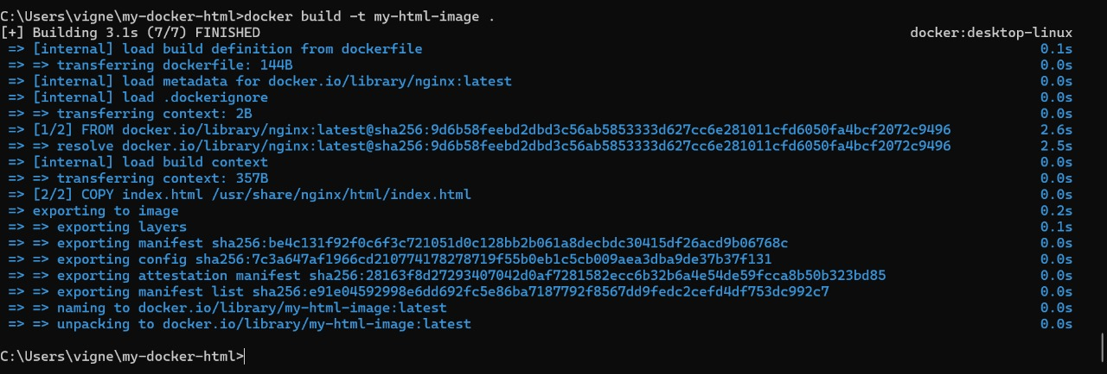
—+ Uses the current directory (where the Dockerfile is located).
Step 6:
Run the Docker Container
Run this command to start a container from the image and expose it on port 8080:
Runs the container in detached mode (background).

Slide 9
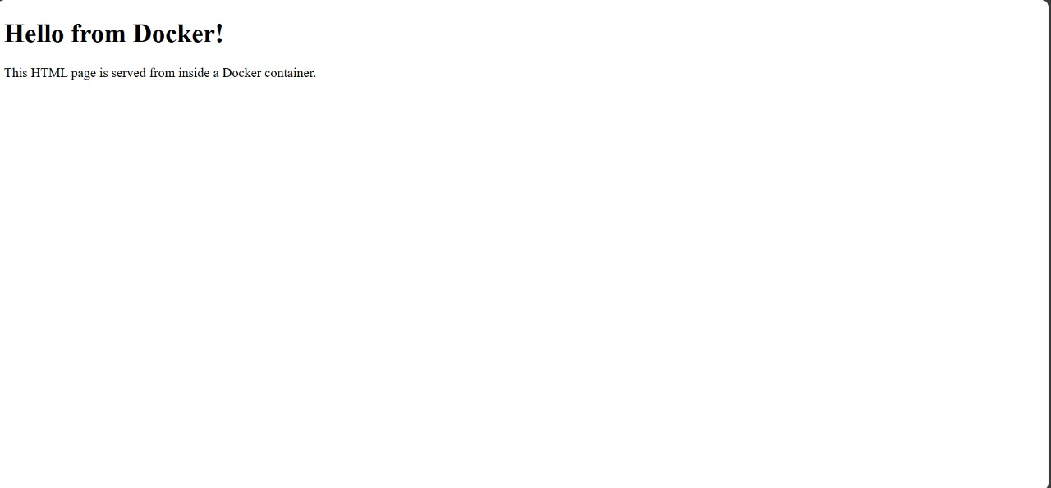
Step 7:
-p 8080:80 —+ Maps port 8080 on your computer to port 80 inside the container.
View the Web Page in a Browser
Open a browser and go to:
http://localhost:8080
You should see the "Hello from Docker!"
message.
* O

Slide 10
Outcome
@ Successfully built and ran a Docker container hosting an HTML webpage.
@ Accessed the webpage using http://localhost:8080.
Understood how Docker images and containers work for web applications.
Gained practical experience in containerization using Docker.

