Slide 1

Student Details
Name : PUDI LAKSHMI LIKITHA
Skill build email ID : lakshmipudi919@gmail.com
College name : VIGNAN’S INSTITUTE OF ENGINEERING FOR WOMEN
College state : ANDHRA PRADESH
Internship domain : CYBER SECURITY
Start date-end date : 05/06/2023 -09/07/2023

Slide 2
Simulating DoS attack using NS2 tool

Slide 3
PROJECT TITTLE :- Dos attack using NS2 tool PROBLEM STATEMENT:- The objective of this project is to simulate and analyze the effects of a Denial-of-Service (DOS) attack on a network using the NS2 tool. The project involves installing NS2 on Ubuntu or any Linux operating system, creating a network topology using the Tcl language, and executing a DOS attack simulation. The simulation aims to emulate the impact of a DOS attack on network performance, network packet loss, and latency. The main problem to address in this project is to design and implement an efficient simulation environment that accurately models a DOS attack and its consequences on a network. The simulation should replicate various types of DOS attacks, such as TCP SYN flood, ICMP flood, or UDP flood attacks, and measure their impact on network resources. The project will require developing or utilizing existing NS2 scripts to configure the network topology, simulate the DOS attack, and record the output data obtained during the simulation. The output data will be stored in a file for subsequent analysis.

Slide 4
AGENDA
Importance of DOS Attack Simulation
Methodology
DOS Attack Types
Results
Conclusion

Slide 5
Importance of DOS Attack Simulation
For Understanding Network Vulnerabilities
Testing Network Resilience
Developing Effective Mitigation Strategies
Training and Awareness
Compliance and Auditing
Proactive Incident Response Planning

Slide 6
METHODOLOGY
Installation of NS2 Tool on Ubuntu/Linux OS
Network Topology Creation using Tcl Language
DOS Attack Simulation Design and Implementation
Data Collection and Analysis

Slide 7
Installation of NS2 Tool on Ubuntu/Linux OS
Open terminal in ubuntu Linux
Type “sudo apt install ns2” inside the terminal to install ns2 tool
Enter your root password to start installation
It will completes downloaded
Before starting updating and upgrading all tools is preferred.
To do update and upgrade type “sudo apt update && upgrade”.

Slide 8
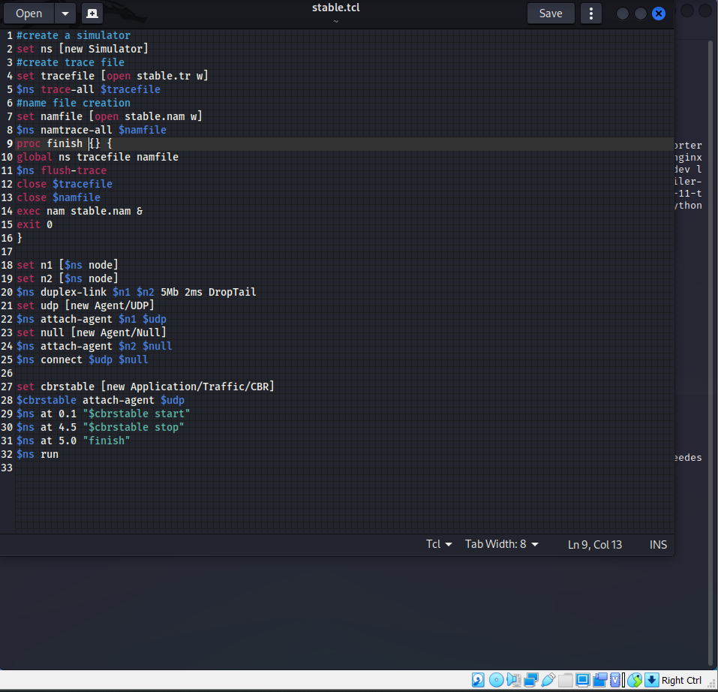
Network Topology Creation using Tcl Language
Type “gedit stable.tcl” and type the code shown in the image.
Tcl is a case sensitive language so make sure to type each and every letter correctly.
The code in the image will create a network topology of udp connection.
After typing the code save it and run it using the command
“sudo ns2 stable.tcl” to start simulating the network topology we have created.
After running the code output will be captured as a stable.nam and stable.tr

Slide 9
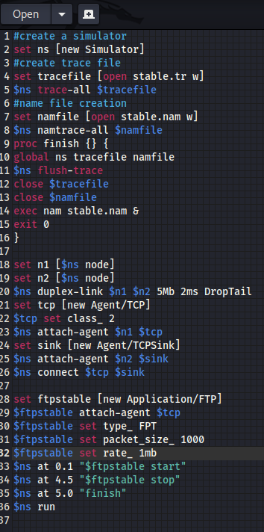
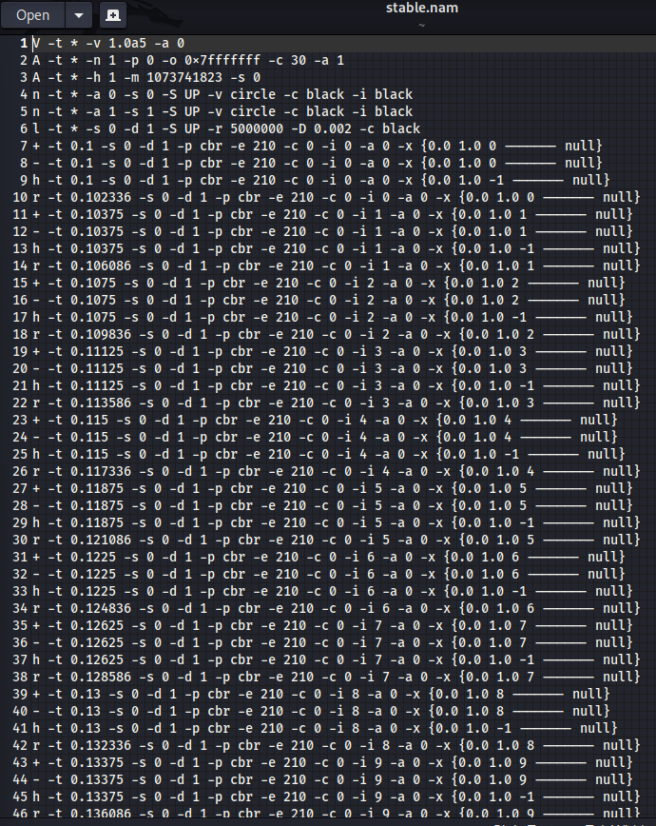
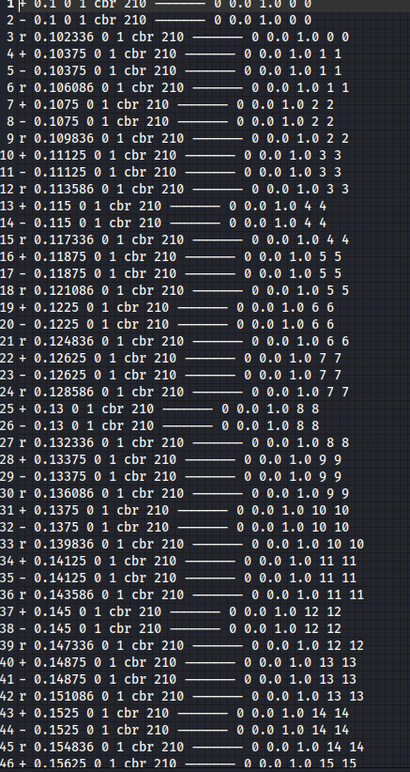
This code represents the creation of tcp connection of our network topology.
Nam file output
Trace file output

Slide 10
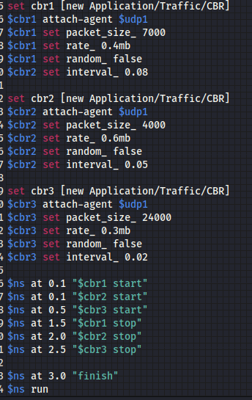
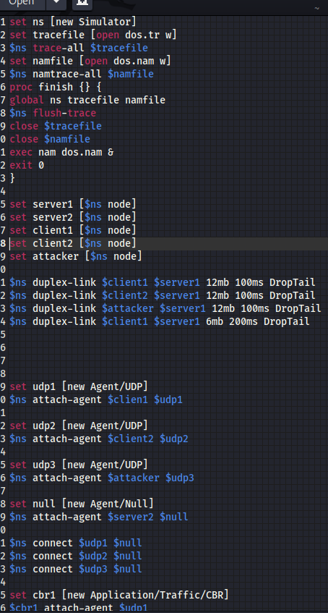
DOS Attack Simulation Design and Implementation

Slide 11
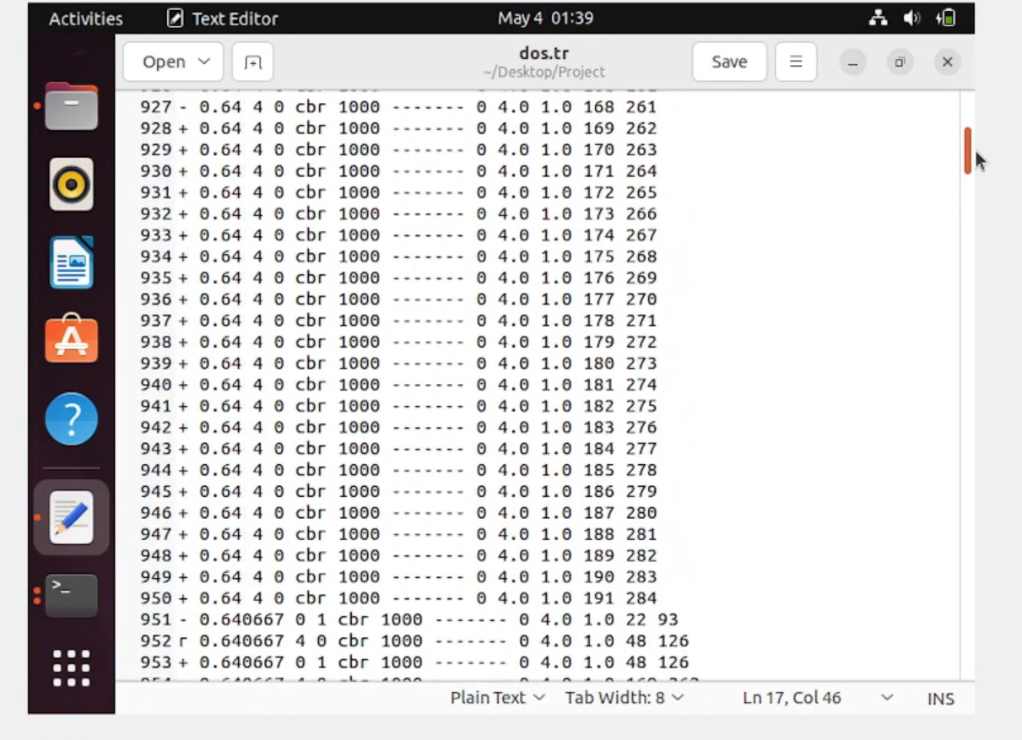

Slide 12
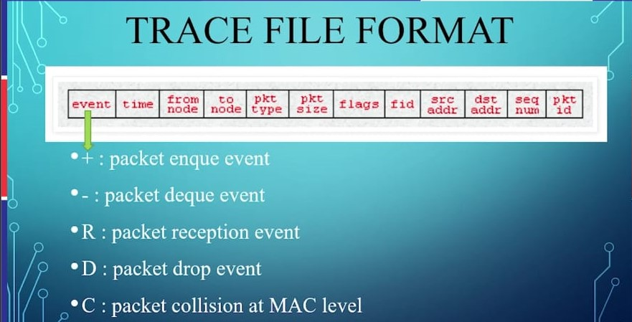
Data Collection and Analysis

Slide 13
DoS attack types
Ping Flood
SYN Flood
Smurf Attack
HTTP Flood
Slowloris
UDP Flood
DNS Flood
NTP Amplification
Smurf Amplification
Application-Level Attacks

Slide 14
Results
The DOS attack simulation using the NS2 tool revealed the following key findings:
1.Impact on Network Performance:
Network Congestion: The attack led to increased congestion levels, resulting in packet loss and higher latency.
Packet Loss: The victim node experienced a significant packet loss rate due to the overwhelming SYN packets.
Latency: Average latency increased as the network became congested, causing delayed packet delivery.
2. Attack Intensity:
The attack rate of 1000 packets per second proved highly effective in overwhelming the victim node.
Higher attack rates could result in more severe network degradation and complete service unavailability.

Slide 15
Results
3.Defense Mechanisms:
Effective defense measures, such as rate limiting, access controls, and traffic filtering, are essential to mitigate the impact of DOS attacks.
Implementing these measures can reduce packet loss, restore network performance, and protect against future attacks.
4.Anomaly Detection:
Analyzing network traffic patterns and monitoring performance metrics enables the timely detection of abnormal network behavior during DOS attacks.
Proactive anomaly detection aids in swift mitigation and minimizing the impact of DOS attacks.
5.Proactive Response:
Proactive incident response planning and training are crucial to minimize the impact of DOS attacks and ensure efficient recovery.

Slide 16
conclusion
In conclusion, the DOS attack simulation using the NS2 tool provides valuable insights into the vulnerabilities, resilience, and mitigation strategies of network infrastructure.
By conducting simulations, we have gained a deeper understanding of the impact of DOS attacks on network performance, including network congestion, packet loss, and latency.
The simulation results have allowed us to identify potential entry points for attacks and develop effective countermeasures, such as rate limiting, access controls, and traffic filtering.
Through this project, we have highlighted the importance of DOS attack simulations for understanding network vulnerabilities, testing network resilience, and developing proactive security measures.

Slide 17
links
https://skillsbuild.edunetworld.com/courses/cs/dos-attack-using-ns2/
https://networksimulator2.com/ns2-ddos-attack/
https://www.paloaltonetworks.com/cyberpedia/what-is-a-denial-of-service-attack-dos
https://www.ncsc.gov.uk/collection/denial-service-dos-guidance-collection

Slide 18


