Slide 1
Concealed Object Detection: Depth-wise and Depth-wise Separable YOLO models
Dissertation Presentation
By:
Lakshmy Santhosh
Roll no. 222828
MSc Data Science(2022-24)
Supervisor :
Dr. Singara Singh
Professor
Central University of Haryana

Slide 2
INTRODUCTION
There are many methods for object detection used in day to day lives, but when it comes to concealed objects(objects hidden in clothes and all) we cannot detect such objects from normal images.
Here, we use terahertz images to train a model to detect concealed objects.
The type of objects we are dealing with here are mostly objects which can cause threat such as knife, pistol, etc.
Terahertz videos enable security personnel to visualize hidden objects that may pose risks, enhancing overall safety measures without invasive procedures.
This technology proves valuable in security screening scenarios, such as airports or public events, where identifying concealed threats is important.

Slide 3
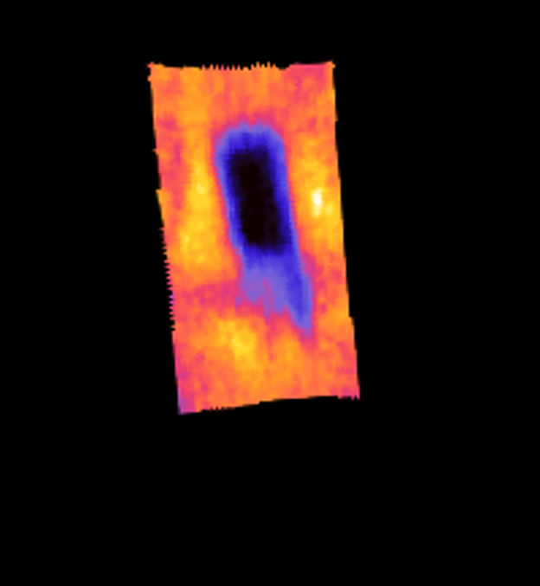
TERAHERTZ IMAGES
Terahertz images, operating in the electromagnetic spectrum between microwave and infrared wavelengths, offer unique capabilities in detecting concealed objects.
Terahertz radiation can penetrate many materials, including clothing and packaging, providing detailed images without compromising privacy.
Terahertz videos, used in security systems like those in airports, leverage these waves to expose hidden items beneath clothing or within packages, enhancing traditional screening methods.

Slide 4
Terahertz imaging is of two types:
Active terahertz imaging: In this method, terahertz rays are passed from source through object and captured using a terahertz camera.
Passive terahertz imaging: In this method, the natural radiations emitted by the object are captured using a terahertz camera.
Both the types of terahertz imaging are safe for humans unlike imaging systems like X-rays which produce harmful radiations.
The dataset we used is made using passive terahertz imaging
TYPES OF TERAHERTZ IMAGING SYSTEMS

Slide 5
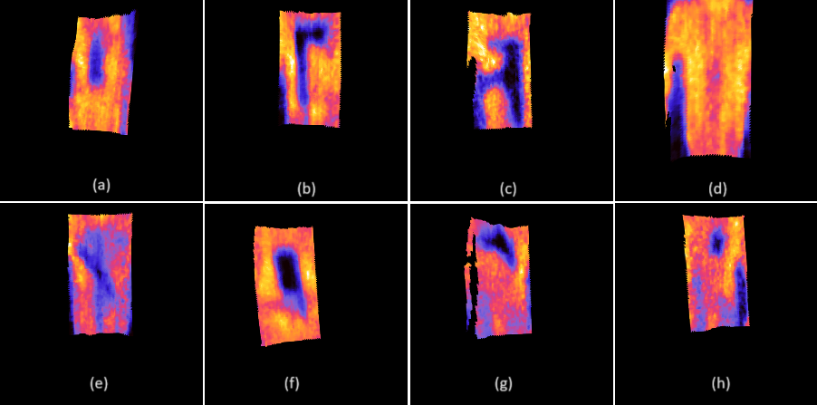
DATASET
Our dataset includes 22 classes of images with objects like pistol, gandGranade, A4paper, etc. The images are extracted from a terahertz video dataset. Some of the images are
(a)bottle, (b)axe, (c)AK, (d)no object (e) knife (f) meatknife (g)pistol (h)cigaretteBox

Slide 6
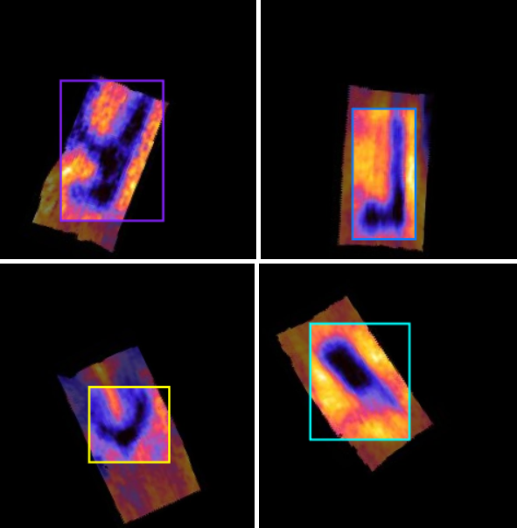
DATA AUGMENTATIONS
Since our dataset is limited and has similar images, the model can result in overfitting, so we did some data augmentations like flip(horizontal and vertical), rotation(45° and -45°) and brightness(15° and -15°) on the data. This increased dataset size as well as diversity
(a)AK
(b)axe (c)pistol (d)meatKnife

Slide 7
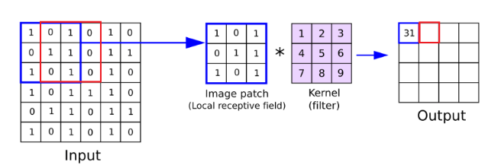
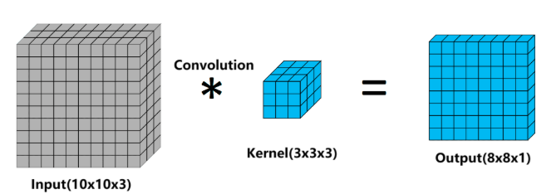
CONVOLUTION OPERATION
A convolution is a type of matrix operation, consisting of a kernel, a small matrix of weights, that slides over input data performing element-wise multiplication with the part of the input it is on, then summing the results into an output.

Slide 8
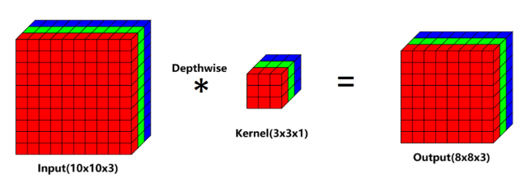
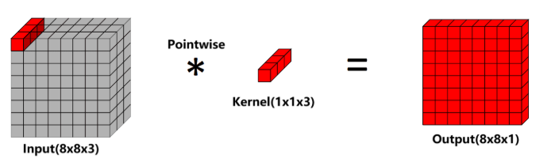
DEPTHWISE SEPARABLE CONVOLUTION
A Depth-wise convolution is a convolution along only one spatial dimension of the image whereas normal convolution is applied across all spatial dimensions of the image.
In a Depth-wise separable convolution, point-wise convolution is applied after Depth-wise convolution. A point-wise convolution has a 1 × 1 × M kernel.

Slide 9
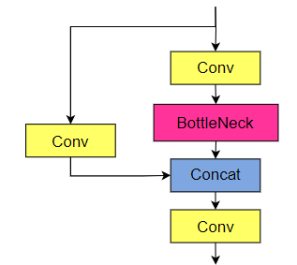
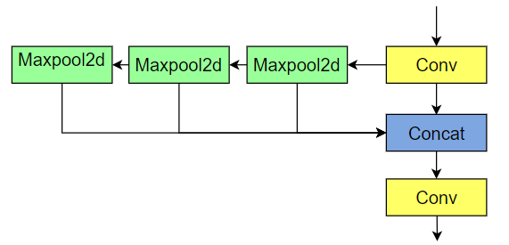
YOLOv5m
The architecture of YOLOv5m includes:
stem (initiates processing)
backbone (feature extraction): comprises of Conv, C3 and SPPF block
neck (feature combination): comprises of Conv, C3, Concat and upsample
head (predicts object details): detects objects and bounding boxes
SPPF block
C3 block
Enhances features extracted in the backbone
Feature extraction

Slide 10
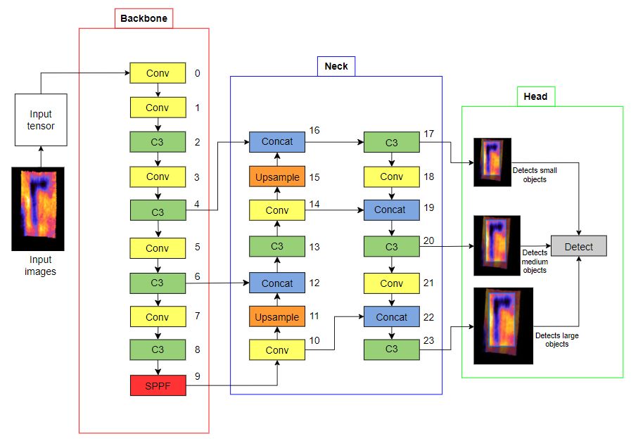
STRUCTURE OF YOLOv5m

Slide 11
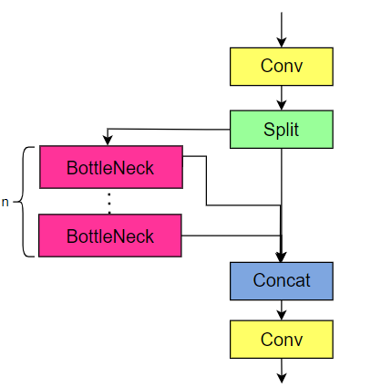
YOLOv8m
The architecture of YOLOv8m includes:
stem (initiates processing)
backbone ( feature extraction): comprises of Conv, C2f andSPPF
neck (feature combination):comprises of Conv, C2f, Concat and upsample
head (predicts object details): detects objects and bounding boxes
The architecture of YOLOv8 is quite similar to YOLOv5
SPPF block
C2F block
Feature extraction
Enhances features extracted in the backbone

Slide 12
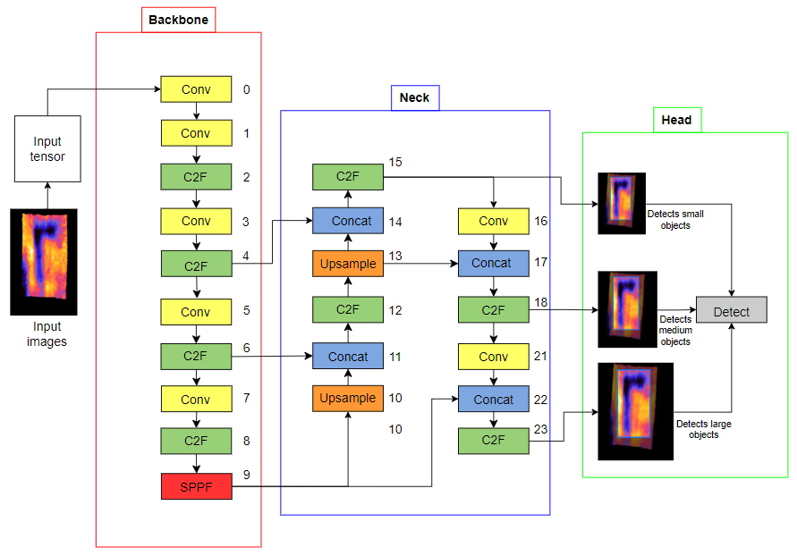
STRUCTURE OF YOLOv8m

Slide 13
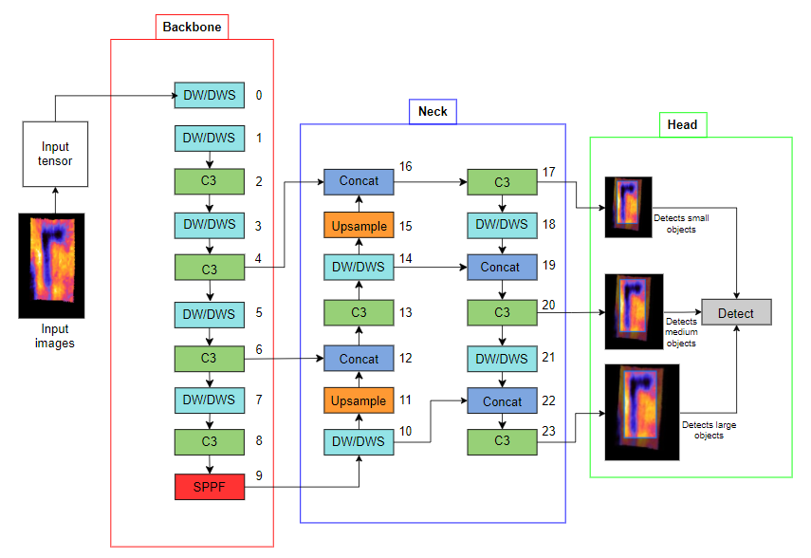
STRUCTURE OF MODIFIED YOLOv5m
Here, DW/DWS represents the modified block. In case of Depth-wise YOLOv5, the block is replaced by Depthwise Convolution block (DW Conv) and in case of Depth-wise Separable YOLOv5, the block is replaced by Depthwise Seperable Convolution block(DWS Conv)

Slide 14
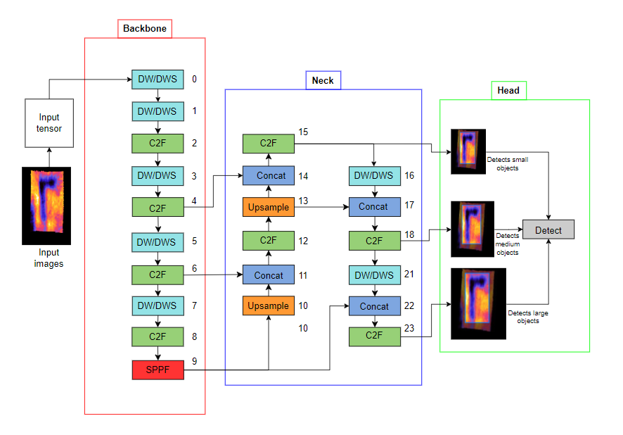
STRUCTURE OF MODIFIED YOLOv8m
Here, DW/DWS represents the modified block. In case of Depth-wise YOLOv8, the block is replaced by Depthwise Convolution block (DW Conv) and in case of Depth-wise Separable YOLOv8, the block is replaced by Depthwise Seperable Convolution block(DWS Conv)

Slide 15
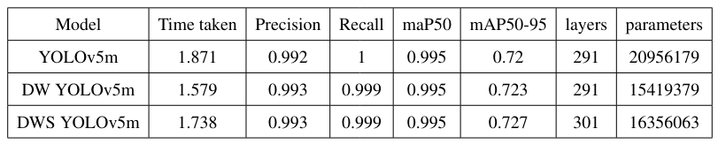
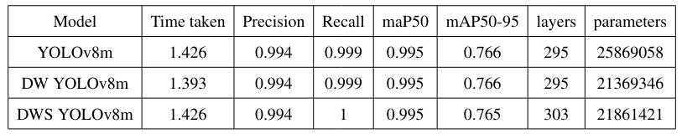
RESULTS
Results of YOLOv5m models
Results of YOLOv8m models

Slide 16
CONCLUSIONS
Evaluation matrices like precision, recall and mAP has slight increase or remained same in all the cases.
The number of parameters has decreased significantly in modified models. In depthwise models, the decrease in number of parameters are 26% and 17% in YOLOv5 and YOLOv8 respectively.
In case of Depthwise-Separable models, the decrease in number of parameters are 21% and 15% in YOLOv5 and YOLOv8 respectively.
From all all the models, we can come to a conclusion that the Depthwise and Depthwise-Separable YOLO models give same results as that of the original model, with significantly less computational complexity.
Hence, these new models can be run on devices which has less computational complexity.

Slide 17
THANK YOU

