Slide 1
Personality prediction

Slide 2
AIM
Eradicates the traditional way of going through numerous applications and CVs.
seeks a more efficient way to short-list submitted candidate CVs by using
MBTI test, instead of the Big 5 which was what we were going to do last time

Slide 3
Reference
Research Reference
https://link.springer.com/article/10.1007/s10462-019-09770-z
https://www.researchgate.net/publication/339935842_Machine_Learning_Approach_to_Personality_Type_Prediction_Based_on_the_Myers-Briggs_Type_Indicator_R
https://web.stanford.edu/class/archive/cs/cs224n/cs224n.1184/reports/6839354.pdf

Slide 4
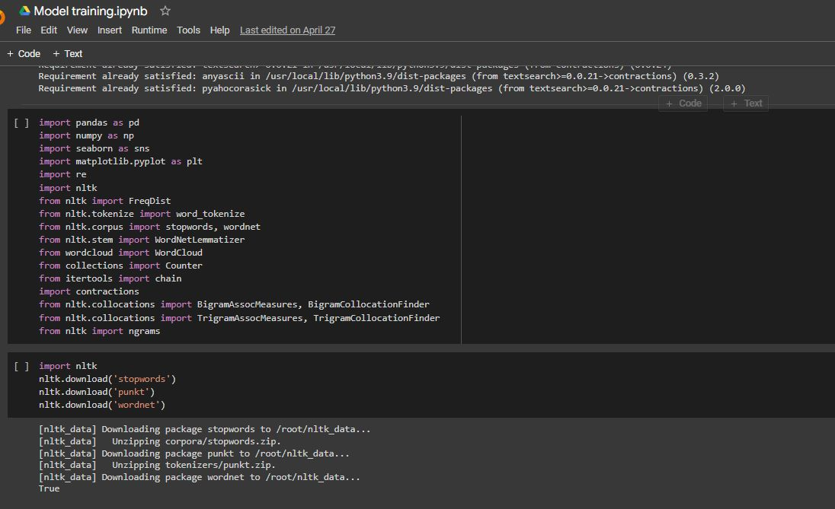
LIBRARIES
pandas: including CSV, Excel
numpy: support for arrays
matplotlib: plotting graphs
seaborn: making the graphs visually appealing
re: used for cleaning the data.
nltk: used in data cleaning
WordCloud: visual representation of personality type
collections: count the frequency of elements
contractions: "don't" to "do not".
ngrams: generate n-grams (BigramAssocMeasures), (TrigramAssocMeasures)

Slide 5
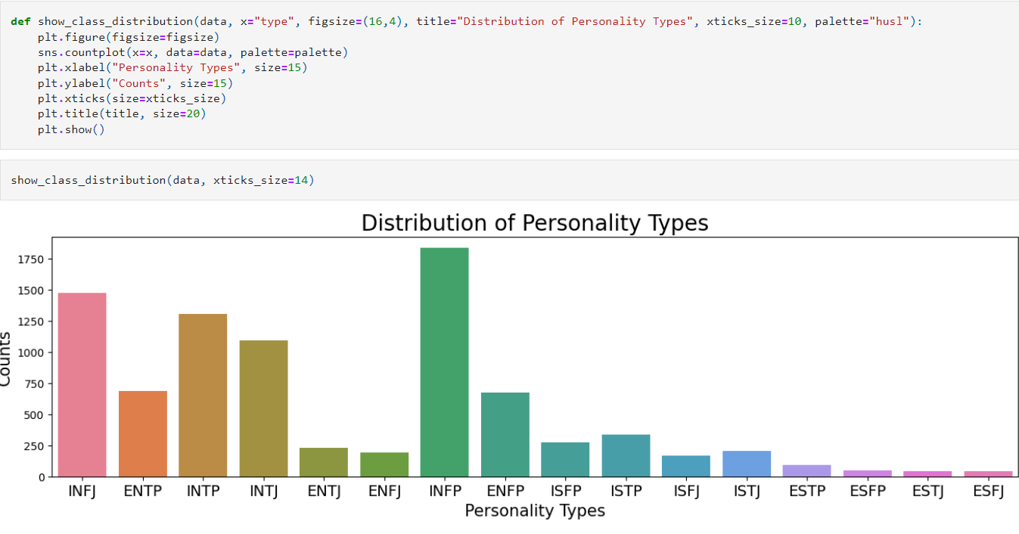
Class Distribution
The dimensions are as follows
Extraversion (E) vs Introversion
(I)Sensing (S) vs Intuition
(N)Thinking (T) vs Feeling
(F)Judging (J) vs Perceiving (P)

Slide 6
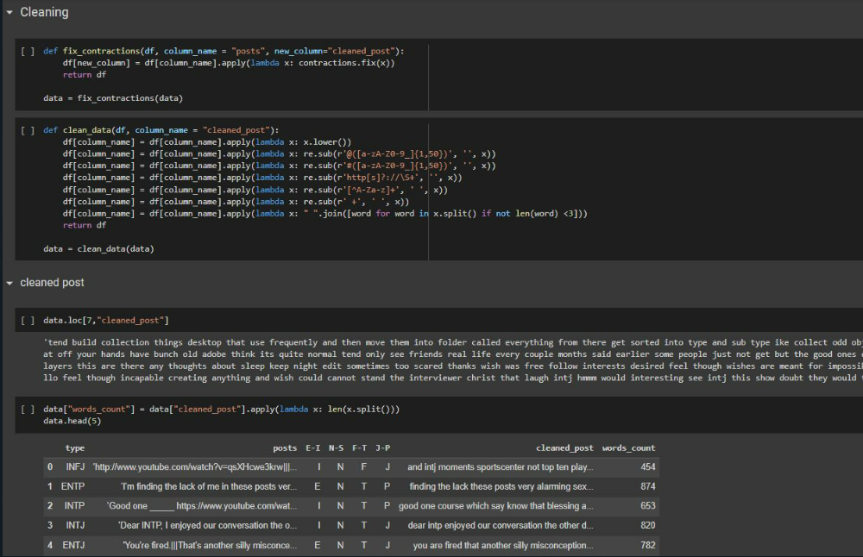
Data CLEANING
Fixing contraction
Using regEx eliminating irrelevant information
Hashtags

Slide 7
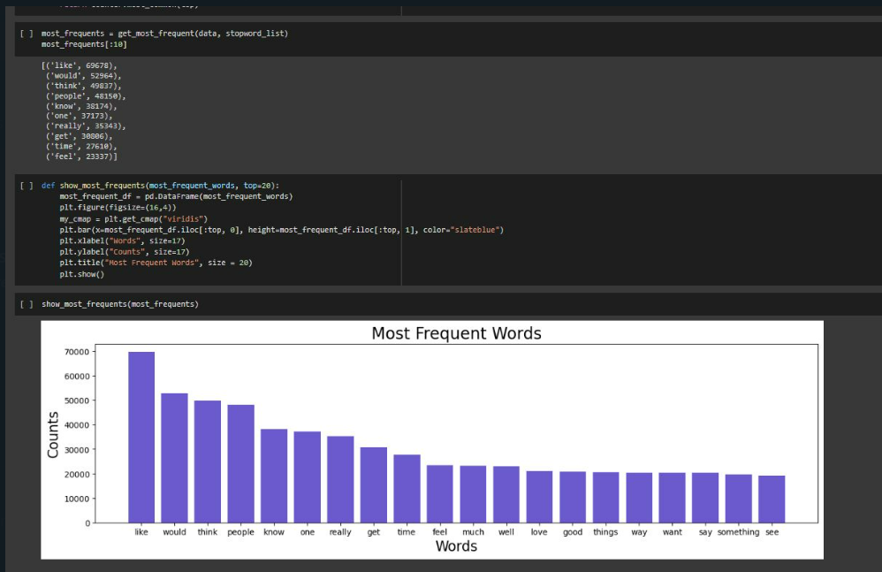
MOST FREQUENTLY USED
Eliminating stopwords
Representing most frequently used

Slide 8
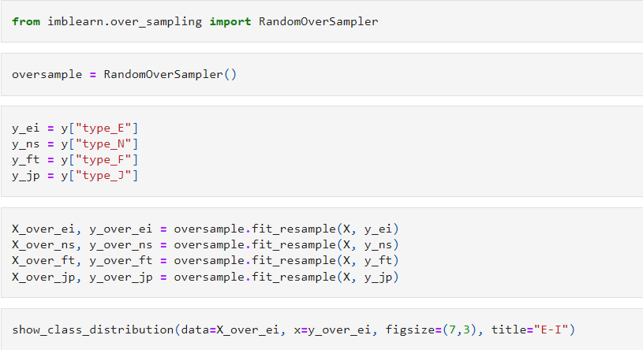
Handling imbalanced data
Using RandomOverSampler
Applying oversampler to each personality trait
Selecting randomly from larger data class to reduce it

Slide 9
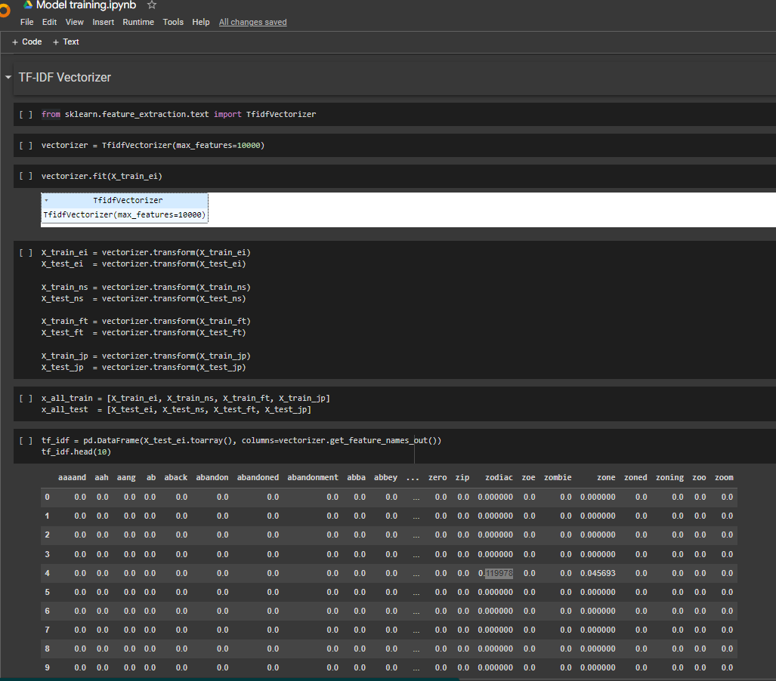
vectorizer
A vectorizer takes raw text data as input and converts it into a numerical representation that can be used as input to machine learning models.

Slide 10
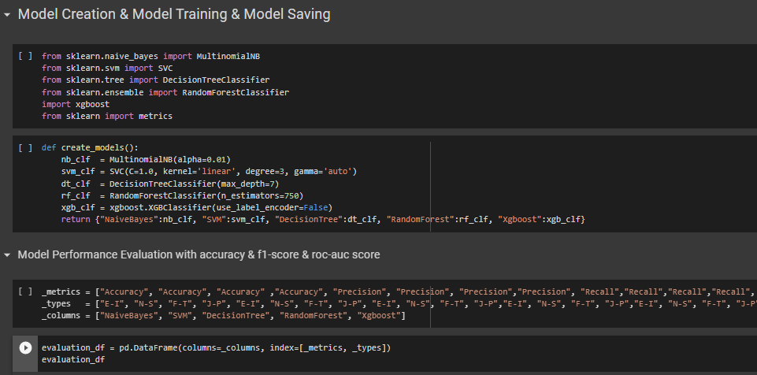
Model Used
sklearn.svm.SVC: used for both classification and regression tasks.
sklearn.tree.DecisionTreeClassifier: used for classification problems and creates a model that predicts the value of a target variable based on several input variables
sklearn.ensemble.RandomForestClassifier: ensemble method that combines multiple decision trees to reduce overfitting and improve accuracy.
xgboost.XGBClassifier: used for both classification and regression tasks.
sklearn.metrics: provides various metrics for evaluating the performance of machine learning models, such as accuracy, precision, recall, and F1 score.

Slide 11
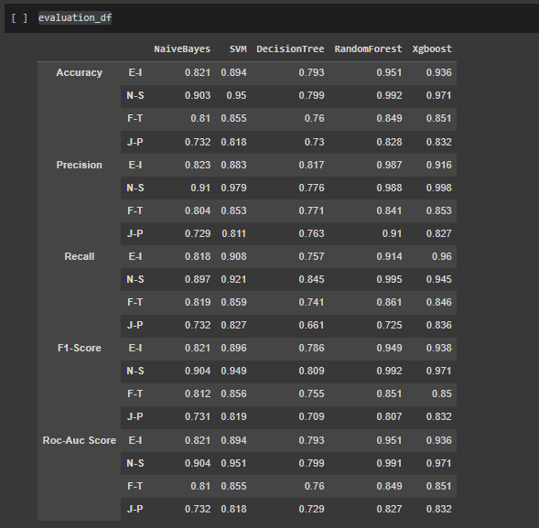
Analysis
Accuracy: calculated by dividing the number of correct predictions by the total number of predictions.
Precision: calculated by dividing the number of true positives by the sum of true positives and false positives
Recall: This measures the proportion of true positive predictions made by the model out of all the positive examples in the data. It is calculated by dividing the number of true positives by the sum of true positives and false negatives. High recall means that the model correctly identifies more positive examples.
F1 score: calculated by taking the harmonic mean of precision and recall.
Roc-Auc Scor: .with the curve indicating the trade-off between these two rates as the probability threshold is varied.

Slide 12
THANK YOU

