Slide 1
SECOND REVIEW
DriftSentinel
Predictive Early Warning System for Concept Drift in Data Streams
Laksh Raj
Team member 2 ____________________
Registration No. 23BDS0109
Team member 3 ____________________
80%+ implementation completed
Full working prototype with dashboard, experiments, tests, and CI is ready.
github.com/Lakshraj99/Drift-sentinel
01
Notes:
Repository: https://github.com/Lakshraj99/Drift-sentinel
Implementation status verified from the repository and CI on 17 September 2026.

Slide 2
PROBLEM AND CONTRIBUTION
Abstract
Concept drift can make a deployed stream classifier obsolete as the relationship between inputs and labels changes. Most established detectors identify change after statistical or error evidence accumulates, which limits preparation time for adaptation. DriftSentinel studies a supervised early-warning alternative: rolling distribution and confidence features are converted into current-batch or 10-batch sequences to predict whether a verified drift onset will occur within the next five batches. Logistic Regression, GRU, LSTM and Transformer models are compared with binary ADWIN, DDM and KSWIN alarms on deterministic SEA streams and the INSECTS abrupt-balanced stream; Elec2 is retained only for provenance because it lacks authoritative onset labels. Evaluation aligns the five-batch target with the five-batch warning window and reports F1, PR-AUC, lead time, coverage, false alarms, missed events and alert-triggered recovery. GRU achieved the strongest strict warning coverage among predictive models, but with substantial false alarms and adaptation cost, so the result supports feasibility rather than deployment readiness.
Research question
Can recent stream behaviour provide a useful warning before a known drift onset?
DriftSentinel | Review 2
02
Notes:
Abstract length: 143 words.
Project sources: README.md; docs/METHODOLOGY.md; docs/FINDINGS.md.

Slide 3
PRIOR WORK
Literature Review
Author / Year | Method / Dataset | Key idea | Limitation | Relevance
Gama et al., 2014 | Concept drift survey | Detection and adaptation taxonomy | Early warning is not central | Frames the research problem
Gama et al., 2004 | DDM | Monitors online error statistics | Reactive and label-dependent | Reactive baseline
Bifet and Gavaldà, 2007 | ADWIN | Adaptive windows test mean change | Evidence accumulates after change | Statistical baseline
Raab et al., 2020 | KS-based drift test | Non-parametric window comparison | Distribution alarm, not prediction | KSWIN comparison
Souza et al., 2020 | INSECTS streams | Controlled real drift benchmark | Few verified real event streams | Real benchmark
Cho et al., 2014; Vaswani et al., 2017 | GRU / Transformer | Gated recurrence versus attention | Not designed for sparse drift events | Sequence models
Detection and sequence modelling are mature; strict pre-onset utility and adaptation cost remain less studied.
DriftSentinel | Review 2
03
Notes:
Sources:
https://doi.org/10.1145/2523813
https://doi.org/10.1007/978-3-540-28645-5_29
https://doi.org/10.1137/1.9781611972771.42
https://doi.org/10.1016/j.neucom.2019.11.111
https://doi.org/10.1007/s10618-020-00698-5
https://arxiv.org/abs/1406.1078
https://proceedings.neurips.cc/paper/2017/hash/3f5ee243547dee91fbd053c1c4a845aa-Abstract.html

Slide 4
MOTIVATION
Research Gaps
What remains under-tested
Most drift detectors are reactive rather than predictive.
Early-warning evaluation receives less attention than post-change detection accuracy.
Lead time, false alarms, missed drift and adaptation cost are rarely assessed together.
Deep sequence models need direct comparison with transparent supervised baselines.
Real datasets with reliable drift-event labels remain limited.
DriftSentinel focus
Predict first
Score strictly
Count the cost
A five-batch prediction horizon must use the same five-batch warning window.
DriftSentinel | Review 2
04
Notes:
Gap statements synthesize the cited literature and the audited project methodology.

Slide 5
RESEARCH PLAN
Objectives
01
Build
Rolling-window distribution, PSI and confidence features
02
Predict
Drift onset within the next five batches
03
Compare
Logistic Regression, GRU, LSTM and Transformer
04
Benchmark
ADWIN, DDM and KSWIN reactive alarms
05
Evaluate
Lead time, coverage, FAR, misses, recovery and adaptation cost
06
Deliver
Reproducible pipeline, tests, CI and interactive dashboard
DriftSentinel | Review 2
05
Notes:
Objectives are implemented in the final repository and mapped to the three project phases.

Slide 6
SYSTEM FLOW
Proposed Design and Methodology
Raw stream
Online classifier
Rolling features
PSI and confidence
Sequence builder
LR / GRU / LSTM /
Transformer
Drift probability
Event and recovery
evaluation
Alert-triggered
adaptation
Early warning
Validation threshold
Scientific contract
ADWIN / DDM / KSWIN
reactive baselines
target(t)=1 for onset in (t,t+5]
valid warning window = [onset-5, onset)
06
Notes:
Source: README.md and docs/METHODOLOGY.md. All diagram elements are editable PowerPoint objects.

Slide 7
BENCHMARK
Dataset
Dataset | Source | Events | Usage | Notes
SEA abrupt | Deterministic generator | 10 | Event benchmark | Exact abrupt onsets; 6/2/2 events
SEA gradual | Deterministic generator | 10 | Event benchmark | Exact transition anchors; 6/2/2 events
INSECTS abrupt-balanced | Verified mirror of Souza et al. | 5 | Real event benchmark | 52,848 rows; 33 features; 6 classes
Elec2 | River | N/A | Provenance only | No authoritative onset truth; event evaluation invalid
Proposal-to-benchmark change
The proposal listed Electricity, Airlines, Forest CoverType and USENET. Phase 1 contained Elec2, INSECTS abrupt-balanced and SEA. The final reproducible benchmark uses only the verified available streams and does not claim that Airlines, CoverType or USENET were evaluated.
DriftSentinel | Review 2
07
Notes:
Project sources: docs/EXPERIMENTS.md; docs/REPRODUCIBILITY.md; results/tables/class_event_distribution.csv.
INSECTS paper: https://doi.org/10.1007/s10618-020-00698-5
Mirror used by the project: https://raw.githubusercontent.com/durga256/OnlineLearning_ML/master/INSECTS-abrupt_balanced_norm.csv
SHA-256: e4819251b250a6fc1bf2a3798bbb7a1cbd2aff81d2ea34252a904c5266272fff

Slide 8
MEASUREMENT
Evaluation Metrics
F1
Batch FAR
Harmonic mean of precision and recall at the selected threshold
Alerts outside all valid warning windows
PR-AUC
Missed drift
Probability ranking quality for predictive models only
One minus warning coverage
Lead time
Recovery
Batches between first valid warning and onset
Batches to regain 95% of pre-drift rolling accuracy
Coverage
Adaptation cost
Fraction of drift events with a valid warning
Deduplicated resets per 100 evaluated batches
ADWIN, DDM and KSWIN PR-AUC = N/A
Only binary alarm flags are available, so no genuine continuous detector threshold curve exists.
DriftSentinel | Review 2
08
Notes:
Metric definitions: docs/METHODOLOGY.md. Baseline area handling: docs/METHODOLOGY_AUDIT.md.

Slide 9
USE CASES
Application
Any monitored stream
Financial fraud
Recommendation systems
Early adaptation for
streaming ML
Industrial IoT
Network intrusion
Demand forecasting
Application claim: a research prototype for decision support, not a production deployment.
DriftSentinel | Review 2
09
Notes:
Use cases are illustrative domains where early adaptation can matter. The project has not been deployed in these domains.

Slide 10
BUILD PROGRESS
80%+ Implementation Status
Project is beyond 80%
Complete working prototype is ready
VERIFIED
43
Phase 1
Data, rolling features and baselines audited and corrected
tests passed
Phase 2
Logistic Regression, GRU, LSTM and Transformer implemented
Phase 3
Event metrics, threshold trade-off, recovery replay and adaptation cost implemented
GitHub Actions
PASSING
Dashboard
Six-page Streamlit presentation interface completed
Quick reproduction succeeds in a clean environment
DriftSentinel | Review 2
10
Notes:
Test result verified locally on 17 September 2026: 43 passed, 1 warning.
Latest main CI run at preparation time: https://github.com/Lakshraj99/Drift-sentinel/actions/runs/35183325453 (success).
Project sources: docs/REPRODUCIBILITY.md; docs/DASHBOARD_DEMO.md.

Slide 11
FINAL MACRO VIEW
Analysis of Results
Method | F1 | PR-AUC | Lead | Coverage | FAR | Miss | Adapt/100
Logistic Regression | 0.1068 | 0.0909 | 0.00 | 0.0000 | 0.6652 | 1.0000 | 2.3592
GRU | 0.1345 | 0.1039 | 1.83 | 0.3889 | 0.4972 | 0.6111 | 3.6415
LSTM | 0.1222 | 0.0843 | 0.44 | 0.0556 | 0.7199 | 0.9444 | 1.6890
Transformer | 0.0797 | 0.1020 | 0.11 | 0.0556 | 0.3086 | 0.9444 | 1.3425
ADWIN | 0.0370 | N/A | 1.33 | 0.1667 | 0.0199 | 0.8333 | 1.9670
DDM | 0.0513 | N/A | 0.67 | 0.1667 | 0.0083 | 0.8333 | 0.8777
KSWIN | 0.0000 | N/A | 0.00 | 0.0000 | 0.0087 | 1.0000 | 0.8466
Interpretation
GRU has the strongest strict warning coverage among predictive models, but its FAR and reset cost remain high.
Logistic Regression confirms that current rolling statistics already contain useful signal.
DDM and ADWIN are conservative: much lower FAR, but lower warning coverage.
Transformer underperformed under sparse supervision; no implementation bug was found.
DriftSentinel | Review 2
11
Notes:
Source: results/tables/macro_dataset_summary.csv and docs/FINDINGS.md.
Macro = seed mean within each event-labelled dataset, then equal mean across three datasets.
Do not interpret values as production-ready performance. Pooled F1 slightly favours Logistic Regression (0.1423 vs 0.1358).

Slide 12
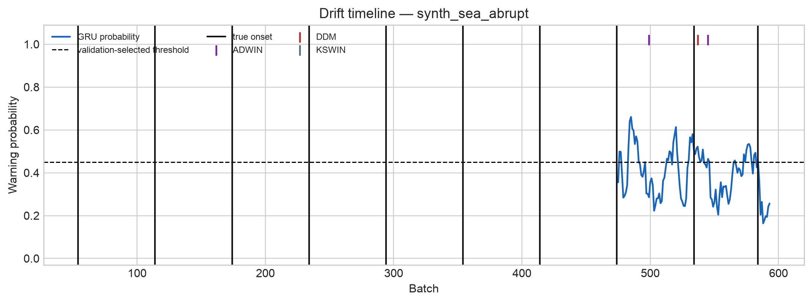
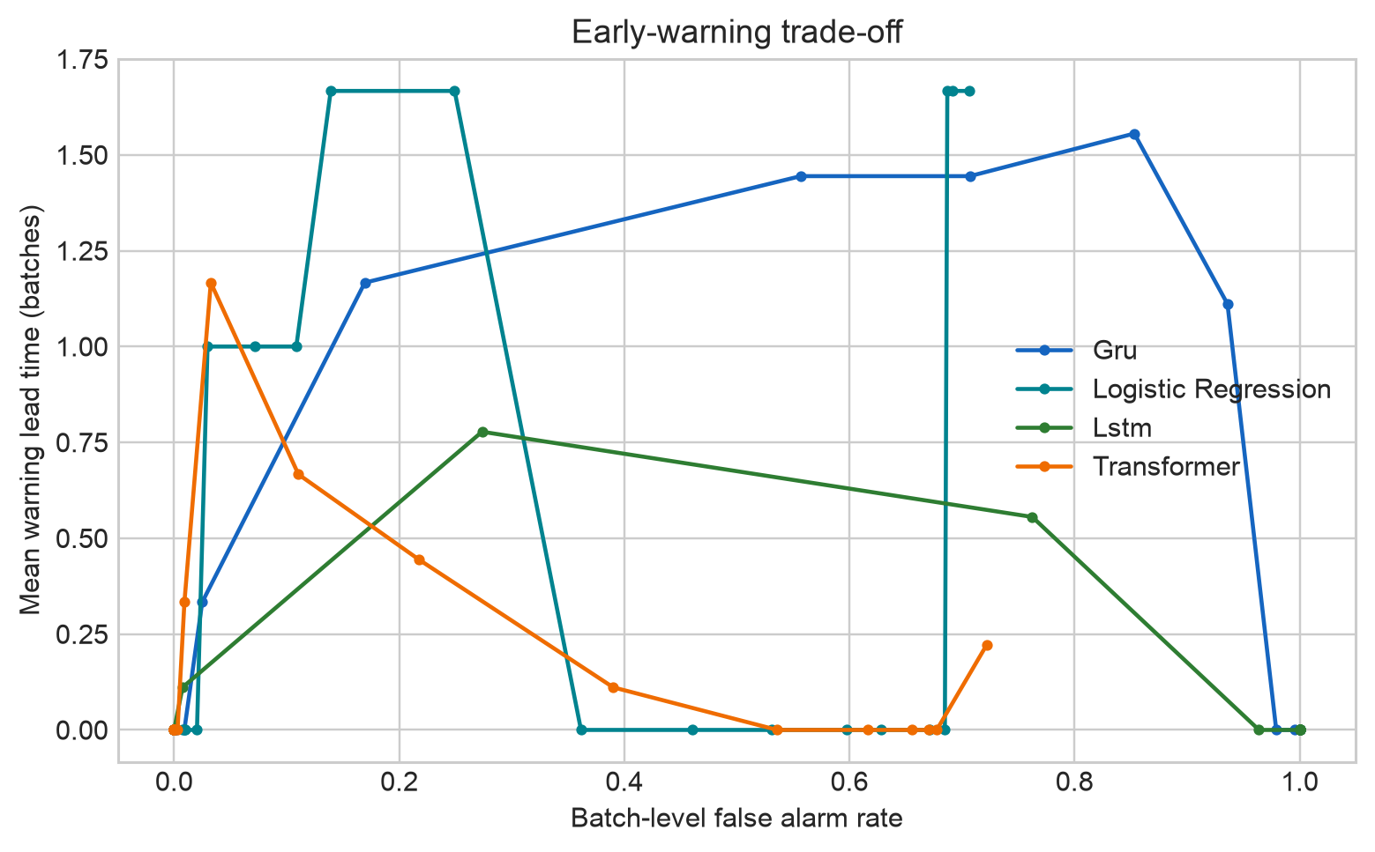
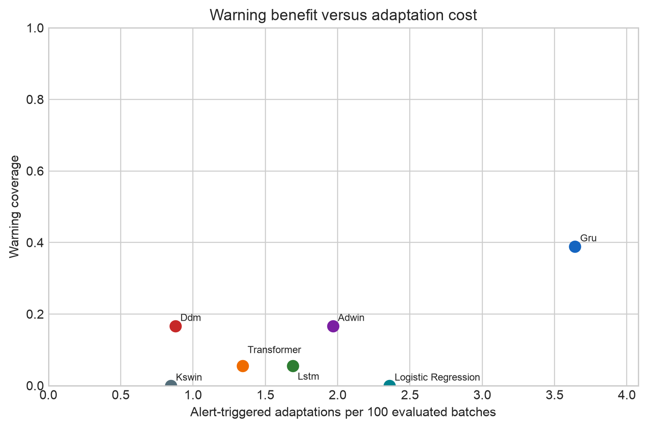
INTERACTIVE RESULT
Dashboard Demo and Visual Outcome
Six views: Overview | Drift Timeline | Model Comparison | Threshold Trade-off | Recovery and Adaptation | Research Findings
DriftSentinel | Review 2
12
Notes:
Figures are generated project artifacts under results/figures/.
Dashboard guide: docs/DASHBOARD_DEMO.md.
The dashboard reads committed results only and does not retrain or alter metrics at startup.

Slide 13
PUBLICATION DIRECTION
Tangible Outcome
Planned output
IEEE conference paper
Selected target
Predictive concept-drift early warning in data streams
ICoICC 2027
Aligned five-batch prediction and warning evaluation
Direct temporal models versus current-vector baseline
Strict event metrics with false-alarm and missed-drift cost
Causal alert-triggered adaptation replay
Audited reproducible benchmark and interactive artifact
4th International Conference on Intelligent and Cloud Computing
IEEE technical co-sponsorship
Paper deadline: 31 Jan 2027
Planned only - not submitted or accepted
DriftSentinel | Review 2
13
Notes:
Venue source: https://icoicc.org.in/ (accessed 17 September 2026).
The official site lists the 2027 event, IEEE technical co-sponsorship, a 4-6 page IEEE format, and 31 January 2027 full-paper deadline.
Target selection remains subject to faculty approval, fit review, and verification of the final call before submission.

Slide 14
COMMUNICATION TIMELINE
Tangible Outcome Plan
Sep 2026
Oct 2026
Nov 2026
Dec 2026
By 31 Jan 2027
After review
Freeze evidence
Complete manuscript
Faculty review
Revision
Communicate
Respond
Confirm final metrics, figures, repository and author list
Draft IEEE-style paper and tighten related work
Internal technical review and venue fit decision
Address feedback, format paper and validate reproducibility
Submit to ICoICC 2027 if approved and eligible
Revise and communicate the final version
Decision gate
Submit only after faculty approval, CFP re-check, authorship agreement and final plagiarism / formatting review.
DriftSentinel | Review 2
14
Notes:
Venue and deadline source: https://icoicc.org.in/ (accessed 17 September 2026). No submission or acceptance is claimed.

Slide 15
SELECTED SOURCES
References
[1] J. Gama et al., ‘A Survey on Concept Drift Adaptation,’ ACM Computing Surveys, 46(4), 2014.
[7] S. Hochreiter and J. Schmidhuber, ‘Long Short-Term Memory,’ Neural Computation, 9(8), pp. 1735-1780, 1997.
[2] J. Gama et al., ‘Learning with Drift Detection,’ SBIA, LNCS 3171, pp. 286-295, 2004.
[8] A. Vaswani et al., ‘Attention Is All You Need,’ NeurIPS 30, 2017.
[3] A. Bifet and R. Gavaldà, ‘Learning from Time-Changing Data with Adaptive Windowing,’ SDM, pp. 443-448, 2007.
[9] J. Montiel et al., ‘River: Machine Learning for Streaming Data in Python,’ JMLR, 22(110), pp. 1-8, 2021.
[4] C. Raab, M. Heusinger and F.-M. Schleif, ‘Reactive Soft Prototype Computing for Concept Drift Streams,’ Neurocomputing, 416, pp. 340-351, 2020.
[10] J. Gama, R. Sebastião and P. P. Rodrigues, ‘On Evaluating Stream Learning Algorithms,’ Machine Learning, 90, pp. 317-346, 2013.
[5] V. M. A. Souza et al., ‘Challenges in Benchmarking Stream Learning Algorithms with Real-World Data,’ Data Mining and Knowledge Discovery, 34, pp. 1805-1858, 2020.
[11] J. Montiel et al., ‘Scikit-Multiflow: A Multi-output Streaming Framework,’ JMLR, 19(72), pp. 1-5, 2018.
[6] K. Cho et al., ‘Learning Phrase Representations using RNN Encoder-Decoder,’ arXiv:1406.1078, 2014.
DriftSentinel | Review 2
15
Notes:
Reference links:
https://doi.org/10.1145/2523813
https://doi.org/10.1007/978-3-540-28645-5_29
https://doi.org/10.1137/1.9781611972771.42
https://doi.org/10.1016/j.neucom.2019.11.111
https://doi.org/10.1007/s10618-020-00698-5
https://arxiv.org/abs/1406.1078
https://doi.org/10.1162/neco.1997.9.8.1735
https://proceedings.neurips.cc/paper/2017/hash/3f5ee243547dee91fbd053c1c4a845aa-Abstract.html
https://www.jmlr.org/papers/v22/20-1380.html
https://doi.org/10.1007/s10994-012-5320-9
https://www.jmlr.org/papers/v19/18-251.html

