Slide 1
Traffic Violations Analytics System
Submitted By: Lakshana Murugesan
Tech Stack: Python, MySQL, Streamlit, Pandas, Plotly

Slide 2
Problem Statement
Process large-scale traffic violation datasets and extract actionable insights through interactive visual dashboards.

Slide 3
Project Objectives
Data Cleansing
Database Integration
SQL Analytics
Interactive Dashboard
Visual Insight Generation

Slide 4
Dataset Overview
Records Count: 2,067,761
Feature Count: 43
Dataset: Traffic Violations Dataset

Slide 5
Tools & Technologies
Python
MySQL
Pandas
Plotly
Streamlit
SQLAlchemy

Slide 6
System Architecture
CSV → Data Preprocessing → MySQL → SQL Analysis → EDA → Interactive Dashboard

Slide 7
Data Preprocessing
Eliminated duplicate records
Addressed missing and null values
Feature Extraction (Month, Day of Week)

Slide 8
Database & SQL Analysis
Most Common Violations
Frequent Vehicle Makes
Gender Analysis
Race Analysis

Slide 9
Dashboard Features
Summary Overview
Traffic Violation Insights
Vehicle Breakdown
Demographic Breakdown
Location-Based Analysis

Slide 10
DASHBOARD SCREENSHOTS

Slide 11
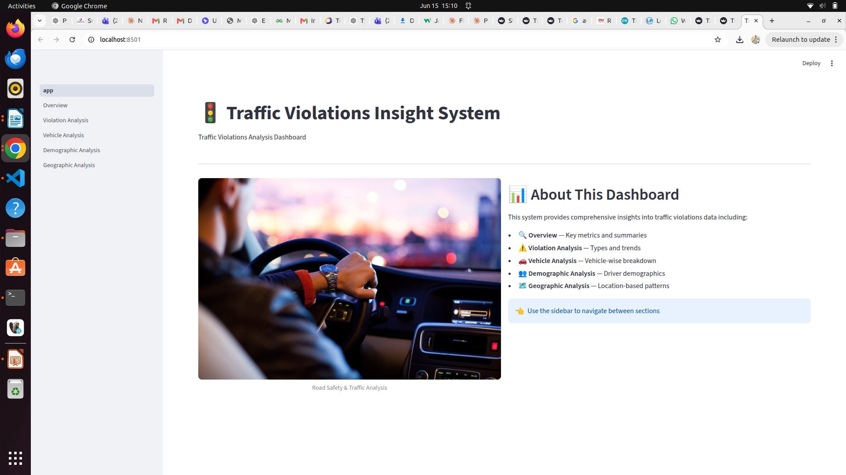

Slide 12
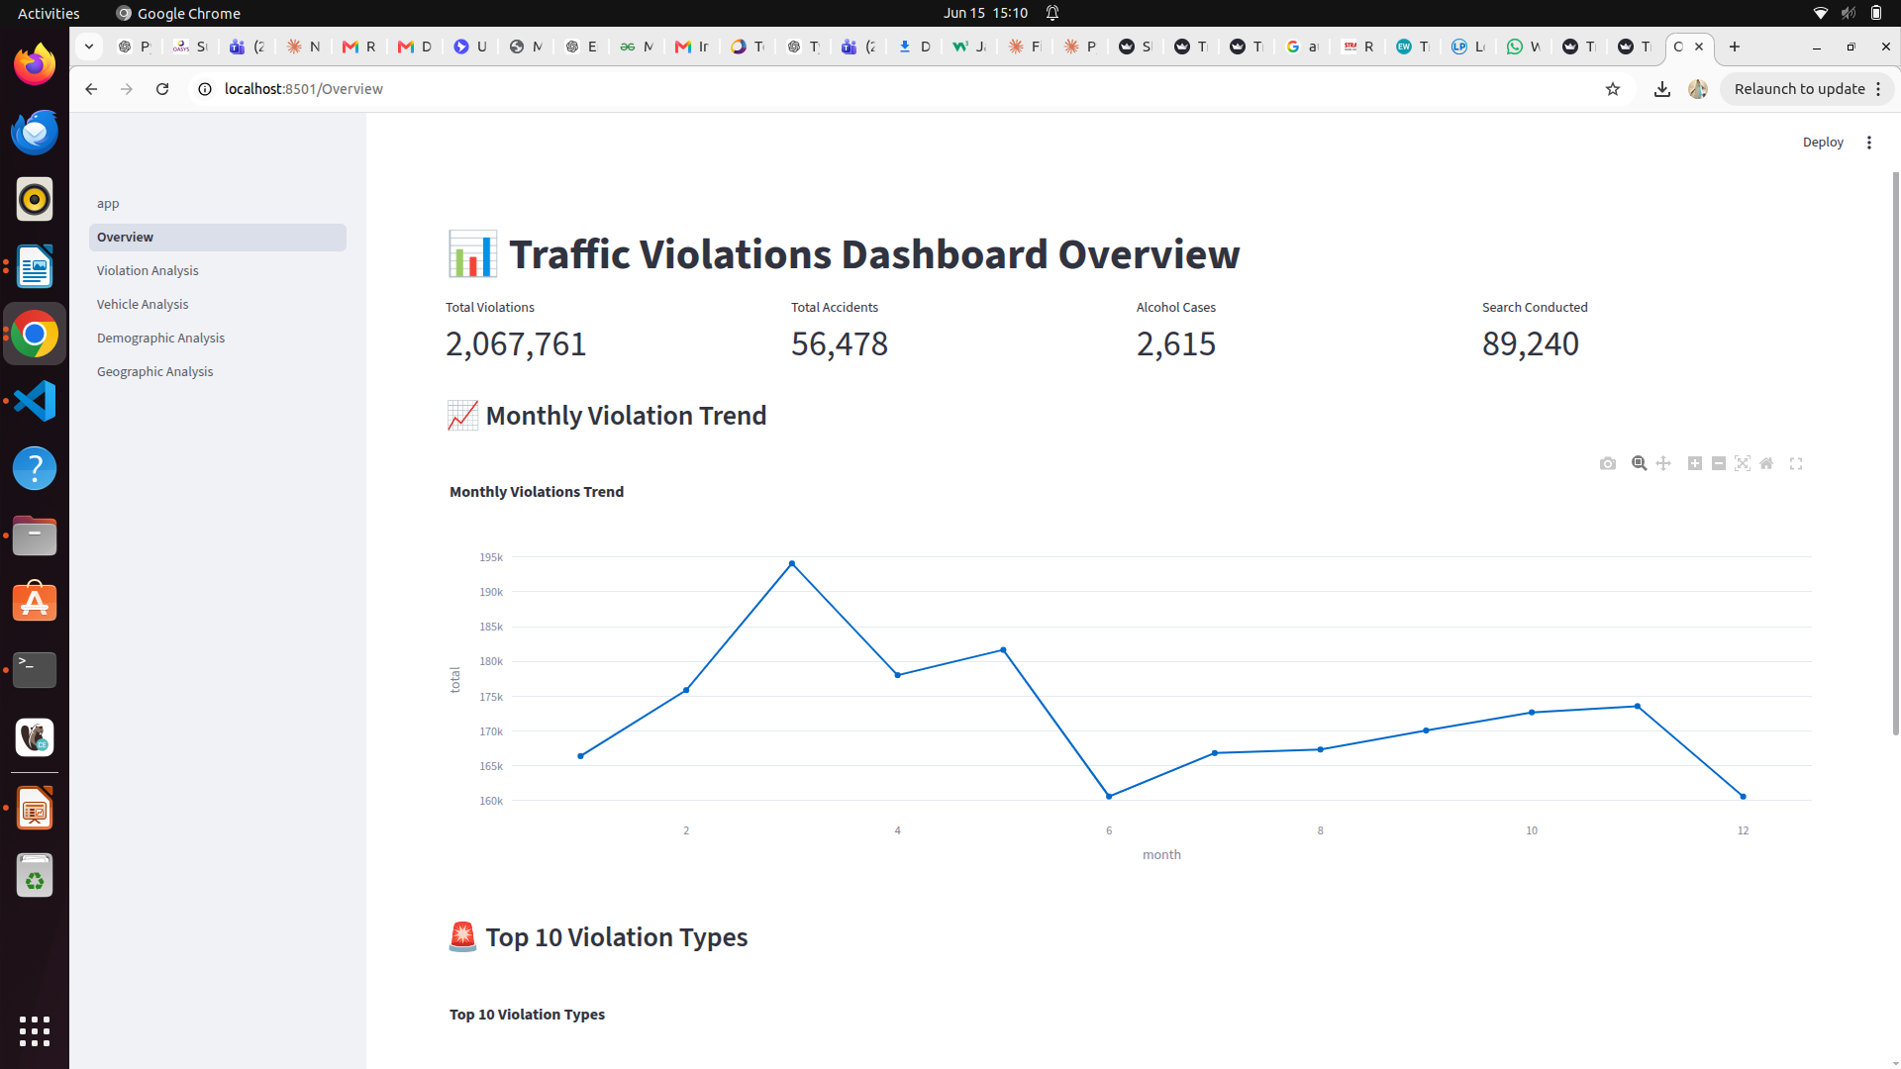

Slide 13
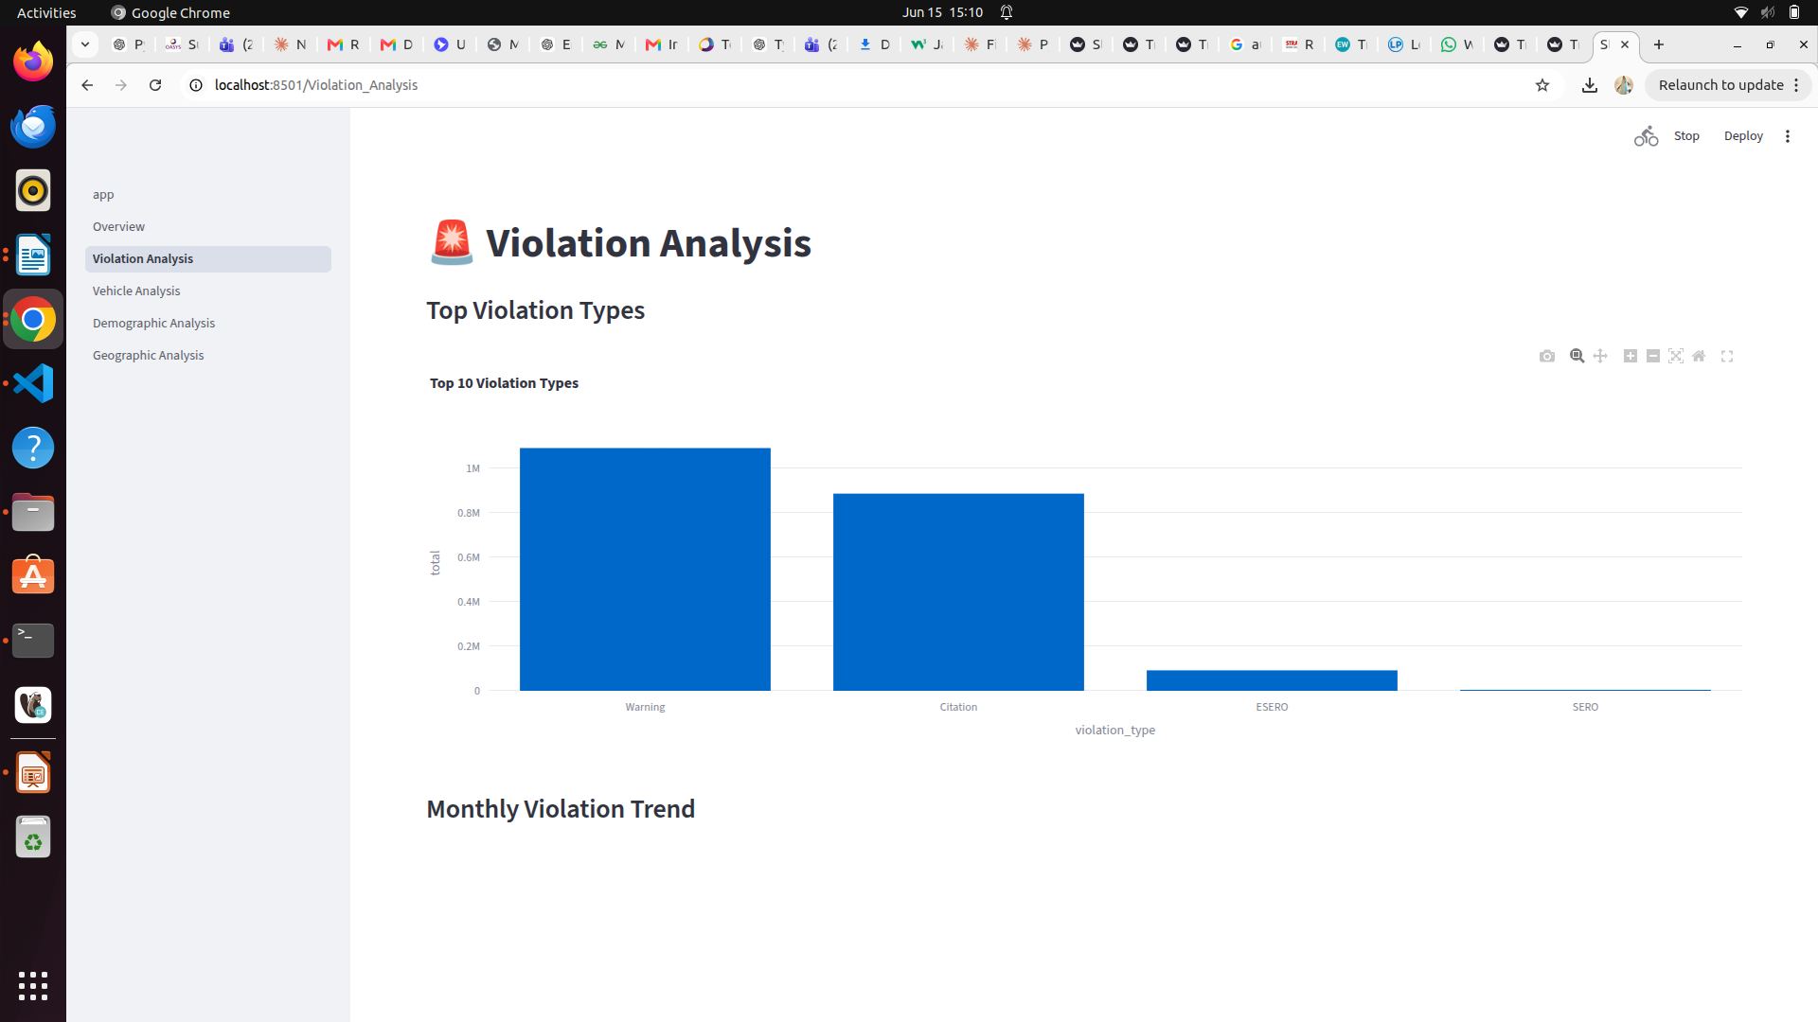

Slide 14
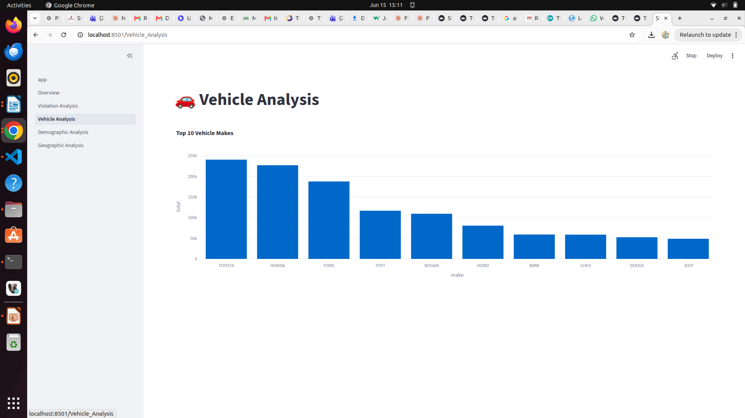

Slide 15
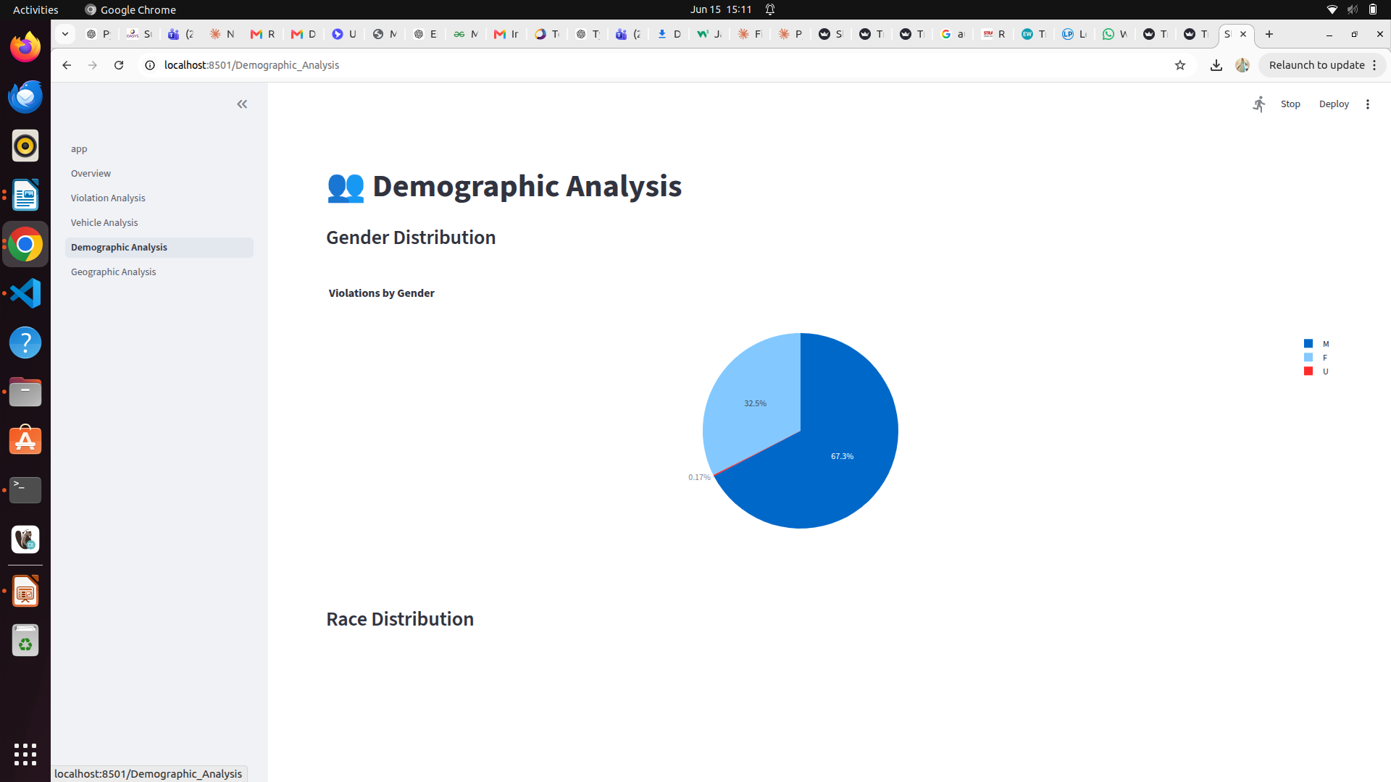

Slide 16
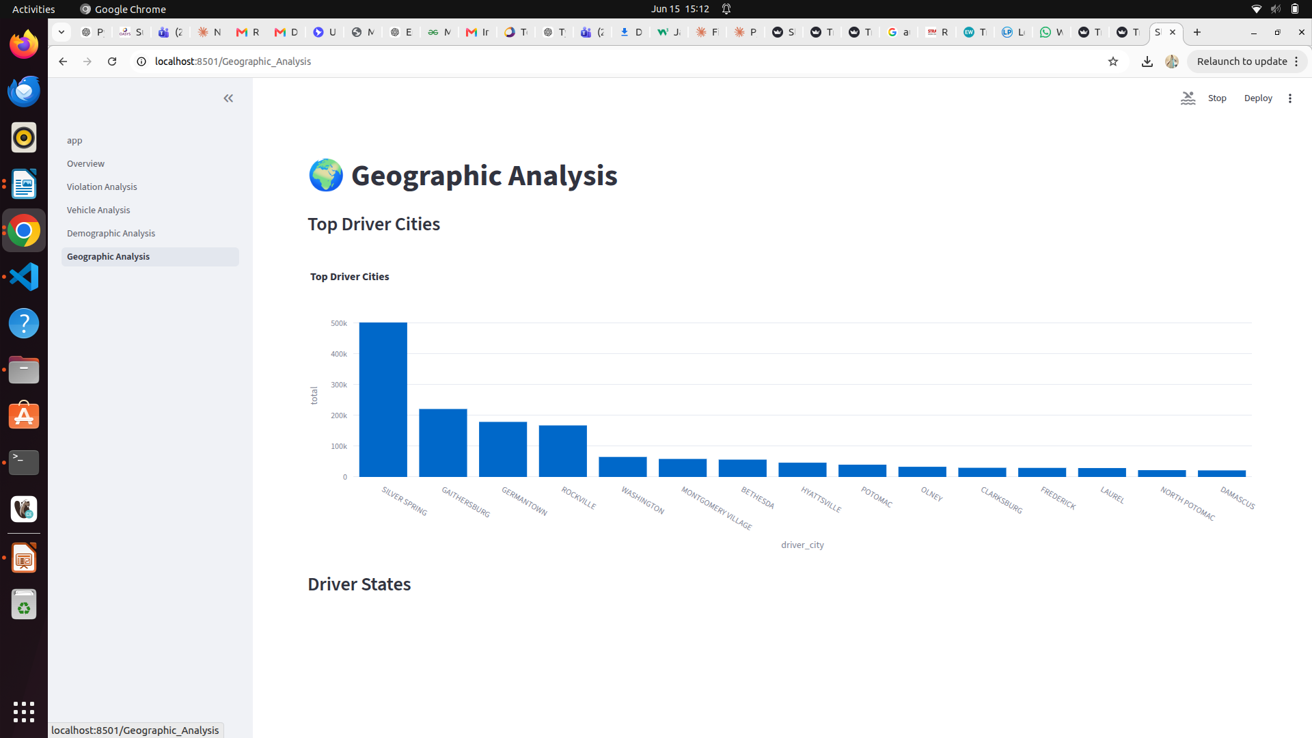

Slide 17
Conclusion
Effectively processed over 2 million records and developed a fully interactive analytics dashboard for traffic violation insights.

