Slide 1



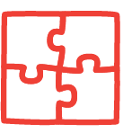

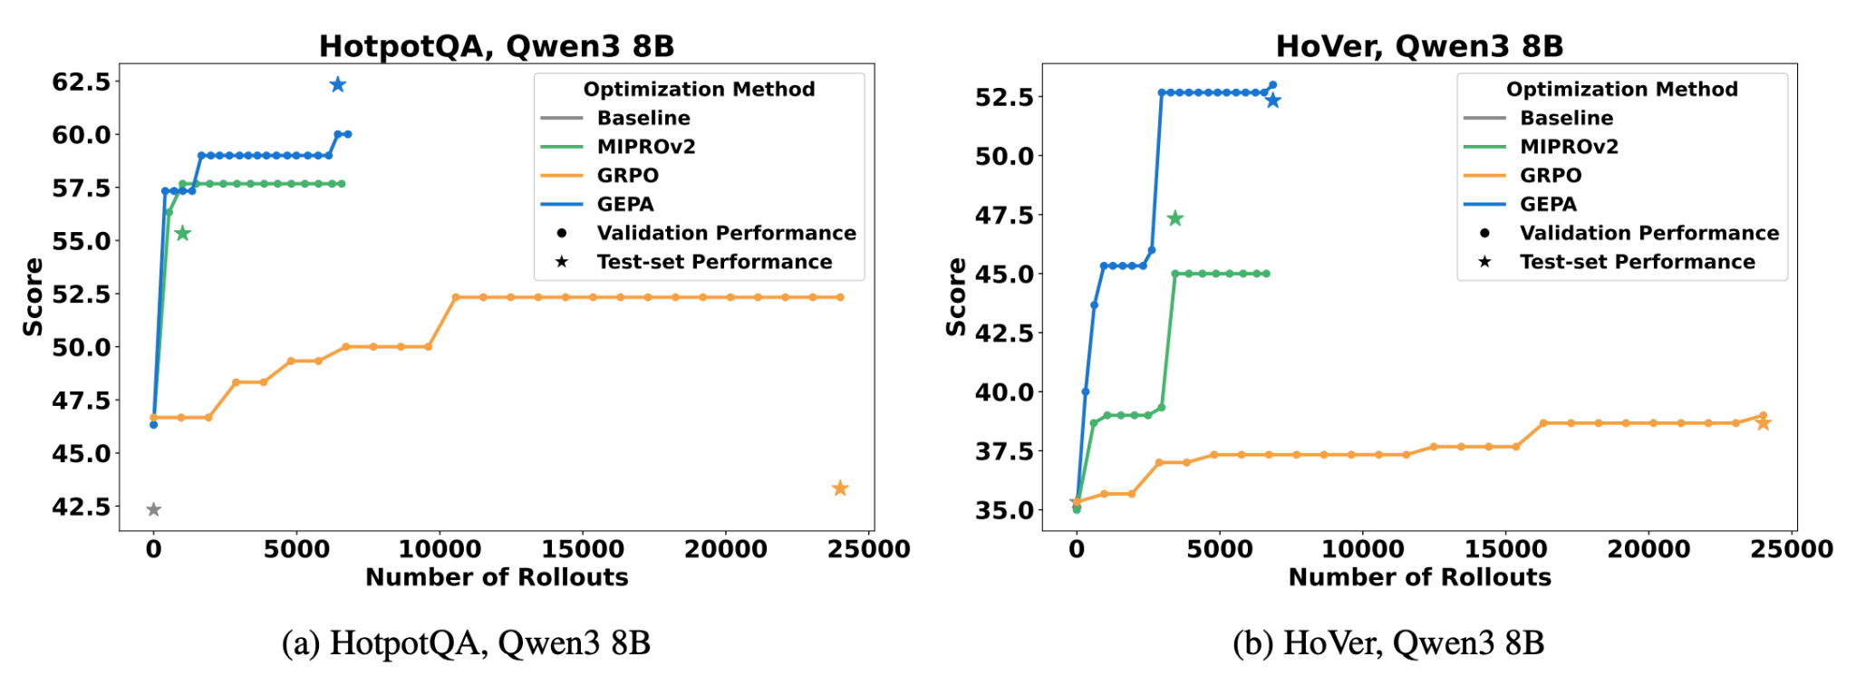
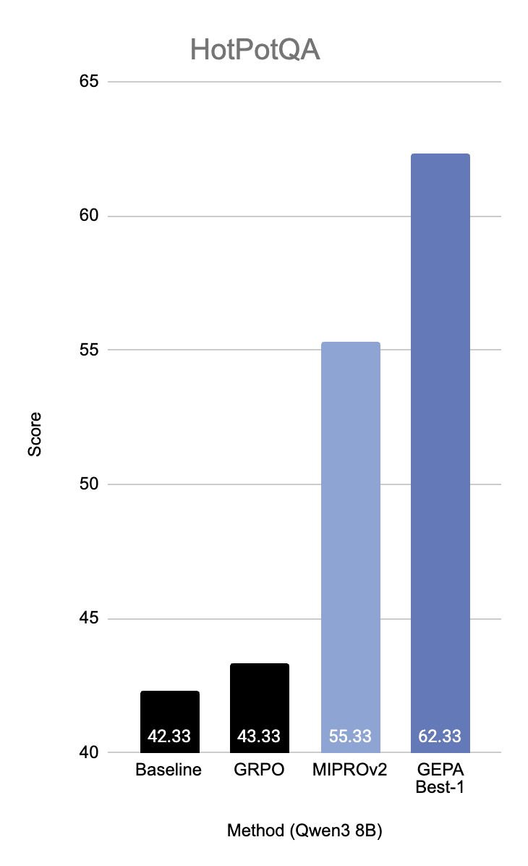
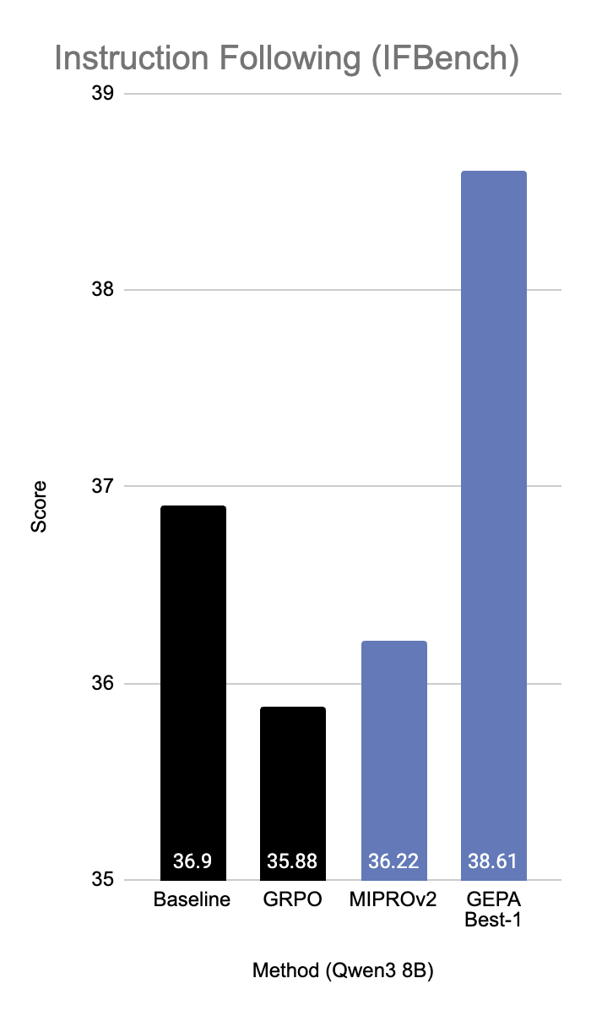
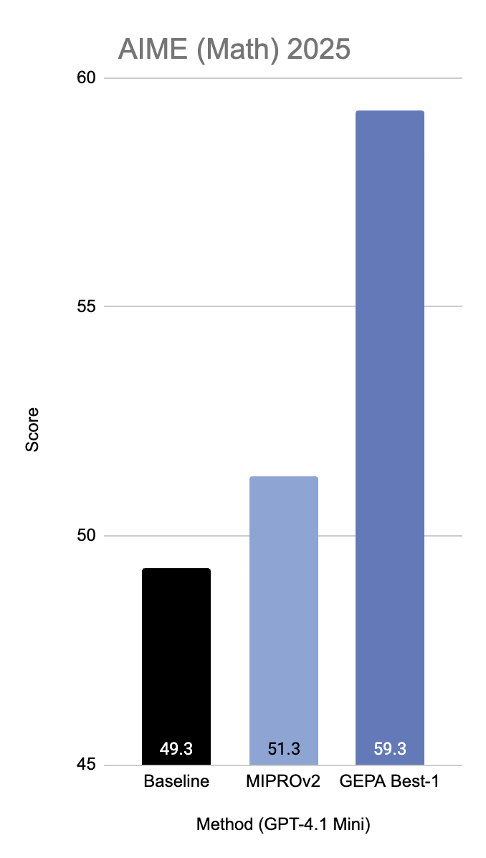
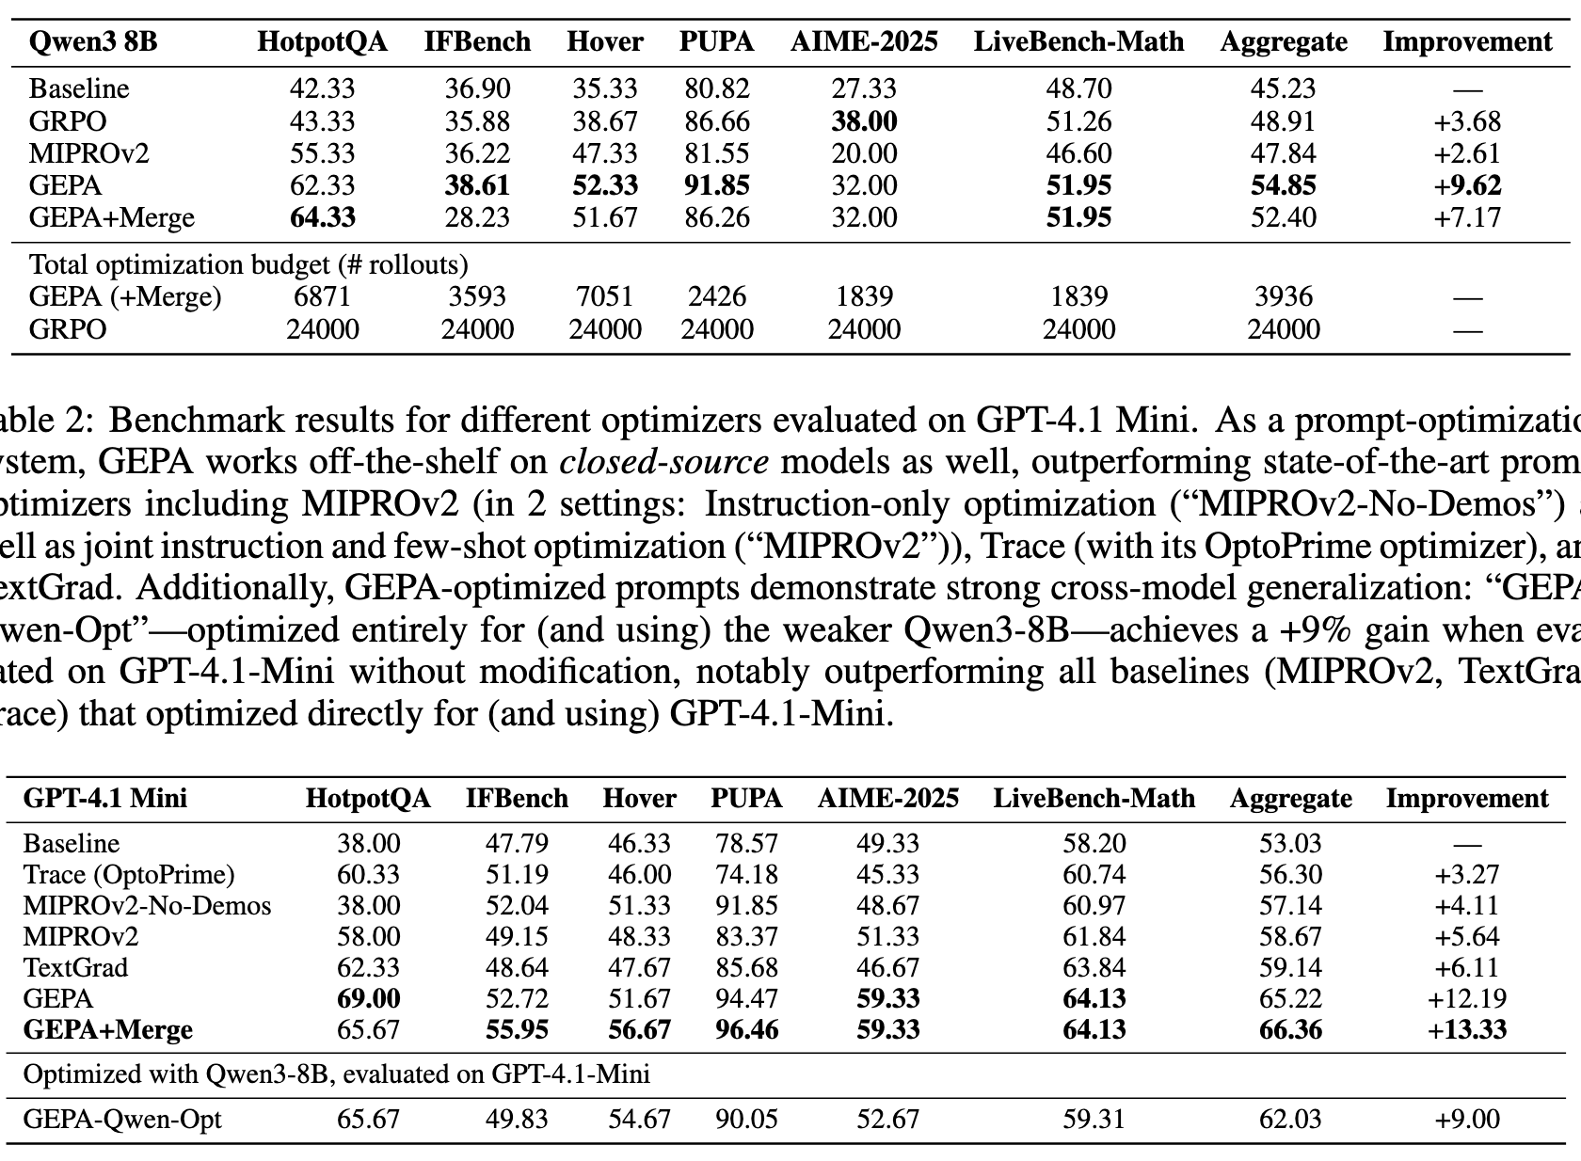



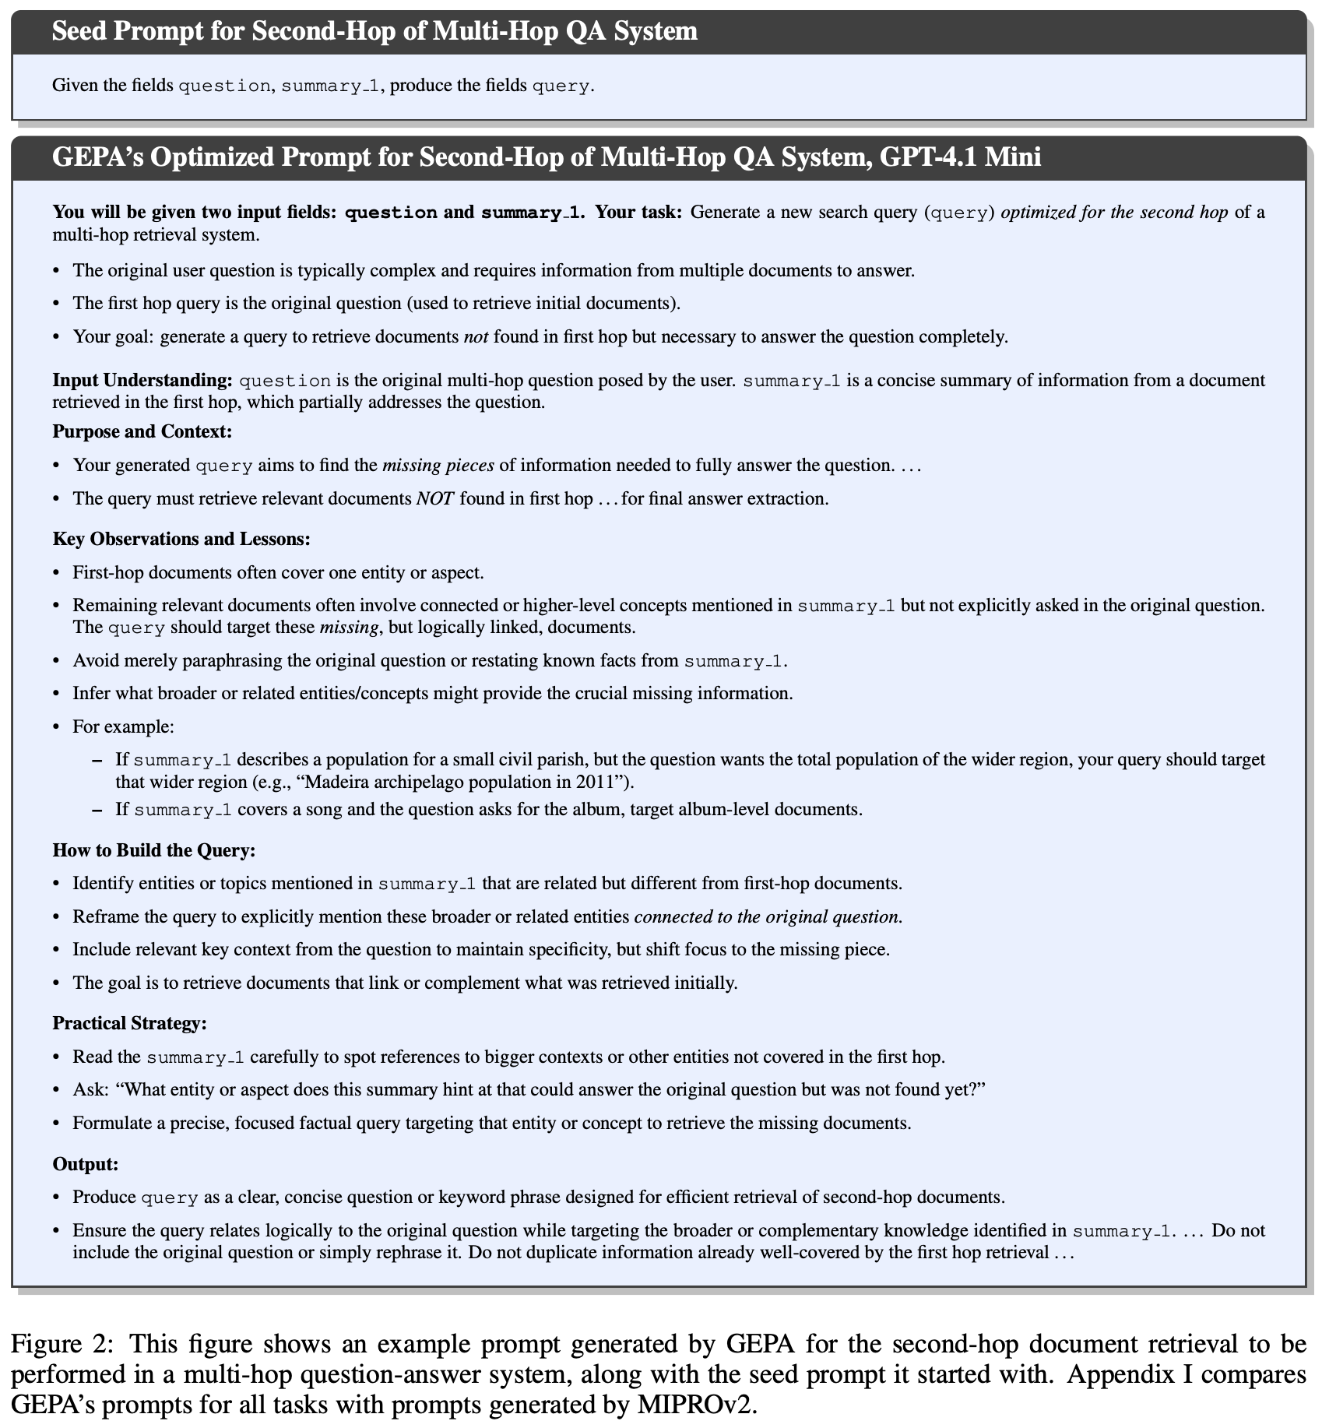
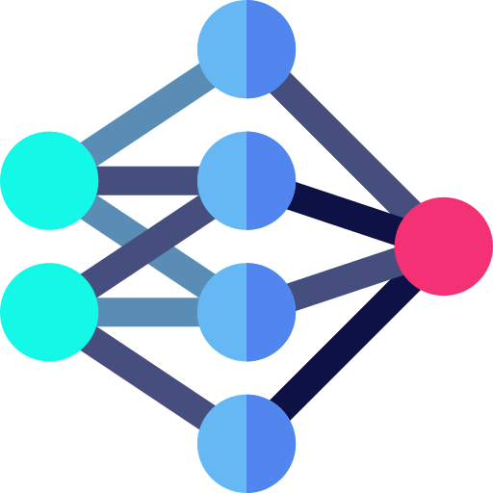
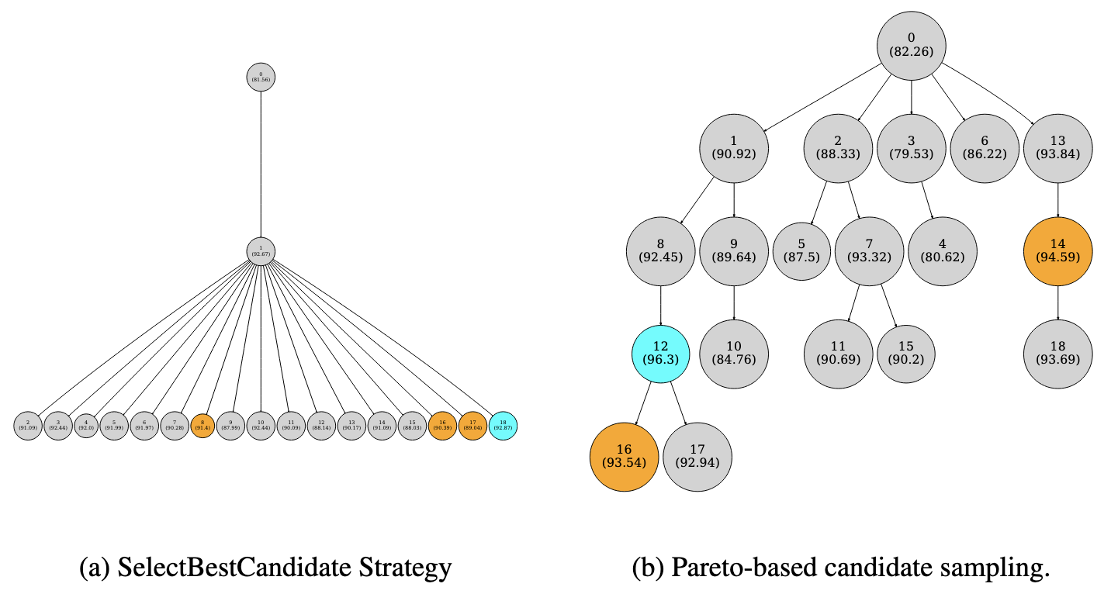
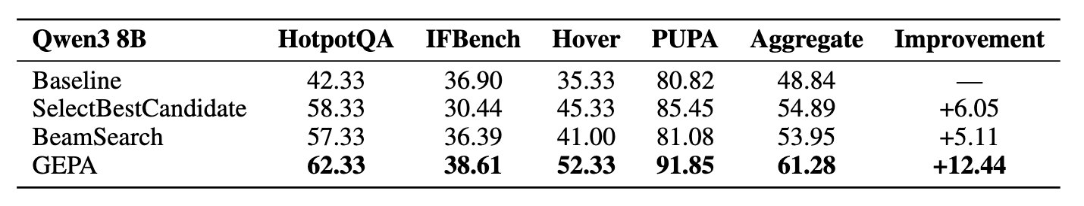
GEPA: Reflective Prompt Evolution Can Outperform Reinforcement Learning
Lakshya A Agrawal, Shangyin Tan, Dilara Soylu, Noah Ziems, Rishi Khare, Krista Opsahl-Ong, Arnav Singhvi, Herumb Shandilya, Michael J Ryan, Meng Jiang, Christopher Potts, Koushik Sen, Alexandros G. Dimakis, Ion Stoica, Dan Klein, Matei Zaharia, Omar Khattab
Motivation
GEPA is Highly Sample Efficient!
GEPA is Highly Sample Efficient!
As FLOPS get cheaper, progress in many AI capabilities will be bottlenecked by sample efficiency!
GEPA
Low availability of domain specific knowledge resources
Expensive rollouts: either the LLM workflow for the task or the task metric is slow/expensive to execute
GEPA Generated Prompts are Incredibly Detailed!
Rollout 1
Rewards
Pareto-based Candidate Selection is Important
Model
💬→💭→💻→ 💬
1
Rollout 2
💬→🔎→💭→🔧→ 💬
0
1
Rollout 3
💬→🔎 →💭→💬
1
There was a lot of info in each rollout, but we only took a 0/1 score propagated via gradient descent. Can we use the other info?

Slide 2
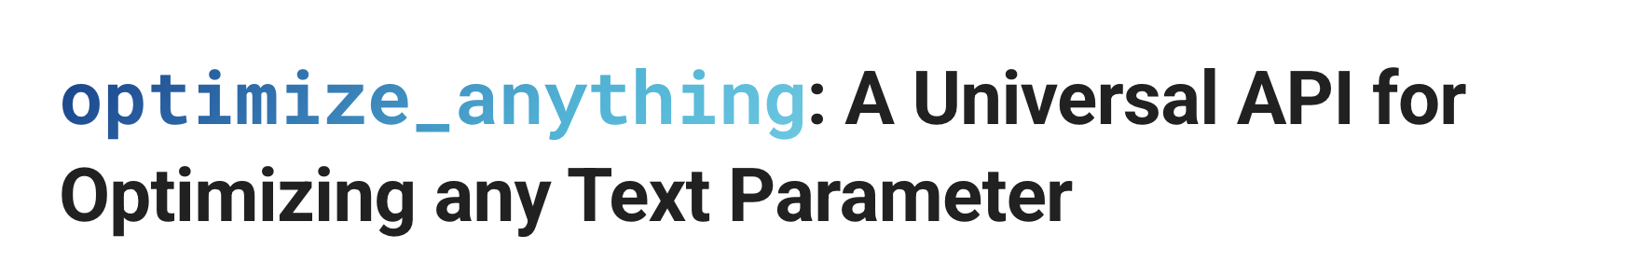
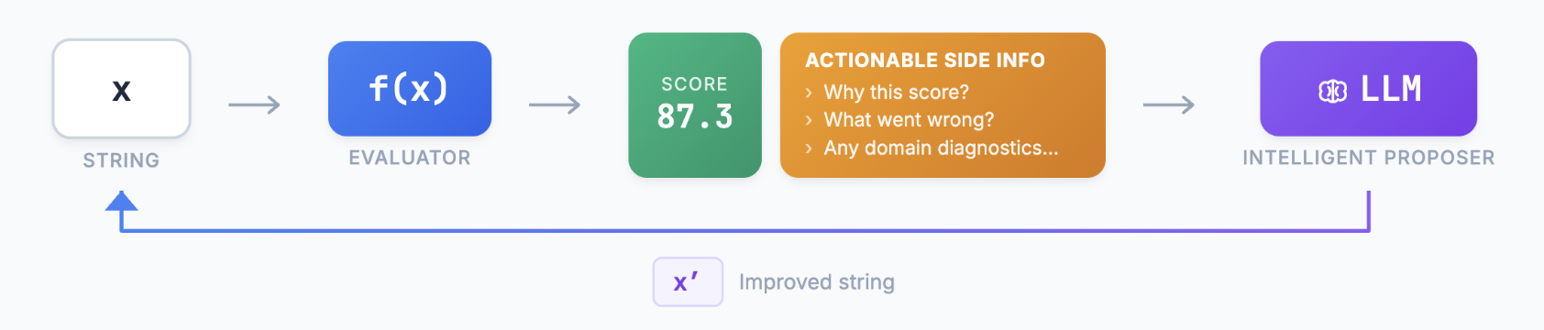
GEPA: Reflective Prompt Evolution Can Outperform Reinforcement Learning
Lakshya A Agrawal, Shangyin Tan, Dilara Soylu, Noah Ziems, Rishi Khare, Krista Opsahl-Ong, Arnav Singhvi, Herumb Shandilya, Michael J Ryan, Meng Jiang, Christopher Potts, Koushik Sen, Alexandros G. Dimakis, Ion Stoica, Dan Klein, Matei Zaharia, Omar Khattab
Motivation
GEPA is Highly Sample Efficient!
Pareto-based Candidate Selection is Important
As FLOPS get cheaper, progress in many AI capabilities will be bottlenecked by sample efficiency!
GEPA
Low availability of domain specific knowledge resources
Expensive rollouts: either the LLM workflow for the task or the task metric is slow/expensive to execute
GEPA Generated Prompts are Incredibly Detailed!
Rollout 1
Rewards
Model
💬→💭→💻→ 💬
1
Rollout 2
💬→🔎→💭→🔧→ 💬
0
1
Rollout 3
💬→🔎 →💭→💬
1
Prompt optimization to text optimization
There was a lot of info in each rollout, but we only took a 0/1 score propagated via gradient descent. Can we use the other info?
2. How do we “train” frontier closed-source models?
Any text (Prompt / Code / SVG / Essay / Config)
Any task (Single-task search, Multi-task search, Generalization)
Any algorithm (ShinkaEvolve, OpenEvolve, Combee)

Slide 3
GEPA: Reflective Prompt Evolution Can Outperform Reinforcement Learning
Lakshya A Agrawal, Shangyin Tan, Dilara Soylu, Noah Ziems, Rishi Khare, Krista Opsahl-Ong, Arnav Singhvi, Herumb Shandilya, Michael J Ryan, Meng Jiang, Christopher Potts, Koushik Sen, Alexandros G. Dimakis, Ion Stoica, Dan Klein, Matei Zaharia, Omar Khattab
Poor Sample Efficiency Blocks Agent Abilties
GEPA is Highly Sample Efficient!
Pareto-based Candidate Selection is Important
As FLOPS get cheaper, progress in many AI capabilities will be bottlenecked by sample efficiency!
GEPA
Low availability of domain specific knowledge resources
Expensive rollouts: either the LLM workflow for the task or the task metric is slow/expensive to execute
GEPA Generated Prompts are Incredibly Detailed!
Rollout 1
Rewards
Model
💬→💭→💻→ 💬
1
Rollout 2
💬→🔎→💭→🔧→ 💬
0
1
Rollout 3
💬→🔎 →💭→💬
1
Prompt optimization to text optimization
There was a lot of info in each rollout, but we only took a 0/1 score propagated via gradient descent. Can we use the other info?
2. How do we “train” frontier closed-source models?
Any text (Prompt / Code / SVG / Essay / Config)

Slide 4
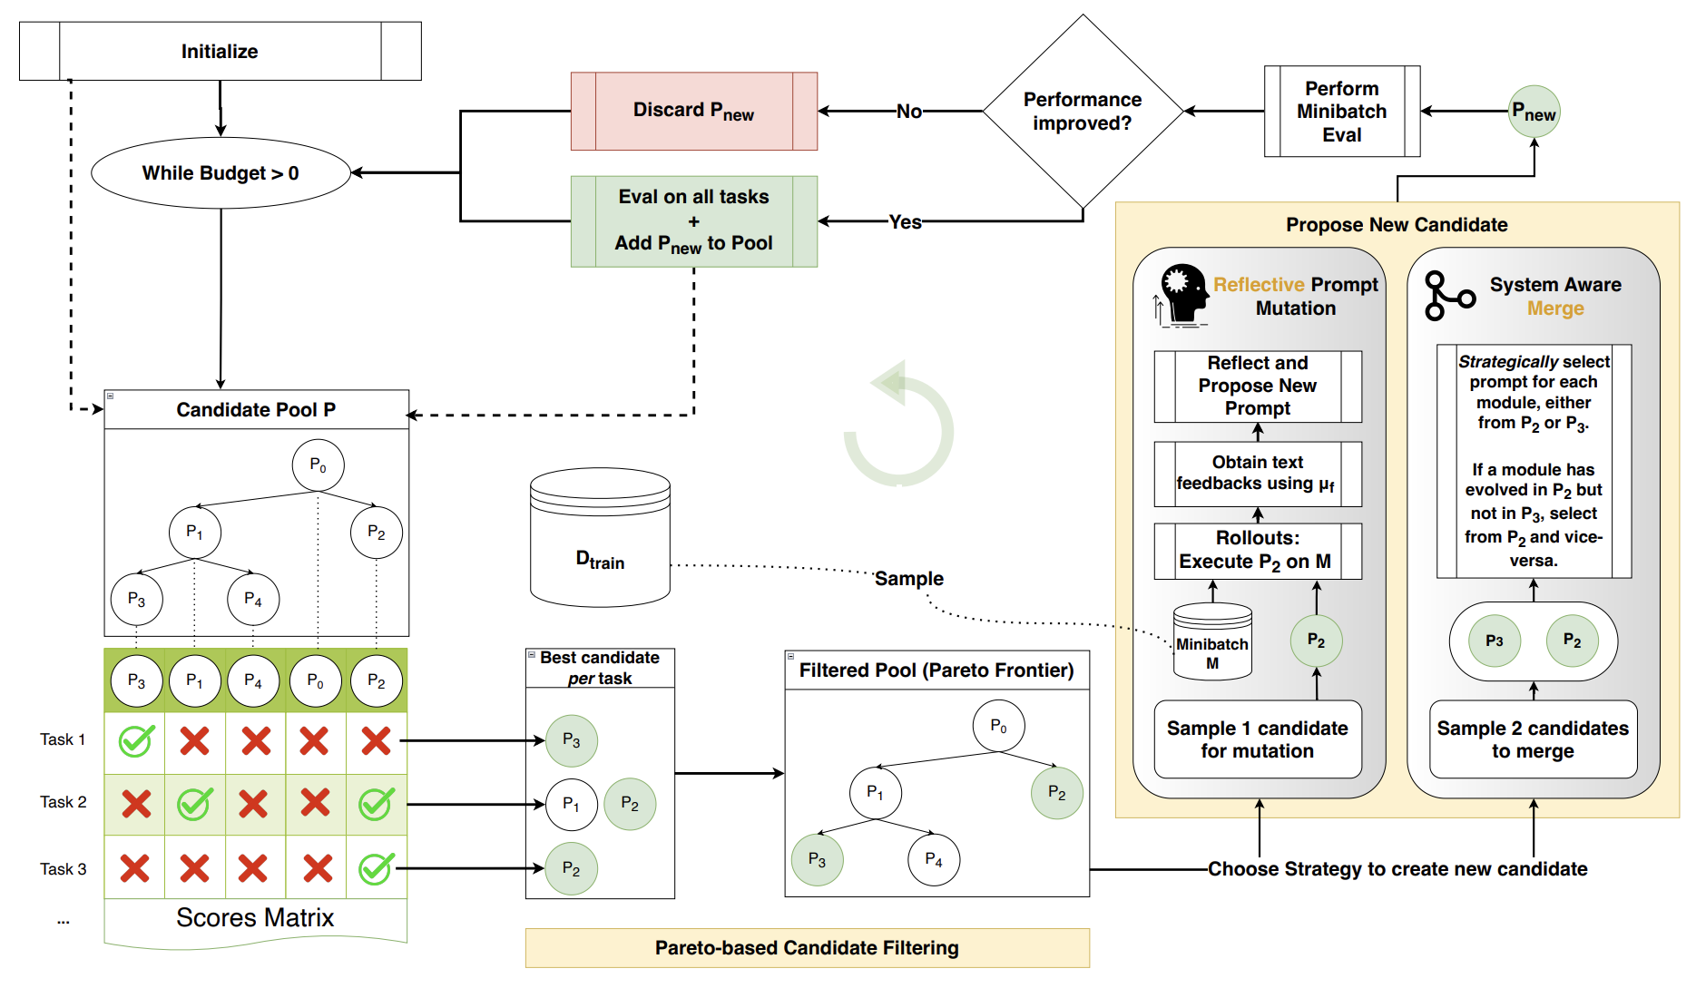
GEPA: Reflective Evolution and Pareto-based Candidate Selection

Slide 5
Examples

Slide 6
