Slide 1
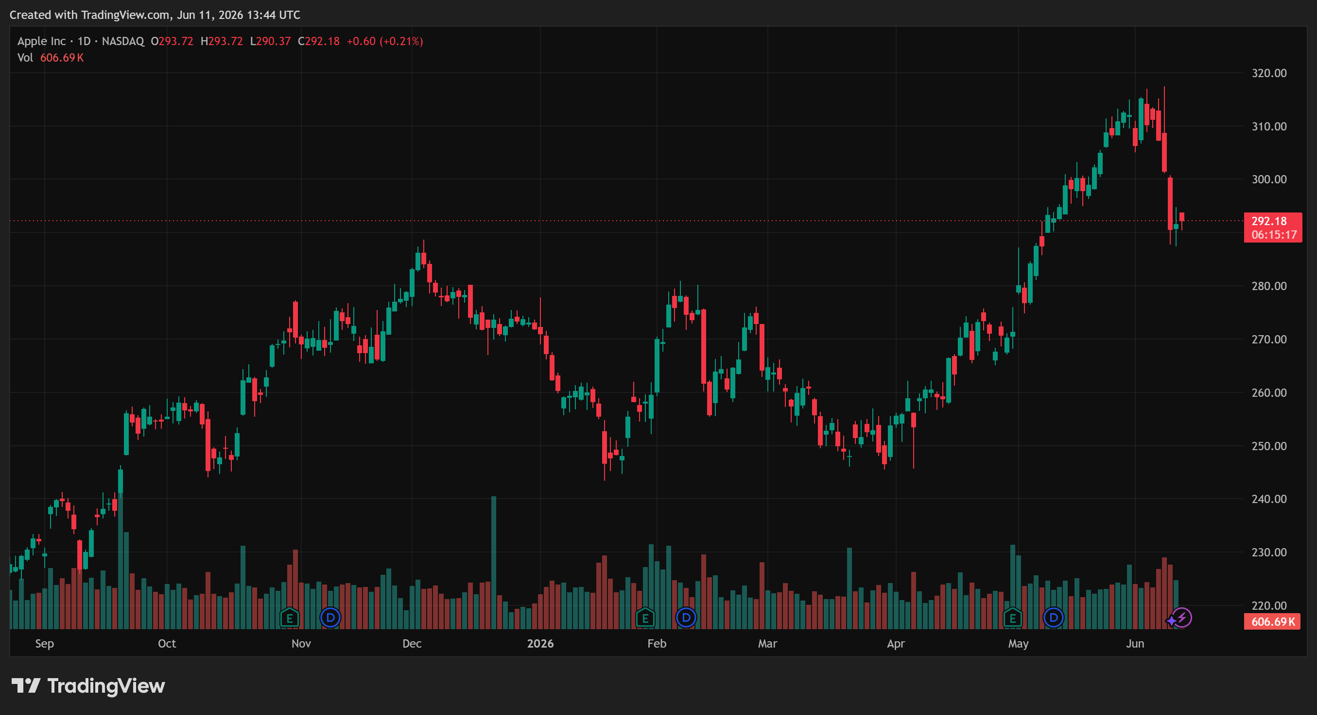
CAPSTONE PROJECT · DATA ANALYTICS
Mutual Fund Analytics Platform
Built an end-to-end analytics solution using Python, SQLite and Power BI to analyze mutual fund performance and investor behavior.
PYTHON
PANDAS
SQLITE
POWER BI
GITHUB
SQL
Lakshya Arora
Data Analytics Intern

Slide 2
PROBLEM STATEMENT
Problem Statement & Project Objectives
The Challenge
Project Objectives
Mutual fund data was available across multiple datasets and was difficult to analyze manually.
Key information such as NAV history, investor transactions, portfolio holdings and fund performance was spread across different files.
• Build a structured ETL pipeline
• Clean and organize mutual fund datasets
• Store data in SQLite database
• Analyze performance and risk metrics
• Generate investor insights
• Create interactive Power BI dashboards

Slide 3
DATA SOURCES
Project Data Sources
Fund Master Data
NAV History
Contains scheme information such as fund name, category, risk level, expense ratio and AMC details for all schemes used in the project.
Historical NAV records used to calculate returns, risk metrics, rolling Sharpe ratio, VaR and CVaR analysis.
Investor Transactions
Portfolio Holdings
Transaction-level data containing SIP, Lumpsum and Redemption activities used for cohort and investor behavior analysis.
Fund holdings data used to analyze sector allocation and calculate portfolio concentration using HHI.
10 datasets | 40 schemes | 46,000+ NAV records | 35,000+ investor transactions

Slide 4

ETL ARCHITECTURE
Project Architecture & Data Flow
Extract
Source:
MFAPI + 10 Raw CSV Datasets
Transform
Data Cleaning
Missing Values Handling Validation & Standardization
Load
Store Cleaned Data
into SQLite Database
Serve
Python Analytics
Power BI Dashboards Risk & Investor Insights
The ETL pipeline collects raw mutual fund data, performs validation and cleaning, stores processed records in SQLite, and generates analytics through Python and Power BI.

Slide 5
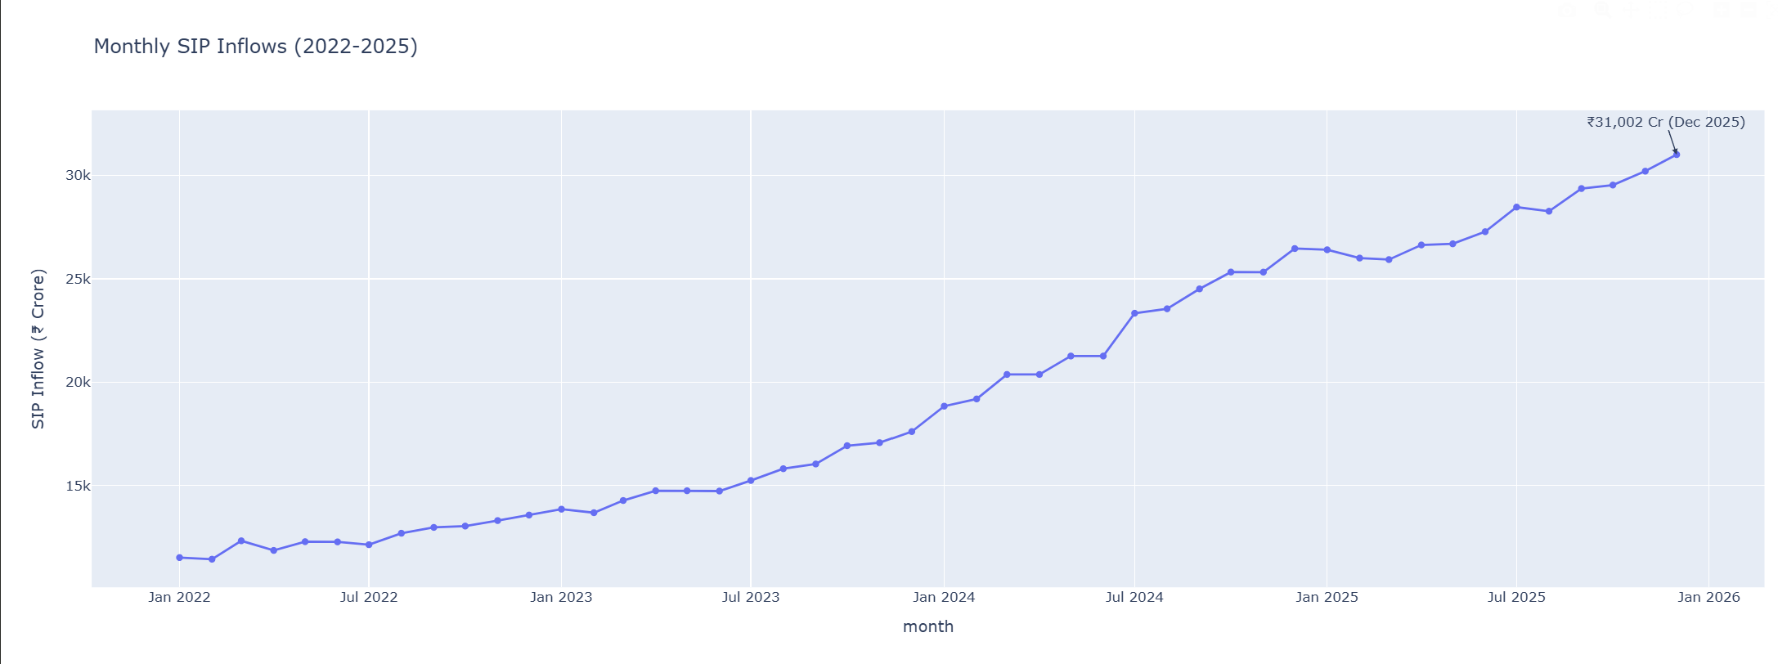
EXPLORATORY DATA ANALYSIS
EDA Highlights: SIP Growth Trends
• SIP inflows increased from ~₹12,000 Cr to ₹31,002 Cr.
• Highest inflow recorded in Dec 2025.
• Consistent investor participation indicates strong retail growth.

Slide 6
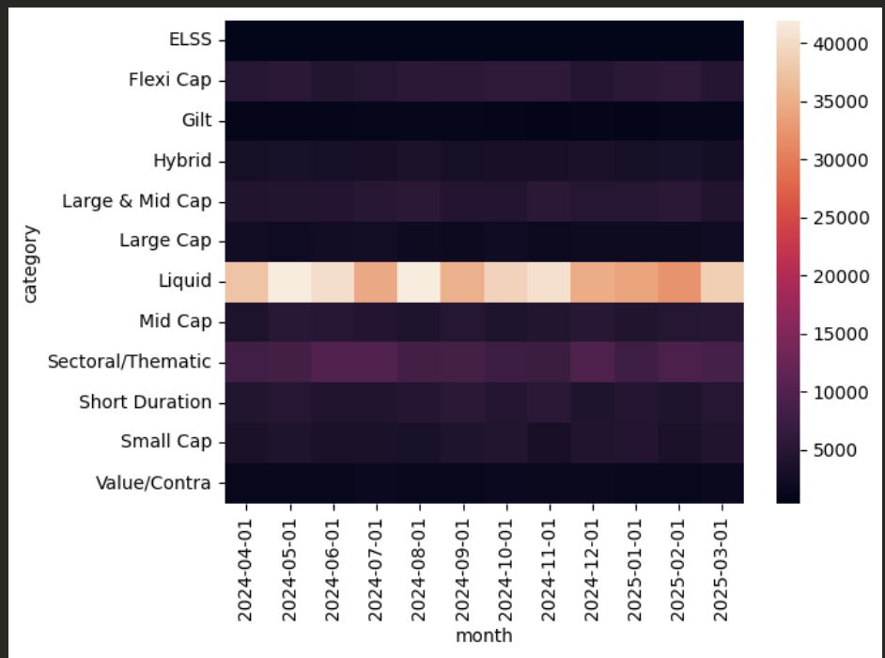
EDA FINDINGS
EDA Highlights: Category Inflow Analysis
Key Insights
Equity funds attracted the highest inflows across most months.
Debt fund inflows remained relatively stable.
Hybrid funds showed seasonal fluctuations.
Investor preference shifted towards equity-oriented schemes during market uptrends.

Slide 7
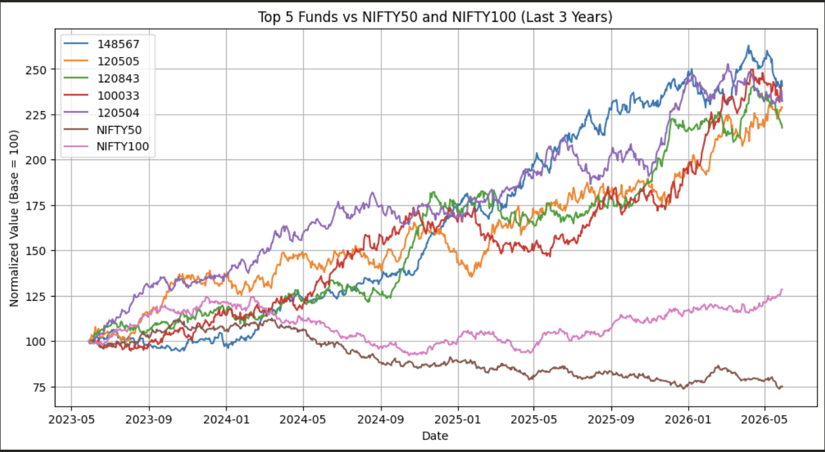

PERFORMANCE ANALYTICS
Fund Performance Analytics
Key Points:
Compared top 5 mutual funds against NIFTY 50 and NIFTY 100 benchmarks.
Performance was normalized to a base value of 100 for fair comparison.
Several funds outperformed benchmark indices over the 3-year period.
Return trajectories highlight differences in consistency and volatility.

Slide 8
RISK ANALYTICS
Advanced Risk & Performance Metrics
Key Metrics Calculated
• CAGR (3-Year) Analysis
• Sharpe Ratio Evaluation
• Alpha & Beta Calculation
• Maximum Drawdown Analysis
• Fund Scorecard Ranking
• Tracking Error Measurement
Key Results
• Average Alpha: 0.159
• Average Beta: -0.002
• Average Tracking Error: 0.204
• Fund Scores normalized on a 0–100 scale
• Top funds identified using composite ranking methodology

Slide 9
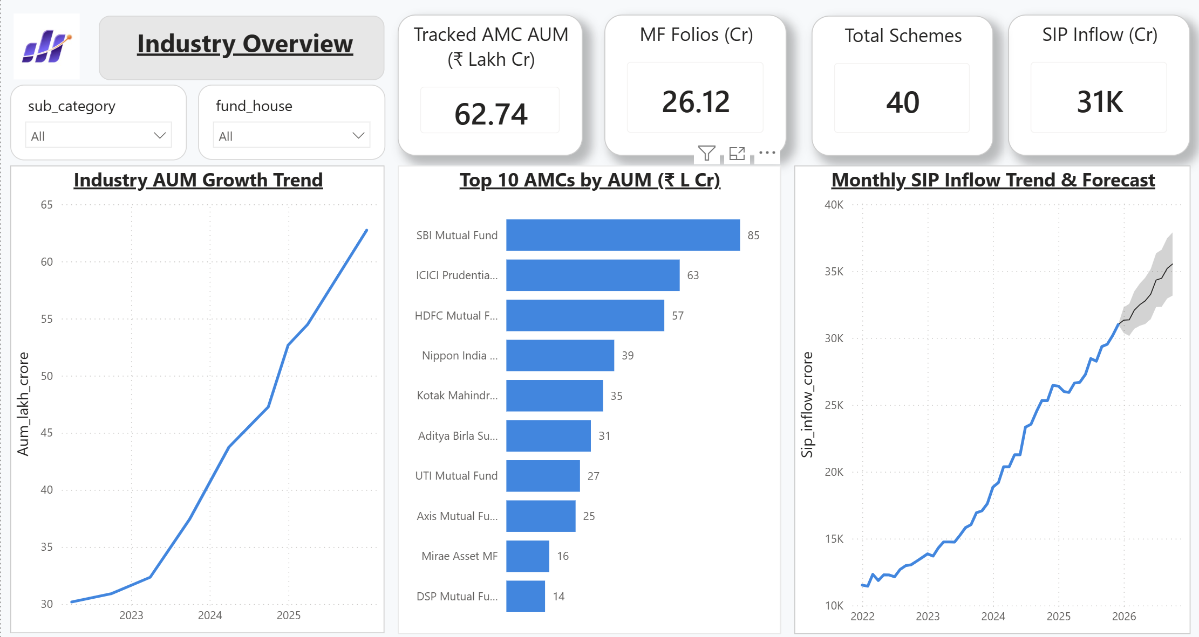
POWER BI DASHBOARDS
Interactive Analytics Dashboards
Industry Overview
• Interactive filtering by fund category, fund house.
• AMC-wise performance comparison
• Monthly SIP trend analysis
• Dynamic KPI monitoring

Slide 10
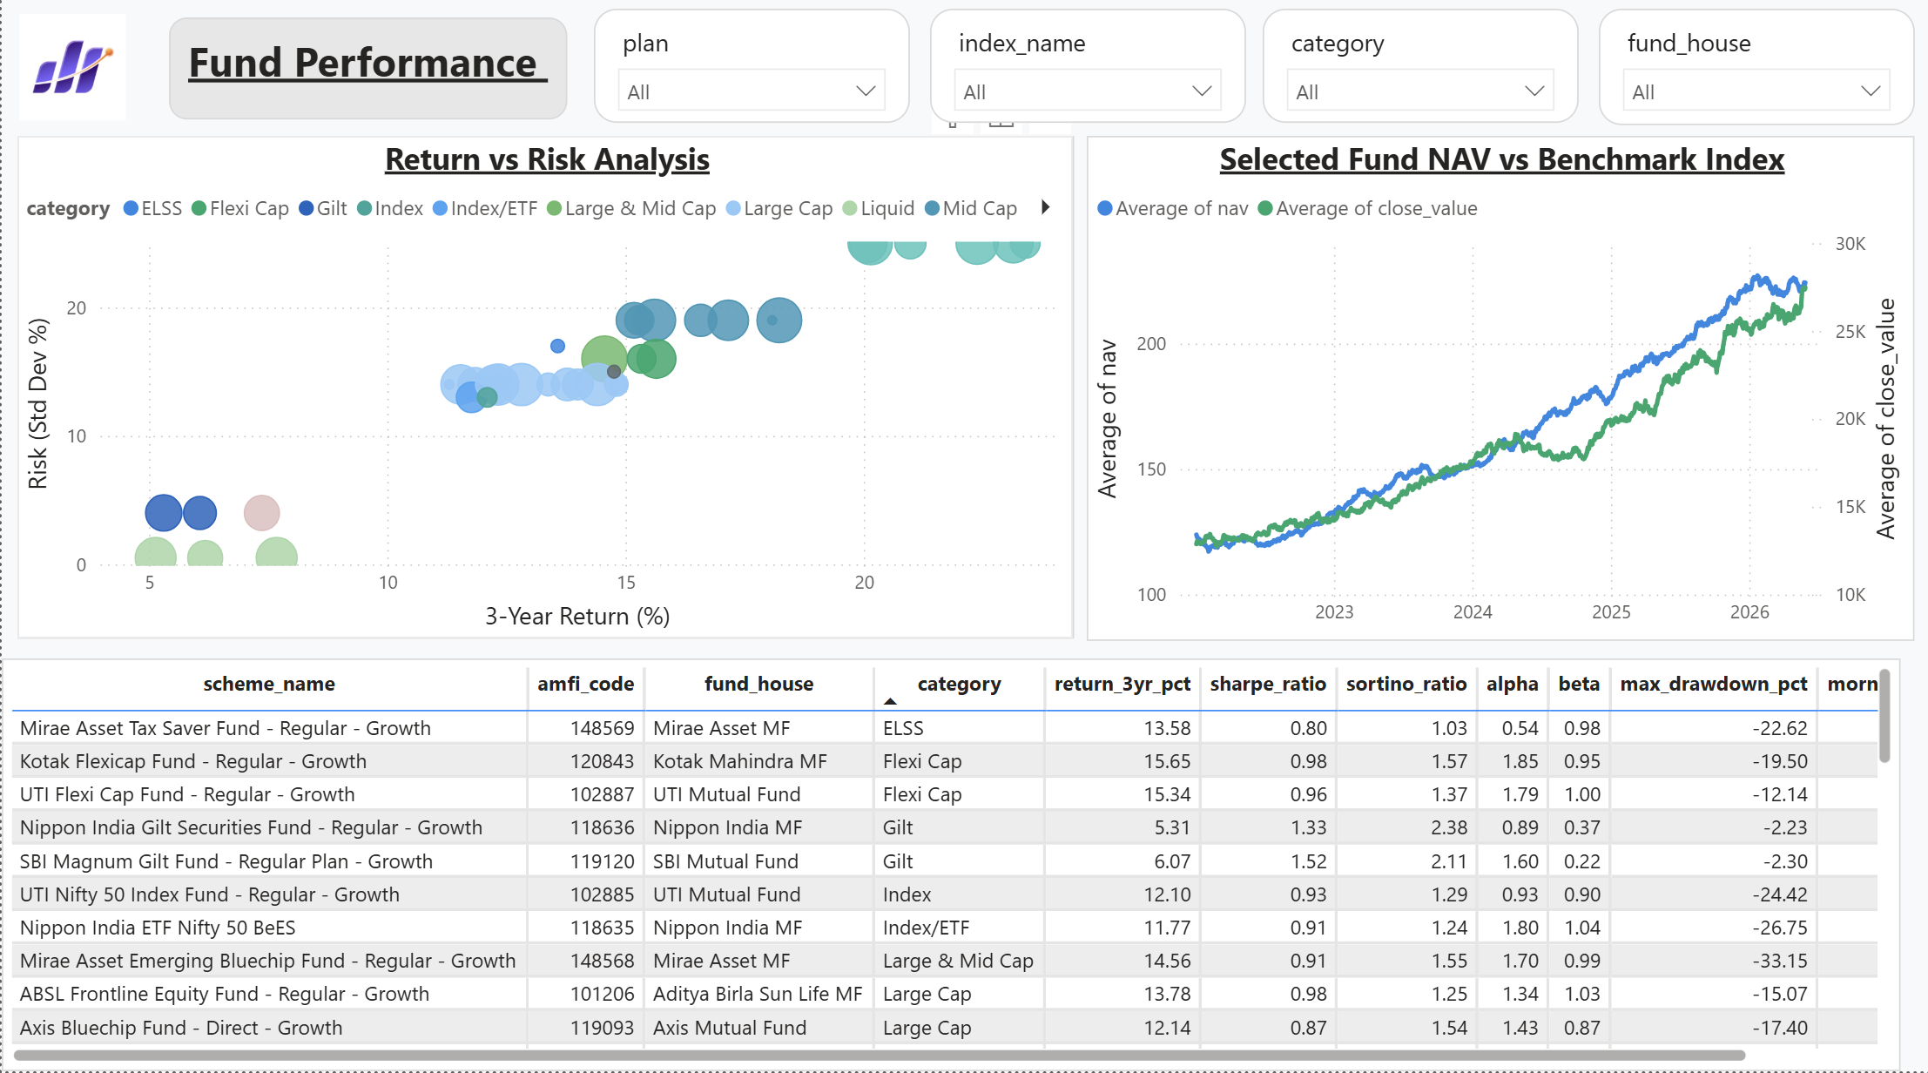
POWER BI DASHBOARDS
Interactive Analytics Dashboards
Fund Performance Analytics
• Return vs Risk comparison across fund categories
• NAV performance against benchmark indices
• Scheme-level performance comparison using return and risk metrics
• Detailed analytics table with CAGR, Sharpe Ratio, Alpha, Beta and Drawdown metrics

Slide 11
KEY FINDINGS & RECOMMENDATIONS
Key Findings & Recommendations
Findings
• Industry AUM doubled from ₹30L Cr to ₹63L Cr.
• SIP inflows reached a record ₹31K Cr in Dec 2025.
• Equity and Flexi Cap funds delivered the strongest returns.
• Top-ranked funds outperformed benchmark indices over 3 years.
Recommendations
• Evaluate funds using risk-adjusted metrics, not returns alone.
• Track drawdown and benchmark performance regularly.
• Prefer consistently performing funds for long-term investing.

Slide 12
THANK YOU

