Slide 1

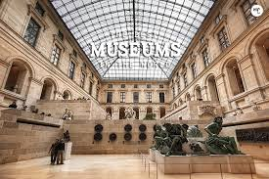
Ministry:-Ministry Of Culture PS Code:-SIH1648 Theme Name:-Travel and Tourism Problem Statement Title:- A chatbot-based ticketing system can streamline bookings, enhance customer service, manage high volumes, minimize errors, and offer valuable data insights, while also supporting multilingual interactions and integrated payments. Team Name:-QTick Team Leader Name:-Prerna Sharma Institute Name:- Ajay Kumar Garg Engineering College, Ghaziabad Institute Code (AISHE):-C-46109
PROBLEM STATEMENT- Enhancing Museum Visitor Experience Through an Efficient and Responsive Multilingual Chatbot-Based Ticketing System. Visitors to museums often face challenges with manual ticket booking, leading to long queues, errors, and reduced satisfaction. This impacts the museum's reputation and visitor numbers. Implementing a multilingual chatbot-based ticketing system will streamline the process, improve customer service, reduce errors for better decision making.
The solution is a comprehensive, multilingual, chatbot-based ticketing system for museums designed to streamline the booking process and enhance the visitor experience. This system will:
Automate Ticket Booking: Allow visitors to book tickets for museum entry and special events through a user-friendly chatbot interface, eliminating the need for manual booking and reducing wait times.
Multilingual Support: Offer support in multiple languages, making the system accessible to a diverse range of visitors.
Payment Integration: Include a secure payment gateway that enables visitors to complete transactions online, making the process fully automated and reducing the chances of human error.
Improved Efficiency: Handle high volumes of bookings efficiently, reduce errors, and improve overall customer service by providing quick, accurate, and consistent responses to visitor queries.

Slide 2
Use Cases
When designing a ticket booking system, allowing users to select the date, time, and number of tickets involves several important components and considerations to ensure a smooth and user-friendly experience.
Providing details about current and upcoming events involves several key components to ensure users have a comprehensive and engaging experience.
Implement dynamic pricing strategies, offering discounts during off-peak hours or for early bookings to manage crowd flow and increase visitor numbers..
Enhance visitor engagement and educational outreach by offering a short quiz that educates users about the museum's history, exhibits, and cultural significance.
Offer virtual previews or 360-degree tours of exhibitions within the chatbot interface, helping visitors decide on their bookings.
Features
Automatically send ticket confirmation details via successful bookings, ensuring they have all necessary information ail, SMS, or app notifications to users after successful bookings, ensuring they have all necessary information readily available.
Offer interactive ,guided tours which provides an engaging way for users to explore the museum’s exhibits and historical artefacts
.
Host Q&A sessions where visitors can submit questions to museum experts about current or upcoming exhibits.
Ensure the ticketing system integrates smoothly with existing museum apps, allowing users to access maps, audio guides, and event schedules directly.
Offer audio descriptions of exhibits with key details on significance, history, and visuals, accessible via QR codes or museum devices.

Slide 3
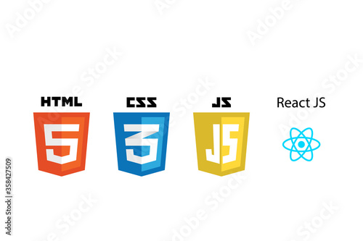
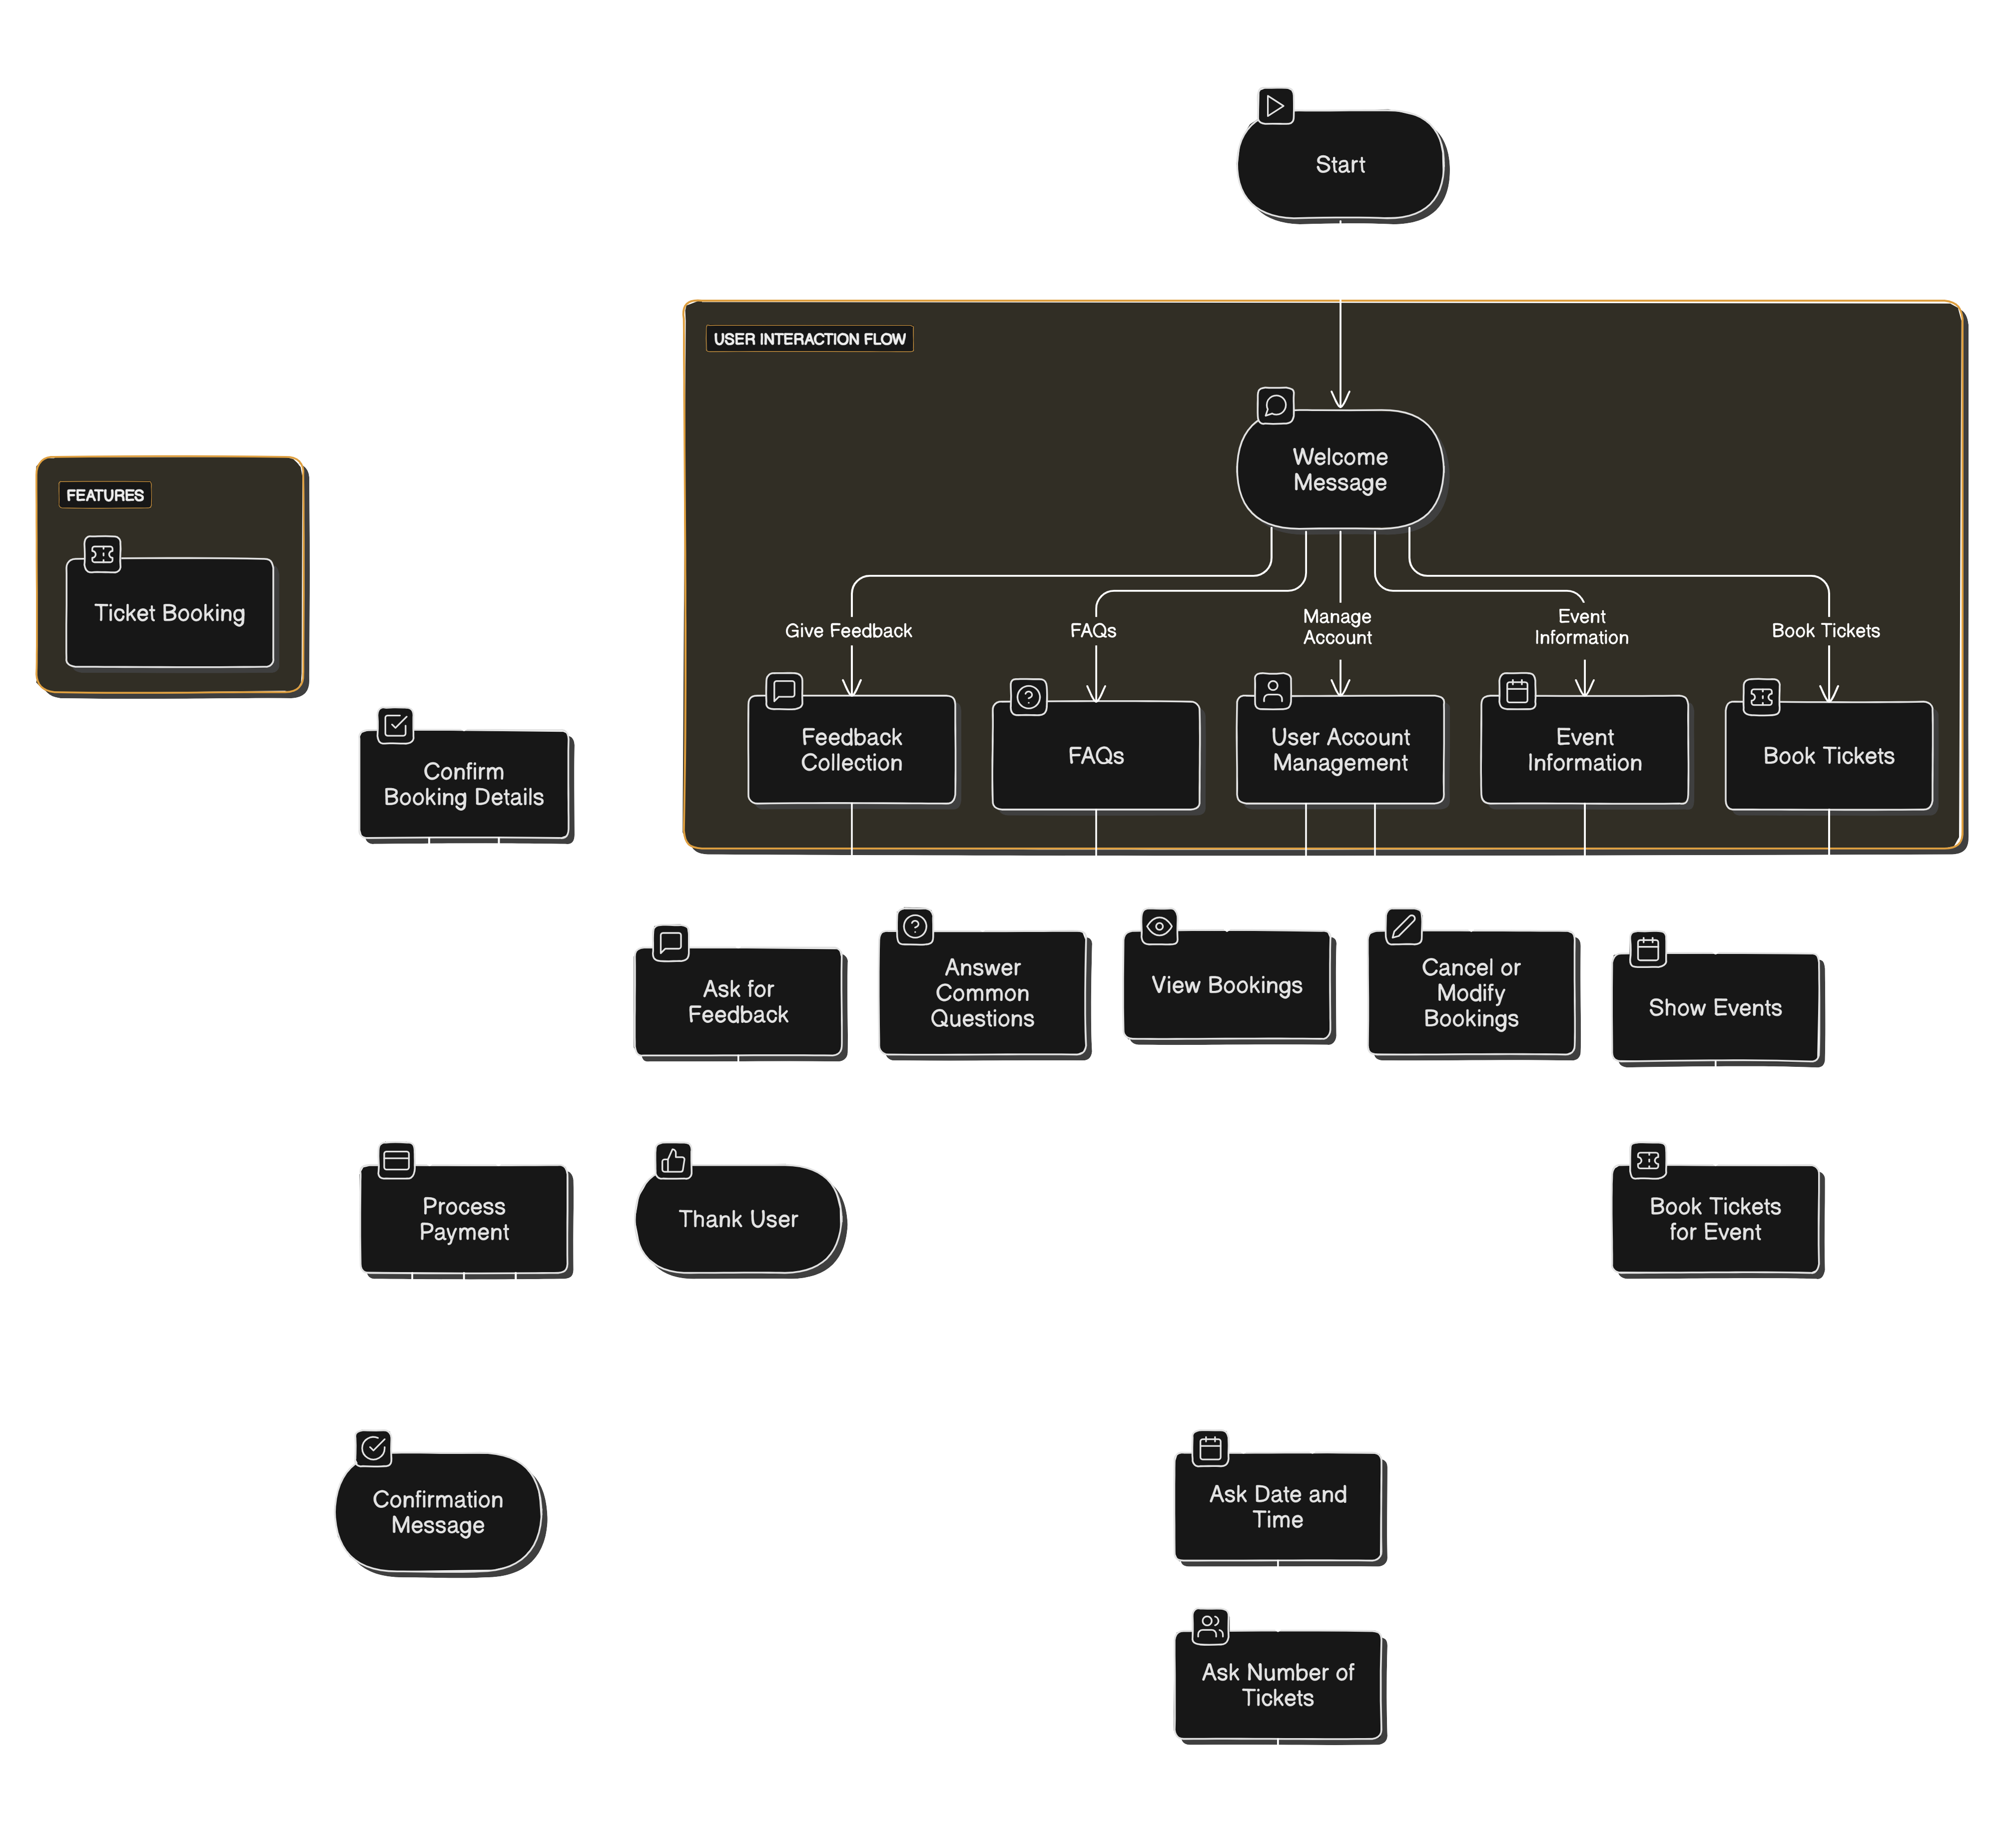






Technology Stack
Flow Diagram
Front-End:
Back-End:
Database:
Chatbot Integration:

Slide 4
Feasibility
Technical Feasibility
Chatbot Development: Development involves natural language processing (NLP) capabilities to understand and respond to user queries effectively. Platforms like Dialogflow, Microsoft Bot Framework, or custom solutions could be used.
Financial Feasibility
Development Costs: Includes chatbot design and development, payment gateway integration, and multilingual capabilities. Estimated costs can range from 3000 to 10000 depending on complexity and customization.
Operational Feasibility
Ease of Use: The chatbot should provide an intuitive and smooth booking process to ensure visitor satisfaction.
Accessibility: Features such as voice commands and screen reader compatibility will enhance accessibility for all users.
Legal and Compliance Feasibility
Compliance: Ensure compliance with data protection regulations such as GDPR (General Data Protection Regulation) or CCPA (California Consumer Privacy Act) to safeguard visitor data.
Market Feasibility
User Research: Conduct surveys or focus groups to understand visitor preferences for chatbot interactions and ticketing processes.
Feature Demand: Identify which features are most desired by potential users.

Slide 5
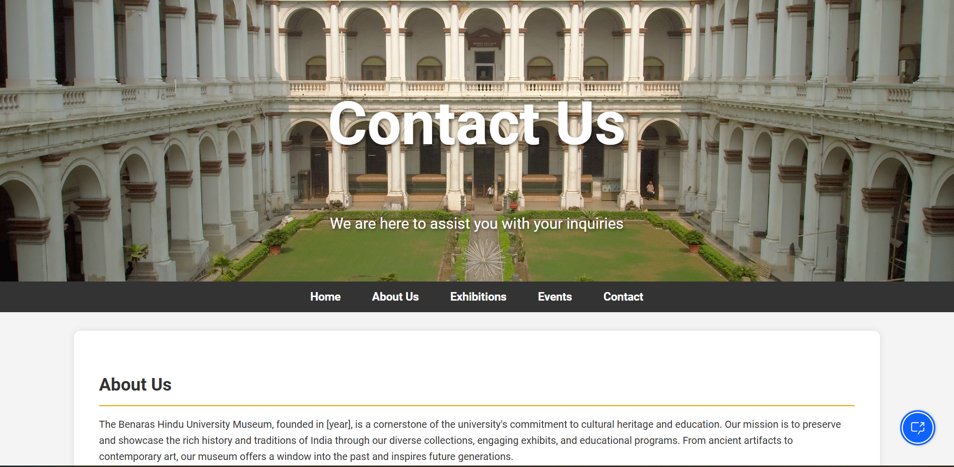
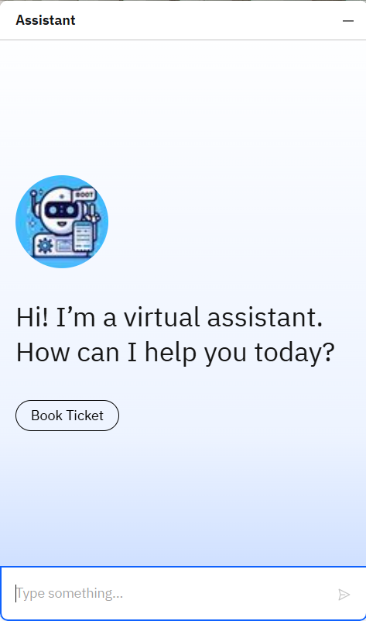
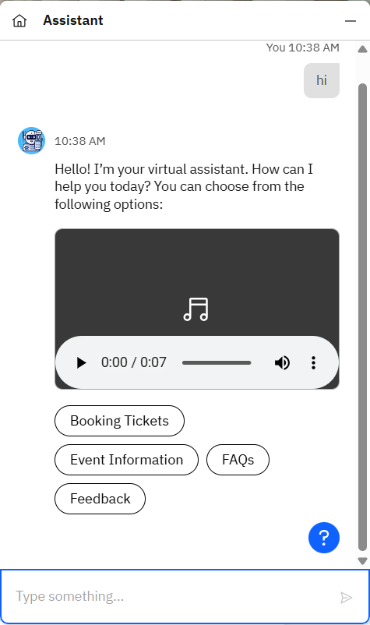
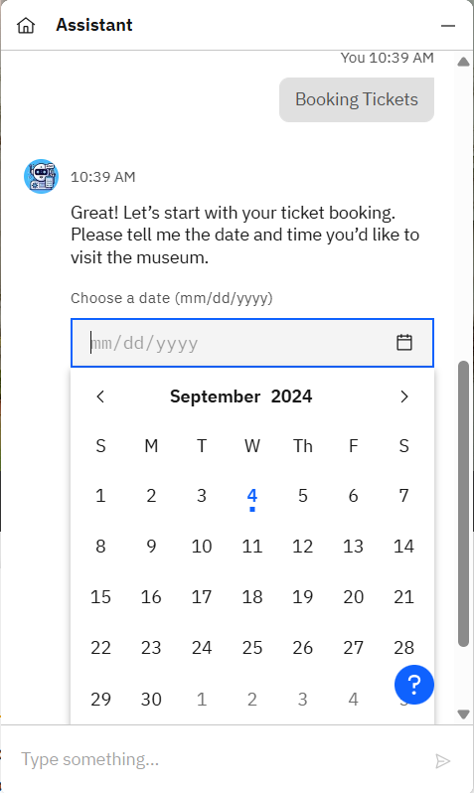
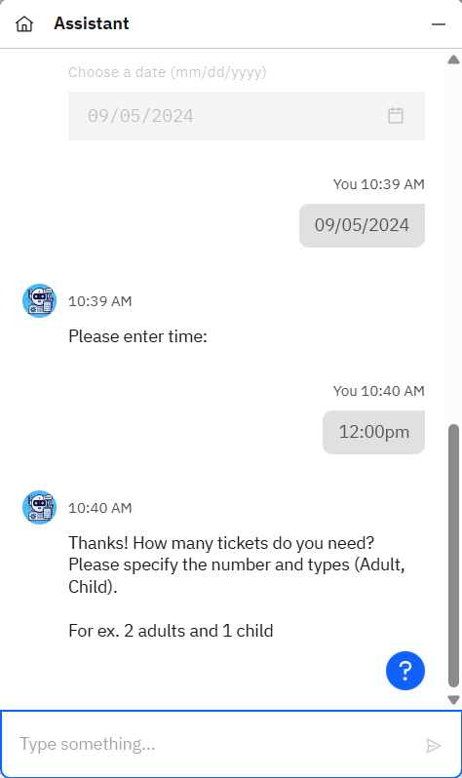
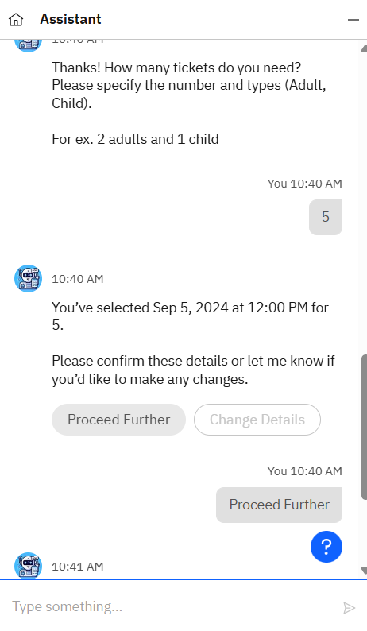


Slide 6


Seamless Multi-Channel Integration: Future chatbots may integrate seamlessly with various platforms such as social media, mobile apps, and websites, offering a consistent and cohesive booking experience across all channels.
Dependencies
Failures in the payment gateway integration can prevent users from completing transactions, resulting in abandoned bookings and lost sales.
Loss of connectivity to the internet or between the user’s device and the server can cause the web app and chatbot to become inaccessible.
Centralized Booking: A unified chatbot system could streamline booking and scheduling for events or memberships that involve multiple museums, enhancing convenience for visitors.
Future Aspects
PAYMENT GATEWAY ISSUES
SERVICE DISRUPTION
Exhibit Descriptions: Deliver detailed audio descriptions of exhibits, artworks, and artifacts, including contextual information that helps users understand and appreciate the displays.
Problems with migrating existing data (e.g., user information, historical booking records) to the new system can lead to data inaccuracies or loss.
Insufficient support for users encountering issues with the booking system or chatbot.
Voice Commands: Enable users to interact with the chatbot via spoken commands for ticket bookings, exhibit details, and museum facilities.
Speech-to-Text: Convert spoken input into text to assist visually impaired users by allowing them to dictate queries.
DATA ACCURACY
INADEQUATE SUPPORT
.
Prototype Link:
Click Here!
Team Leader: Prerna Sharma Branch: CSE AIML Year: 4
Mentor1 Name: Speciality:
Team Member 1: Tanmye Gorain Branch: CSE AIML Year: 4
Team Member 2: Divya Tyagi Branch: CSE AIML Year: 4
Mentor2 Name: Speciality:
Team Member 3: Pranav Singhal Branch: CSE AIML Year: 4
Team Member 4: Rachit Agarwal Branch: CSE AIML Year: 4
Team Member 5: Lakshya Jindal Branch: CSE AIML Year: 4

