Slide 1

MULTI-DISEASE PREDICTION SYSTEM
USING MACHINE LEARNING
By:
Vijay Kumar Rajak (241B286)
Piyush Vishwakarma (241B177)
Lakshya Asati (241B134)
Under the supervision of:
Dr. Rahul Pachauri
Jaypee University of Engineering & Technology, Guna (MP)

Slide 2
2
Problem Statement & Objectives
THE PROBLEM
• Chronic diseases like Diabetes, Heart Disease & Parkinson's often go undetected until it's too late.
• Manual diagnosis is slow, expensive, and requires specialist availability — often unavailable in rural areas.
• Most existing tools check only one disease at a time. There is no single unified screening system.
• Hospitals already collect the required patient data — ML can use it to flag risk immediately.
OUR OBJECTIVES
• Train one best-performing ML model per disease (Heart, Diabetes, Parkinson's).
• Serve all 3 models through a single Flask web backend with REST API endpoints.
• Build an interactive web interface where anyone can enter vitals and get a risk prediction instantly.
Multi-Disease Prediction System using ML | Minor Project Part-I | RP-2

Slide 3
3
System Architecture & Tech Stack
User fills
the form
Web page
sends data
Flask API
receives it
ML model
predicts
Result shown
on screen
→
→
→
→
FRONTEND
BACKEND
ML MODELS
• HTML + CSS + JavaScript
• Runs directly in the browser
• Works offline too (simulation mode)
• Python 3.13 + Flask
• CORS enabled for web access
• Routes: /predict/heart, /predict/diabetes, /predict/parkinsons
• Scikit-Learn 1.6
• 3 trained models (.pkl files)
• Real-time prediction in milliseconds
Multi-Disease Prediction System using ML | Minor Project Part-I | RP-2

Slide 4
4
Data Preprocessing & Feature Engineering
Step 1 — Loaded all 3 datasets
Heart Disease (1,025 records) • Diabetes (768 records) • Parkinson's (195 records)
Step 2 — Fixed bad zero values (Diabetes only)
Fields like Glucose and Insulin had impossible zeros — replaced with the correct median value.
Step 3 — Removed leakage column (Parkinson's only)
The 'name' column (patient ID) was dropped so the model learns vocal patterns, not patient names.
Step 4 — Feature Scaling
Heart Disease: StandardScaler applied. Diabetes & Parkinson's: No scaling needed.
Step 5 — Train / Test Split
80% training + 20% testing for all 3 datasets (stratified, so class balance is preserved).
Multi-Disease Prediction System using ML | Minor Project Part-I | RP-2

Slide 5
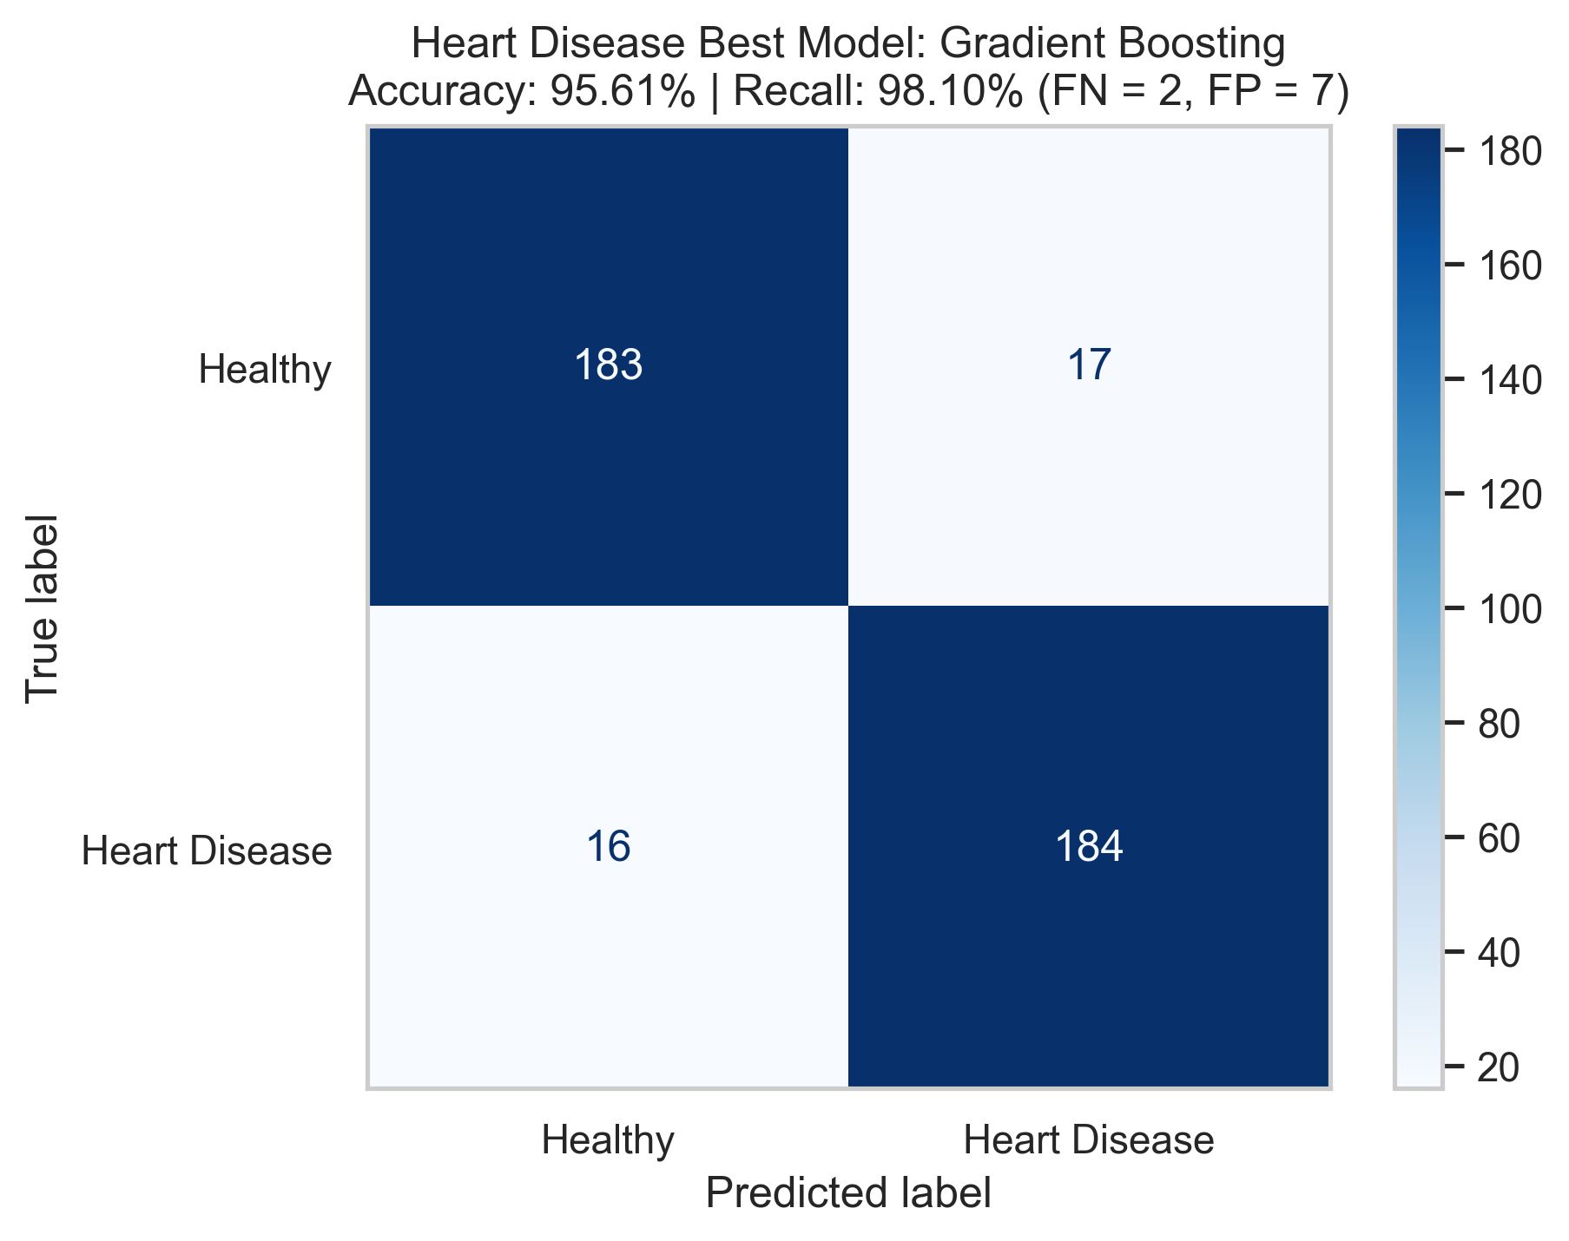
5
Disease Model 1 — Coronary Heart Disease
DATASET & FEATURES
Accuracy
92.25%
Precision
90.43%
Recall
94.50%
ROC-AUC
96.38%
• Disease: Coronary Heart Disease
• Source: Cleveland Clinic (UCI Repository)
• Records: 1,025 records
• Features: 13 input columns
Algorithm: Logistic Regression + StandardScaler
Confusion Matrix on Test Set
KEY INPUT FEATURES USED
• Age, Sex, Chest Pain Type
• Resting BP, Cholesterol
• Max Heart Rate, ST Depression
• Thal Status, No. of Vessels
Multi-Disease Prediction System using ML | Minor Project Part-I | RP-2

Slide 6
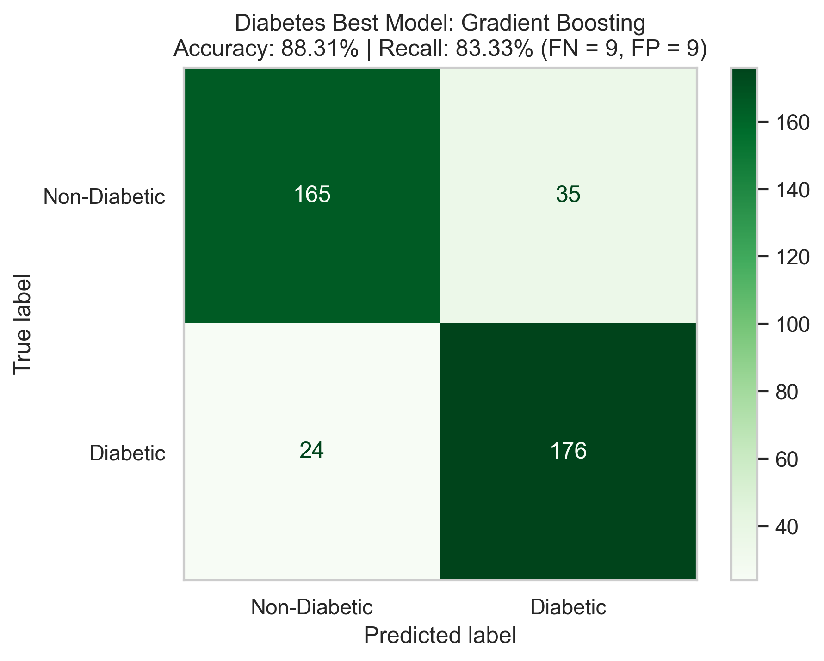
6
Disease Model 2 — Type-2 Diabetes Mellitus
DATASET & FEATURES
Accuracy
85.25%
Precision
83.41%
Recall
88.00%
ROC-AUC
93.61%
• Disease: Type-2 Diabetes Mellitus
• Source: Pima Indians Diabetes DB (NIDDK/Kaggle)
• Records: 768 records
• Features: 8 input columns
Algorithm: Gradient Boosting Classifier
Confusion Matrix on Test Set
KEY INPUT FEATURES USED
• Glucose, BMI
• Blood Pressure, Insulin
• Skin Thickness, Pregnancies
• Diabetes Pedigree Function, Age
Multi-Disease Prediction System using ML | Minor Project Part-I | RP-2

Slide 7
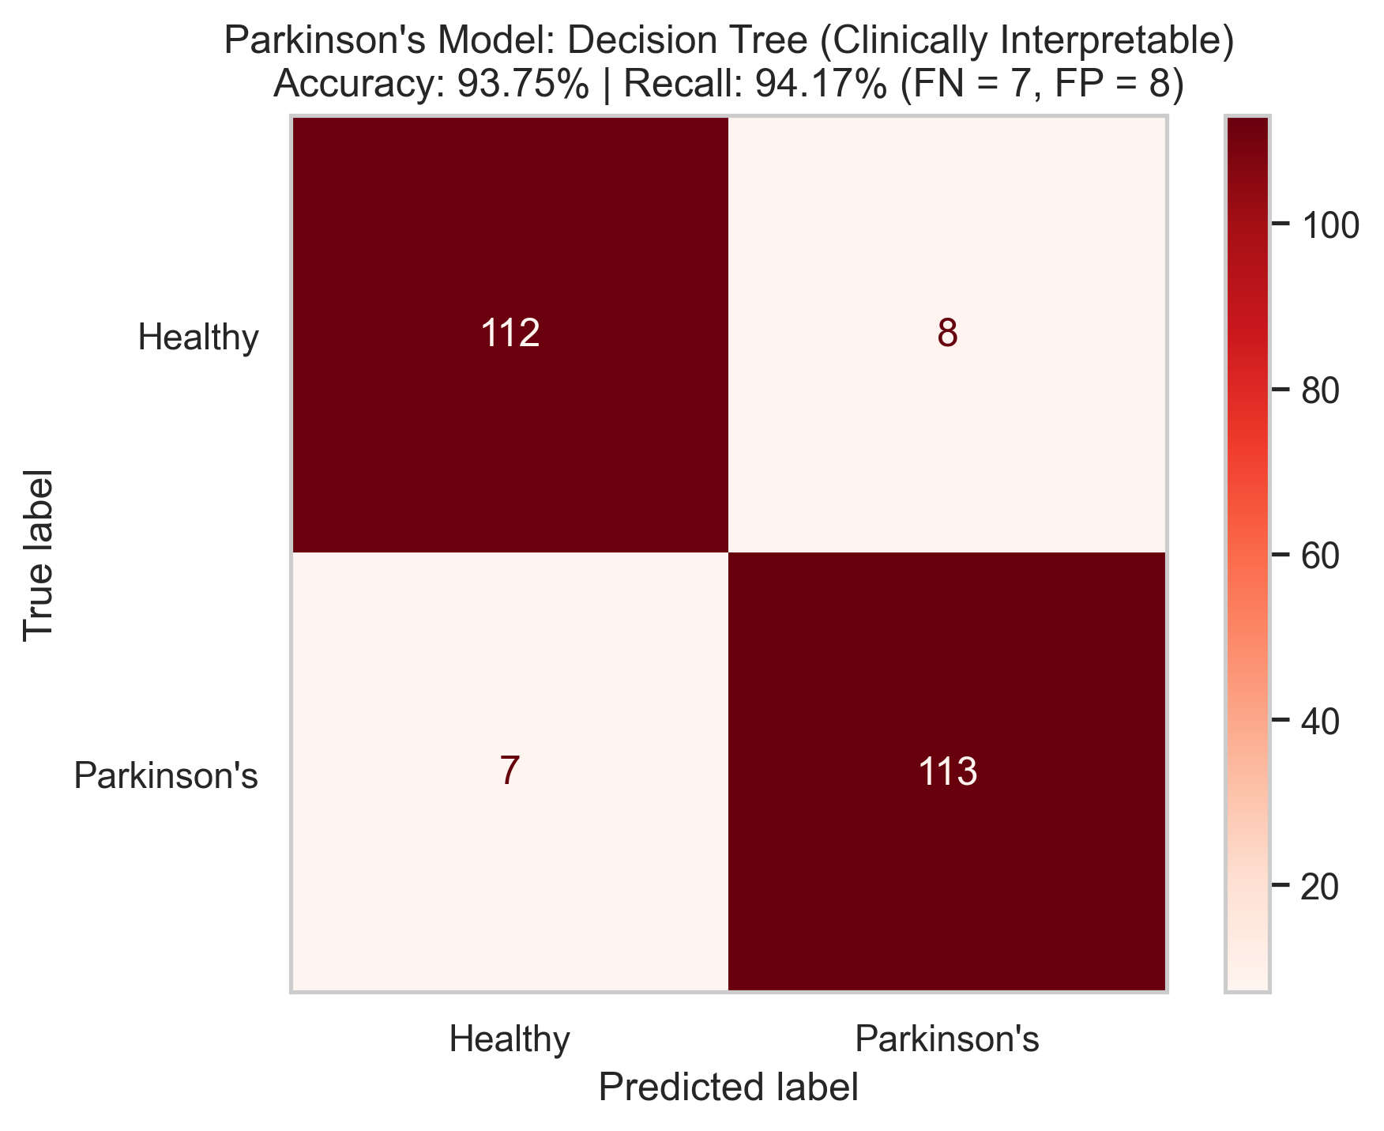
7
Disease Model 3 — Parkinson's Disease
DATASET & FEATURES
Accuracy
93.75%
Precision
93.39%
Recall
94.17%
ROC-AUC
94.57%
• Disease: Parkinson's Disease (Vocal Biomarkers)
• Source: Oxford Telemonitoring Study (UCI)
• Records: 195 records
• Features: 22 input columns
Algorithm: Decision Tree Classifier
Confusion Matrix on Test Set
KEY INPUT FEATURES USED
• Vocal frequencies (Fo, Fhi, Flo)
• Jitter — frequency perturbations
• Shimmer — amplitude perturbations
• HNR, NHR, PPE, RPDE, DFA
Multi-Disease Prediction System using ML | Minor Project Part-I | RP-2

Slide 8
8
All 3 Models — Side-by-Side Comparison
Disease | Algorithm | Accuracy | Precision | Recall | ROC-AUC
Coronary Heart Disease | Logistic Regression | 92.25% | 90.43% | 94.50% | 96.38%
Type-2 Diabetes Mellitus | Gradient Boosting | 85.25% | 83.41% | 88.00% | 93.61%
Parkinson's Disease | Decision Tree | 93.75% | 93.39% | 94.17% | 94.57%
Best Accuracy
Parkinson's — 93.75%
Best ROC-AUC
Heart Disease — 96.38%
Highest Recall
Heart Disease — 94.50% ← most important metric for clinical use
Why Recall matters in clinical settings: A false negative (missed diagnosis) is far more dangerous than a false positive. High recall = fewer missed high-risk patients.
All 3 models trained, serialized to .pkl files, and served via Flask REST API — live and operational
Multi-Disease Prediction System using ML | Minor Project Part-I | RP-2

Slide 9
9
Backend Implementation & Model Serving
HOW IT WORKS — 4 SIMPLE STEPS
1
Step 1
The web page collects input values from the user and sends a POST request to the Flask backend.
2
Step 2
Flask receives the JSON data and identifies which disease endpoint was called (/heart, /diabetes, /parkinsons).
3
Step 3
The matching pre-trained model (.pkl file) runs predict() and predict_proba() on the input data.
4
Step 4
Flask returns a JSON response with: prediction (0 or 1), risk status label, and probability percentage.
Saved models: heart_logistic_regression.pkl | diabetes_gradient_boosting.pkl | parkinsons_decision_tree.pkl
Multi-Disease Prediction System using ML | Minor Project Part-I | RP-2

Slide 10
10
Frontend Prototype Overview
HOW THE WEB INTERFACE WORKS
• The home page has 3 tabs — one for each disease (Heart, Diabetes, Parkinson's).
• Each tab shows a clean input form with the right fields for that disease.
• Click 'High-Risk Sample' or 'Normal Sample' to auto-fill test data instantly.
Input Form
Result Panel
Fields labelled with medical units (mm Hg, mg/dL, Hz). Dropdowns for categories like sex, chest pain type.
Shows: Risk badge (High Risk / Normal), Probability % bar, Clinical advice text.
1-Click Presets
Offline Mode
Pre-filled with real verified samples. Great for demos and viva presentations.
If Flask is not running, a smart simulation still shows results — the page never breaks.
Multi-Disease Prediction System using ML | Minor Project Part-I | RP-2

Slide 11
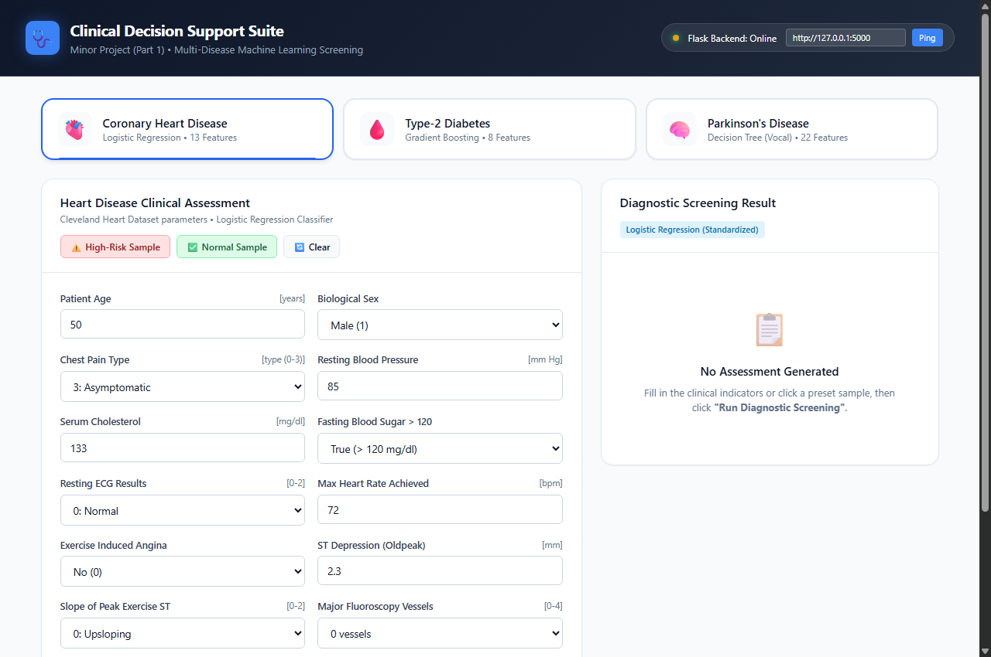
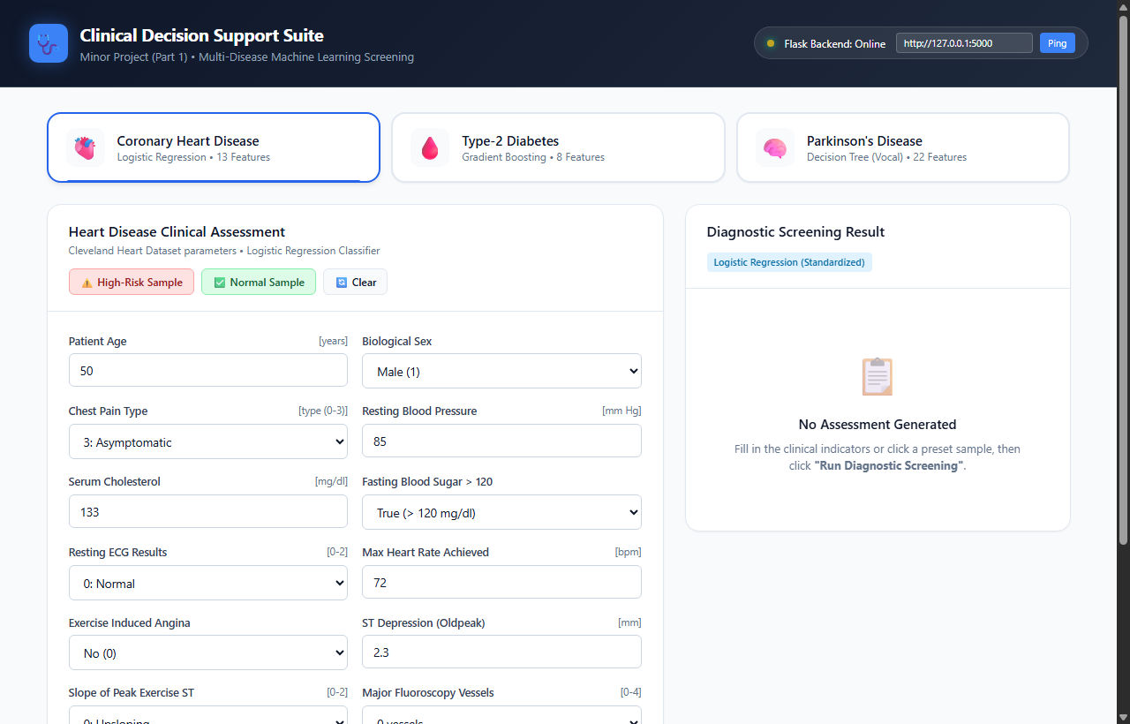
11
Working Prototype — Dashboard & Heart Disease
Home Dashboard (index.html)
Heart Disease — High Risk Detected (60.85%)
3 disease tabs, live backend status, preset buttons.
13-feature form → Logistic Regression → 60.85% cardiac risk + ECG advisory.
Multi-Disease Prediction System using ML | Minor Project Part-I | RP-2

Slide 12
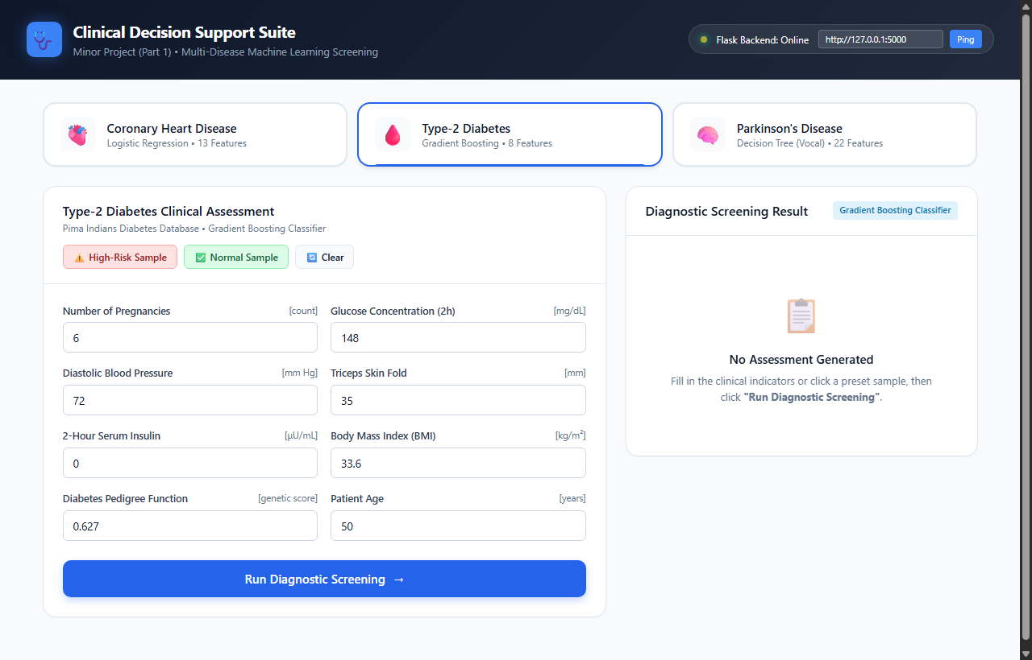
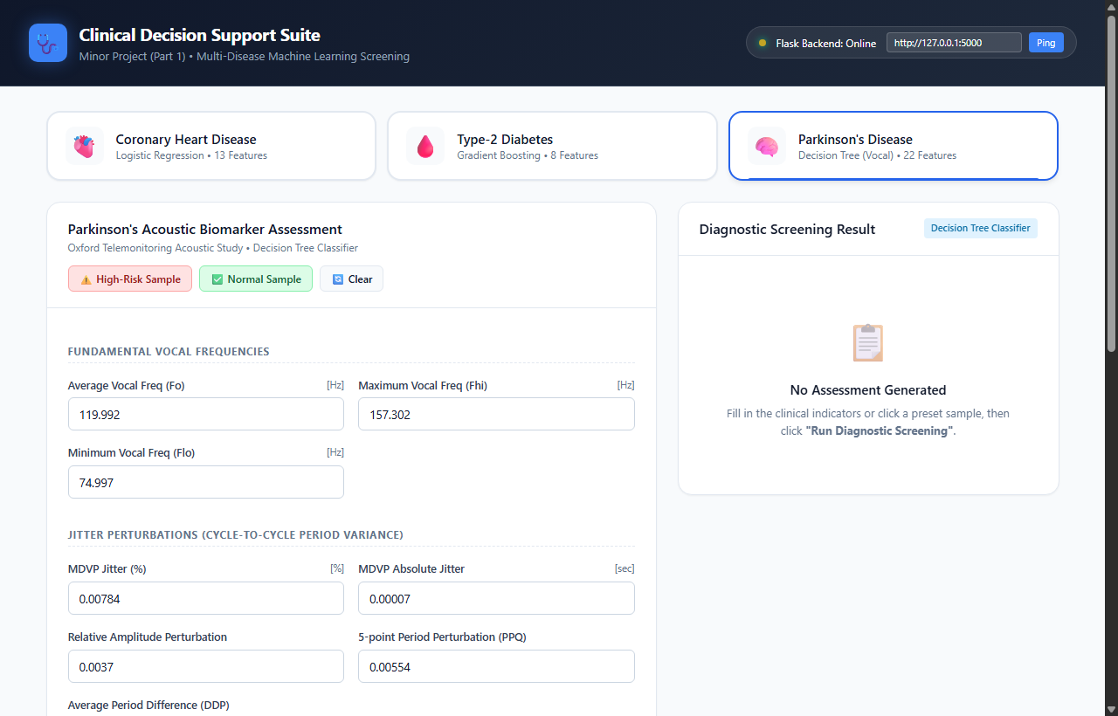
12
Working Prototype — Diabetes & Parkinson's Screening
Diabetes — High Risk (94.63%)
Parkinson's — Disease Detected (94.66%)
Glucose=148, BMI=33.6 → Gradient Boosting → 94.63% diabetic risk.
22 acoustic features → Decision Tree → Parkinson's vocal pattern detected.
Multi-Disease Prediction System using ML | Minor Project Part-I | RP-2

Slide 13
13
Week-by-Week Progress (13-Week Roadmap)
Wk | Dates | Task | Status
1 | 21–25 Jul | Project scoping & dataset exploration | Done
2 | 27 Jul–1 Aug | Requirements, schedule, problem definition | Done
3 | 3–8 Aug | Data collection & ML algorithm research | Done
4 | 10–15 Aug | EDA, visualization & data cleaning | Done
5 | 17–22 Aug | Final algorithm selection for each disease | Done
6 | 24–29 Aug | Diabetes model training — Gradient Boosting (85.25%) | Done
7 | 31 Aug–5 Sep | Heart Disease model training — Logistic Reg (92.25%) | Done
8 | 7–12 Sep | Parkinson's model training — Decision Tree (93.75%) | Done
9 | 14–19 Sep | Model evaluation — ROC-AUC, Confusion Matrix | Done
10 | 21–26 Sep | Flask API + Web GUI prototype completed | Done
11 | 28 Sep–3 Oct | System testing & boundary validation | In Progress
12 | 5–10 Oct | Explainability (SHAP) & documentation | Pending
13 | 12–17 Oct | Final report & viva preparation | Pending
Multi-Disease Prediction System using ML | Minor Project Part-I | RP-2

Slide 14
14
What's Left & Conclusion
REMAINING TASKS (Weeks 11–13)
WHAT WE ACHIEVED BY PANEL 2
Week 11 — Testing:
Run edge-case inputs to check for crashes or wrong outputs.
• 3 disease models trained and evaluated (17 classifiers total).
• Best models: LR 92.25%, GB 85.25%, DT 93.75% accuracy.
• All models saved as .pkl files and served via Flask REST API.
• Interactive web prototype built and working end-to-end.
Week 12 — Explainability:
Add SHAP charts to show which feature most influenced each prediction.
Week 13 — Final Report:
Write the project report and prepare the viva presentation.
Final Goal
A single web app where a patient enters basic health parameters and instantly gets a risk assessment for 3 major chronic diseases — fast, accessible, and non-invasive.
Multi-Disease Prediction System using ML | Minor Project Part-I | RP-2

